Slide 1
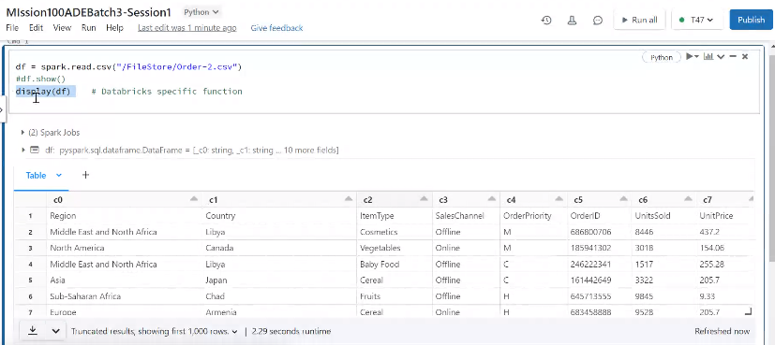
This function won’t work in Spark

