Slide 1
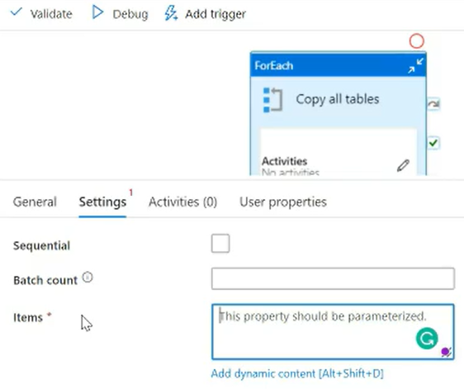
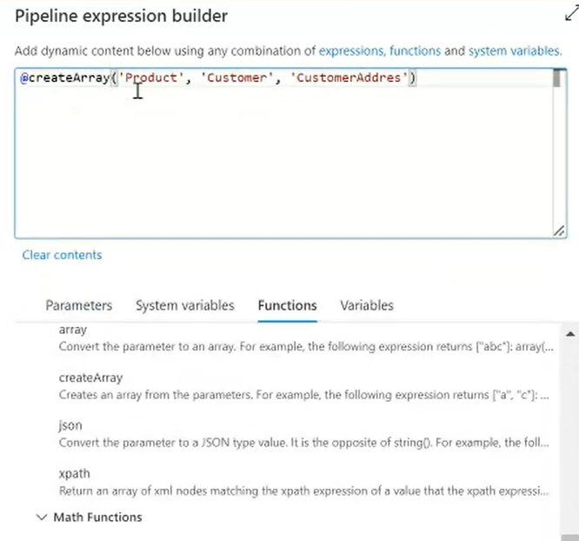
Method 01: using Add dynamic content

Slide 2
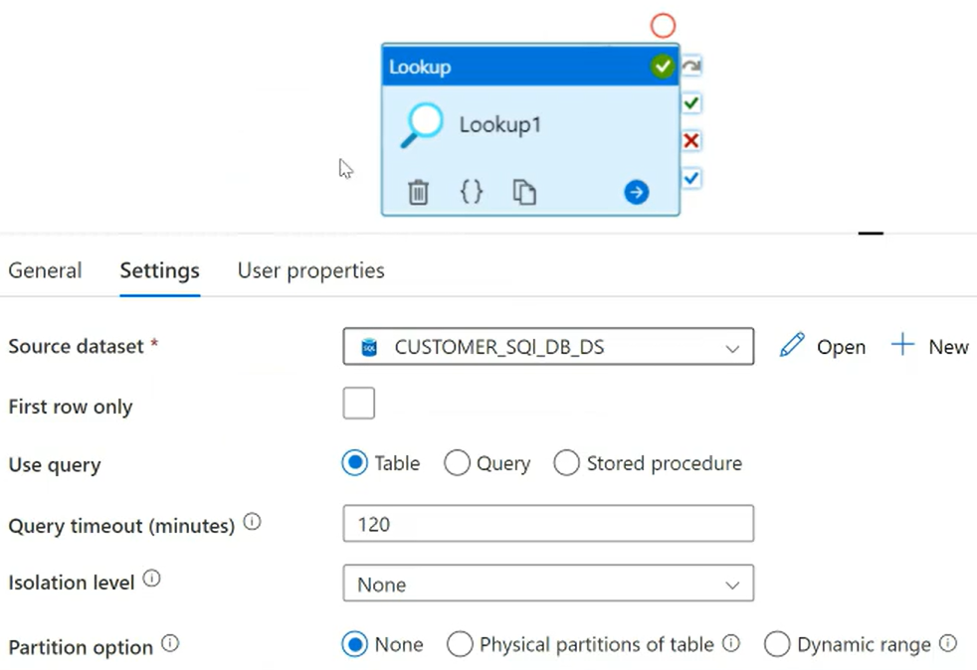
Method 02: Lookup Activity & foreach

Slide 3
