Slide 1
Car Racing Game
Team 10
Submitted by:
Mario Remon 19P6892
Malak Mohamed 19P7787
Mai Hossam 19P6129

Slide 2
Introduction
Our project features a multi-player 2D car racing game with a chatting feature. The game supports real time playing where all players can see each other and can chat and exchange messages during the game.
We implemented the multiple players using client/server model and the system is distributed among different clients and servers.
Robustness is emphasized, ensuring uninterrupted gameplay even if a participant node crashes, with the ability to recover seamlessly.
To enhance fault tolerance, multiple replicas are maintained, and techniques like caching and copy migration are utilized to optimize the gaming experience.

Slide 3
Project Features and Concepts
Multiple, Autonomous agents supported
Racing game [GUI]
Chatting feature
Robust System
Fault tolerance
Socket Programming
Linked database
Deployment
Dispatcher

Slide 4
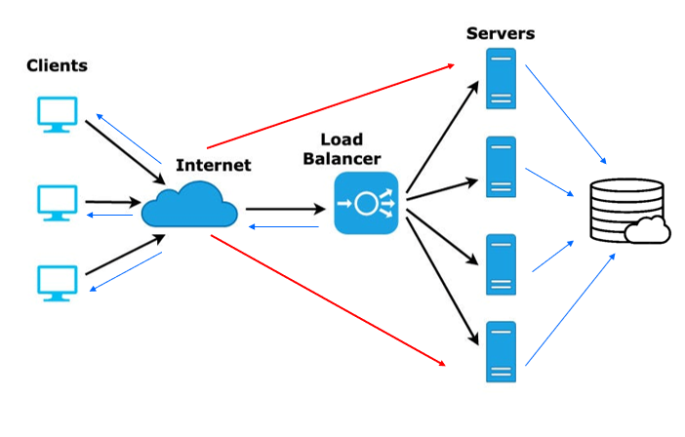
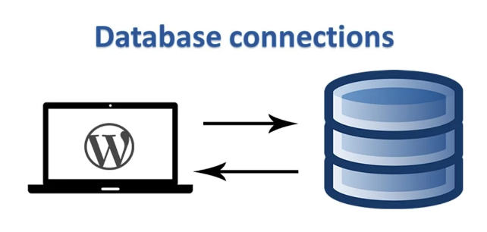
Car Racing Game Hierarchy

Slide 5
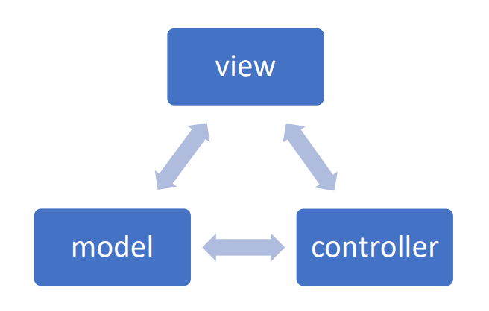
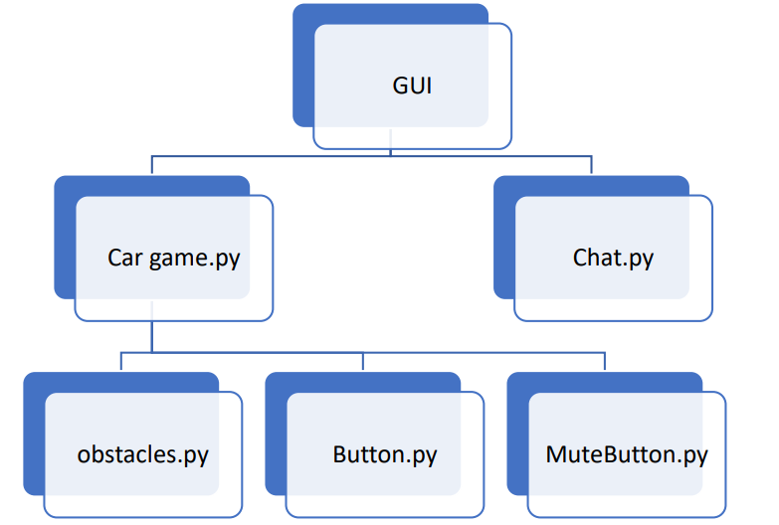
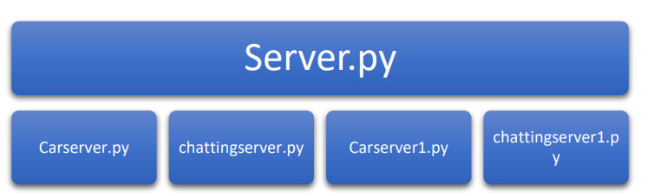
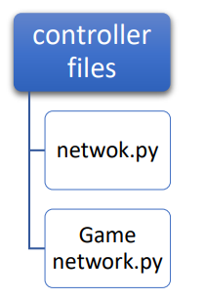
System Architecture

Slide 6
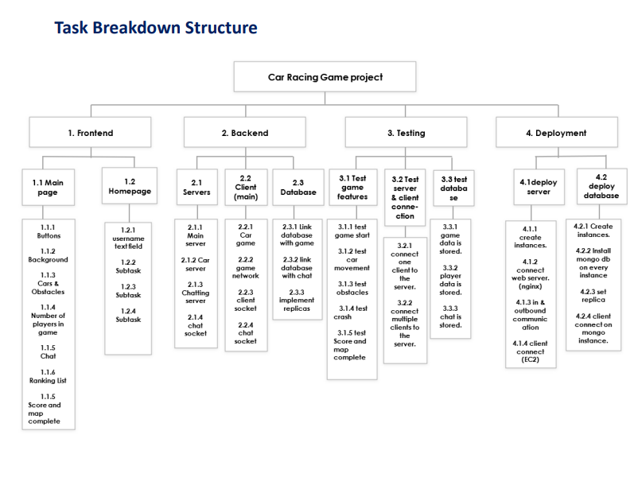

Slide 7
Faults
1 - Player lost connection
Game Continues properly, Number of players changes, ranking changes , and car is removed from the screen

Slide 8
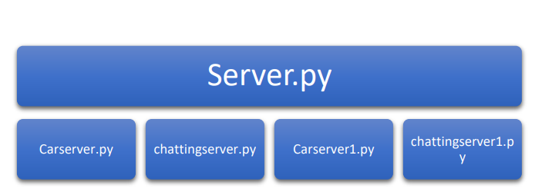
2 – Server Failed
Stateful Servers

Slide 9
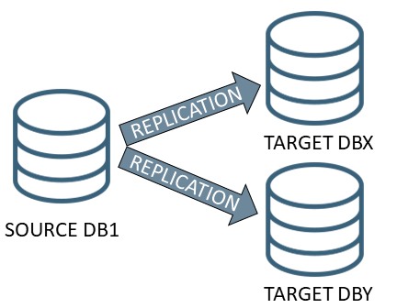
Database Hierarchy
3 – Database Failed
Machine 2
Machine 3
Machine 1

Slide 10
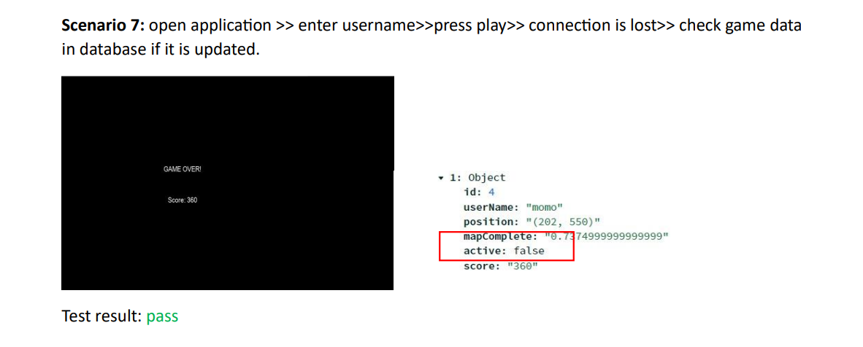
Robustness

Slide 11
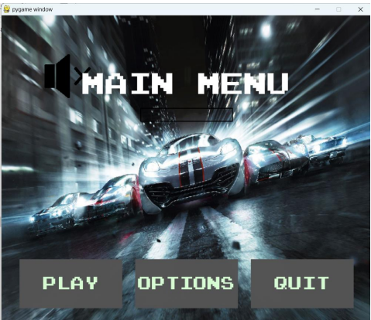
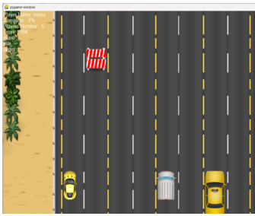
Racing Game

Slide 12
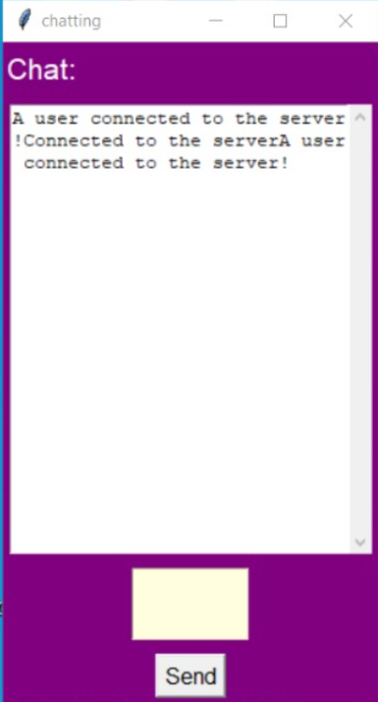
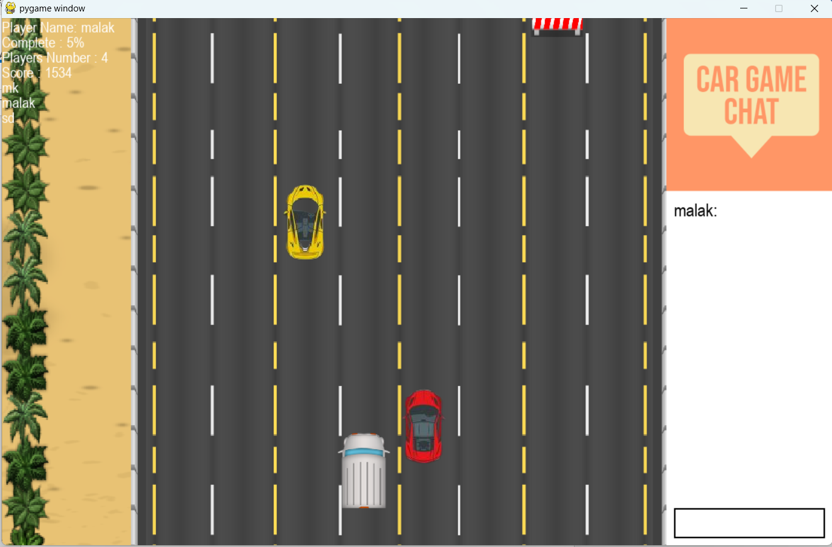
Chatting Feature

Slide 13
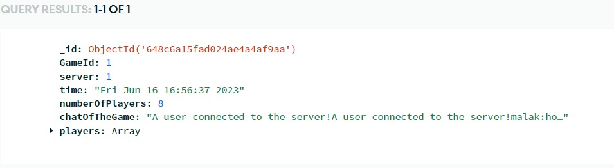
Linked Database
Connection
Example

Slide 14


Deployment

Slide 15
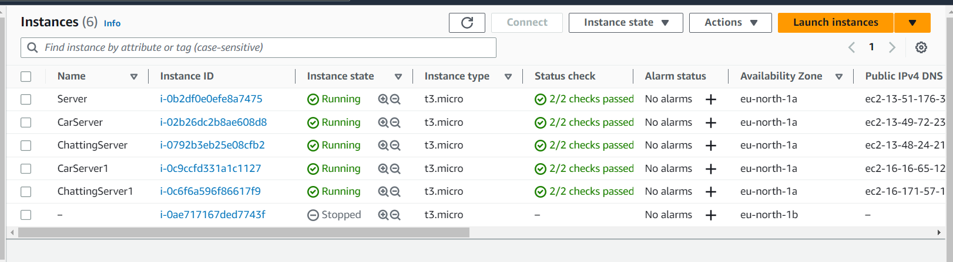
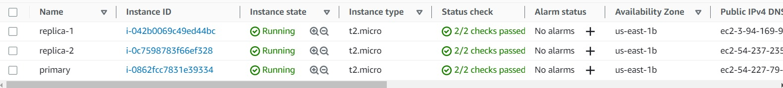
AWS EC2 Server Instances
AWS EC2 Database Instances

Slide 16
Conclusion

Slide 17

Thank you

