Slide 1
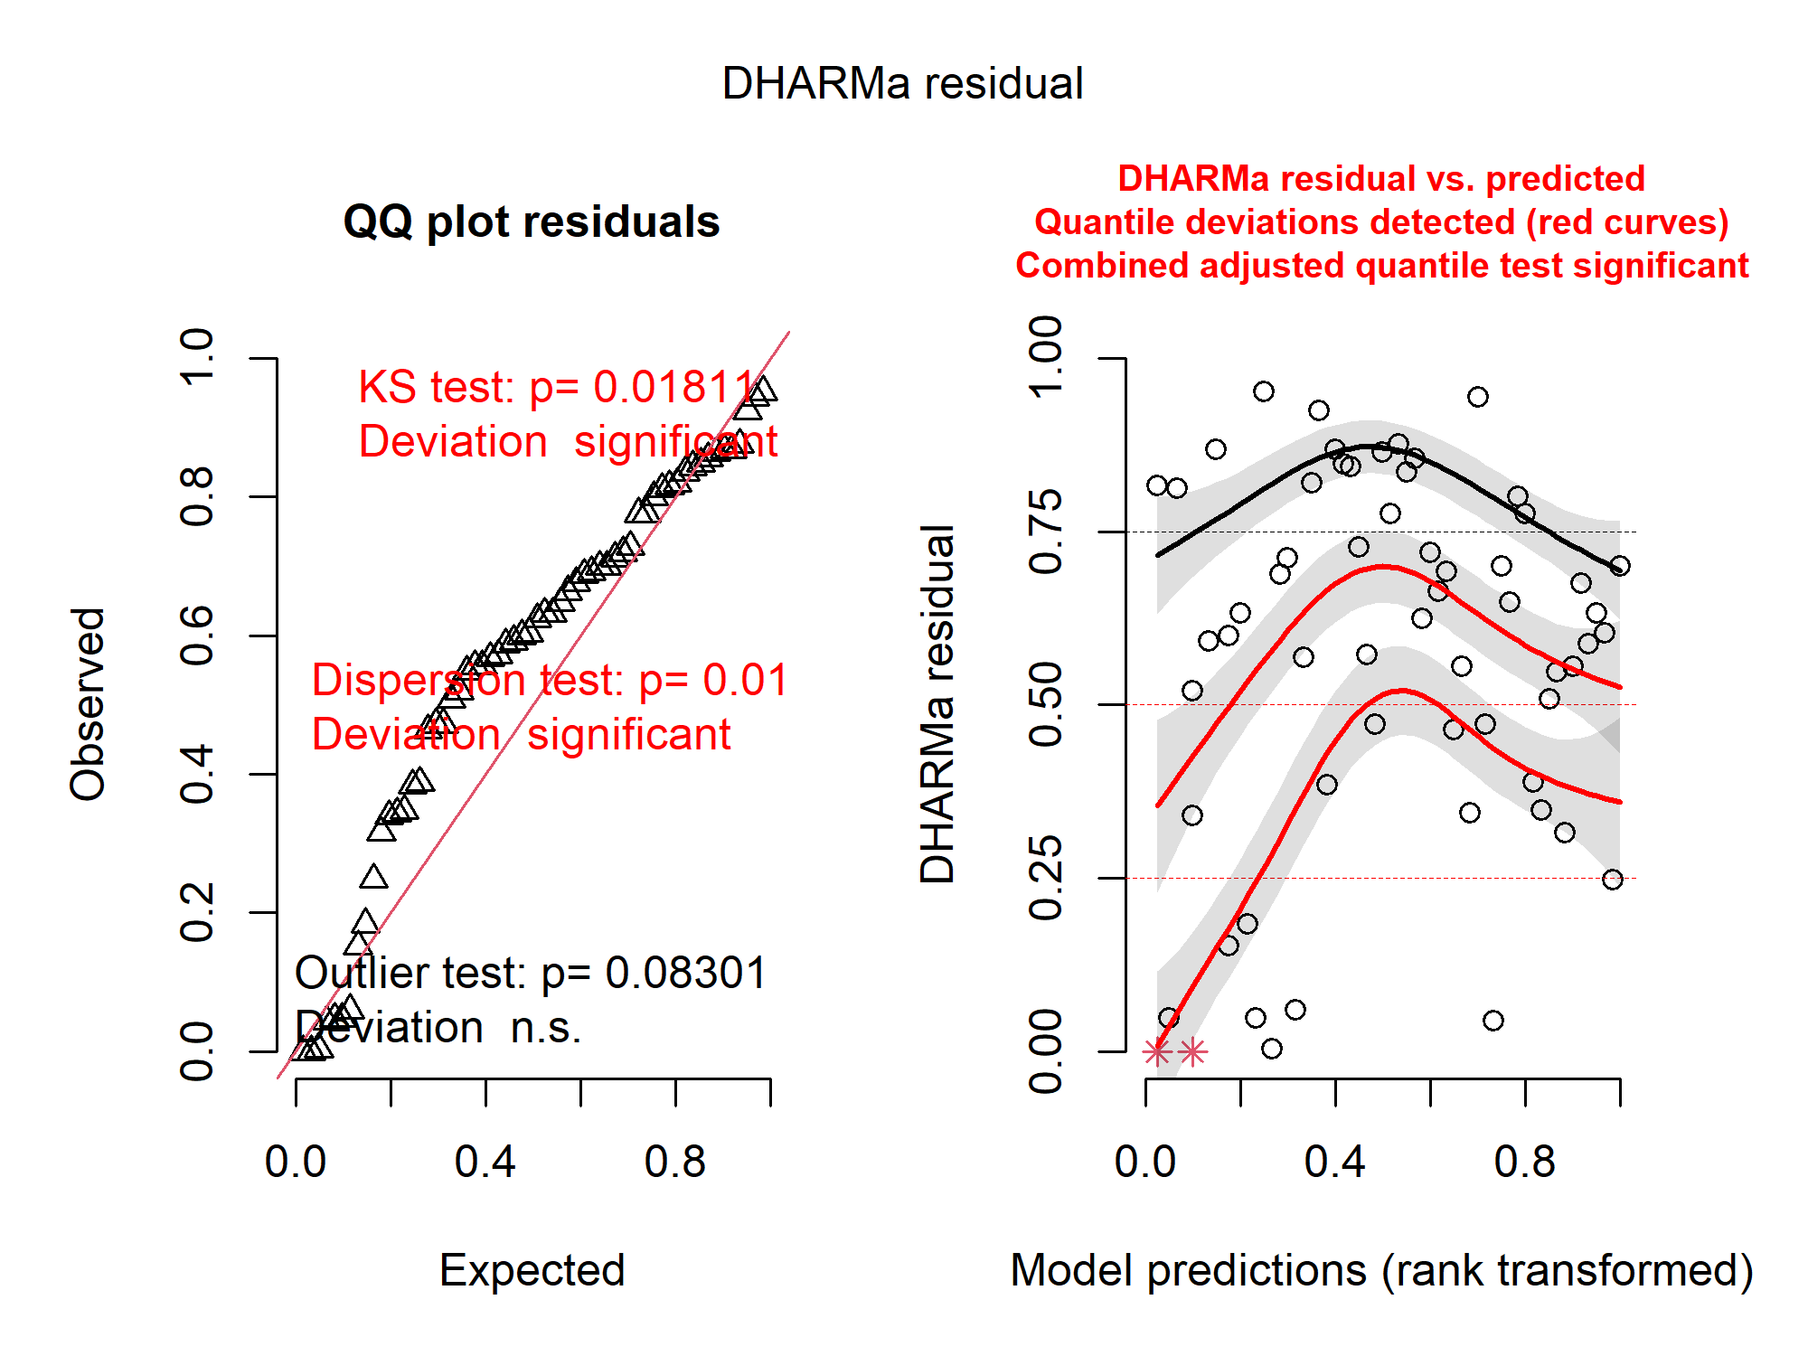
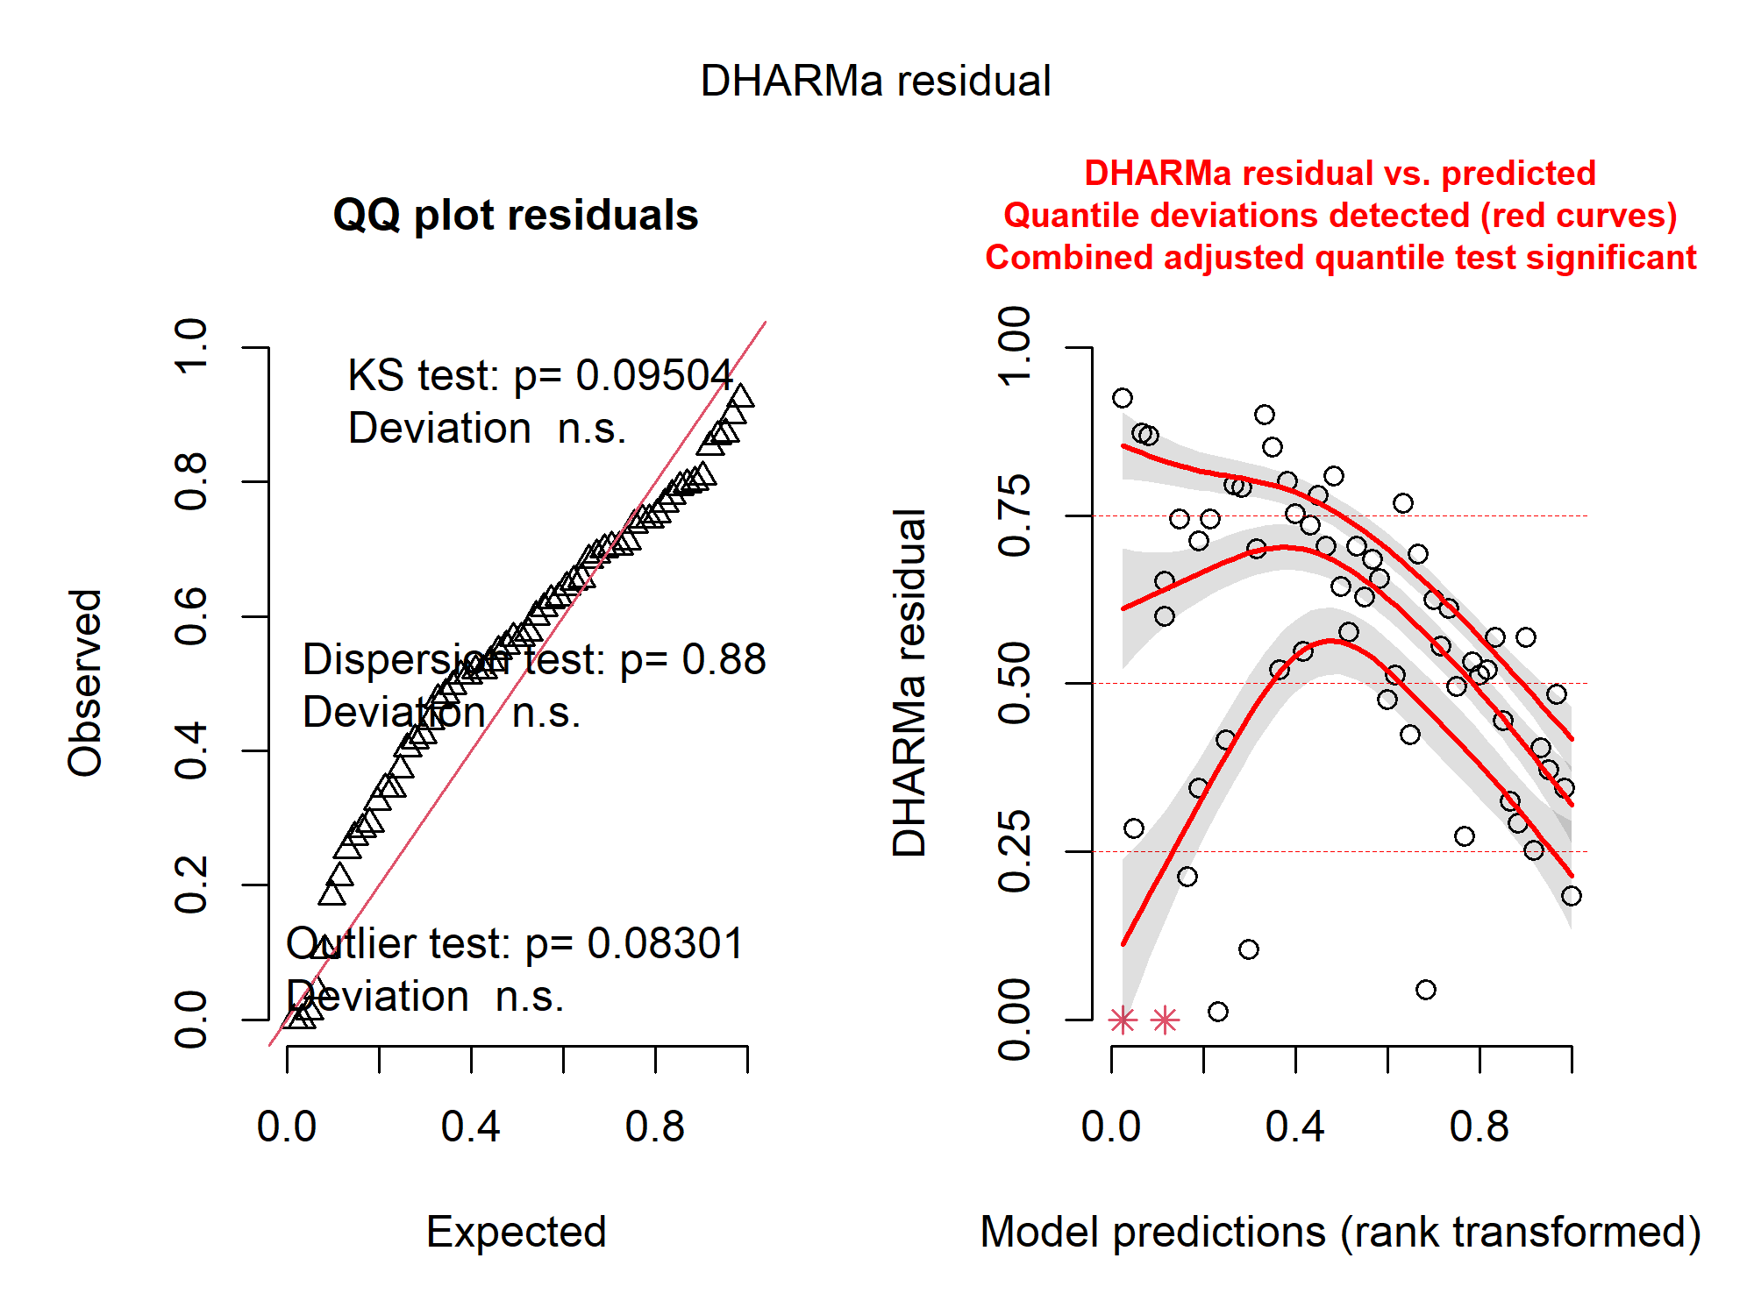
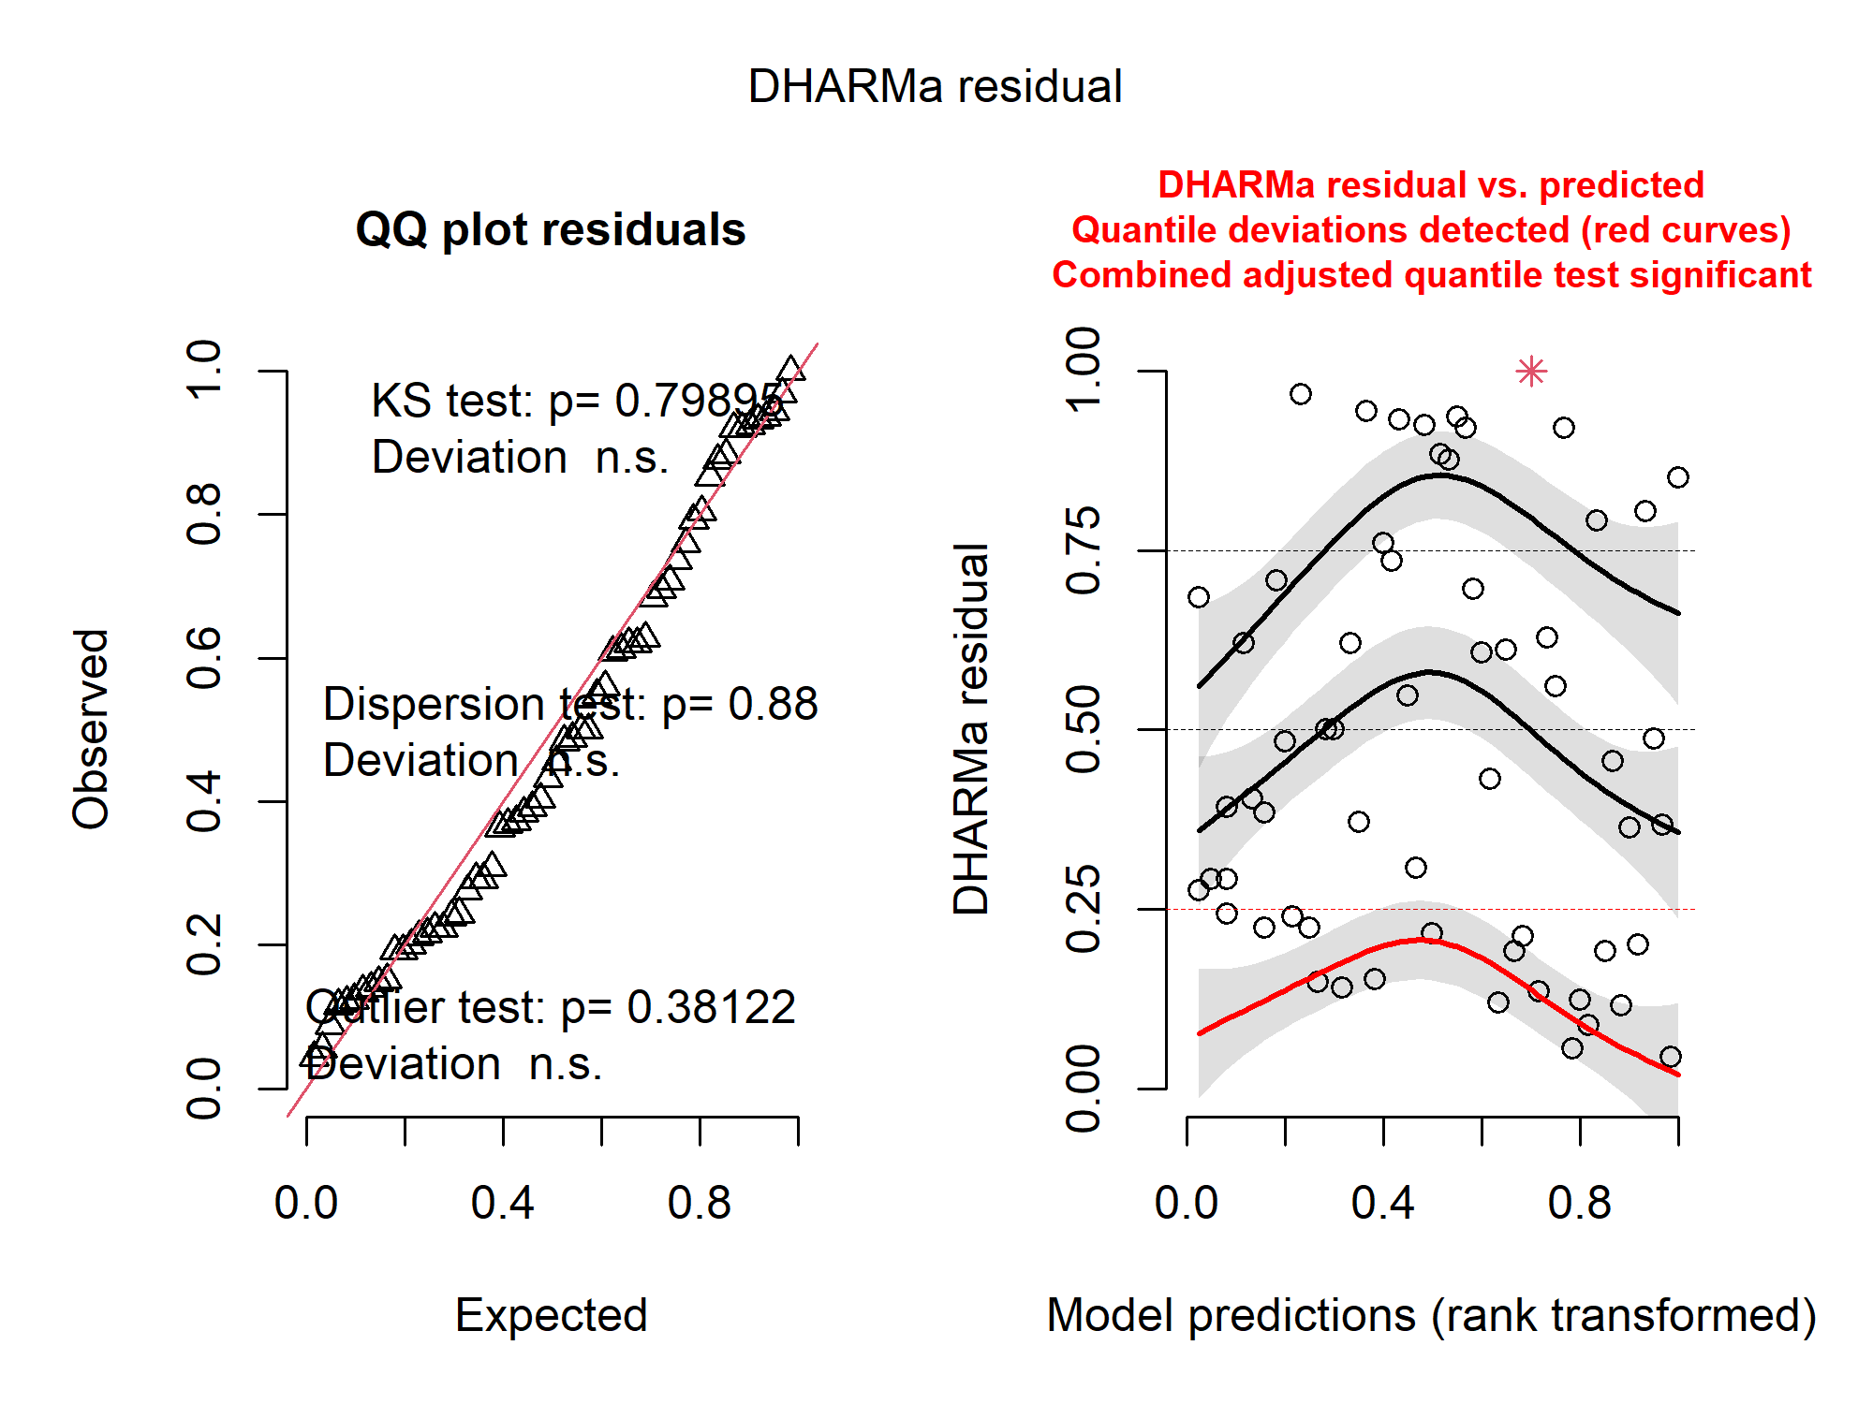
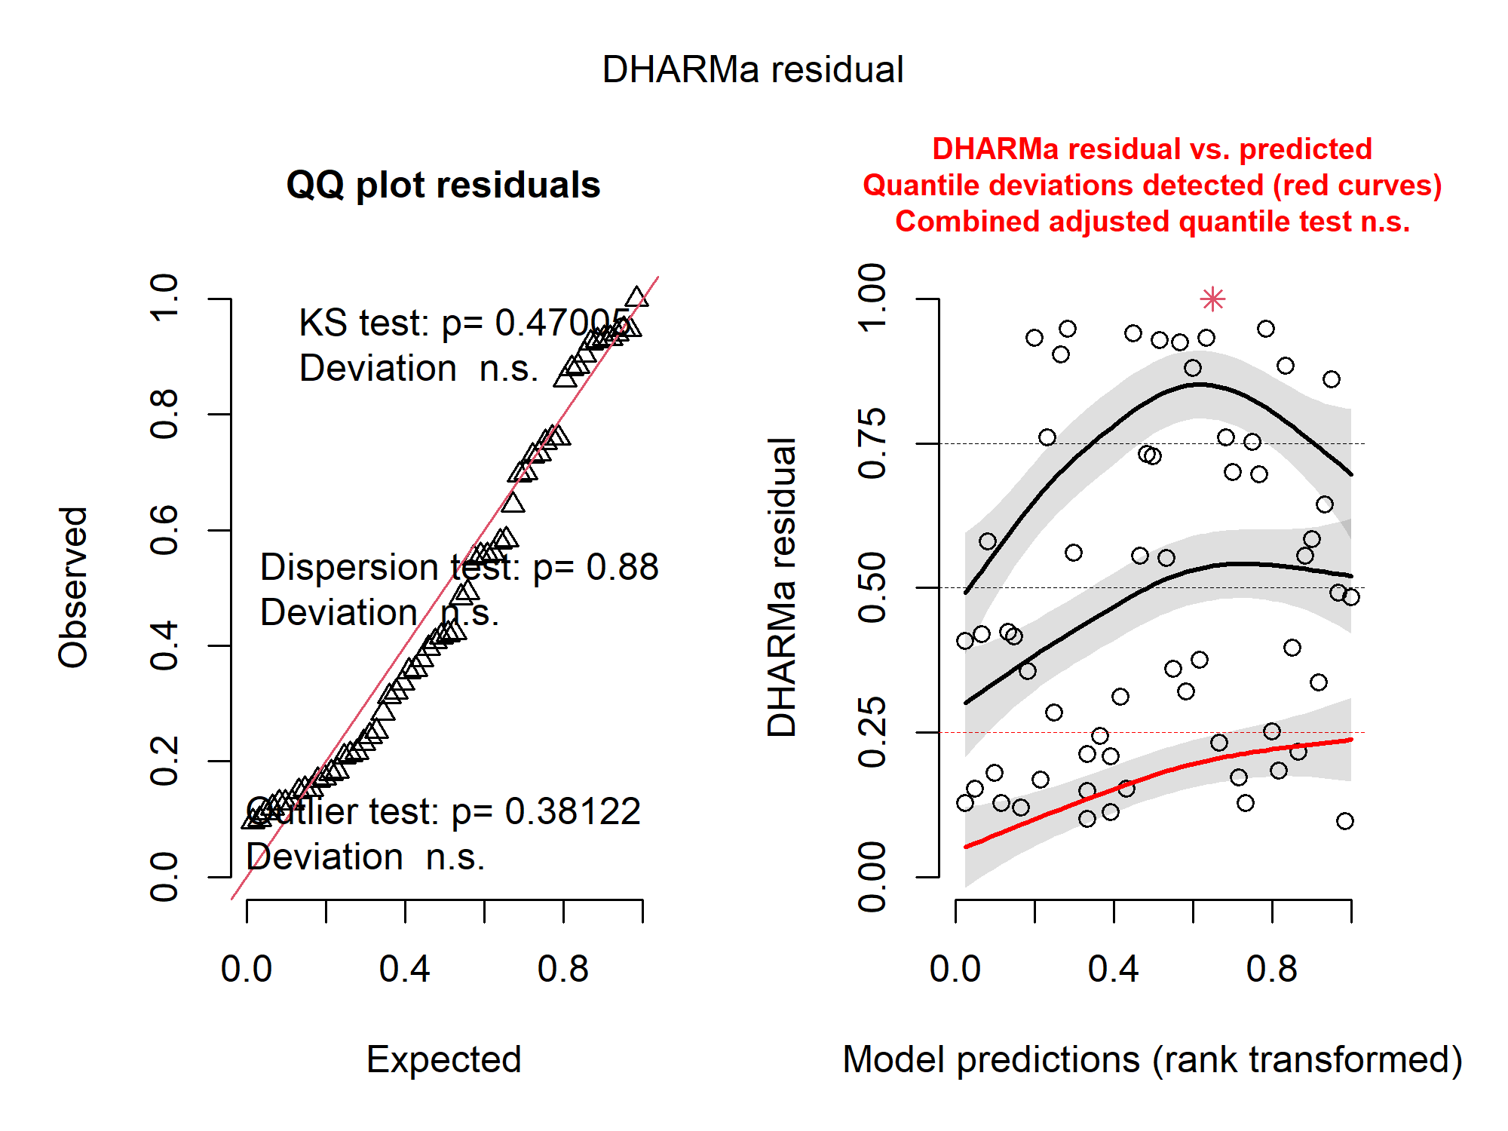
(A) glm(MCP ~ platform + log(num_obs), family=Gamma(link="log"))
(B) glm(log(MCP) ~ platform + log(num_obs), family=gaussian))
(C) glm(MCP ~ platform + log(num_obs), family=gaussian))
(D) glm(MCP ~ platform + num_obs, family=gaussian))

Slide 2
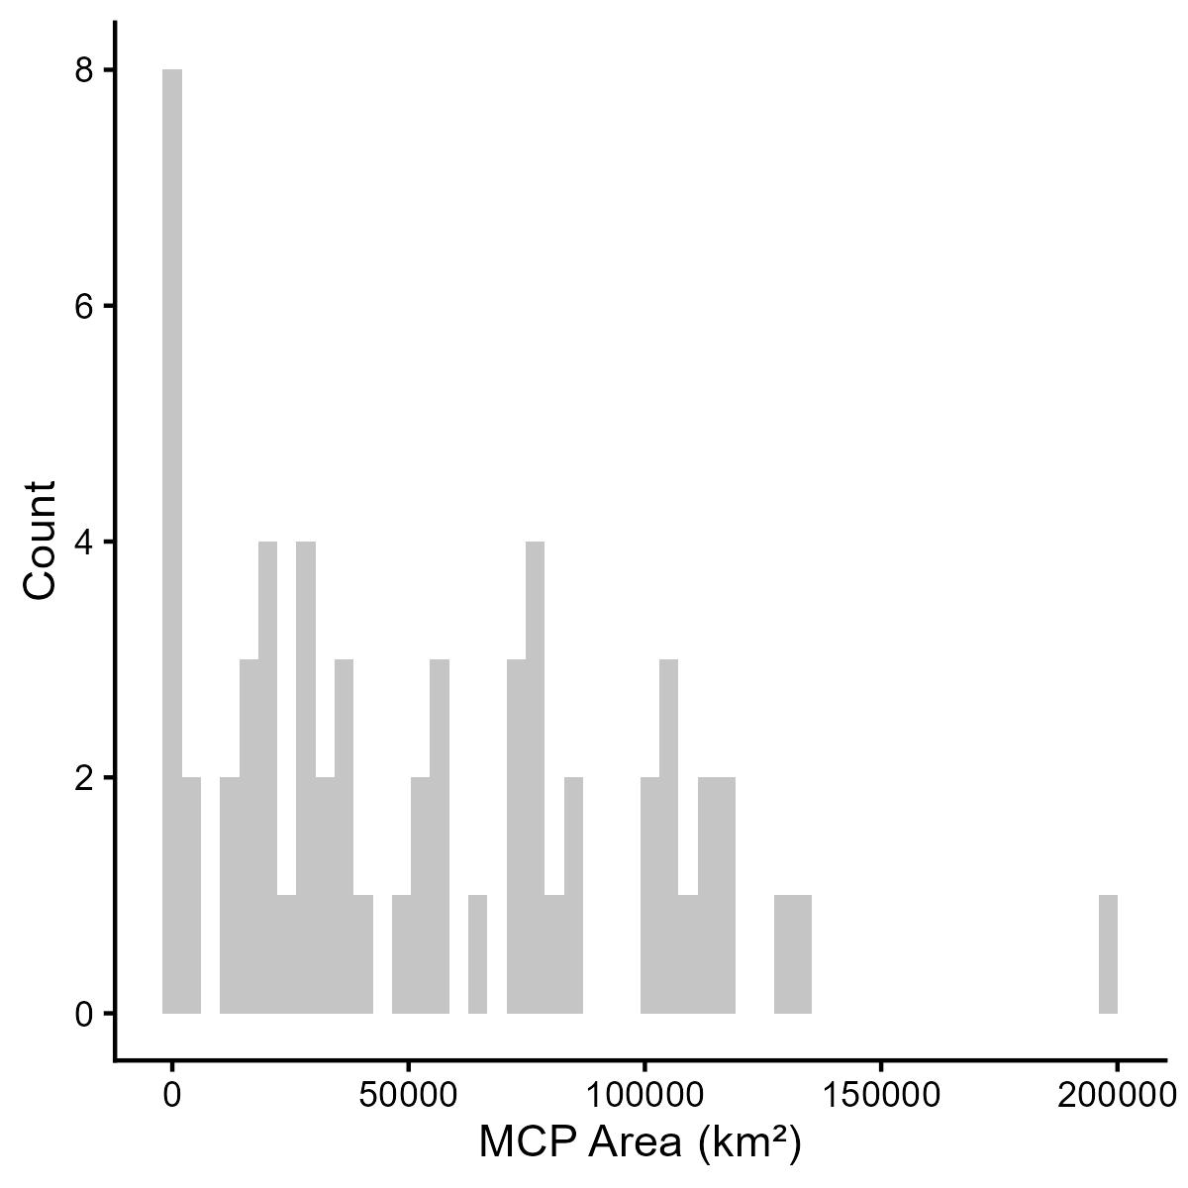
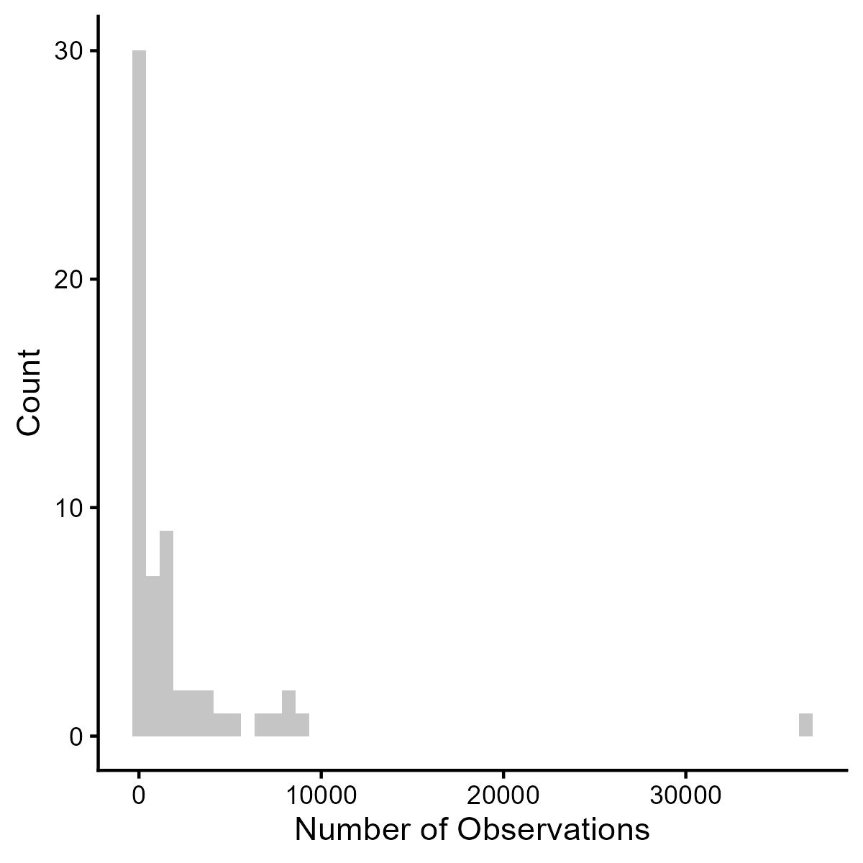
(A)
(B)

Slide 3
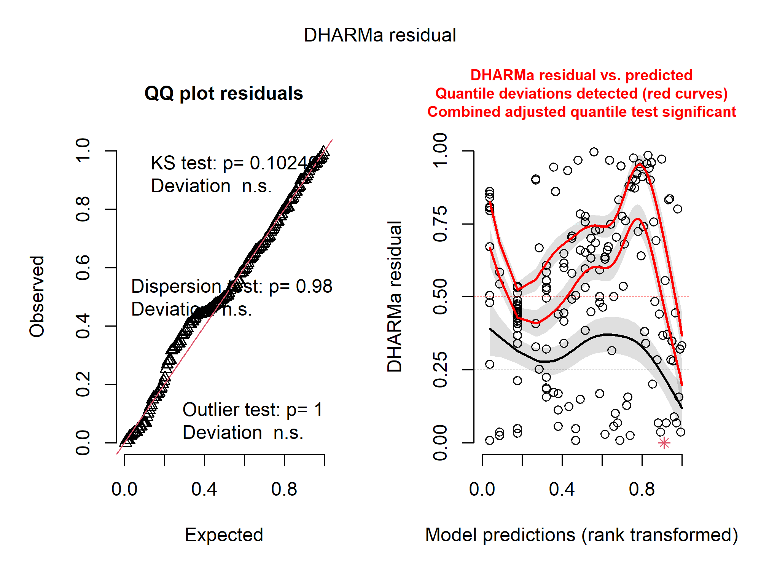
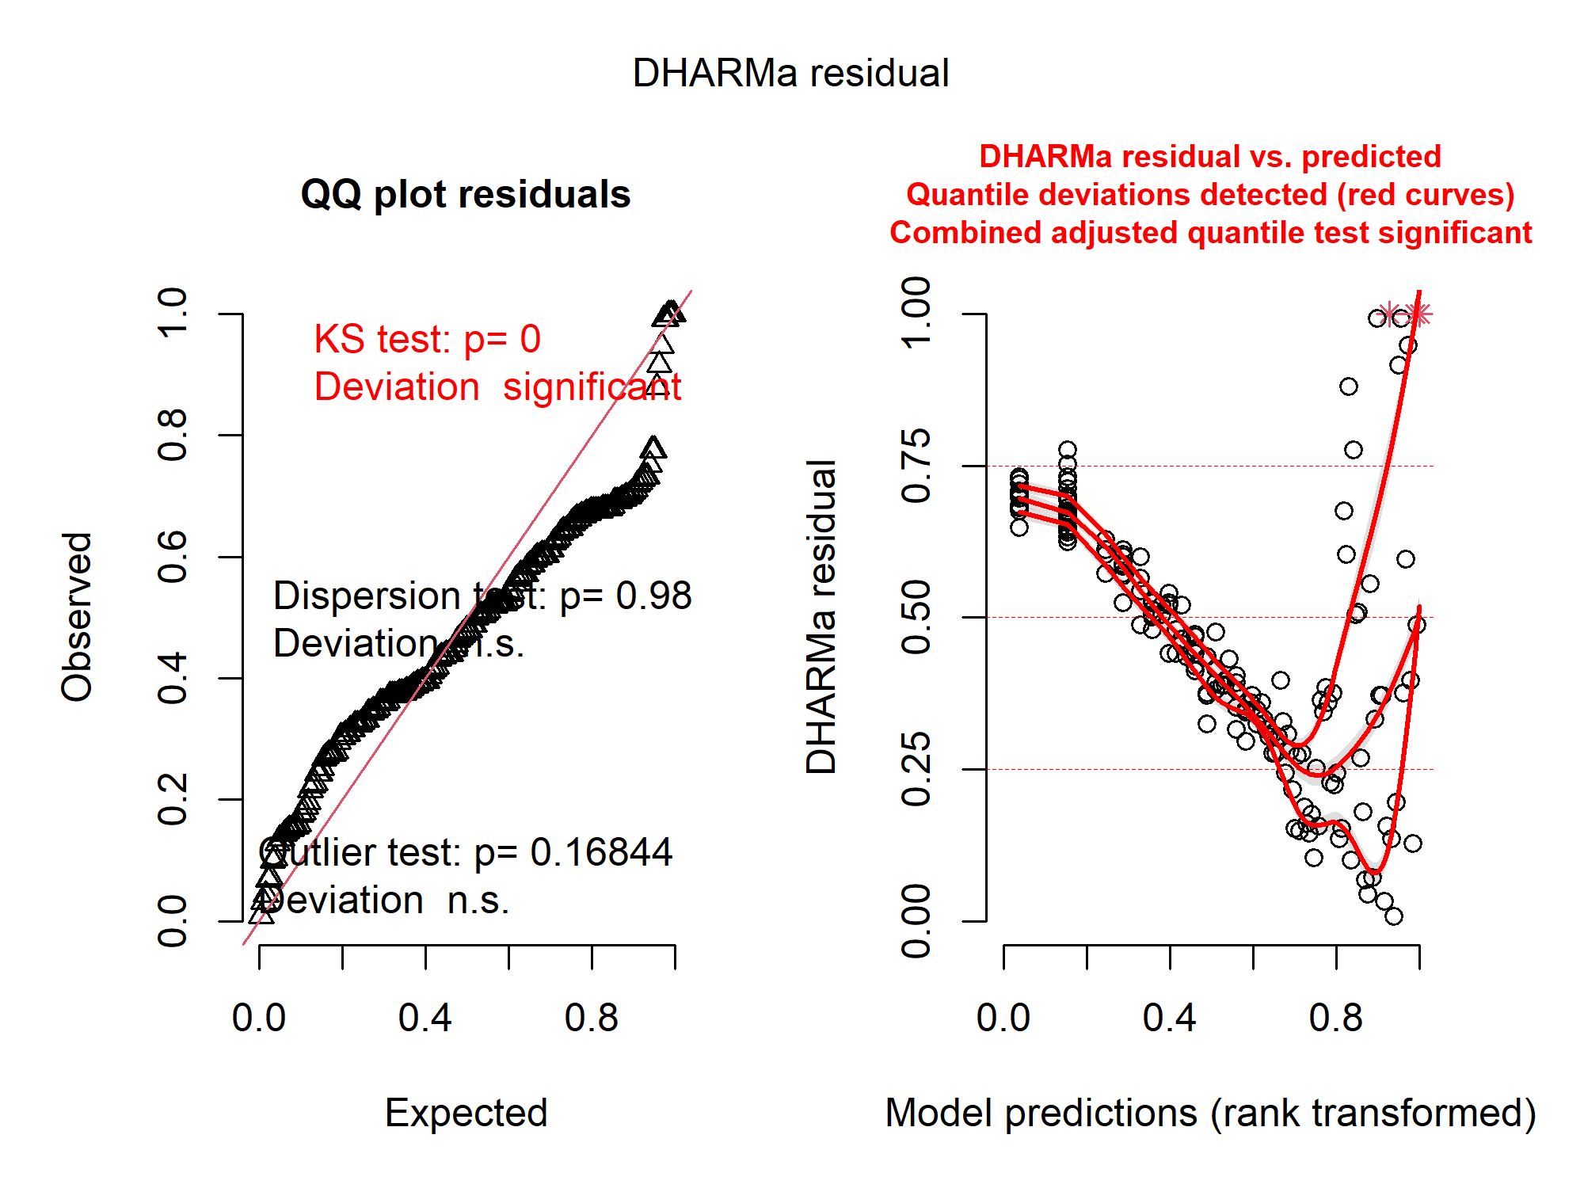
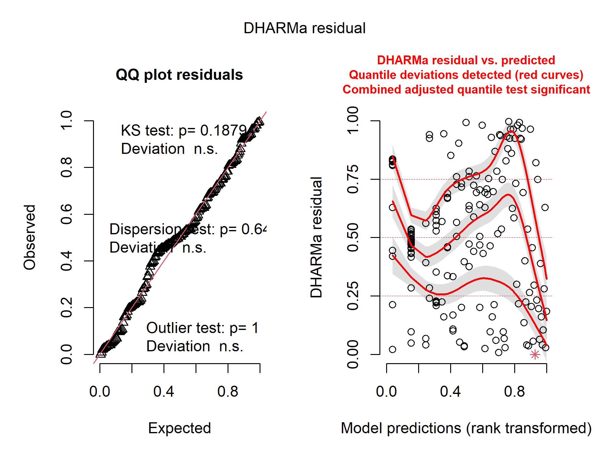
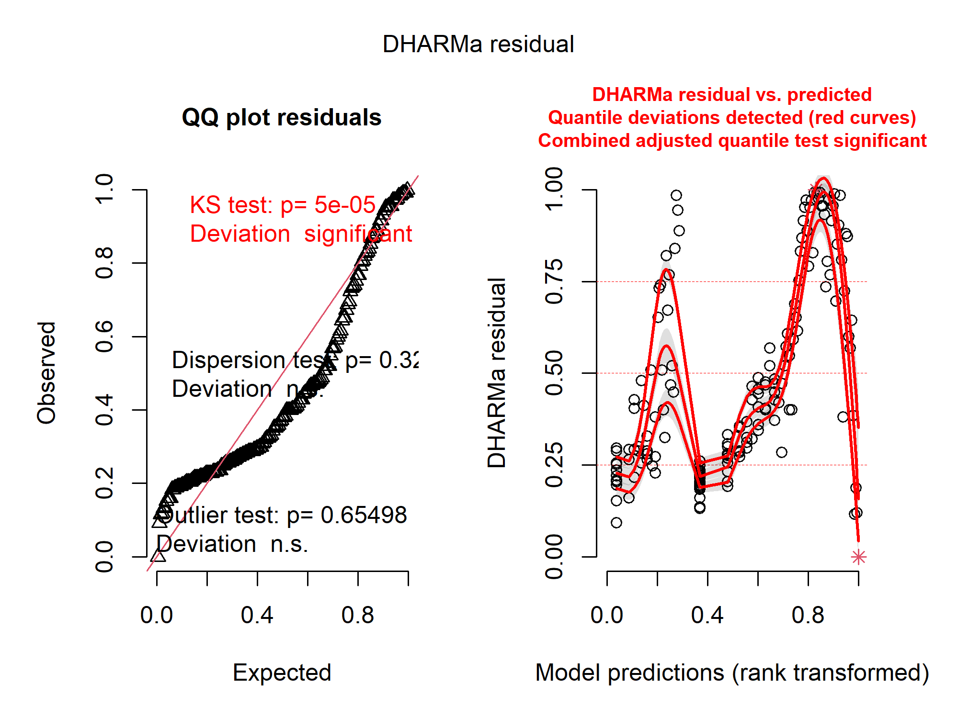
(A) glm(log(grid_area) ~ platform + log(num_obs), family=gaussian)
(B) glm(grid_area ~ platform + log(num_obs), family=gaussian)
(C) glm(grid_area ~ platform + log(num_obs), family=Gamma(link="log"))
(D) glm(grid_area ~ platform + num_obs, family=Gamma(link="log"))

Slide 4
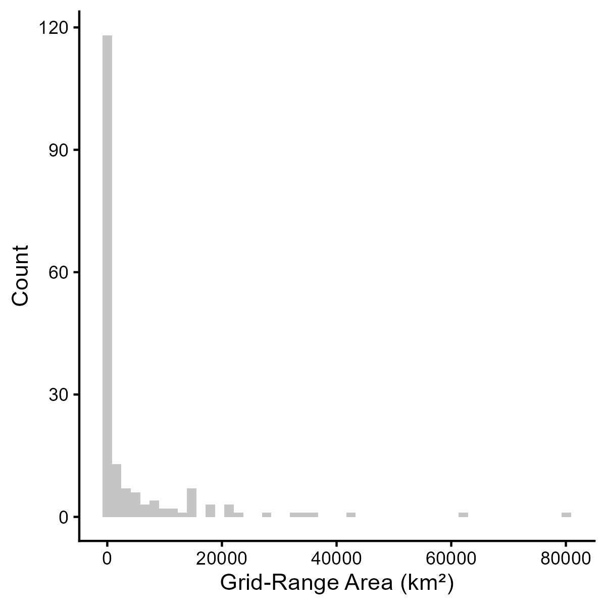
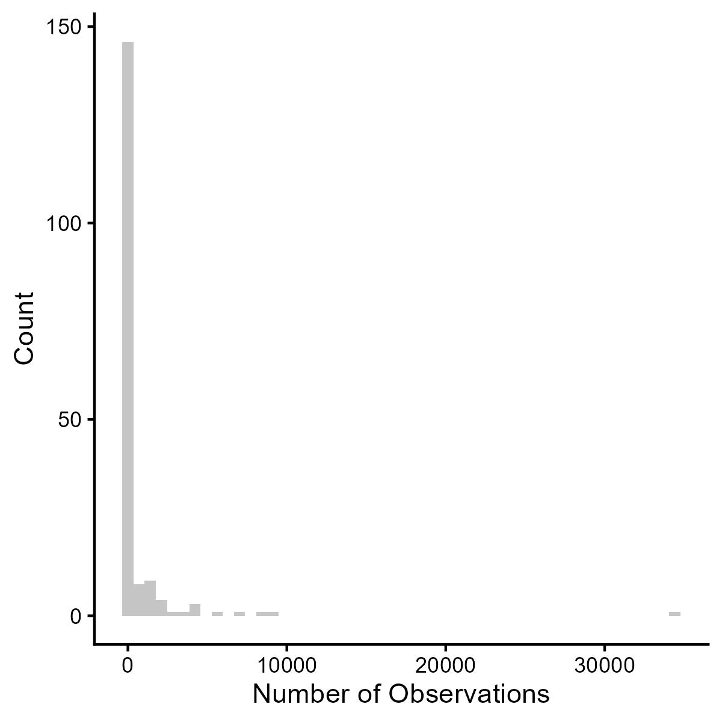
(A)
(B)

