Slide 1
Endangered Species Portfolio Project
Analysis by : Mario Giraldo

Slide 2
Summary of Datasets used
Observations dataset:
Consisted of 3 columns : “Scientific Name”, “Park Name”, and “Observations”
There were 23,296 rows
No missing or “NaN” values
There were 5,541 unique scientific names
There were 4 National Parks where observations were made : “Great Smoky Mountains”, “Yosemite”, “Bryce”, and “Yellowstone”

Slide 3
Summary of Datasets used
Species dataset:
Consisted of 4 columns : “ Category” , “Scientific Name”, “Common Names”, and “Conservation Status”
There were 5,824 rows
There were 7 different values in the Category column (e.g. Mammal, Reptile, etc.
4 Different Conservation Statuses : “Species of Concern”, “Endangered”, “Threatened”, “In Recovery”
There were 5,633 “NaN” values in the Conservation Status column
Which comes out to only 3% of the entire dataset having a Conservation Status value
These “Nan” values were replaced with the value “No Data or No Concern”

Slide 4
Summary of Datasets used (species cont.)
As there is no certainty of those species with “NaN” values in the Conservation Status column being “not endangered” I did not treat them as such.
Given this interpretation of the dataset, I was not able to perform a Chi-square test to draw any conclusive correlation between species and their conservation status.
I was not able due to the general rule of performing this correlation calculation between variables where there is at least 50% of data from one variable to make calculations against another.
For those species that did have a conservation status value, they were grouped together as a “Conservation group” for purposes of being able to draw conclusions on species and where they were observed.

Slide 5
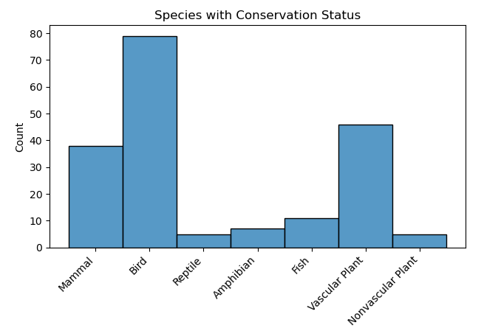

Slide 6
Conclusions from Species graph
As observations were made at national parks, the impact felt by animals in those areas would be more indirect that direct as there is not the possibility of development happening at National Parks which could lead to conservation issues for some animals.
As birds were the most prevalent species to have a conservation status, one could surmise (given the changing climate) that air quality has affected birds more than other animals due to their innate exposure to more parts of the atmosphere than other animals.
Another potential reason for birds to be more affected would be that they are more sensitive to temperature changes than other animals.

Slide 7
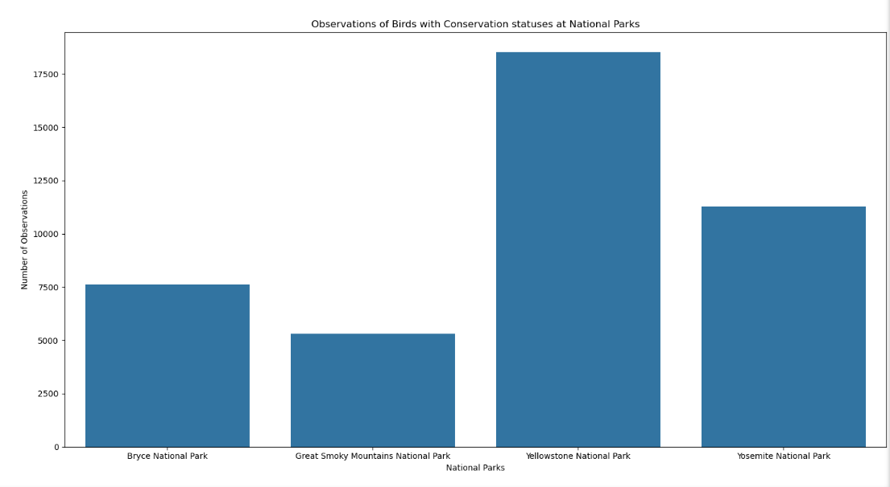

Slide 8
Conclusions from National Park observations graph
As the observations in Yellowstone are far greater than at the other parks, it lead to the realization that park size might be the major contributor to the observation distribution.
Yellowstone area : 3,471 square miles
Yosemite area : 1,169 square miles
Great Smoky Mountains : 800 square miles
Bryce : 56 square miles

