Slide 1
Python for Data Analysis
Marion GATINOIS et Katell GOURLET

Slide 2
Sommaire
Explanation of the problem
Data Visualization
Data Modelization
API
Conclusion

Slide 3
Explanation of the problem
We chose to used the folowing data set for this projet : https://archive.ics.uci.edu/ml/datasets/Online+News+Popularity
This data set have 39797 instances with 58 predictive attributes and 1 goal field with is the number of shares for a given article.
The statistic of this data set are about articles that were published by Mashable.
The predictive attributes describe the articles shape, published date, content…
Objective:
Find if the article is popular or unpopular using a decision threshold, that we will define.

Slide 4
Data Preparation
We will not use all the columns for our visualisation or our modelization :
For example, the two first attribute are :
- url: URL of the article
- timedelta: Days between the article publication and the dataset acquisition
We will remove them as we won't use them for our prediction.
We might also remove colums feature that contain redundance feature as is_weekend as redundant feture will perturbate our modelisation.
However, we don’t have mission values so we won’t have to deal with incomplete data.

Slide 5
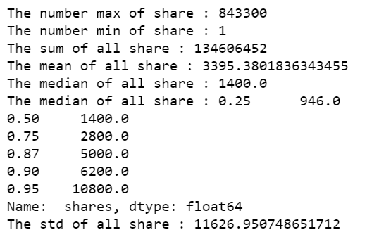
Data Visualization
Information contained in the dataset :
We can see here that there is only 5% of the data that have more than 10 800 share or the maximum of share is 843 300.
There is some exceptional article that are very popular, with a different magnitude comparing to the majority of the data.
That is why, for a better display of the graph, we won’t always display those data. In the following page, you will see the difference.

Slide 6
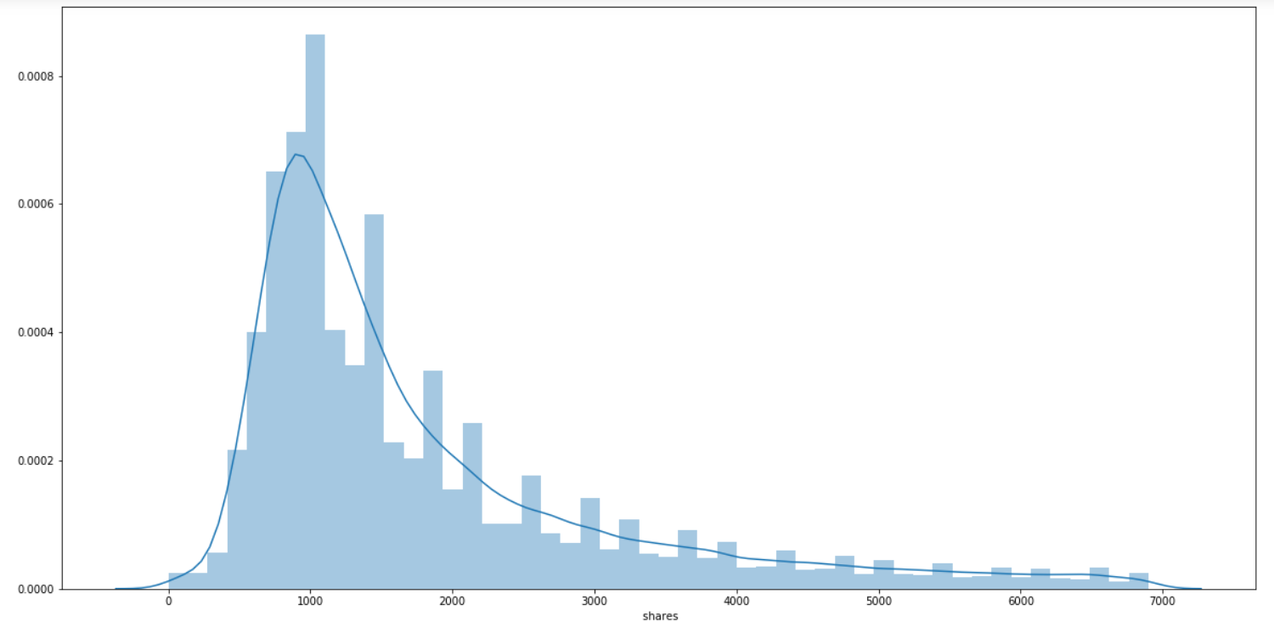
Data Visualization
As the quantil of 0.90 is at 6200.0, we will take all the share of Y < 7000 for a better display, there are almost 92% of the data. Otherwise we can't see correctly the results.
In this graph we can see that the majority of the data are concentrated arounf the median that is at 1400. The mean, that is at 3000 seems to separate the majority of the data from the data with best rate of share

Slide 7
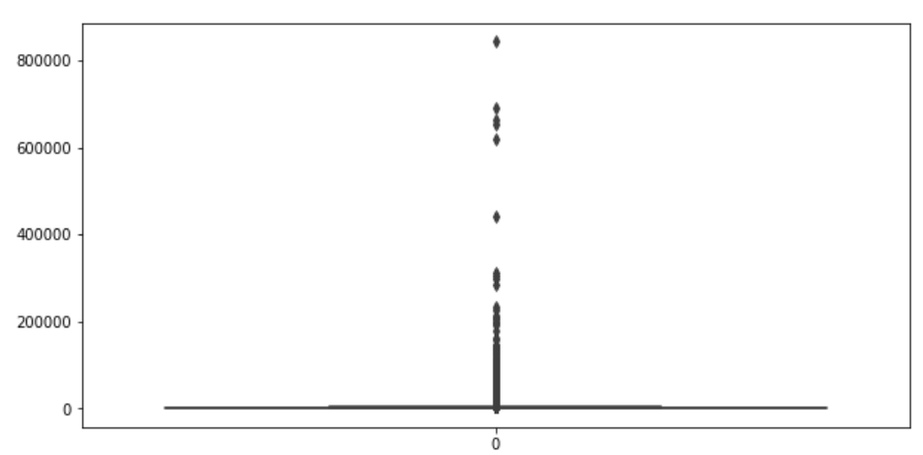
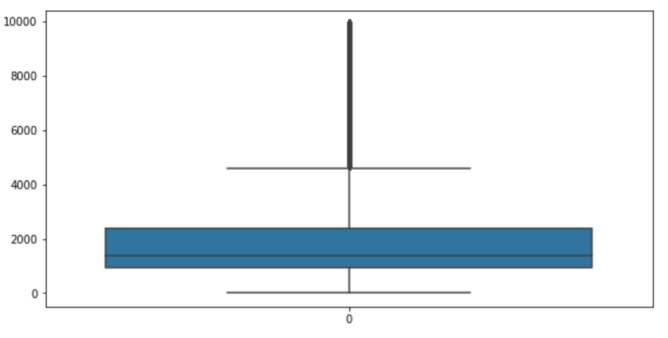
Data Visualization
On the first box plot we use all the data. However, we can’t see anything.
On the second graph, for better display, we take 95% of the data.
Then, for Data Visualization, we should only use 90 to 95, as explain in the previous slide.

Slide 8
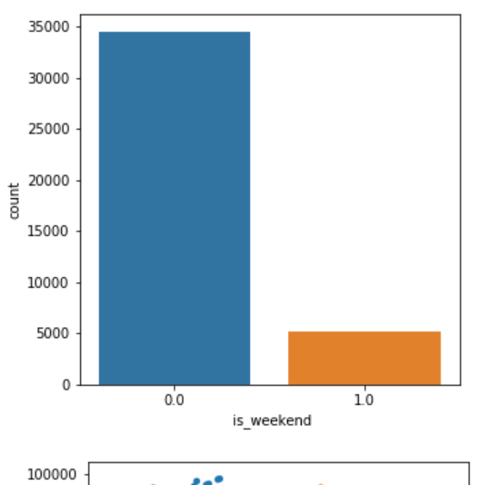
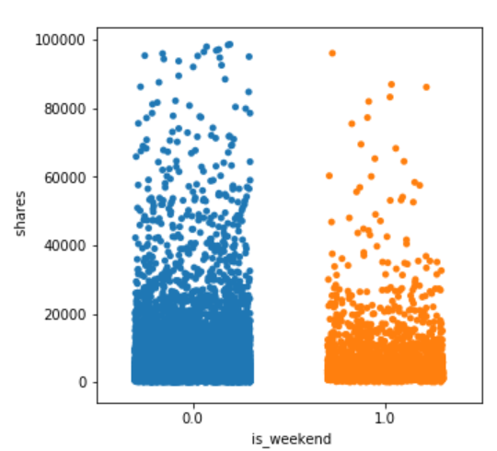
Data Visualization
The repartition look the same between the count of published articles, it seems to not have a real impact on the shares rate.

Slide 9
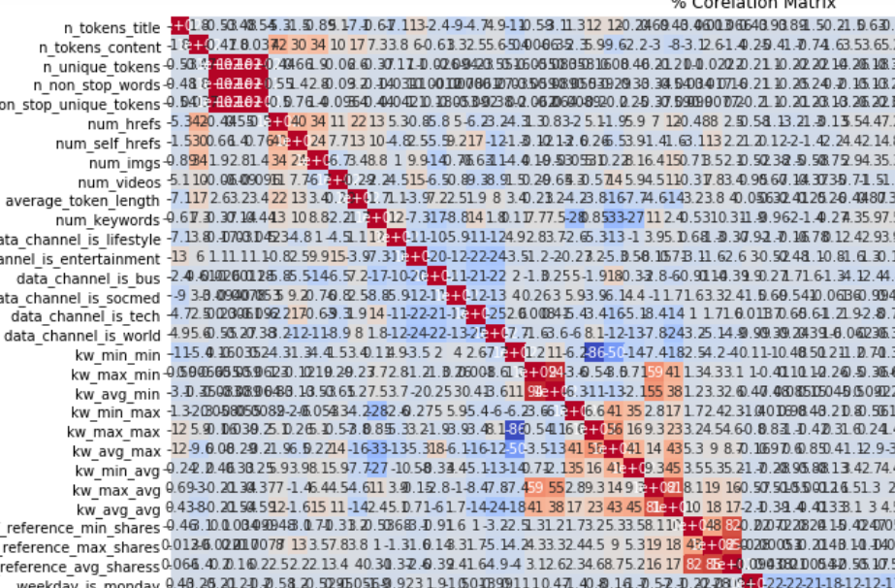
Data Visualization
We can also observe with the data visualization if data depending on something or not.
With this correlation matrix, we can deduce that every data depends on everything.
We can’t especially find out that 2 or 3 features influence mainly the share rate.
We need to keep all ours features.

Slide 10
Data Modelization
, the last columns share is our target columns. So, we will separate the target and the features.
We can then calculate of the accuracy of the prediction on the column "shares" :
This accuracy in% means that depending on a value (average, median), if the value obtained is greater than this value, then there is this % that the prediction "popular" is true .

Slide 11
Data Modelization : Calculation of the accuracy on the column "shares"
1 ) Regression
We use regression here, rather than classification, because we want to know the exact number of shares.
So, we try to use A)the random Forest regression and B)the logistic regression.
A) Using the RF regression we obtain –95%.
B) Using the logistic regression we obtain 79,4% for the train dataset and 79.6 for the test dataset.
This value of RF regression is impossible, so we try another regression method : the logistic regression.
We then obtain a very correct value and we compare the result of the values of the 2 datasets which are very similar. We then keep this very satisfactory result. 80% of good predictions.

Slide 12
Data Modelization : Calculation of the accuracy on the column "shares"
2) Classification
Here, we use classification rather than regression, because we want to know if there is success or not (popular or unpopular), not the exact number of shares.
So, we use the random forest classification. We try using A) the mean and B) the median
A) Using the mean ( that is 3395) we obtain 79 %
B) Using the median (that is 1400) we obtain 65 %
The difference is quite big because there is a big difference between the mean and the median and it is therefore observed that using an average, the prediction is more precise.

Slide 13
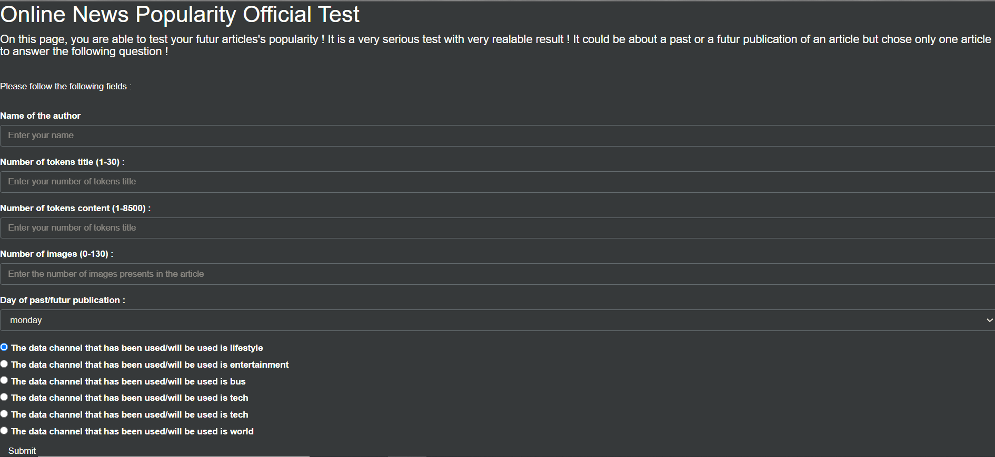
Flask API
Here is the display of or flask API with the classification modelization. Try your article ! Be aware that after you click on the submit button, the model take a few minute to give you result.

Slide 14
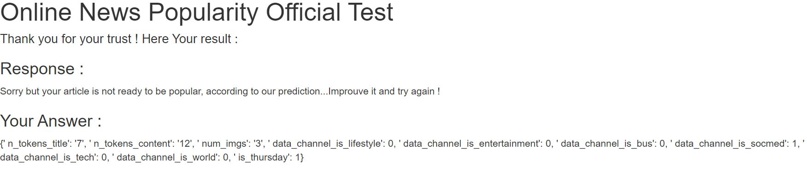
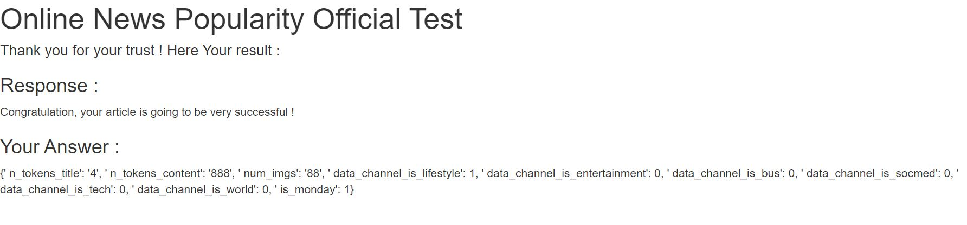
Flask API
Here is some example of the result for success or failure according to the answer given:

Slide 15
Conclusion
We can observe that classification have better results.

