Slide 1
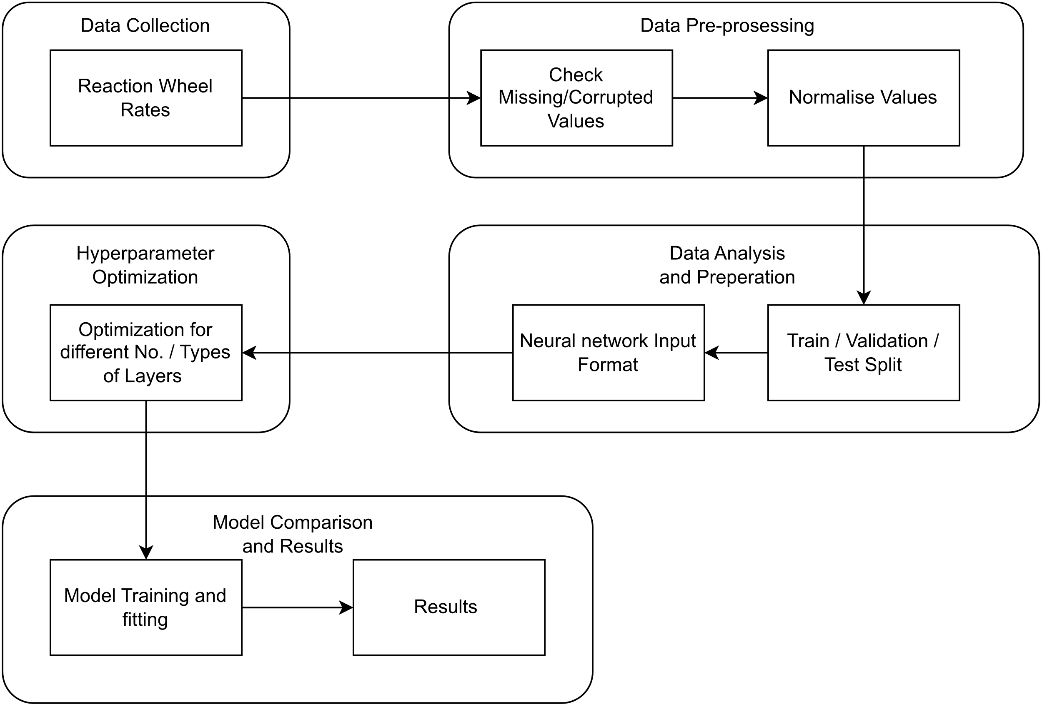

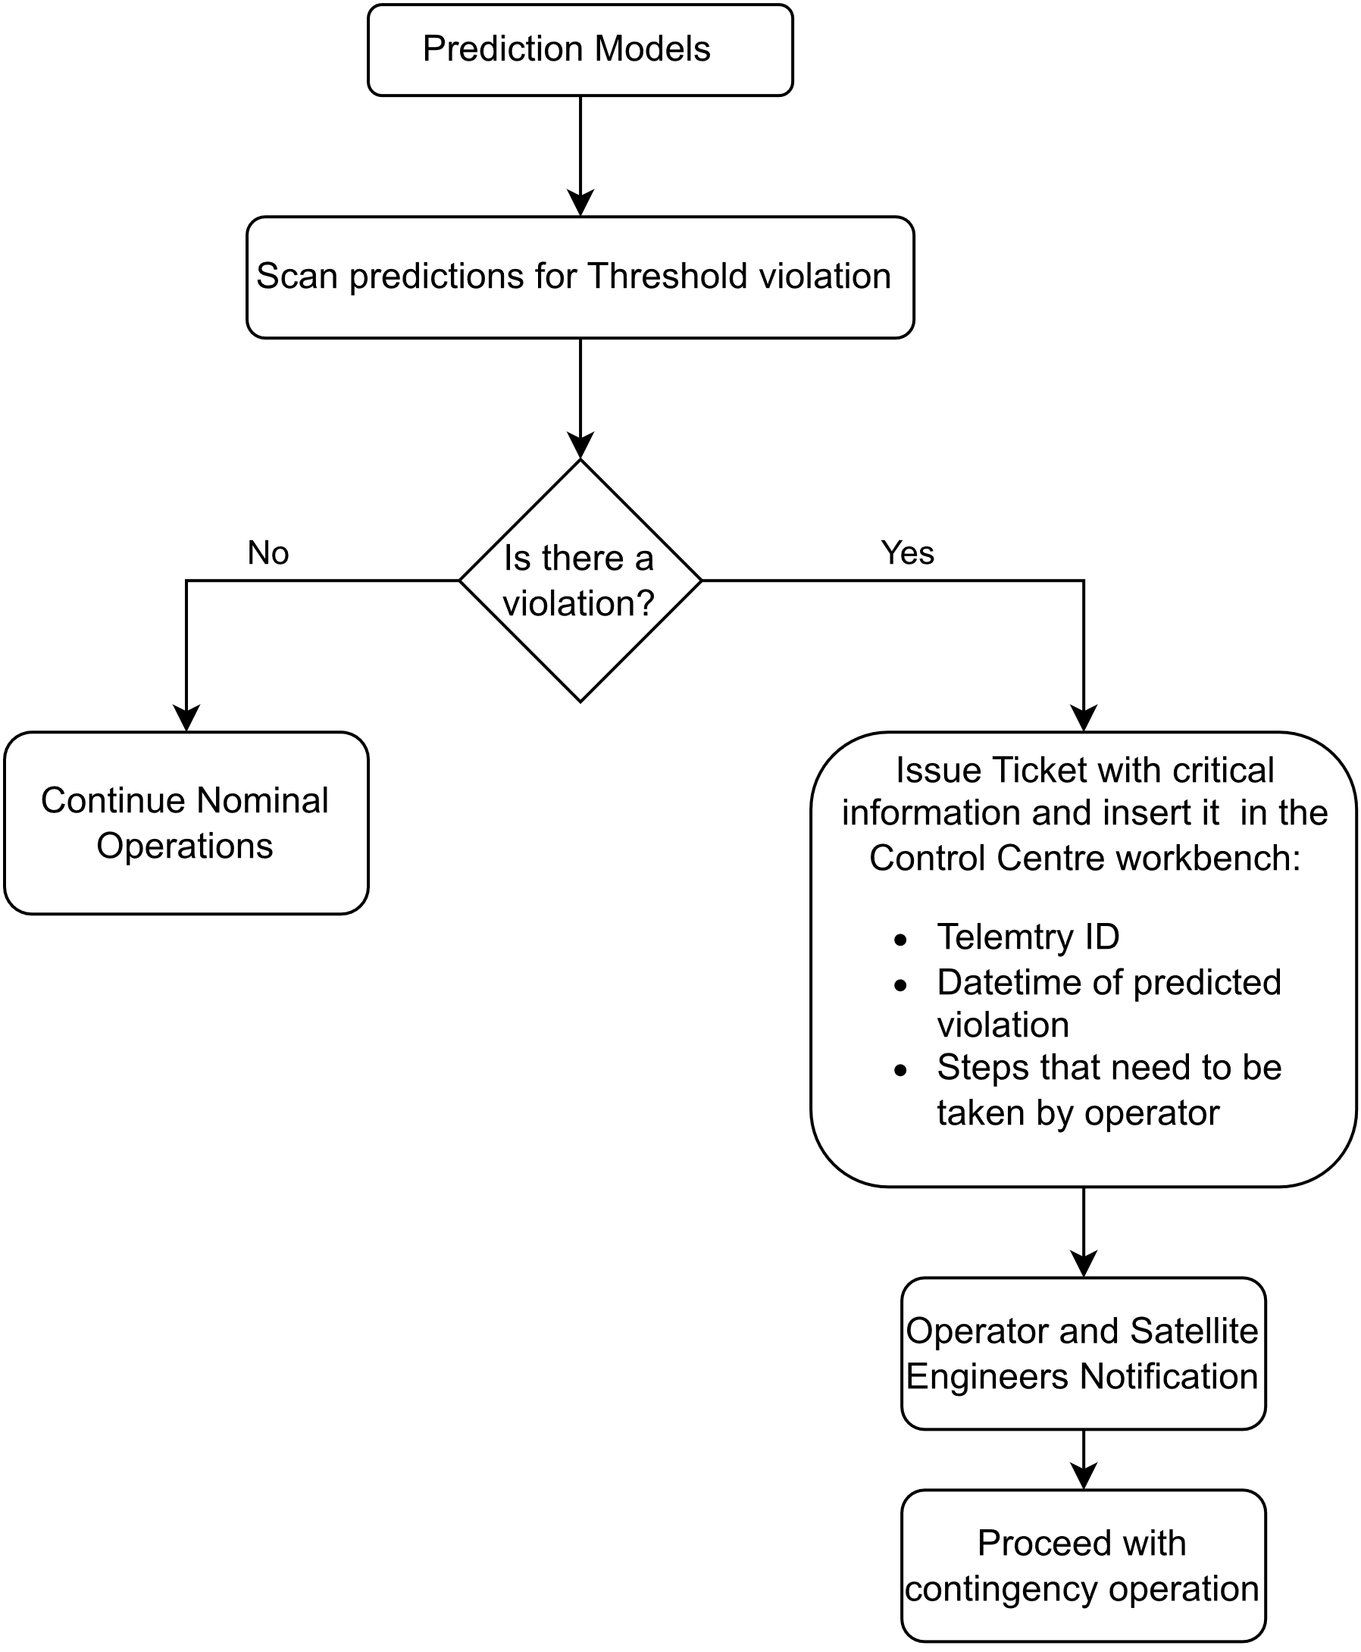
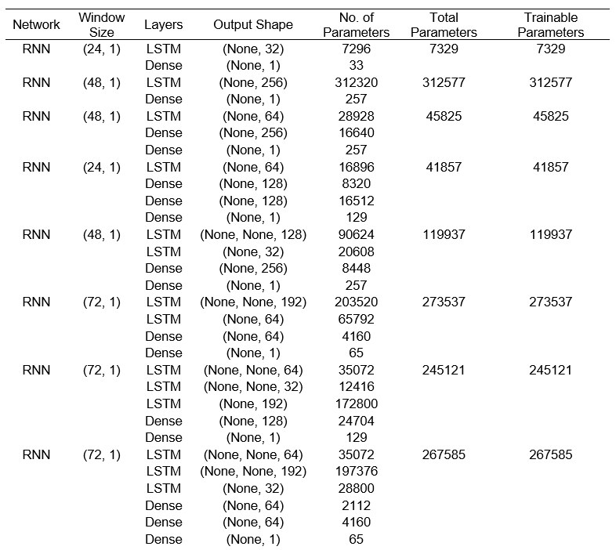


Introduction: Satellite platforms need to be constantly monitored by satellite operators and action needs to be taken in order to keep the satellites’ performance nominal. Such activities can be scheduled in advance, because of the knowledge of the orbit of the satellites and the environment they cope with. However, the conditions they face are dynamic and constantly changing and as a result additional operational procedures need to be conducted out of schedule.
Optimization of satellite operations scheduling using an AI-based tool
Aim:
The aim of this IRP was to create a tool that will allow satellite operators to predict how specific values of the telemetry will evolve over time and warn them when they exceed a threshold, using timeseries forecasting with Recurrent Neural Network. Then the operators can take action by implementing contingency procedures to make sure that the spacecraft and its mission will not be put in danger.
Development:
The tool that was developed is based on Hellas Sat 3, a telecommunications geostationary satellite operated by Hellas Sat. They provided all the necessary data and information in order to be able to create the tool.
Methodology:
Firstly, the data were pre-processed and prepared to be used as input in the models, by being split in new datasets for training, validation and testing.
Multiple architectures were tested for each telemetry dataset and additionally hyperparameter optimization was performed on the parameters that constitute each model, in order to get the best performing architecture. In the following table there are the results just for one telemetry dataset on different possible architectures, regarding the number of layers, input window and number of units on each layer. The best model was chosen based on metrics of performance, such as validation loss and RMSE.
After having chosen the optimized
models, predictions can be made
for a timespan of up to 3 days
ahead. Those predictions are
being surveyed and if one of the
telemetry variables exceeds a
certain threshold, satellite operators are being notified by an automatically created ticket on their workbench. This ticket includes all critical information, such as the date of the threshold violation, the telemetry code that will surpass the limit and the contingency procedure they have to execute.
Results: The resulting product is an end-to-end pipeline tool that includes forecasting values for specific telemetry, surveying those predictions and creating a ticket on the operator’s workbench to notify them in case of future detected threshold violation. Using this tool, operators can be notified about contingency cases and plan their actions accordingly with enough time margin, to assess and investigate the situation properly.
Marios Anastasopoulos, MSc Astronautics and Space Engineering
Supervisor: Dr. Nicola Garzaniti
m.anastasopoulos.980@cranfield.ac.uk
College Rd, Wharley End, Bedford MK43 0AL, UK
48 Konstantinoupoleos,
Koropi 19441 Athens, Greece

