Slide 1
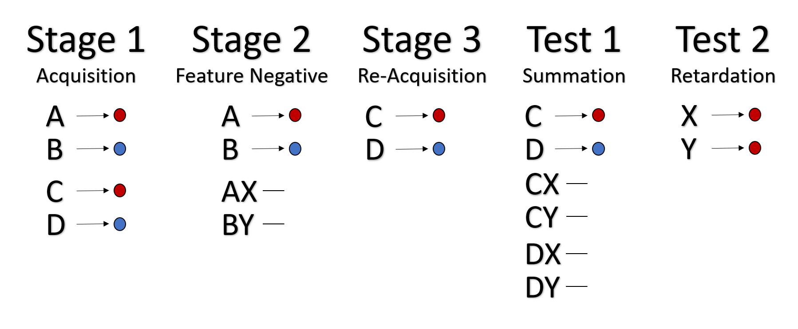

Slide 3
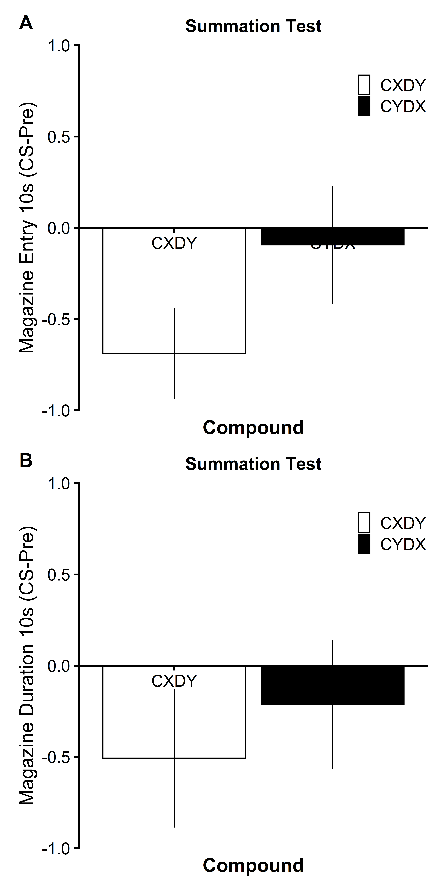

Slide 5
Conditioned Reinforcement

Slide 6
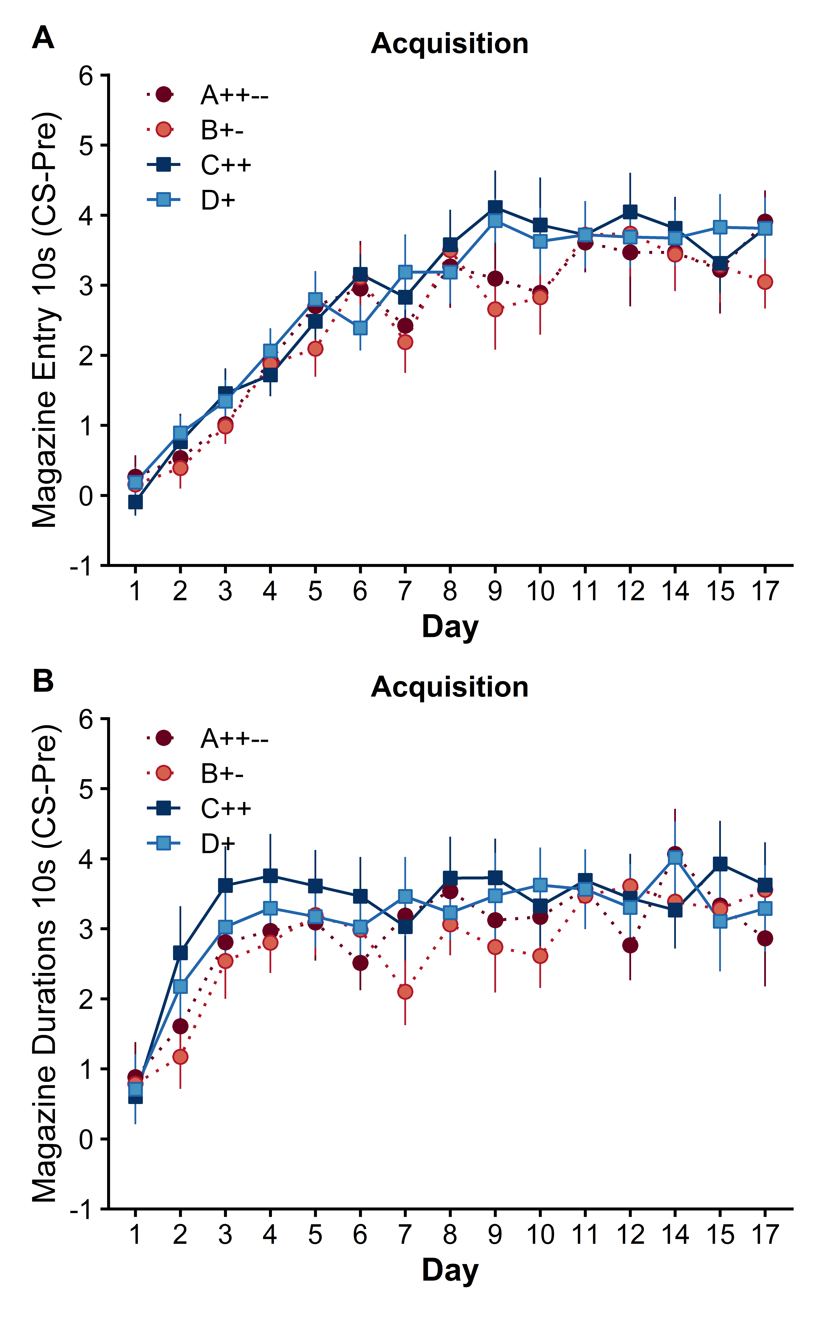

Slide 7
No Exclusions….

Slide 9
