Slide 1
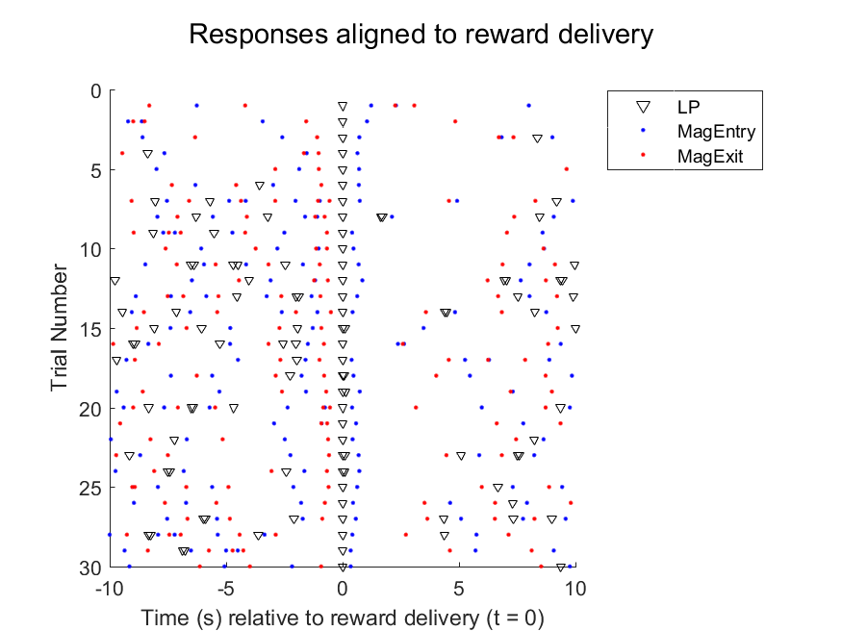
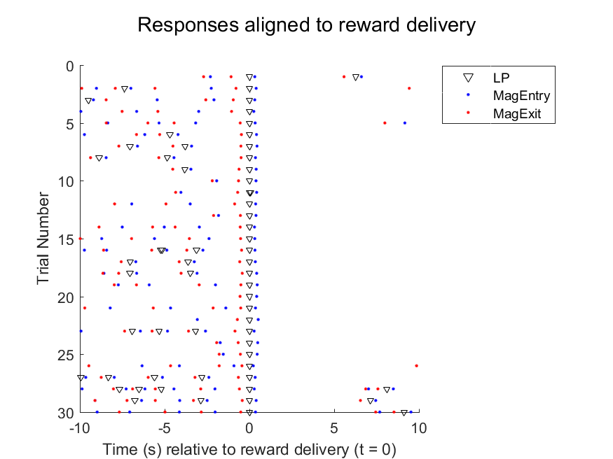
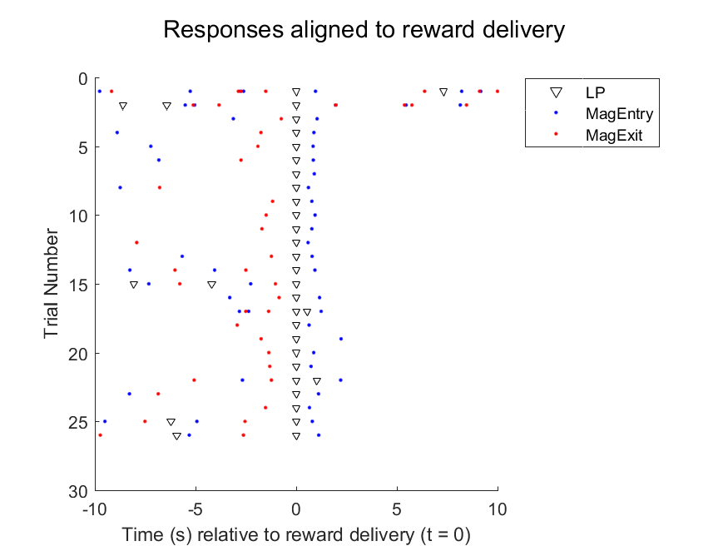
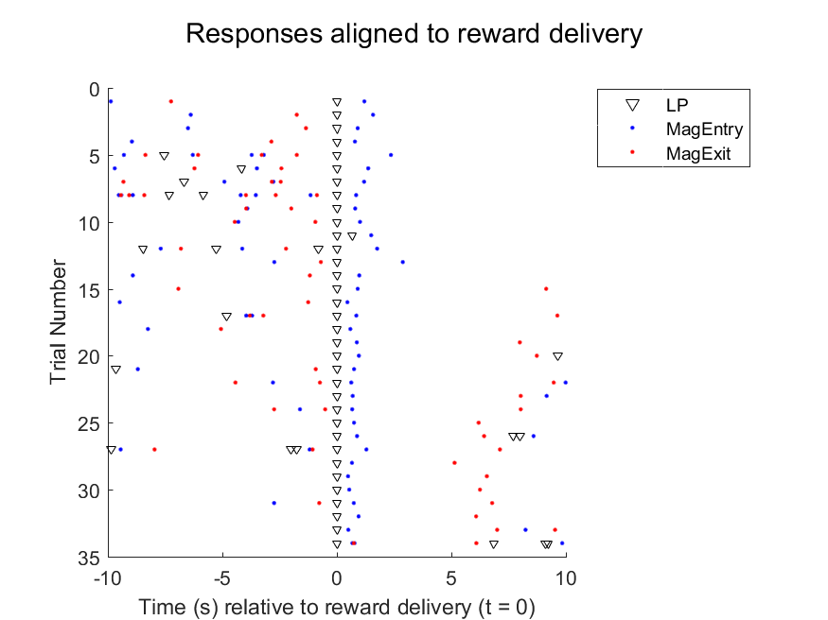
H3_GLRA48.3h
H4_GLRA48.3i
KO
F0_GLRA55.2a
L3_GLRA47.3a
WT
Summary: Most check the magazine quite quickly after making an LP.
KO mice just do these LP->Mag checks more frequently.
Most mice stay in the magazine for quite a few seconds to consume reward in the recessed magazines.

Slide 2
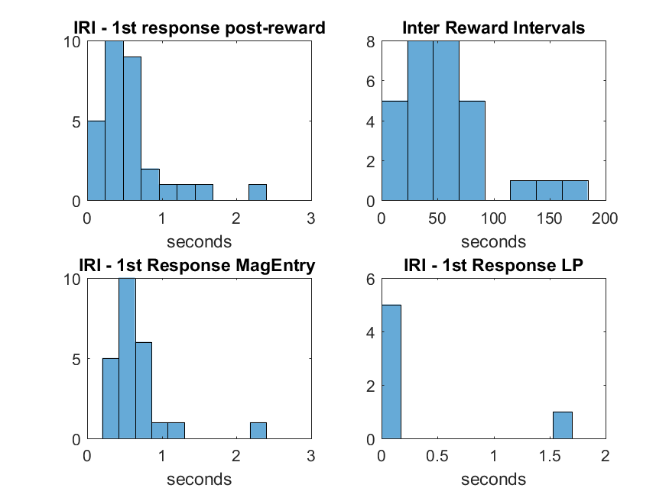
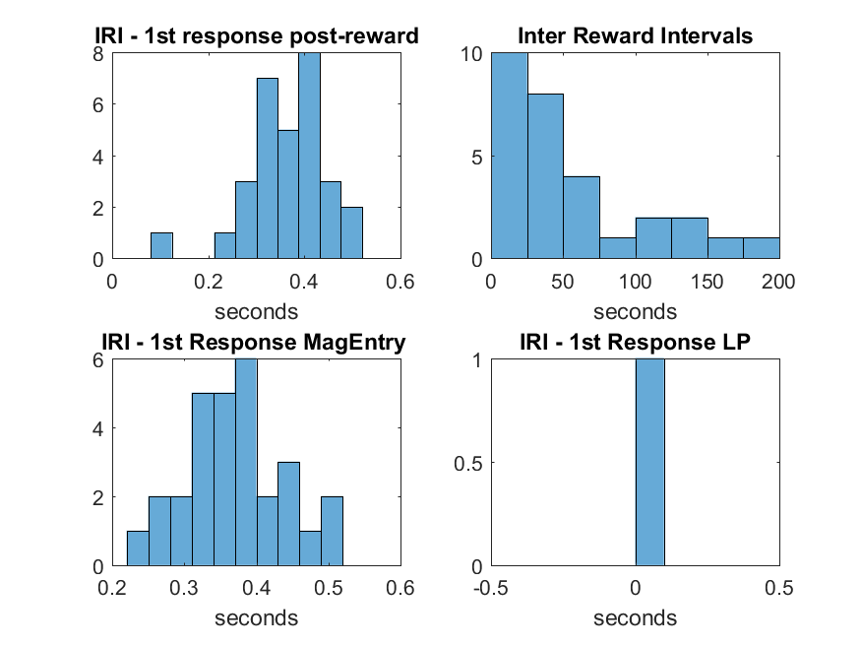
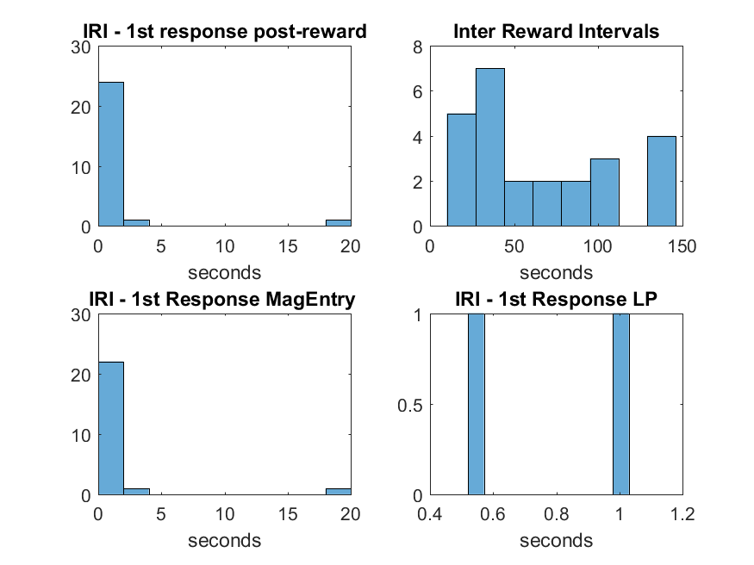
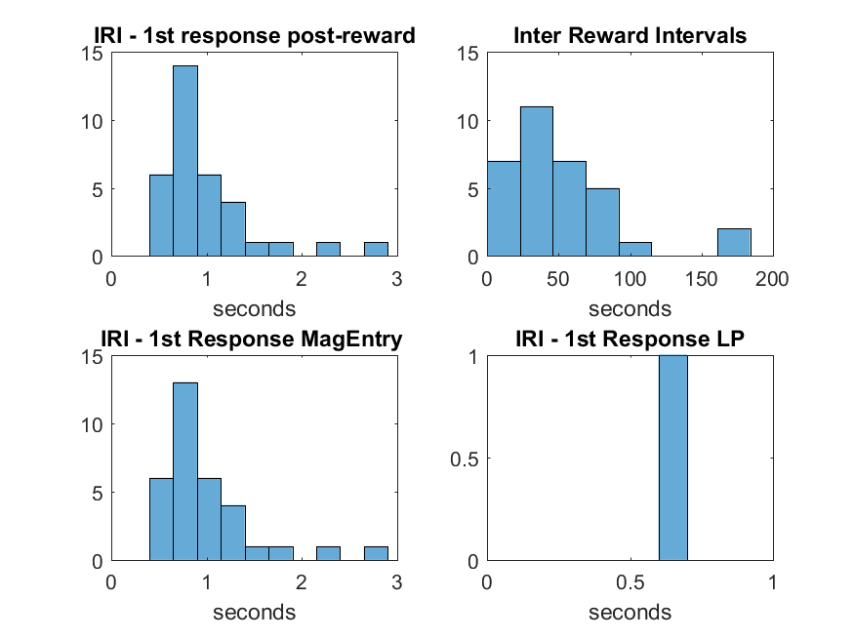
H3_GLRA48.3h
H4_GLRA48.3i
KO
Frequency Histograms Y-axis = count/frequency
IRI = inter-response-interval
1st response = following reward delivery
F0_GLRA55.2a
L3_GLRA47.3a
WT
Summary: Most mice made a response within 1s of a reward being delivered. This was almost always a magazine check and not an extra LP.

Slide 3
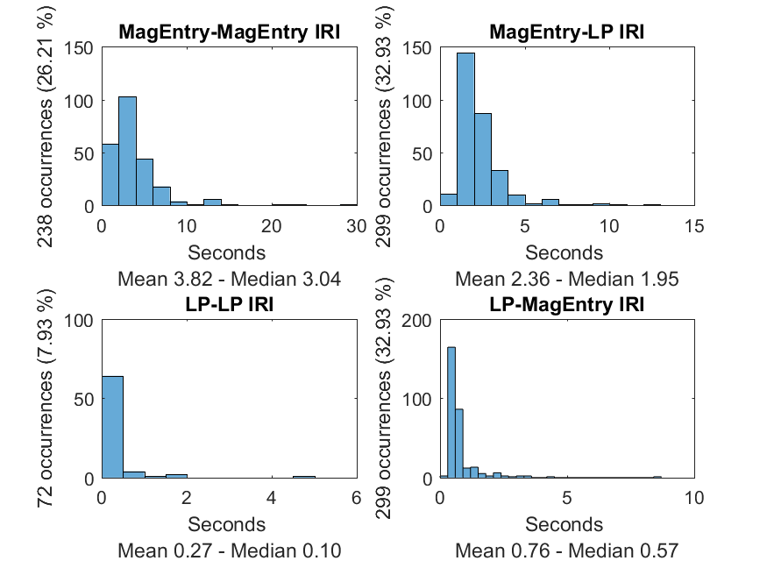
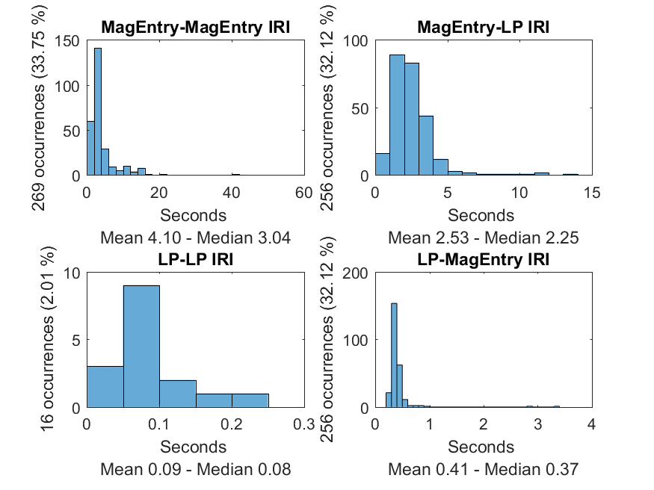
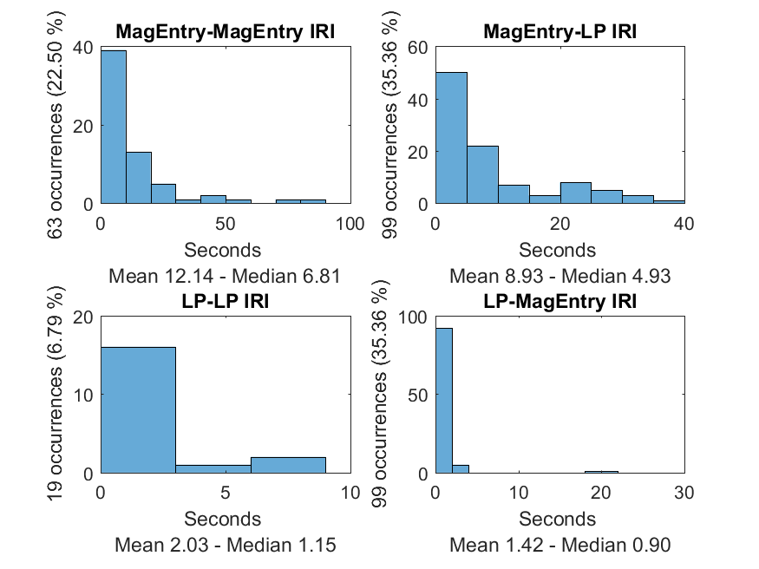
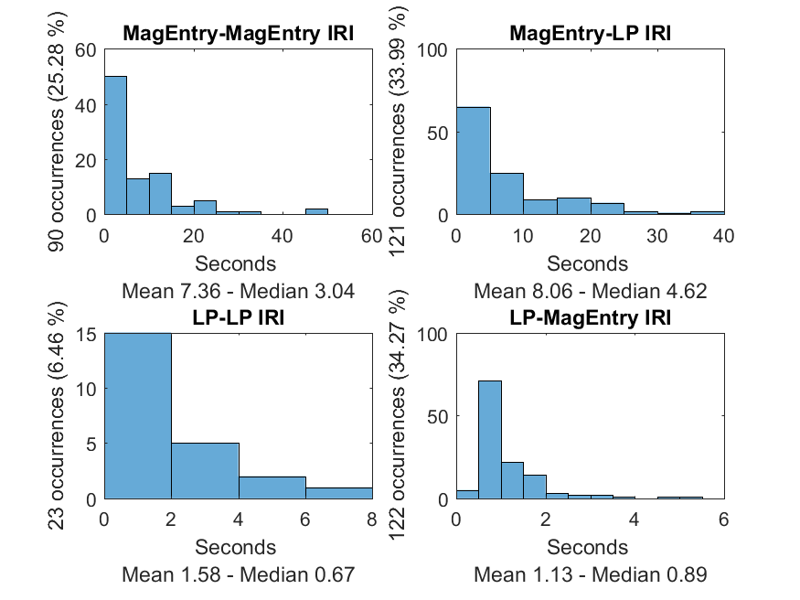
H3_GLRA48.3h
H4_GLRA48.3i
Response chain data IRI = inter-response-interval
KO
F0_GLRA55.2a
L3_GLRA47.3a
WT
Summary: Most mice did not press the lever for long bouts. Checking of the magazine immediately after lever pressing was most common, and quite rapid i.e. within 0.5-1.5s

