Slide 1
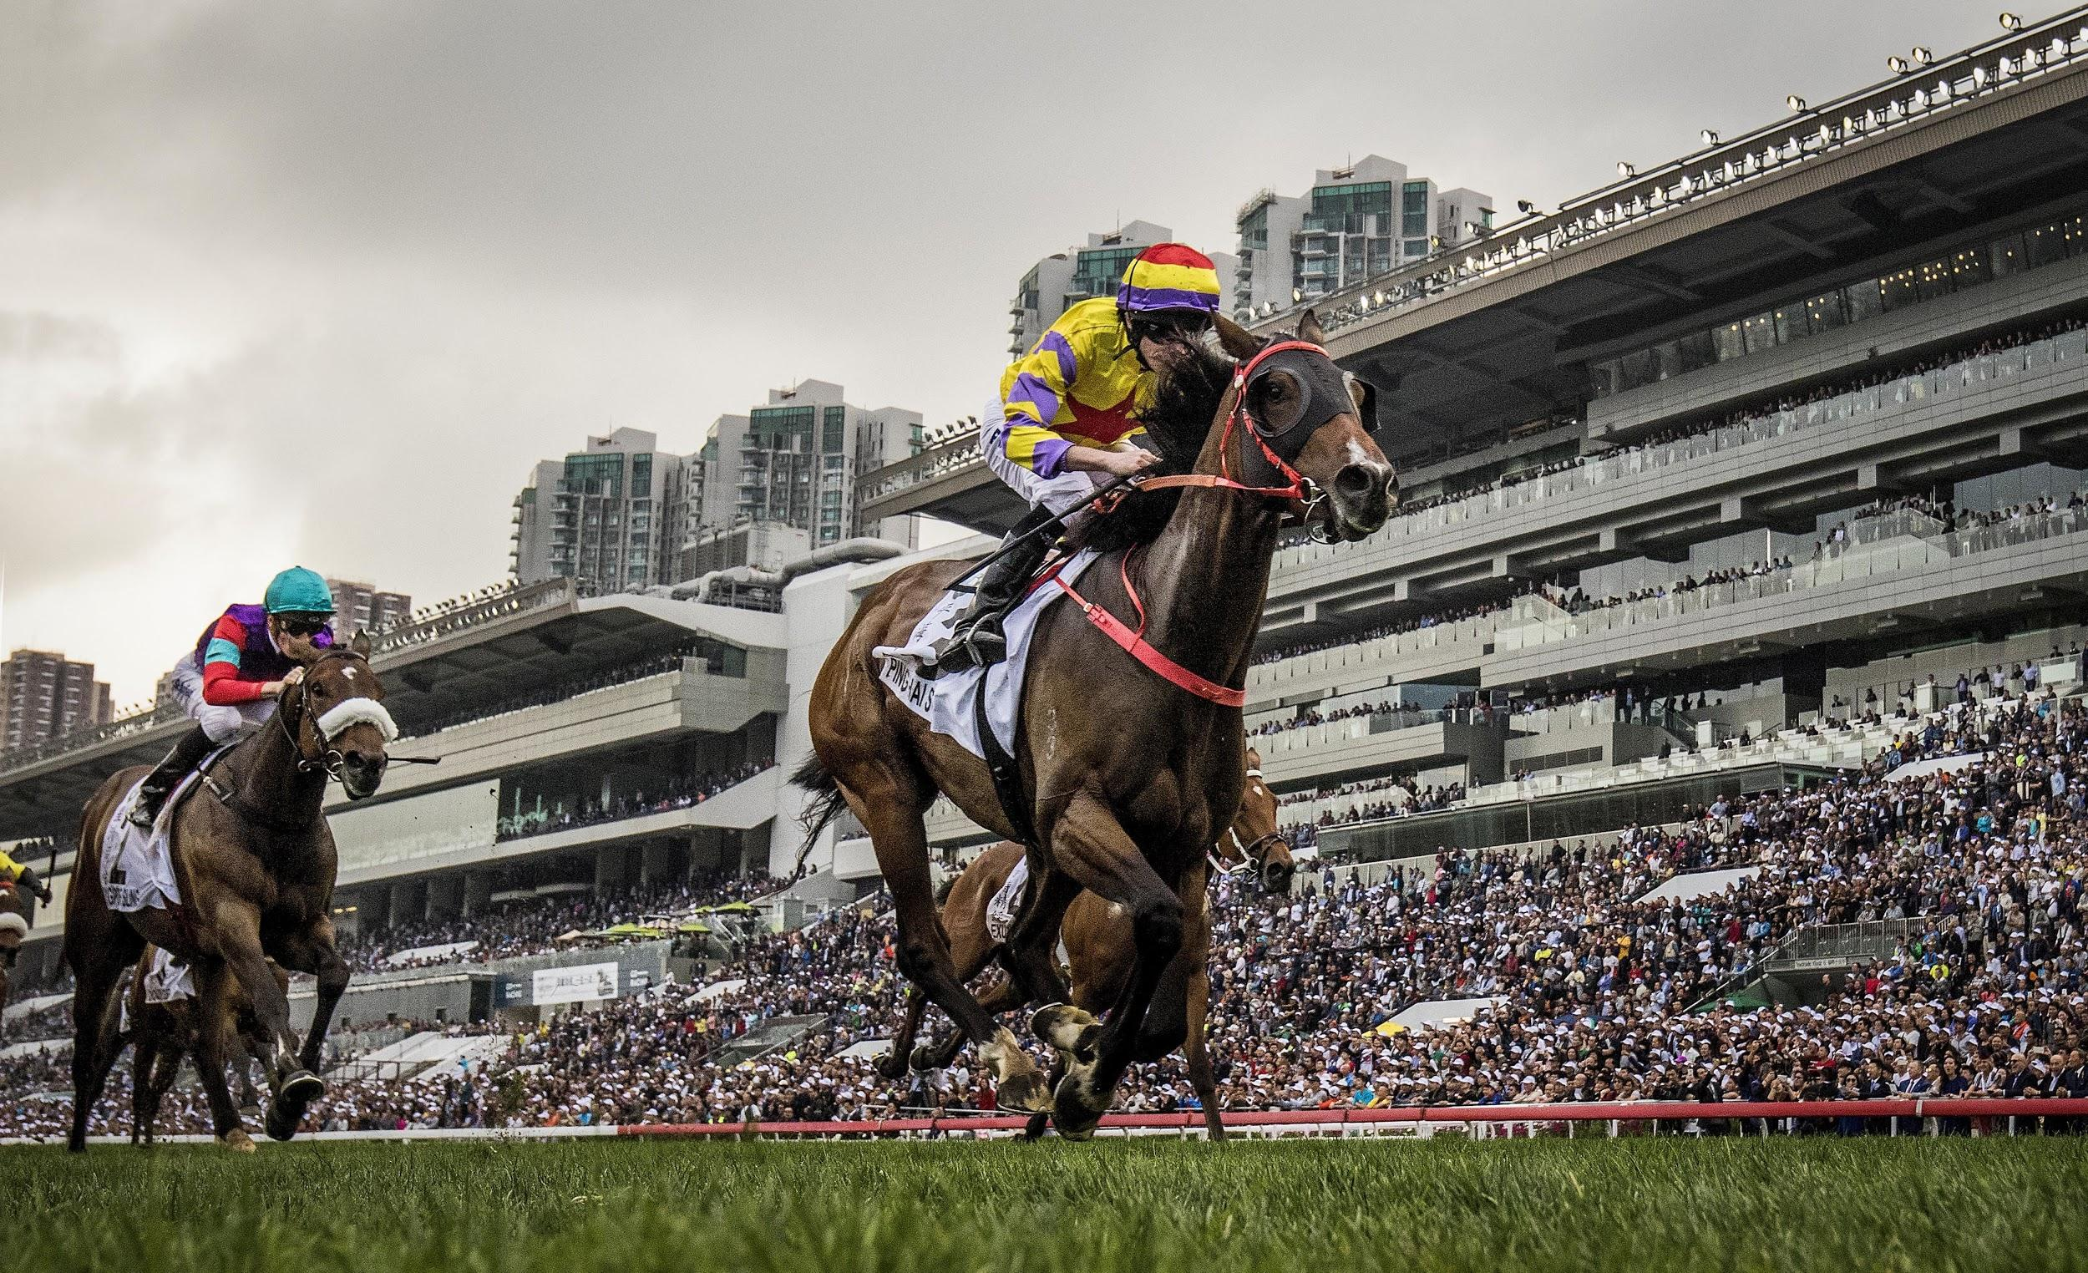
Horse Racing in Hong Kong
Abraham Calderon
Mario Martinez
Martin Jaramillo
Sergio Reyna

Slide 2
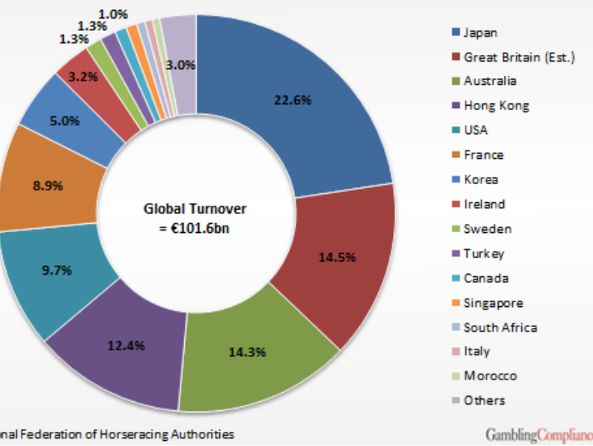
Global revenue of Horse Racing 2019
Ticket price JP: 1.87 USD
Ticket price AUS: 0 USD
Ticket price HK: 1.3 USD
Ticket price US: 14 USD
Ticket Price MX:0.42 USD

Slide 3
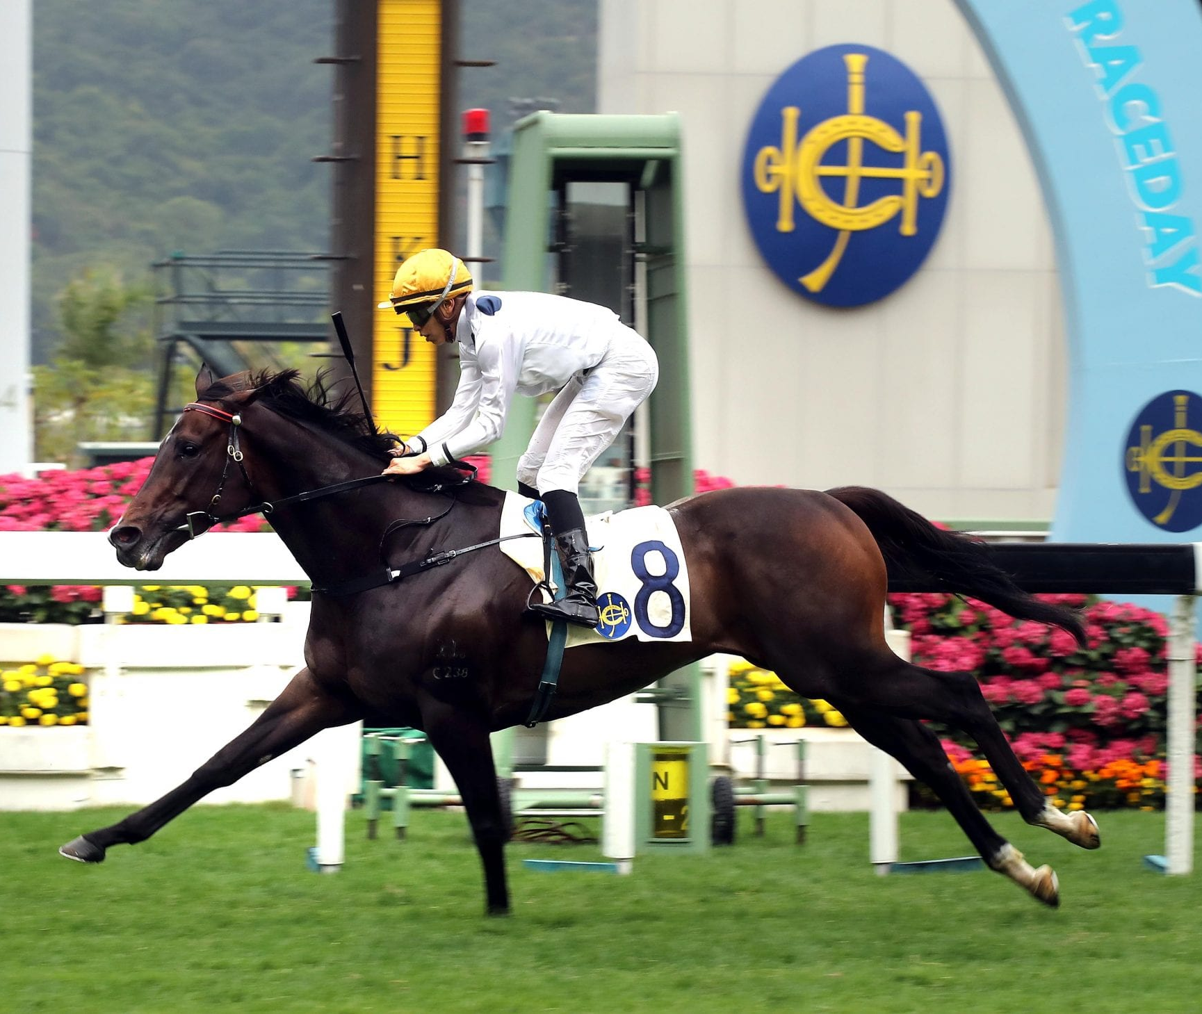
Winning settings
Trainer
Carried weight
Age
Horse Type

Slide 4
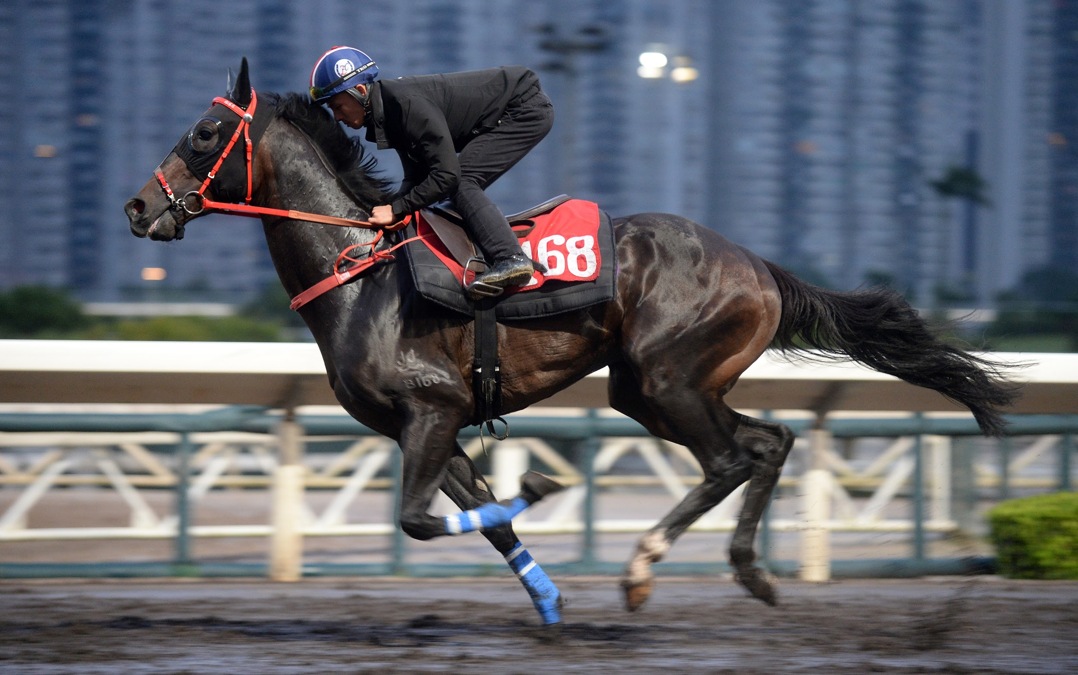
Our DataSet
2 Venues
Shatin
Happy Valley
Carried weight range
103lb-133lb
Horse types
Gelding
Mare
Horse
Brown
Rig
Colt
Roan
Filly
Grey
Countries
16
Rows
79448
Columns
47
Horse age range
3-10 yrs

Slide 5
Eliminamos fechas: Porque no hay relación en el performance del caballo

