Slide 1
Diabetes Dataset
How can individual factors and bodily variables predict the progression of diabetes in pre-diagnosed patients?

Slide 2
The dataset
 | AGE | SEX | BMI | BP | map | tc | ldl | hdl | Tch | glu | Y
count | 442 | 442 | 442 | 442 | 442 | 442 | 442 | 442 | 442 | 442 | 442
mean | 48.5180995 | 1.46832579 | 26.3757919 | 94.6470136 | 189.140271 | 115.43914 | 49.7884615 | 4.07024887 | 4.64141086 | 91.260181 | 152.133484
std | 13.1090278 | 0.49956117 | 4.41812156 | 13.8312834 | 34.6080517 | 30.413081 | 12.9342022 | 1.2904499 | 0.52239056 | 11.4963347 | 77.0930045
min | 19 | 1 | 18 | 62 | 97 | 41.6 | 22 | 2 | 3.2581 | 58 | 25
25% | 38.25 | 1 | 23.2 | 84 | 164.25 | 96.05 | 40.25 | 3 | 4.2767 | 83.25 | 87
50% | 50 | 1 | 25.7 | 93 | 186 | 113 | 48 | 4 | 4.62005 | 91 | 140.5
75% | 59 | 2 | 29.275 | 105 | 209.75 | 134.5 | 57.75 | 5 | 4.9972 | 98 | 211.5
max | 79 | 2 | 42.2 | 133 | 301 | 242.4 | 99 | 9.09 | 6.107 | 124 | 346

Slide 3
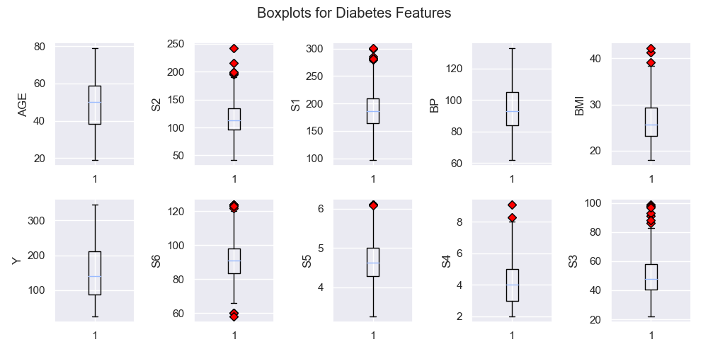
Exploratory Analysis
fig, axes = plt.subplots(ncols=5, nrows=2, figsize=(10, 5))
for indx, col in enumerate(diabetes_unaltered.columns):
outliers = dict(markerfacecolor='r', marker='D')
if col != 'Sex':
if indx == 0:
axes[0][indx].boxplot(diabetes_unaltered[col], flierprops=outliers)
axes[0][indx].set_ylabel(col)
elif indx <= 5 and indx >=2:
axes[0][6-indx].boxplot(diabetes_unaltered[col], flierprops=outliers)
axes[0][6-indx].set_ylabel(col)
elif indx <=10 and indx>=6:
axes[1][10-indx].boxplot(diabetes_unaltered[col], flierprops=outliers)
axes[1][10-indx].set_ylabel(col)
fig.suptitle("Boxplots for Diabetes Features")
fig.tight_layout()
fig.subplots_adjust(top=0.88)
plt.savefig(f'plots/Boxplots_features')
plt.clf()

Slide 4
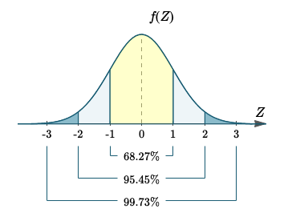
Removal of Outliers
from scipy import stats
z = np.abs(stats.zscore(diabetes_df))
diabetes_df_o = diabetes_df[(z < 3).all(axis=1)]

Slide 5
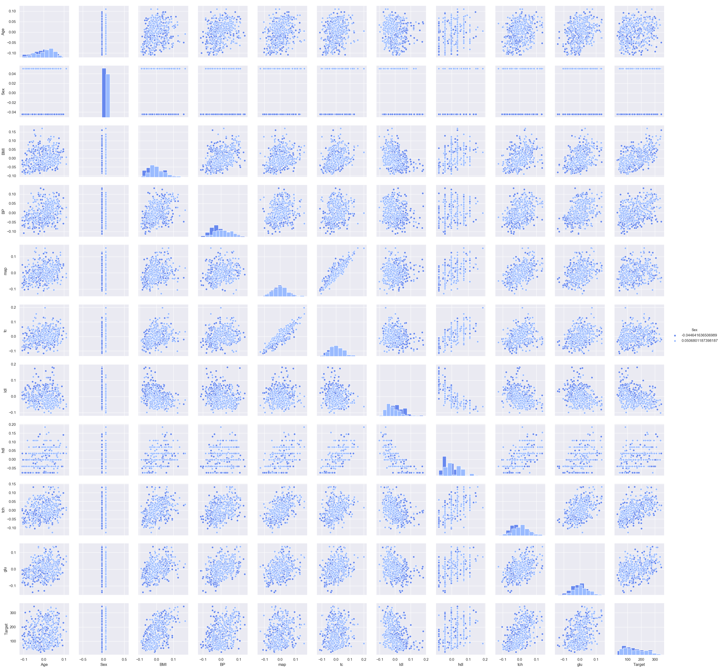
Deciding on Analysis
sns.pairplot(diabetes_df, hue='Sex', diag_kind='hist')
plt.savefig('plots/diabetes_pairplot.png')
plt.clf()

Slide 6
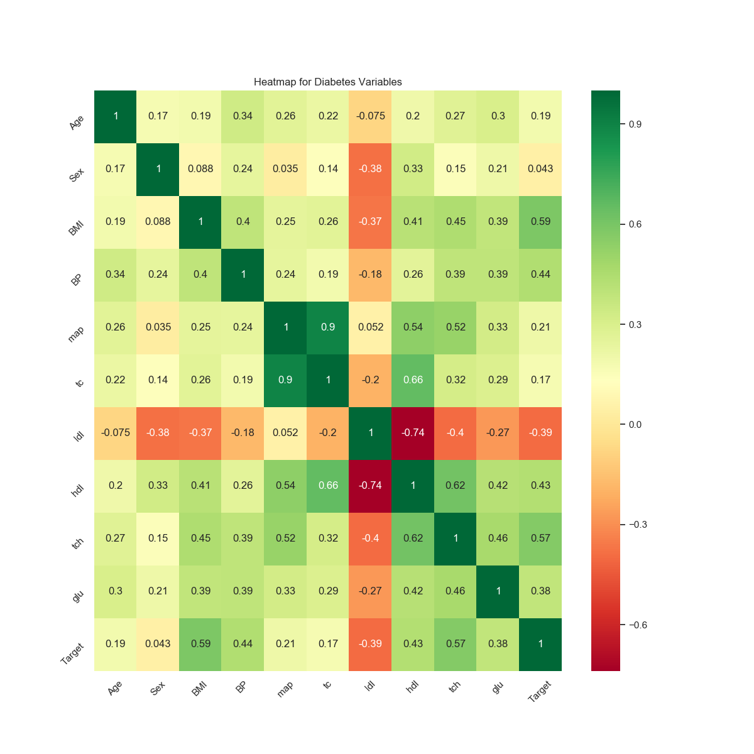

Slide 7
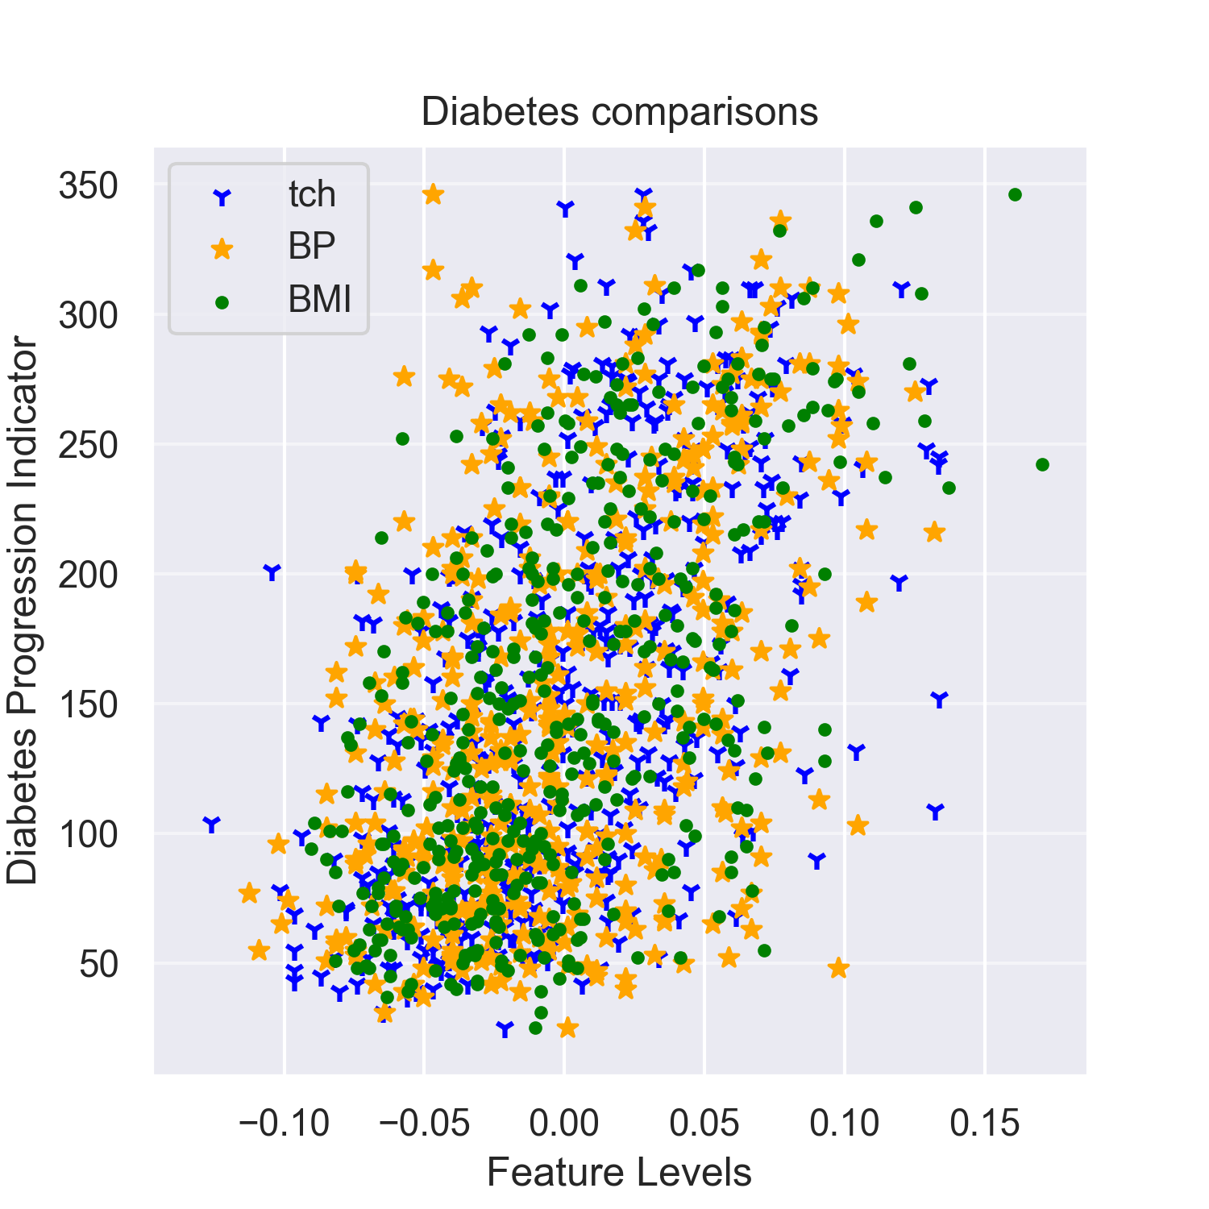

Slide 8
Lasso Regression Analysis
Another technique to reduce model complexity and prevent over-fitting
It estimates sparse coefficients, that is, it reduces the number of features that
will be used in the regression model, by preferring a solution with fewer coefficients.

Slide 9
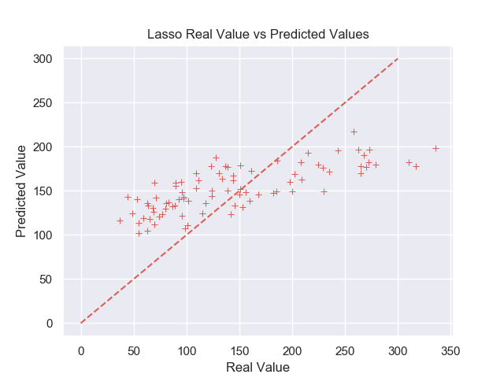
Results
Target = 308.078485*BMI + 48.349328*BP + 270.965511*Tch.

Slide 10
Conclusion
Overall error for the model (at its best) was an RMSE of ~57
Lasso regression model used BP, BMI, and Tch
Not as great error as the standard linear regression model, but avoids overfitting
After removal of outliers left only 430 observations -> Need more data to have more powerful results

