Slide 1
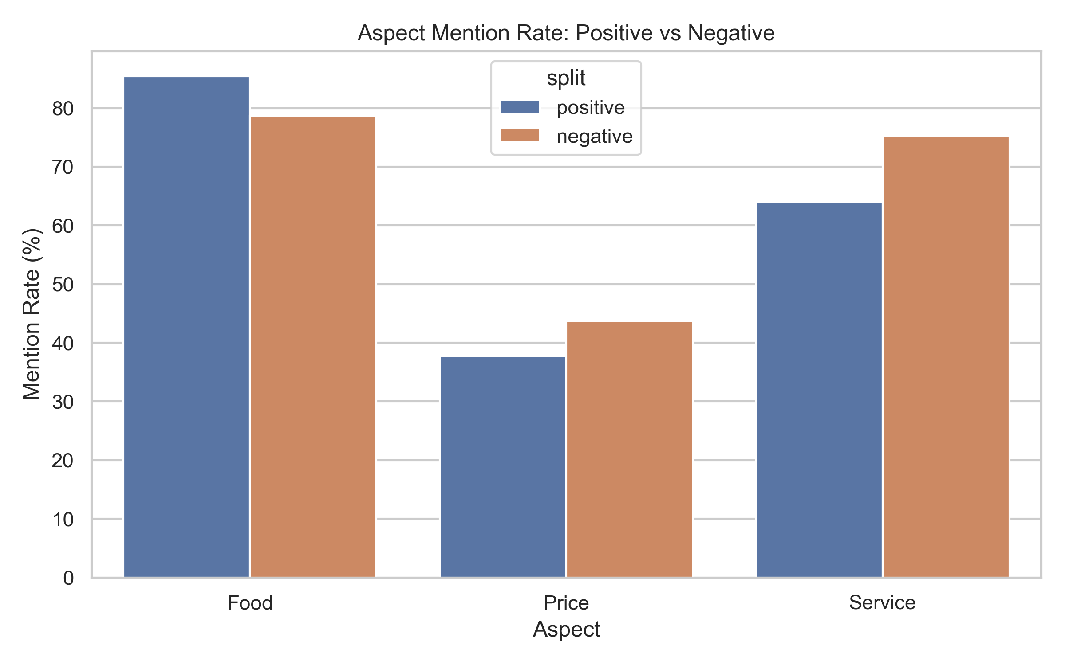
Project Overview
Star ratings show what happened, but not why.
We used Yelp review text to explain customer satisfaction and dissatisfaction.
Goal: turn unstructured reviews into actionable insights.
Source: outputs/figures/aspect_mention_rate.png

Slide 2
Problem & Motivation
Text model Macro-F1: 0.5949
Majority baseline accuracy: 0.4051
Review text adds meaningful signal beyond star averages.
Headline metrics
Accuracy: 0.6482
Macro-F1: 0.5949
Weighted-F1: 0.6430
Baseline Acc: 0.4051
Source: outputs/tables/model_metrics.csv

Slide 3
Data Source & Scope
Dataset: Yelp Academic Dataset (Philadelphia restaurants).
Working sample size: 100,000 reviews.
Real customer language from real restaurant experiences.
Example row (raw review):
"Wow! Yummy, different, delicious. Our favorite is the lamb curry and korma. With 10 different kinds of naan!!! Don't let the outside deter you (because we almost..."
Source: data/processed/reviews_processed.csv

Slide 4
Data Preparation Pipeline
Business + review JSON files were merged by business_id.
Reservoir sampling kept a random 100,000-review sample.
Scalable approach without loading the full stream into memory.
# reservoir sampling
if len(sampled_rows) < max_reviews:
sampled_rows.append(row)
else:
idx = random_generator.randint(1, seen_matching_reviews)
if idx <= max_reviews:
sampled_rows[idx - 1] = row
Source: src/data_loader.py

Slide 5
Text Preprocessing
Text was normalized to reduce noise and improve consistency.
Cleaning steps included tokenization, lemmatization, and filtering.
Result: stable, interpretable inputs for modeling.
Before (text):
"Wow! Yummy, different, delicious. Our favorite is the lamb curry and korma. With 10 different kinds of naan!!! Don't let the outside deter you (because we almost..."
After (cleaned_text):
"wow yummy different delicious favorite lamb curry korma different kind naan let outside deter change try new glad"
Source: data/processed/reviews_processed.csv

Slide 6
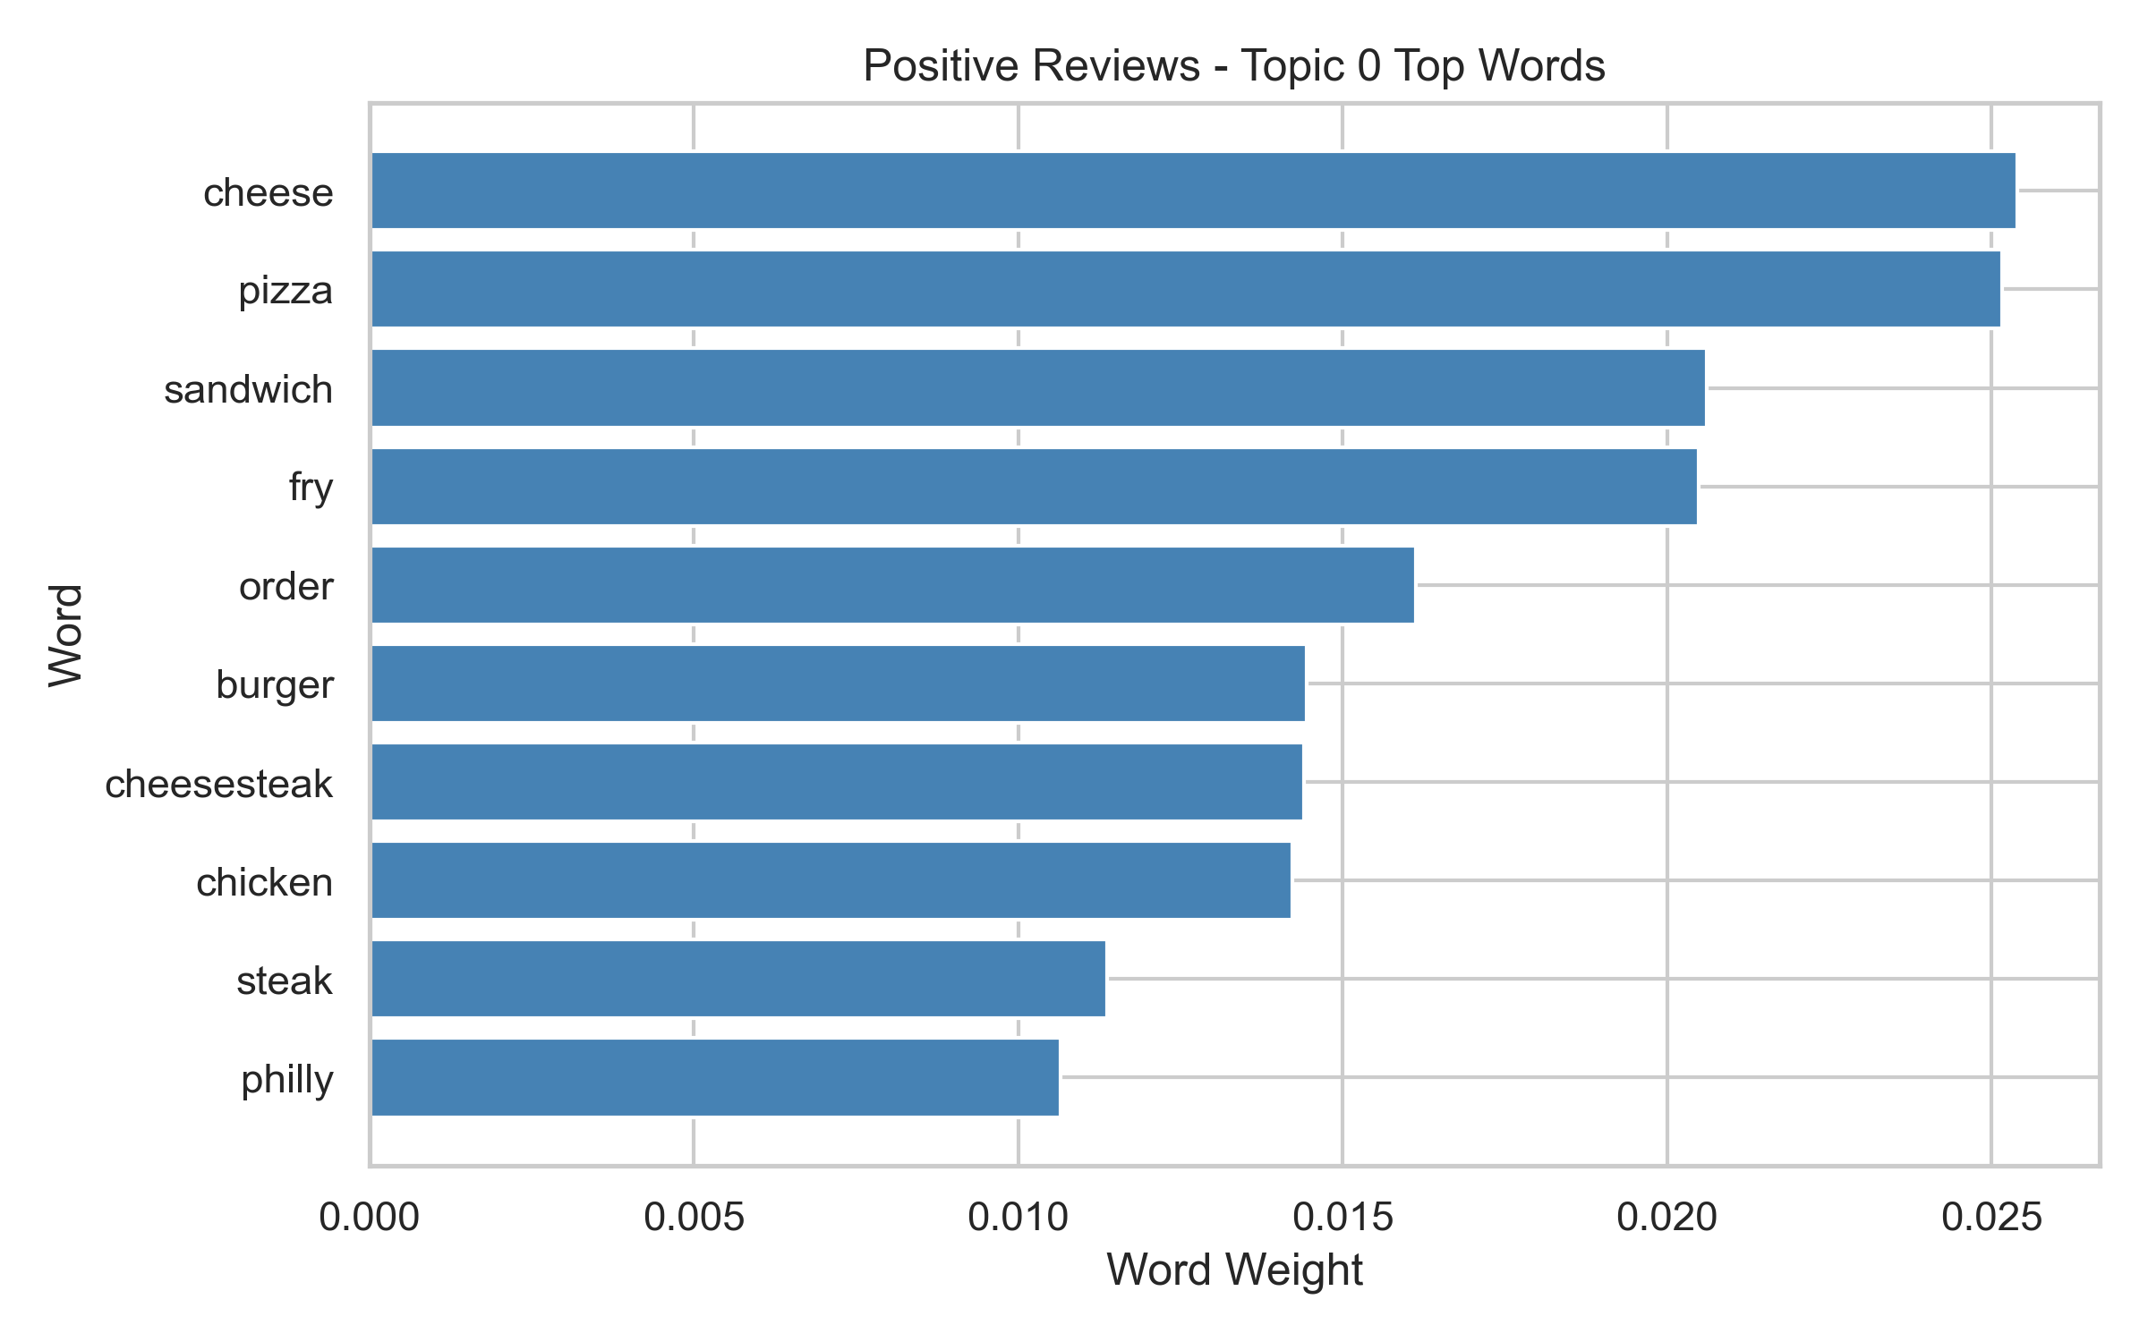
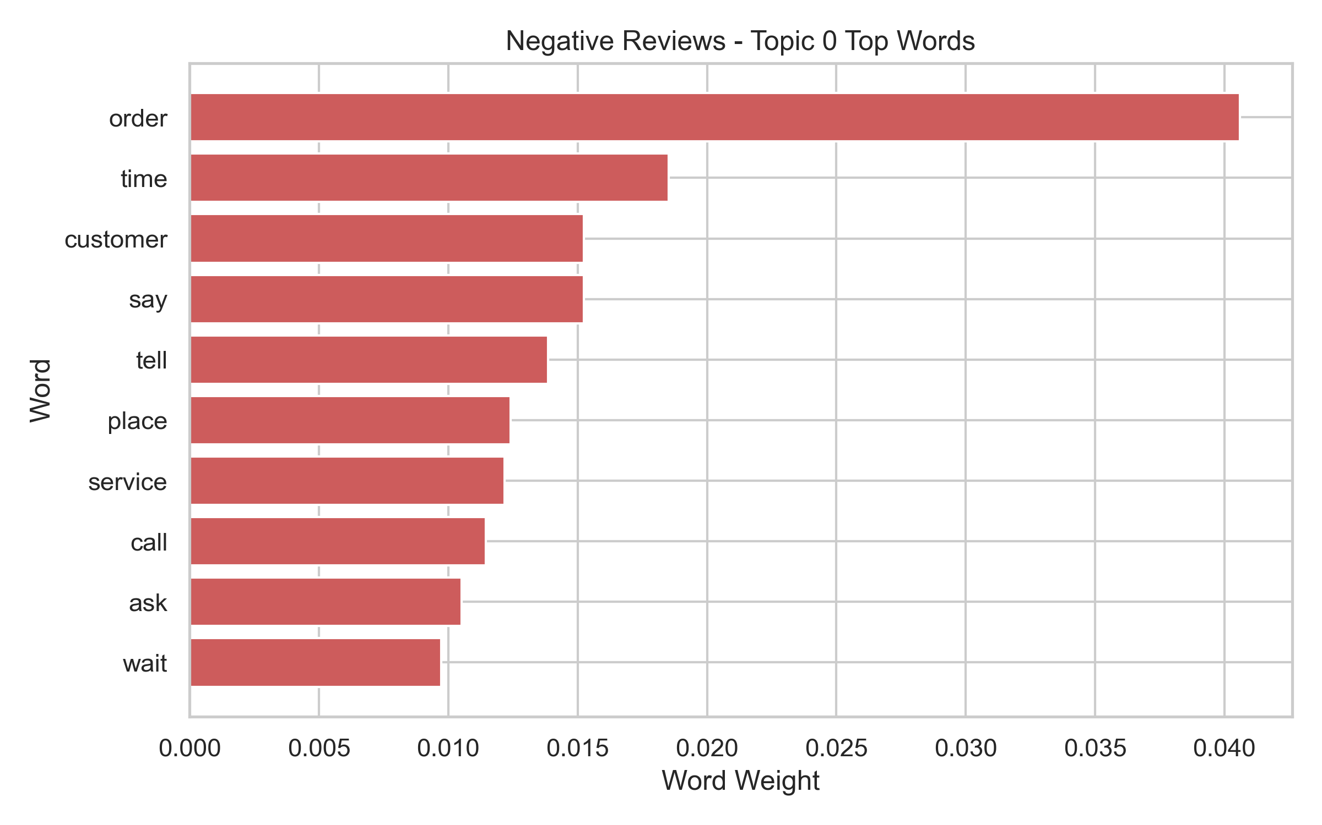
Topic Modeling (Unsupervised NLP)
Separate topic models were built for positive and negative reviews.
Positive and negative groups focus on different recurring themes.
This helps explain what customers talk about by sentiment.
Source: outputs/figures/lda_positive_topic_0.png; outputs/figures/lda_negative_topic_0.png

Slide 7
Topic Model Quality
Positive topic coherence (c_v): 0.4300
Negative topic coherence (c_v): 0.4246
Vocabulary tuning improved topic interpretability.
Final coherence values
Positive: 0.4300
Negative: 0.4246
Source: outputs/tables/lda_coherence.csv

Slide 8
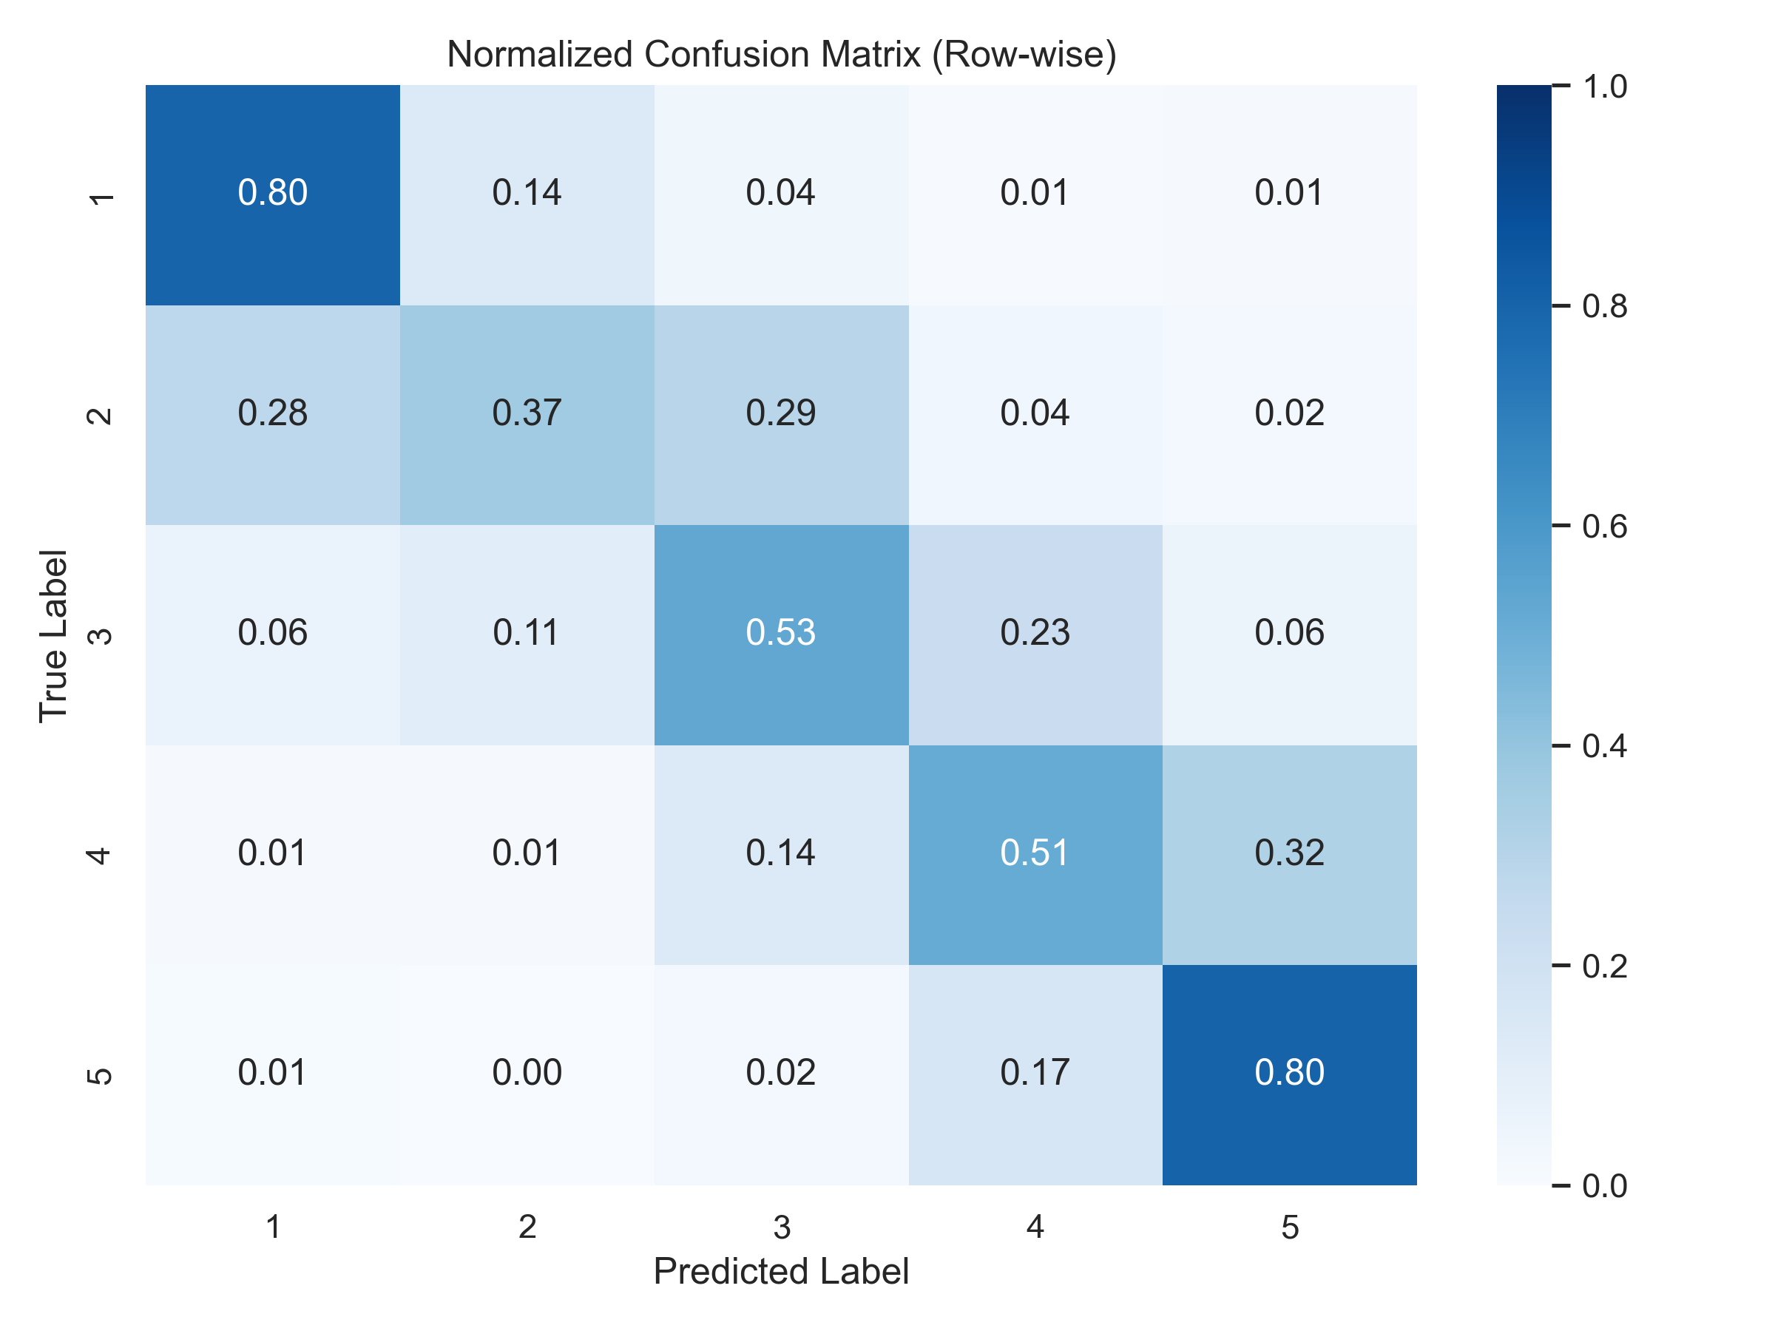
Rating Prediction (Supervised NLP)
Accuracy: 0.6482 (vs baseline 0.4051)
Macro-F1: 0.5949
Text-based model predicts 1–5 stars substantially better than baseline.
Source: outputs/figures/confusion_matrix_normalized.png; outputs/tables/model_metrics.csv

Slide 9
Model Interpretability
The linear model is transparent: we can inspect influential words.
Top positive words align with praise language.
Top negative words align with complaint language.
Top positive words
- best
- great
- amazing
- the best
- so good
Top negative words
- worst
- not
- rude
- the worst
- bad
Source: outputs/tables/top_features.csv

Slide 10
Key Insights & Takeaways
Text model performance is strong (Macro-F1 0.5949).
Topic quality is interpretable (coherence 0.43/0.42).
Service and Price are key dissatisfaction drivers (Service lift 1.17, Price lift 1.16).
Fully reproducible pipeline: raw data -> preprocessing -> modeling -> analysis -> report
Source: outputs/tables/model_metrics.csv; outputs/tables/lda_coherence.csv; outputs/tables/aspect_significance.csv

