Slide 1



Dynamic Tensor Rematerialization
Presenter: Marisa Kirisame*
Steven Lyubomirsky* Altan Haan* Jennifer Brennan Mike He
Jared Roesch Tianqi Chen Zachary Tatlock
*Equal contribution

Slide 2
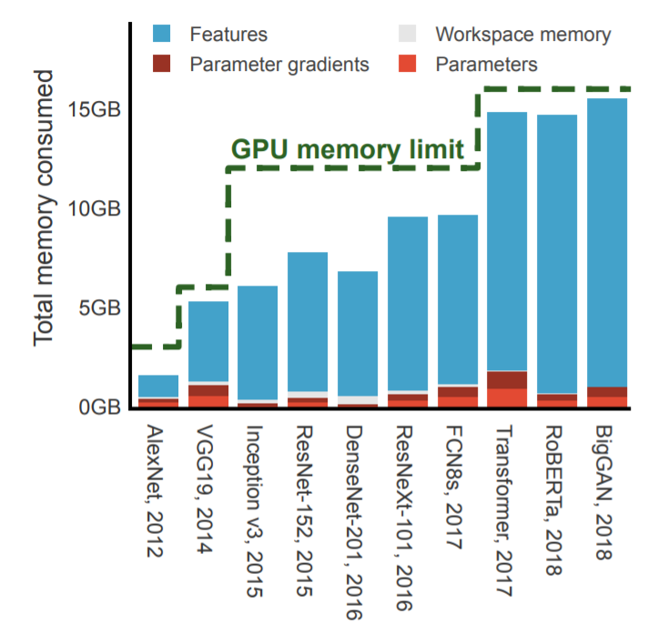
“The limited availability of high bandwidth on-device memory creates a memory wall that stifles exploration of novel architectures. Across applications, authors of state-of-the-art models cite memory as a limiting factor in deep neural network (DNN) design.”
—Jain et al., “Checkmate: Breaking the Memory Wall With Optimal Tensor Rematerialization” (2020)

Slide 3
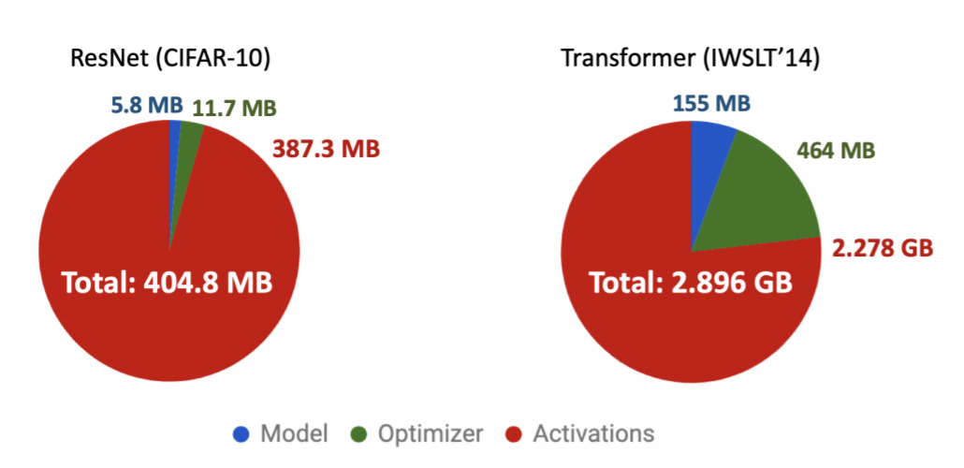
The Bottleneck: Activations
Sohoni et al., “Low-Memory Neural Network Training: A Technical Report” (2019)

Slide 4
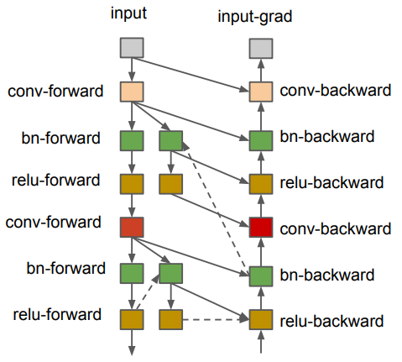
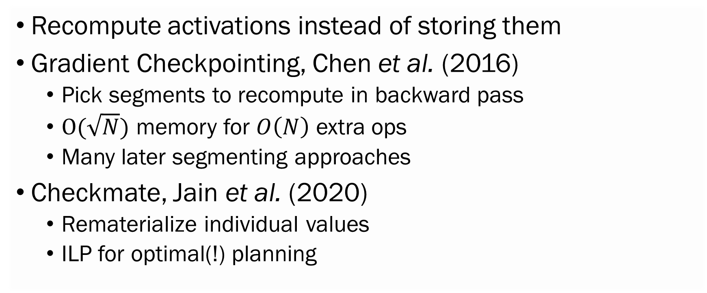
Checkpointing: Trade Time for Space
Recompute activations instead of storing them
Gradient Checkpointing, Chen et al. (2016)
Pick segments to recompute in backward pass
$O(\sqrt{N})$ memory for $O\left(N\right)$ extra ops
Many later segmenting approaches
Checkmate, Jain et al. (2020)
Rematerialize individual values
ILP for optimal(!) planning

Slide 5
Static Planning is Unnecessary
Past approaches plan checkpoints in advance
Require static knowledge of the model
Does not fit the eager execution framework
Planning can be expensive, limits applications
Our contributions:
Static planning is unnecessary for checkpointing
Still achieve good compute-memory tradeoffs

Slide 6
Dynamic Tensor Rematerialization
Gradient Checkpointing is a Tensor Level Cache!
A simple cache on top of the runtime system
Greedily allocate, evict and recompute as needed
No static information necessary
Can be easily implemented in all kind of framework
Decoupled from automatic differentiation
Trivially usable on higher order gradient
Can also be used without autodiff (e.g. Island Algorithm)
Very general, still competitive with static planning!

Slide 7

Rematerializing on the Fly
Pin: Needed right now
Circles: Tensors
t₂
t₄
t₆
t₇
…
t₀
t₁
t₃
t₅
Arrows: Dependencies
MEMORY BUDGET: 4
= IN MEMORY
Current operation: PerformOp(op₇, [t₅, t₆])

Slide 8
Rematerializing on the Fly
t₂
t₄
t₆
t₇
…
Problem: Need to compute t₇ but t₅ is evicted
t₀
t₁
t₃
t₅
MEMORY BUDGET: 4
= IN MEMORY
Current operation: Rematerialize(t₅)

Slide 9
Rematerializing on the Fly
t₃ is present, but no room for result
t₂
t₄
t₆
t₇
…
t₀
t₁
t₃
t₅
MEMORY BUDGET: 4
= IN MEMORY
Current operation: PerformOp(op₅, [t₃])

Slide 10
Rematerializing on the Fly
The heuristic is free to pick t₂
t₂
t₄
t₆
t₇
…
t₀
t₁
t₃
t₅
MEMORY BUDGET: 4
= IN MEMORY
Current operation: PerformEviction()

Slide 11
Rematerializing on the Fly
t₂
t₄
t₆
t₇
…
Now we can recompute t₅
t₀
t₁
t₃
t₅
MEMORY BUDGET: 4
= IN MEMORY
Current operation: AllocateBuffer(t₅.size); op₅(t₃)

Slide 12
Rematerializing on the Fly
Our arguments are back—but still no room for t₇!
t₂
t₄
t₆
t₇
…
t₀
t₁
t₃
t₅
MEMORY BUDGET: 4
= IN MEMORY
Current operation: AllocateBuffer(t₇.size)

Slide 13
Rematerializing on the Fly
t₂
t₄
t₆
t₇
…
Don’t need t₃ right now, so we can evict
t₀
t₁
t₃
t₅
MEMORY BUDGET: 4
= IN MEMORY
Current operation: PerformEviction()

Slide 14
Rematerializing on the Fly
Now we can proceed
t₂
t₄
t₆
t₇
…
t₀
t₁
t₃
t₅
MEMORY BUDGET: 4
= IN MEMORY
Current operation: op₇(t_{5,} t₆)

Slide 15
Rematerializing on the Fly
t₂
t₄
t₆
t₇
…
t₀
t₁
t₃
t₅
MEMORY BUDGET: 4
= IN MEMORY

Slide 16
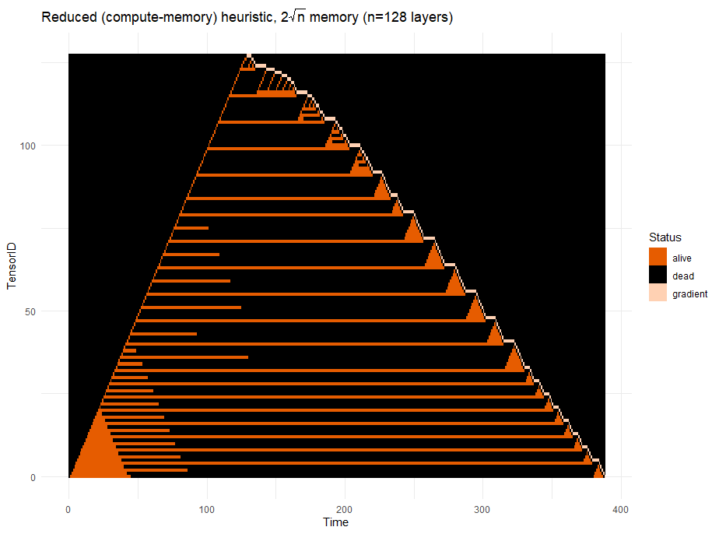
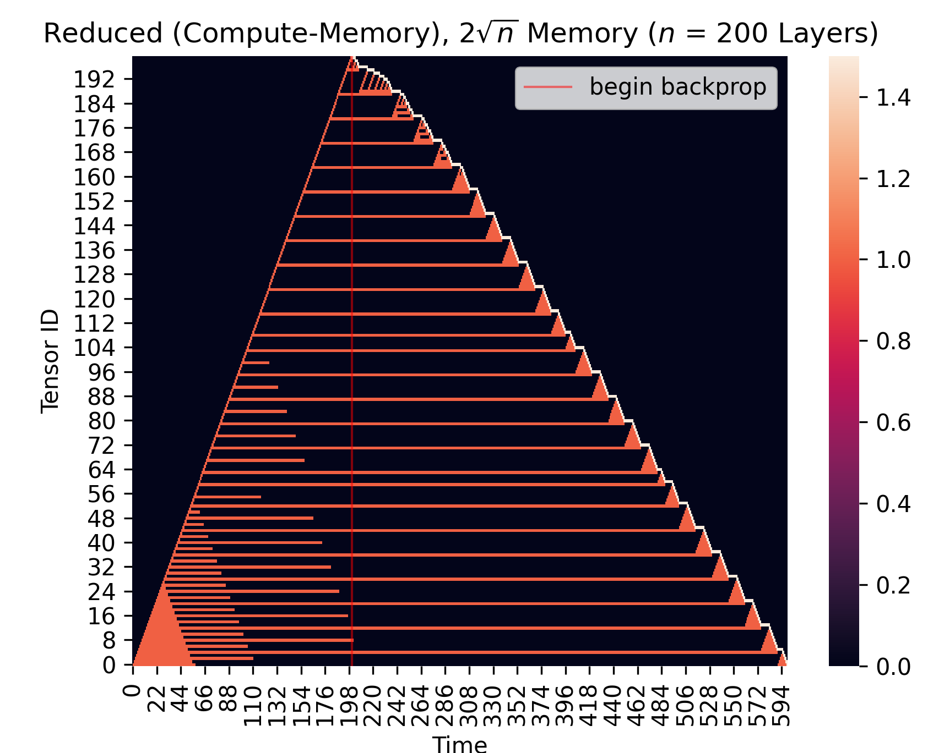
DTR in Pictures
Reduced (compute-memory), $2\sqrt{n}$ memory (n=128 layers)
Begin Backprop

Slide 17
DTR in Pictures
Reduced (compute-memory), $2\sqrt{n}$ memory (n=128 layers)
Begin Backprop
Horizontal lines: Checkpoints!
Triangles: Recomputing segments

Slide 18
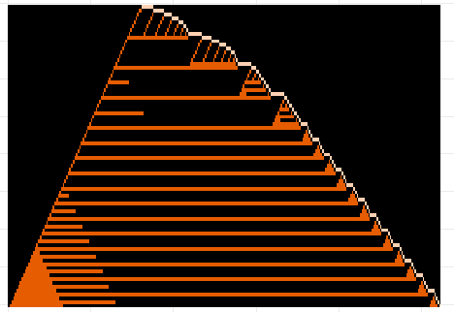
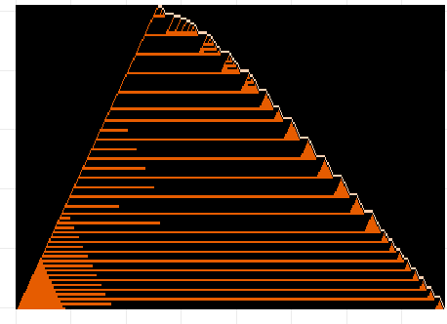
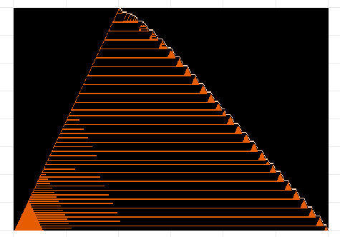
DTR In Pictures
80 layers
128 layers
200 layers

Slide 19
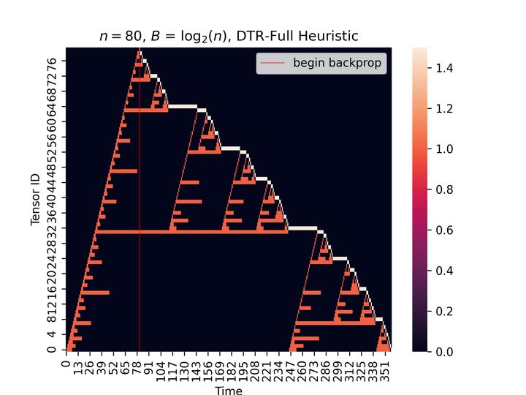
DTR in Pictures
O(log N) memory in
O(n log N) time!

Slide 20
DTR: Just Some Callbacks
AllocateBuffer(size): Allocate if enough room, else evict until there is
PerformEviction(): Heuristic chooses a tensor to evict
Rematerialize(t): Recompute t by replaying its parent op (PerformOp)
PerformOp(op, args):
Rematerialize evicted arguments
Make room for result and compute it
Update metadata

Slide 21
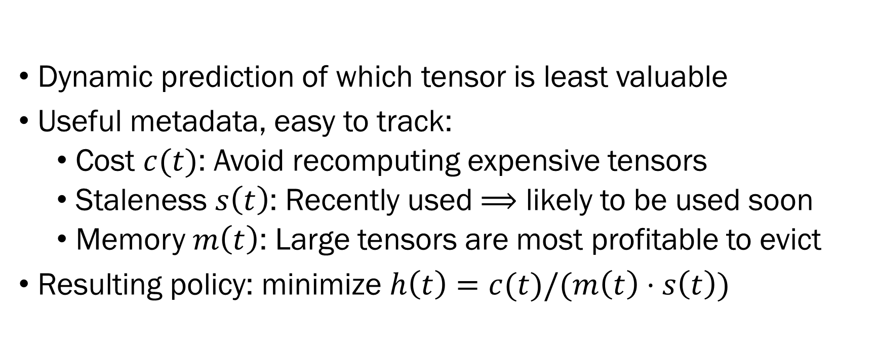
What Do Heuristics Look Like?
Dynamic prediction of which tensor is least valuable
Useful metadata, easy to track:
Cost $c(t)$: Avoid recomputing expensive tensors
Staleness $s\left(t\right)$: Recently used $⟹$ likely to be used soon
Memory $m\left(t\right)$: Large tensors are most profitable to evict
Resulting policy: minimize $h\left(t\right)=c(t)/(m\left(t\right)⋅s\left(t\right))$

Slide 22
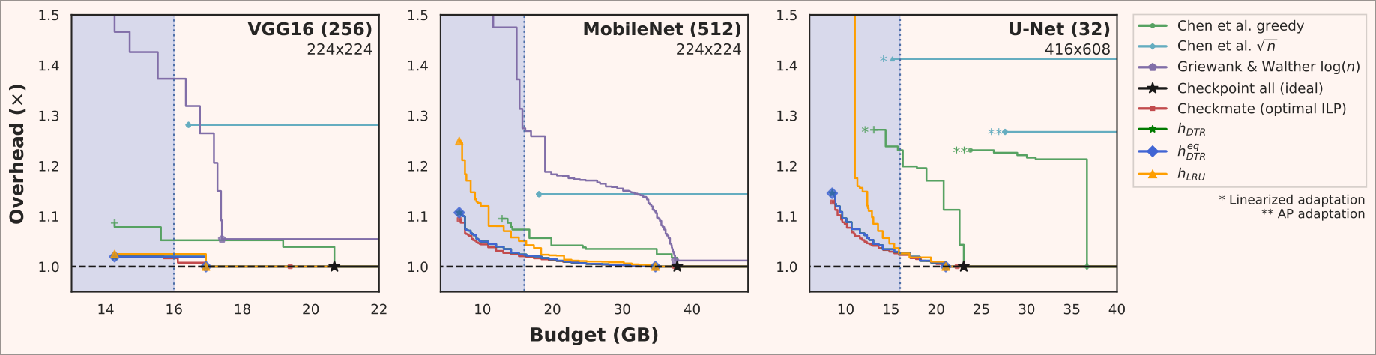
Comparison Against Static Techniques
Simulated comparison via the Checkmate MLSys 2020 artifact

Slide 23
Pseudocode
// Evict until enough memory.
function AllocateBuffer(size):
while size > AvailableMemory():
PerformEviction()
return RawAllocate(size)
function PerformEviction():
free tensor with smallest score
function Rematerialize(t):
if t has been evicted:
PerformOp(t.op, t.args)
function PerformOp(op, args):
exclude args from eviction
for arg in args:
Rematerialize(arg)
update arg’s last access time
buf = AllocateBuffer(out_size)
res = store op(args) into buf
allow eviction for args again
update bookkeeping for res
return res

Slide 24
Reasoning About Tensor Cost
True cost of a rematerialization includes recursive calls
Recursively computing exact cost is expensive!
We approximate evicted components via union-find
Each equivalent class denote a evicted neighborhood
Neighbor = parent/child in the computation graph
Maintain a compute cost for each evicted neighborhood
When a tensor is evicted, join the equivalent class with its evicted neighbor
When tensor rematerialized, map to a new component
Leaves “phantom connections” but is fast

Slide 25
Equivalence Class via Union Find
Given a finite set of element:
Can merge two set into one
Can check if two element in one set
Can keep information on each finite set
Merge(1, 2)
Merge(2, 5)
Merge(6, 8)
Merge(3, 4)
Merge(5, 6)

Slide 26
Evicted Neighborhood example
t₂
t₄
t₆
t₇
…
t₀
t₁
t₃
t₅
{t1, t2, t4} in one evicted neighborhood (cost = 3)
{t5, t7} in one evicted neighborhood (cost = 2)

Slide 27
Further Prototype Optimizations
Eager Eviction: evict tensors with no external references
Three optimizations to speed up eviction search
Ignoring small tensors (<1% of average size)
Random sampling (visit square root of size of total pool)
Batch eviction: search for min cost, then evict all tensor < 2x min cost
Considerably reduces overhead of DTR
Danger of excluding tensor needed to meet budget!

Slide 28
DTR as a compiler pass
Suppose static graph
Run dtr once, record all eviction/rematerialization
Generate a new graph based on the recording
Known as staging: move compute from runtime to compile time
Remove all search overhead at runtime
Can now use further compiler pass to do more optimization
Inspired by MegEngine’s implementation

Slide 29
Prototype Implementation in PyTorch
Pytorch support many different kinds of Tensor
GPU, CPU, Dense, Sparse, Quantified…
Autodiff and Dynamic Batching also implemented as Tensor!
The core of pytorch dispatch operators into their implementation
Checkpointing Is implemented as a Tensor
CheckpointTensor wrap a Tensor and Its operator
Only maintain metadata and make eviction decision

Slide 30
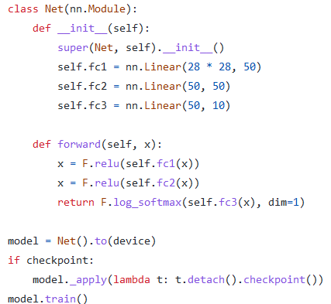
Prototype Implementation in PyTorch
One Line!!!

Slide 31
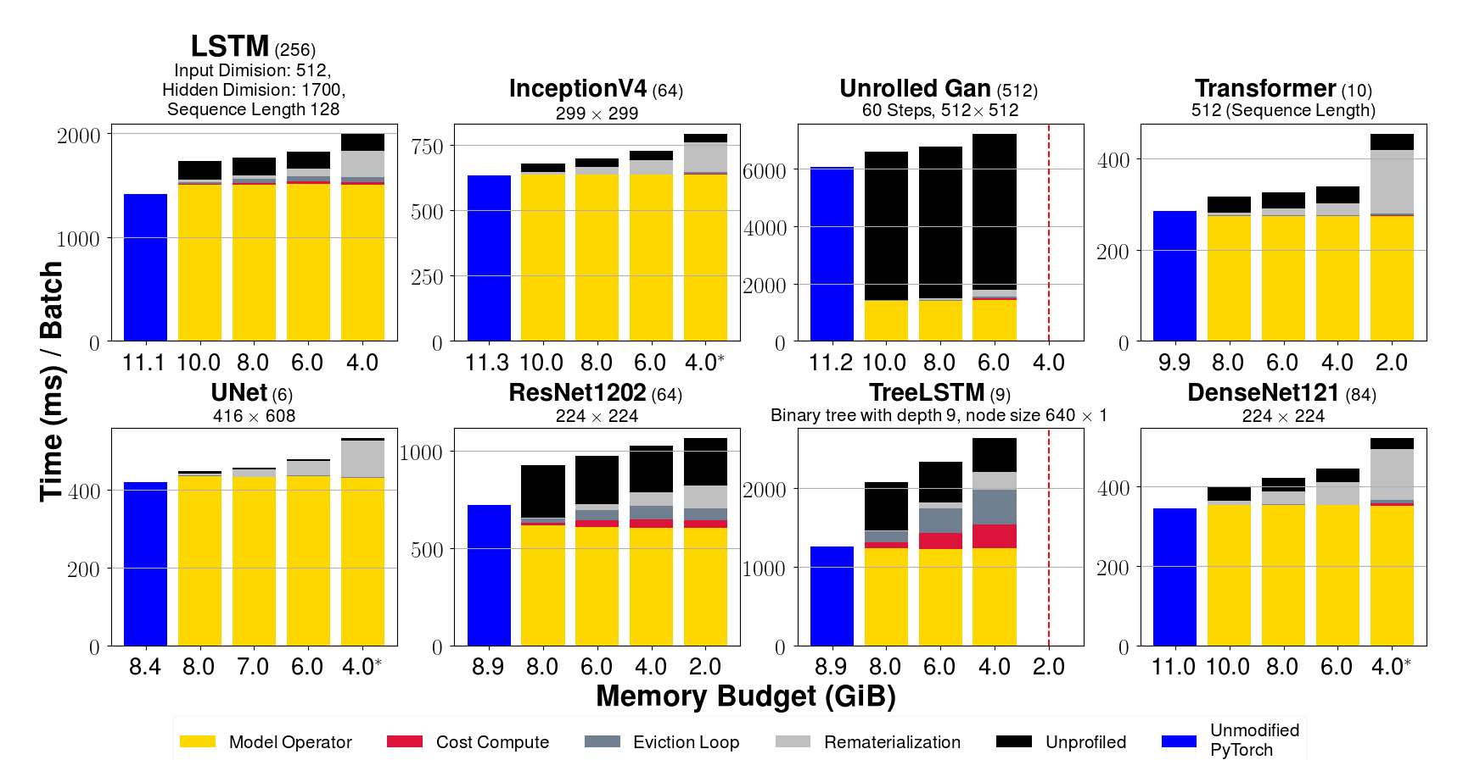
Prototype Implementation in PyTorch
Thin wrapper over tensor operators, core logic a few hundred LOC

Slide 32
Conclusion
Train bigger networks on smaller GPUs
Useful both as a runtime cache, and as a compiler pass
Model parallelism: use fewer GPUs, cheaper
Implemented by the Megengine team, upstreaming to pytorch
Read the paper and see our prototype:
https://github.com/uwsampl/dtr-prototype
Happy to answer questions about implementation!
marisa@cs.utah.edu

