Slide 1
MemBalancer
Marisa Kirisame

Slide 2



Slide 3
Lets reduce browser memory use!
JS use a lot of memory in a web browser
How to make it use less memory?
Set a lower heap limit!

Slide 4
Lower heap limit
Less memory usage, more cpu cost.
The classical space time tradeoff.
How to pick the right limit?

Slide 5
What is a right limit?
One abstract framework about tradeoff - pareto-optimality
If a vm use less space and less time than another, it is pareto-improvement
If no pareto-improvement can be made for a vm, it is pareto-optimal
If a vm use more space and more time than another, not pareto-optimal
The set of all pareto optimal point - pareto frontier
Pareto optimality allow modeling other tradeoff as well
e.g. latency vs throughput, idletime vs critical pause, energy saving…

Slide 6
Pareto Optimality
But… All heap limit is already pareto optimal!
To be faster, a bigger heap limit is required
To use less memory, more time need to be spent on GC
So… Is there something to do here?

Slide 7
Pareto Optimality
Obviously we don’t want spotify to use 1GB of memory
(even though it is ‘optimal’)
Why?
Imagine you are also running vs code.
Spotify more memory = Vscode less memory!
Vscode less memory = Vscode more time = total more time!
Does the total system tradeoff make sense?

Slide 8
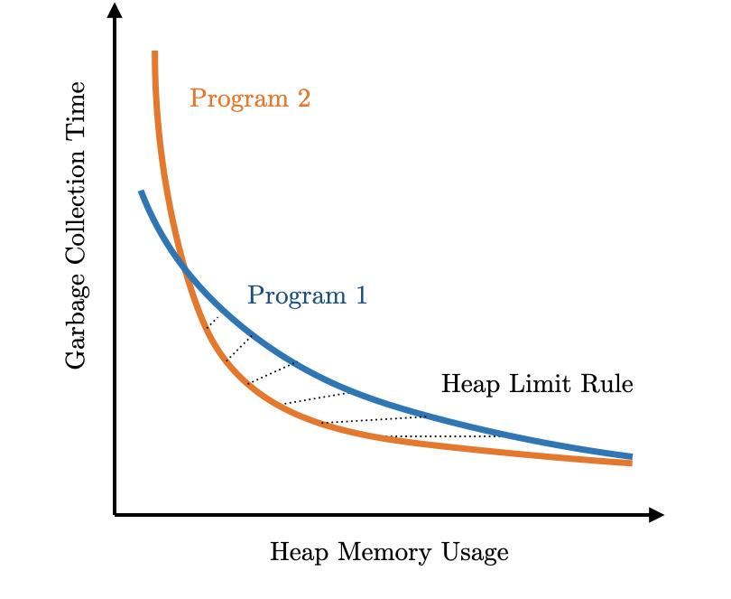
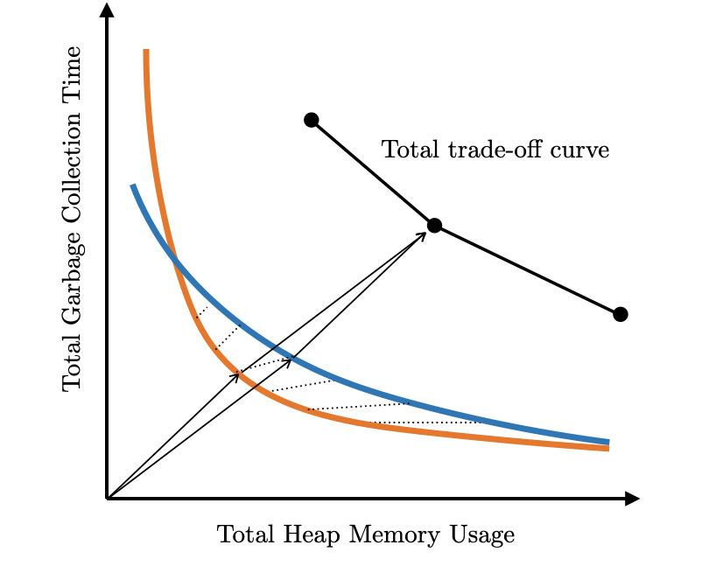
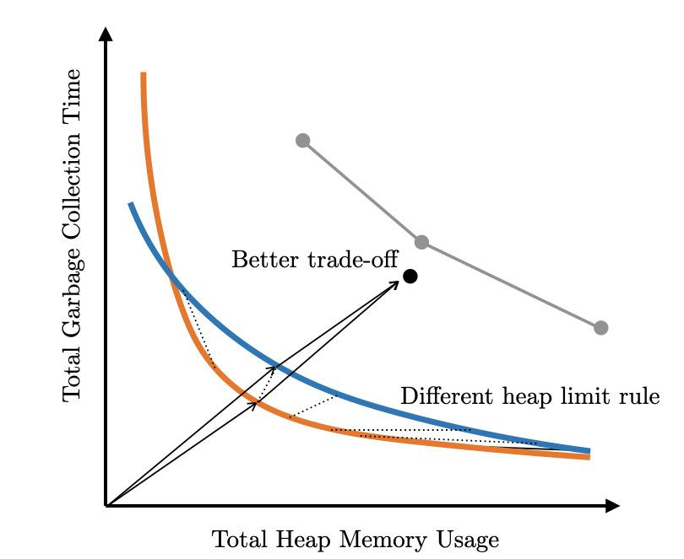
Compositional Heap Limit Rule
Heap Limit Rule: given a program, return a heap limit
Given multiple program, a heap limit rule might not be pareto-optimal!

Slide 9
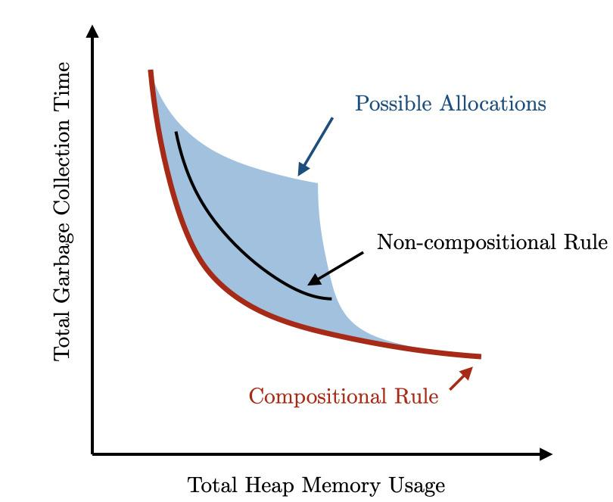
Compositional Heap Limit Rule
Heap Limit Rule: given a program, return a heap limit
Given multiple program, a heap limit rule might not be pareto-optimal!

Slide 10
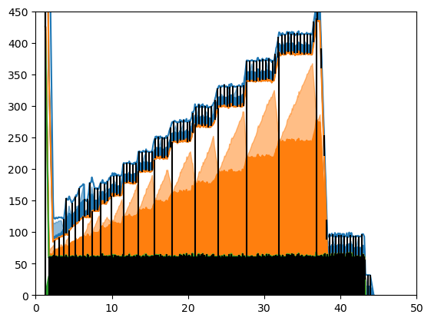
Is current v8 heap limit rule compositional
Heap Limit Rule: given a program, return a heap limit
Currently: about ~2x working memory

Slide 11
Compositional Heap Limit Rule
Make a formal model of program time vs memory
Take two program, set their total heap size = constant
Take derivative of total run time w.r.t heap size split, optimize

Slide 12
The squareroot rule
Result: Memory should be W + Sqrt(W)
Giving 1MB to big heap < 1MB to small heap
Give me 1000$ > Give bill gate 1000$
time ~ 1/memory
So - instead of a proportional rule, a square root rule is used
Compare to baseline - take memory from big heap, give to small heap
Just like robinhood!

Slide 13
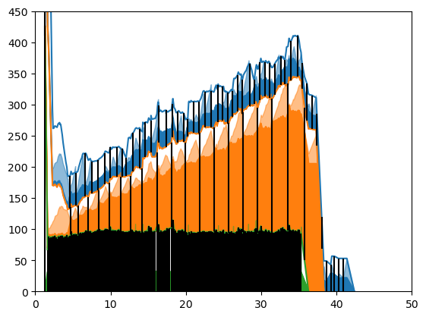
How it look for jetstream

Slide 14
W + Sqrt(Wg/cs)
More measurement improve the result
Enrich our mathematical model
More Extra Memory when:
More working memory (W)
Allocate faster (g)
GC slower (s)
With a tunable parameter c

Slide 15
Flexible: Tunable parameter c
Represent the exchange rate between space and time
W + Sqrt(Wg/cs): Higher c = less memory
API for our model! Tune it to reflect practical concern!
Higher c for e.g.:
Background tab
Phone
Outdated Hardware

Slide 16
Potential Implementation in v8
Per heap variable: w(working memory), g(allocation rate), s(gc speed)
On CollectGarbage(): update w, g, s at gc
Heartbeat thread: update g every second
w g s are atomic variable, cheap and safe!
When w, g, or s is updated: also update heap limit.

Slide 17
Potential Implementation in v8
When heap limit drop beyond current heap size, schedule a gc
Heap limit may decrease outside of gc, caused by heartbeat thread
Major example: idleness
Replace idle time gc memory reducer in a coherent framework

Slide 18
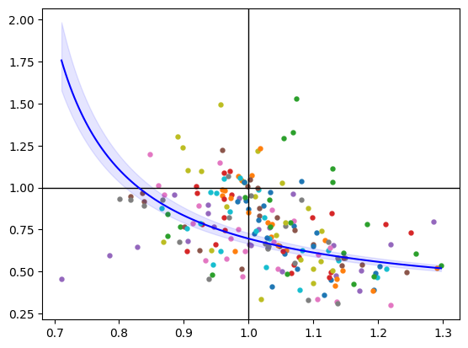
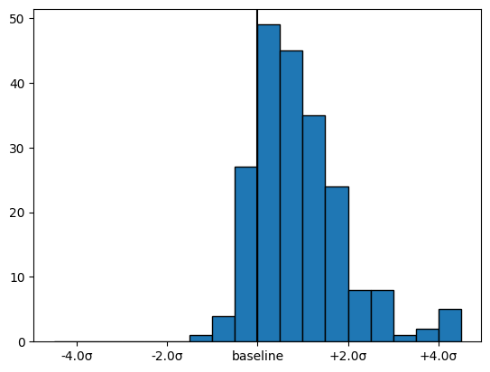
Result
Turned off MPN, Memory Reducer, MemCap, the default rule, for MemBalancer
Also cleaner - removed a bunch of heuristic from v8
Save ~15% memory on real web page!

Slide 19
Q
Chrome A/B Test?
Incremental GC?
Concurrent GC?
Cross Component GC?

