Slide 1

Data and Visualization Project 1: Student Loan Analysis
Contributors: Marissa Saucedo, Xiang Li and Alejandro Godina

Slide 2
Analysis Proposal: Student Loans
Higher education is placing students into debt each year. Whether it be a technical degree, under-grad, graduate, or post graduate work, graduating students are facing long term student loan debt. Utilizing nces.ed.gov, Education Data Initiative and Federal Student Aid websites. We will answer these three questions to identify the impact of student loans on the population.
What age and location type are most impacted by student debt?
What is the average student loan per student across America?
What is the average cost of tuition relative to the average amount of student debt for a 4-year university?

Slide 3
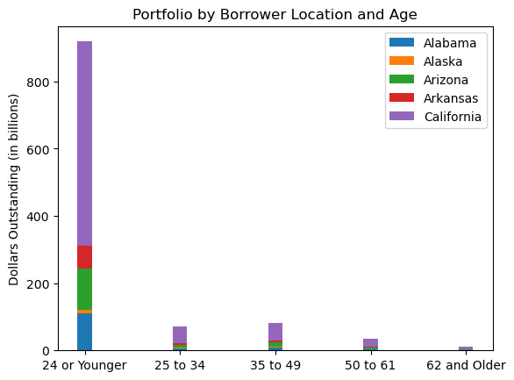
What age and location type are most impacted by student Loan debt?
Utilizing the Education Data Initiative and Federal Student Aid websites. We were able to identify student loans in California younger than the ages of 24 held the most student debt.
The stacked graph shows Arizona and Alabama cam came in 2nd and 3rd.

Slide 4
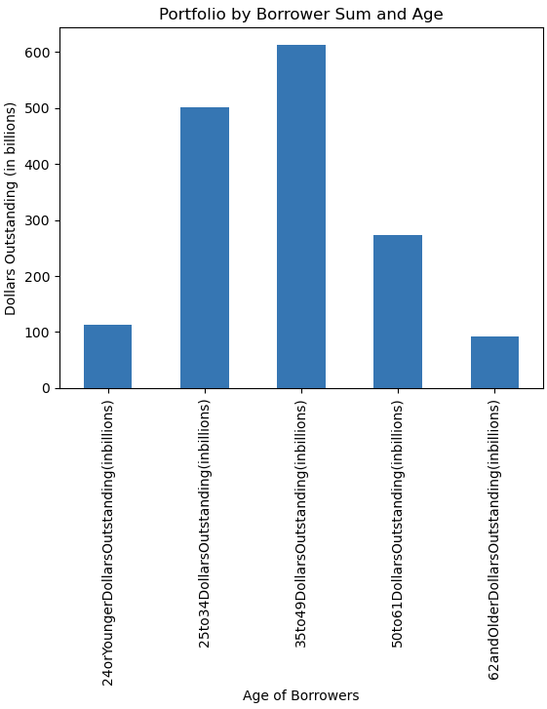
What age and location type are most impacted by student Loan debt?
Focusing on all of America, the greatest student loan debt is owned by the population aged 35 to 49 with a total just over 600 billion dollars.

Slide 5
Reference Page:
https://data.ed.gov/dataset/federal-student-loan-portfolio/resources?resource=9f3366c2-ef2c-489c-86ad-12e334113e5b

