Slide 1


Data and Visualization Project 1: Student Loan Analysis
Contributors: Marissa Saucedo, Xiang Li and Alejandro Godina

Slide 2
Analysis Proposal: Student Loans
Higher education is placing students into debt each year. Whether it be a technical degree, under-grad, graduate, or post graduate work, graduating students are facing long term student loan debt. Utilizing nces.ed.gov, Education Data Initiative and Federal Student Aid websites. We will answer these three questions to identify the impact of student loans on the population.
What age and location type are most impacted by student debt?
How much has been borrowed?
How many students have taken out loans from 2007 to 2022?
What is the average cost of tuition relative to the average amount of student debt for a 4-year university?

Slide 3
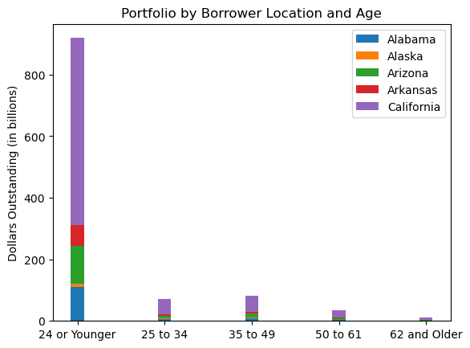
What age and location type are most impacted by student Loan debt?
Utilizing the Education Data Initiative and Federal Student Aid websites. We were able to identify student loans in California younger than the ages of 24 held the most student debt.
The stacked graph shows Arizona and Alabama cam came in 2nd and 3rd.

Slide 4
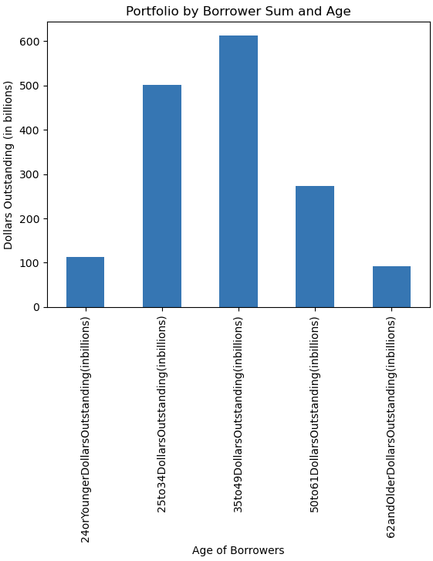
What age and location type are most impacted by student Loan debt?
Focusing on all of America, the greatest student loan debt is owned by the population aged 35 to 49 with a total just over 600 billion dollars.

Slide 5
Students Loan
Let’s look at
How much has been borrowed?
How many students have taken out loans?

Slide 6
2007 - 2022
01
Total Dollars vs Recipients
Direct Loan, Federal Femily Education Loan, Perkin
Overview

Slide 7

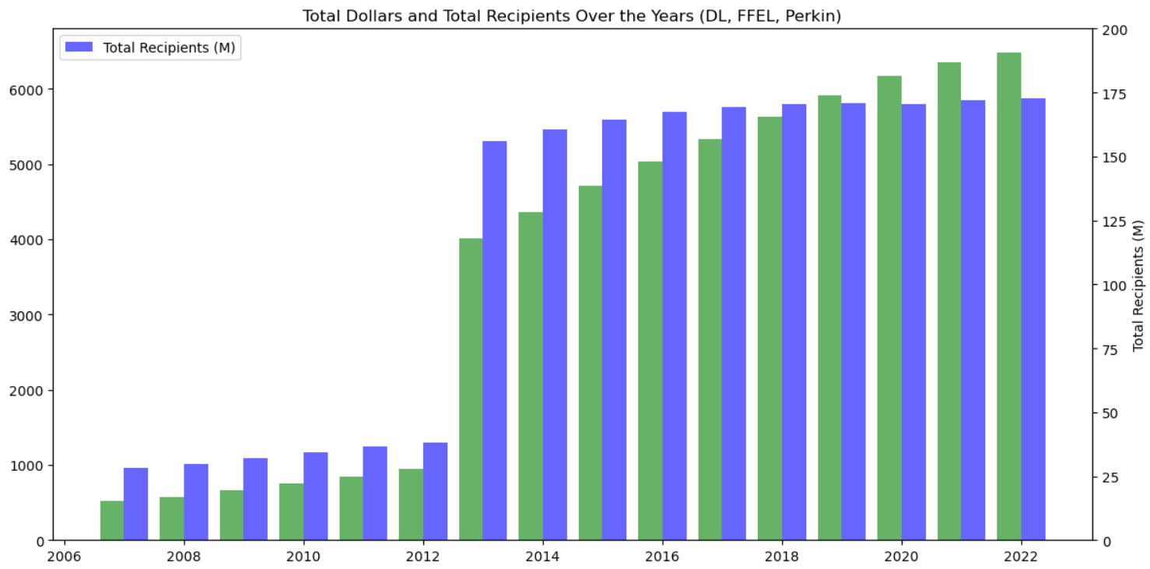
This bar graph presents a comparison between total dollar amounts and the number of recipients from the years 2007 to 2022.
A significant increase is evident in 2013, with the number of recipients surging to more than three times the previous year's figure.
Notably, from 2007 up until 2019, the funds available did not suffice to cater to all students

Slide 8
2007 - 2022
02
Recipients Over the Years
Direct Loan, Federal Femily Education Loan, Perkin
Overview

Slide 9
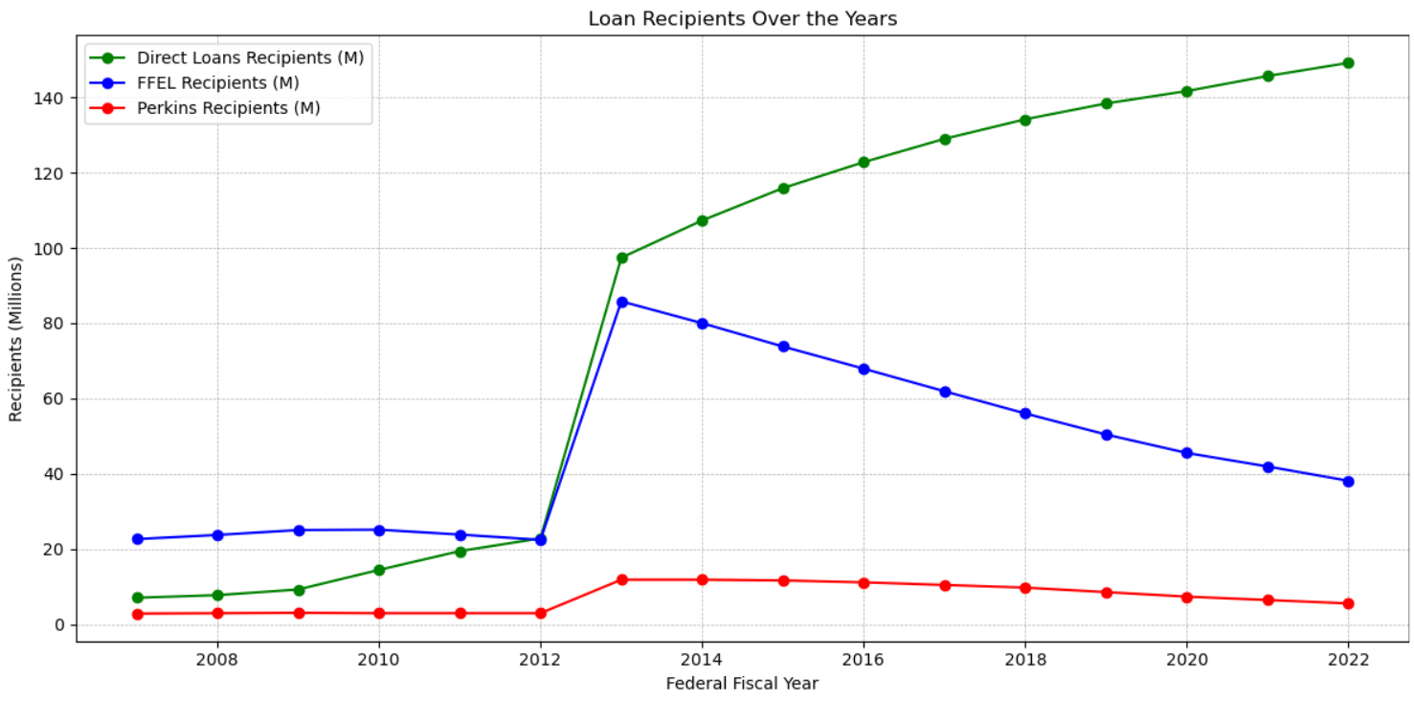
A consistent increase in Direct Loans recipients from 2008 to 2022, with a sharp rise between 2012 and 2014.
FFEL recipients peaked in 2014 but dwindled by 2022, indicating changing borrowing trends.
Perkins loan recipients showed minor fluctuations, suggesting consistent demand and funding over the years.

Slide 10
2007 - 2022
03
The Distributions
Direct Loan, Federal Femily Education Loan, Perkin
Overview

Slide 11
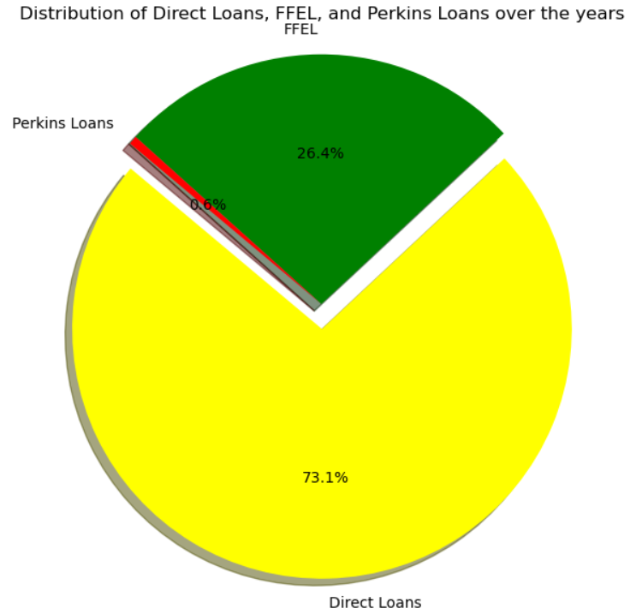
Direct Loans constitute a substantial 73.1% of the total.
FFEL loans account for 26.4%, showing significant but lesser adoption.
Perkins Loans represent a minimal 0.6% of the distribution.

Slide 12
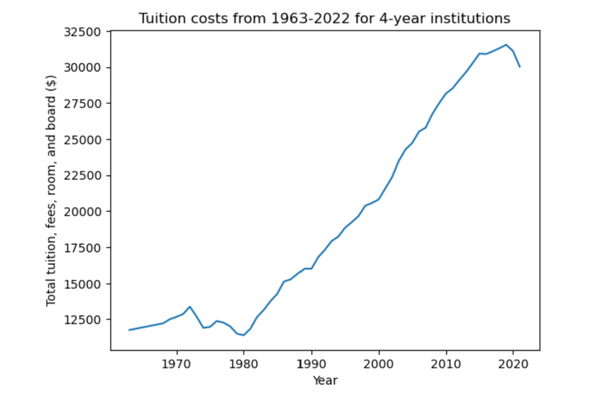
Tuition Costs
This graph displays tuition, fees, room, and board costs for 4-year institutions over the past 60 years.
There is an exponential increase in tuition costs from 1963-2022.
As time goes on it’s costing students more and more money to attend college and receive the same education as previous generations.
We can see a slight dip in costs in 2020 but that is an outlier that can likely be attributed to COVID.
According to the data displayed here the cost of tuition has gone up 155% during this given time period

Slide 13
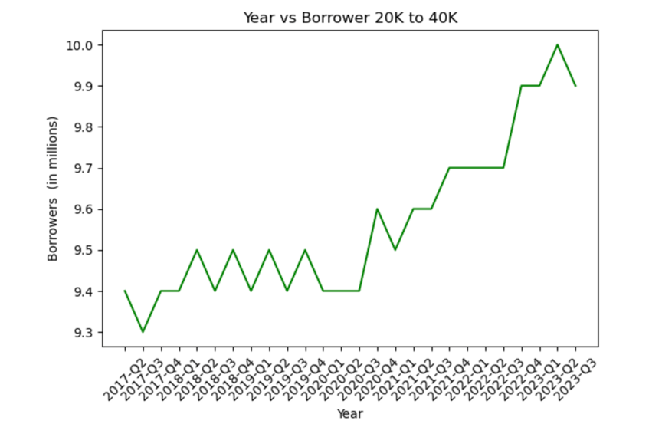
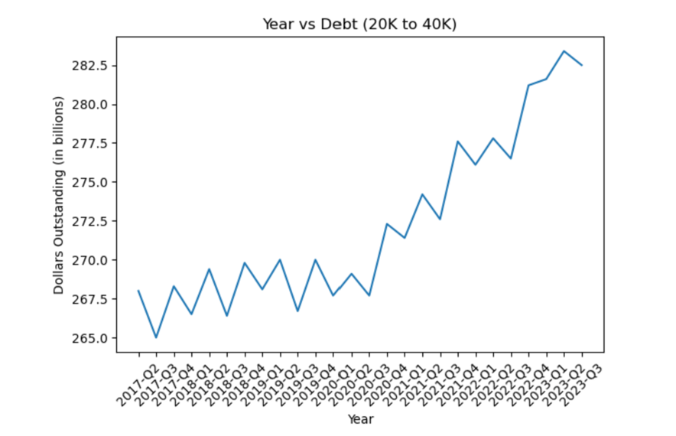
How does the rise in tuition costs relate to student debt?
Notes:
In this first chart on the left we can see outstanding student debt in billions for borrowers that have taken out loans for $20K to $40K from 2017 to 2023. The line below demonstrates the number of borrowers in millions taking out loans for this amount.
Using this visual we can see just how many Americans are being impacted by student debt and to what degree.
As tuition costs continue to increase more students are having to take out loans to pay for school.
While it costs more and more each year to attend college students across the nation are more accruing an increasing amount of student debt
This in turn is perpetuating to the student debt crisis.

Slide 14

Reference Page:
https://data.ed.gov/dataset/federal-student-loan-portfolio/resources?resource=9f3366c2-ef2c-489c-86ad-12e334113e5b
https://studentaid.gov/data-center/student/portfolio

