Slide 1

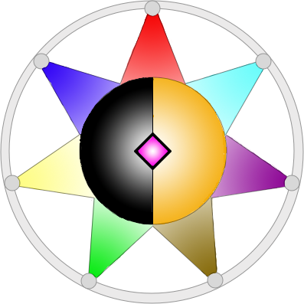
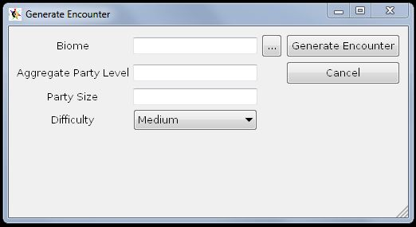
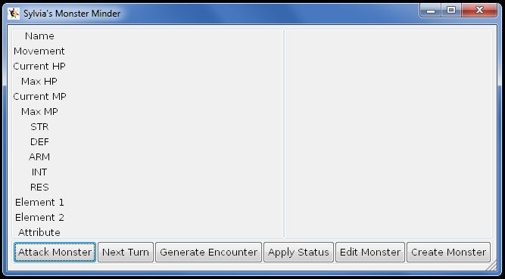
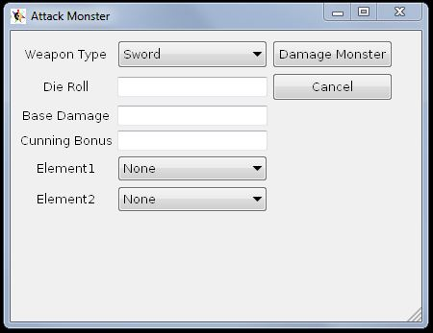

Introduction
Software
Fables of Sylvius© TM is a table top role playing game (RPG) made by University of the Pacific alumnus Matthew Anderson. During gameplay, the game master (GM) will create groups of monsters (encounters) for players to fight. Combat in Fables of Sylvius © TM (Fables) involves many variables: the base damage the player does with an attack, the value they roll on the dice, the weapon they use, any status ailments inflicted on the monster, and the stats of the monsters. Subsequently, the GM spends a large amount of time calculating to find the damage dealt to a monster by an attack.
Sylvia’s Monster Minder was coded in C++, with a Graphical User Interface (GUI) enabled for both Unix and Windows computers. The main program reads in a file with monster data and stores it in a vector (resizable array). This vector contains base monster data which assumes monsters are level 1. When an encounter is generated, the vector is checked and monsters are randomly pulled from it. Using player specified data for party size, total party level, and encounter difficulty preference, the monsters are leveled up until they fit the requested difficulty. These monsters are stored in a list from which they can be accessed for use in damage calculation. They are also accessed from the list for the process of monster editing, where the GM can change their leveled stats if such an occurrence is needed during gameplay. Monsters can be added to this list by the GM. These are fully customized monsters that must be added manually, but this gives a great deal of flexibility to the way encounters can be generated.
Fig 1: The Generate Encounter window. A biome is a text file that lists the types of creatures found in a biome and their base stats. The file path of the biome is entered into the “Biome” entry to pick that biome for monster generation data. There is also the option of using a file selection dialog to obtain the biome file path. Aggregate party level takes the total added levels of all your party members. Party size is the number of players in your party. Difficulty of an encounter can be easy, medium, or hard.
Objective
We wanted to create a powerful tool that would allow the GM of a Fables game to create dynamic, varied opponents for the players to fight, without having to spend hours designing them by hand. In order to help the GM save time, the monster minder needed to handle encounter generation, in addition to calculating the monster’s current state.
Encounter generation is done by taking in user information about party size, party level, and difficulty of encounter, to create a set of enemies to fight.
To track the monster states, the program would need to know the monster’s stats, and any relevant information from the player when they declare their attack. This would be used to determine how much health the monster loses to an attack. Once its health drops below zero it is considered “dead” and is removed from the encounter’s list of enemies.
Status ailments. such as poison and burn, affect a monster’s stats and last across multiple turns. A monster minder would also need to keep track of status ailments of each monster.
Finally, we wanted to be able to dynamically alter monster stats and create custom monsters for unique boss-style encounters.
Fig 2: The main window of the Monster Minder. Available targets are displayed in a list on the right side. When selected, a monster’s stats and relevant information are displayed on the left side. When a monster is selected, the attack button, apply status button, and edit monster button can be used to alter the monster. “Create Monster” allows creation of a custom monster, and next turn increments the game to the next turn, applying any status ailments that are in effect.
Final Outcome
Our final program successfully generates encounters of appropriate difficulty. It handles the application of damage to monsters, and appropriately removes dead monsters from the list. All monsters in the list are given a number; this way the GM can correspond the number to a enemy on the physical field map to make tracking simple.
Fig 3: The Attack Monster dialog. In the Attack Monster dialog the weapon type can be selected from a drop down menu. The player’s dice roll and base damage are input into the fields. If the knife weapon is used, the player’s Cunning Bonus can be entered. If an attack would be associated with an element through a weapon or spell, up to two elements can be selected.
UNIVERSITY OF THE PACIFIC
Rose Nish, Victor Aw, and Marissa Melen

