Slide 1

Analysis of UW Course Grade Distribution 2010-2016

Slide 2
SUMMARY:
My research project analyzed the grades received by UW students in every offered course over a 5 year period.
The dataset I am using provides course numbers, instructor, student count, number of students who received letter grade A-F & W, and the average GPA.
This data is available as public record and released as part of a FOIA request in April 2016.
Research Questions:
1) Is there a correlation between larger classes and lower grades?
2) Which department awarded the most “A”s and which had the most “F”s?
3) What is the ranking of instructors based on grades?
4) Which level of courses (100-400) has the narrowest grade distribution?

Slide 3
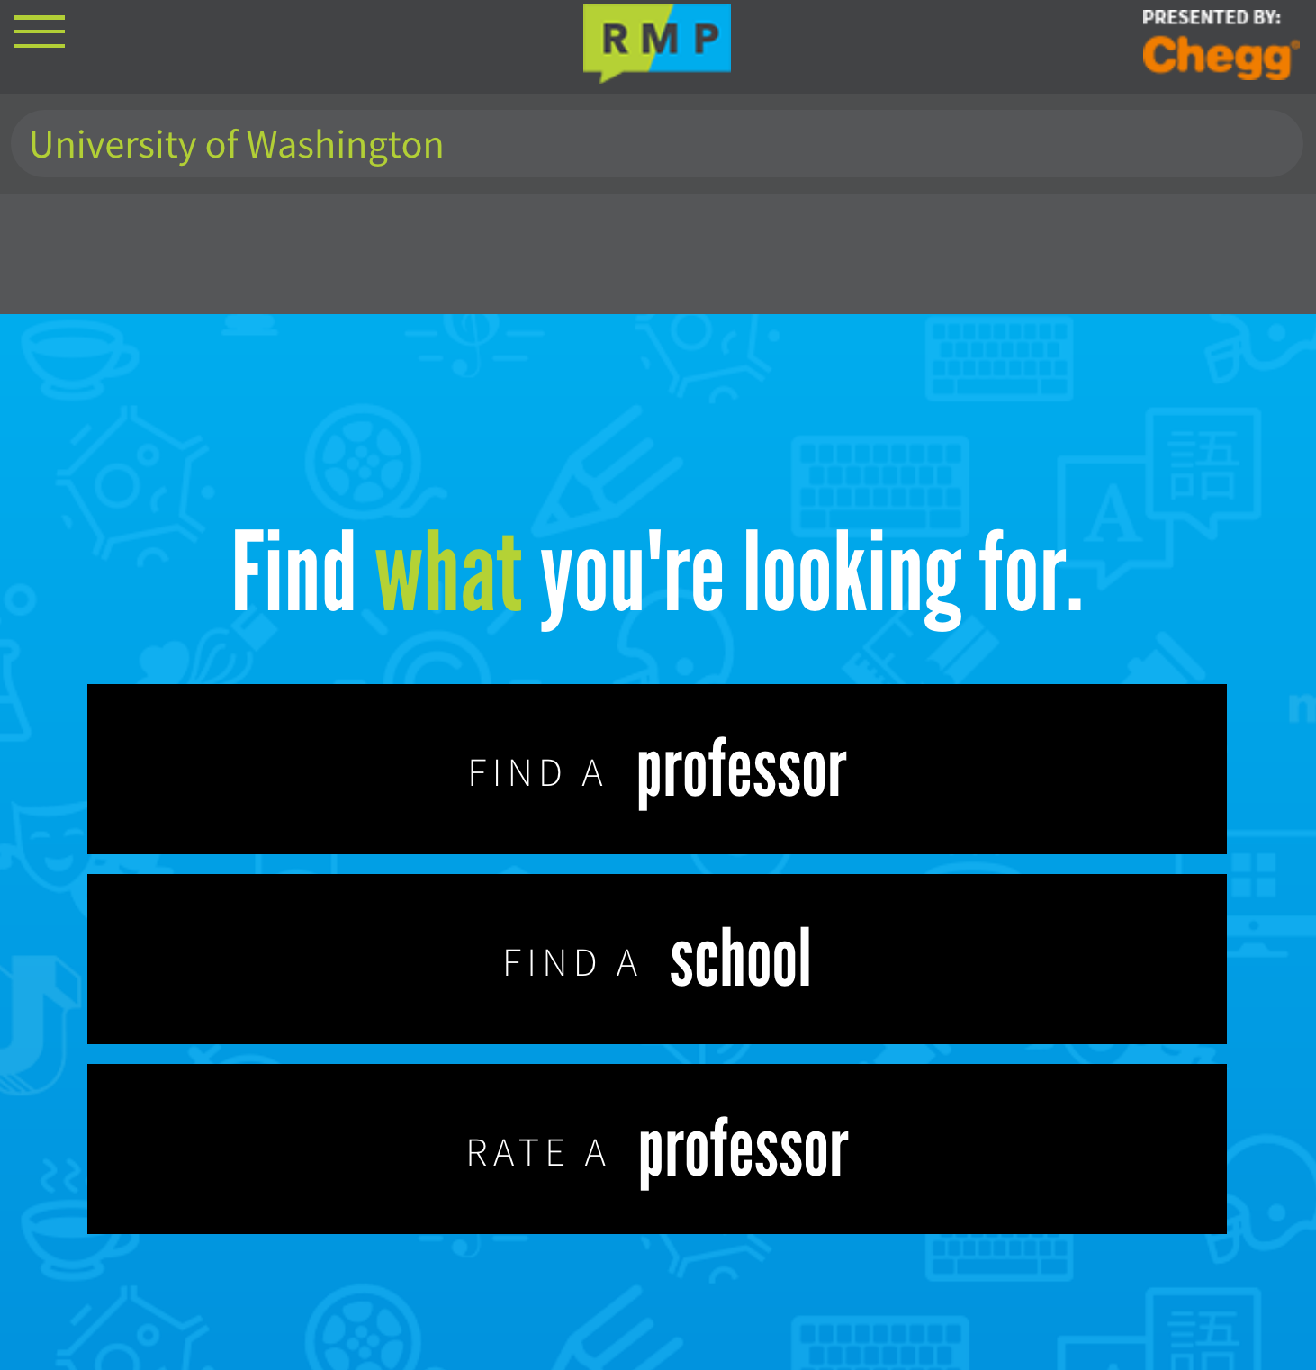
Motivation:
Many students use ratemyprofessor.com to read opinions on prospective teachers, so I think that having access to a legitimate record of grades will provide a more trustworthy
measure in which to help make their course decisions.

Slide 4
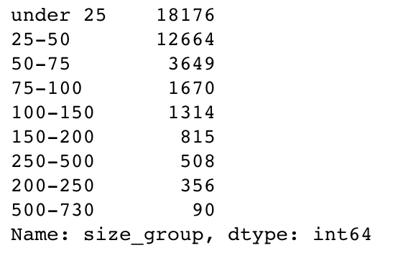
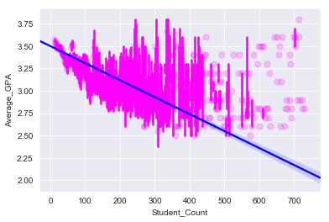
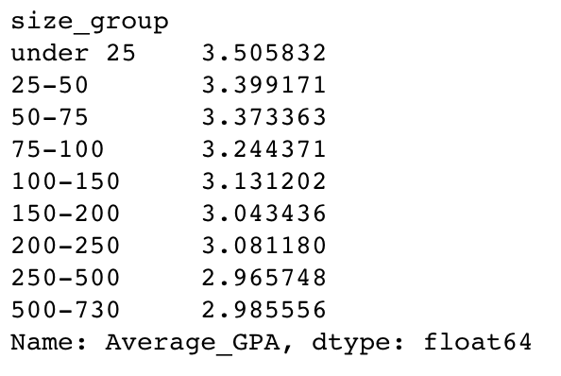
Q1: Class size/GPA correlation: Do people get worse grades in big classes?
Number of classes by size
Yes…
Results showed a slight correlation between larger class size and lower average GPA
Average GPA by size groups

Slide 5
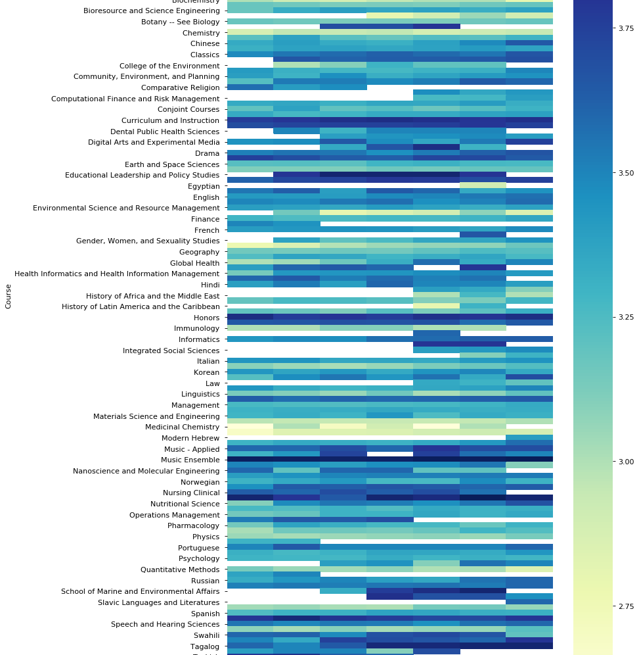
Q2: Which courses might be
easiest to get an ”A” in to
boost my GPA?

Slide 6
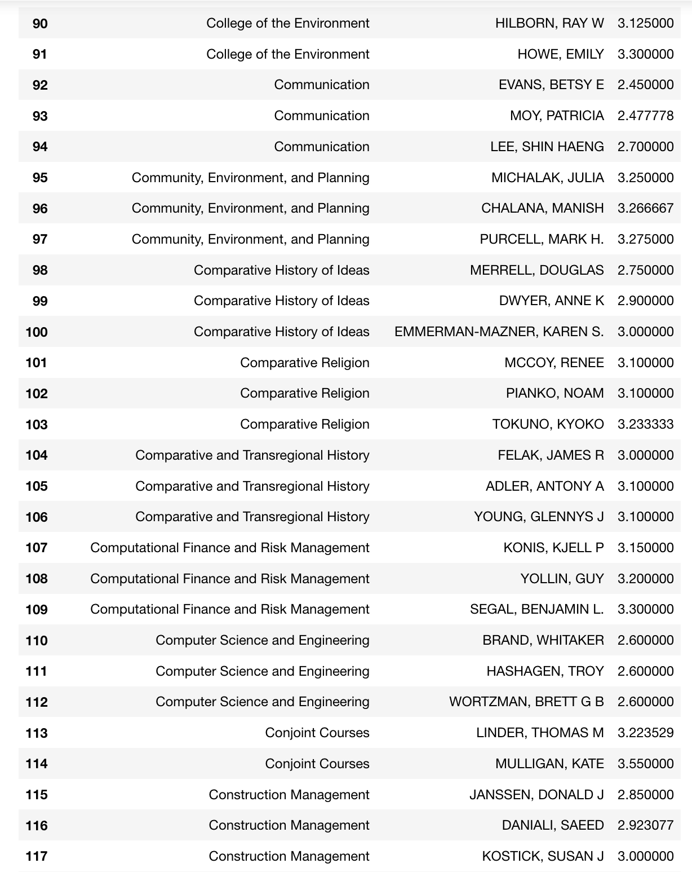
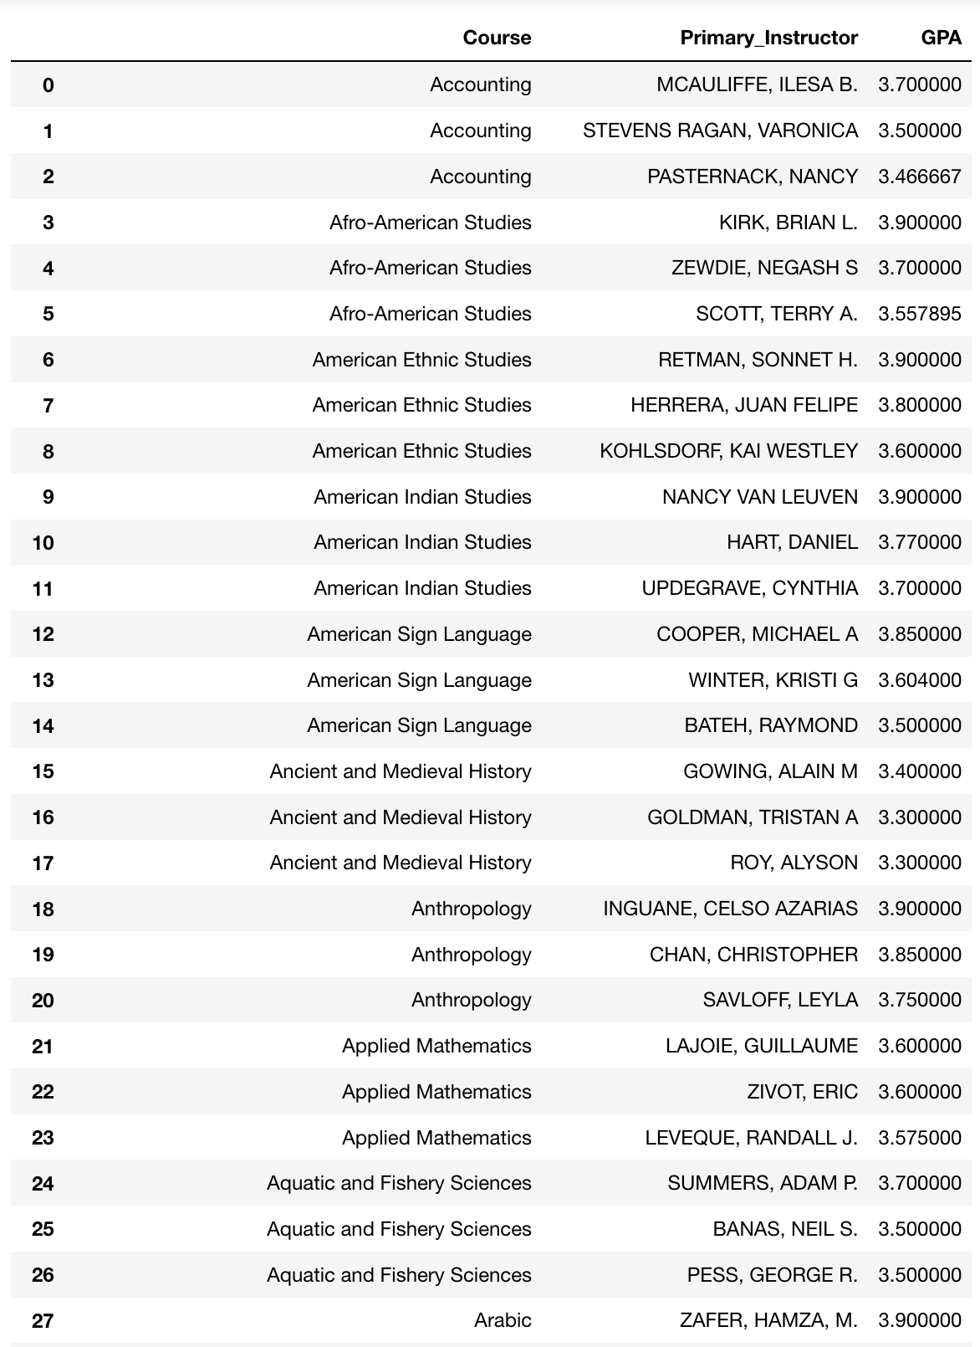
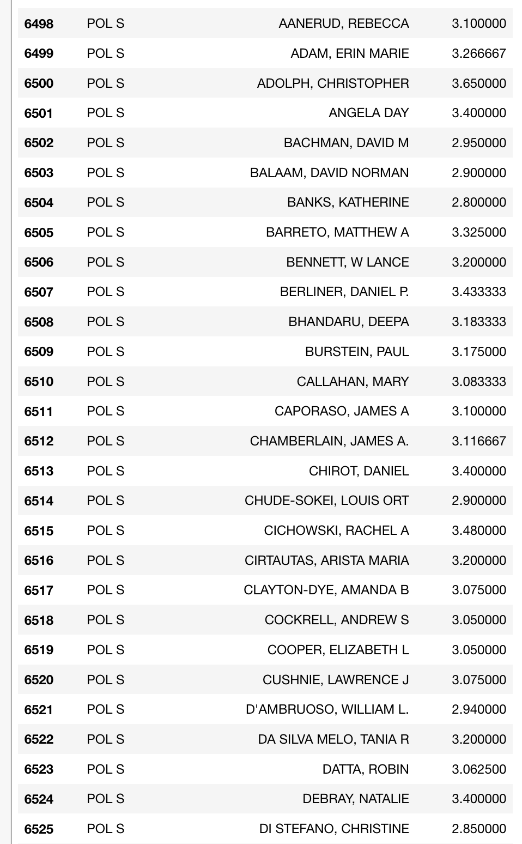
Q3: Ranking Teachers: What is the ranking of instructors based on grades?
Who gives the highest?
View by course
Who gives out the lowest grades?

Slide 7
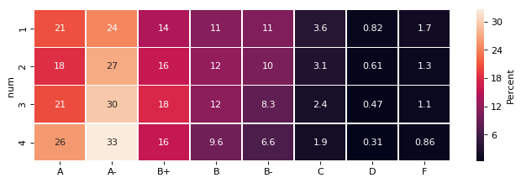
Q4: Grade Distribution by Course Level: Is their correlation between course level and grades?
A little…
People tend to do worse in lower level classes

