Slide 1
12-FA26-SP27-SLL-AI
Sprint 2 Presentation
Team lead: Marissa Cho
Team Members: Quan Ho, Jose Hurtado-Sanchez, Rylan Cody

Slide 2
Sprint 2 Objectives
Set up a shared server environment for storing data and training models
Automate downloading audio and transcripts from TalkBank
Convert transcripts into .rttm speaker label files
Clean and check the labels so errors doesn’t affect the model
Design the system architecture
Prepare to learn PyTorch for fine-tuning

Slide 3
Feature Implementation
Feature | Before | After | Validation
Data Downloading | Manual Browser Download | One command downloads a corpus straight to the secure server, with size check, progress, and resume-able | Verified file types and counts, resumable, no partial files
.CHA to .RTTM Pipeline | Reference scripts hard-coded to one corpus | One config file per corpus, same 3 commands for any corpus | Spot checked random transcripts to ensure validity
Speaker Labeling | Transcripts used corpus-specific speaker codes | Every speaker mapped to KCHI / OCH / FEM / MAL | Labels validated, only KCHI / OCH / FEM / MAL in the output
Dataset Calculation | No idea how much usable data we had | 3000 h audio, 900 h labeled | None

Slide 4
UI & Client Feedback
List speakers
python data_preparation/cha_to_rttm/cha_speaker_list.py configs/corpora/<Corpus>.toml
Build speaker map
python data_preparation/cha_to_rttm/cha_vtc_map_by_file.py configs/corpora/<Corpus>.toml
Write RTTMs
python data_preparation/cha_to_rttm/map_cha_to_rttm.py configs/corpora/<Corpus>.toml
Check corpus size
python data_preparation/talkbank_audio_scrapper.py <database> <corpus path> --list
Download audio
python data_preparation/talkbank_audio_scrapper.py <database> <corpus path>
Download transcripts
python data_preparation/talkbank_transcript_scrapper.py <database> <corpus path>
Calculate amount of data
python data_preparation/calculate_audio_hours.py

Slide 5
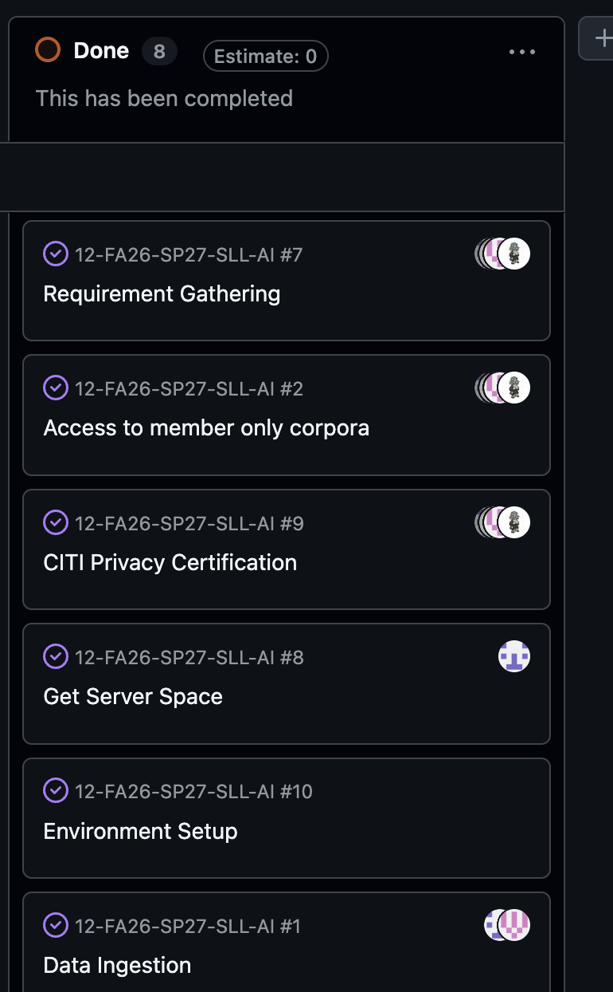
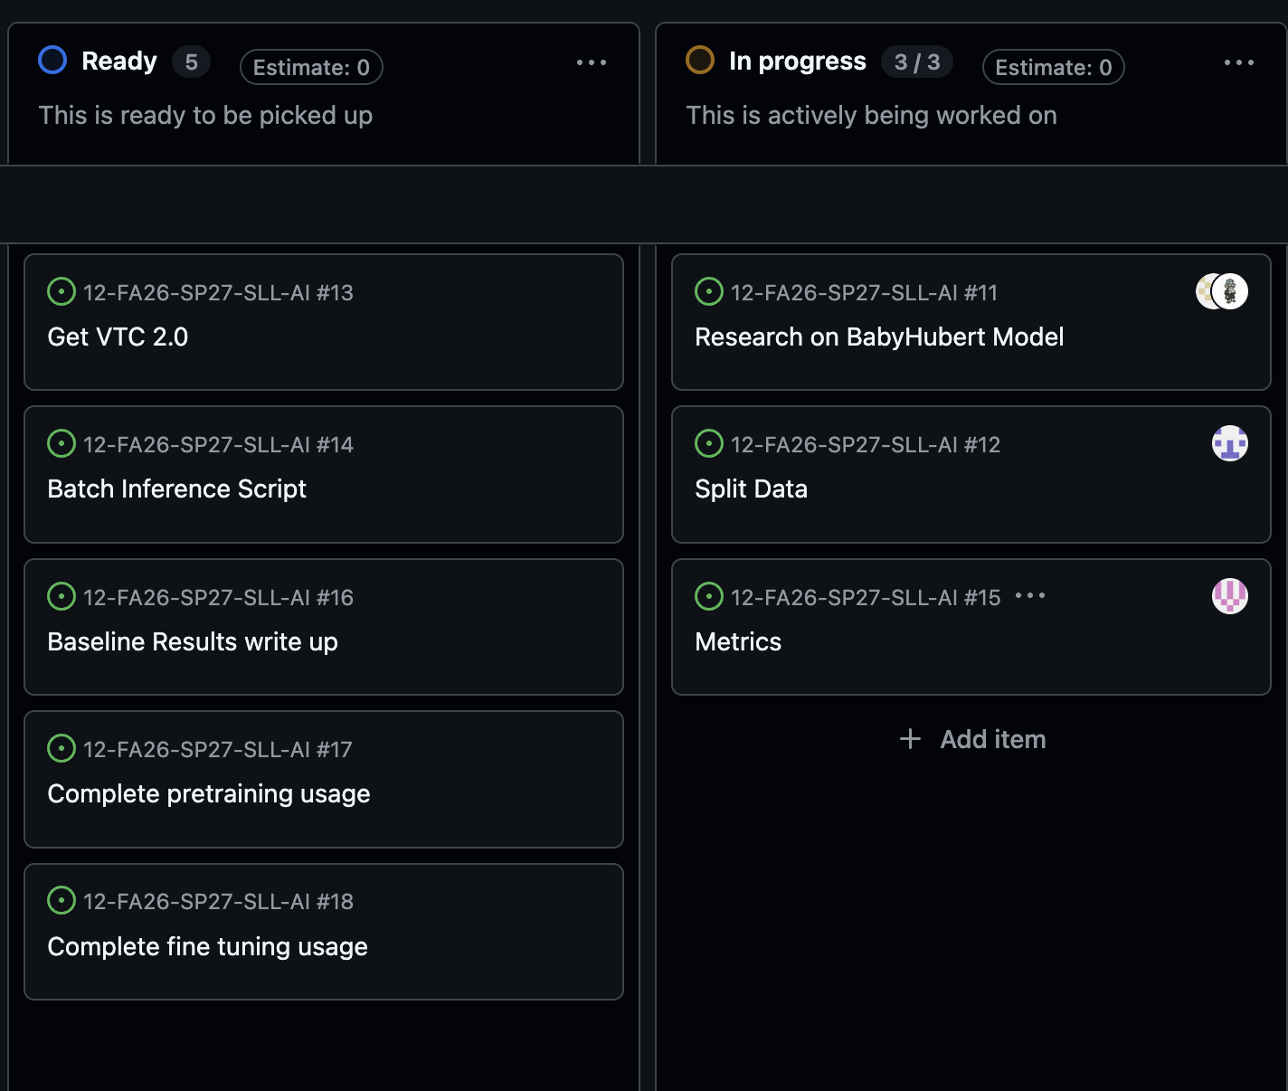
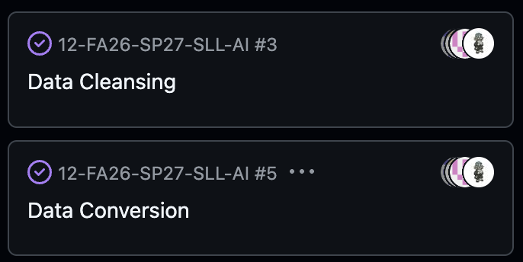
Kanban Overview & Team Contributions

Slide 6
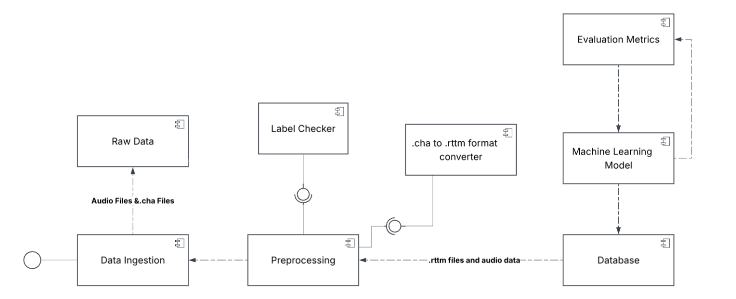
System Architecture
System Architecture
Database
Testing Plan

Slide 7
Responsible Use Of AI
AI was not utilized when working with the dataset as this is private information and cannot be shared with AI tools
AI (Claude Sonnet 5.5, Chat GPT 6) was used to help communicate our ideas with creating a basic template and structure for us when writing our report
  Through this we were able to use AI as a tool to continue to convey our ideas in a clear and concise way while ensuring we stay on track to our end goals

Slide 8
Sprint Achievements and Challenges
Achievements
  Remote Server Setup
  Data Ingested
  Data Cleaned – Labels converted to match what is needed for our model
    Jose: 3 Corpora
    Ben: 4 Corpora
    Rylan: 3 Corpora
    Marissa: 2 Corpora
Challenges
  Data Segmentation
    Data from TalkBank not always segmented properly, brings concern for accuracy
  Speaker Determination
    Key Child and Other Child labeling missing from some datasets, left to infer

Slide 9
Next Steps
Researching and developing the BabyHubert Model
Separate the data into training and testing data
Now prioritize working on metrics and F-1 scores
Working with the client to better understand metrics and working through the different problems brought up by our client (cocktail problem)

Slide 10
Conclusion
We are on track according to our client and making great progress
Continue constant communication with our client
Focus on training and testing data and establishing evaluation metrics

