Slide 1
Lecture 15
Introduction to Programming
Bowu Zhang
Department of Computer Science
Marist College

Slide 2
Review: Event Handlers
To respond to such an event, we need an event handler
  event handlers are written in Javascript
  event handlers are attached to HTML event attributes
    Keyboard event attributes: onkeydown, onkeypress, onkeyup
    Mouse event attributes: onclick, onmouseover, onmouseout, etc.

Slide 3
Review: Example
In HTML:
<p> Where do you come from? </p>
<input id="hometown" >
<button type="button" onclick = "clicksubmit();">Submit</button> <br>
In External JS:
function clicksubmit() {
// get access to the input box with id “hometown”
var inputfield = document.getElementById('hometown');
// display the value of input box using alert
alert("Oh, you come from "+ inputfield.value);
}

Slide 4
Review: User-defined Function
Create our own functions
  function definition
    Placed in external JS file
    Won’t be executed automatically
    Syntax:
    function name(parameters)
    {
    // statements
    }

Slide 5
Review: How to Execute a JS Function?
A function definition is not a regular statement, thus won’t be executed automatically
Call (means invoke) a JS function by its name
  a JS function name includes "()" even if there is nothing inside
<button type="button" onclick = "clicksubmit();">Submit</button> <br>

Slide 6
Review: How to Execute a JS Function?
How to execute a JS function?
  Connect the function to an event attribute in HTML
    would be executed only when the corresponding event occurs
  Call the function in the external JS file
    would be executed automatically
In HTML:
<button type="button" onclick = "clicksubmit();">Submit</button> <br>
In JS:
clicksubmit();

Slide 7
Review: In-class Exercise
Create a html page
  an input field
    ask user for his/her height in feet
  one button
    connect a JS function to this button
  one empty paragraph
Create a JS file
  define the JS function used in html
    read user input, and convert it to height in cm
      1 foot = 30.48 cm
    write the result in the empty paragraph

Slide 8
In-class Exercise
Create a html page
  two input fields
    ask user for the number of cups of coffee he/she drinks every day
    ask user for the price of one cup of coffee
  one button
    attach a JS function to this button
  one empty paragraph
Create a JS file
  define the JS function used in html
    read user input, and calculate how much he/she needs to pay every day
    write the result in the empty paragraph

Slide 9
Other Events
In the future
  Radio buttons
  Checkboxes
  ...

Slide 10
Boolean Variables

Slide 11
Boolean
logic value
  true
  false
  not strings, thus don't add quotation marks

Slide 12
Boolean Expression
A boolean expression is an expression that is true or false.
  The simplest boolean expressions are just
  true,
  and
  false

Slide 13
Relational Operator
Relational operators compare two arithmetic expressions and evaluate to a boolean result.
  == Equal To if(x == 10)
  != Not Equal To if(score != 100 )
  < Less Than if(hours < 40)
  <= Less Than or Equal To if(dollars <= 100)
  > Greater Than if(dollars > 100)
  >= Greater than or Equal To if(hours >= 40)
Note the difference between the equality operator (==) and the assignment operator (=)

Slide 14
Relational Operator
The relational operators are used to compare variables/values
  variable1/constant relational operator variable2/constant
Relational operators have lower precedence than the arithmetic operators.
  That is, Javascript does the “math” first, then the comparison.

Slide 15
Precedence
Evaluated
First
( ) parentheses
! NOT
*, /, % multiplication, division,mod
+, - addition,subtraction
==, !=, >, >=, <, <= relational ops
&& AND
|| OR
= assignment
Evaluated
Last

Slide 16
Example
var x = 15;
var y = 100;
console.log(x + y < 15);
console.log(x - 6 < 15 );
console.log(x == y)
console.log(x != 5);

Slide 17
In-class Exercise
Assume var x = 1; and var y = 2;
console.log(x / y < 1);
console.log(x +y*8 < 15 );
console.log(x+1 == y);

Slide 18
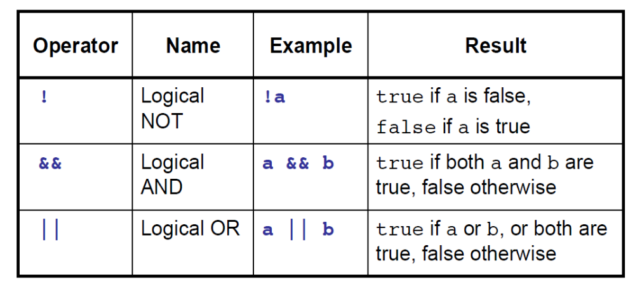
Logical Operator
Logical operators combine boolean expressions
  boolean ex1 logic operator boolean ex2 logic operator....

Slide 19
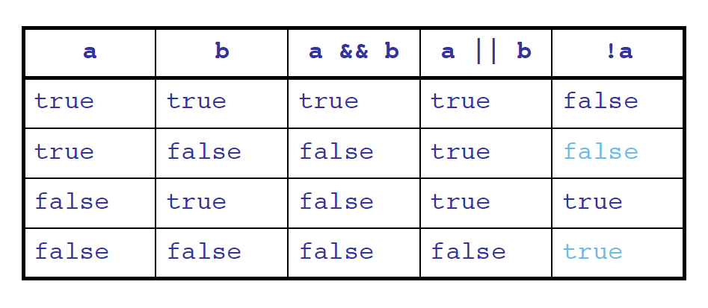
Truth Table

Slide 20
Example
Part time: 0<hours<20
In Javascript: 0<hours && hours<20
Full time: 20<hours<40
In Javascript: 20<hours && hours<40

Slide 21
In-class Exercise
Write down boolean expressions for the following questions:
  Let x be a number variable,
    1. if x is between 10 and 20?
    2. if x is larger than 50, and not equal to 88?
    3. if x is equal to 100?

Slide 22
In-class Exercise
Assume x, y, and z are variables that have been initialized.
boolean areAllEqual = _________________________;

Slide 23
Precedence
Evaluated
First
( ) parentheses
! NOT
*, /, % multiplication, division,mod
+, - addition,subtraction
==, !=, >, >=, <, <= relational ops
&& AND
|| OR
= assignment
Evaluated
Last

Slide 24
Example
var x = 15;
var y = 100;
console.log(x > y && x >= 15);
console.log(x < 15 || x > 15);
console.log(x == y && y == 100)
console.log(x != 5 && x < y);
console.log(x + y > 100 || y <= 10);
&& is evaluated after relational operators.
|| is evaluated after &&.

Slide 25
In-class Exercise
Assume var i = 5; and var j = 10;
i == 5 && j > 7
i == 10 || j == 10 && i == j
i == j - 5 && i>1
j == i * 2

Slide 26
Selection

Slide 27
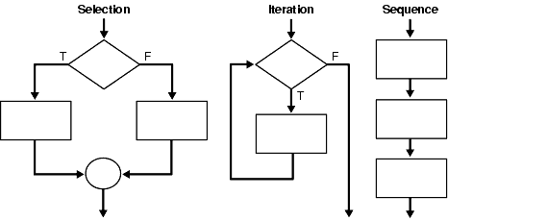
Control Flow
The order of statements to be executed
  sequentially
  control structure

Slide 28
Example
function sequential(){
// Statements are executed sequentially
alert("This is alert 1");
alert("This is alert 2");
alert("This is alert 3");
alert("This is alert 4");
alert("This is alert 5");
alert("This is alert 6");
}

Slide 29
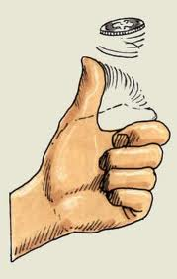
Example
Flip a coin
  If it comes up heads, it should print ``heads''.
  If it comes up tails, it should print ``tails''.

Slide 30
Algorithm
What do I get?
    If I get heads, then print “Heads.”
    If I get the other side, then print “Tails.”
if(coin == "heads")
{
alert("Heads!");
}
else
{
alert("Tails!");
}

Slide 31
If-else
Javascript uses If Else to choose between alternatives
Syntax:
if(condition)
{
STATEMENT
}
else
{
STATEMENT
}

Slide 32
If-else Control Flow
if(condition)
{
STATEMENT
}
else
{
STATEMENT
}
True
When condition is true,
  the statements between the next curly braces are executed
  it skips down past the else curly braces and continues executing
When condition is false,
  the statements between the if braces are ignored,
  then the statements between the else braces are executed, then it continues executing whatever is next
Execute this part
Skip this part
One or the other will be executed, but not both
if(condition)
{
STATEMENT
}
else
{
STATEMENT
}
False
Skip this part
Execute this part

Slide 33
Condition
Condition: boolean expressions
  The value of a boolean expression is either true or false
  single boolean expression
    variable1 relational operator variable2/constant
    x > y
    x < 9
  combined boolean expression
    boolean expression1 logic operator boolean expression2 logic operator....
    x>y && x < 9

Slide 34
Example
function CheckifPositive()
{
  var x = parseFloat(prompt("Enter a number:"));
  if(x >= 0)
  {
  alert("x is positive");
  }
  else
  {
  alert ("x is negative");
  }
  alert(“This is the end of function.");
}

Slide 35
Example
function CheckNumber()
{
    var getnumber =parseInt(prompt( "Enter an integer: "));
  if(getnumber > 100)
  {
  alert("greater then 100");
  }
  else
  {
  alert("less than or equal to 100");
  }
}

Slide 36
Example
false
true
getnumber > 100
print “ less than or equal to 100”
print “greater than 100”
Psuedocode:
    If getnumber is greater than 100
    Print “greater than 100
    else
    Print “less than or equal to 100 ”

Slide 37
In-class Exercise
Write a function that asks user for an integer and check whether the given integer is even (evenly divisible by 2) or not (not evenly divisible by 2)

Slide 38
In-class Exercise
Write a function that reads 2 integers from the user and determines whether or not the sum of integers is greater than 10.

Slide 39
In-class Exercise
Write a function that reads 2 integers from the user and determines whether or not the sum of integers is between 0 and 100.

Slide 40
In-class Exercise
Write a function that reads 2 integers from the user and determines whether both integers are larger than 10.

Slide 41
Common Mistakes
When using comparison operators, always use ‘==‘ for checking equality, never ‘=‘
  Most compilers will not give you any errors or warnings, but your program will not operate as you expect
You can not string multiple comparisons together without the “and” or “or” operators
  Incorrect: if(10 < x < 15)
  Correct: if((10 < x) && (x < 15))

Slide 42
Parentheses Are Mandatory
You can not write
if hours_worked > 8
{
alert( "It's quittin' time!");
}
else
{
alert( "Get back to work!");
}

Slide 43
Omitting Braces
You can omit the curly braces for the if block or the else block ONLY if there is exactly one statement
I recommend always using the braces
  Easier to read
  Less chance of errors if you add more statements later on
if(hours_worked > 8)
alert( "It's quitting time!");
else
alert( "Get back to work!");

Slide 44
Else Block Is Optional
You can omit the else block, if there are no statements in else
function CheckifPositive()
{
  var x = 15;
  if(x > 0)
  {
  alert("x is positive");
  }
  //else
  //{
  //}
  alert(“This is the end of function.");
}

Slide 45
Multiple Alternatives
Standard if-else statements give you two choices
You can have more choices by adding else if statements in between the if and else
  Each will be tested in order until one of the conditions is true, and the else statements will only run if none of the conditions are true
  You can always omit the else block (including else keyword) if you want

Slide 46
Syntax of Multi-way If-else
if(Condition1)
{
//run statements if expression 1 is true
}
else if(Condition2)
{
//run statements if condition 1 is false,
//and condition 2 is true
}
else if(Condition3)
{
//run statements if both condition 1 and 2 are false,
//and condition 3 is true
}
......
else
{
//run statements if none of the conditions is true
}

Slide 47
Example
if(x > 10)
{
alert( "x is greater than 10");
}
else if(x > 5)
{
  alert( "x is between 5 and 10 ");
}
else
{
alert( "x is less than 5");
}

Slide 48
Example
if(x > 10)
{
alert("x is greater than 10");
}
else if(x > 5)
{
  alert("x is between 5 and 10");
}
else if(x > 0)
{
alert("x is between 0 and 5");
}
else
{
alert("x is less than 0");
}

Slide 49
Example
var hours = parseInt(prompt("Enter the hours in 24 hour notation: ");
if((hours >= 1) && (hours <= 11))
{
alert("That is " +hours +"am");
}
else if((hours >= 13) && (hours <= 23))
{
hours = hours - 12;
alert("That is " + hours + "pm");
}
else if(hours == 12)
{
alert("That is " + hours + "pm");
}
else if(hours == 0)
{
alert("That is 12am");
}
else
{
alert("That is not a valid hour!");
}

Slide 50
In-class Exercise
Write a function that reads a numeric score from the user and outputs a letter grade
  If the score is >=90, output A
  If the score is >=80 and <90, output B
  If the score is >=70 and <80, output C
  If the score is >=60 and <70, output D
  If the score is <60, output F

Slide 51
In-class Exercise
Write a function that reads two exam scores from the user.
  If both exam scores are greater than 90, print "Way to go!".
  If either exam score is less than 70, print "Study more!".
  Otherwise, print "Keep it up!".

Slide 52
Nested If-else
An if-else statement inside another if-else statement
  in the if block or the else block
  if ( num > 0 ) // Outer if
  {
  if ( num < 10 ) // Inner if
  {
  alert( "num is between 0 and 10." ) ;
  }
  else
  {
  alert("num is greater than 10");
  }
  }
  else
  {
  alert("num is less than or equal to 0.");
  }

Slide 53
Example
if(day==0)
{
alert("Sunday!");
}
else
{
if(day == 6)
{
alert("Saturday!");
}
else
{
alert("Weekday!");
}
}

Slide 54
In-class Exercise
This exercise shows how to assign the correct honorific based upon a person's gender and age.
  Females under the age of 18 are referred to as Miss, while those 18 and over are referred to as Ms.
  Males under the age of 18 are called Master, while those 18 and over are called Mr.
function honorific(){
  var age = parseInt(prompt("What is the person's age?"));
  var gender = prompt("What is the person's gender (male/female)?");
  var honorific;
  // Complete the method here
  alert(" The person shall be called "+honorific);
}

Slide 55
In-class Exercise
Two-player game rock/paper/scissors, each player secretly chooses one of three values (rock, paper, scissors) and both players announce their choices at the same time. The rules are:
  rock beats scissors;
  scissors beats paper;
  paper beats rock;
  a tie is declared if both players choose the same value.
Continued on the next page

Slide 56
In-class Exercise
Assume that the variables p1 and p2 each hold one of the three strings "rock", "paper", or "scissors" for player 1 and player 2, respectively.
Flesh out the function so that it pops up an alert box displaying
  players tie if the players tie.
  player 1 wins if player 1 wins
  player 2 wins if player 2 wins
function playgame(){
var p1 = prompt("Player 1: enter one of rock,paper,scissors","rock");
var p2 = prompt("Player 2: enter one of rock,paper,scissors","rock");
// flesh out the rest of the program …
}

Slide 57
In-class Exercise
Modify the program so that it complains if either player enters an invalid value.

Slide 58
Quiz
Read Chapter 7
Quiz
  Form elements
  Event handlers/Functions
  Boolean

