Slide 1


LANDED
helping people land their dream job
By: Ricky Isheja, Jumin Shrestha

Slide 2
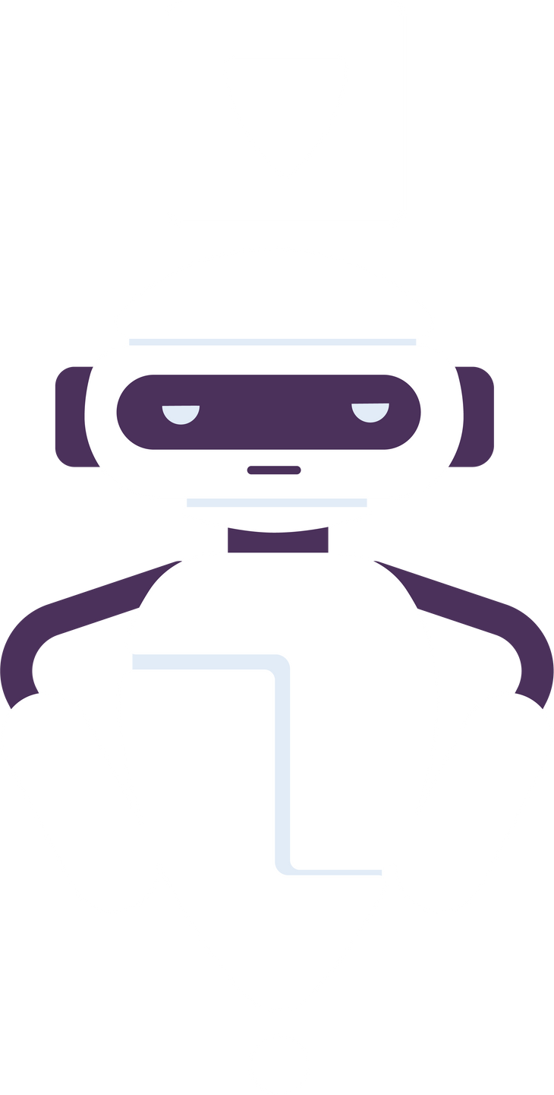

PRODUCT
Landed is a web application designed to simplify as well as supercharge the job application process at the same time using the power of AI.
It serves as a one-stop solution when applying for jobs, from tailoring or creating resumes and coverletters to practicing interview questions. Landed is a tool that will help anyone in the job application stage land their dream job.

Slide 3

WHY LANDED?
Applying for a job is a full time job itself and we wanted to help fellow applicants in making this journey easier.
We ourselves have applied to hundreds of jobs and know how tedious the process is, we wanted to create a versatile tool that would not only help people in every step of the job application process but also get them the most optimized responses for their application.
Since most applications gets scanned by AI itself, we wanted to use AI to make sure the application stands out!

Slide 4



OUR AIM
LANDED WILL HELP YOU
Automate Repetitive tasks
Customize responses for specific positions
Prepare every step in the application
ATS friendly optimized application

Slide 5
KEY FEATURES
COVER LETTER GENERATOR:
Personalized cover letters based on your resume and job descriptions
RESUME TAILORING:
Create ATS friendly resume for specific job descriptions
SKILLS ANALYSIS:
Identify missing skills and recommendations for improvement
DOCUMENT MANAGEMENT:
Save, edit, and download your tailored documents

Slide 6

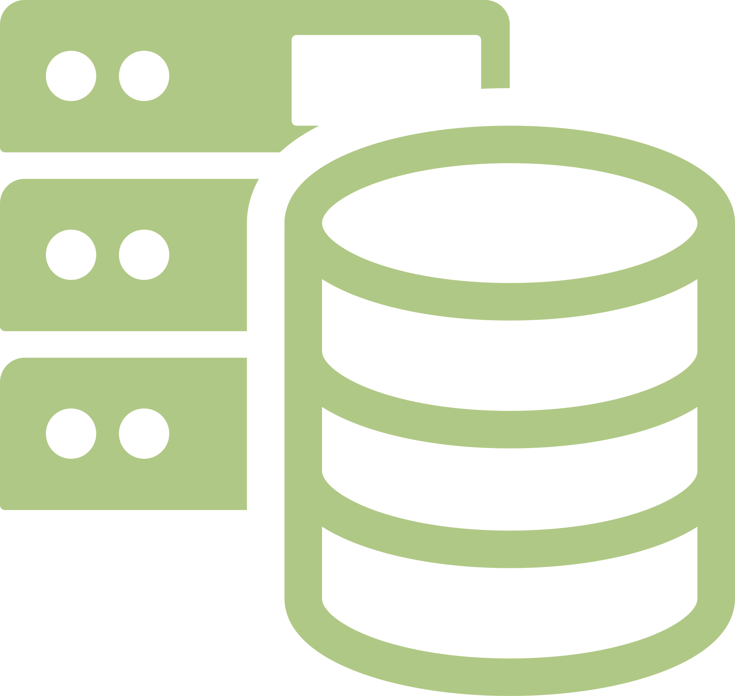

TECH STACK
Frontend: React, Tailwind CSS
Backend: Firebase (Authentication, Firestore, Storage)
Deployment: Firebase Hosting
Frontend: ReactJS, React Router, Tailwind CSS
Backend: Firebase (Authentication, Firestore, Storage), Node JS, Express, and Postgresql
Deployment: Firebase Hosting

Slide 7
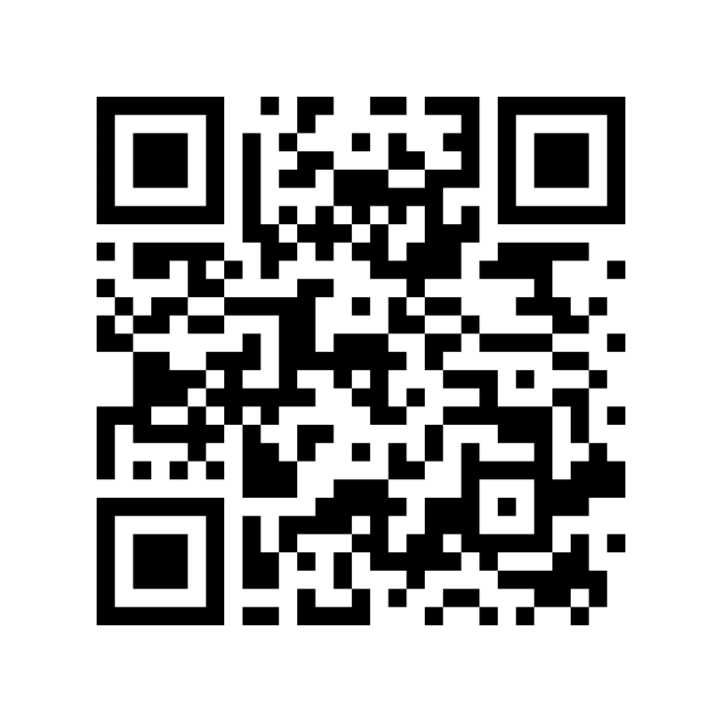

QR CODE
Landed

Slide 8
DEMO VIDEO
Demo video

Slide 9

FUTURE ENHANCEMENTS
Finding a better Job search API
Creating a Portal for Companies hiring
Migrating from firebase

Slide 10
LESSONS LEARNT
System design comes before implementing code
Commit often
With teams, there must be a separation of tasks to avoid Git conflicts
Research on tools before applying them

Slide 11
THANK YOU

