Slide 1
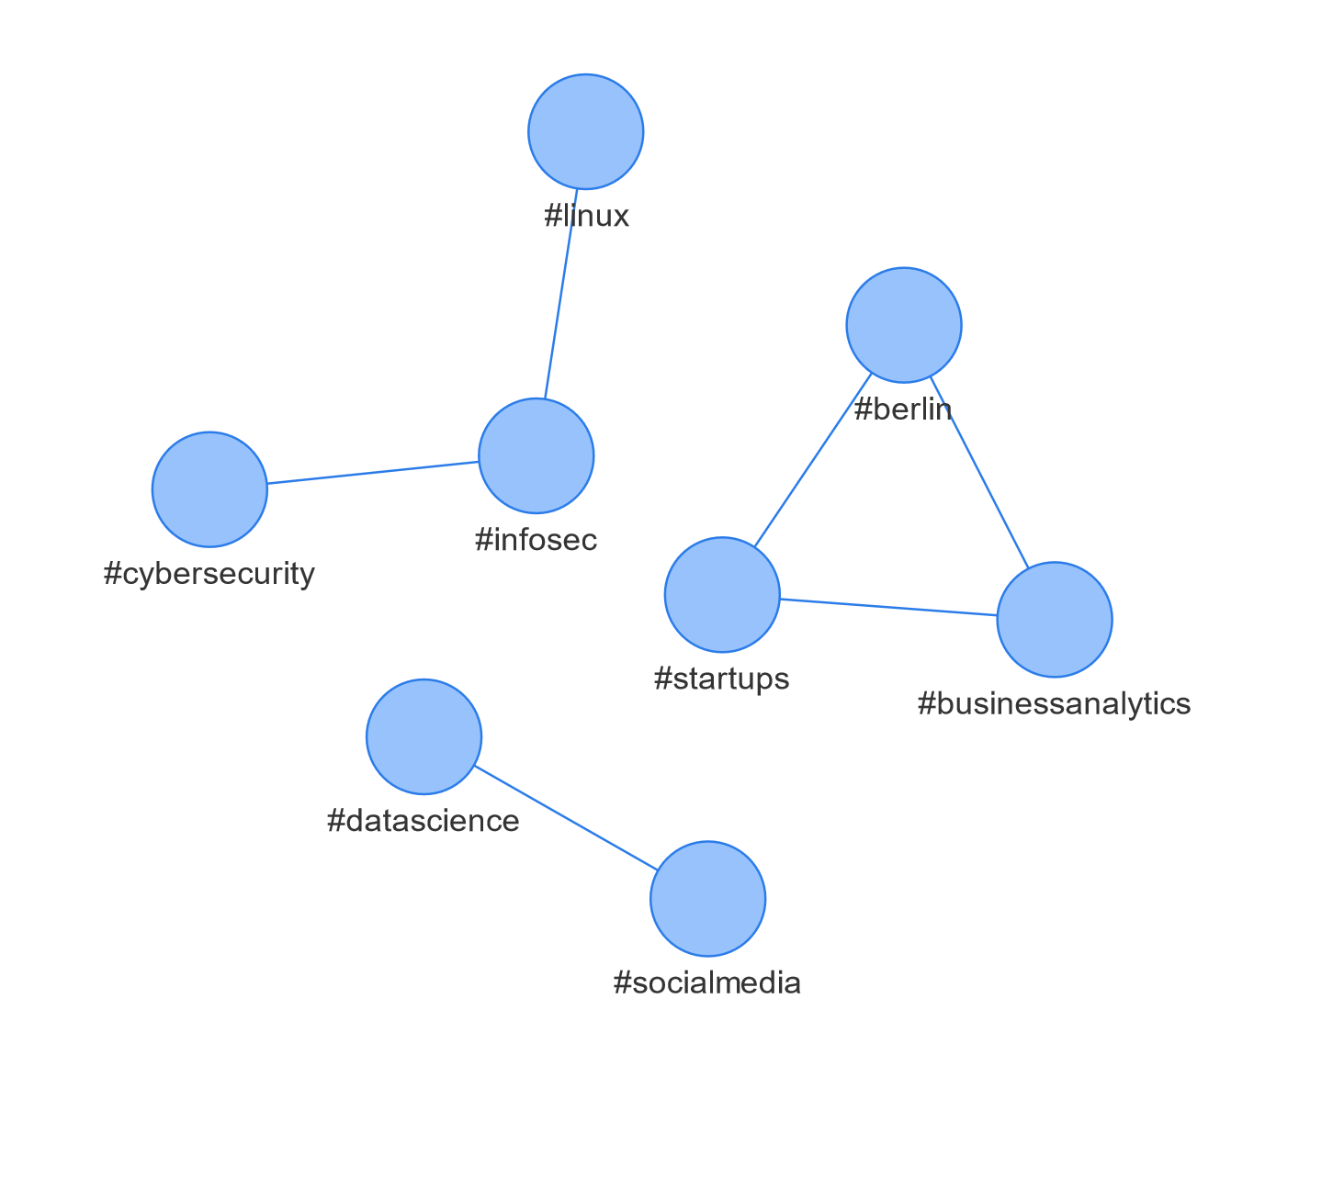
#cybersecurity;#infosec
#infosec;#linux
#datascience;#socialmedia
#startups;#businessanalytics;#berlin

