Slide 1
CRUD Operation in Angular

Slide 2

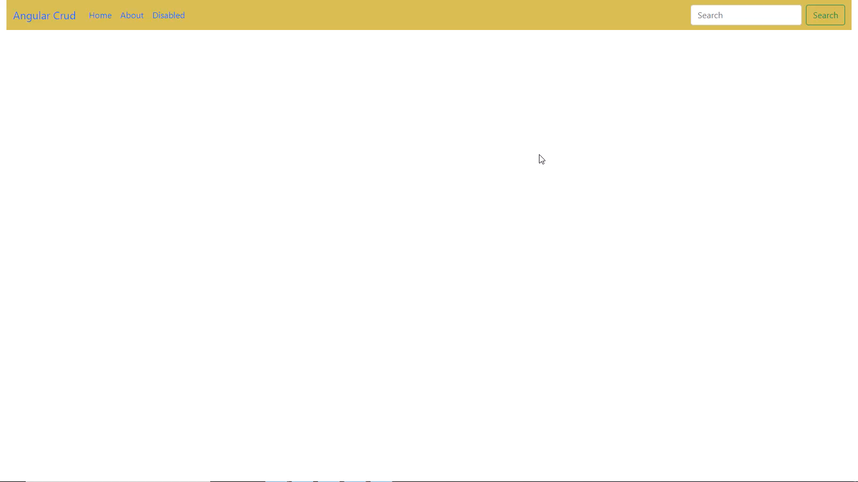

Slide 3
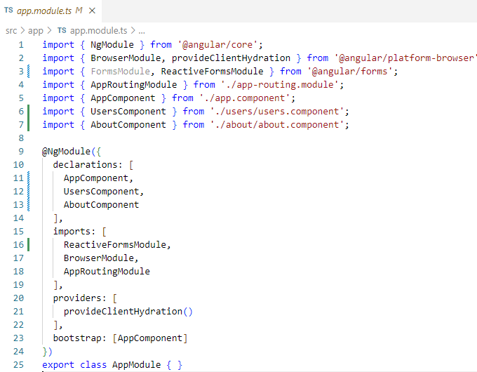
Install Bootstrap
npm install bootstrap@v5.1.3

Slide 4
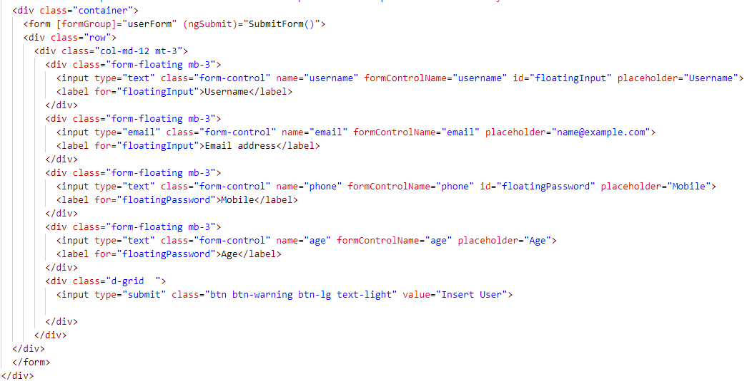

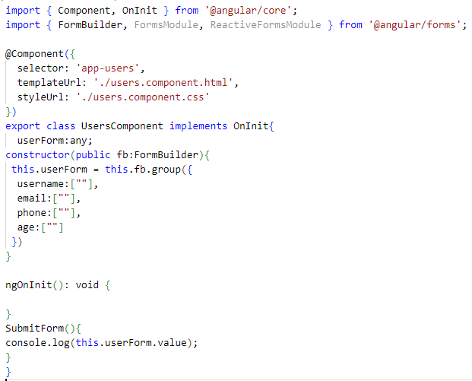

Slide 5
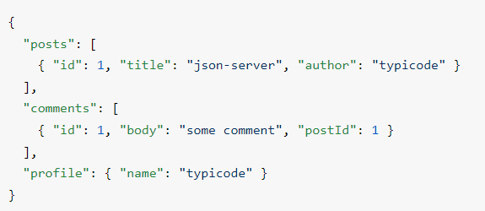
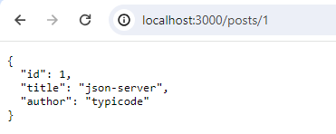
Insert Operation Via JSOn Server
https://www.npmjs.com/package/json-server
Install JSON Server
npm install -g json-server
Create a db.json file with some data
Start JSON Server
json-server --watch db.json
Now if you go to http://localhost:3000/posts/1, you'll get

Slide 6
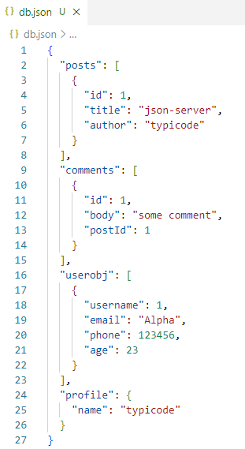
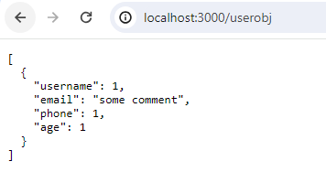
Create Own Inputs Values Add in db.json file
Get user data using ‘userobj’ object

Slide 7
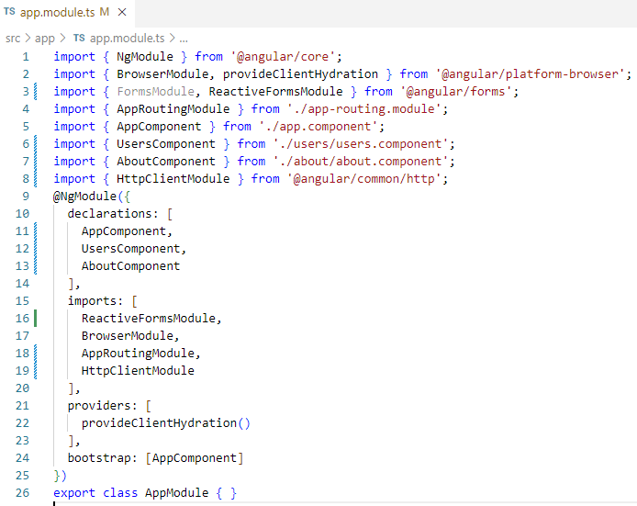
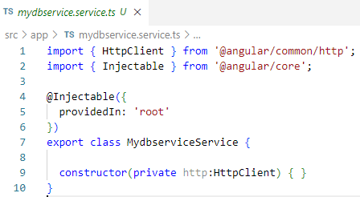
Create Service to Post the data in JSON API DB
Ng g s mydbservice
Add HTTPClient in that service in which you can easily used GET,POST,DELETE api.

Slide 8
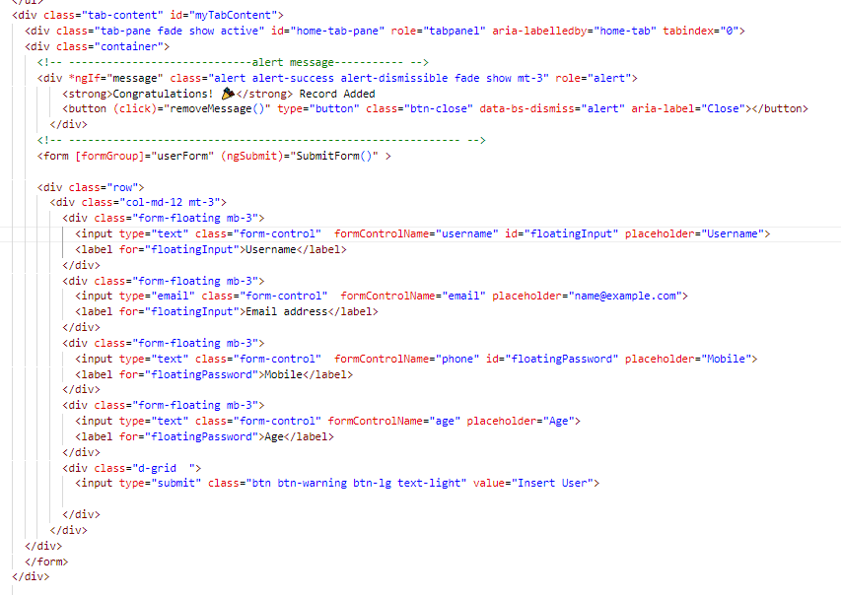
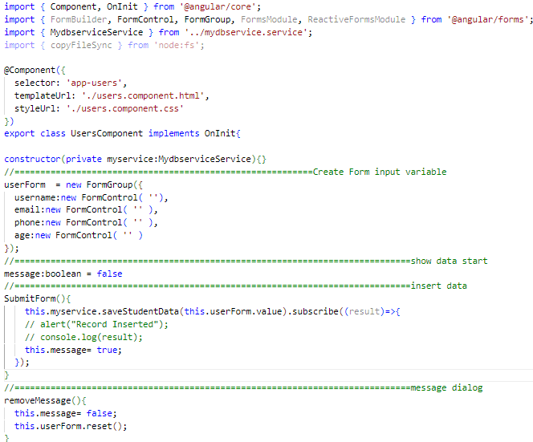
Step:01

Slide 9
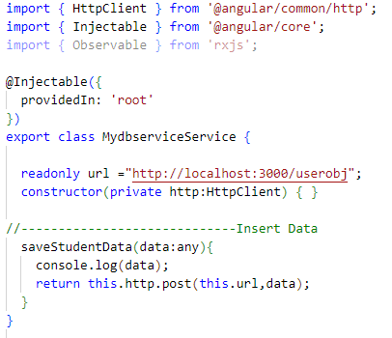
Code In Service

Slide 10

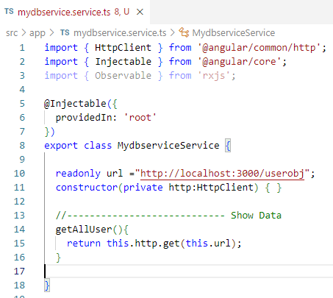
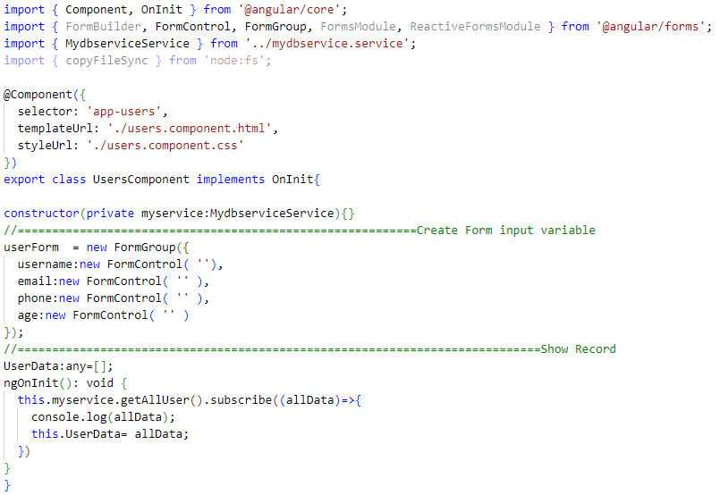
Show User

Slide 11

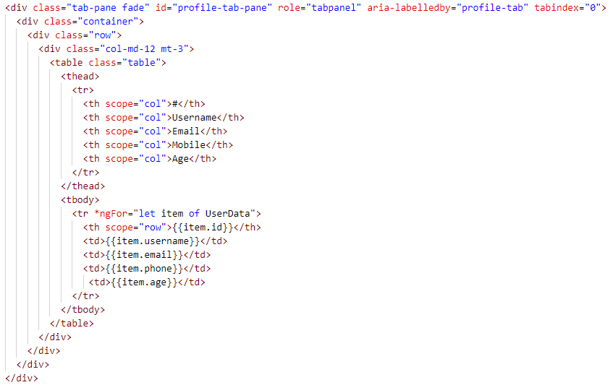
Show User data

Slide 12
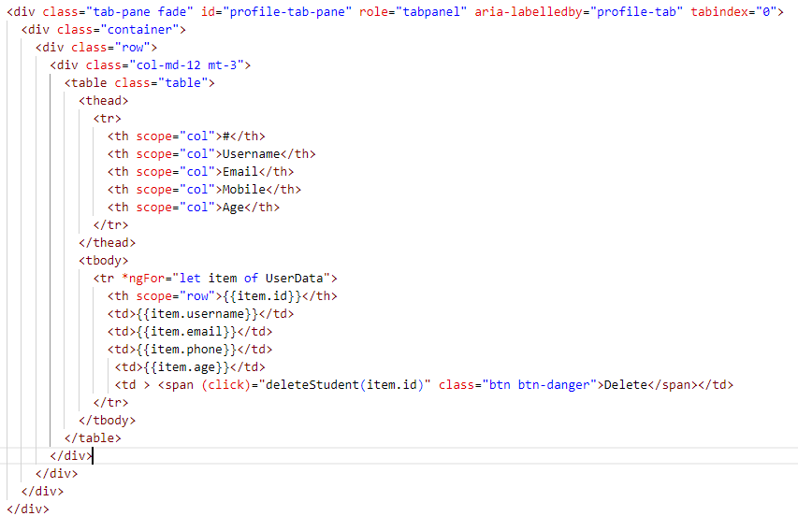


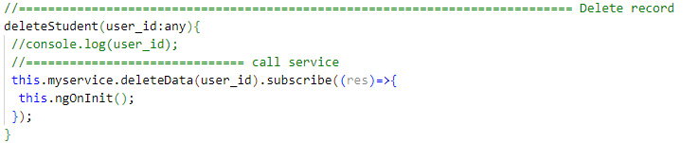
Delete Work

Slide 13

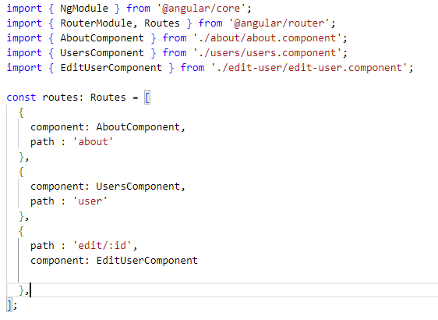
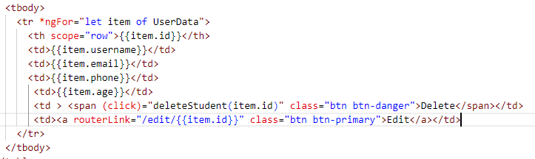
Update Work

Slide 14
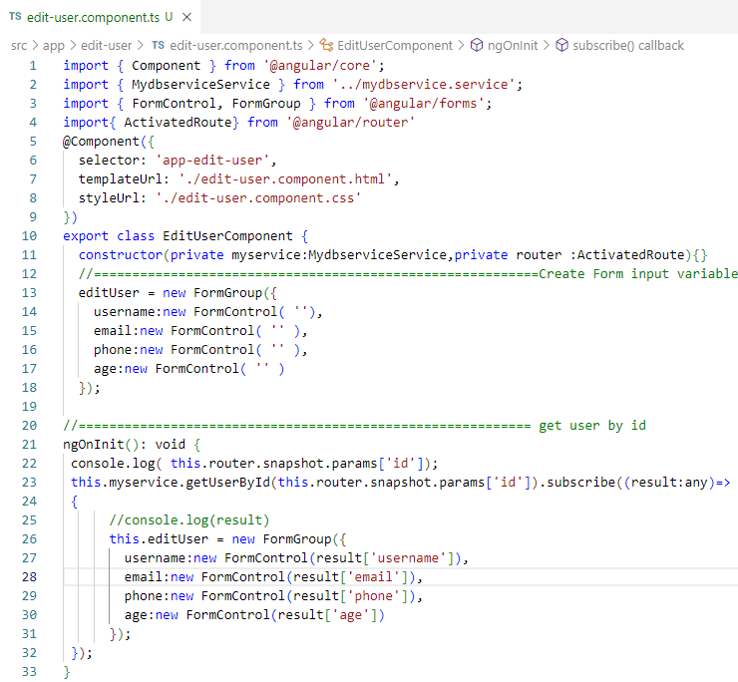

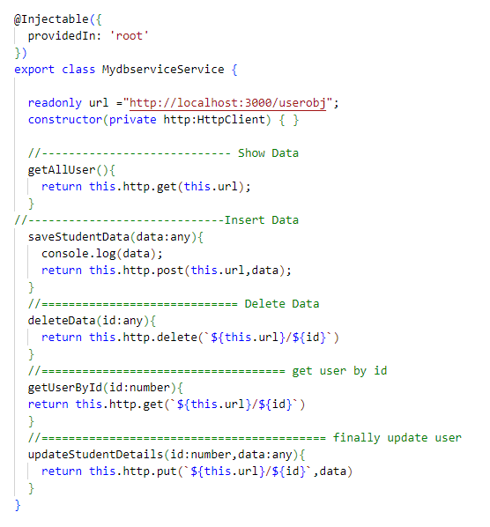

Slide 15
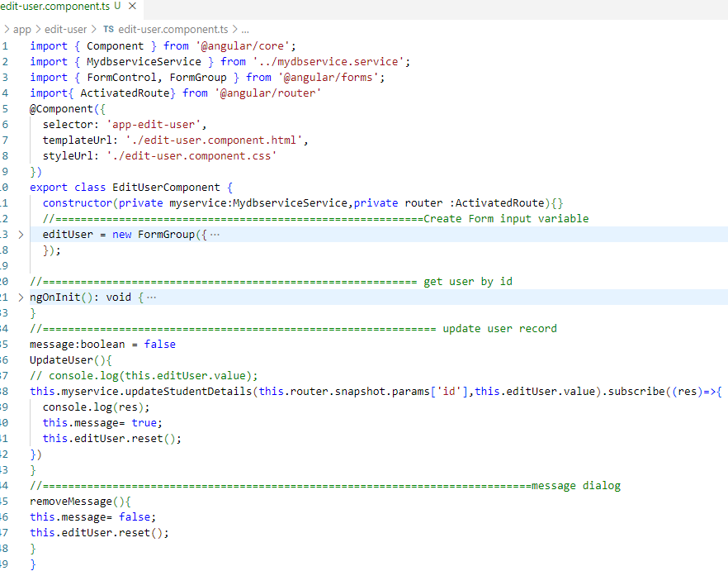

Slide 16
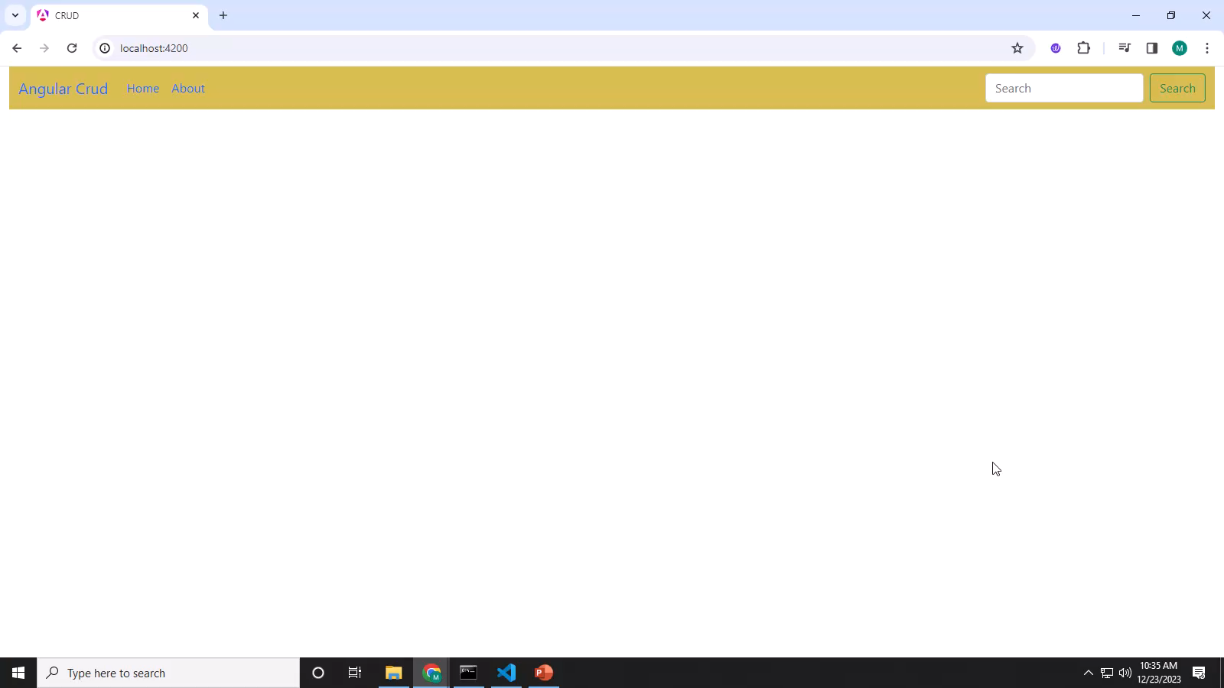
Video CRUD

