Slide 1


Slide 2

Arrays
  Array is a collection of variables of the same type that are collectively referred to by the common name.
  Elements in an array share the same name.

Slide 3

Name of array (Note that all elements of this array have the same name, c)
Array
  Group of consecutive memory locations
  Same name and type
To refer to an element, specify
  Array name
  Position number
Format:
    arrayname[ position number ]
  First element at position 0
  n element array named c:
    c[ 0 ], c[ 1 ]...c[ n – 1 ]
c[0]
-45
c[1]
6
c[2]
0
c[3]
72
c[4]
1543
c[5]
-89
c[6]
0
c[7]
62
c[8]
-3
c[9]
1
c[10]
6453
c[11]
78
Position number of the element within array c

Slide 4

  We can reference array elements by using the array’s subscript/index. The first element has a subscript/index of 0. The last element in an array of length n has a subscript/index of n-1.

Slide 5
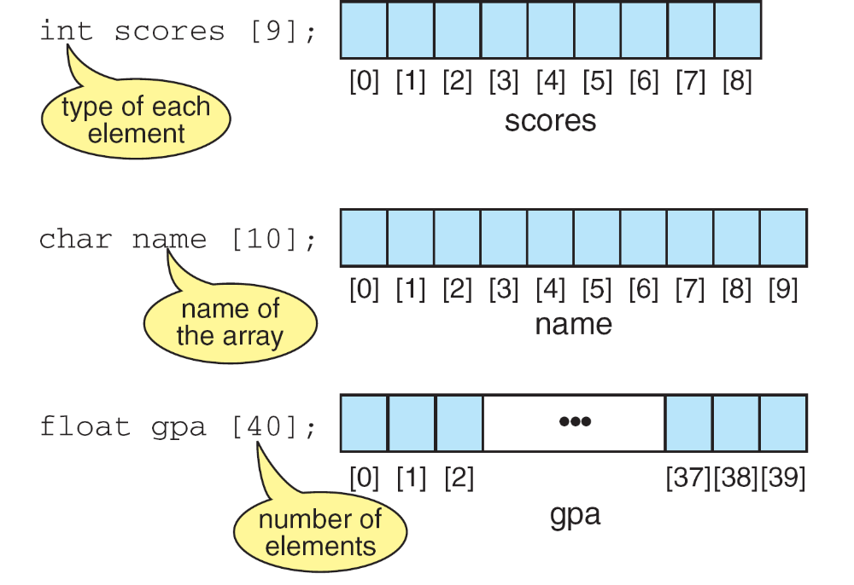
Declaration Examples

Slide 6

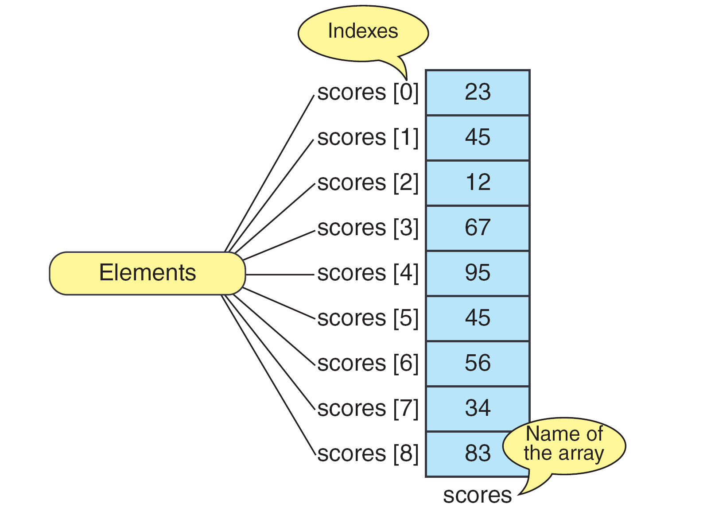

Slide 7

C supports two types of arrays:
  Fixed Length Arrays – The programmer “hard codes” the length of the array, which is fixed at run-time.
  Variable-Length Arrays – The programmer doesn’t know the array’s length until run-time.

Slide 8

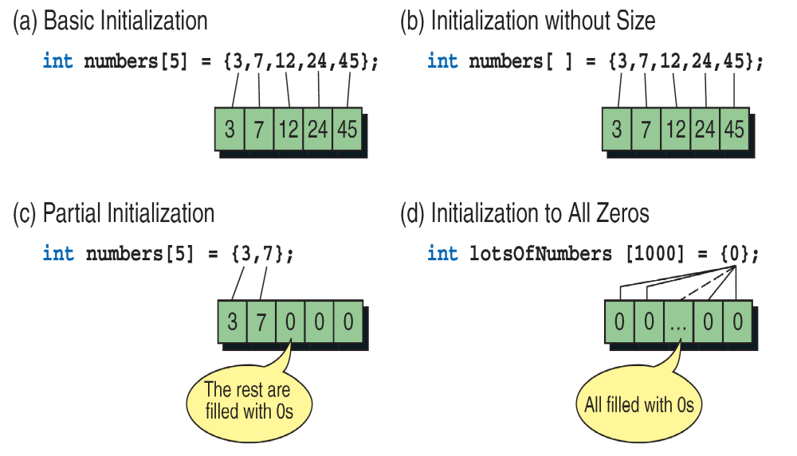

Slide 9

Array elements are like normal variables
    c[ 0 ] = 3;
    printf( "%d", c[ 0 ] );
  Perform operations in subscript/index. If x equals 3
    c[ 5 - 2 ] == c[ 3 ] == c[ x ]

Slide 10

When declaring arrays, specify
  Type of array
  Name
  Number of elements
    arrayType arrayName[ numberOfElements ];
  Examples:
    int c[ 10 ];
    float myArray[ 3284 ];
Declaring multiple arrays of same type
  Format similar to regular variables
  Example:
    int b[ 100 ], x[ 27 ];

Slide 11

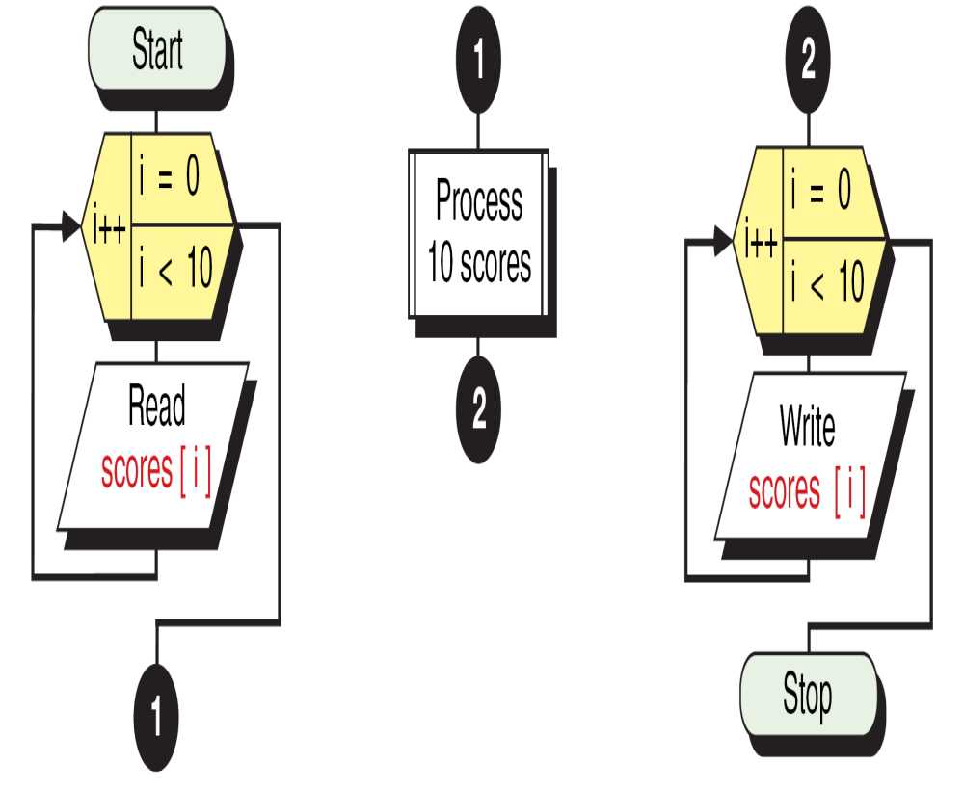
Since we can refer to individual array elements using numbered indexes, it is very common for programmers to use for loops when processing arrays.

Slide 12
Examples Using Arrays
Initializers
    int n[ 5 ] = { 1, 2, 3, 4, 5 };
  If not enough initializers, rightmost elements become 0
      int n[ 5 ] = { 0 }
    All elements 0
  If too many a syntax error is produced syntax error
  If size omitted, initializers determine it
    int n[ ] = { 1, 2, 3, 4, 5 };
  5 initializers, therefore 5 element array

Slide 13
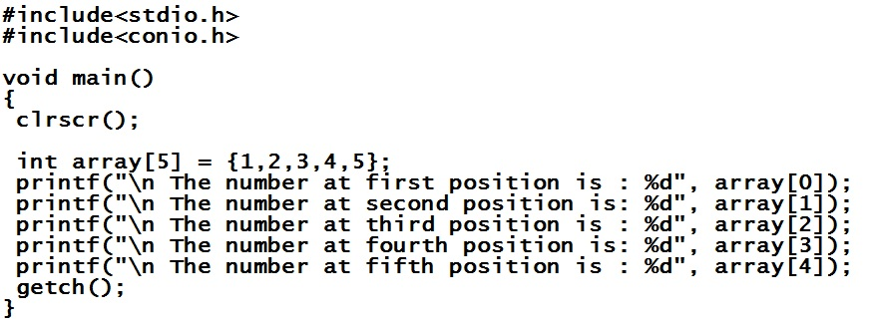
Array Example

Slide 14
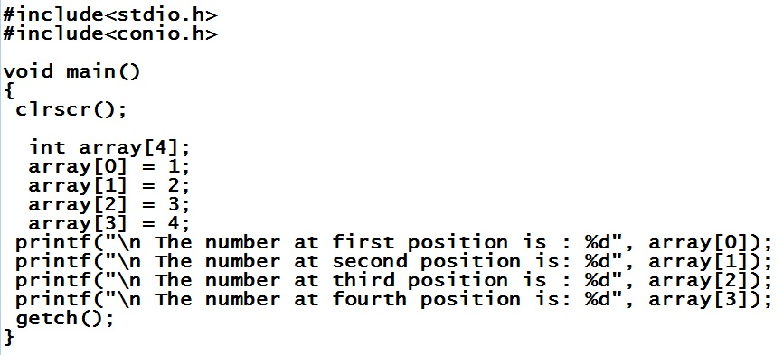
Array Example

Slide 15
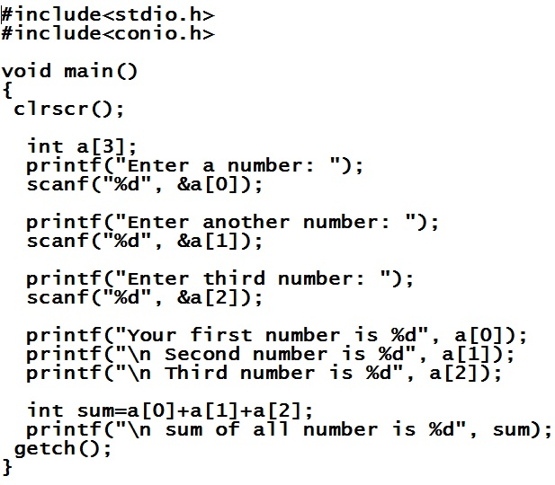
Array Example

Slide 16
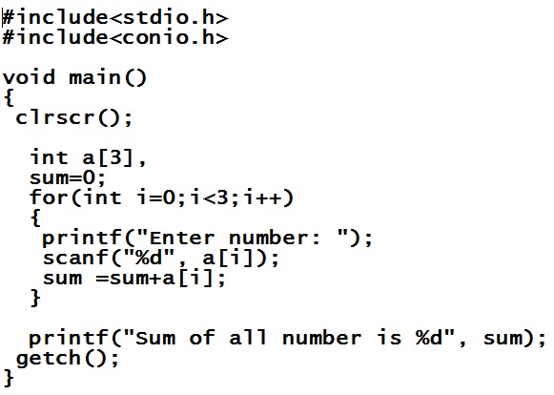
Array Example

Slide 17
Two-Dimensional/2D Arrays
The simplest and the most commonly used multi-dimensional array is the two - dimensional array
A two-dimensional array can be thought of as an array of two single dimensional arrays
A two-dimensional array looks like a railway time-table consisting of rows and columns
A two–dimensional array is declared as -
int temp[4][3];

Slide 18

Initialization of 2D Arrays
int ary[3][4] =
{1,2,3,4,5,6,7,8,9,10,11,12};
The result of the above assignment will be as follows :

Slide 19
Initialization of Multidimensional Arrays
int ary[3][4]=
{
{1,2,3},
{4,5,6},
{7,8,3}
};

Slide 20

Initialization of Multidimensional Arrays
The result of the assignment will be as follows :
A two - dimensional string array is declared in the following manner :
char str_ary[25][80];

Slide 21
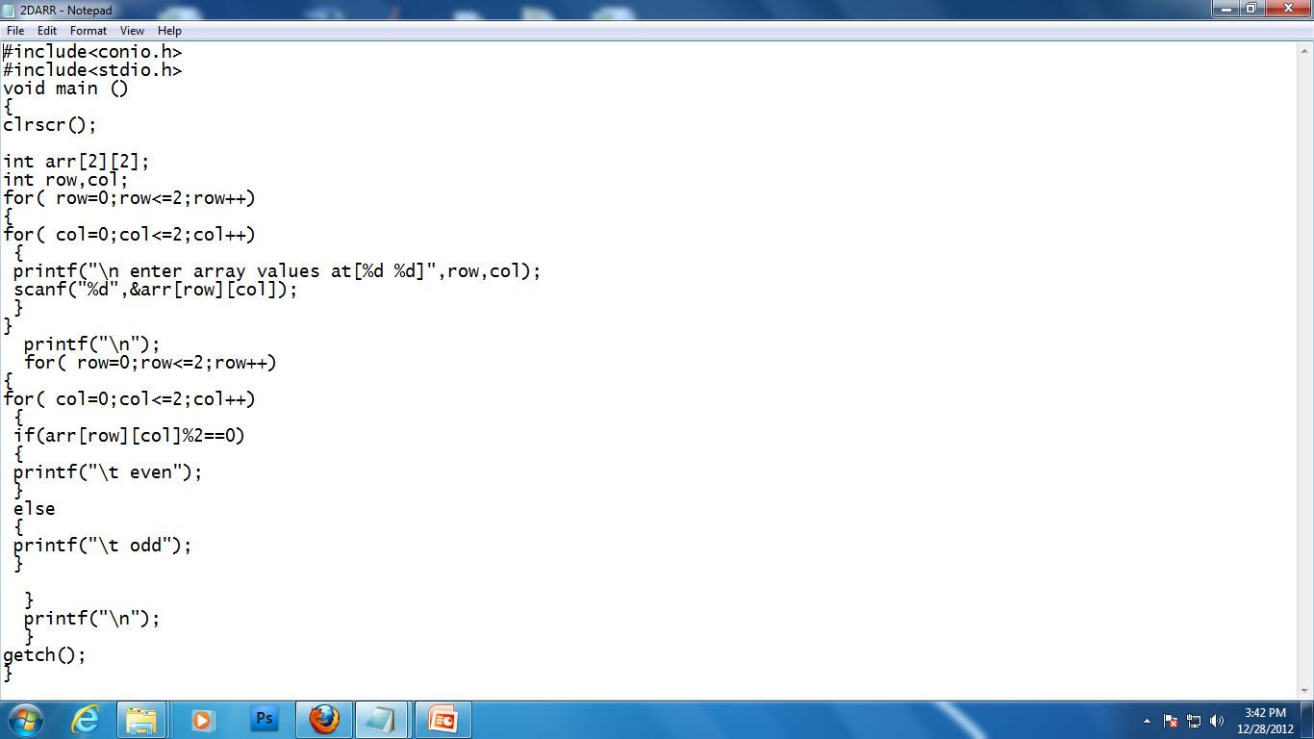
2D Array example

Slide 22
