Slide 1
Input/Output in C

Slide 2
Objectives
To understand formatted I/O functions -
scanf() and printf()

Slide 3
Standard Input/Output
In C, the standard library provides routines for input and output
The standard library has functions for I/O that handle input, output, and character and string manipulation
Standard input is usually the keyboard
Standard output is usually the monitor
Input and Output can be rerouted from or to files instead of the standard devices

Slide 4
The Header File <stdio.h>
#include <stdio.h>
This is a preprocessor command
stdio.h is a file and is called the header file
contains the macros for many of the input/output functions
used in ‘C’
printf(), scanf()functions are designed
such that, they require the macros in stdio.h for proper execution

Slide 5
<conio.h>
conio.h is a C header file used mostly by MS-DOS compilers to provide console input/output.

Slide 6
Formatted Input/Output
printf() – for formatted output
scanf() – for formatted input
Format specifiers specify the format in which the
values of the variables are to be input and printed

Slide 7
printf ()-1
used to display data on the standard output – console
Syntax→ printf ( “control string”, argument list);
The argument list consists of constants, variables, expressions
or functions separated by commas
There must be one format command in the control string for
each argument in the list
The format commands must match the argument list in
number, type and order
The control string must always be enclosed within
double quotes, which are its delimiters

Slide 8
printf ()-2
The control string consists of one or more
of three types of items:
Text characters:
consists of printable characters
Format Commands:
begins with a % sign and is followed by a format code -
appropriate for the data item
Nonprinting Characters:
Includes tabs, blanks and new lines

Slide 9
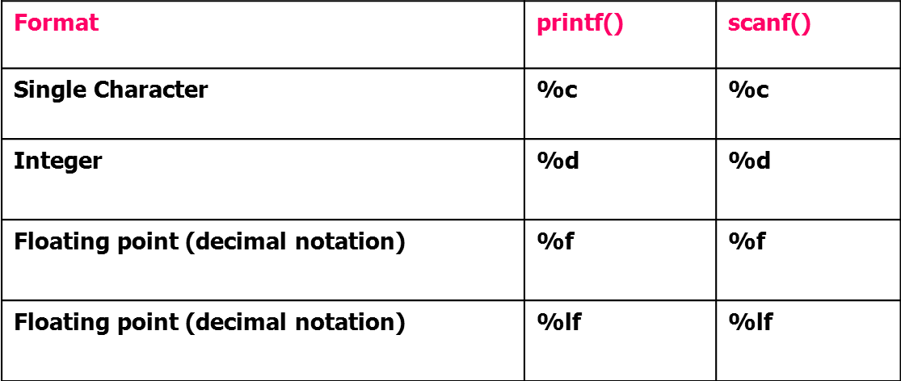
Format codes

Slide 10
scanf()
Is used to accept data
The general format of scanf() function
scanf(“control string”, argument list);
The format used in the printf() statement are used with the same syntax in the scanf() statements too

Slide 11
Differences in argument list of between printf() and scanf()
printf() uses variable names, constants , symbolic constants
and expressions
scanf() uses pointers to variables
When using scanf() follow these rules, for the argument list:
If you wish to read in the value of a variable of basic data type,
precede the variable name with a & symbol
When reading in the value of a variable of derived data type,
do not use a & before the variable name

Slide 12

Task:
Write a code that prints your name, your enrollment number and your institute’s name.

Slide 13
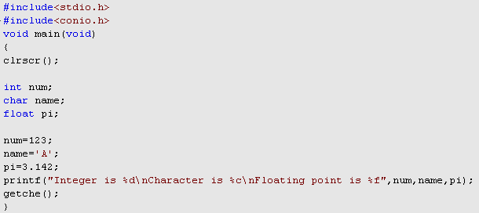
Try the given code

Slide 14
Tasks
Take 3 integers as input from user and print them on screen.
Take two integers from user and calculate their sum, difference, product and quotient. Also give the remainder of given integers.
Take radius of a circle as input from user and calculate its area and circumference.
Circumference = 2 • π • radius
Circle Area = π • r²

