Slide 1
Decision making in programming

Slide 2
Decision making with
-if else
-nested if else

Slide 3
The if-else statement allows conditional execution of a group of statements.
The if statement enables you to test for a condition and branch to different parts of your code, depending on the result.
The expression may consist of logical or relational operators like(> >= < <= && ||)

Slide 4
Syntax: The syntax of an if...else statement in C programming language is:
if(boolean_expression)
{ /* statement(s) will execute if the boolean expression is true */ }
else
{ /* statement(s) will execute if the boolean expression is false */ }

Slide 5
The general form of an if-else statement is
if (expression)
{
statement;
}
else
{
statement;
}

Slide 6
The if...else if...else Statement
An if statement can be followed by an optional else if...else statement, which is very useful to test various conditions using single if...else if statement.
When using if , else if , else statements there are few points to keep in mind:
An if can have zero or one else's and it must come after any else if's.
An if can have zero to many else if's and they must come before the else.
Once an else if succeeds, none of the remaining else if's or else's will be tested.

Slide 7
Syntax: The syntax of an if...else if...else statement in C programming language is:
if(boolean_expression 1)
{ /* Executes when the boolean expression 1 is true */ }
else if( boolean_expression 2)
{ /* Executes when the boolean expression 2 is true */ }
else if( boolean_expression 3)
{ /* Executes when the boolean expression 3 is true */ }
else { /* executes when the none of the above condition is true */ }

Slide 8
Nested if else
The statement means that one if else construct is a part of other. When an if else statement is the target of another if or else, it is said to be nested with in the outer if.

Slide 9
The general form of nested if-else statement is
if (expression)
statement;
else
if (expression)
statement;
else
if (expression)
statement;
……………………………………………………………………………………………………
else
statement;

Slide 10
Example
int year;
printf("Enter year: ");
scanf("%d",&year);
if
{
((year%4)==0&&(year%100)!=0||(year%400)==0)
printf("%d is leap year",year); }
else
{ printf("%d is not leap year",year);
}

Slide 11
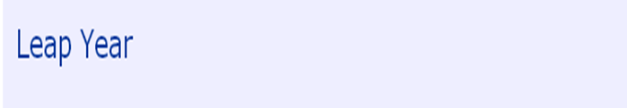
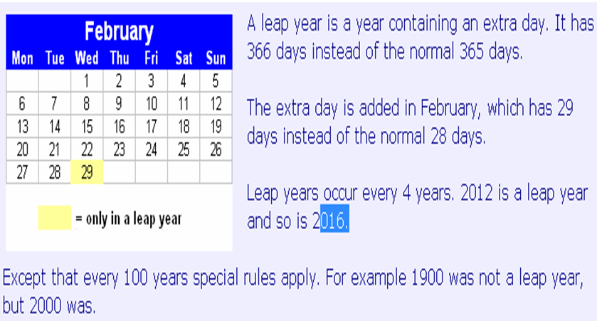

Slide 12
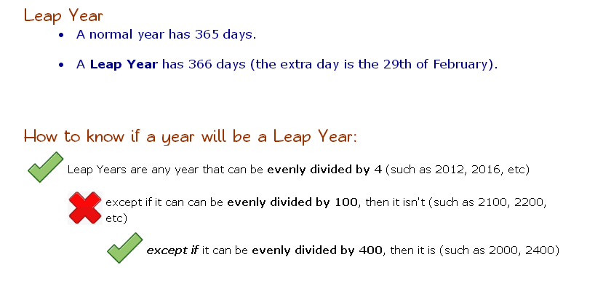

Slide 13
Switch Statement
The switch statement is C’s multiple selection statement. It is use to select one of several alternative paths in program execution.
A variable is successfully tested against a list of integer or character constants. When a match is found, the statement sequence associated with that match is executed.

Slide 14
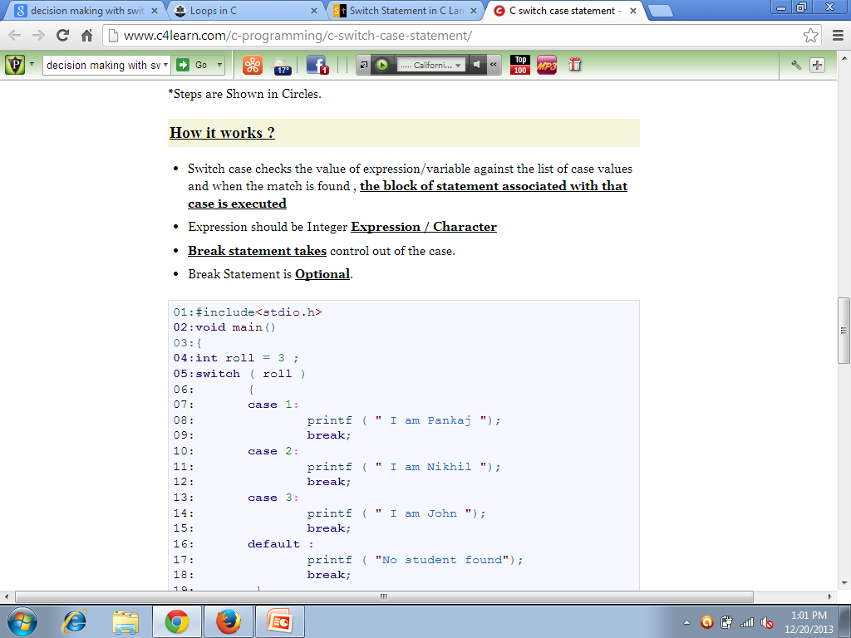
Working of switch statement

Slide 15
GENERAL SYNTAX
switch (variable)
{
case 1:
statement 1;
break;
case 2:
statement 2;
break;
case 3:
statement 3;
break;
default:
statement;
break;
}

Slide 16
Flow chart
start
case1
Statement 1
case2
Statement 2
case3
Statement 3
stop

Slide 17
switch (2)
{
case 1:
statement 1;
break;
case 2:
statement 2;
break;
case 3:
statement 3;
break;
}
statement N;

Slide 18
Lets have an example
{
int i;
printf(“Enter a number between 1 and 3:\n”);
scanf(“%d”,&i);
switch(i)
{
case 1:
printf(“one”);
break;
case 2:
printf(“two”);
break;

Slide 19
case 3:
printf(“three”);
break;
default:
printf(”number not found!”);
}
}

Slide 20
Output:
Enter a number between 1 and 3:
2
two
Enter a number between 1 and 3:
1
one
Enter a number between 1 and 3:
7
number not found

Slide 21
What will be the output of given code?
{
int i=2;
switch(i)
{
case 1:
printf(“I am in case 1\n”);
case 2:
printf(“I am in case 2\n”);
case 3:
printf(“I am in case 3\n”);
default:
printf(”I am in default!”);
}
}

Slide 22
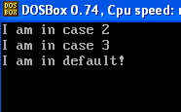

Slide 23
Output will be:
Why it is executing all the three statements?
And not only “I am in case 2”?
And why not printing “I am in case 1”?
I am in case 2
I am in case 3
I am in default!

Slide 24
loops
For
While
Do while

Slide 25
For loop
It is often the case in programming that you want to do something a fixed number of times.
E.g.:
Calculate the paycheck for 120 employees
Print the square of all the numbers from 1 to 50

Slide 26
Structure of for loop
The parentheses following the keyword contain what we’ll call the loop expression. this loop expression is divided by semicolons into three separate expression :
the initialize expression, the test expression, and the increment expression.
for(a=0;a<=10;a++)
printf(“a=%d\n”,a);

Slide 27
The initialize expression is always executed as soon as the loop is executed.
The second expression test each time through the loop to see if the condition is true or false.
The increment expression increments the variable each time the loop is executed.

Slide 28
The entire combination of the for keyword , the loop expression, and the statement constituting the body of the loop is considered to be a single c statement, thus ended with a semicolon.
Printing takes place before count is incremented by the ++ operator.

Slide 29
Formate specifier \t causes the next item printed to start eight spaces from the start of the last item.
for(n=32;n<256;n++)
printf(“%d=%c\t”n,n);

Slide 30
Nested for loop
for(rows=1; row<=10row++)
{
printf(“\n”);
for(cols=1;cols<=10;cols++)
printf(“%d\t”,cols*rows);
}

Slide 31
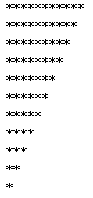
TASK
Write a for loop to print out the values 1 to 10 on separate lines.
Write a for loop which will produce the following output (hint: use nested for loops)
1
22
333
4444
55555
Write a program to execute this code?

Slide 32
The while loop
The while loop shines in situations where a loop may be terminated unexpectedly by conditions developing within the loop.
Initialization step is included in variable definition
int a=0;
The incrementing of the a variable can be seen in the printf() statement. As soon as a is printed it is incremented

Slide 33
While-loop
int main ()
{ /* local variable definition */
int a = 10; /* while loop execution */
while( a < 20 )
{
printf("value of a: %d\n", a);
a++;
}
return 0;
}

Slide 34
The do-while loop
This loop is very similar to the while loop. The difference is that in the do loop the test condition is evaluated after the loop is executed, rather than before.
Best use : any time you want to be sure the loop body is executed once.

Slide 35
int a=0;
int b=0;
do
{
b=b+a;
printf(“a=%d,b=%d\n”,a++,b);
}
While(a<10);

Slide 36
output
#include <stdio.h>
main()
{
int i;
i = 65;
do
{
printf("The numeric value of %c is %d.\n", i, i);
i++;
} while (i<72);
}
The numeric value of A is 65.
The numeric value of B is 66.
The numeric value of C is 67.
The numeric value of D is 68.
The numeric value of E is 69.
The numeric value of F is 70.
The numeric value of G is 71.

