Slide 1
Pointer in C

Slide 2
What is a Pointer?
A pointer is a variable, which contains the address of a memory location of another variable
If one variable contains the address of another variable, the first variable is said to point to the second variable
A pointer provides an indirect method of accessing the value of a data item
Pointers can point to variables of other fundamental data types like int, char, or double or data aggregates like arrays or structures

Slide 3
What are Pointers used for?
Some situations where pointers can be used are -
To return more than one value from a function
To pass arrays and strings more conveniently from one function to another
To manipulate arrays easily by moving pointers to them instead of moving the arrays itself

Slide 4
Pointer Variables
A pointer declaration consists of a base type and a variable name preceded by an *
General declaration syntax is :
type *name;
For Example:
int *var2;

Slide 5
Pointer Operators
There are 2 special operators which are used with pointers :
&
and
*
The & operator is a unary operator and it returns the memory address of the operand
var2 = &var1;
The second operator * is the complement of &. It is a unary operator and returns the value contained in the memory location pointed to by the pointer variable’s value
temp = *var2;

Slide 6
Assigning Values To Pointers
Values can be assigned to pointers through the & operator.
ptr_var = &var;
Here the address of var is stored in the variable ptr_var
It is also possible to assign values to pointers through another pointer variable pointing to a data item of the same data type
ptr_var = &var;
ptr_var2 = ptr_var;

Slide 7
Assigning Values To Pointers
Variables can be assigned values through their pointers as well
*ptr_var = 10;
The above declaration will assign 10 to the variable var if ptr_var points to var

Slide 8

Pointer Arithmetic
Addition and subtraction are the only operations that can be performed on pointers
Let us assume that var is stored at the address 1000
Then ptr_var has the value 1000 stored in it. Since integers are 2 bytes long, after the expression “ptr_var++;” ptr_var will have the value as 1002 and not 1001

Slide 9
Pointers Notation
Consider the declaration.
int i=3;
This declaration tells the C compiler to:
Reserve space in memory to hold the integer value.
Associates the names i with this memory location.
Store the value 3 at this location.

Slide 10
We can represent I’s location in memory by the following memory map.
Location Name
i
66524
3
Value At location
Location number

Slide 11
Pointer
Pointer operator available in C is ‘ * ‘,called value at address operator. It gives the value stored at a particular address. The value at address operator is also called “indirection operator”

Slide 12
#include<stdio.h>
int main()
{ int x;
int *ptr_p;
x = 5;
ptr_p = &x;
*ptr_p = 10;
printf("value of x =%d\n", x);
}
OUTPUT
Value of x is 10
Note: First the ptr_p contains the address of the integer x (ptr_p = &x). Then we change the value of the integer where ptr_p is pointing to (*ptr_p = 10;). The integer x now equals ten.

Slide 13
main()
{
int i=3;
printf(“\nAddress of i=%u”,&i);
printf(“\n value of i=%d”,i);
printf(“\n value of i=%d”,*(&i));
}
The output is:
Address of i=66524
Value of i=3
Value of i=3
main()
{
int i=3
Printf(“\nAddress of i=%u”,&i);
Printf(“\n value of i=%d”,i);
}
The output is:
Addess of i=66524
Value of i=3

Slide 14
#include<stdio.h>
int main()
{
int x,y;
int *ptr_p;
x = 5;
ptr_p = &x;
y = *ptr_p;
printf("value of y %d\n", y);
}
Output:
Value of y is 5
Note: The integer x has a value of five. The pointer ptr_p gets the address of integer x. The value pointed to is *ptr_p. (in this case five). So the integer y now contains the value of five.

Slide 15
Program
#include<stdio.h>
#include<conio.h>
void main(void){
clrscr();
int i=54;
int *ptr;
ptr=&i;
printf("Value of i= %d \n address of i=%x ",i,&ptr);
getch();
}

Slide 16
Counting the number of vowels in a string using pointers
void main()
{
char *ptr; \\ declare a character pointer variable.
char word[10];
int i,vowcnt=0;
printf(“\nEnter a word:”);
scanf(“%s”,&word);
ptr=&word[0]; \\ Assign the characters pointers to the string
for(i=0;i<strlen(word);i++)
{
if((*ptr==‘a’)||(*ptr==‘e’)||(*ptr==‘i’)||(*ptr==‘o’)||(*ptr==‘u’)||(*ptr==‘A’)||
(*ptr==‘E’)||(*ptr==‘I’)||(*ptr==‘O’)||(*ptr==‘U’))
vowcnt++;
ptr++;
}
printf(“\nThe word is:%s\nThe number of vowels in the word is:%d”,word,vowcnt);
}

Slide 17
OUTPUT
Enter a word: Consonants
The word is consonants
The number of vowels in the word is :3

Slide 18
#include <stdio.h>
int main()
{
int my_variable = 6, other_variable = 10;
int *my_pointer;
printf("the address of my_variable is : %p\n", &my_variable);
printf("the address of other_variable is : %p\n", &other_variable);
my_pointer = &my_variable;
printf("\nafter \"my_pointer = &my_variable\":\n");
printf("\tthe value of my_pointer is %p\n", my_pointer);
printf("\tthe value at that address is %d\n", *my_pointer);
my_pointer = &other_variable;
printf("\nafter \"my_pointer = &other_variable\":\n");
printf("\tthe value of my_pointer is %p\n", my_pointer);
printf("\tthe value at that address is %d\n", *my_pointer);
}

Slide 19
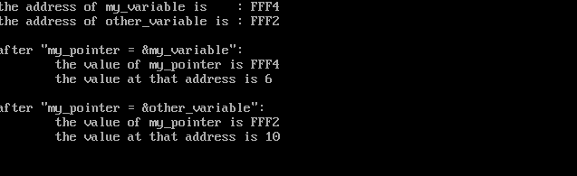
Output

Slide 20
#include<stdio.h>
int main(void)
{
char *p1 = "Himanshu";
char *p2 = "Arora";
char *p3 = "India";
char *arr[3];
arr[0] = p1;
arr[1] = p2;
arr[2] = p3;
printf("\n p1 = [%s] \n",p1);
printf("\n p2 = [%s] \n",p2);
printf("\n p3 = [%s] \n",p3);
printf("\n arr[0] = [%s] \n",arr[0]);
printf("\n arr[1] = [%s] \n",arr[1]);
printf("\n arr[2] = [%s] \n",arr[2]);
}
Note: In the above code, we took three pointers pointing to three strings. Then we declared an array that can contain three pointers. We assigned the pointers ‘p1′, ‘p2′ and ‘p3′ to the 0,1 and 2 index of array.

Slide 21
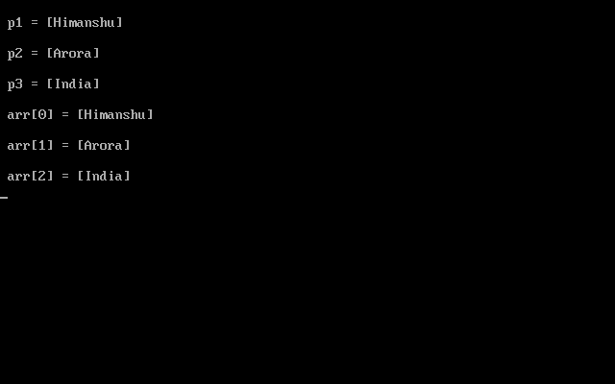
OUTPUT

Slide 22
Structure program using pointer
#include<conio.h>
#include<stdio.h>
struct book{
char name[25];
char auth[25];
int callno;
};
void main()
{
clrscr();
struct book b1={"Let us C","YPK",101};
struct book *ptr;
ptr=&b1;
printf("\n %s %s %d",b1.name,b1.auth,b1.callno);
printf("\n %s %s %d",ptr->name,ptr->auth,ptr->callno);
getch();
}
NOTE:Structure pointer member can also be accessed
using -> operator.
(*ptr).name is same as ptr->name
(*ptr).auth is same as ptr->auth
(*ptr).callno is same as ptr->callno

