Slide 1

Session 2
Variables and Data Types

Slide 2

Understanding Data Types in Dart
Data Type | Keyword
Numbers | int, double, num
Boolean | bool
Strings | String
List | List
Map | Map
Constants | const
Dynamic | dynamic
Var | var
Variables are utilized in programming to hold values used in a program.
A data type is a categorization that determines
which type of value a variable can hold.
Mathematical, logical, and relational operations can be utilized on the created variable.
In clearer terms, a data type defines the kind of operations that can be performed upon variables.

Slide 3
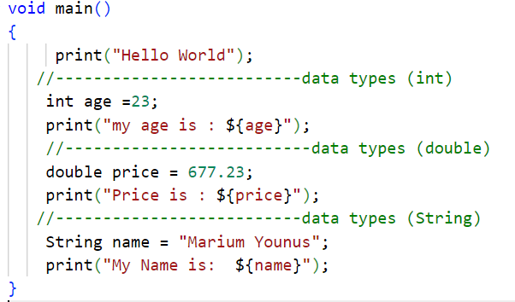
Understanding Data Types in Dart
Note : You can use ${} to interpolate the value of Dart expressions within strings. The curly braces can be omitted when evaluating identifiers:
const string = 'dartlang'; print('$string has ${string.length} letters');

Slide 4
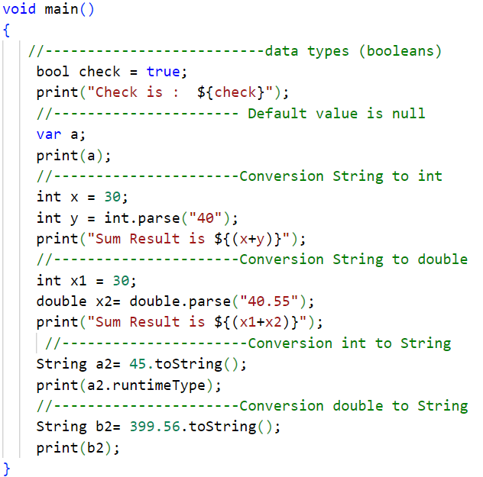
Data Type Conversion in Dart

Slide 5
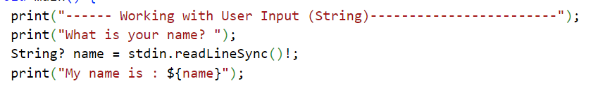
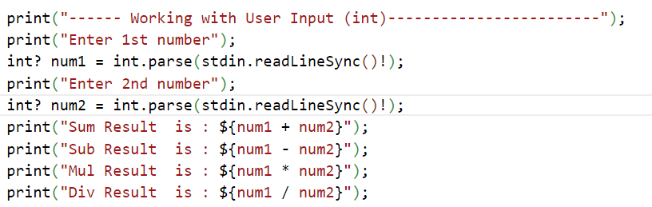
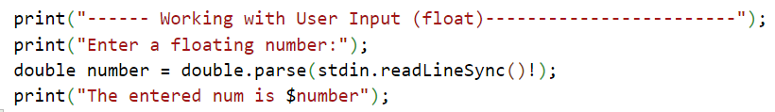
User Input using stdin.readLineSync()

Slide 6

Numbers
The number data type holds a numeric value.
It is categorized into two types: integer and double.
Integer represent a whole number and is declared using the int keyword. Double represents a 64-bit floating number and is declared using the
double keyword.
Example for int:
int price
Example for double:
double total
= 450;
= 899.90;

Slide 7
String and Boolean
String
Boolean
The string data type represents the concatenation of several characters.
The variable value will be encased either in single or double quotes.
The String keyword has to be used to declare a string variable.
The boolean data type can either hold a value of true or false.
Boolean data is mostly used in decision-making statements.
The bool keyword has to be used to declare a boolean variable.
String name = “Alexander”;
bool value = false;

Slide 8
List
The list data type is utilized to represent a list of entities using a single variable.
The list can only hold an ordered group of items.
Fixed Length List | Variable Length List
This kind of list cannot be changed or modified at runtime. | This specific list is one that can be altered or modified at runtime.
var marks = List.filled(2,0); marks[0] = 72; marks[1] = 63; | var marks = [10,20]; marks.add(72); marks.add(63);

Slide 9
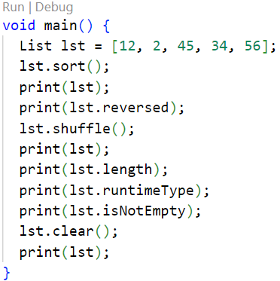
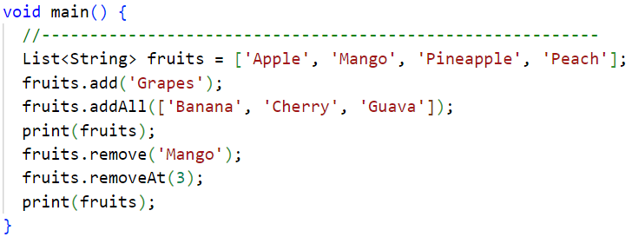
Program

Slide 10
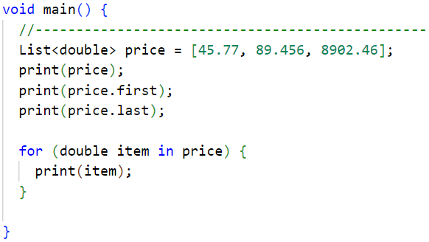
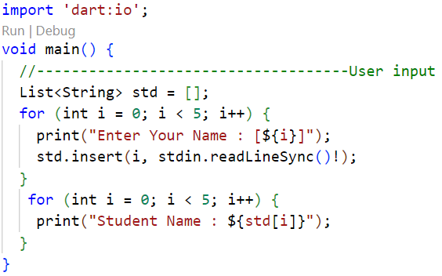
User input

Slide 11

Map
The map data type is utilized to represent data in key and value form.
The item stored in this particular type can only be accessed using the associated key provided for the map object.
The key-value pairs are stored inside curly braces {} and separated from other key- pairs using commas.
HashMap, LinkedHashMap, and SplayTreeMap are the commonly used map types.

Slide 12
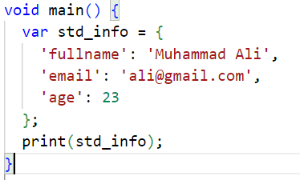
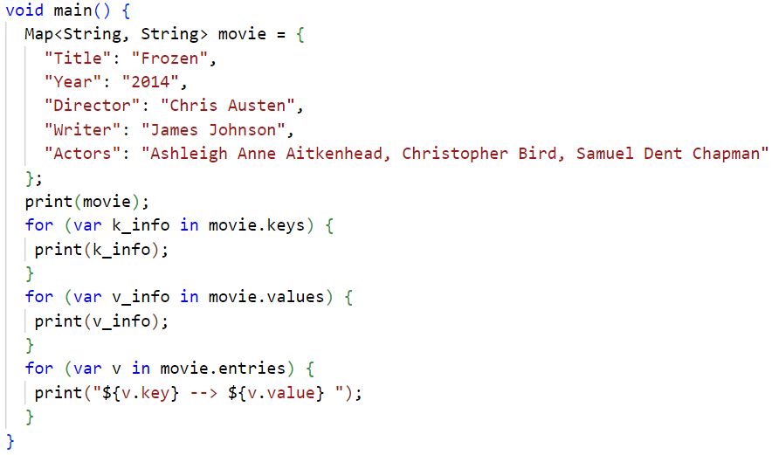
Program

Slide 13
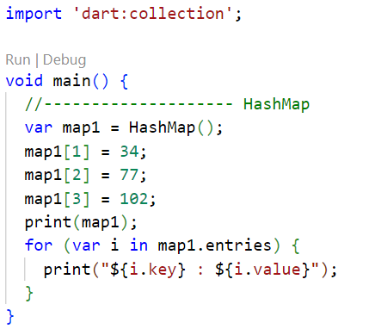
HashMap
A hash table based implementation of Map.

Slide 14
Arrays
An array is one of the most commonly used data types to represent a collection of data in Dart.
Arrays are represented using lists in Dart.
A list is a collection of elements of the same data type.
An element in a list can be accessed using its index number.
● D
Identifier | Index | Value
my_array | 0 | 10
 | 1 | 14

Slide 15
Dynamic and Constants
dynamic const
final
The dynamic keyword, as the name indicates, is dynamic in nature and chooses not to be initialized with a value at declaration time.
The final keyword is used to hardcode the values of the variable and it cannot be altered in future.
The const keyword in Dart behaves exactly like the final keyword.
dynamic value =
100.05;
final name =
‘Felix’;
const pi = 3.14;

Slide 16
Variables in Dart
Upon creation of a variable in Dart, some space is allotted for that particular variable by the Dart compiler.
var
Keywords for declaring variables
string
dynamic
int
final
double
const

Slide 17
Creating a Variable Using the var Keyword
Developers can use the var keyword for assigning variables in Dart.
The Dart compiler will infer the type of data assigned based on the value given with the var
keyword.
void main(){
var name = &#39;dan&#39;; var number1 = 10;
var number2 = 5.5; print(name); print(number1); print(number2);
void main(){
var tocheckerror =
‘alexa’;
tocheckerror = 5;
}
}

Slide 18
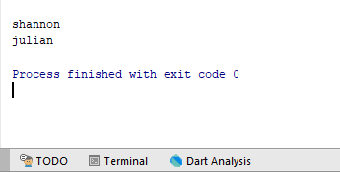
Creating a Variable Using the String Keyword
The String keyword is utilized for assigning a string data type to a variable.
A string represents a chain of individual characters.
It is practical to declare the variable as a string and then assign a certain value accordingly.
void main(){
String name = ‘shannon’;
print(name); name = ‘julian’; print(name);
}

Slide 19
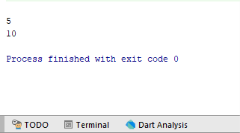
Creating a Variable Using the int Keyword
Variables declared using the int keyword represent a non-decimal number that can be either
a positive or a negative number.
It is feasible to declare a variable as an int and assign the respective value to it.
void main(){ int num1 = 5; print(num1); num1 = 10; print(num1);
}

Slide 20
Creating a Variable Using the dynamic Keyword
Variables declared using the dynamic keyword do not have any predefined data type.
The assigned value for a dynamic variable can be modified or altered at any juncture.
void main(){
dynamic name = ‘rubel’;
void main(){
dynamic changingdatatype = 5.5;
print(changingdatatype); changingdatatype = ‘jimmy’; print(changingdatatype);
}
dynamic | number1 | = | 10;
dynamic | number2 | = | 5.5;
print(name); print(number1); print(number2);
}

Slide 21
Creating a Variable Using the final Keyword
The final keyword is utilized for the creation of immutable objects in Dart.
The variable with the final keyword is utilized when the user wants to always store the same value and does not want it to change.
An important fact to keep in mind is that the value assigned to a final variable
cannot be modified once it is assigned.
void main(){
final name = David; print(name);
}
void main(){
final name = David;
name = ‘sam’;
}

Slide 22
Creating a Variable Using the const Keyword
The const keyword is utilized to let the user know that the value stored in the variable is
constant and cannot change during program execution.
If the value for the said variable is known at compile-time, then const can be used over final.
The only difference between the final and const keyword is that final is a runtime-constant, which in turn means that its value can be assigned at runtime instead of compile-time.
void main(){
const name = ‘Sylvia’; name = ‘sam’; print(name);
}
void main(){
const name = ‘Sylvia’;
print(name);
}

Slide 23
Summary
A data type in Dart determines the value a specific variable can hold. This enables any mathematical, logical, or relational operation to be performed on the variable while avoiding errors in code.
When a variable is declared in Dart, memory is assigned for that variable. The value of that variable is stored in this memory location and can be modified through execution.
The data type for any variable dictates the memory size, space allocation, and the value the particular variable tends to hold.
The type annotation in Dart helps to add a data type before the name while declaring a
variable.
The prefix or data type warrants the fact that the variable holds the assigned data type.

