Slide 1

Session 3
Operators and Control Flow Statements

Slide 2
Session Overview
Define operators
Explain the various operators
Outline the usage of operators
Define control flow statements in Dart
Explain the various control flow statements in Dart
Define decision-making statements in Dart
Explain the various decision-making statements in Dart
Define looping statements in Dart
Explain the various looping statements in Dart
Illustrate jump statements in Dart
List the various jump statements in Dart

Slide 3


Different Types of Operators
Arithmetic operators
Relational operators Assignment operators
Logical operators Conditional operators
<
%
<

Slide 4
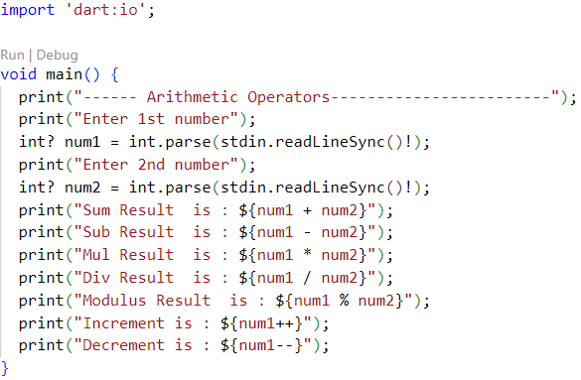
Arithmetic Operators
Addition
Decrement
Subtraction
Arithmetic Operators
Increment
Multiply
Modulus
Division

Slide 5
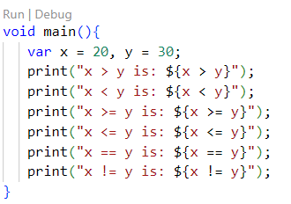
Relational Operators
Relational operators
Greater than
Greater than or equal to
Equal to
Less than or equal to
Not equal to
Less than

Slide 6
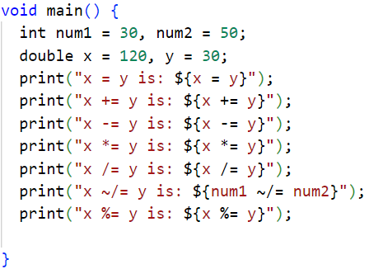
Assignment Operators
=
Assignment operator
+=
Add and assign
-=
Subtract and assign
*=
Multiply and assign
/=
Divide and assign
~/=
Divide and assign (integer)
%=
Mod and assign

Slide 7
Conditional Operators
Code Snippet 1:
void main()
{
var n1= 10; var n2 = 15; var n3 = null;
var result = n1 >n2 ? n1 : n2; print(result);
var result1 = n3 ?? n2; print(result1);
}
Condition ? Expression1 : Expression2
Expression1 ?? Expression2

Slide 8

Logical Operators
Code Snippet 2:
void main()
{
int a=5; int b=7;
AND ➔ &&
OR ➔ ||
bool c = a > 10 && b < 10; print(c);
bool d = a > 10 || b < 10; print(d);
Not ➔ !
bool e = !(a>10); print(e);
}

Slide 9
Control Flow Statements
These statements change the flow of control as and when required.
Decision-making statements
Looping statements
Jump statements

Slide 10






Decision-making Statements [1-3]
if
These statements decide which block of statements has to be executed based on given conditions.
if-else
Types
if-else-if
switch

Slide 11
Decision-making Statements [2-3]
Code Snippet 3:
int num=5; if (num>0) {
print(‘Number is positive’);
}
Code Snippet 4:
int num=0; if (num>0) {
print(‘Number is positive’);
}
else {
print(‘Number is not positive’);
}

Slide 12
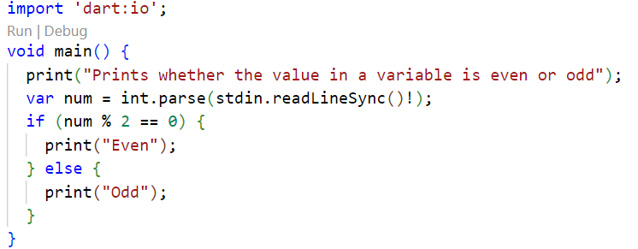
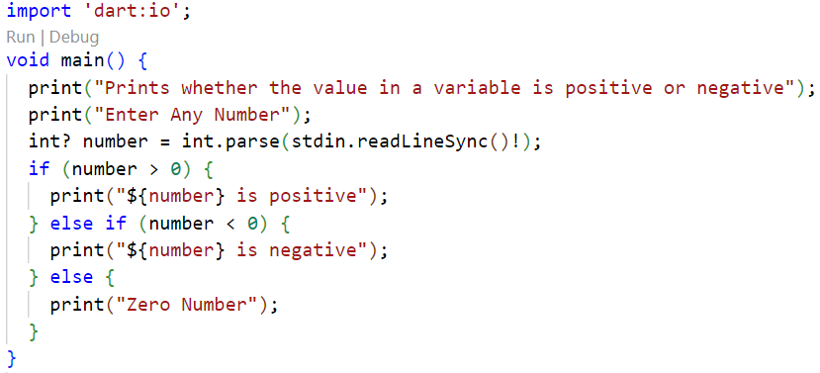
Program

Slide 13
Decision-making Statements [3-3]
Code Snippet 6:
Code Snippet 5:
int num=-5;
if (num>0) {
print(‘Number is positive’);
}
else if(num == 0) {
print(‘Number is zero’);
}
else {
print(‘Number is negative’);
}
var grade=‘B’; switch(grade) {
case ‘A’: { print(‘Excellent’); } break;
case ‘B’: break; | { | print(‘Good’); | }
case ‘C’: | { | print(‘Fair’); | }
break;
case ‘D’: | { | print(‘Poor’); | }
break;
default: | { | print(‘Excellent’);
break;
}
}
}

Slide 14






Looping Statements [1-3]
Types
These statements are used for executing a set of statements multiple times.
for
for...in
while
do while

Slide 15
Looping Statements [2-3]
Code Snippet 7:
int num=1;
for(num; num<=10;num++){ print(num);
}
Code Snippet 8:
var list = [10,20,30,40,50];
for(var i in list) {
print(i);
}

Slide 16
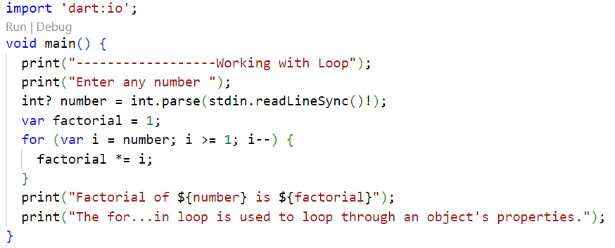
Factorial Program for

Slide 17
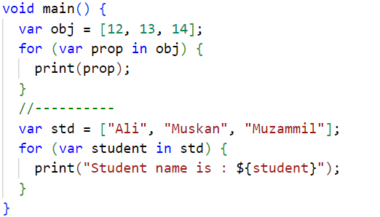
Program using for in

Slide 18
Looping Statements [3-3]
Code Snippet 9:
Code Snippet 10:
var a = 1;
var n = 10;
var num = 5;
do {
while(a<num) {
print(n);
print(a);
n--;
a=a+1;
} while(n>=0);
}

Slide 19
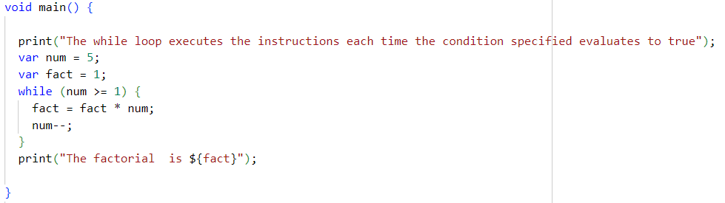
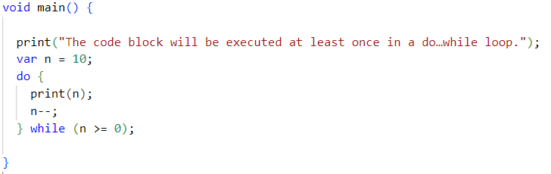
Program While and Do-While

Slide 20
Jump Statements [1-2]
break
These statements transfer the execution of the program from the current statement to another statement.
continue

Slide 21
Jump Statements [2-2]
Code Snippet 12:
Code Snippet 11:
var count = 0;
print(‘Dart break statement’); while(count<=10) {
count = count + 1; if(count == 5) {
break;
}
print(‘Inside loop ${count}’);
}
print(‘Out of while loop’);
var num = 0;
print(‘Dart continue statement’); while( num < 10) {
num = num + 1; if( num == 5) {
print(‘5 is skipped’); continue;
}
print(‘Number is ${num}’);
}
print(‘Out of while loop’);

Slide 22
Summary
Depending on the type of operator, actions can be performed on operands. For example, in an arithmetic operator, an addition operator (+) would add operands whereas a subtraction operator (-) would subtract one operand from the other.
A control statement allows smooth flow of the program. In Dart, statements inside the code are generally executed sequentially, from top to bottom, within the order that they appear.
One may not want to execute the code sequentially each time. Instead, one might want to skip a certain set of instructions or execute a code repeatedly.
Depending on the scenario, a code can be written with a control flow statement by using decision- making statements, looping statements, or jump statements.
All three statements or either of them can be used depending upon the scenario and also depending on the logic being built.

