Slide 1

Session 4
Object-Oriented Programming in Dart

Slide 2
Session Overview
Explain an overview of OOP concepts in Dart.
Describe various types of methods in Dart.
Elaborate on classes, objects, inheritance, polymorphism, interfaces, and abstraction.
Explain constructors in Dart.
Outline the purpose of the this, static, and super keywords in Dart.

Slide 3
OOP Approach
Classes and Objects
Inheritance Abstraction Polymorphism
Encapsulation

Slide 4
Classes and Objects
Classes are user-defined data types that describe the characteristics of an entity.
A class combines both data members and member functions. An instance of a class is defined as an object.
Syntax for defining a class:
class ClassName {
}
Syntax for creating objects:
ClassName ObjectName = ClassName();

Slide 5
Instance and Class Variables
Instance Variables | Class Variables
These are class variables that are accessed using instances of the class. | These are static variables that are declared inside the class.
Each instance of the class can have a different value of the instance variable. | A class variable has only one value and is shared by all objects of the class.
The value is retained till the object is active. | The value termination. | is | retained | till | the | program
Example: class NewClass{ int counter; } | Example: class NewClass{ static int counter; }

Slide 6
Methods [1-2]
They are declared using the static keyword.
These methods are not accessed using objects.
Class Methods
Syntax:
static Returntype methodname(arguments)
{
//statement
}
These methods are accessed only using objects of the class.
They can be accessed within the class also using the this keyword.
Syntax:
Returntype methodname(arguments)
{
//statement body
}
Instance Methods

Slide 7
Methods [2-2]
Code Snippet 1:
class Student {
var name = "Adelina”;
static void printName(name){
print(name);
}
}
void main(){ Student.printName("Eliza");
}
Code Snippet 2:
class Student {
var name = "Adelina";
void printName(name){
print(name);
}
}
void main(){
Student im = new Student(); im.printName("Julia");
}

Slide 8
Getter and Setter Methods
Code Snippet 3:
Syntax:
class Employee { late String eName; String get ename {
return eName;
}
set ename(String name) {
this.eName = name;
}
}
void main() {
Employee emp = new Employee(); emp.ename ='Jeff';
print("Employee name Is : ${emp.ename}");
}
Getter Method
returntype get fieldname{
}
Syntax:
Setter Method
set fieldname(value)
{
}
In Dart, we use the late keyword to declare variables that will be initialized later.

Slide 9
Inheritance
Syntax:
class ParentClass{
...
}
//single level inheritance
class ChildClass1 extends ParentClass
{
...
}
// multi level inheritance
class ChildClass2 extends ChildClass1
{
...
}
A class can inherit the properties and methods of another class.
The main class that has properties and methods is called the parent class.
The class that inherits the parent class is called the child class.

Slide 10
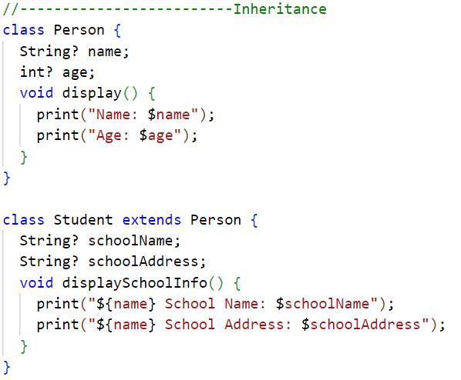
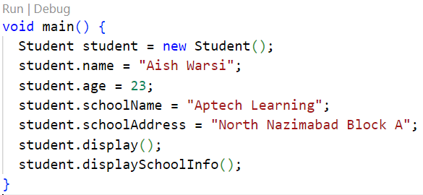
Program1

Slide 11
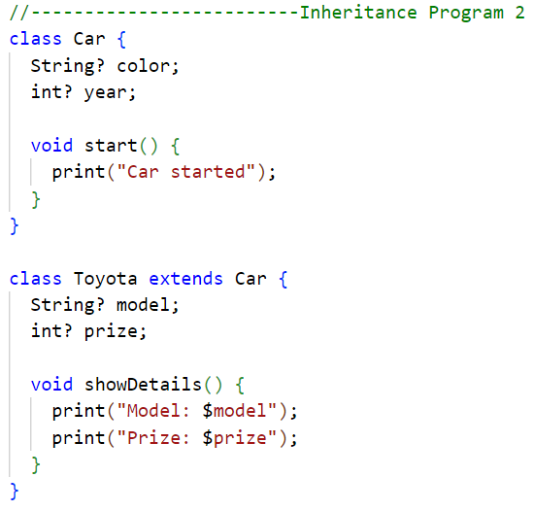
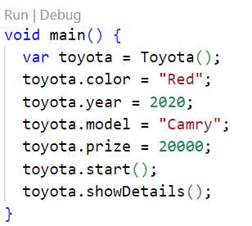
Program2

Slide 12
Encapsulation
Encapsulation can be achieved by:
Declaring the class properties as private by using underscore(_).
Providing public getter and setter methods to access and update the value of private property.
Getter and setter methods are used to access and update the value of private property. Getter methods are used to access the value of private property. Setter methods are used to update the value of private property.
Note: Dart doesn’t support keywords like public, private, and protected. Dart uses _ (underscore) to make a property or method private. The encapsulation happens at library level, not at class level.

Slide 13
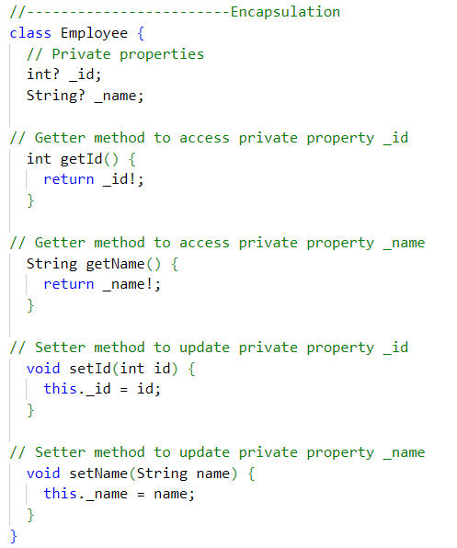
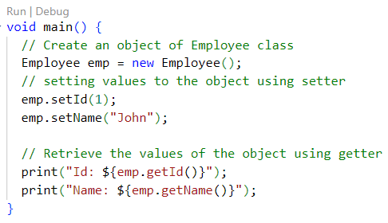
Program

Slide 14
Polymorphism
Syntax:
 |  | class ParentClass{
 |  | void parentMethod(){
 |  | //do something
 |  | }
 |  | }
 |  | class ChildClass extends
 |  | ParentClass{
 |  | @override
 |  | void parentMethod(){
 |  | //do something more
 |  | }
 | }
Polymorphism refers to one object having many forms.
The existing features of a parent class are modified in the child class.
Polymorphism is achieved using method overriding.
Dart classes do not support constructor overloading

Slide 15
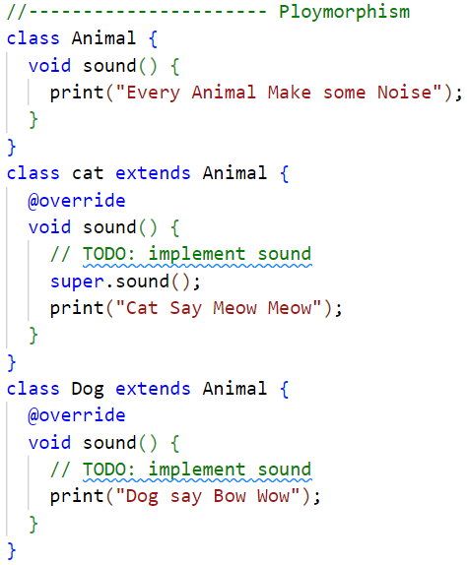
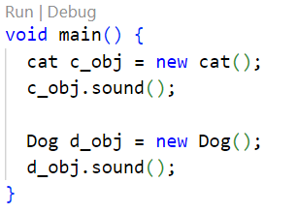
Program

Slide 16

Abstraction
Abstraction means hiding unnecessary information.
Abstract classes are created using the abstract keyword.
Syntax:
abstract class MainClass{
void abstractPrintMethod();
}
class ImplementationClass implements MainClass{
@override
void abstractPrintMethod(){
//do something
}
}

Slide 17
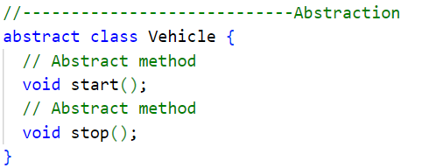
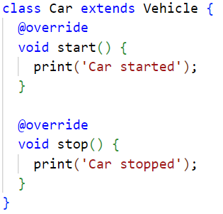
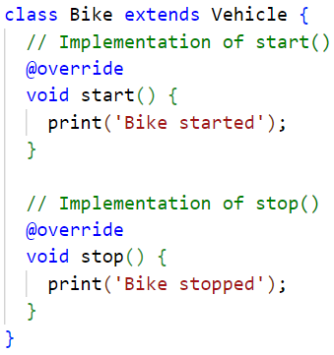
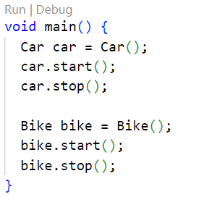
Program

Slide 18
Interfaces
Abstract declaration of methods is provided in an interface.
Every class implicitly defines an interface.
class ClassName{
...
Returntype Method(){
//some functionality
}
}
All the methods of an inherited class must be re-defined.
class ClassName implements InterfaceClassName
{
...
@override Returntype Method(){
//different functionality than that
//which was defined in parent class
} }

Slide 19
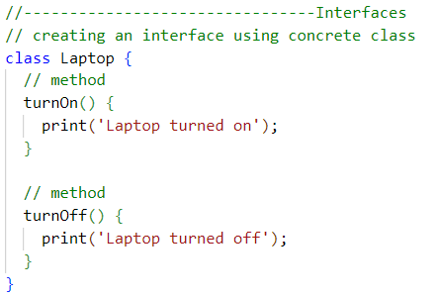
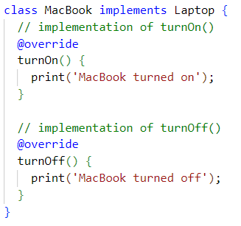
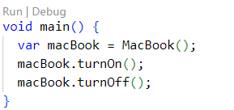
Program

Slide 20
Constructors [1-2]
A constructor is a special method used to initialize objects. It has the same name as a class.
A constructor is automatically called when an object is created.
Default constructors have no parameters. Parameterized constructors take variables as arguments.
A named constructor is used to create multiple constructors with different names in the same class.

Slide 21
Constructors [2-2]
Code Snippet 4:
class Student{ Student(){
print("Default Constructor");
}
Student(String name){ print("Student name is: ${name}");
}
Student.namedConst(String branch){ print("Branch name is: ${branch}");
void main() {
Student | std1 | = | new Student();
Student | std2 | = | new Student("Ray");
Student | std3 | = | new
Student.namedConst("Computer
Science");
}

Slide 22
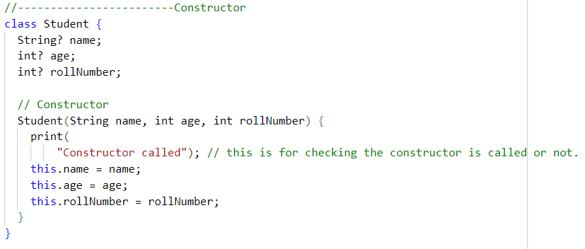
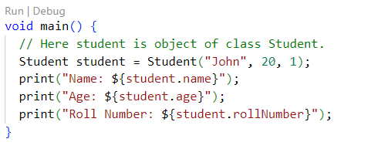
Program
https://dart-tutorial.com/object-oriented-programming/constructor-in-dart/

Slide 23
The this Keyword
The this keyword refers to the current class object.
It helps to remove ambiguity when the class variable and parameters have the same name.
class Student
{
var stid;
Student(var stid)
{
this.stid = stid;
print("Dart this keyword Example"); print("Student ID is : ${stid}");
}
}
Code Snippet 5:
void main()
{
Student s1 = new Student('101');
}

Slide 24
The super Keyword
The super keyword is used to refer to parent class properties or methods when both the parent and child class have the same method or property name.
Code Snippet 6:
class ParentClass {
String subject = "Example of Super Keyword";
}
class SubClass extends ParentClass { String subject = "Science";
void showMessage(){ print(super.subject);
print("$subject has ${subject.length} letters.");
}
}
void main(){
SubClass myClass = new SubClass(); myClass.showMessage();
}

Slide 25
Summary
Object-oriented programming is a programming approach based on four pillars: inheritance, polymorphism, abstraction, and encapsulation.
In OOP, everything is treated as an object. OOP enforces security and generalization in a program.
In the Dart programming language, a method is a block of code that is defined inside a class and runs only when called.
Methods divide a large task into small parts and perform a specific program operation. This increases the reusability of code and enhances the program's approach.
Getter and setter methods in Dart are used for getting and setting a value. The getter method is used to get, read, or retrieve the class fields whereas the setter method is used to set, write, or initialize the class fields.
Constructors are used when an object is created in the program. They have the same name as the class and are often used to initialize values.
Classes have their default constructor that is created by the compiler during the execution of the program, but the user can create custom constructors for a class. If the user creates his/her own constructor, the default constructor will be ignored. Constructors must not have a return type.

