Slide 1

Session 5
Collections and Exceptions in Dart

Slide 2
Session Overview
Define a collection and its usage
Explain types of collections in Dart
Outline exceptions in Dart
Explain exception handling in Dart
Elaborate on errors in Dart

Slide 3

Collections
Collections are used for storage, retrieval, and communication of mass data.
Collections are a group of classes and interfaces that are highly optimized data structures.
The dart:core library is imported using the
import keyword to add collections to a Dart script.

Slide 4
Types of Collections
List
LinkedList
LinkedHashSet
Set
LinkedHashMap
Map
Nested Collections
HashSet
Collection-if
HashMap
Collection-for

Slide 5
List
Fixed Length List
Growable Length List
Code Snippet 1:
void main() {
List list1 = List.filled(2, []); list1[0] = 50;
list1[1] = 100; print(list1);
}
Specifying size is not mandatory during initialization.
Size is specified during initialization.
Code Snippet 2:
void main() {
var newlist = [10,20,30,40,50]; newlist.add(60); print(newlist);
}
Size can be modified at runtime.
Size cannot be modified later.

Slide 6
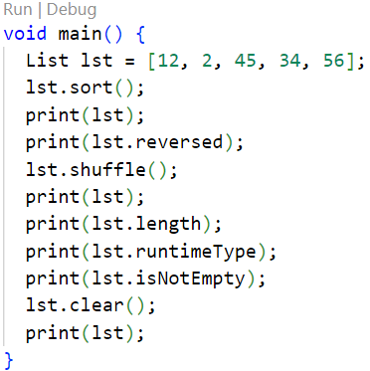
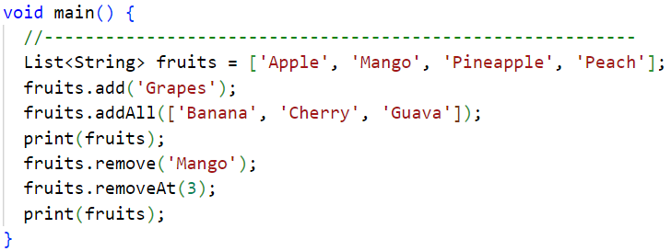
Program

Slide 7
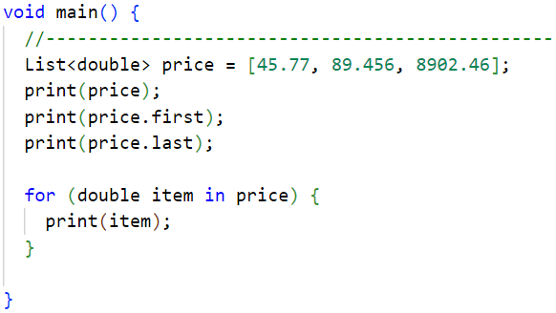
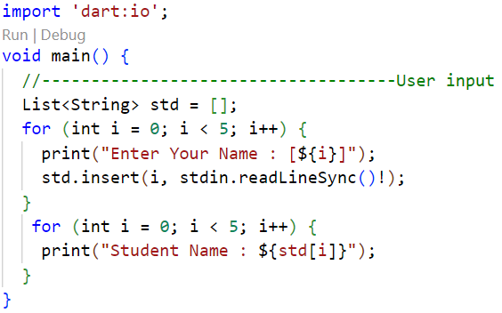
User input

Slide 8
Set and Map
A set is a unique, unordered collection of different values of the same data type.
Code Snippet 3: | } | s.add(30); s.add(40); s.add(40); print(s);
void main() { Set s = new Set(); s.add(10); s.add(20);
Code Snippet 4:
var userdetails = {'email' : 'jack@gmail.com' ,
'Password' : '12345'}; print(userdetails);
Code Snippet 5:
var details = new Map(); details['username'] = 'ron'; details['password'] = '1234'; print(details);
A map is a dynamic collection of all kinds of data types.
Data is stored in the form of key-value pairs, in which keys should be unique.

Slide 9
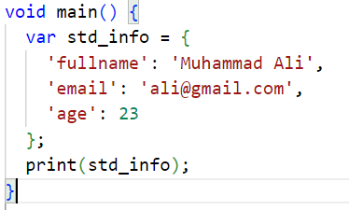
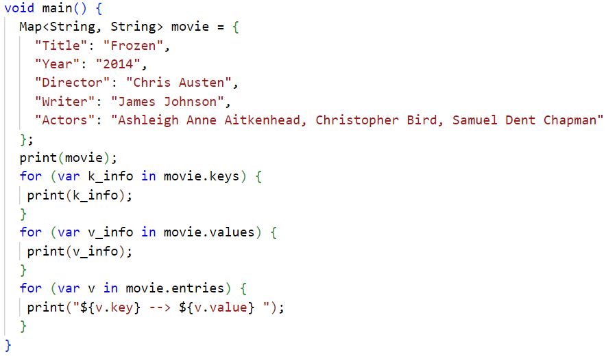
Program

Slide 10
HashSet and HashMap [1-2]
HashSet is a hash table that has an unordered set implementation.
HashMap is a hash table map implementation that is unordered. HashSet and HashMap are provided in the dart:collection
library.
In both these collections, the order of retrieving may not be the same as the order in which they are inserted.

Slide 11
HashSet and HashMap [2-2]
Code Snippet 6: HashSet
import 'dart: collection'; void main() {
Set numbers = new HashSet(); numbers.add(10); numbers.add(20); numbers.add(30); numbers.add(40); numbers.add(50); print(numbers);
}
Code Snippet 7: HashMap
import 'dart: collection’;
void main() {
Map details = new HashMap();
details['name'] = 'dan’; details['email'] = 'dan@gmail.com'; details['number'] = 'xxxxxxxxx’;
print(details);
}

Slide 12
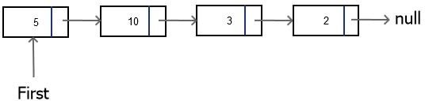
LinkedList
A LinkedList is a sequential data structure.
Code Snippet 8:
import 'dart:collection';
class Items extends LinkedListEntry<Items> { final int id;
final String name; Items(this.id, this.name); @override
String toString(){ return '$id : $name';
}
}
void main() {
final linkedList = LinkedList<Items>(); linkedList.addAll(
[Items(1, 'jon'), Items(2, 'natalia'), Items(3, 'dina')]);
print(linkedList);
}
A LinkedList is unidirectional.
A LinkedList supports faster insertions and removal of elements.

Slide 13
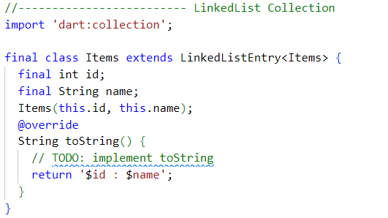
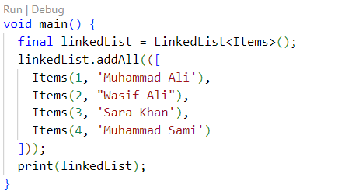
Program

Slide 14
LinkedHashMap and LinkedHashSet
Both these data structures execute data in the same order as they are inserted.
While LinkedHashSet can store only one null value, LinkedHashMap can store one null key with multiple null values.
Code Snippet 9: LinkedHashMap
import 'dart:collection';
void main() {
var l1 = new LinkedHashMap(); l1['1'] = 'Alice';
l1['2'] = 'Bob';
l1['3'] = 'Cindy';
l1['4'] = 'Alex';
print(l1);
}
Code Snippet 10: LinkedHashSet
import 'dart:collection'; void main() {
var l1 = new LinkedHashSet(); l1.add('dan');
l1.add('rony');
l1.add('sam');
print(l1);
}

Slide 15
Collection-if and Collection-for
Collection of objects can be checked for certain conditions using an if statement.
Collection-if
Collection of objects can be iterated using
for and foreach loops.
Collection-for
Code Snippet 12: | } | for(var v in l1){ print(v); } if(l1[0] < l1[1]){ l1[0] = l1[0] + 10; print(l1[0]); }
import 'dart:collection';
void main() {
List l1 = new List();
l1.add(10);
l1.add(20);
l1.add(30);
l1.add(40);

Slide 16
Exception Handling [1-2]
Every exception that occurs should be handled so that the program does not terminate abruptly.
All exceptions in Dart are a sub-type of the Exception class.
The code that can cause exceptions is written in the try
block.
The on block is coded to handle a specific exception while the catch block is coded when a handler requires a generic Exception object.
The code that has to be executed irrespective of exception occurrence is given in the finally block.
This block is coded after the try-catch/on block.
try- catch/on block
finally
block
throw
clause
The developer can raise an exception explicitly using the
throw keyword.
This exception should also be handled.

Slide 17
Exception Handling [2-2]
Code Snippet 13:
void main() { int a = 5; int b = 0; int res;
try {
res = a~/b;
}
on IntegerDivisionByZeroException {
print('Cannot divide by zero');
} finally{
print('Finally block executed');
}
}
Code Snippet 14:
void main() {
void checkAge(int age) { if(age<0) {
throw new FormatException();
}
}
try {
checkAge(-10);
}
catch(e) {
print('Age cannot be negative');
}
}

Slide 18
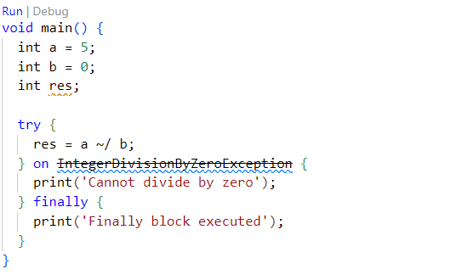
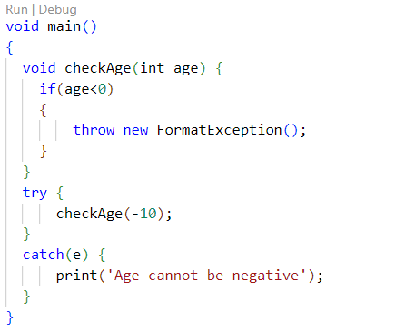
Program

Slide 19
Built-in Exceptions
DefferedLoadException
FormatException IntegerDivisionByZeroException IOException
Timeout

Slide 20

Errors
Errors | Exceptions
Errors may occur due to lack of system resources. | Exceptions occur due to application code.
Errors that occur at runtime are not known by the compiler. | Exceptions may or may not be caught by the compiler.
Errors are unchecked. | Exceptions can be checked or unchecked.
Errors occur when there is an unexpected problem that can be fixed by the programmer.
Some syntax check,
examples are errors, null of
and use
invalid methods.

Slide 21
Summary
A collection is an entity that represents a group of elements that can be of any data type.
The dart:core library enables support for collections in Dart and can be appended to the Dart script using the import keyword.
Collections are utilized to store, retrieve, and communicate mass data. They represent data items that form a natural cluster such as a mail folder (assortment of letters) or a directory (a mapping of names to phone numbers).
An exception is an abnormal condition that disrupts the natural rhythm of execution in a program. It may occur during execution time (runtime).
When an exception is raised, it stops other parts of the program as well. Hence, Dart has a methodology to handle such conditions by utilizing exception handlers. This is called as exception handling.

