Slide 1

Session 8
JSON in Dart

Slide 2
Session Overview
Identify JSON in Dart.
Elaborate on the structure of a JSON document.
Explain encoding and decoding of JSON objects.

Slide 3
JSON
JavaScript Object Notation (JSON) is a text-based open standard designed and developed for data interchange that is human-readable.
JSON files have .json
as extension.
Applications use JSON parsing to fetch data from the Internet.

Slide 4
JSON Parsing
Write JSON parsing codes manually
Automate the process
of code generation
Encoding and decoding JSON
json_serializable
Parsing JSON to Dart code using a factory constructor
Freezed
Serializing back to JSON
Data validation Defining type-safe model
class

Slide 5
Structure of JSON Document
File
product_data.json
Code Snippet 1:
{
"productName": "Suit", "brand": "Armani", "reviews": [
{
"rating": 4.5,
"review": "Superb brand!"
},
{
"rating": 5.0,
"review": "Amazing fabric and look!"
}
]
}

Slide 6
Data Types in JSON
Data Types | Description
String | Surrounded by quotation marks (" ")
Number | Integer or any numeric data type
Float | Double (decimal number)
Array | JSON array
Object | JSON object (can be nested)
Boolean | True or false
Empty | Null

Slide 7
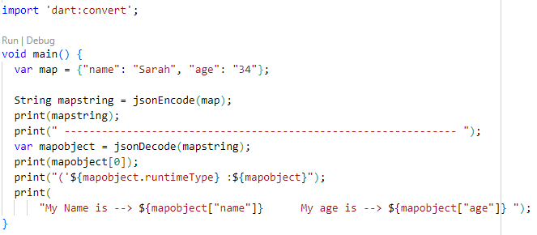
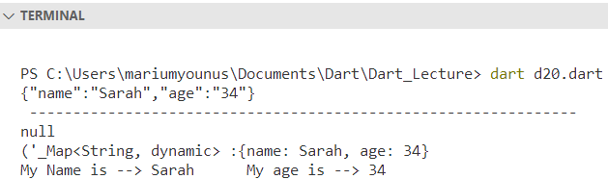
Encoding & Decoding of JSON in Dart
-- To send JSON data over the network, it first needs to be Encoded or Serialized.
-- Encoding is the process of turning a data structure into a string.
-- The opposite process is called Decoding or Deserialization.

Slide 8
Parsing JSON to Model Class & Factory Constructor
A Factory constructor will return an already created object instead of creating a new instance.
This improves memory and performance.
JSON parsing is done using Factory
constructor.

Slide 9
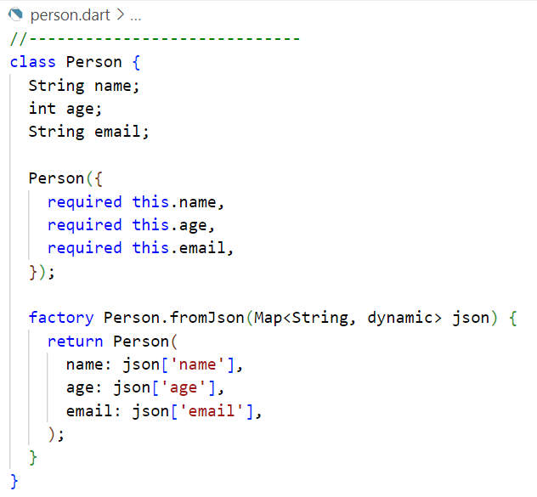
Parsing JSON to Model Class
Create a Dart class representing the model:

Slide 10
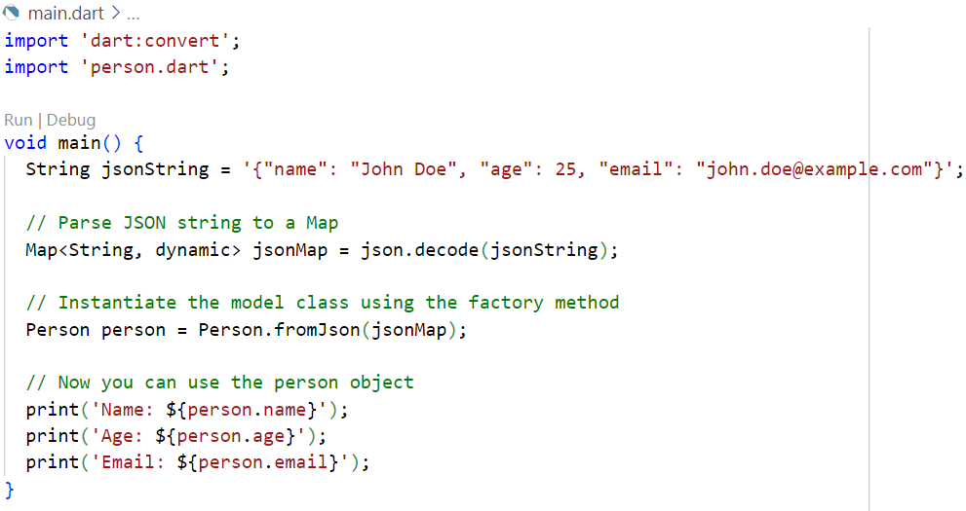
Next, use the json library to parse the JSON string into a Map and then instantiate the model class:
Let's assume you have a JSON structure like this:

Slide 11
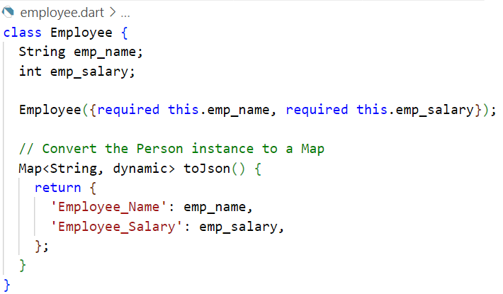
Serialization with toJson()
The toJson() method is used to convert a model object back to JSON data.

Slide 12
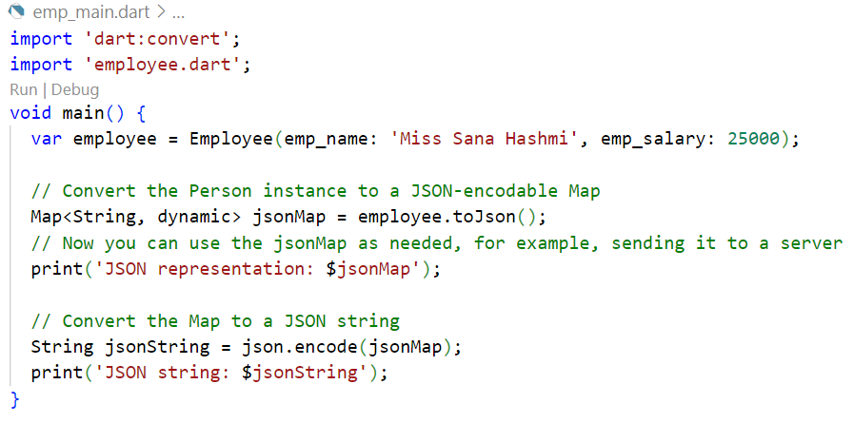
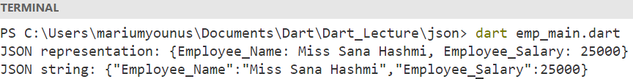

Slide 13
Summary
JSON also called 'JavaScript Object Notation', is a lightweight text-based open standard that is designed and developed for human- readable data interchange.
JSON has been derived from JavaScript and it is a language-independent data format. Support for it is included in many modern programming languages such as Dart, to generate and parse JSON-format data.
JSON data can contain both maps of key-value pairs using ({}) and lists using ([]) separated by a colon (:). Each key-value pair is
separated by a comma (,).
JSON data must be encoded or serialized before sending it over the network. This process of manipulating data structure into a string is called encoding.
When JSON data is received as a string from the network, it must be decoded or deserialized. This process of deserializing the data is called decoding.
JSON parsing is done using a Factory constructor and it allows users to create variables and perform validations before the result is returned.

