Slide 1
CSS Gradients

Slide 2
Linear Gradients (goes down/up/left/right/diagonally)
Radial Gradients (defined by their center)

Slide 3


Slide 4
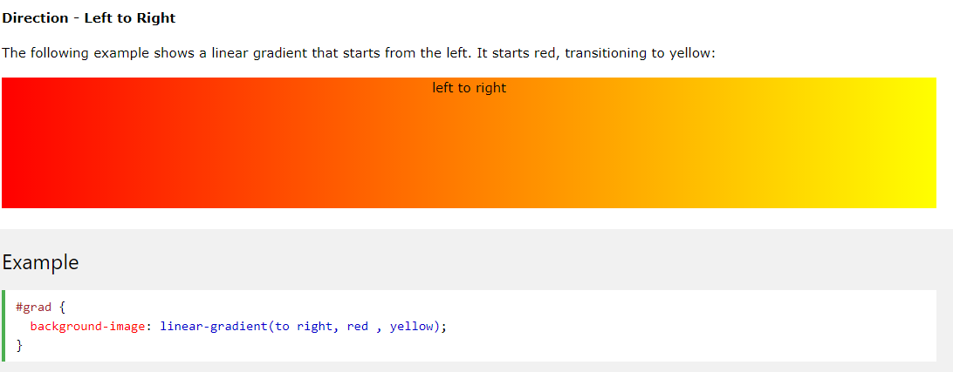

Slide 5
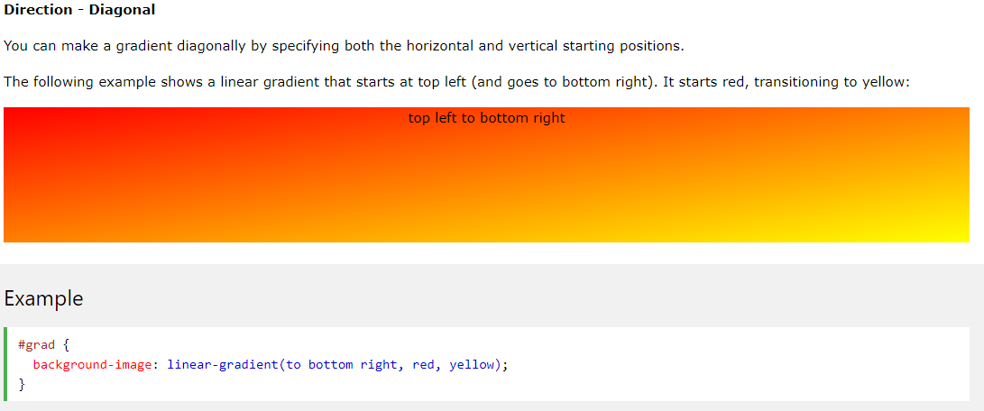

Slide 6
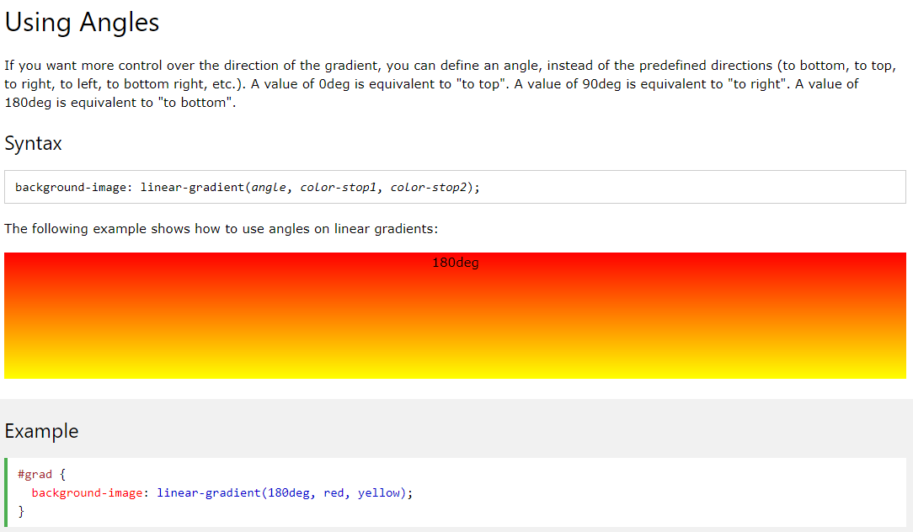

Slide 7
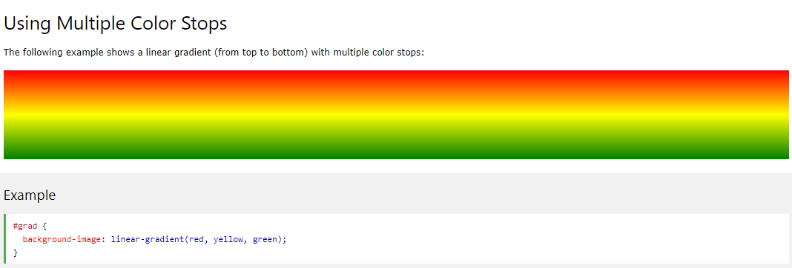

Slide 8
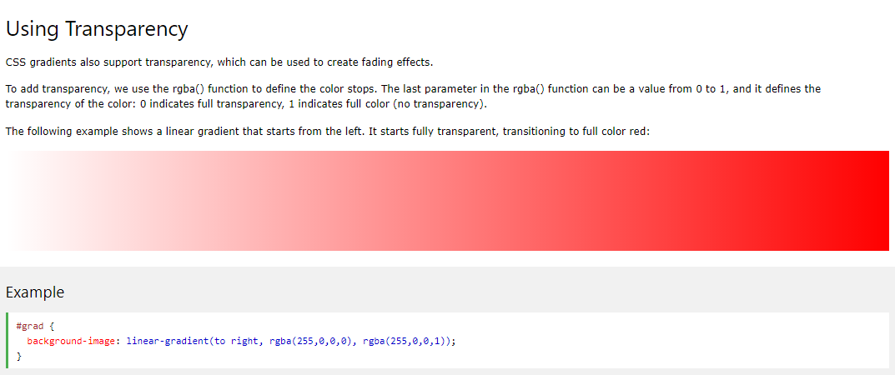

Slide 9
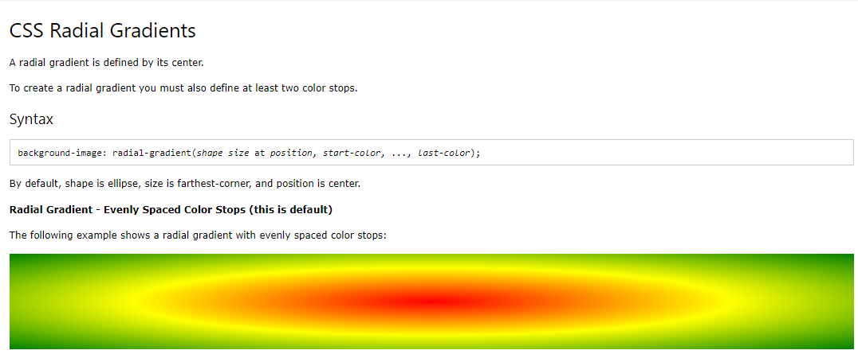

Slide 10


Slide 11
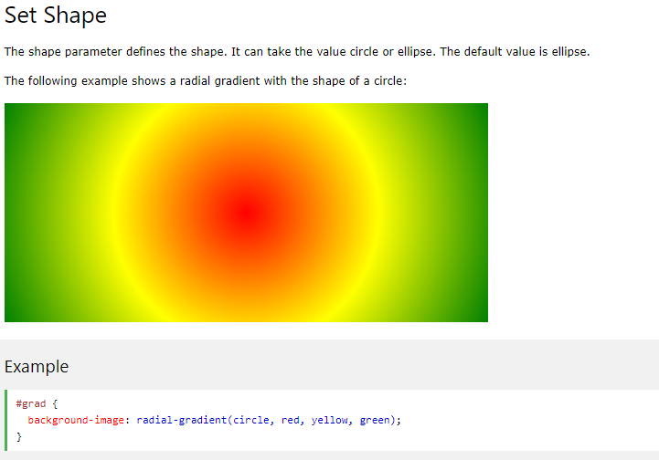

Slide 12
