Slide 1
<DIV>
It is a block-level element.
The <div> tag defines a division or a section in an HTML document.
The <div> tag is used to group block-elements to format them with CSS.
The <div> element is very often used together with CSS, to layout a web page
You can’t have <DIV> inside a paragraph.

Slide 2
<SPAN>
It is an inline-level element.
The <span> tag is used to group inline-elements in a document.
The <span> tag provides no visual change by itself.
The <span> tag provides a way to add a hook to a part of a text or a part of a document.
The <SPAN> tag can be inside <P> or <DIV> tags.

Slide 3
<SPAN>
<p>
My mother has <span style="color:blue">Blue </span> eyes.
</p>
My mother has Blue eyes.

Slide 4
DISPLAY PROPERTY
CSS allows you to control how a given element is displayed using the DISPLAY property.
Value | Description
None | The element will generate no box at all
2. Block | The element will generate a block box ( a line break before & after the element)
3. Inline | The element will generate an inline box (no line break before or after the element). This is default.
4. Inherit | Specifies that the value of the display property should be inherited from the parent element.

Slide 5
BOX MODEL

Slide 6
BOX MODEL
The CSS box model represents every element on a Web page in a bounded box which contains four components:
Content : The content of the box, where text and images appear.
Padding :an envelope of padding around the element.
Border :a border around the padding, which demarcates the visible area of the element.
Margin :a margin around the border.

Slide 7
BOX MODEL: CONTENT
CONTENT
This is any HTML element.
It could be paragraph, table, image , list etc

Slide 8
BOX MODEL:
Margin
BORDER
PADDING
CONTENT
Each element has a border around it & padding is the distance between the box boundaries and its content.

Slide 9
1.BORDER

Slide 10
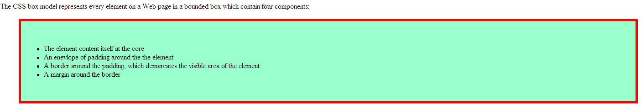
1.BORDER PROPERTIES
The CSS border properties allow you to specify the style and color of an element's border.
border-width
border-style
border-color

Slide 11
i. border-style
Sets the style of the four borders
Value | Description
none | Specifies no border
dotted | Specifies a dotted border
dashed | Specifies a dashed border
solid | Specifies a solid border
double | Specifies a double border
groove | Specifies a 3D grooved border. The effect depends on the border-color value
ridge | Specifies a 3D ridged border. The effect depends on the border-color value
inset | Specifies a 3D inset border. The effect depends on the border-color value
outset | Specifies a 3D outset border. The effect depends on the border-color value

Slide 12
Individual sites
border-top-style : dotted; border-right-style : solid; border-bottom-style : dotted; border-left-style : solid;
Shorthand property
border-style: top right bottom left;

Slide 13
ii. border-width
Set the width of the border.
The "border-width" property works with "border-style”.
Value | Description
thin | Specifies a thin border
medium | Specifies a medium border. This is default
thick | Specifies a thick border
length | Allows you to define the thickness of the border

Slide 14
Individual sites
border-top-width : thick; border-right-width : thin; border-bottom-width: medium; border-left-width : 5px;
Shorthand property
border-width: top right bottom left;

Slide 15
iii. border-color
Set the color of the border.
Value | Description
color_name | Specifies the border color with a color name, like red
hex_number | Specifies the border color with a hex code, like #ff0000
rgb_number | Specifies the border color with an RGB code, like rgb(255,0,0)

Slide 16
Individual sites
border-top-color : red; border-right-color: blue; border-bottom-color: green; border-left-color : cyan;
Shorthand property
border-color: top right bottom left;

Slide 17
Border - Shorthand property
Border : width style color;

Slide 18
Individual border sites
Property | Description | Values
border-bottom | Sets all the bottom border properties in one declaration | border-bottom-width border-bottom-style border-bottom-color
border-left | Sets all the left border properties in one declaration | border-left-width border-left-style border-left-color
border-right | Sets all the right border properties in one declaration | border-right-width border-right-style border-right-color
border-top | Sets all the top border properties in one declaration | border-top-width border-top-style border-top-color

Slide 19
2.OUTLINES

Slide 20
Outlines
An outline is a line that is drawn around elements, outside the border edge.
The outline properties specifies the style, color, and width of an outline.

Slide 21
Property | Description | Values
outline | Sets all the outline properties in one declaration | outline-color outline-style outline-width
outline-color | Sets the color of an outline | color_name hex_number rgb_number invert
outline-style | Sets the style of an outline | none dotted dashed solid double groove ridge inset outset
outline-width | Sets the width of an outline | thin medium thick length

Slide 22
3.MARGIN

Slide 23
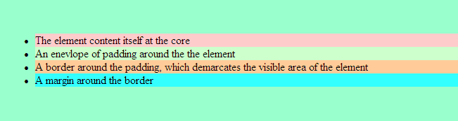
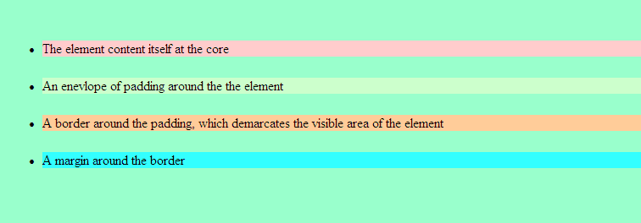
MARGIN
Without Margin: The list items are closed to one another
With Margin of 25px at bottom: The list items are separated from one another from bottom having distance of 25px

Slide 24
MARGIN
Margin defines the distance between HTML tags.
It doesnot have a background color.
margin:100px;

Slide 25
Individual sites
margin-top: 12px; margin-right: 10px; margin-bottom : 13px; margin-left : 5px;
Shorthand property
margin: top right bottom left;

Slide 26
4.PADDING

Slide 27
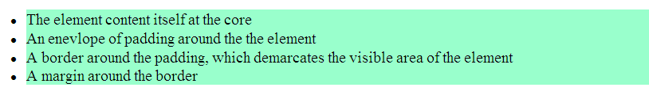
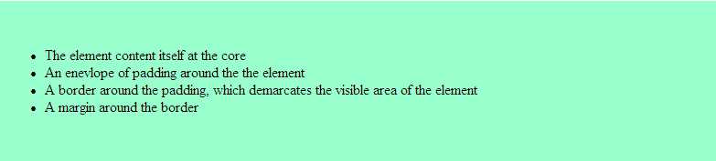
PADDING
Without Padding: The list is starting closed with the border
With Padding = 50px: The list is 50 pixels away from the border

Slide 28
Padding
Padding is the space between the border and the content.
The padding is affected by the background color of the element.
padding:25px;
all four paddings are 25px
padding:25px 50px;
top and bottom paddings are 25px
right and left paddings are 50px

Slide 29
Individual sites
padding-top: 12px; padding-right: 10px; padding-bottom : 13px; padding-left : 5px;
Shorthand property
padding: top right bottom left;

