Slide 1
Code igniter
Workshop

Slide 2
CodeIgniter Workshop Outline
CodeIgniter Fundamentals
CodeIgniter Introduction
Installation and setting up CodeIgniter
Architecture , overview and routing
CodeIgniter Fundamentals – MVC
MVC Framework Introduction
Working with Controller and Views using Helper Classes
Creating a model
Creating the users controller and creating a user model method
Fundamentals – Database –Query Builder
Learn to use “Query Builder” https://www.codeigniter.com/user_guide/database/query_builder.html
Inserting data https://www.codeigniter.com/user_guide/database/query_builder.html#inserting-data
Updating Data Deleting Data https://www.codeigniter.com/user_guide/database/query_builder.html#updating-data
Reading Data https://www.codeigniter.com/user_guide/database/query_builder.html#selecting-data
Reading / Finding with Constraints More ways to retrieve data

Slide 3

Introduction
CodeIgniter is a free, open-source, easy-to-use, object-oriented PHP web application framework, providing a ready-to-use library to use with your own PHP applications.
For example, there is a Database API to make it easier and more convenient to execute SQL queries, such as SELECT, UPDATE, DELETE, INSERT, etc., without having to create a lot of repetitive code yourself. This is how an application framework is useful in application development.

Slide 4
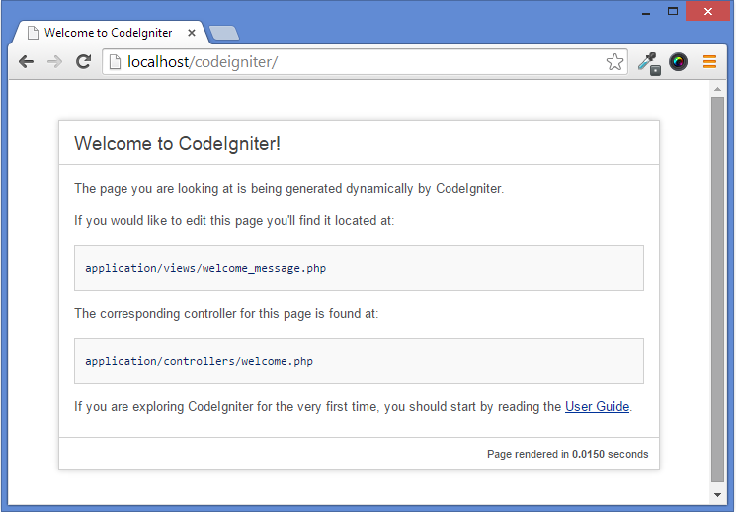
Installation and setting up CodeIgniter
https://codeigniter.com/

Slide 5


Removing the index.php file
By default, the index.php file will be included in your URLs:
If your Apache server has mod_rewrite enabled, you can easily remove this file by using a .htaccess file with some simple rules. Here is an example of such a file, using the “negative” method in which everything is redirected except the specified items:

Slide 6
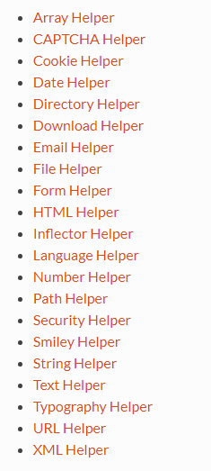
Helpers
Libraries
form
url
session
database
form_validation
session

Slide 7

URL Helper
The URL Helper file contains functions that assist in working with URLs.
Loading this Helper
This helper is loaded using the following code:
Available Functions
base_url() : Returns your site base URL, as specified in your config file

Slide 8
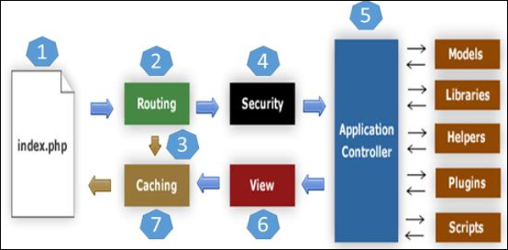
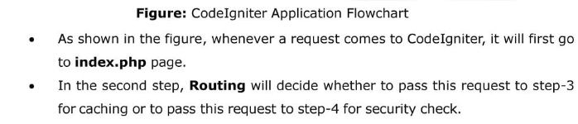
Application Architecture

Slide 9
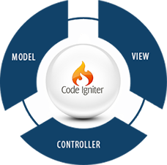
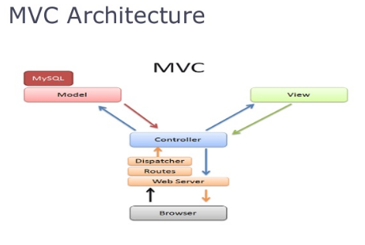
MVC Framework Introduction
Separate User Interface from business Logic
Model : All database-related work is done through the model file
View : The front-end view (here HTML)design is contained in the view file
Controller :The Controller , the base of MVC , controls everything inside the application. You can use Views and models only through a controller ;without a controller file your CodeIgniter app will not run

