Slide 1
Looking back; Bengal to Bangladesh

Slide 2
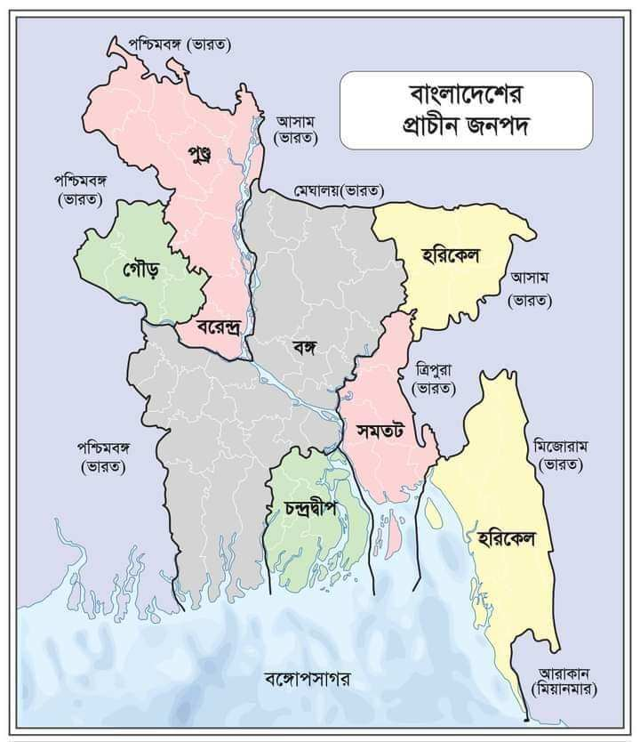
Ancient janapadh

Slide 3
Banga
Pundra
Goura
Varendra
Samatate
Harkele
Chandradip

Slide 4
Ancient dynatities
The maurya Empire : This empire was founded by chandragupta Maurya. But Asoka was one of the greatest empires of mauriya. He was also femous for ‘BRAHMILIPI’.

Slide 5
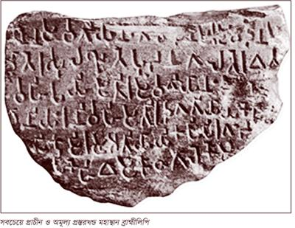
Brahmilipi of asoka

Slide 6
The Gupta Empire : This empire was an encient Empire in Indian subcontinent . Which existed from the mid third century .
The Pala Empire : This Empire established by Gopala in the 8th century and the greatest ruler of this Empire was Chandragupta.

Slide 7
The Sen Empir : This Empire was founded by King vallal Sen and the last king was Laxman Sen .

Slide 8
Muslim dynasities
Khilji rule
Independent Sultanate period
Nawabi period
British period

Slide 9
Partition of 1947
In 1947, the Indian subcontinent was divided into two countries.
India
Pakistan
Pakistan was again divided into two parts.
East Pakistan and West Pakistan

Slide 10
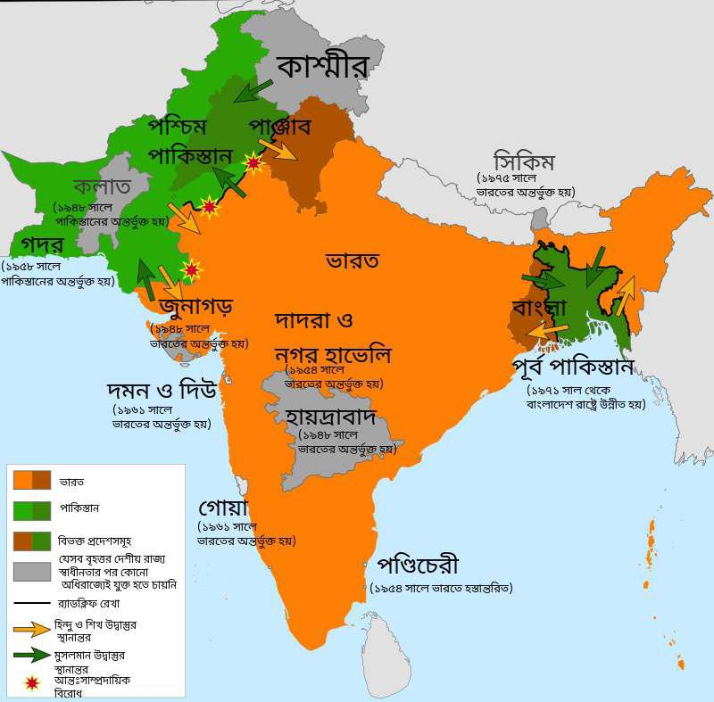

Slide 11
Language movement
The language movement is one of the most important cultural and political movements in Bengali history. 21 February 1952 Rafiq uddin Ahmed, Abdul jabbar, Abdul Barkat, Salam died in the shooting for their language movement.

Slide 12
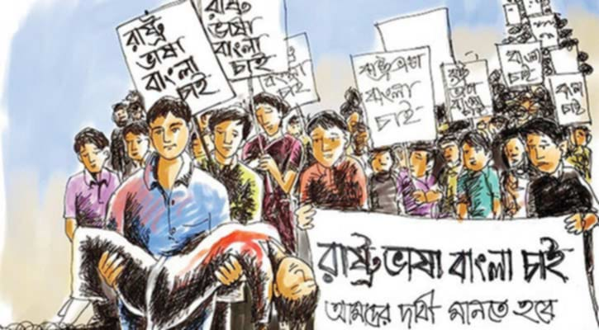

Slide 13
Six points movement
Constitutional structure and nature of the state
Powers of Central Government
Power in respect of currency or money
Power of relating to revenue taxes or duties
Foreign Trade Power
Power to form regional armies

Slide 14
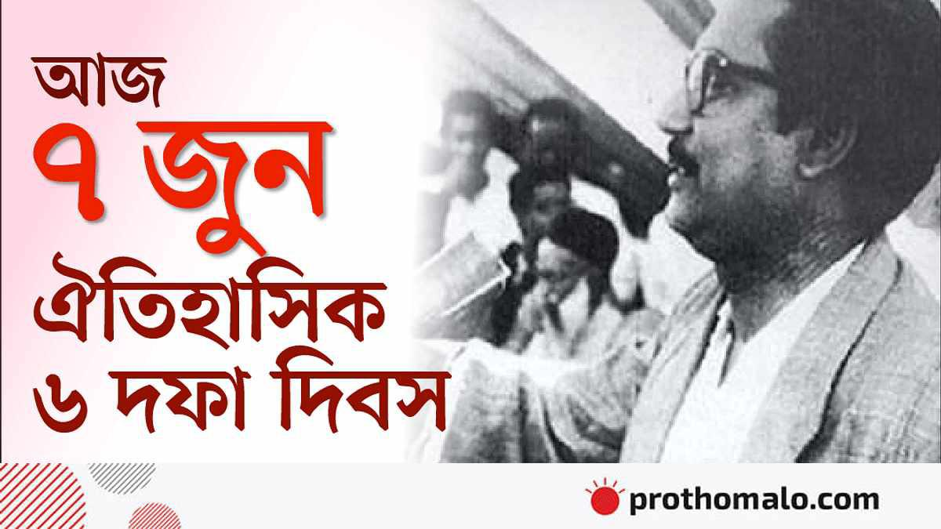

Slide 15
Mass Uprising
1968 Agartala Conspiracy Case
11 points of student leadership of 1969
Asaduzzaman, a student of Dhaka University, was killed on January 20, 1969
Police crackdown on 24 January 1969

Slide 16
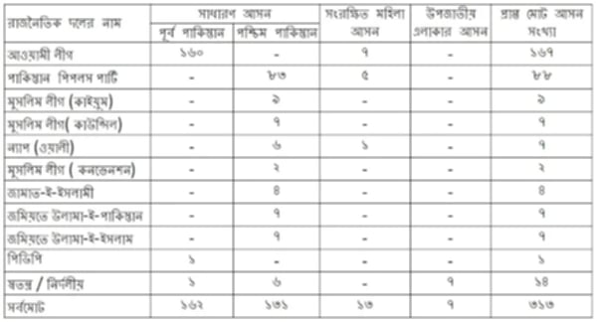
election of 1970

Slide 17
Born of Bangladesh
On the dark night of March 25, 1971, the Pakistani occupation forces attacked the unarmed Bengalis. And this is the continuation of the Great War of Liberation. Bangladesh in return was achieved Independence on 16th December 1971 For 9 months of bloodshed war.

Slide 18
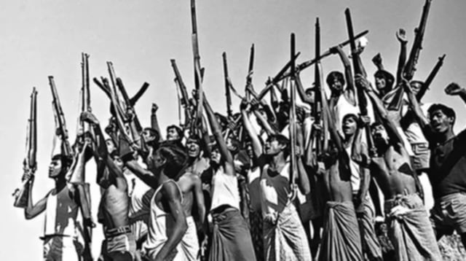
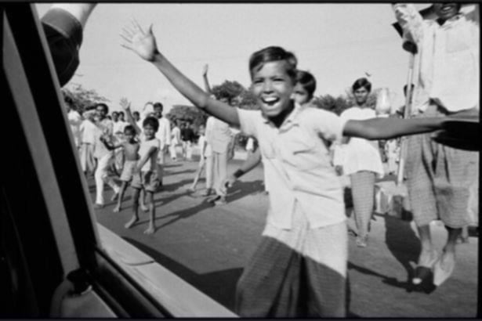

Slide 19
Conclusion
This history of change from Bengal to Bangladesh has taught us that the struggle to preserve language culture and human rights is always important. Through these changes Bengali language and culture not only survived but attained new dimensions.This journey of Bengal inspires us to be proud of our cultural and linguistic identity and protect it.

