Slide 1


Securing the Future of Fog based IoT Healthcare: A Framework Informed by Large-Scale Network Analysis for Suspicious Traffic Detection
Submitted by:
Md. Iftekhar Hossain Turja 20301049
Marium Malek 20301151
Khalid Redwan Sun 20301281
Sheikh Sadi Emon 20301349
Submitted to:
Annajiat Alim Rasel, Sr. Lecturer
Humaion Kabir Mehedi, RA
Farah Binta Haque, ST

Slide 2

Abstract
The Rise of IoT in Healthcare and its Security Challenges
Limitations of Traditional Security Solutions for IoT
Introducing a Novel Framework for Context-Aware Security
Leveraging Open-Source Tools for Realistic Data Generation
Machine Learning for Anomaly Detection and Threat Classification
Enhancing Patient Safety with Proactive Security Measures
2

Slide 3

Introduction
IoT in Healthcare and its Security Implications
Traditional Solutions: Falling Short in the Face of IoT
A New Dawn: The Need for Context-Aware Security
Introducing a Novel Framework: Open Source for Enhanced Security
Contributions and Significance: Empowering Research and Protecting Patients data privacy
Building upon the Existing Literature
3

Slide 4
Related Works
Efficiency in Health Monitoring
Quality of Service (QoS) in Healthcare
Cloud Integration in Healthcare
Specialized Applications and Innovations
Blockchain Integration
4

Slide 5
Methodology
Previous work
Framework Design
Data Collection
Large-Scale Network Analysis
Comprehensive review of IoT healthcare security and network analysis.
Development of a novel framework integrating large-scale network analysis.
Inclusion of both normal and potentially malicious data for realistic testing.
Application of advanced techniques, including graph-based models and machine learning algorithms.
5

Slide 6
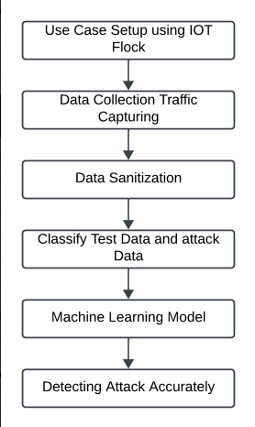
Proposed Framework
IoT Traffic Generation
Use Case Development
Real-World Application
IoT Traffic Simulation
Packet Flow Analysis
Dataset Creation for ML Models
Machine Learning Model Development
6

Slide 7

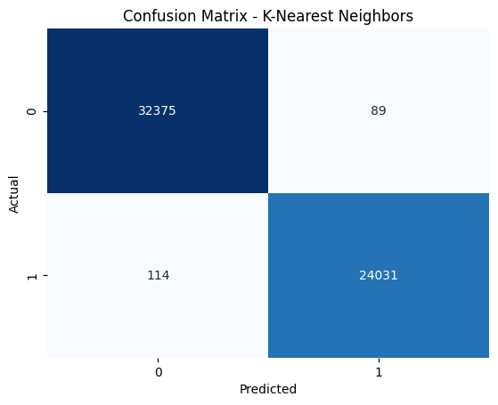
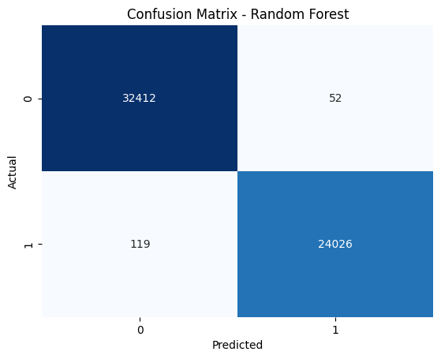

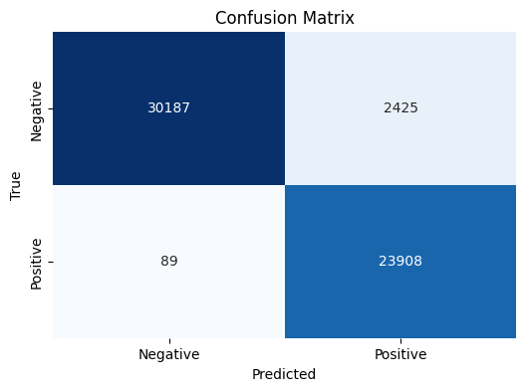
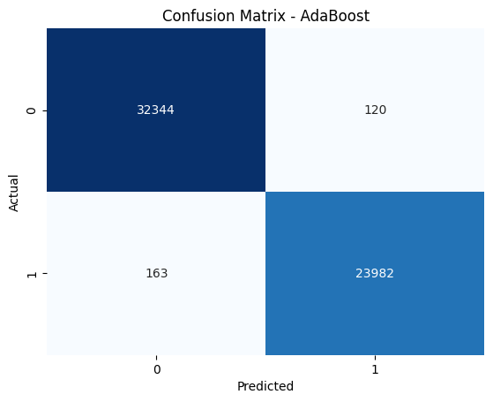
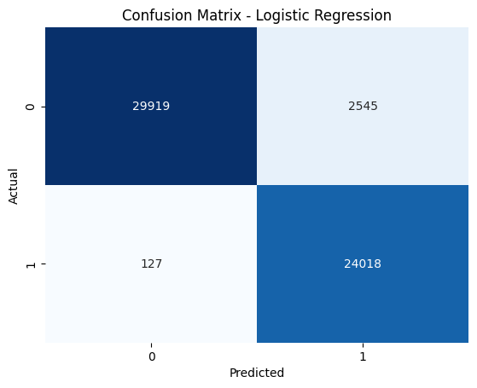
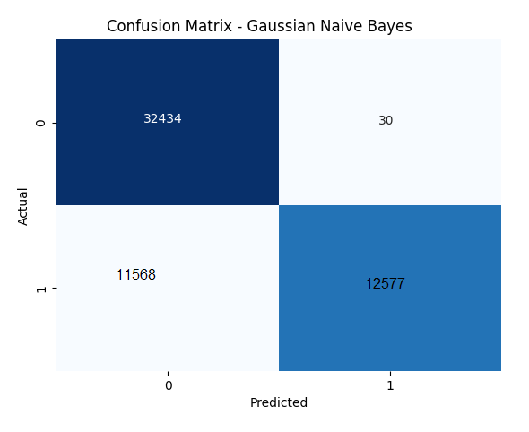
Results
7

Slide 8
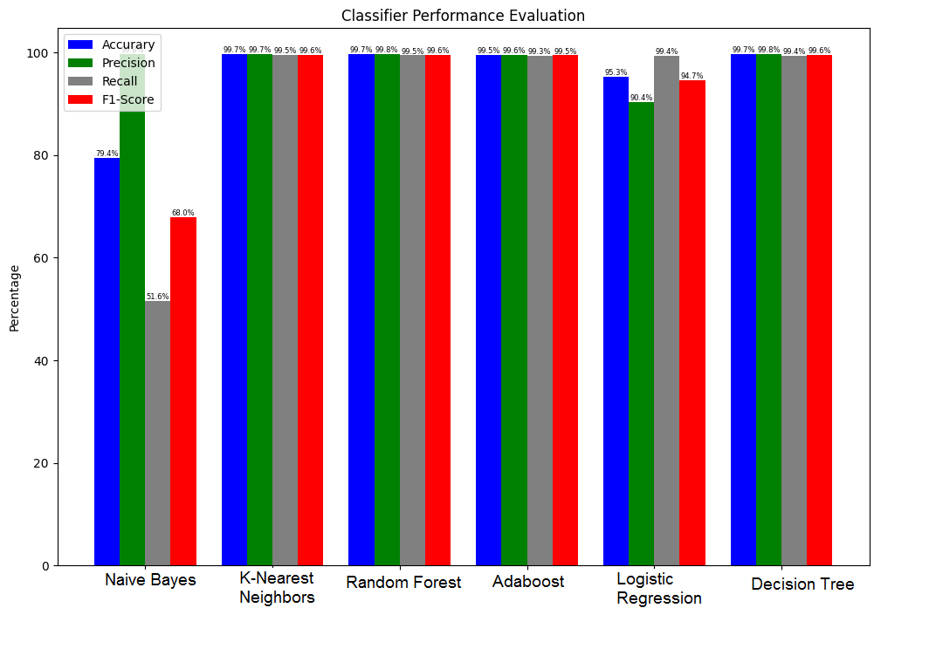
Results
8

Slide 9
Limitations
Cost Implication
Network Latency
Diversity of IoT Devices
Interoperability Challenges
9

Slide 10
Conclusion
Large-scale network analysis
Performance assessment
Detecting and mitigating malicious traffic.
Simulation and real-world testing.
10

Slide 11

Thank You!
Any Questions?

