Slide 1
Rehabilitation Tool

Slide 2
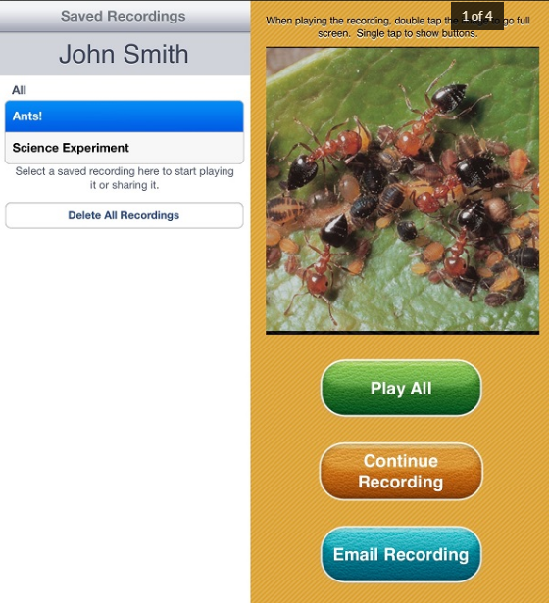
Assistive Technology for Speech Difficulties
Speech Journal
Audio wed to images for multiple learning/teaching goals.
Price: $3.99.
Platforms: iPad.
https://www.commonsense.org/education/top-picks/top-assistive-technology-for-speech-difficulties

Slide 3
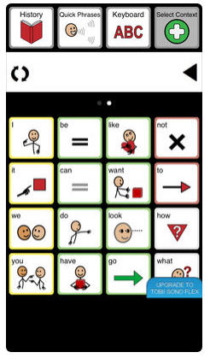
Sono flex [100$] [for IOS devices] Make sentences by choosing photos and this sentences converted from text to speech .
https://www.tobiidynavox.com/en-us/software/content/sono-flex-for-communicator-5/

Slide 4
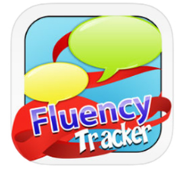
fluency tracker [10$] For iPhone, specific for stuttering By ask parents some questions about when, with whom and so on then make results depend on this answers.

Slide 5

Aphasia speech therapy [ free ] Click on photos that contain numbers, food and emotions to listen them He can also write sentence and listen it or even record it.

Slide 6
Arabic Applications

Slide 7
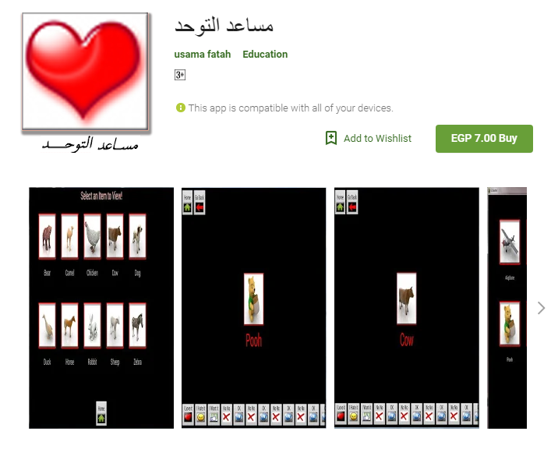
For Difficulty and delay of speech

