Slide 1
Rehabilitation Tool

Slide 2
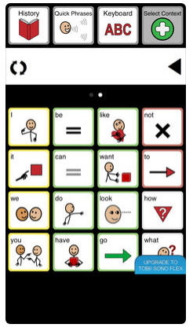
Sono flex [100$] [for IOS devices] Make sentences by choosing photos and this sentences converted from text to speech .
https://www.tobiidynavox.com/en-us/software/content/sono-flex-for-communicator-5/

Slide 3
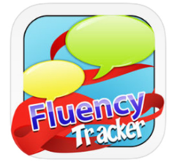
fluency tracker [10$] For iPhone, specific for stuttering By ask parents some questions about when, with whom and so on then make results depend on this answers.

Slide 4

Aphasia speech therapy [ free ] Click on photos that contain numbers, food and emotions to listen them He can also write sentence and listen it or even record it.

Slide 5
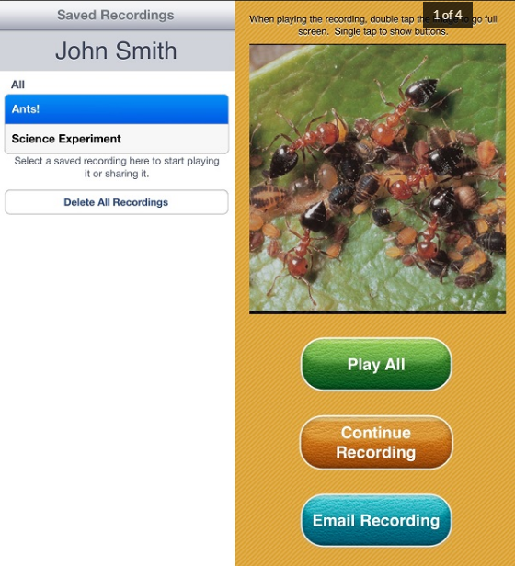
Speech Journal
Audio wed to images for multiple learning/teaching goals.
Price: $3.99.
Platforms: iPad.

Slide 6
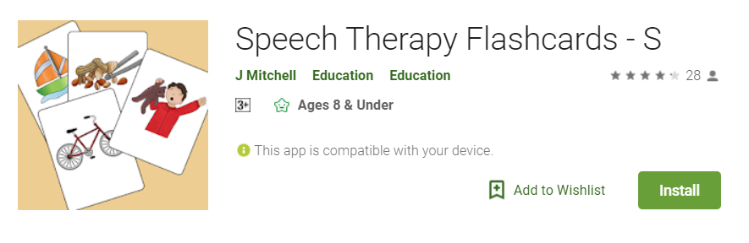
Speech therapy Free

Slide 7
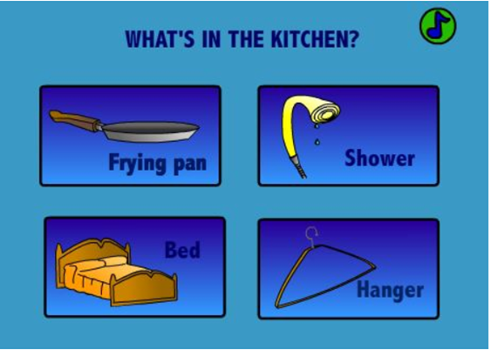
Alzheimer Info
Free

Slide 8
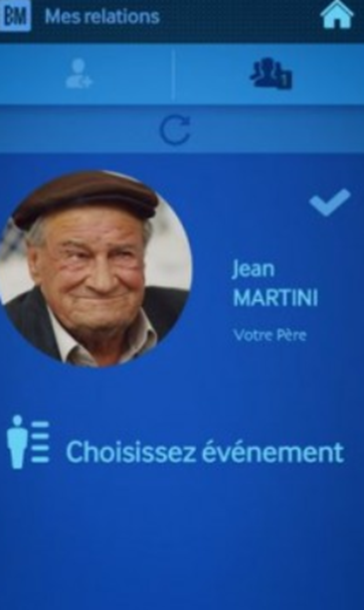
Samsung Memory Recaller

Slide 9
Arabic Applications

Slide 10
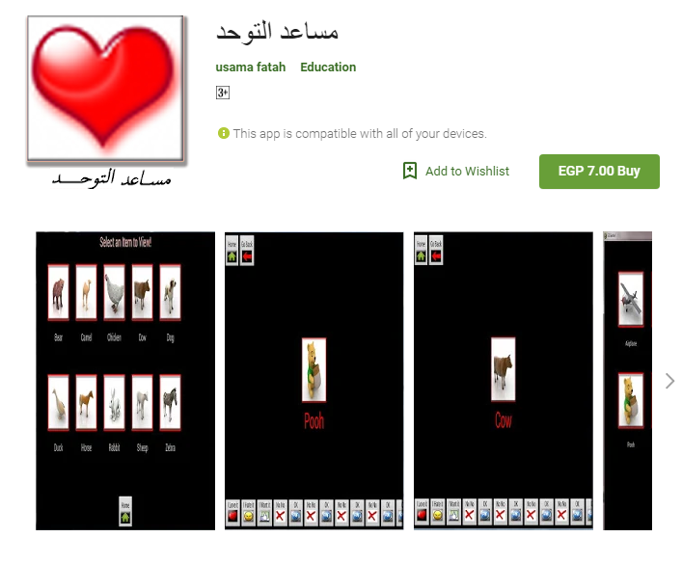
For Difficulty and delay of speech

