Slide 1
Rehabilitation Tool

Slide 2
Top Assistive Technology for Speech Difficulties
These assistive apps help students with speech difficulties or disabilities communicate.
1-Speech Journal
Audio wed to images for multiple learning/teaching goals.
Price: $3.99.
Platforms: iPad.

Slide 3
https://www.commonsense.org/education/top-picks/top-assistive-technology-for-speech-difficulties

Slide 4
Arabic Applications

Slide 5
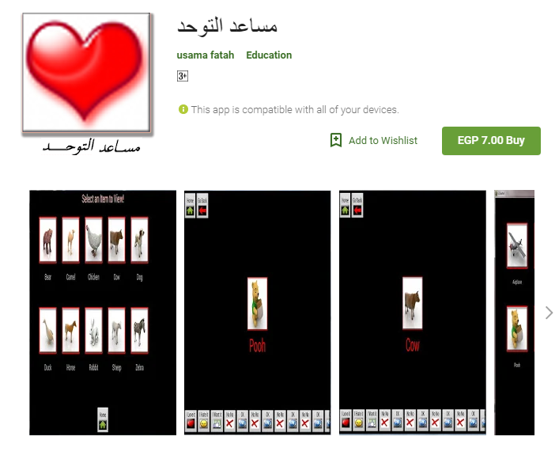
For Difficulty and delay of speech

