Slide 1
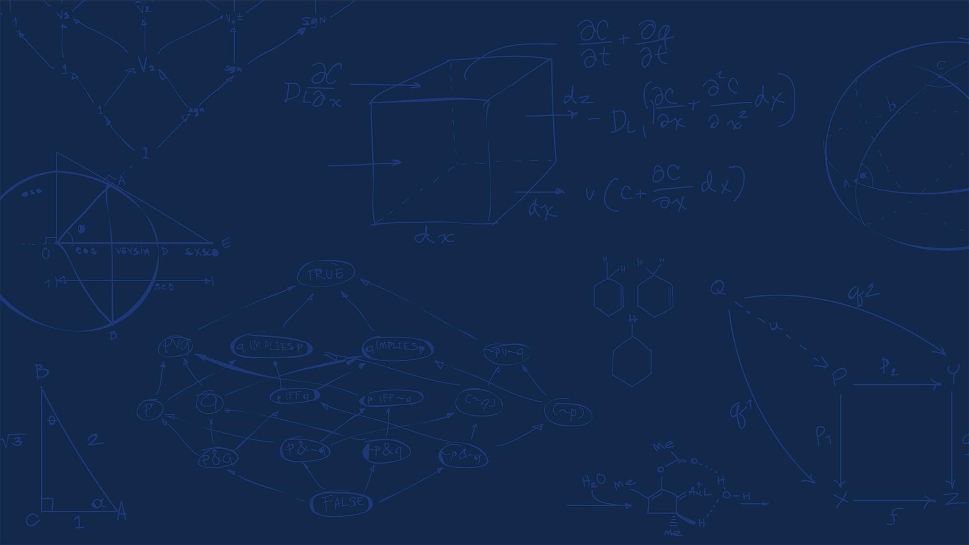

SE 423: Introduction to Mechatronics
Lecture 19: Trajectory planning
Marius Juston
Wednesday, April 1st, 2026

Slide 2

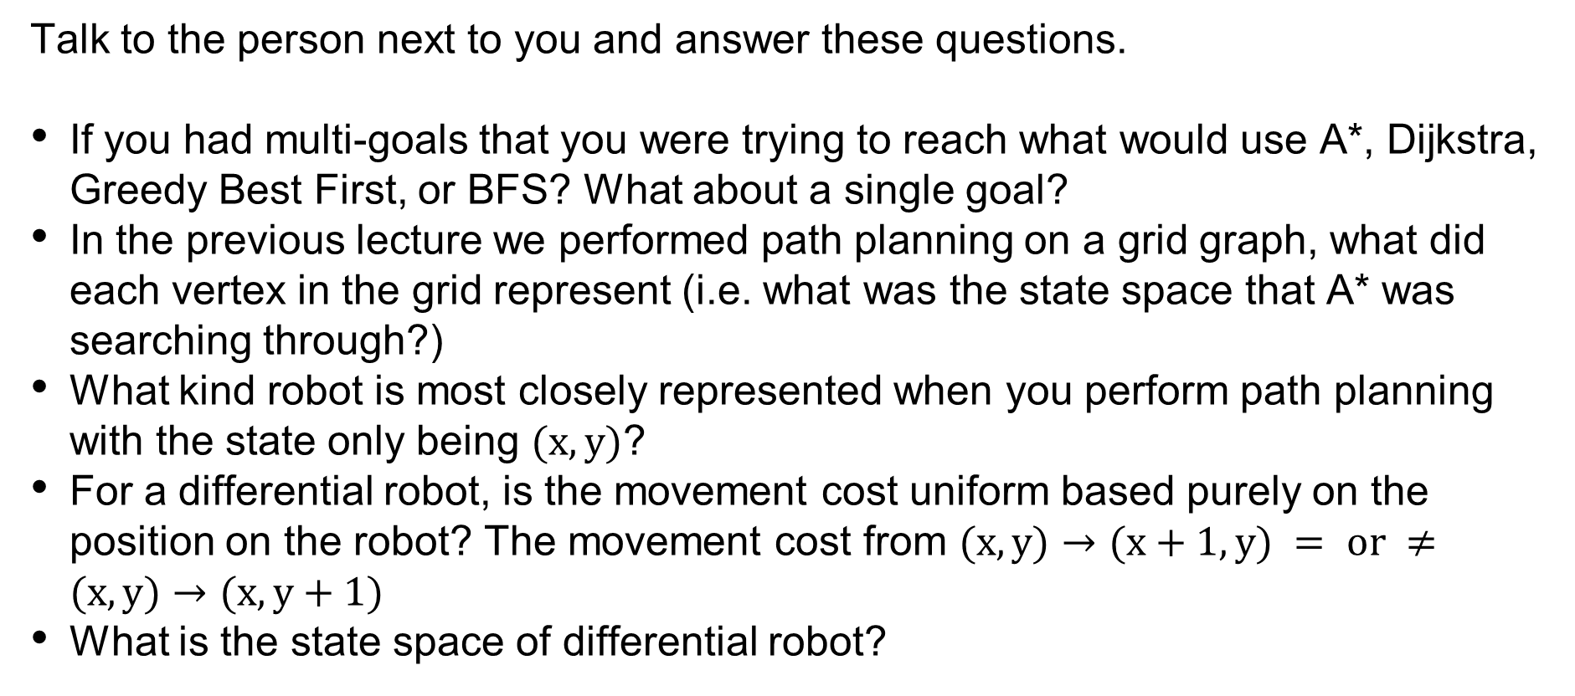
Review – 5-minute partner discussion
Talk to the person next to you and answer these questions.
If you had multi-goals that you were trying to reach what would use A*, Dijkstra, Greedy Best First, or BFS? What about a single goal?
In the previous lecture we performed path planning on a grid graph, what did each vertex in the grid represent (i.e. what was the state space that A* was searching through?)
What kind robot is most closely represented when you perform path planning with the state only being $(x, y)$?
For a differential robot, is the movement cost uniform based purely on the position on the robot? The movement cost from $(x, y)→(x+1, y) = or ≠(x, y)→(x, y+1)$
What is the state space of differential robot?
SYSTEMS ENGINEERING
GRAINGER ENGINEERING

Slide 3
Reminders
Office Hours:
Monday: 4-6 PM, Neel
Tuesday: 11-1 PM, Lakshmi
Tuesday: 1-3 PM, Samuel
Tuesday: 2-5 PM, Dan & Marius
Lab: Starting Lab 6 this week. This a 3-week lab!
Don’t forget to have the Lab LabVIEW application implemented before lab.
Homeworks:
Check-offs for homework 4 Ex 4 are due April 7, 5PM (The end of office hours)
Remainder of homework 4 due on Gradescope on April 8, 9AM
Next homework is primarily the personal project due on April 22, 9AM.
I would highly recommend you thinking now and maybe even starting it now if you have a good idea already!
SYSTEMS ENGINEERING
GRAINGER ENGINEERING

Slide 4
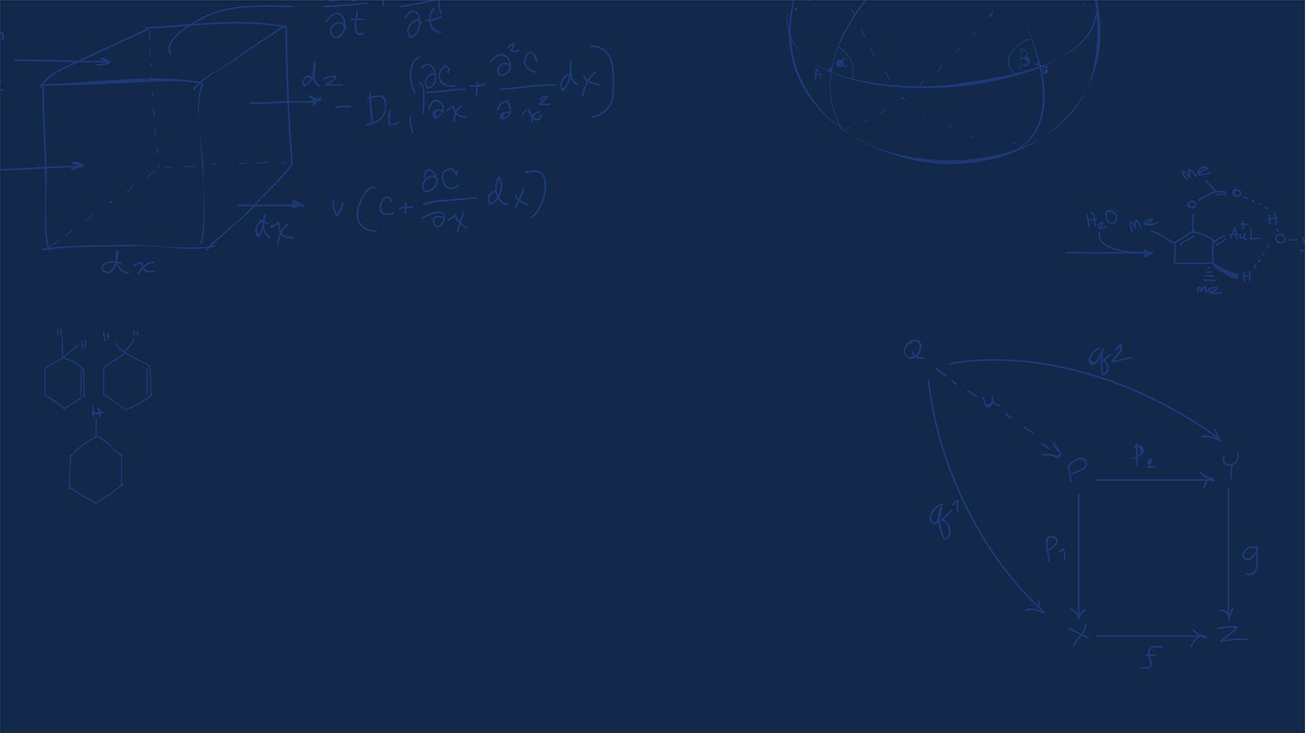
Questions?
Homework, Lab, LabVIEW?
SYSTEMS ENGINEERING
GRAINGER ENGINEERING

Slide 5
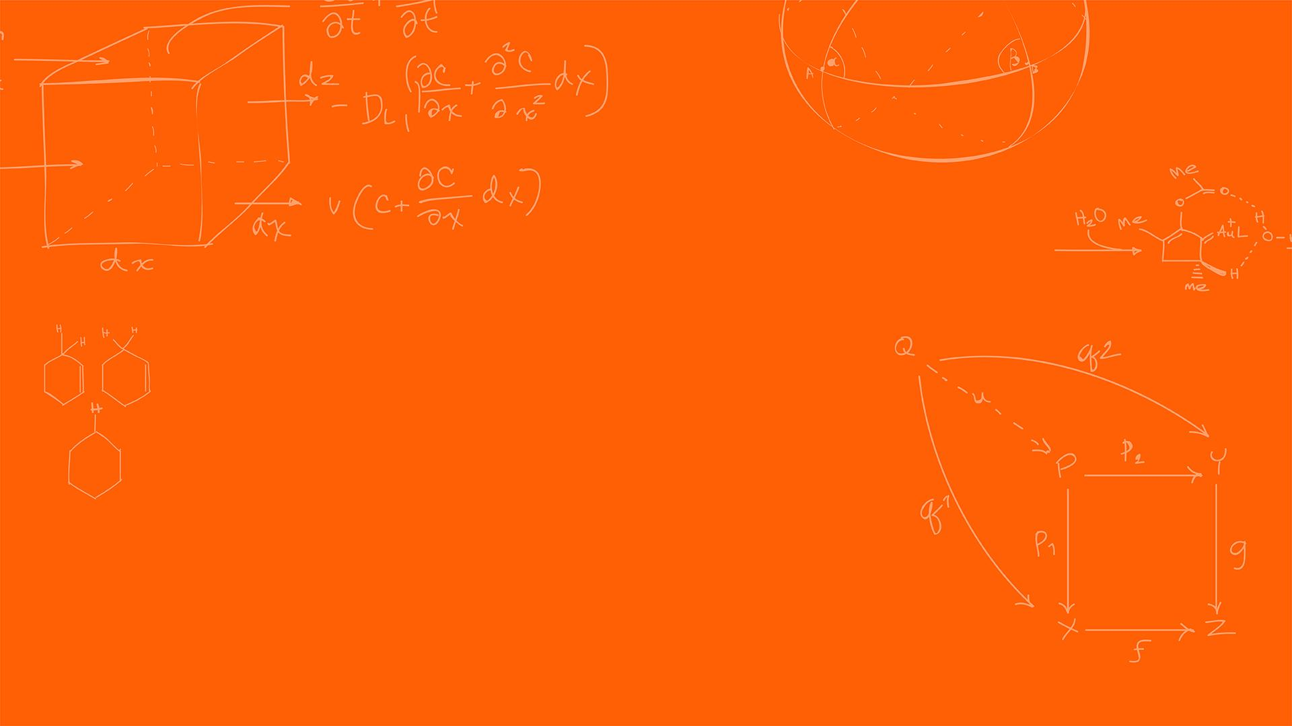

Path planning
SYSTEMS ENGINEERING
GRAINGER ENGINEERING

Slide 6
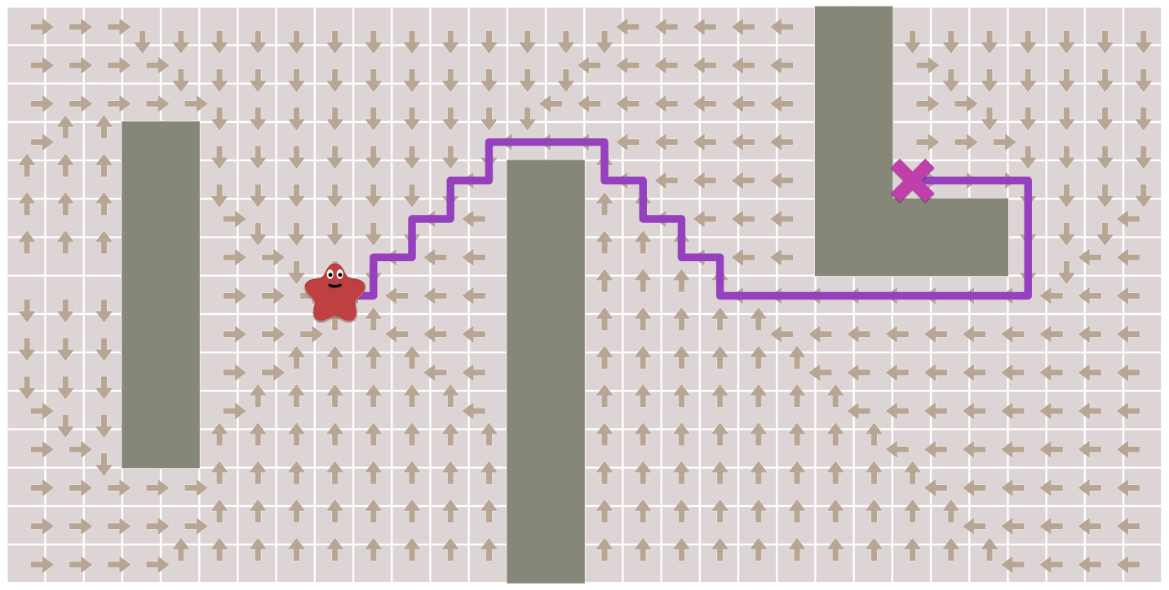
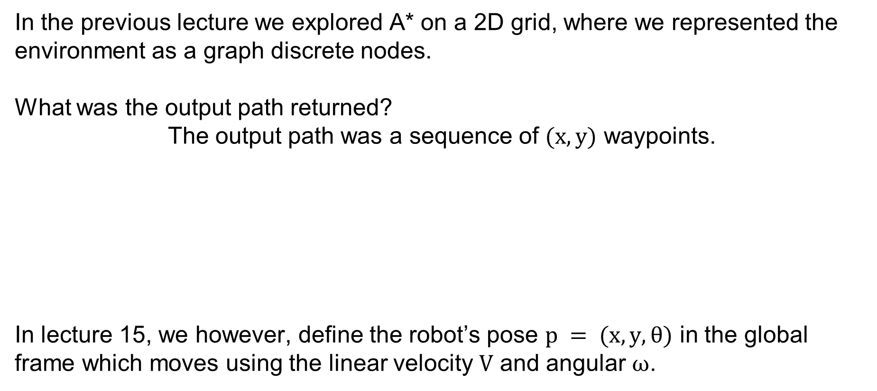
Path Planning
In the previous lecture we explored A* on a 2D grid, where we represented the environment as a graph discrete nodes.
What was the output path returned?
The output path was a sequence of $(x, y)$ waypoints.
In lecture 15, we however, define the robot’s pose $p = (x, y, θ)$ in the global frame which moves using the linear velocity $V$ and angular $ω$.
SYSTEMS ENGINEERING
GRAINGER ENGINEERING

Slide 7
Path Planning
Standard A* assumes the robot is a "point mass" that can move in any direction!
However, differential drive robots cannot translate sideways! A drone, however, would be fine with this “point mass” definition.
When the path goes from moving "North" to "East", the angle changes by 90 degrees instantly.
This implies an infinite angular velocity at that corner if you are not already facing that direction. What happens to our DC motors if we command an infinite angular velocity?
How can we handle this?
Stop and turn or try tracking the next waypoint.
SYSTEMS ENGINEERING
GRAINGER ENGINEERING

Slide 8
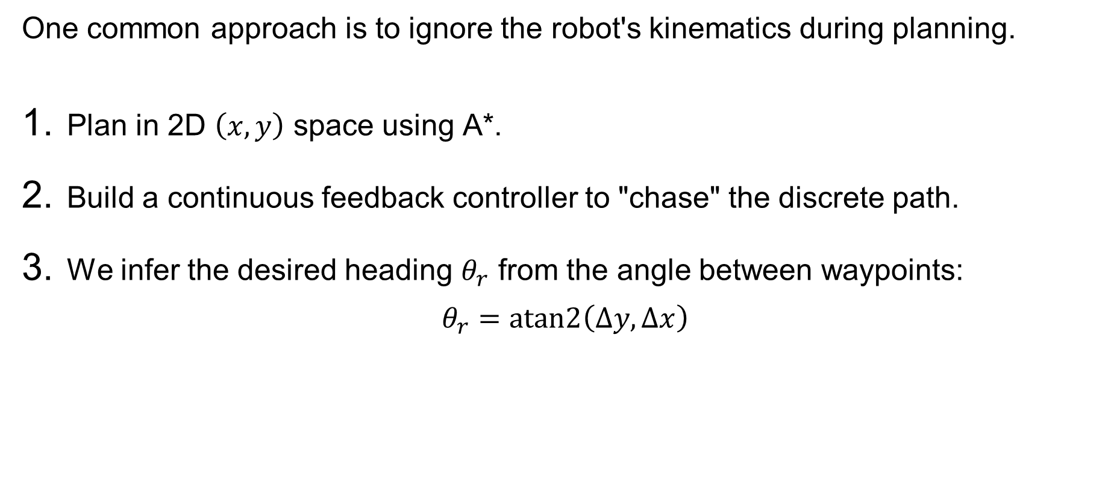
Path Planning
One common approach is to ignore the robot's kinematics during planning.
Plan in 2D $\left(x,y\right)$ space using A*.
Build a continuous feedback controller to "chase" the discrete path.
We infer the desired heading $θ_{r}$ from the angle between waypoints:
$$θ_{r}=\text{atan}\text{2}\left(Δy,Δx\right)$$
SYSTEMS ENGINEERING
GRAINGER ENGINEERING

Slide 9
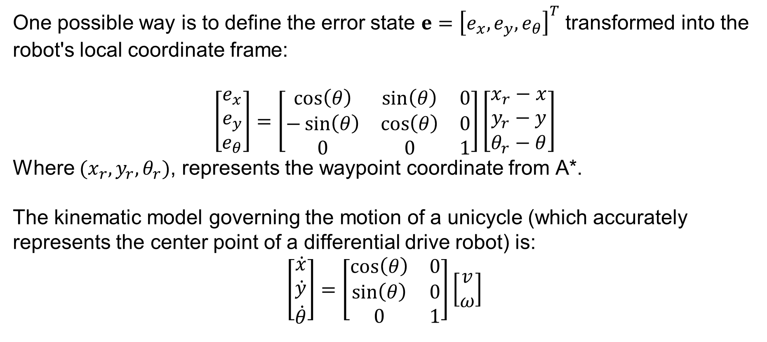
Path Planning
One possible way is to define the error state $e={\left[e_{x},e_{y},e_{θ}\right]}^{T}$ transformed into the robot's local coordinate frame:
$$\left[\begin{matrix}e_{x} \\ e_{y} \\ e_{θ}\end{matrix}\right]=\left[\begin{matrix}\cos\left(θ\right) & \sin\left(θ\right) & 0 \\ −\sin\left(θ\right) & \cos\left(θ\right) & 0 \\ 0 & 0 & 1\end{matrix}\right]\left[\begin{matrix}x_{r}−x \\ y_{r}−y \\ θ_{r}−θ\end{matrix}\right]$$
Where $(x_{r},y_{r},θ_{r})$, represents the waypoint coordinate from A*.
The kinematic model governing the motion of a unicycle (which accurately represents the center point of a differential drive robot) is:
$$\left[\begin{matrix}\dot{x} \\ \dot{y} \\ \dot{θ}\end{matrix}\right]=\left[\begin{matrix}\cos\left(θ\right) & 0 \\ \sin\left(θ\right) & 0 \\ 0 & 1\end{matrix}\right]\left[\begin{matrix}v \\ ω\end{matrix}\right]$$
SYSTEMS ENGINEERING
GRAINGER ENGINEERING

Slide 10
Path Planning
SYSTEMS ENGINEERING
GRAINGER ENGINEERING

Slide 11
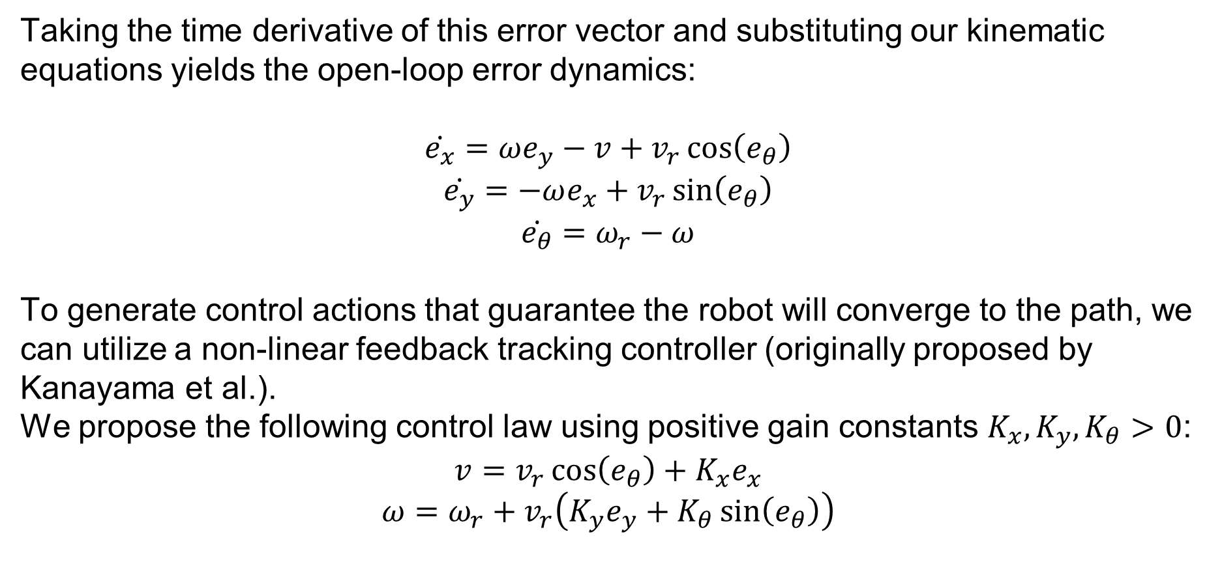
Path Planning
Taking the time derivative of this error vector and substituting our kinematic equations yields the open-loop error dynamics:
$$\dot{e_{x}}=ωe_{y}−v+v_{r}\cos\left(e_{θ}\right)$$
$$\dot{e_{y}}=−ωe_{x}+v_{r}\sin\left(e_{θ}\right)$$
$$\dot{e_{θ}}=ω_{r}−ω$$
To generate control actions that guarantee the robot will converge to the path, we can utilize a non-linear feedback tracking controller (originally proposed by Kanayama et al.).
We propose the following control law using positive gain constants $K_{x},K_{y},K_{θ}>0$:
$$v=v_{r}\cos\left(e_{θ}\right)+K_{x}e_{x}$$
$$ω=ω_{r}+v_{r}\left(K_{y}e_{y}+K_{θ}\sin\left(e_{θ}\right)\right)$$
SYSTEMS ENGINEERING
GRAINGER ENGINEERING

Slide 12
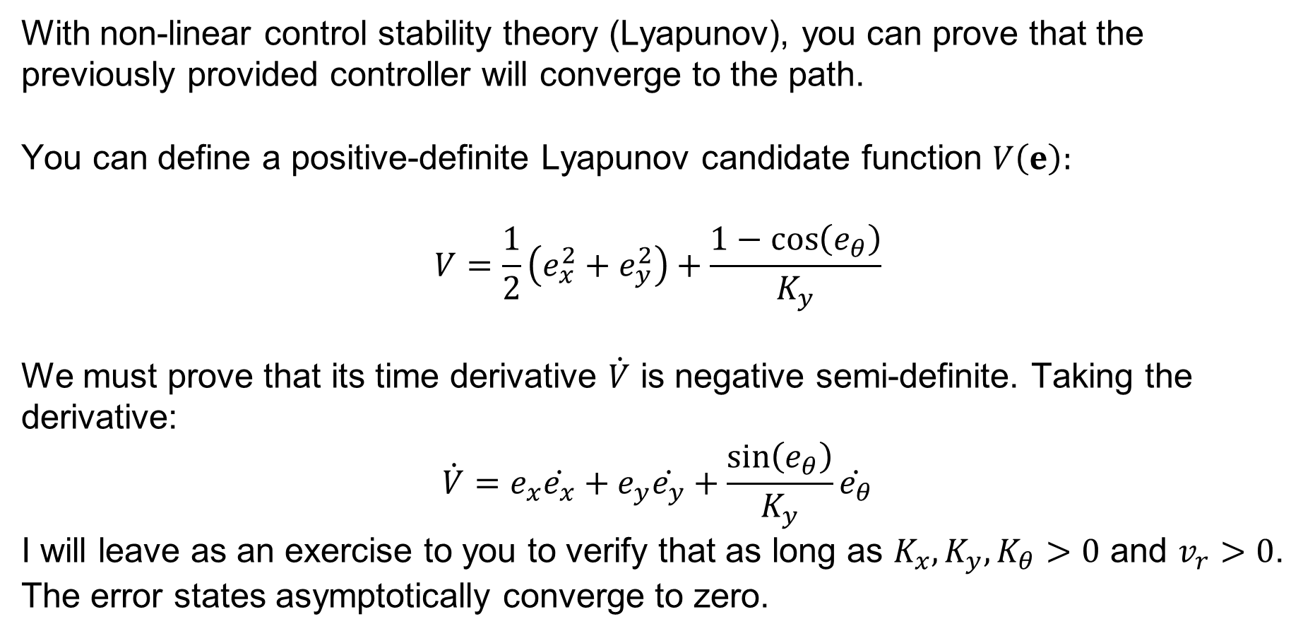
Path Planning
With non-linear control stability theory (Lyapunov), you can prove that the previously provided controller will converge to the path.
You can define a positive-definite Lyapunov candidate function $V\left(e\right):$
$$V=\frac{1}{2}\left(e_{x}^{2}+e_{y}^{2}\right)+\frac{1−\cos\left(e_{θ}\right)}{K_{y}}$$
We must prove that its time derivative $\dot{V}$ is negative semi-definite. Taking the derivative:
$$\dot{V}=e_{x}\dot{e_{x}}+e_{y}\dot{e_{y}}+\frac{\sin\left(e_{θ}\right)}{K_{y}}\dot{e_{θ}}$$
I will leave as an exercise to you to verify that as long as $K_{x},K_{y},K_{θ}>0$ and $v_{r}>0$. The error states asymptotically converge to zero.
SYSTEMS ENGINEERING
GRAINGER ENGINEERING

Slide 13
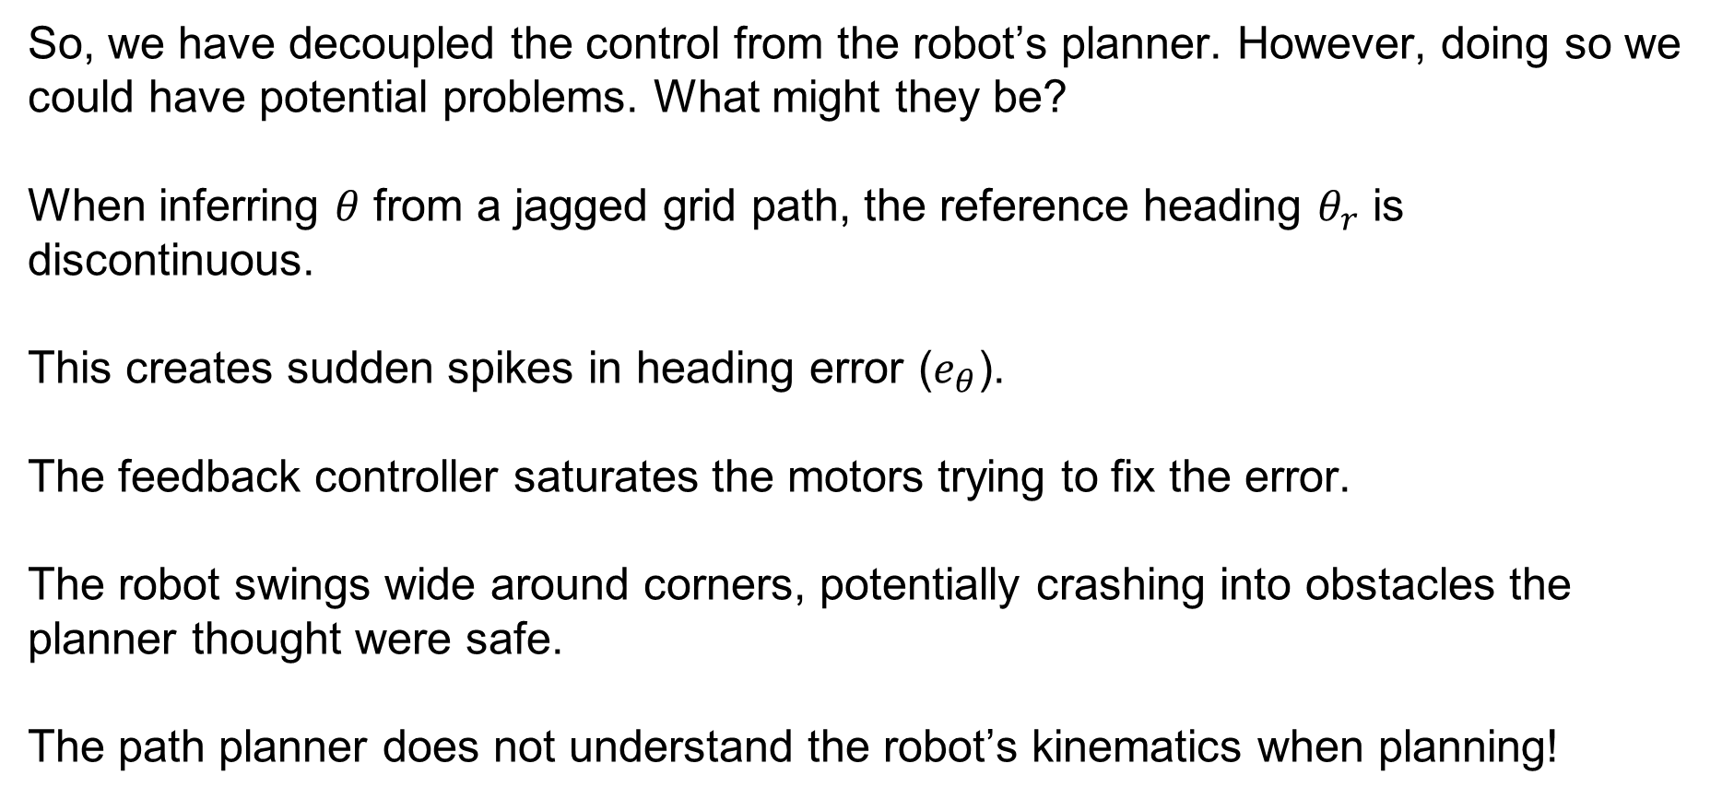
Path Planning
So, we have decoupled the control from the robot’s planner. However, doing so we could have potential problems. What might they be?
When inferring $θ$ from a jagged grid path, the reference heading $θ_{r}$ is discontinuous.
This creates sudden spikes in heading error ($e_{θ}$).
The feedback controller saturates the motors trying to fix the error.
The robot swings wide around corners, potentially crashing into obstacles the planner thought were safe.
The path planner does not understand the robot’s kinematics when planning!
SYSTEMS ENGINEERING
GRAINGER ENGINEERING

Slide 14
Path Planning
SYSTEMS ENGINEERING
GRAINGER ENGINEERING

Slide 15
Path Planning
This decoupled controller, which pursues a target point and has the controller constantly chasing after it is called Pure Pursuit
There are other ways of implementing the trajectory following, among which we will talk about below. Some other ways revolve around solving optimization problems.
SYSTEMS ENGINEERING
GRAINGER ENGINEERING

Slide 16
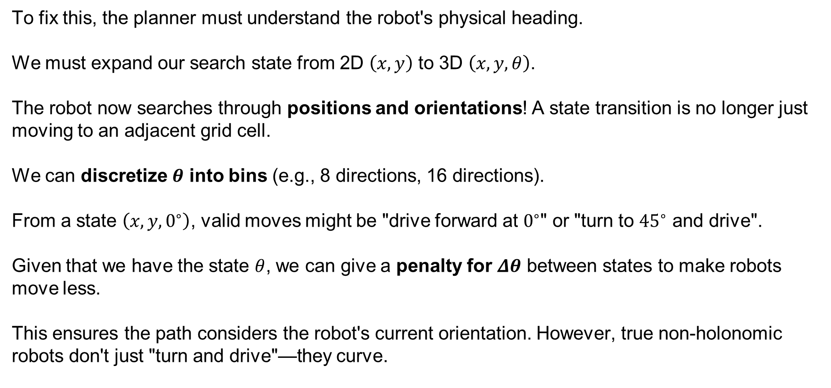
Path Planning
To fix this, the planner must understand the robot's physical heading.
We must expand our search state from 2D $\left(x,y\right)$ to 3D $\left(x,y,θ\right)$.
The robot now searches through positions and orientations! A state transition is no longer just moving to an adjacent grid cell.
We can discretize $θ$ into bins (e.g., 8 directions, 16 directions).
From a state $\left(x,y,0^{∘}\right)$, valid moves might be "drive forward at $0^{∘}$" or "turn to ${45}^{∘}$ and drive".
Given that we have the state $θ$, we can give a penalty for $Δθ$ between states to make robots move less.
This ensures the path considers the robot's current orientation. However, true non-holonomic robots don't just "turn and drive"—they curve.
SYSTEMS ENGINEERING
GRAINGER ENGINEERING

Slide 17
Path Planning
SYSTEMS ENGINEERING
GRAINGER ENGINEERING

Slide 18
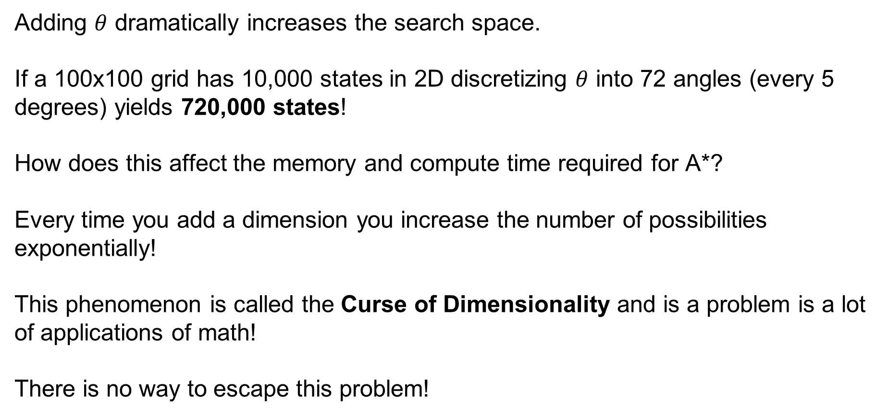
The Curse of Dimensionality
Adding $θ$ dramatically increases the search space.
If a 100x100 grid has 10,000 states in 2D discretizing $θ$ into 72 angles (every 5 degrees) yields 720,000 states!
How does this affect the memory and compute time required for A*?
Every time you add a dimension you increase the number of possibilities exponentially!
This phenomenon is called the Curse of Dimensionality and is a problem is a lot of applications of math!
There is no way to escape this problem!
SYSTEMS ENGINEERING
GRAINGER ENGINEERING

Slide 19
The Curse of Dimensionality
Before we commit to heavy 3D planning, let's establish when 2D is acceptable:
2D planning works well for omnidirectional robots (Mecanum wheels).
It also works for very slow differential drive robots in wide-open spaces (you can have 8-connected neighbors and tune your controller to minimize edge clipping).
It fails catastrophically for cars (Ackermann steering) or robots in tight, cluttered corridors.
SYSTEMS ENGINEERING
GRAINGER ENGINEERING

Slide 20
Hybrid A*
SYSTEMS ENGINEERING
GRAINGER ENGINEERING

Slide 21
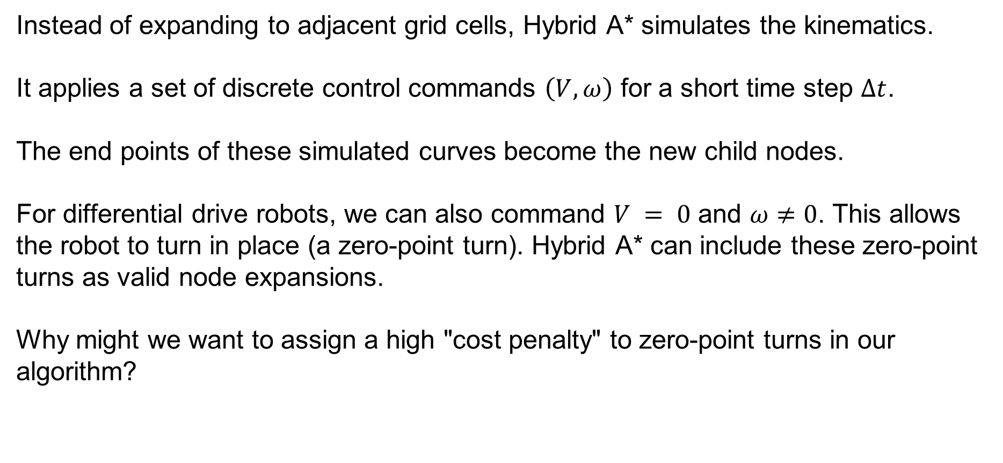
Hybrid A*
Instead of expanding to adjacent grid cells, Hybrid A* simulates the kinematics.
It applies a set of discrete control commands $\left(V,ω\right)$ for a short time step $Δt$.
The end points of these simulated curves become the new child nodes.
For differential drive robots, we can also command $V = 0$ and $ω≠0$. This allows the robot to turn in place (a zero-point turn). Hybrid A* can include these zero-point turns as valid node expansions.
Why might we want to assign a high "cost penalty" to zero-point turns in our algorithm?
SYSTEMS ENGINEERING
GRAINGER ENGINEERING

Slide 22

Hybrid A*
Hybrid A* uses a discrete 3D grid $\left(x,y,θ\right)$ purely for spatial hashing (to know if an area was visited). However, the actual coordinates stored in the nodes are continuous floating-point values.
This guarantees that the generated path is physically drivable and $C^{1}$ continuous (smooth).There are no impossible 90-degree instantaneous turns!
SYSTEMS ENGINEERING
GRAINGER ENGINEERING

Slide 23

Hybrid A*
Computing the cost of each state is relatively similar. We determine the cost by considering the length of the arcs between $s_{n}$ and $s_{n+1}$
SYSTEMS ENGINEERING
GRAINGER ENGINEERING

Slide 24
Hybrid A*
SYSTEMS ENGINEERING
GRAINGER ENGINEERING

Slide 25
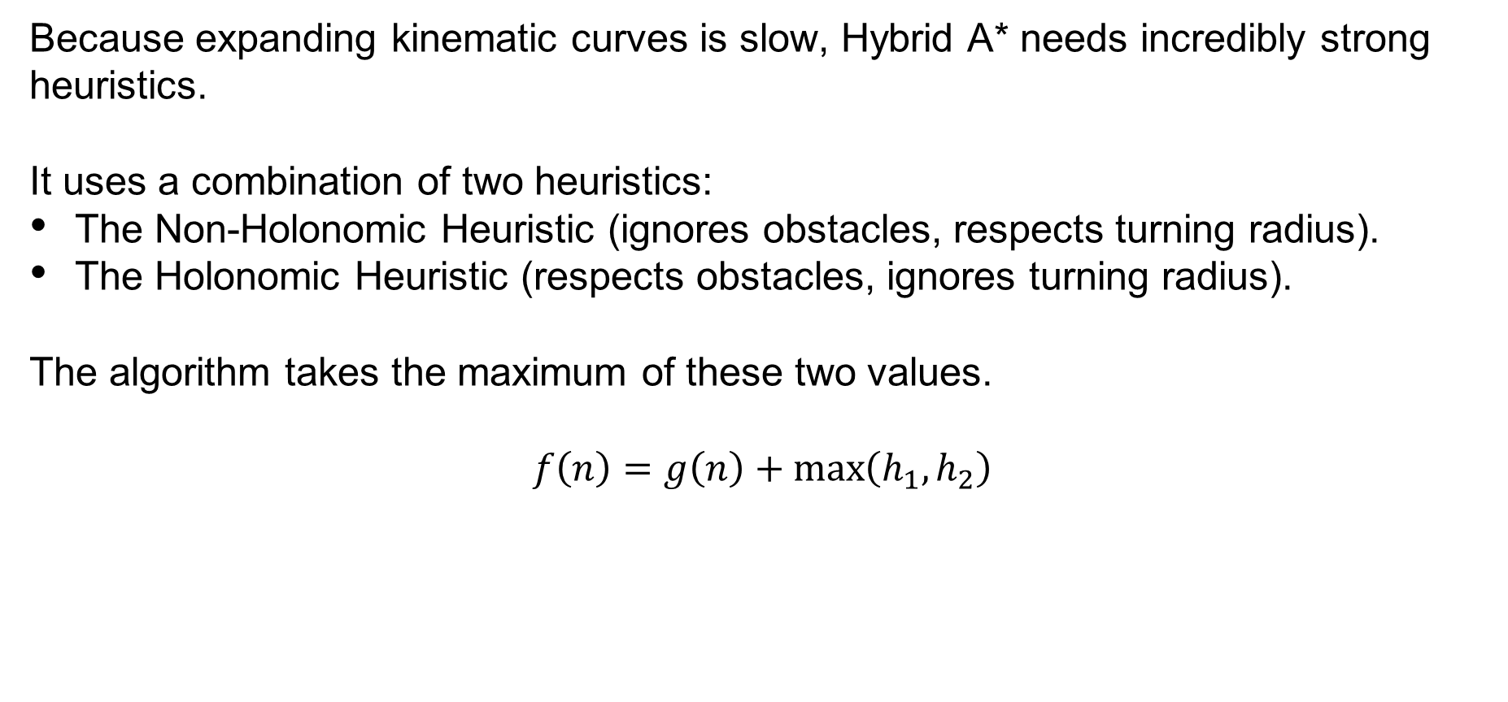
Hybrid A*
Because expanding kinematic curves is slow, Hybrid A* needs incredibly strong heuristics.
It uses a combination of two heuristics:
The Non-Holonomic Heuristic (ignores obstacles, respects turning radius).
The Holonomic Heuristic (respects obstacles, ignores turning radius).
The algorithm takes the maximum of these two values.
$$f\left(n\right)=g\left(n\right)+\max\left(h_{1},h_{2}\right)$$
SYSTEMS ENGINEERING
GRAINGER ENGINEERING

Slide 26
Hybrid A* - Holonomic Heuristic (Obstacle Aware)
This is simply a standard 2D grid A* (or Dijkstra's) running in the background!
It calculates the distance to the goal avoiding all walls.
It prevents the kinematic search from getting stuck in dead ends. Because it's 2D, it computes very quickly.
https://kth.diva-portal.org/smash/record.jsf?pid=diva2%3A1057261&dswid=4852
SYSTEMS ENGINEERING
GRAINGER ENGINEERING

Slide 27
Hybrid A* - Non-Holonomic Heuristic (Turning Aware)
This heuristic ignores all obstacles but calculates the mathematical shortest path for a vehicle with a minimum turning radius.
If the robot needs to arrive at the goal facing a specific direction, it computes the required curves.
These optimal obstacle-free paths are called Dubins curves or Reeds-Shepp curves.
https://kth.diva-portal.org/smash/record.jsf?pid=diva2%3A1057261&dswid=4852
SYSTEMS ENGINEERING
GRAINGER ENGINEERING

Slide 28
Dubins and Reeds-Shepp Curves
SYSTEMS ENGINEERING
GRAINGER ENGINEERING

Slide 29
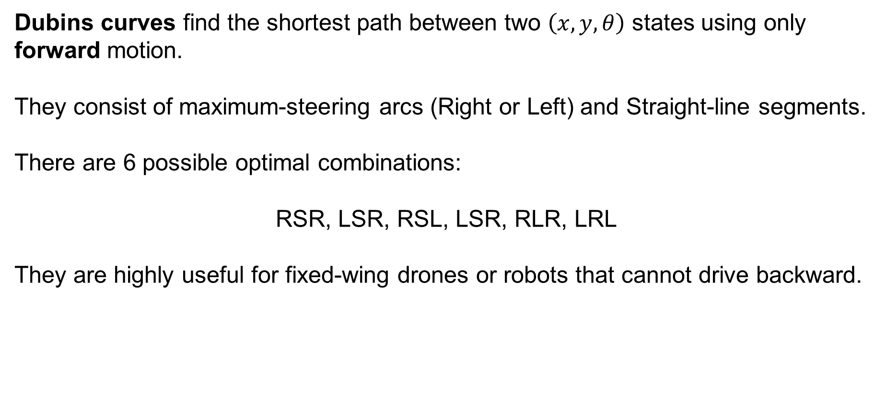
Hybrid A* - Dubins curves
Dubins curves find the shortest path between two $\left(x,y,θ\right)$ states using only forward motion.
They consist of maximum-steering arcs (Right or Left) and Straight-line segments.
There are 6 possible optimal combinations:
RSR, LSR, RSL, LSR, RLR, LRL
They are highly useful for fixed-wing drones or robots that cannot drive backward.
SYSTEMS ENGINEERING
GRAINGER ENGINEERING

Slide 30
Hybrid A* - Dubins curves
RSL
RSR
LRL
https://en.wikipedia.org/wiki/Dubins_path
SYSTEMS ENGINEERING
GRAINGER ENGINEERING

Slide 31
Hybrid A* - Reeds-Shepp Curves
If a robot can drive in reverse, the shortest path changes.
Reeds-Shepp curves extend Dubins curves by allowing the vehicle to shift into reverse (cusps).
This results in 48 possible optimal path combinations (e.g., Forward Right, Reverse Left, Forward Straight).
What is a real-world driving maneuver that uses a Reeds-Shepp curve?
Parallel parking!
SYSTEMS ENGINEERING
GRAINGER ENGINEERING

Slide 32
Hybrid A* - Reeds-Shepp Curves
To speed up the search, Hybrid A* uses an "analytic expansion.“
Every few nodes, the algorithm attempts to connect the current state directly to the goal using a Reeds-Shepp curve.
If that continuous curve doesn't hit any obstacles, the search is finished instantly!
This skips thousands of discrete node expansions near the end of the path.
SYSTEMS ENGINEERING
GRAINGER ENGINEERING

Slide 33
Hybrid A* - Reeds-Shepp Curves
SYSTEMS ENGINEERING
GRAINGER ENGINEERING

Slide 34
Trajectory Planning
SYSTEMS ENGINEERING
GRAINGER ENGINEERING

Slide 35
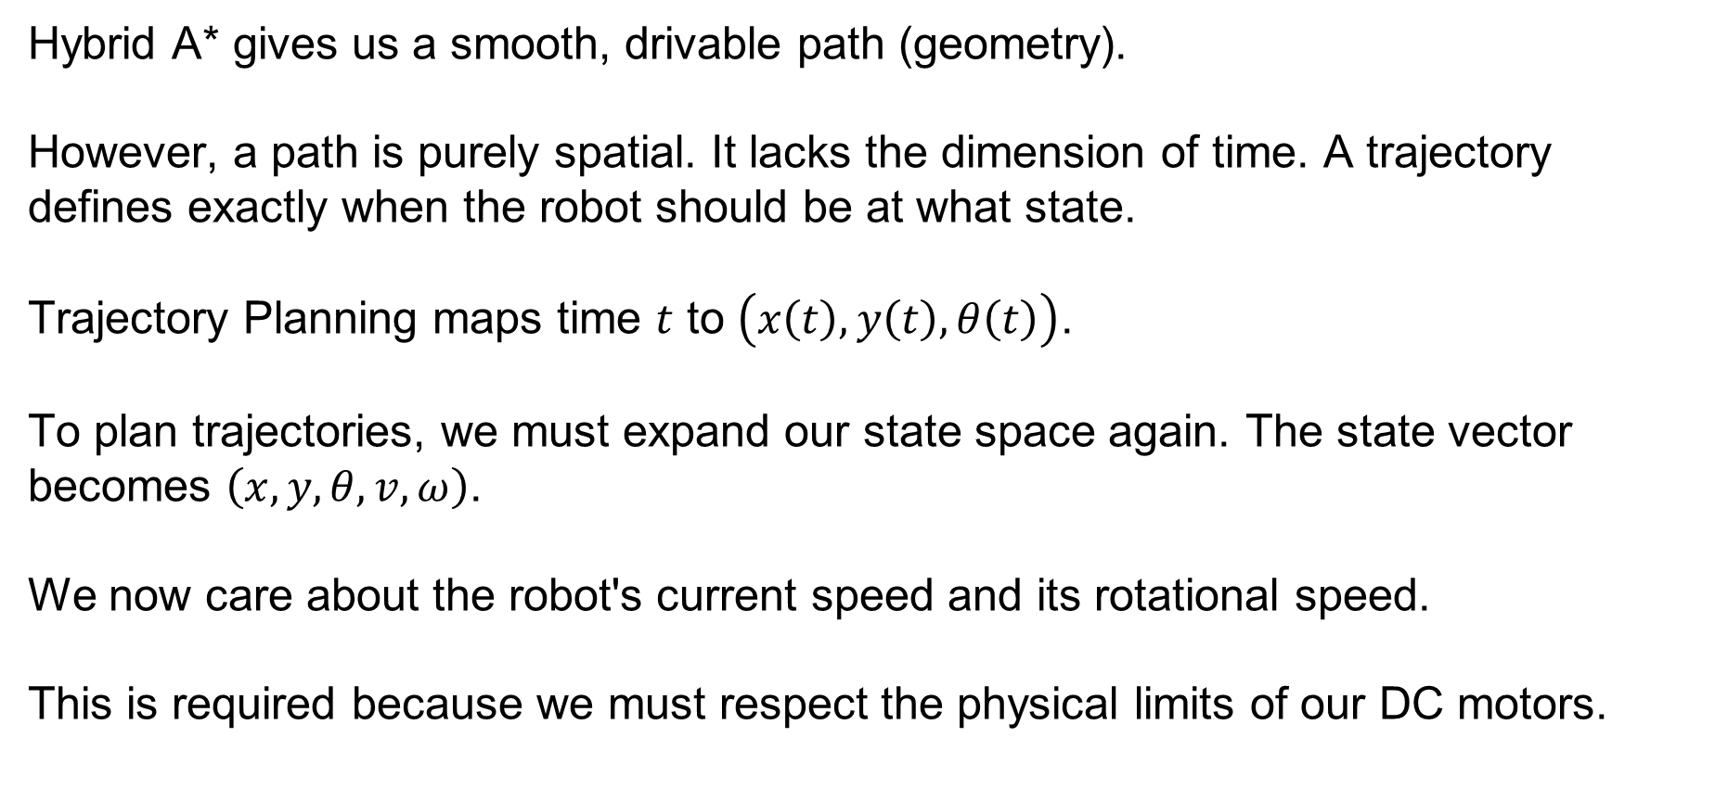
Trajectory Planning
Hybrid A* gives us a smooth, drivable path (geometry).
However, a path is purely spatial. It lacks the dimension of time. A trajectory defines exactly when the robot should be at what state.
Trajectory Planning maps time $t$ to $\left(x\left(t\right),y\left(t\right),θ\left(t\right)\right)$.
To plan trajectories, we must expand our state space again. The state vector becomes $\left(x,y,θ,v,ω\right)$.
We now care about the robot's current speed and its rotational speed.
This is required because we must respect the physical limits of our DC motors.
SYSTEMS ENGINEERING
GRAINGER ENGINEERING

Slide 36
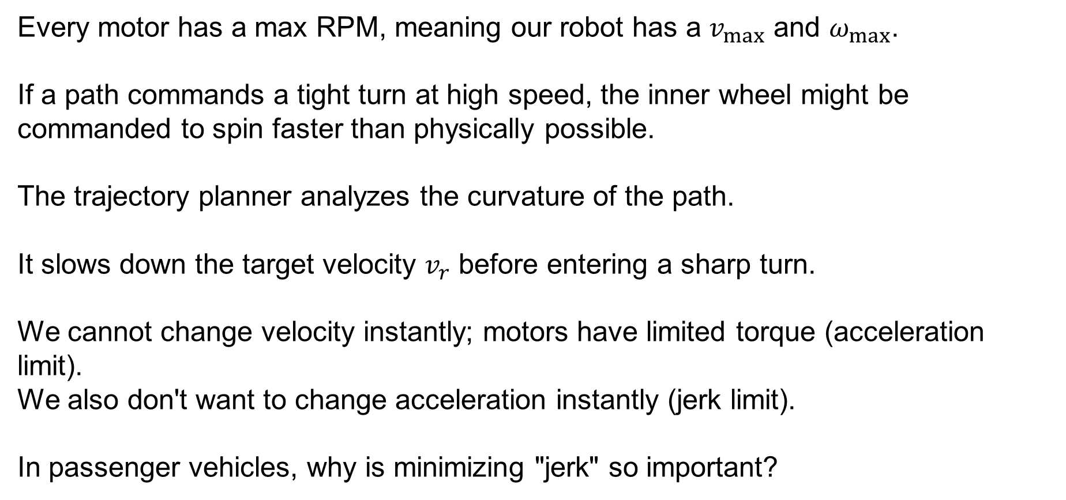
Trajectory Planning
Every motor has a max RPM, meaning our robot has a $v_{max}$ and $ω_{max}$.
If a path commands a tight turn at high speed, the inner wheel might be commanded to spin faster than physically possible.
The trajectory planner analyzes the curvature of the path.
It slows down the target velocity $v_{r}$ before entering a sharp turn.
We cannot change velocity instantly; motors have limited torque (acceleration limit).
We also don't want to change acceleration instantly (jerk limit).
In passenger vehicles, why is minimizing "jerk" so important?
SYSTEMS ENGINEERING
GRAINGER ENGINEERING

Slide 37
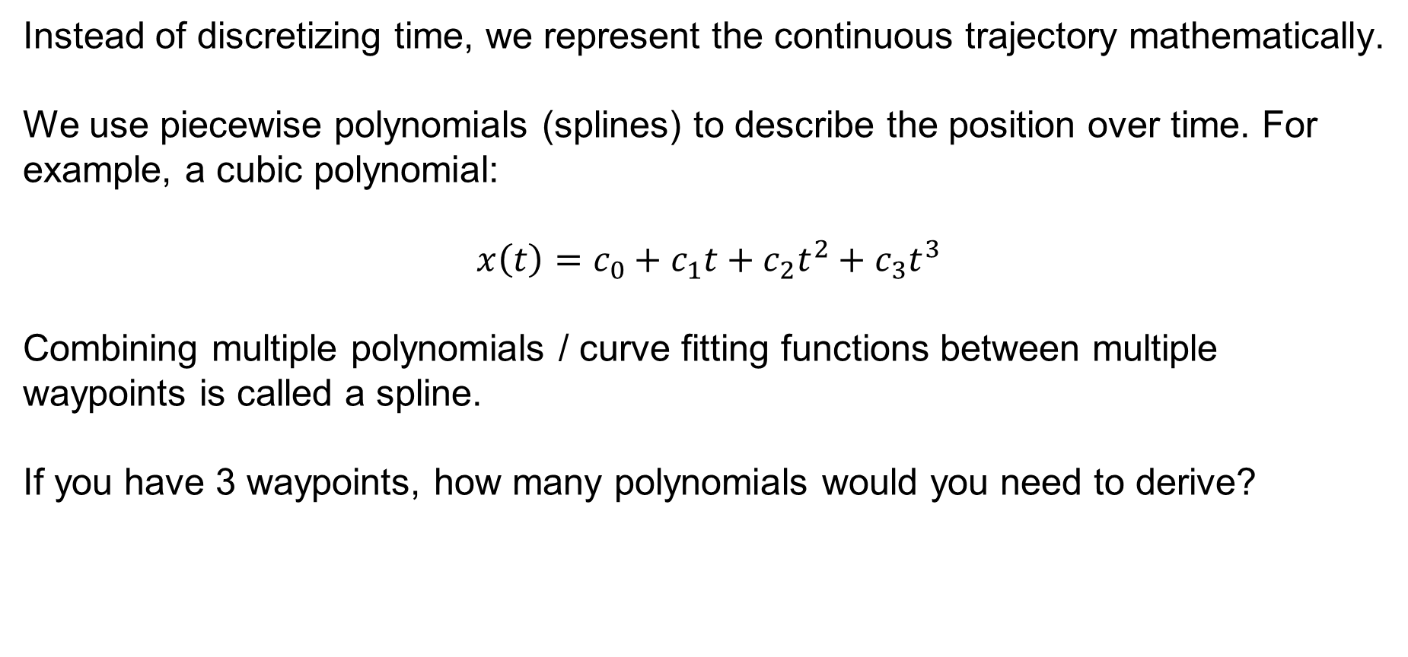
Trajectory Planning
Instead of discretizing time, we represent the continuous trajectory mathematically.
We use piecewise polynomials (splines) to describe the position over time. For example, a cubic polynomial:
$$x\left(t\right)=c_{0}+c_{1}t+c_{2}t^{2}+c_{3}t^{3}$$
Combining multiple polynomials / curve fitting functions between multiple waypoints is called a spline.
If you have 3 waypoints, how many polynomials would you need to derive?
SYSTEMS ENGINEERING
GRAINGER ENGINEERING

Slide 38
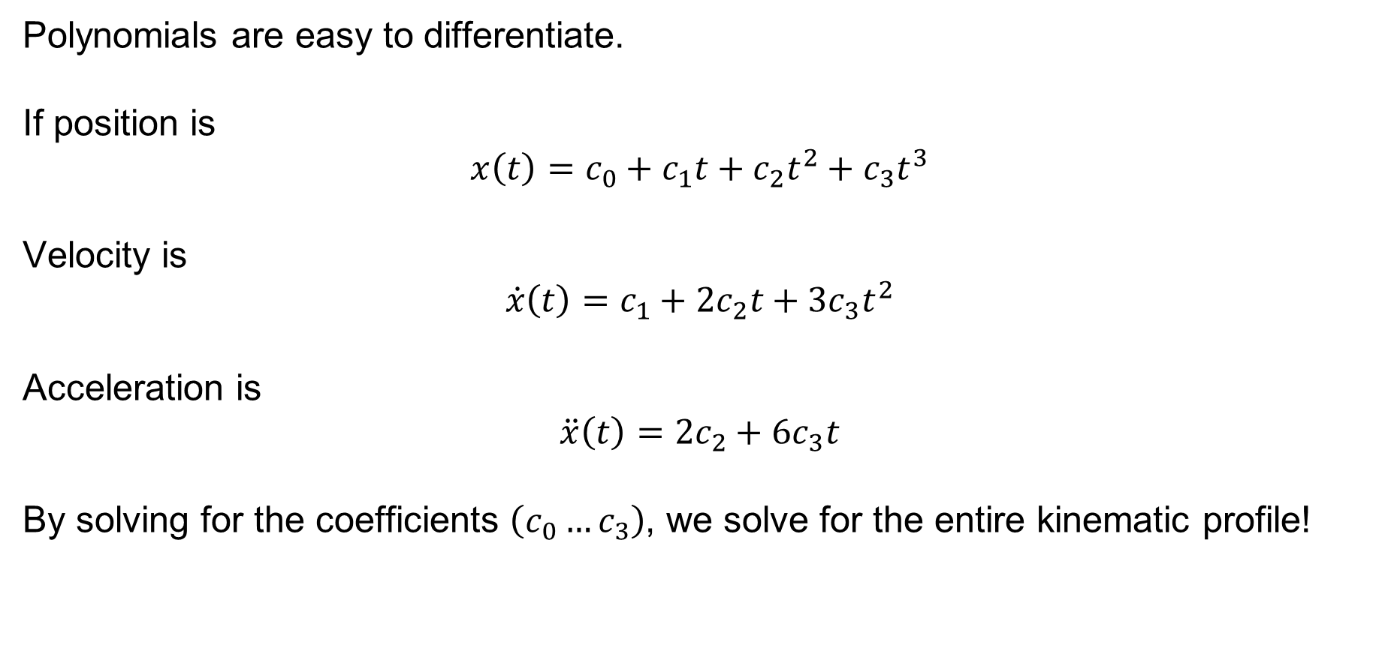
Trajectory Planning
Polynomials are easy to differentiate.
If position is
$$x\left(t\right)=c_{0}+c_{1}t+c_{2}t^{2}+c_{3}t^{3}$$
Velocity is
$$\dot{x}\left(t\right)=c_{1}+2c_{2}t+3c_{3}t^{2}$$
Acceleration is
$$\ddot{x}\left(t\right)=2c_{2}+6c_{3}t$$
By solving for the coefficients $\left(c_{0}…c_{3}\right)$, we solve for the entire kinematic profile!
SYSTEMS ENGINEERING
GRAINGER ENGINEERING

Slide 39
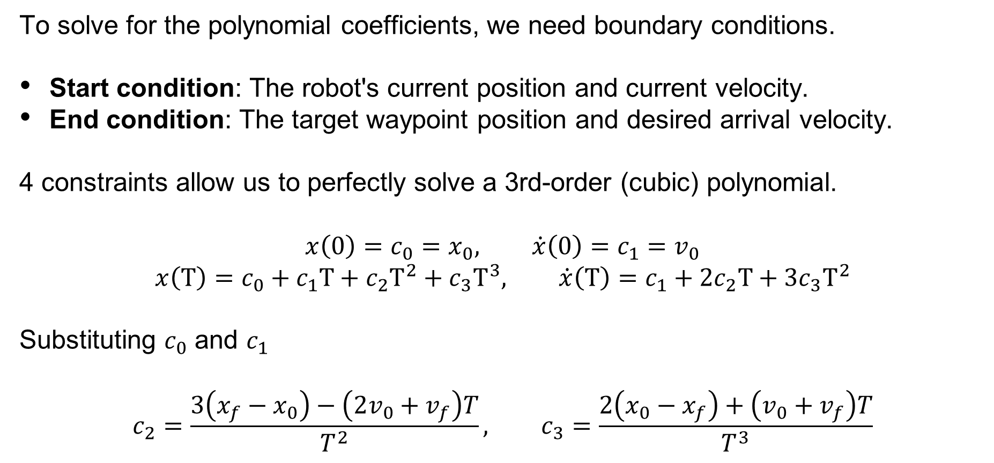
Trajectory Planning
To solve for the polynomial coefficients, we need boundary conditions.
Start condition: The robot's current position and current velocity.
End condition: The target waypoint position and desired arrival velocity.
4 constraints allow us to perfectly solve a 3rd-order (cubic) polynomial.
$$x\left(0\right)=c_{0}=x_{0}, \dot{x}\left(0\right)=c_{1}=v_{0}$$
$$x\left(T\right)=c_{0}+c_{1}T+c_{2}T^{2}+c_{3}T^{3}, \dot{x}\left(T\right)=c_{1}+2c_{2}T+3c_{3}T^{2}$$
Substituting $c_{0}$ and $c_{1}$
$$c_{2}=\frac{3\left(x_{f}−x_{0}\right)−\left(2v_{0}+v_{f}\right)T}{T^{2}}, c_{3}=\frac{2\left(x_{0}−x_{f}\right)+\left(v_{0}+v_{f}\right)T}{T^{3}}$$
SYSTEMS ENGINEERING
GRAINGER ENGINEERING

Slide 40
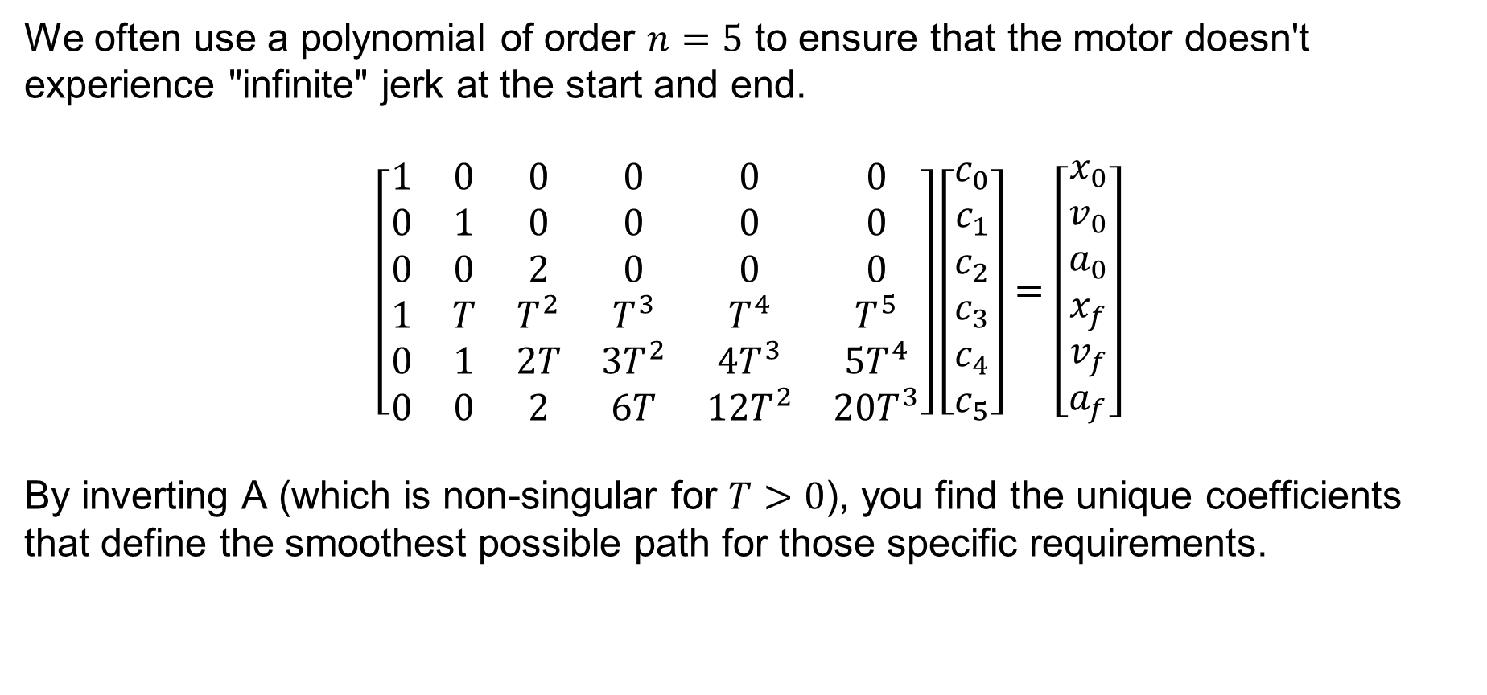
Trajectory Planning
We often use a polynomial of order $n=5$ to ensure that the motor doesn't experience "infinite" jerk at the start and end.
$$\left[\begin{matrix}1 & 0 & 0 & 0 & 0 & 0 \\ 0 & 1 & 0 & 0 & 0 & 0 \\ 0 & 0 & 2 & 0 & 0 & 0 \\ 1 & T & T^{2} & T^{3} & T^{4} & T^{5} \\ 0 & 1 & 2T & 3T^{2} & 4T^{3} & 5T^{4} \\ 0 & 0 & 2 & 6T & 12T^{2} & 20T^{3}\end{matrix}\right]\left[\begin{matrix}c_{0} \\ c_{1} \\ c_{2} \\ c_{3} \\ c_{4} \\ c_{5}\end{matrix}\right]=\left[\begin{matrix}x_{0} \\ v_{0} \\ a_{0} \\ x_{f} \\ v_{f} \\ a_{f}\end{matrix}\right]$$
By inverting A (which is non-singular for $T>0$), you find the unique coefficients that define the smoothest possible path for those specific requirements.
SYSTEMS ENGINEERING
GRAINGER ENGINEERING

Slide 41
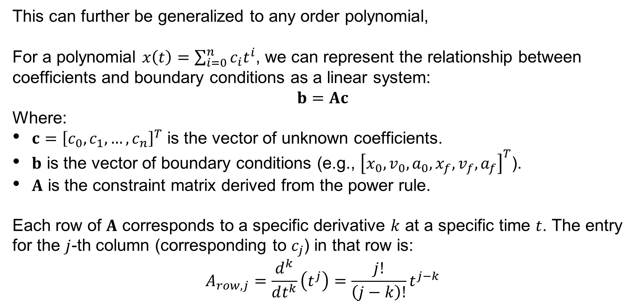
Trajectory Planning
This can further be generalized to any order polynomial,
For a polynomial $x\left(t\right)=\sum_{i=0}^{n}{c_{i}t^{i}}$, we can represent the relationship between coefficients and boundary conditions as a linear system:
$$b=Ac$$
Where:
$c={\left[c_{0},c_{1},…,c_{n}\right]}^{T}$ is the vector of unknown coefficients.
$b$ is the vector of boundary conditions (e.g., ${\left[x_{0},v_{0},a_{0},x_{f},v_{f},a_{f}\right]}^{T}$).
$A$ is the constraint matrix derived from the power rule.
Each row of $A$ corresponds to a specific derivative $k$ at a specific time $t$. The entry for the $j$-th column (corresponding to $c_{j}$) in that row is:
$$A_{row,j}=\frac{d^{k}}{dt^{k}}\left(t^{j}\right)=\frac{j!}{\left(j−k\right)!}t^{j−k}$$
SYSTEMS ENGINEERING
GRAINGER ENGINEERING

Slide 42
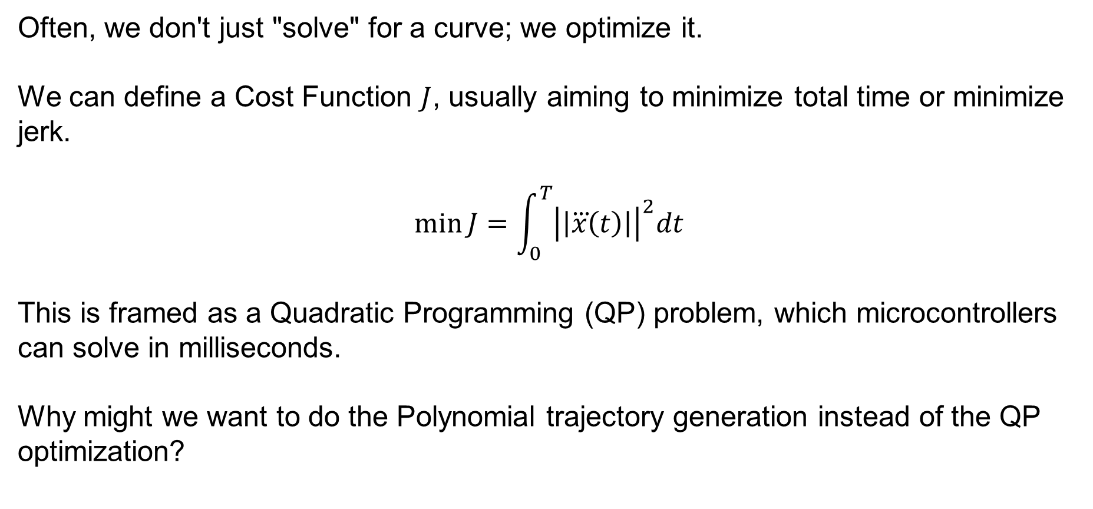
Trajectory Planning
Often, we don't just "solve" for a curve; we optimize it.
We can define a Cost Function $J$, usually aiming to minimize total time or minimize jerk.
$$\min{J}=\int_{0}^{T}{{\left|\left|\overset{⃛}{x}\left(t\right)\right|\right|}^{2}dt}$$
This is framed as a Quadratic Programming (QP) problem, which microcontrollers can solve in milliseconds.
Why might we want to do the Polynomial trajectory generation instead of the QP optimization?
SYSTEMS ENGINEERING
GRAINGER ENGINEERING

Slide 43
Trajectory Planning
A state-of-the-art approach for local trajectory planning is Time-Elastic Bands (TEB).
It treats the path like a rubber band stretched between the start and goal.
Obstacles act as repulsive forces pushing the band away.
Kinematic limits (max velocity, minimum turning radius) act as internal tension forces keeping the band physically viable.
SYSTEMS ENGINEERING
GRAINGER ENGINEERING

Slide 44
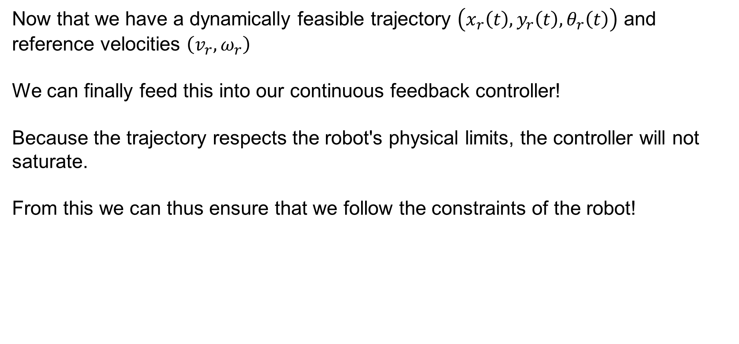
Trajectory Planning
Now that we have a dynamically feasible trajectory $\left(x_{r}\left(t\right),y_{r}\left(t\right),θ_{r}\left(t\right)\right)$ and reference velocities $\left(v_{r},ω_{r}\right)$
We can finally feed this into our continuous feedback controller!
Because the trajectory respects the robot's physical limits, the controller will not saturate.
From this we can thus ensure that we follow the constraints of the robot!
SYSTEMS ENGINEERING
GRAINGER ENGINEERING

Slide 45
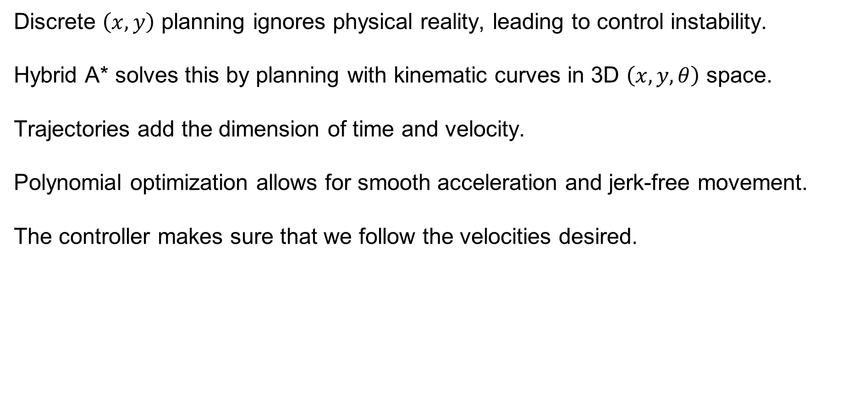
Trajectory Planning
Discrete $\left(x,y\right)$ planning ignores physical reality, leading to control instability.
Hybrid A* solves this by planning with kinematic curves in 3D $\left(x,y,θ\right)$ space.
Trajectories add the dimension of time and velocity.
Polynomial optimization allows for smooth acceleration and jerk-free movement.
The controller makes sure that we follow the velocities desired.
SYSTEMS ENGINEERING
GRAINGER ENGINEERING

Slide 46
Trajectory Planning
SYSTEMS ENGINEERING
GRAINGER ENGINEERING

Slide 47
Questions?
SYSTEMS ENGINEERING
GRAINGER ENGINEERING

Slide 48


