Slide 1
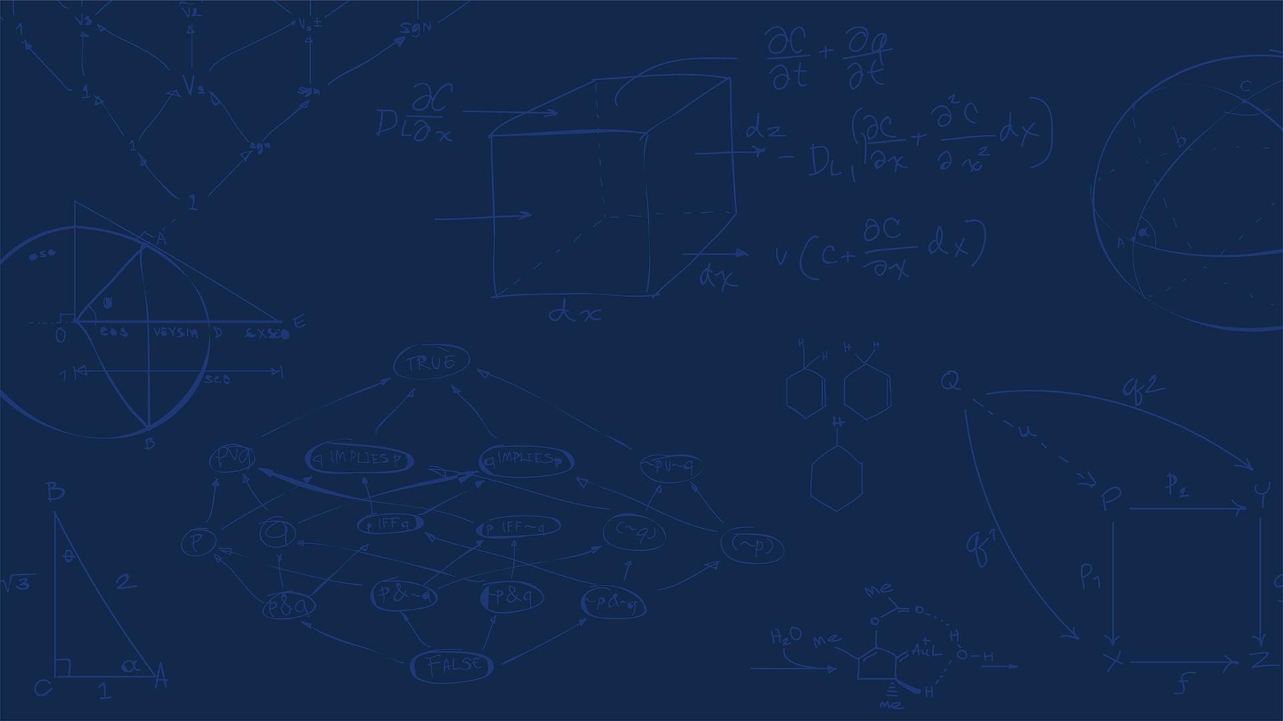

SE 423: Introduction to Mechatronics
Lecture 12: IMU
Marius Juston
Monday, February 2nd, 2026

Slide 2

Review – 5-minute partner discussion
Talk to the person next to you and answer these review questions.
To receive data, you must also ____ data.
What is FIFO? Why is it used?
What is the maximum size for the buffer’s data in bits?
What does SPICHAR = 0xF mean?
What do absolute / incremental encoders measure? When do they fail at measuring travel distance?
SYSTEMS ENGINEERING
GRAINGER ENGINEERING

Slide 3
Reminders
Office Hours:
Monday: 4-6 PM, Neel
Tuesday: 11-1 PM, Lakshmi
Tuesday: 1-3 PM, Samuel
Tuesday: 2-5 PM, Dan & Marius
Lab: Starting Lab 4 this week. This a 2-week lab!
Homeworks:
Check-offs for homework 3 Ex 1, 2, 3 & 4 are due March 10, 5PM (The end of office hours)
Check-offs for homework 3 Ex 5 are due March 24, 5PM (The end of office hours)
Answers and code submissions for homework 3 are due March 25, 9AM
SYSTEMS ENGINEERING
GRAINGER ENGINEERING

Slide 4
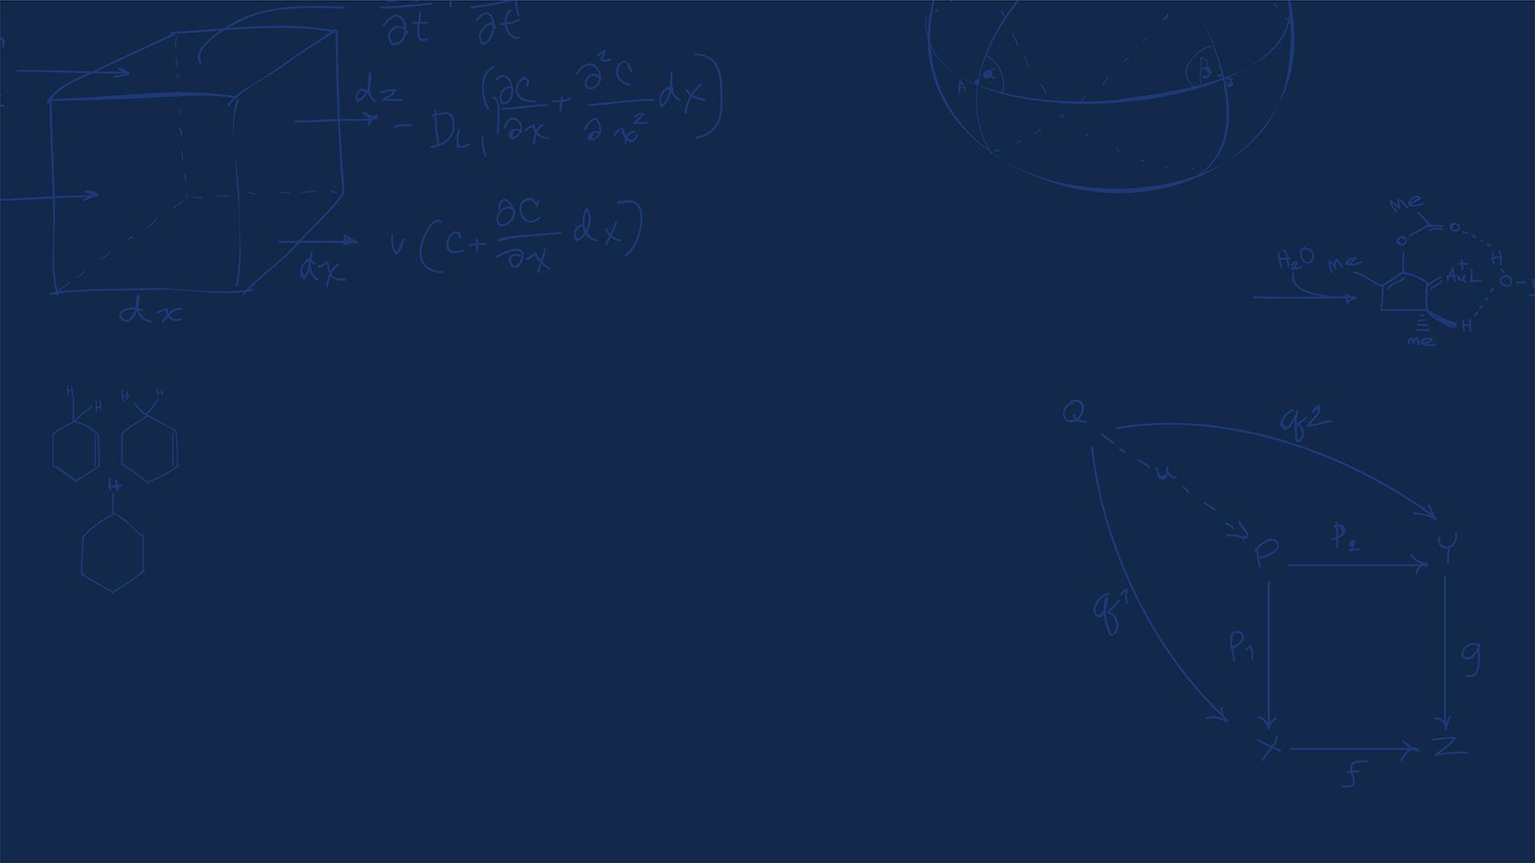
Questions?
Homework, Lab, LabVIEW?
SYSTEMS ENGINEERING
GRAINGER ENGINEERING

Slide 5
Thank you to everyone that responded to my feedback form!
There was a lot of great feedback that I will try to incorporate!
SYSTEMS ENGINEERING
GRAINGER ENGINEERING

Slide 6
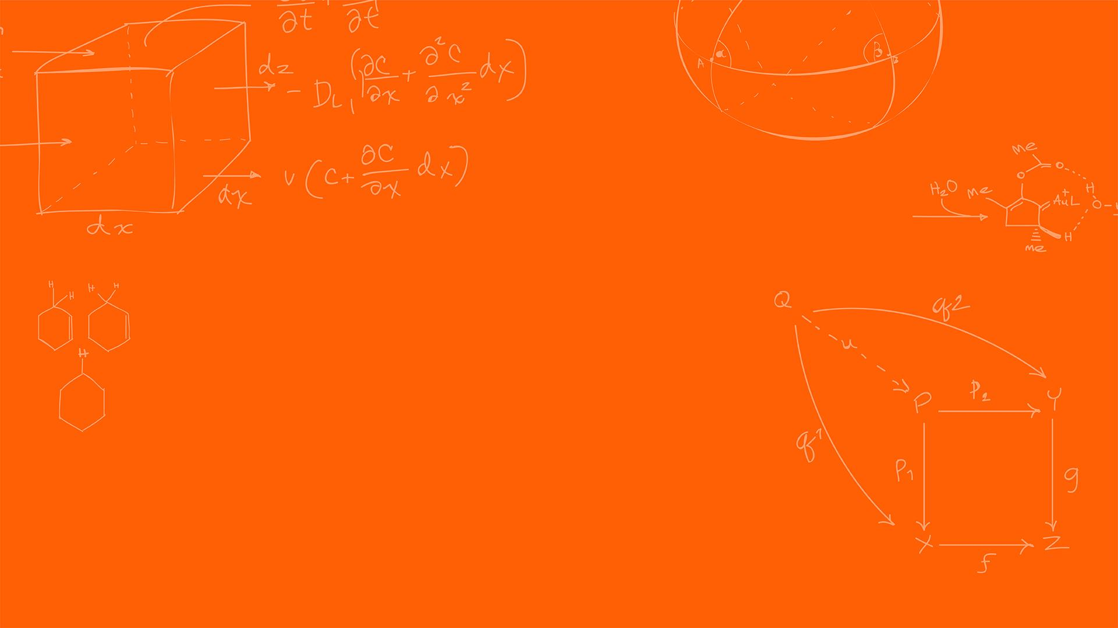

Accelerometer
SYSTEMS ENGINEERING
GRAINGER ENGINEERING

Slide 7
Accelerometer
We cannot and should not rely on a single sensor source (sensor fusion will be covered later), and sometimes we cannot attach encoders.
So, what can we do?
The goal is to measure direction and rotation. What is the most basic component that we can measure?
Forces!
How do calculate velocity and position from forces?
SYSTEMS ENGINEERING
GRAINGER ENGINEERING

Slide 8
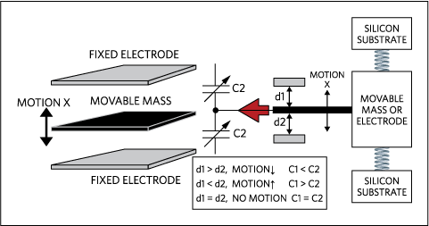
Accelerometer
A MEMS (Micro-Electro-Mechanical Systems) accelerometer measure linear acceleration.
Accelerometers work like a weight suspended by springs. When the mass is moved you measure the displacement, the springs bring it back to the center.
In chips, we use the change of capacitors. The capacitance is based on the distance between the 2 materials. So, the smaller the distance, the larger the returned capacitance.
You then measure this capacitance.
https://www.analog.com/cn/resources/technical-articles/accelerometer-and-gyroscopes-sensors-operation-sensing-and-applications.html
SYSTEMS ENGINEERING
GRAINGER ENGINEERING

Slide 9
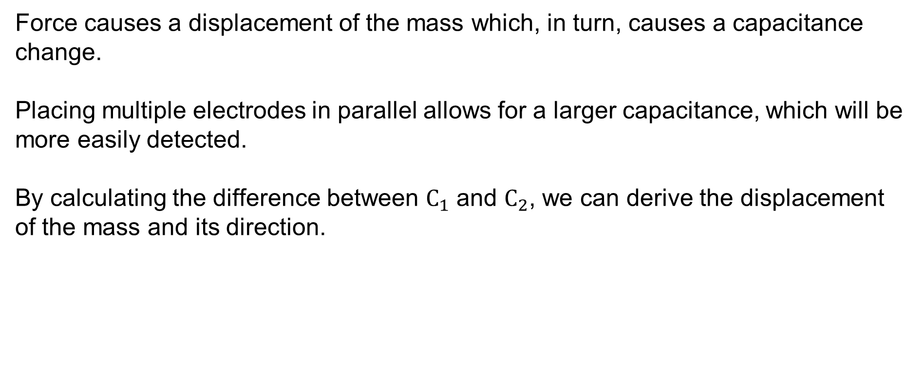
Accelerometer
Force causes a displacement of the mass which, in turn, causes a capacitance change.
Placing multiple electrodes in parallel allows for a larger capacitance, which will be more easily detected.
By calculating the difference between $C_{1}$ and $C_{2}$, we can derive the displacement of the mass and its direction.
SYSTEMS ENGINEERING
GRAINGER ENGINEERING

Slide 10
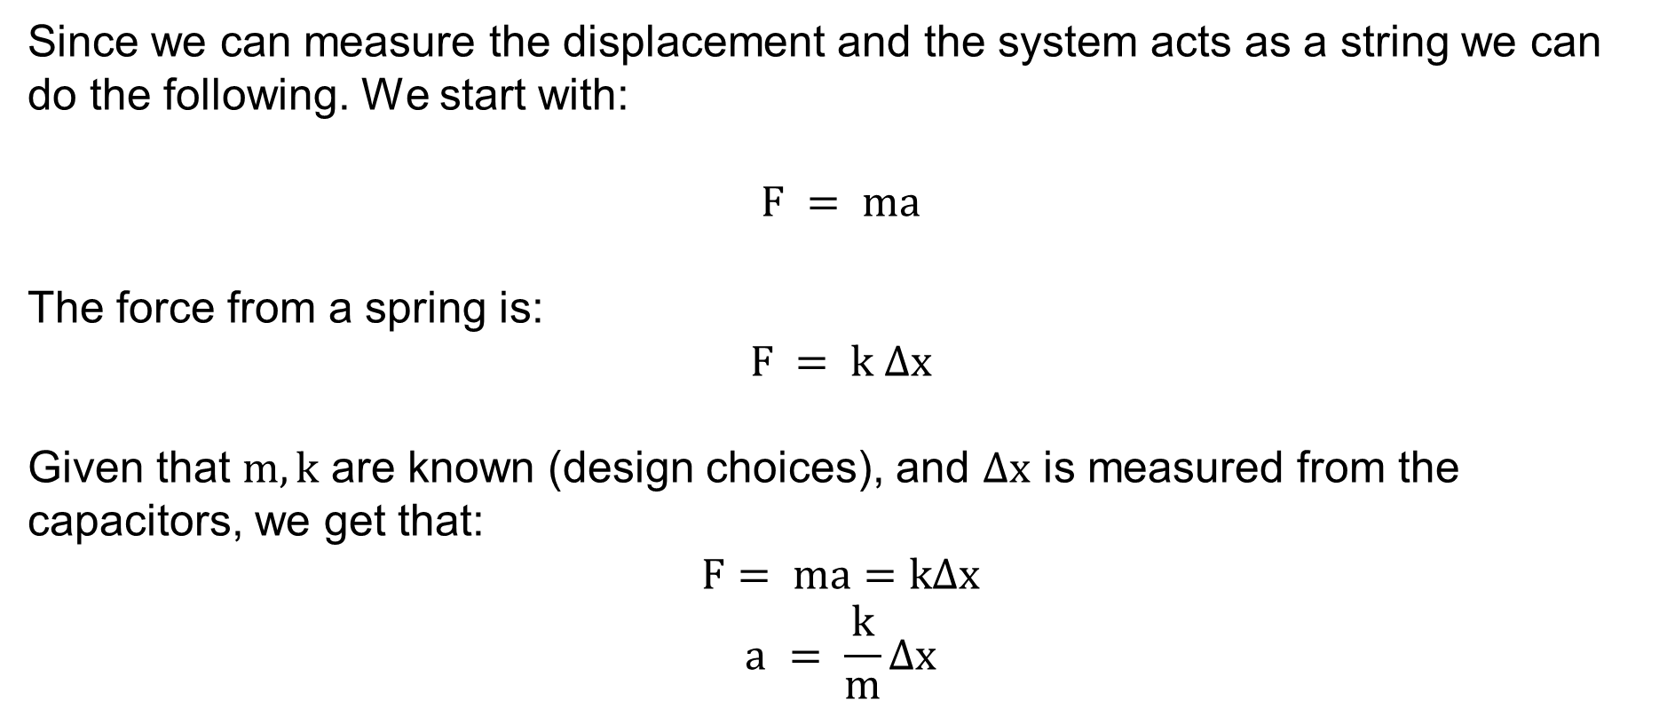
Accelerometer
Since we can measure the displacement and the system acts as a string we can do the following. We start with:
$$F = ma$$
The force from a spring is:
$$F = k ∆x$$
Given that $m, k$ are known (design choices), and $∆x$ is measured from the capacitors, we get that:
$$F= ma=k∆x$$
$$a = \frac{k}{m}∆x$$
SYSTEMS ENGINEERING
GRAINGER ENGINEERING

Slide 11
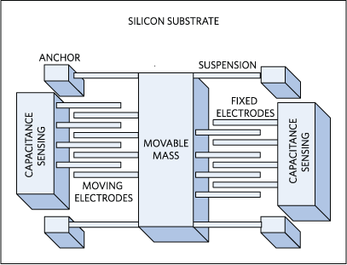
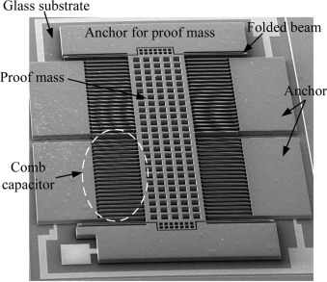
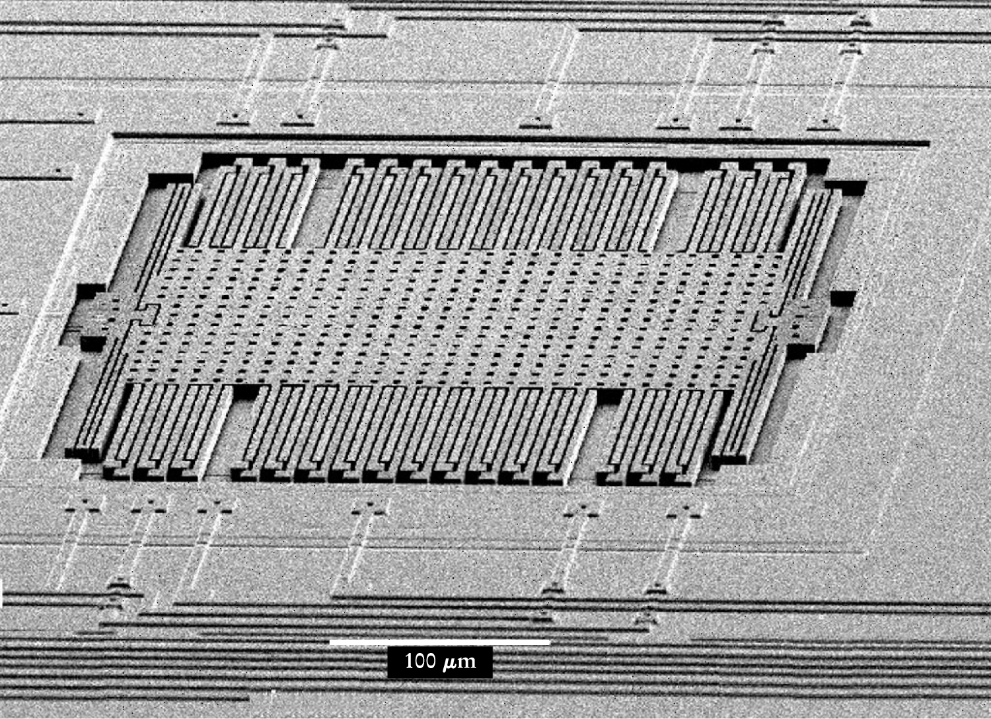
Accelerometer
You keep stacking these to remove the noise to get more accurate readings. In turn we get the following internal system. It is incredible how small these are!
How many axis can the following accelerometers measure?
https://www.analog.com/cn/resources/technical-articles/accelerometer-and-gyroscopes-sensors-operation-sensing-and-applications.html
https://www.sciencedirect.com/science/article/pii/S0924424716300267
https://physicstoday.aip.org/features/the-little-machines-that-are-making-it-big
SYSTEMS ENGINEERING
GRAINGER ENGINEERING

Slide 12
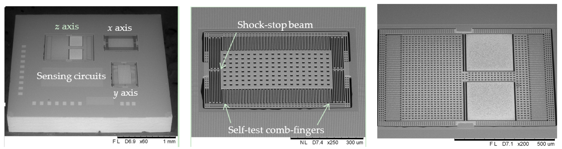
Accelerometer
Think of the z-axis as a trampoline!
What happens if you have too large of an acceleration (think of the combs)?
An accelerometer that is sitting still on a desk reads _g pointing upwards.
What if it gets dropped out of the window in a perfect vacuum?
https://www.mdpi.com/2504-3900/1/4/337
SYSTEMS ENGINEERING
GRAINGER ENGINEERING

Slide 13
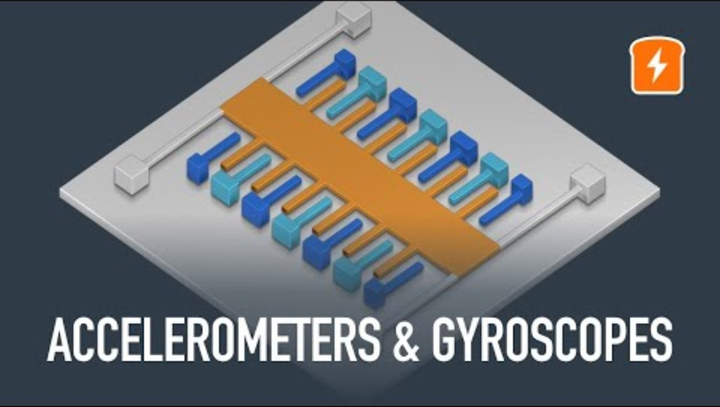
Accelerometer
SYSTEMS ENGINEERING
GRAINGER ENGINEERING

Slide 14
Gyroscope
SYSTEMS ENGINEERING
GRAINGER ENGINEERING

Slide 15
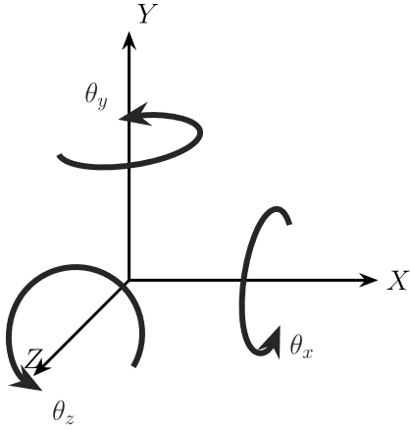
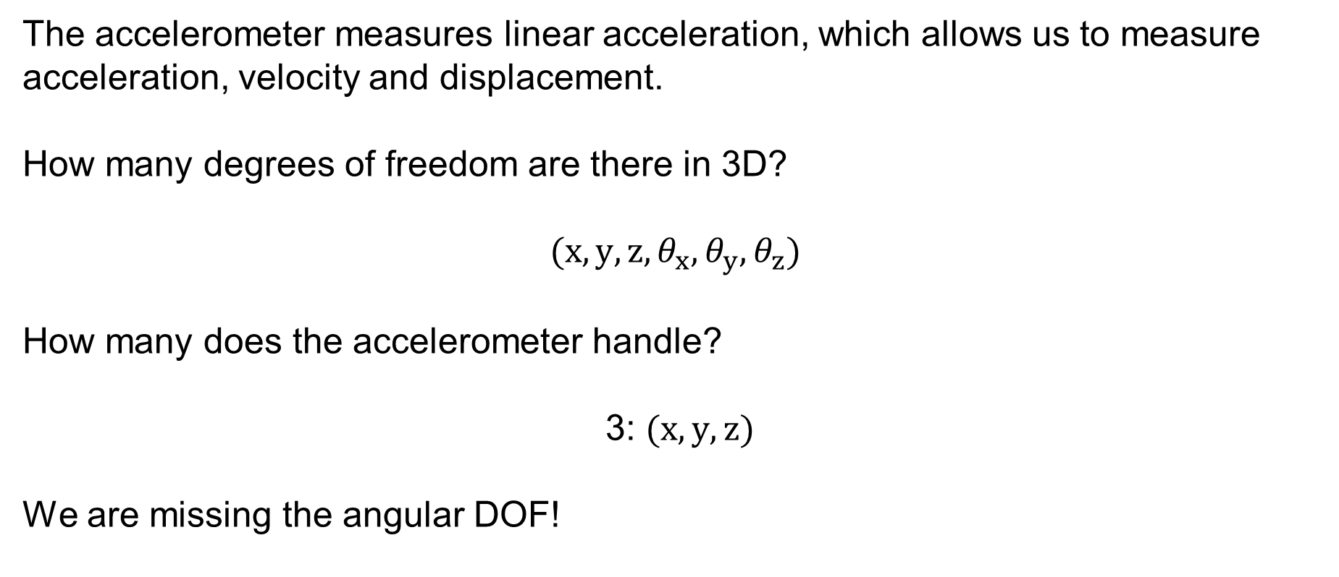
Gyroscope
The accelerometer measures linear acceleration, which allows us to measure acceleration, velocity and displacement.
How many degrees of freedom are there in 3D?
$$(x, y, z,θ_{x},θ_{y},θ_{z})$$
How many does the accelerometer handle?
3: $(x, y, z)$
We are missing the angular DOF!
SYSTEMS ENGINEERING
GRAINGER ENGINEERING

Slide 16
Gyroscope
A MEMS Gyroscope does not use a spinning wheel like classical mechanical gyroscopes. Similarly, you have a tiny mass that is moving when rotating. If the device start rotating, the moving mass experiences a sideways force.
https://www.reddit.com/r/3Dprinting/comments/103v6ef/1001_3d_printed_mems_gyroscope/
SYSTEMS ENGINEERING
GRAINGER ENGINEERING

Slide 17
Gyroscope
Very similar to accelerometers,
The mass sits between capacitors plates.
When the it moves sideways, capacitance changes.
This returns a displacement from which we can compute angular velocity.
SYSTEMS ENGINEERING
GRAINGER ENGINEERING

Slide 18
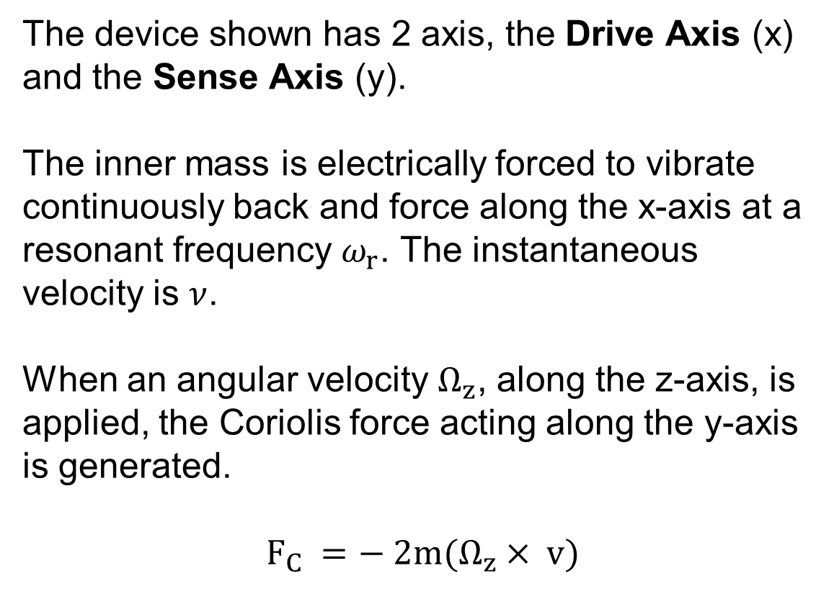
Gyroscope
The device shown has 2 axis, the Drive Axis (x) and the Sense Axis (y).
The inner mass is electrically forced to vibrate continuously back and force along the x-axis at a resonant frequency $ω_{r}$. The instantaneous velocity is $ν$.
When an angular velocity $Ω_{z}$, along the z-axis, is applied, the Coriolis force acting along the y-axis is generated.
$$F_{C} =− 2m(Ω_{z}× v)$$
https://www.reddit.com/r/3Dprinting/comments/103v6ef/1001_3d_printed_mems_gyroscope/
SYSTEMS ENGINEERING
GRAINGER ENGINEERING

Slide 19
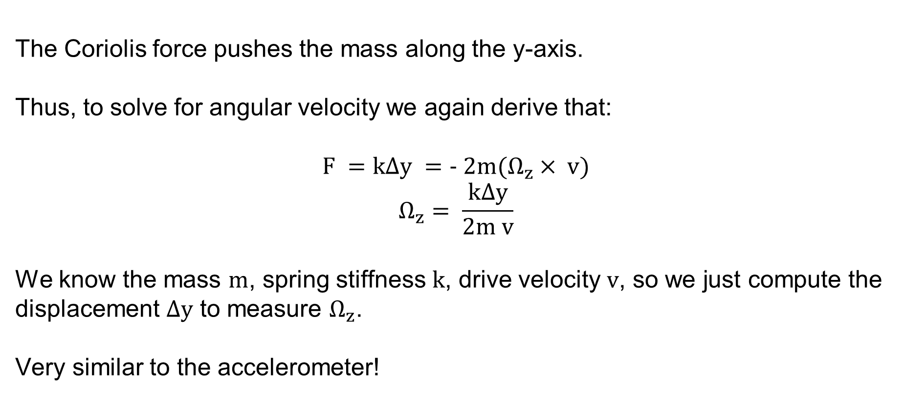
Gyroscope
The Coriolis force pushes the mass along the y-axis.
Thus, to solve for angular velocity we again derive that:
$$F =k∆y =− 2m(Ω_{z}× v)$$
$$Ω_{z}= \frac{k∆y}{2m v}$$
We know the mass $m$, spring stiffness $k$, drive velocity $v$, so we just compute the displacement $∆y$ to measure $Ω_{z}$.
Very similar to the accelerometer!
SYSTEMS ENGINEERING
GRAINGER ENGINEERING

Slide 20
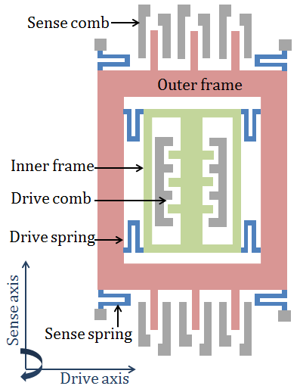
Gyroscope
https://www.semanticscholar.org/paper/Modeling-and-simulation-of-the-MEMS-vibratory-Patel-McCluskey/8dec6605fc5b603df07d74f7b9eb6875b2c17c3a
https://www.reddit.com/r/3Dprinting/comments/103v6ef/1001_3d_printed_mems_gyroscope/
SYSTEMS ENGINEERING
GRAINGER ENGINEERING

Slide 21
Gyroscope
https://quanscient.com/blog/enhancing-mems-gyroscope-design
https://forum.arduino.cc/t/getting-started-with-the-mpu6050-beginner-friendly-guide-with-visual-explanations/1364064
SYSTEMS ENGINEERING
GRAINGER ENGINEERING

Slide 22
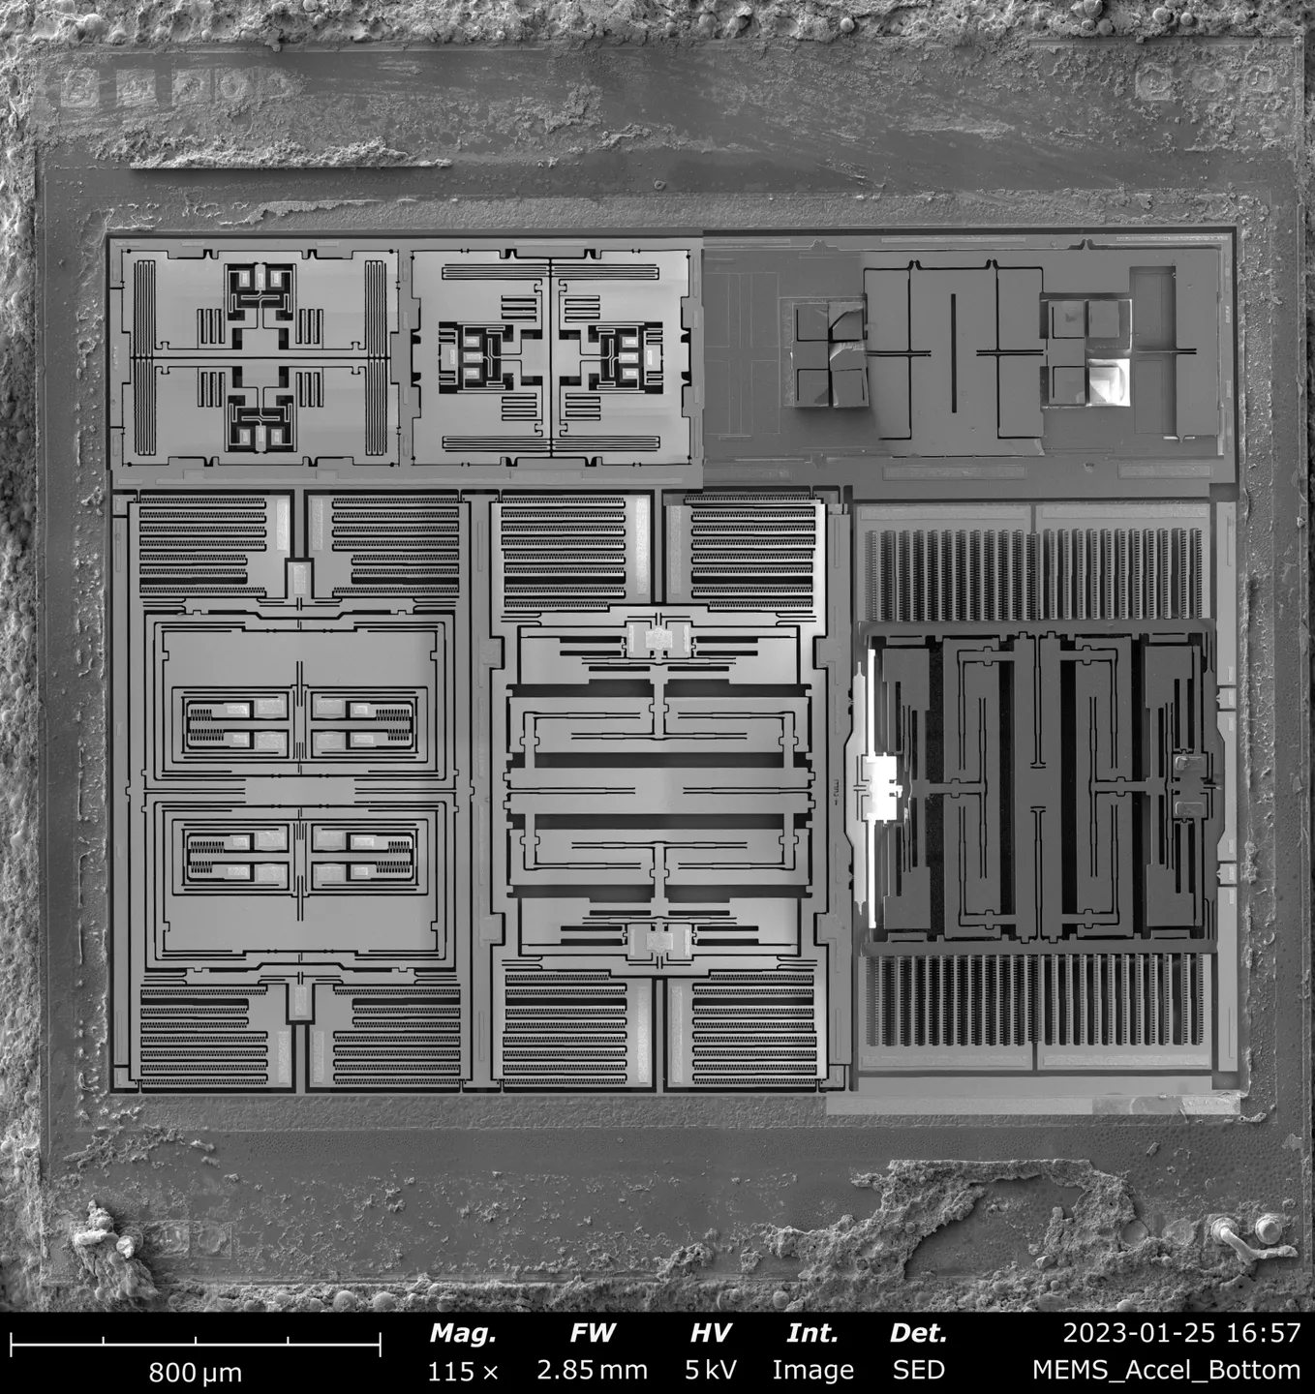
Gyroscope
What is this? The gyros or accelerometers?
What is this? The gyros or accelerometers?
https://www.printables.com/model/413667-mems-model-six-axis-imu-device
SYSTEMS ENGINEERING
GRAINGER ENGINEERING

Slide 23
Magnetometer
SYSTEMS ENGINEERING
GRAINGER ENGINEERING

Slide 24
Magnetometer
What is a device that has been used for traveling for a very long time? That has helped sailors travel?
The compass!
The magnetometer acts as an absolute reference. It measures the strength and direction of the Earth’s magnetic field, allowing the system to establish a global “North”
The more popular method uses the Hall Effect sensor to measure the magnetic field; however, next slide is a slightly different, method, and was chosen since it is more like the previous accelerometer and gyroscope sensors. Although they measure the same thing in the end!
SYSTEMS ENGINEERING
GRAINGER ENGINEERING

Slide 25
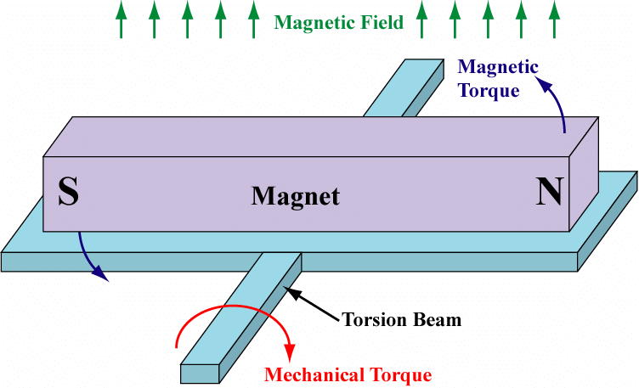
Magnetometer
The magnetic field acts like a counterbalance and you measure the torque
https://www.researchgate.net/figure/llustration-of-a-ferromagnetic-MEMS-magnetometer-design_fig18_255663586
SYSTEMS ENGINEERING
GRAINGER ENGINEERING

Slide 26
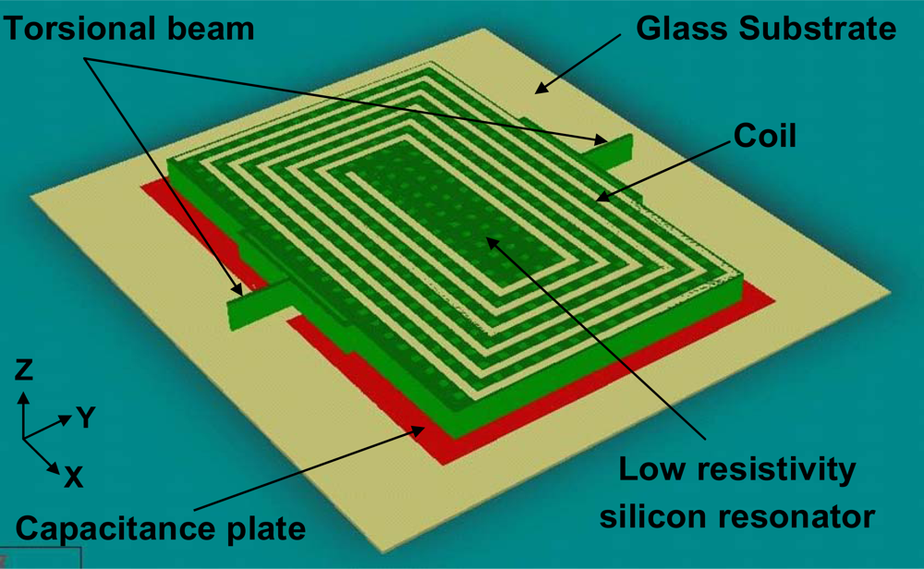
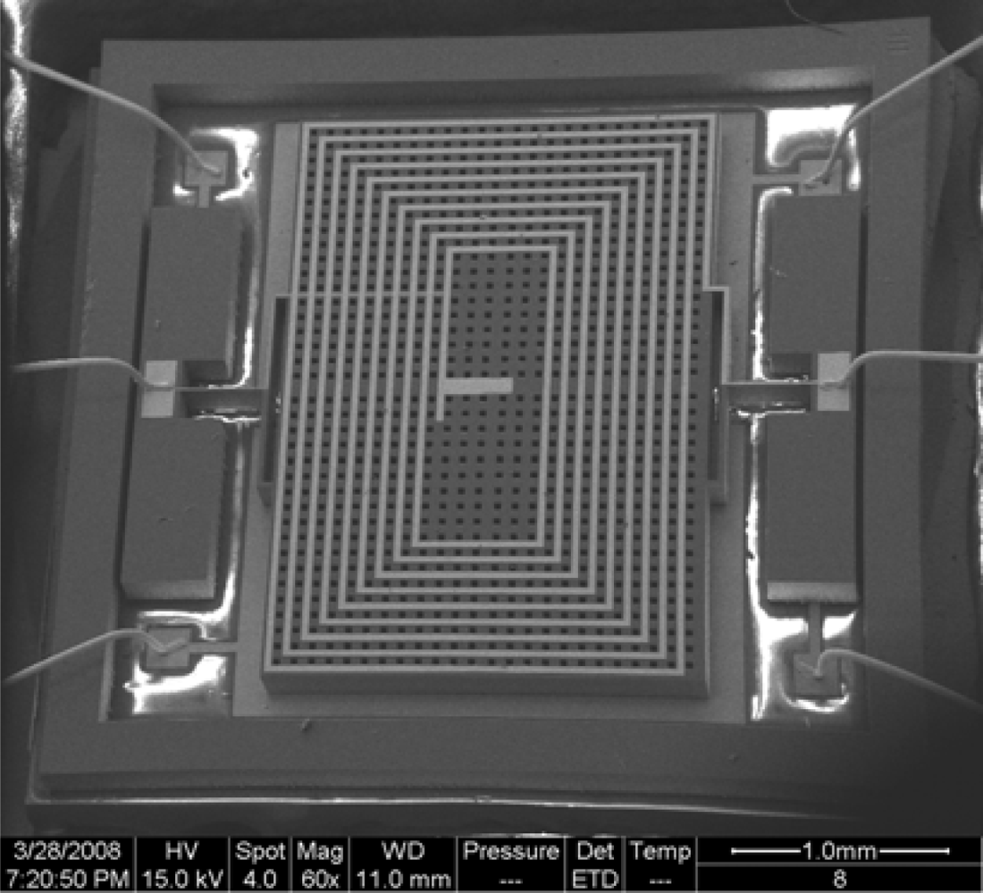
Magnetometer
https://www.mdpi.com/1424-8220/9/9/6951
SYSTEMS ENGINEERING
GRAINGER ENGINEERING

Slide 27
IMU
SYSTEMS ENGINEERING
GRAINGER ENGINEERING

Slide 28
IMU
IMU – stands for Inertial Measurement Unit
Which is just a single chip that packages 3-axis accelerometers, 3-axis gyroscopes and a 3-axis magnetometer (sometimes).
Sometimes includes additional noise filtering, sensor fusion.
Allows to collect all the information about the robot’s inertial state.
SYSTEMS ENGINEERING
GRAINGER ENGINEERING

Slide 29
IMU
We will specially be using the MPU-9250. This specifically contains a 3-axis accelerometer, 3-axis gyroscope and a 3-axis magnetometer.
There are multiple sensitivity levels that you can set the sensors:
Gyroscope: ±250, ±500, ±1000, and ±2000 dps (degrees per second)
Accelerometer: ±2g, ±4g, ±8g, and ±16g
Magnetometer: ±4800µT (Tesla)
We can communicate to it through I2C at 400kHz or SPI at 1MHz (up to 20MHz).
These sensors are meant to be read extremely fast, why is that the case?
We need to integrate to get velocity and position so the smaller the dt the more accurate!
SYSTEMS ENGINEERING
GRAINGER ENGINEERING

Slide 30
IMU
We will be communicating through SPI.
Each the returned results will be 16-bit signed integers. As such:
Acceleration X, Y, Z: [-32768, 32767] = [-4g, 4g]
Gyro X, Y, Z: [-32768, 32767] = [-250 dps, 250 dsp]
SYSTEMS ENGINEERING
GRAINGER ENGINEERING

Slide 31
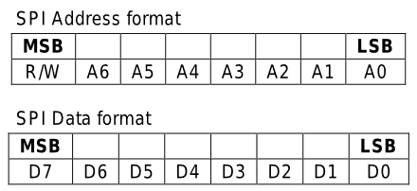
IMU
There are 2 components for this sensor, writing configurations vs reading data. This is encoded inside the SPI data. We separate the message into 2 8-bit parts.
The address (top 8-bits): Says if we are trying to read/write and from where (accel vs gyro)
The data (bottom 8-bits): what we are trying to send to write to that address (ignored if reading)
The address
The 7-bit reference address 0x00 to 0x74
The read/write bit
(1 = read, 0 = write)
16-bit message
The data
SYSTEMS ENGINEERING
GRAINGER ENGINEERING

Slide 32
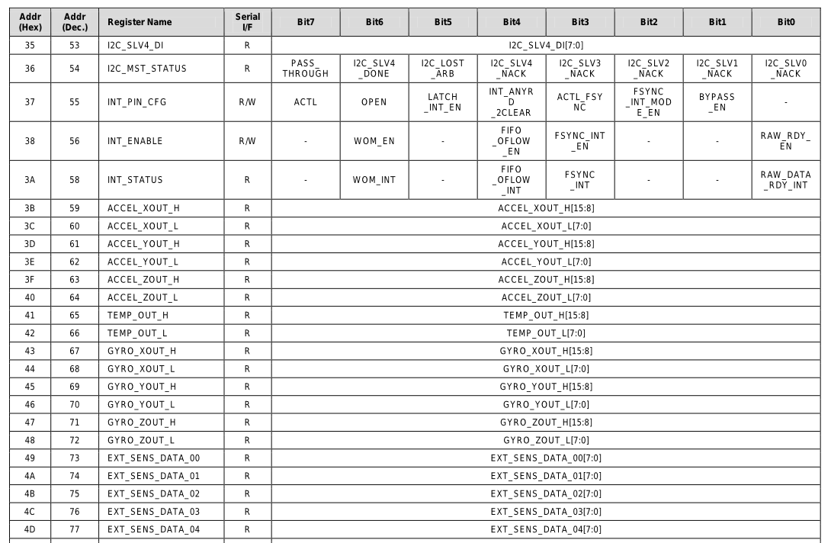
IMU
Data is split into 8-bit high and low bits
The address
If you can read / write to this address
SYSTEMS ENGINEERING
GRAINGER ENGINEERING

Slide 33
IMU
As you previously saw we want to write 16-bits of data and potentially read 16-bits at a time to reduce the complexity of having to bit shift the high and low bits into the same variable.
To do this what would we need to set SPICHAR to?
0xA 0x11 0xF 0x8
SYSTEMS ENGINEERING
GRAINGER ENGINEERING

Slide 34
IMU
When writing configuration to the MPU board, such as the accelerometer X offset (initial bias)
GpioDataRegs.GPCCLEAR.bit.GPIO66 = 1; // Start SPI
// 0x77 = 0111 0111 is this read or writing?
SpibRegs.SPITXBUF = (0x7700 | 0x00EB); // Address + data
while(SpibRegs.SPIFFRX.bit.RXFFST !=1); // Waiting for response
GpioDataRegs.GPCSET.bit.GPIO66 = 1; // Disable SPI
temp = SpibRegs.SPIRXBUF; // Read value even though not needed
DELAY_US(10); // Delay a bit before issuing another MPU-9250 SPI transfer
SYSTEMS ENGINEERING
GRAINGER ENGINEERING

Slide 35
IMU
What if we want to write multiple pieces of data at once?
GpioDataRegs.GPCCLEAR.bit.GPIO66 = 1;
SpibRegs.SPITXBUF = (0x1900 | 0x0013); // One write
SpibRegs.SPITXBUF = (0x0200 | 0x0000); // Second write
while(SpibRegs.SPIFFRX.bit.RXFFST !=2); // Wait that both have been sent
GpioDataRegs.GPCSET.bit.GPIO66 = 1;
temp = SpibRegs.SPIRXBUF; // Read value even though not needed
temp = SpibRegs.SPIRXBUF; // Read second value even though not needed
DELAY_US(10); // Delay a bit before issuing another MPU-9250 SPI transfer
What is the maximum number of writes at a time?
The maximum size of the TX/RX FIFO is 16!
SYSTEMS ENGINEERING
GRAINGER ENGINEERING

Slide 36
IMU
When explicitly wanting to read the data, especially if there is a lot we want to read, accel X, Y, Z, gyro X, Y, Z, each of them having a high and low address. Is there a smart way of doing this?
Yes!
This MPU you send an address that you want to start reading from. If you continue to give it clock cycles it will just continue down to the next address and read down!
Allows us to read the 16-bit data into a single 16-bit read!
SYSTEMS ENGINEERING
GRAINGER ENGINEERING

Slide 37
IMU
Start reading (sent 8-bit start address)
Continue reading 16-bits
Continue reading 16-bits
Continue reading 16-bits
SYSTEMS ENGINEERING
GRAINGER ENGINEERING

Slide 38
IMU
// Code inside CPU Timer 0
GpioDataRegs.GPCCLEAR.bit.GPIO66 = 1;
SpibRegs.SPIFFRX.bit.RXFFIL = 3;
// 0x8 = 1000 = read
// 0x3C = address to read from
SpibRegs.SPITXBUF = ((0x8000) | (0x3C00));
SpibRegs.SPITXBUF = 0; // 0x0000 continue
SpibRegs.SPITXBUF = 0; // 0x0000 continue
int16_t dummy= 0;
int16_t accelYraw = 0;
int16_t accelZraw = 0;
float accelYreading = 0;
float accelZreading = 0;
__interrupt void SPIB_isr(void){
GpioDataRegs.GPCSET.bit.GPIO66 = 1; // Stop SPI transmit
dummy = SpibRegs.SPIRXBUF; // reads from 0x3C Accel x low only
accelYraw = SpibRegs.SPIRXBUF; // reads 0x3D | 0x3E = Accel y out
accelZraw = SpibRegs.SPIRXBUF; // reads 0x3F | 0x40 = Accel z out
accelYreading = accelYraw*4.0/32767.0;
accelZreading = accelZraw*4.0/32767.0;
SpibRegs.SPIFFRX.bit.RXFFOVFCLR=1; // Clear Overflow flag
SpibRegs.SPIFFRX.bit.RXFFINTCLR=1; // Clear Interrupt flag
PieCtrlRegs.PIEACK.all = PIEACK_GROUP6;
}
SYSTEMS ENGINEERING
GRAINGER ENGINEERING

Slide 39
IMU
SpibRegs.SPITXBUF = ((0x8000) | (0x3C00));
SpibRegs.SPITXBUF = 0; // 0x0000 continue
SpibRegs.SPITXBUF = 0; // 0x0000 continue
SYSTEMS ENGINEERING
GRAINGER ENGINEERING

Slide 40
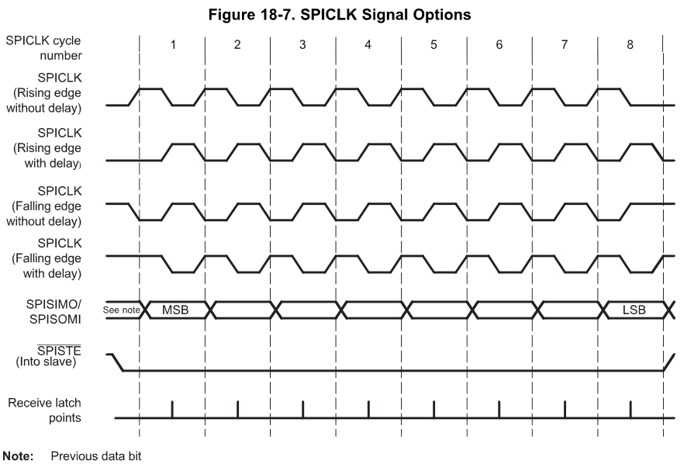
SPI
Polarity | Phase
0 | 0
0 | 1
1 | 0
1 | 1
SYSTEMS ENGINEERING
GRAINGER ENGINEERING

Slide 41
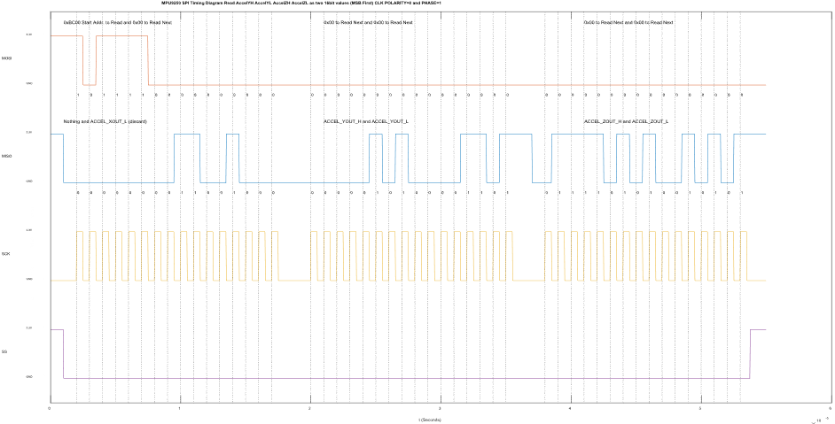
IMU
What is the clock polarity?
What is the clock phase?
SYSTEMS ENGINEERING
GRAINGER ENGINEERING

Slide 42
Questions?
SYSTEMS ENGINEERING
GRAINGER ENGINEERING

Slide 43


