Slide 1
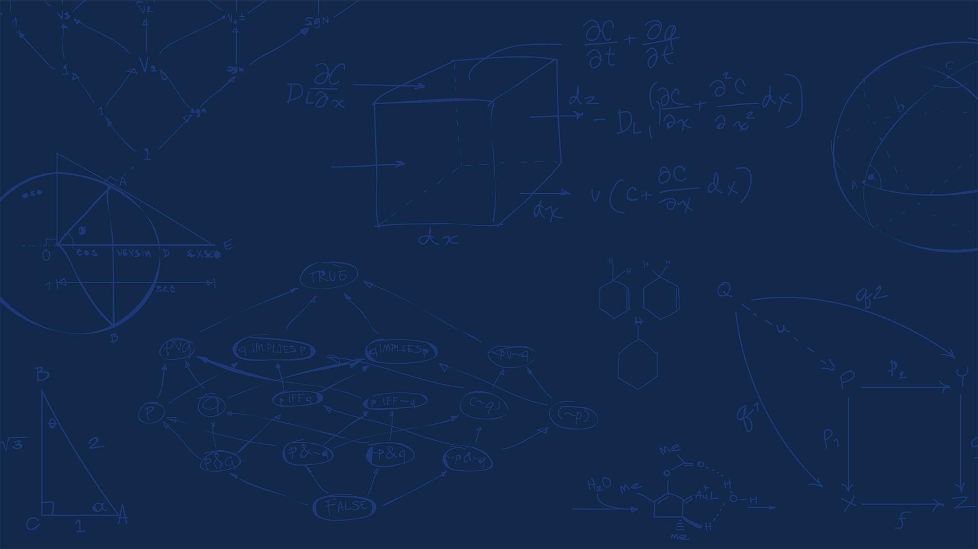
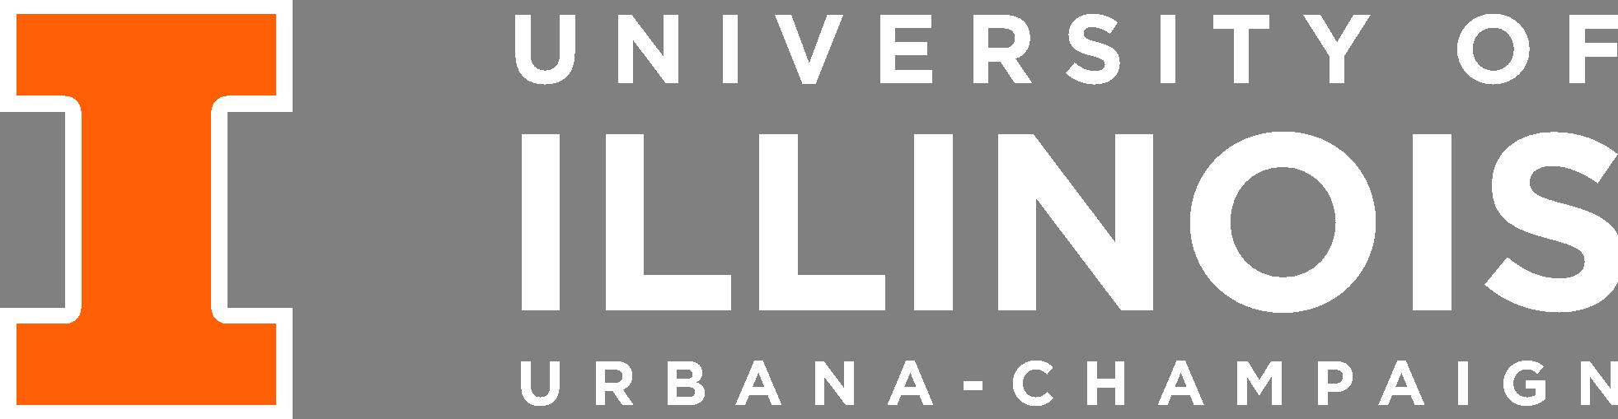
SE 423: Introduction to Mechatronics
Lecture 11: PID Control
Marius Juston
Wednesday, February 25th, 2026

Slide 2

Reminders
Office Hours:
Monday: 4-6 PM, Neel
Tuesday: 11-1 PM, Lakshmi
Tuesday: 1-3 PM, Samuel
Tuesday: 2-5 PM, Dan & Marius
Lab: Starting Lab 4 this week. This a 2-week lab!
Homeworks:
Answers and code submissions for homework 2 are due February 26, 9AM
Check-offs for homework 3 Ex 1, 2, 3 & 4 are due March 10, 5PM (The end of office hours)
Check-offs for homework 3 Ex 5 are due March 24, 5PM (The end of office hours)
Answers and code submissions for homework 3 are due March 25, 9AM
LabVIEW:
All check-offs for LabVIEW 2 are due February 26, 5PM
SYSTEMS ENGINEERING
GRAINGER ENGINEERING

Slide 3
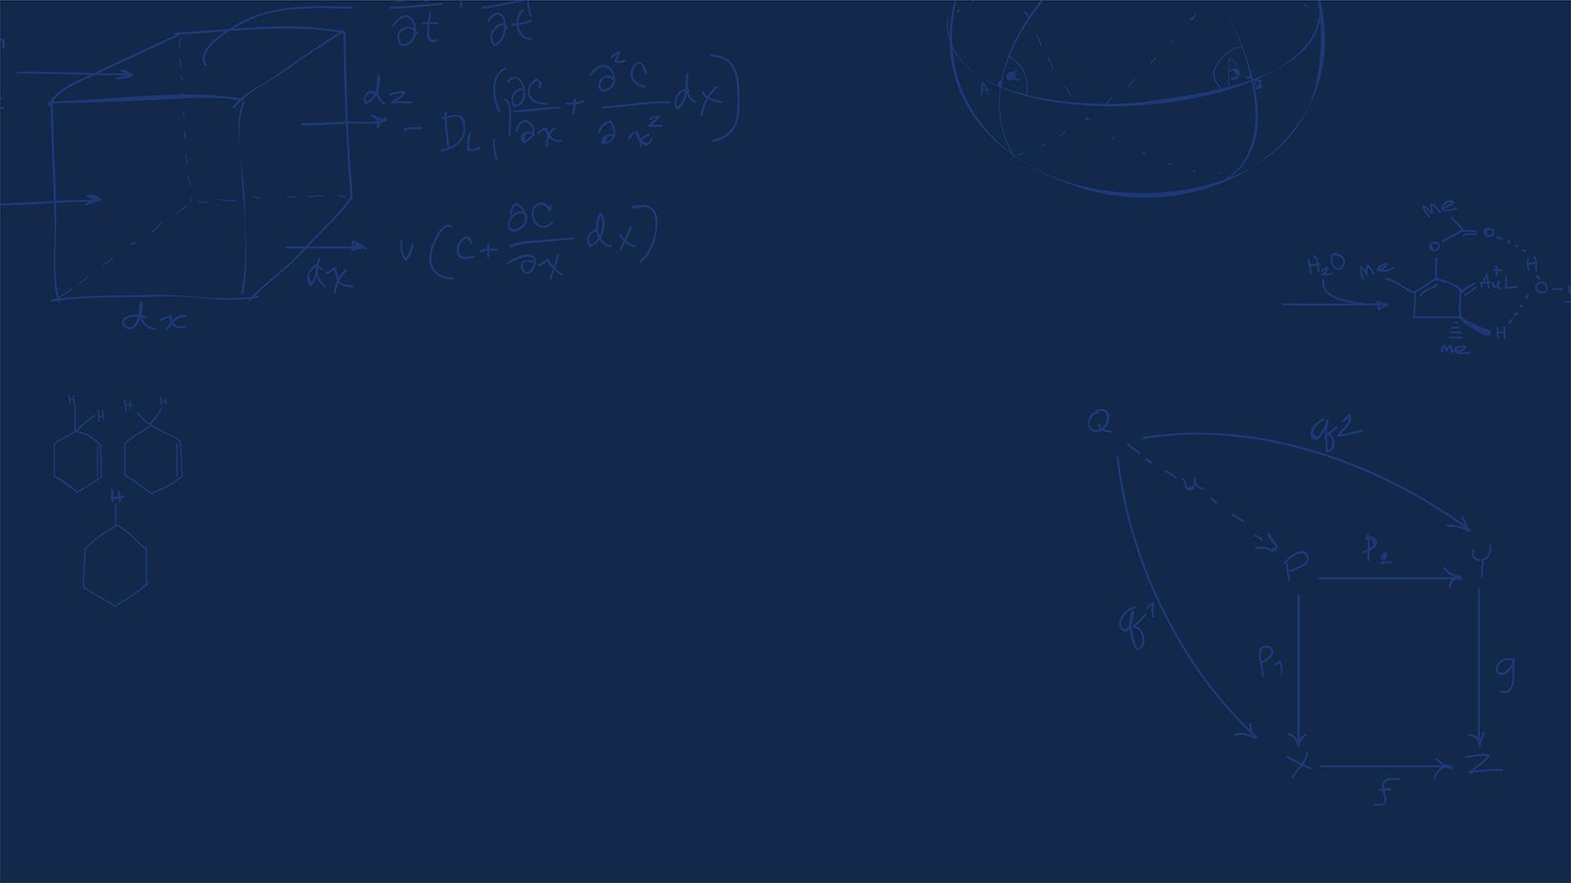
Questions?
Homework, Lab, LabVIEW questions?
SYSTEMS ENGINEERING
GRAINGER ENGINEERING

Slide 4
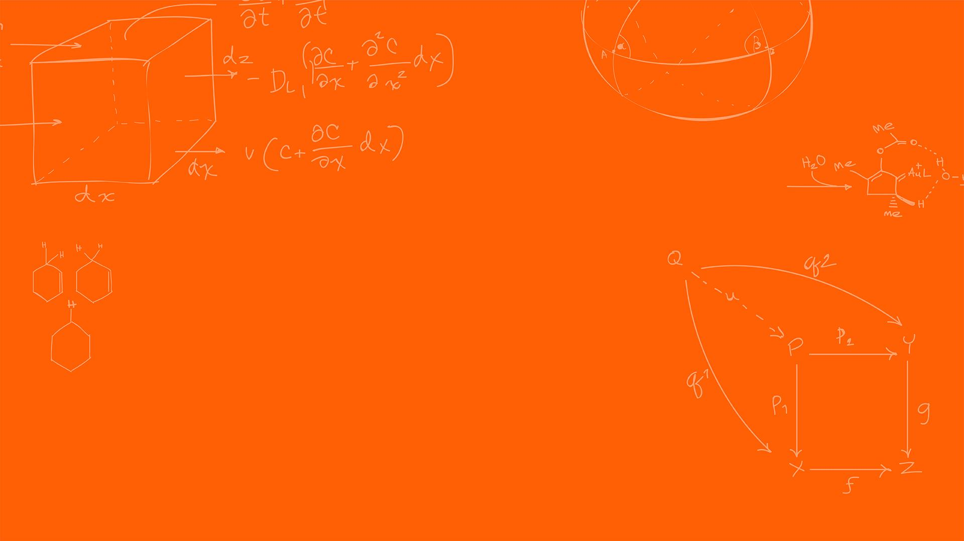

PID Controller
SYSTEMS ENGINEERING
GRAINGER ENGINEERING

Slide 5
PID Controller
There are 2 types of controllers:
Open-Loop systems: Directly dictates the output.
Problems?
Any deviation / noise will cause you to not reach your target.
Closed-Loop systems: Utilizes feedback to compute an error metric, dynamically correcting the control effort
SYSTEMS ENGINEERING
GRAINGER ENGINEERING
Notes:
This is like if I told you to walk blind folded across the room, you might make it

Slide 6
PID Controller
We know it, we love it, it’s the classic PID Controller!
The proportional–integral–derivative (PID) controller is a closed-loop controller.
It is extremely common due to its simplicity, both in the tuning and in the implementation ( you will see how simple it is when you implement it in the code)
SYSTEMS ENGINEERING
GRAINGER ENGINEERING

Slide 7
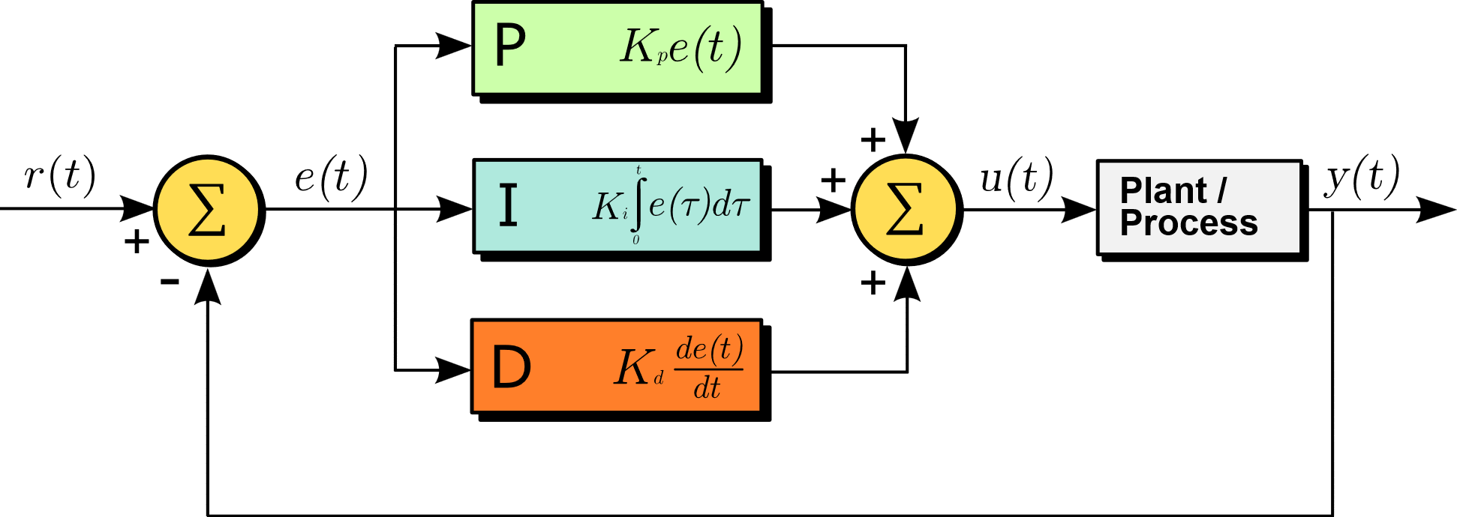

PID Controller
The PID controller is split into 3 parts, as its name states. While each of the terms contribute to improving the output, it is not necessary to use all of them at once.
As the PID controller is a closed-loop controller the input is an error signal $e(t) = r(t) - y(t)$, which represents the reference “what you want to be doing” $r(t)$ and the currently measured input “what you are doing now” $y(t)$
https://en.wikipedia.org/wiki/Proportional%E2%80%93integral%E2%80%93derivative_controller
SYSTEMS ENGINEERING
GRAINGER ENGINEERING

Slide 8
PID Controller
We are going to watch some really good MATLAB videos (I highly recommend looking at them some more!)
What is a PID Controller?
There are 2 main problems with the basic implementation of the PID loop in a real-world example. Any ideas?
Integrator Windup
Derivative noise
For the derivative term we decide that it is not worth using and the robot will follow the path well enough. It is usually more recommended to use if you have a sensor the derivative directly!
SYSTEMS ENGINEERING
GRAINGER ENGINEERING

Slide 9
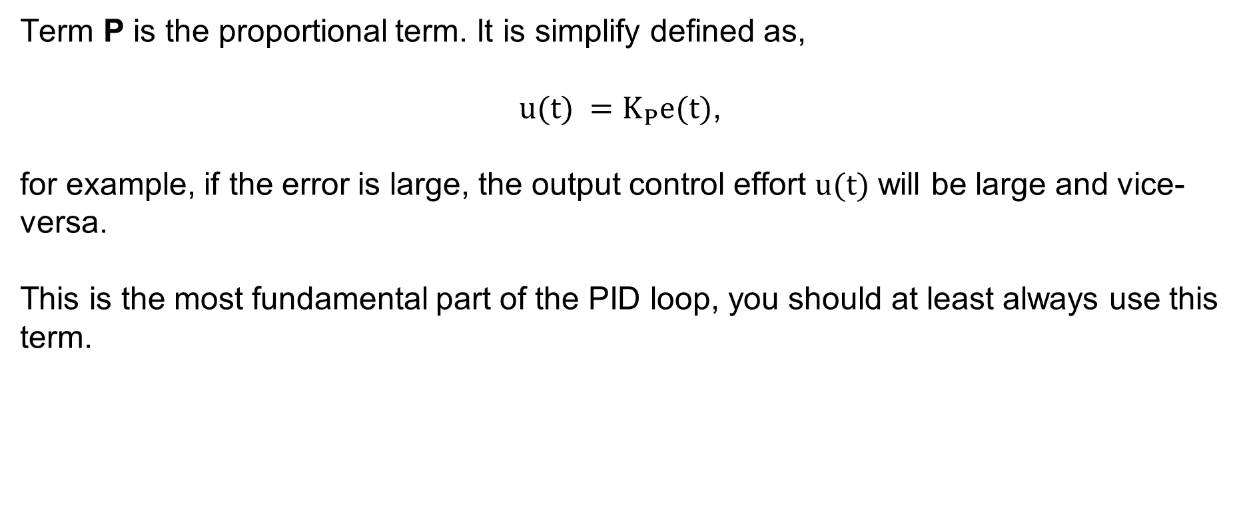
PID Controller
Term P is the proportional term. It is simplify defined as,
$u(t) =K_{P}e(t)$,
for example, if the error is large, the output control effort $u(t)$ will be large and vice-versa.
This is the most fundamental part of the PID loop, you should at least always use this term.
SYSTEMS ENGINEERING
GRAINGER ENGINEERING

Slide 10
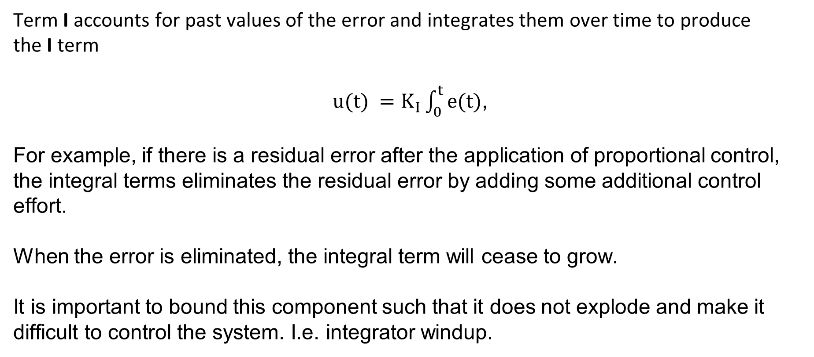
PID Controller
Term I accounts for past values of the error and integrates them over time to produce the I term
$u(t) =K_{I}\int_{0}^{t}{e(t)}$,
For example, if there is a residual error after the application of proportional control, the integral terms eliminates the residual error by adding some additional control effort.
When the error is eliminated, the integral term will cease to grow.
It is important to bound this component such that it does not explode and make it difficult to control the system. I.e. integrator windup.
SYSTEMS ENGINEERING
GRAINGER ENGINEERING

Slide 11
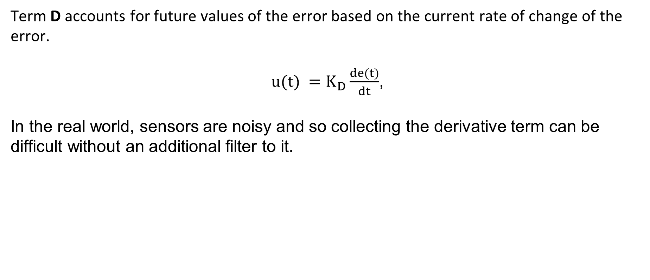
PID Controller
Term D accounts for future values of the error based on the current rate of change of the error.
$u(t) =K_{D}\frac{de(t)}{dt}$,
In the real world, sensors are noisy and so collecting the derivative term can be difficult without an additional filter to it.
SYSTEMS ENGINEERING
GRAINGER ENGINEERING

Slide 12

PID Controller
The full form is thus,
$u(t) =K_{p}e(t) +K_{I}\int_{0}^{t}{e(t)}+K_{D}\frac{de(t)}{dt}$,
Simple as that!
SYSTEMS ENGINEERING
GRAINGER ENGINEERING

Slide 13
PID Controller
#define MAX_EFFORT 10.0f
struct PID {
float Kp;
float Ki;
float integral;
};
float saturate(float input, float satVal){
input = (input > satVal)? satVal : input;
input = (input < -satVal)? -satVal : input;
return input;
}
int sign(float x){
if (x > 0.0f) return 1;
if (x < 0.0f) return -1;
return 0;
}
float PIControl(float reference, float target, float dt, struct PID *pidState){
if (dt <= 0.0f) return 0.0f;
float error = reference - target;
// Compute integral
float integral = pidState->integral + error * dt;
// Compute PI using tentative integral
float effort = pidState->Kp * error +
pidState->Ki * integral;
// Saturate control input
float effortSat = saturate(effort, MAX_EFFORT);
// Anti-windup condition
// The output is saturating
// The error is the same sign as the controller output
if(!(effort != effortSat && sign(effort) == sign(error))){
pidState->integral = integral;
}
return effortSat;
}
SYSTEMS ENGINEERING
GRAINGER ENGINEERING

Slide 14
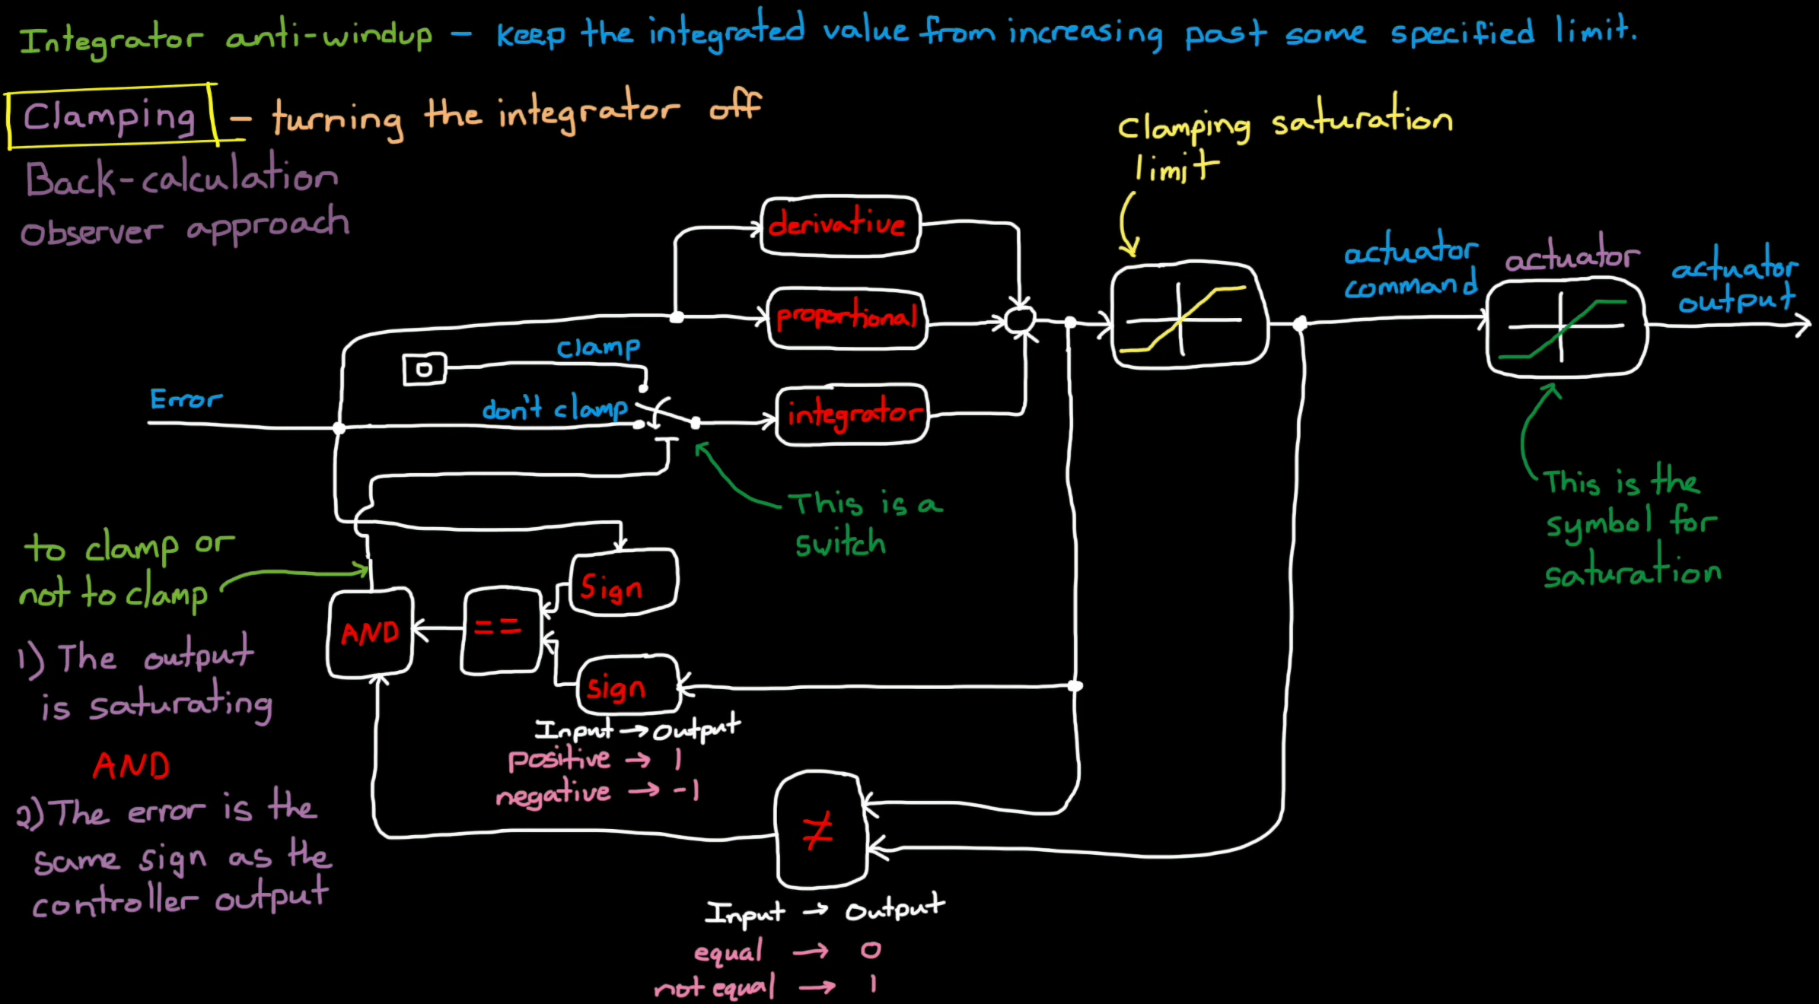
PID Controller
https://www.mathworks.com/videos/understanding-pid-control-part-2-expanding-beyond-a-simple-integral-1528310418260.html
SYSTEMS ENGINEERING
GRAINGER ENGINEERING

Slide 15
Tuning
SYSTEMS ENGINEERING
GRAINGER ENGINEERING

Slide 16
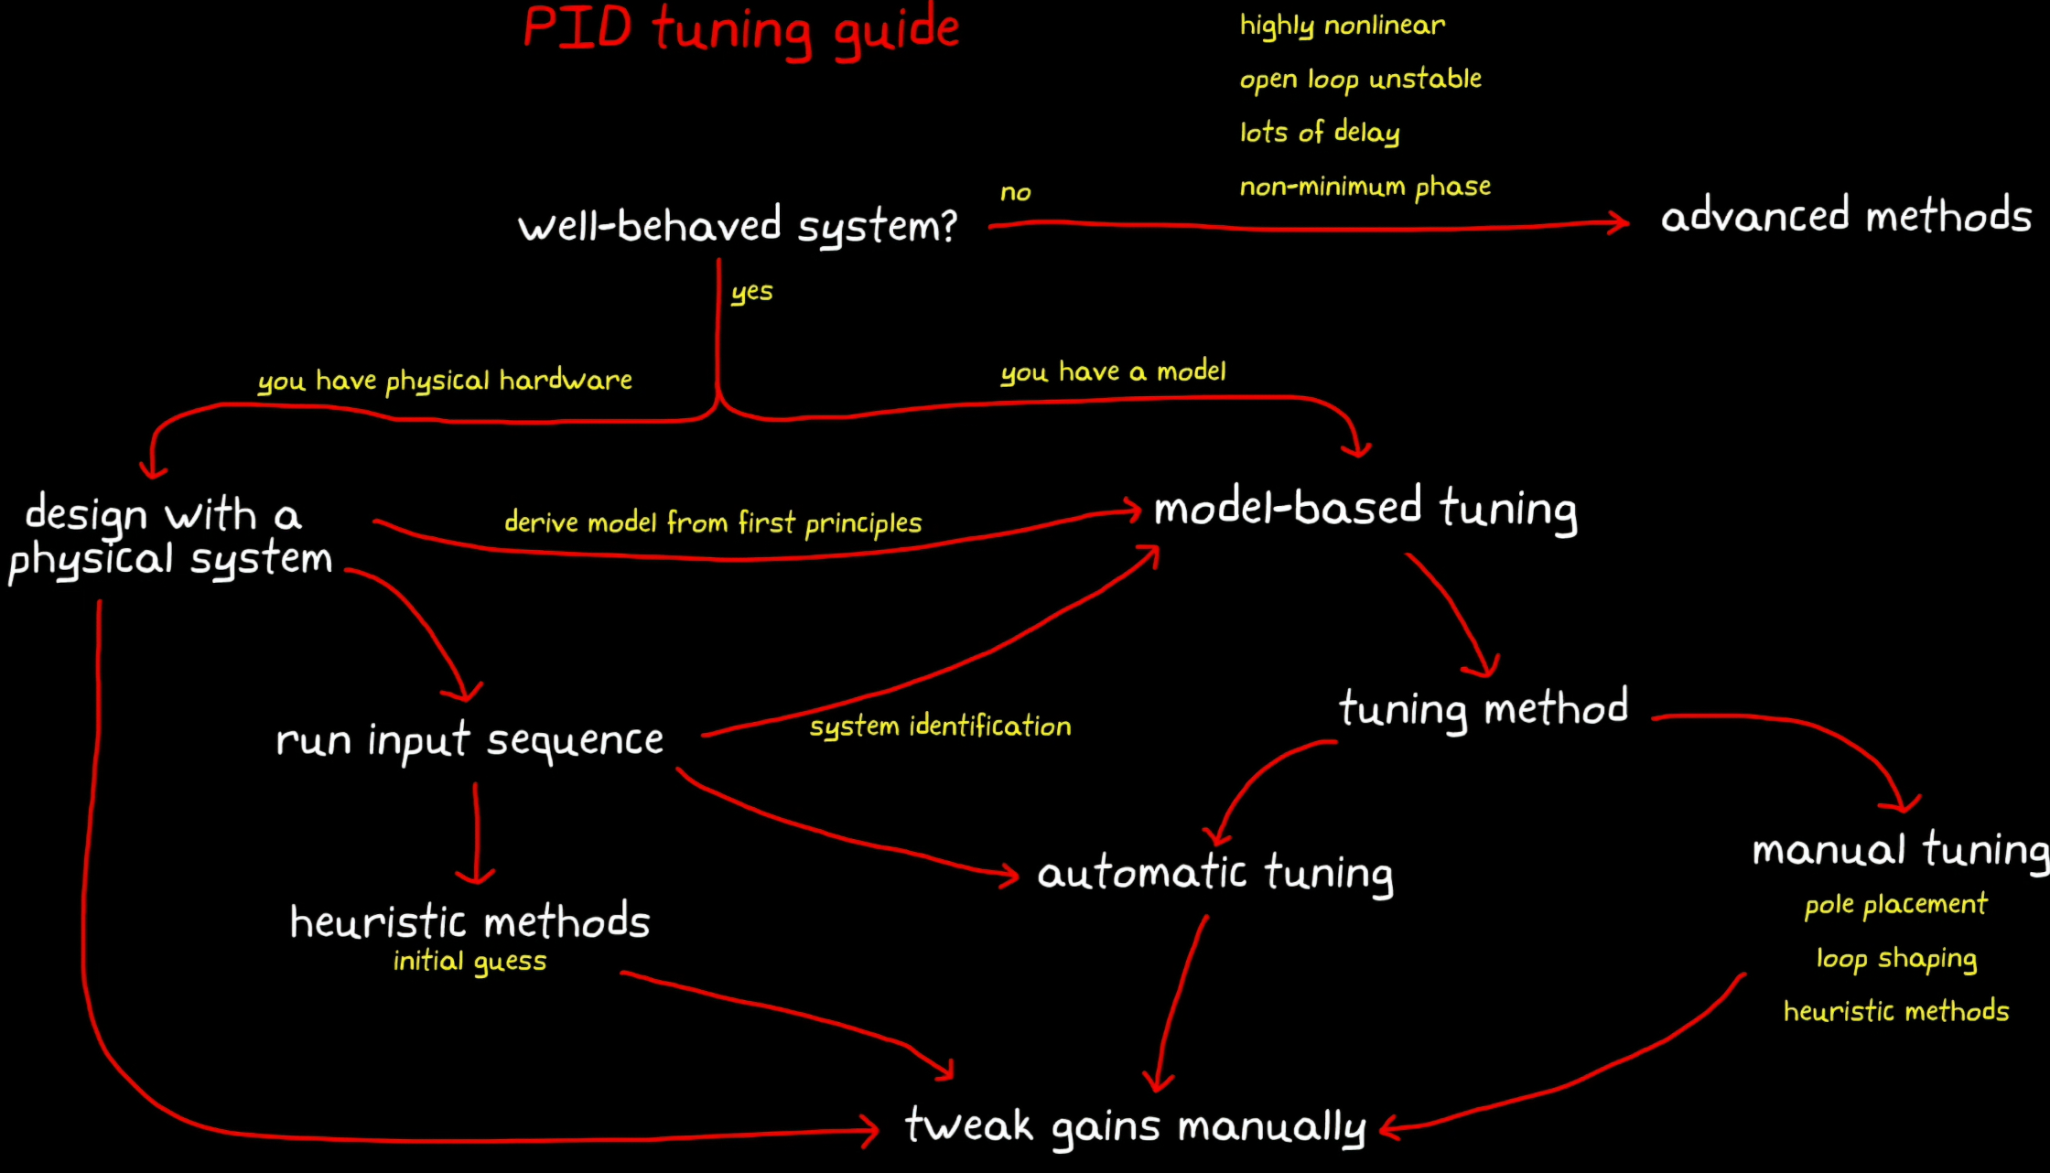
PID Controller
https://www.mathworks.com/videos/understanding-pid-control-part-4-a-pid-tuning-guide-1531124725727.html
SYSTEMS ENGINEERING
GRAINGER ENGINEERING

Slide 17
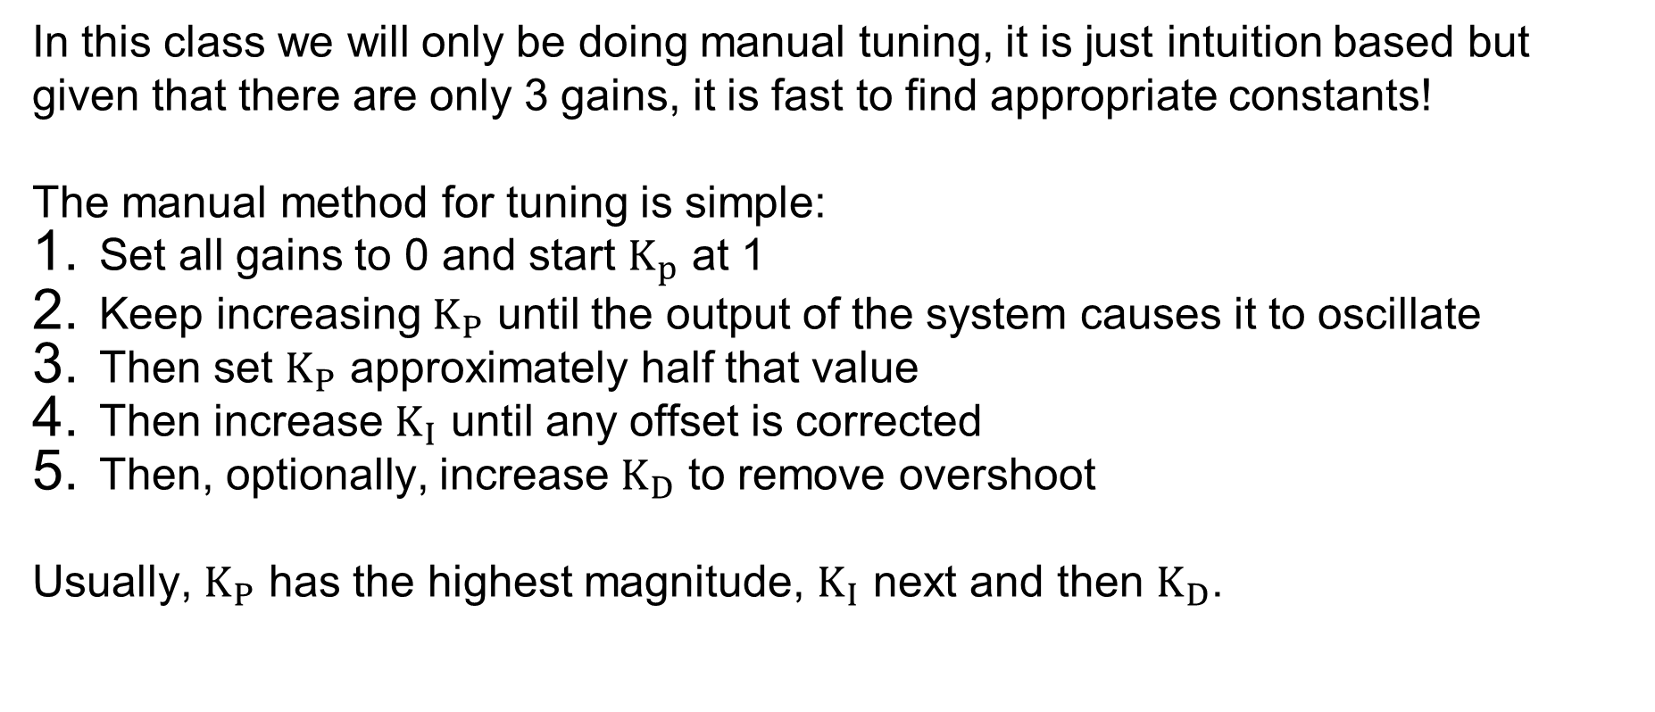
PID Controller
In this class we will only be doing manual tuning, it is just intuition based but given that there are only 3 gains, it is fast to find appropriate constants!
The manual method for tuning is simple:
Set all gains to 0 and start $K_{p}$ at 1
Keep increasing $K_{P}$ until the output of the system causes it to oscillate
Then set $K_{P}$ approximately half that value
Then increase $K_{I}$ until any offset is corrected
Then, optionally, increase $K_{D}$ to remove overshoot
Usually, $K_{P}$ has the highest magnitude, $K_{I}$ next and then $K_{D}$.
SYSTEMS ENGINEERING
GRAINGER ENGINEERING

Slide 18
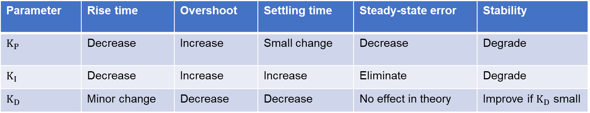
PID Controller
Parameter | Rise time | Overshoot | Settling time | Steady-state error | Stability
$K_{P}$ | Decrease | Increase | Small change | Decrease | Degrade
$K_{I}$ | Decrease | Increase | Increase | Eliminate | Degrade
$K_{D}$ | Minor change | Decrease | Decrease | No effect in theory | Improve if $K_{D}$ small
https://en.wikipedia.org/wiki/Proportional%E2%80%93integral%E2%80%93derivative_controller#Manual_tuning
SYSTEMS ENGINEERING
GRAINGER ENGINEERING

Slide 19
PID Controller
We can try out the effect of gains here!
https://www.luisllamas.es/en/pid-controller-simulator/
SYSTEMS ENGINEERING
GRAINGER ENGINEERING

Slide 20
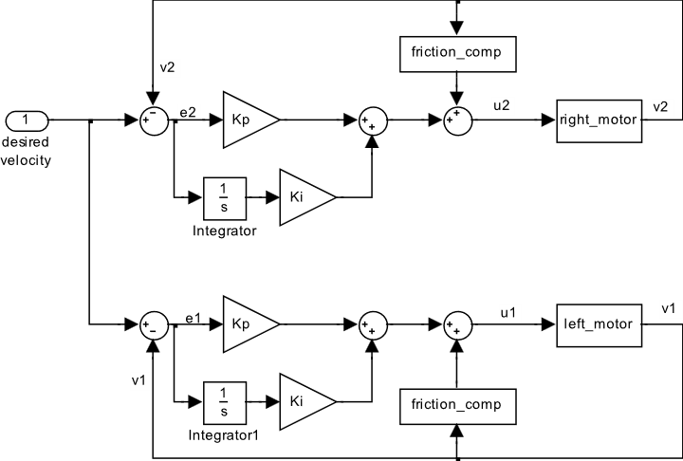
PID Controller – Lab 5
We have a desired velocity we want the robot to go at
Technically not necessary since this is a feedback controller but helps with improving performance
We computed the velocities from last lab
We have 2 PI controllers for setting the motors to the desired velocity
SYSTEMS ENGINEERING
GRAINGER ENGINEERING

Slide 21
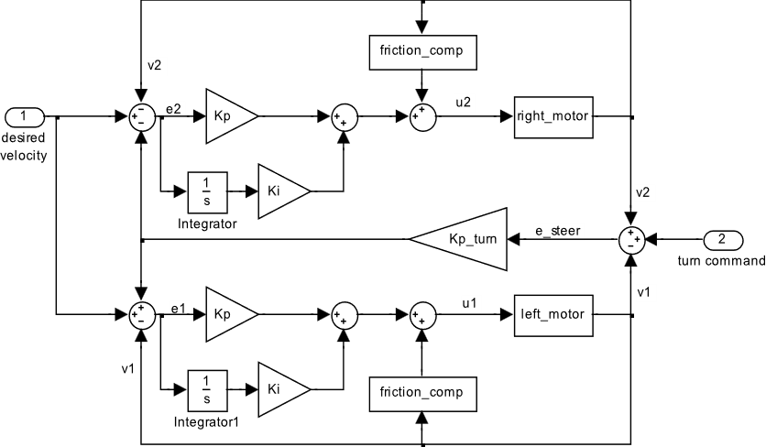
PID Controller
We have a desired velocity we want the robot to go at
We have a desired turn rate we want the robot to go at
We have 2 PI controllers for setting the motors to the desired velocity
SYSTEMS ENGINEERING
GRAINGER ENGINEERING

Slide 22
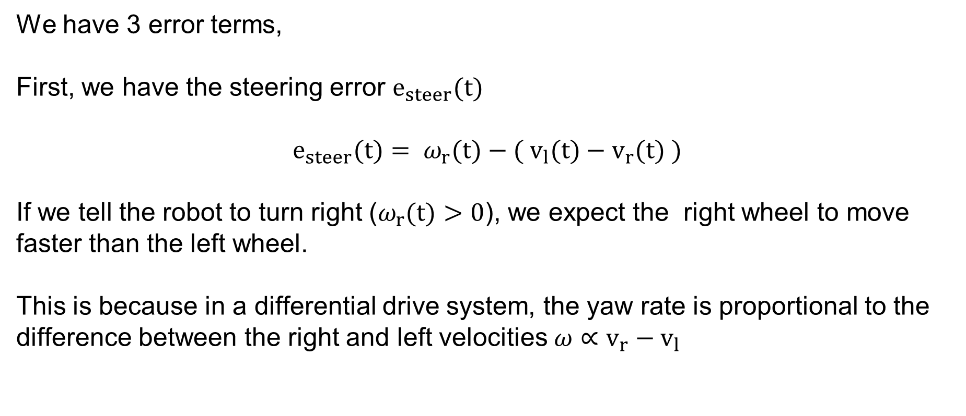
PID Controller
We have 3 error terms,
First, we have the steering error $e_{steer}(t)$
$$e_{steer}(t)= ω_{r}(t)−( v_{l}(t)−v_{r}(t) )$$
If we tell the robot to turn right ($ω_{r}(t)>0$), we expect the right wheel to move faster than the left wheel.
This is because in a differential drive system, the yaw rate is proportional to the difference between the right and left velocities $ω∝v_{r}−v_{l}$
SYSTEMS ENGINEERING
GRAINGER ENGINEERING

Slide 23
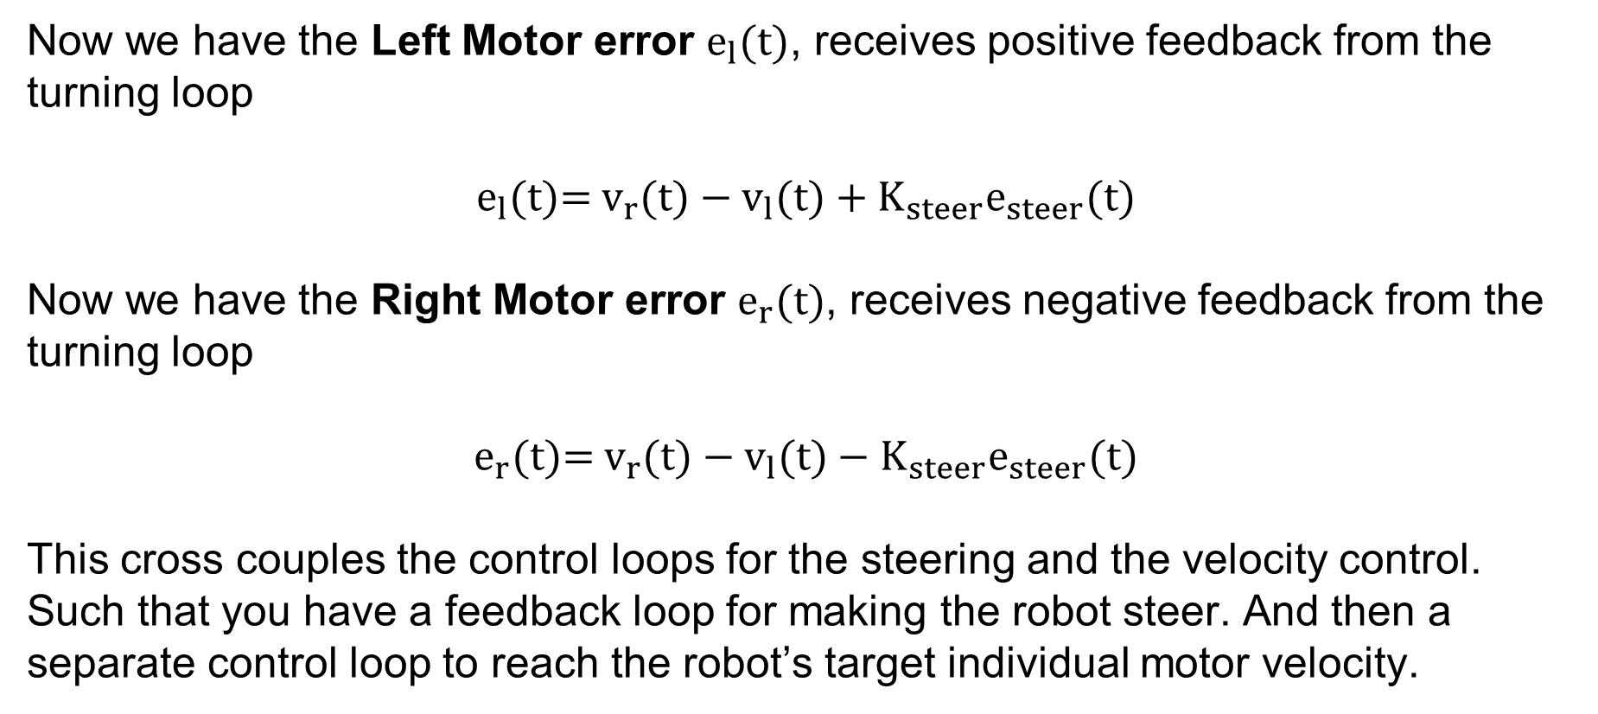
PID Controller
Now we have the Left Motor error $e_{l}(t)$, receives positive feedback from the turning loop
$$e_{l}(t)\text{= }v_{r}(t)−v_{l}(t)+K_{steer}e_{steer}(t)$$
Now we have the Right Motor error $e_{r}(t)$, receives negative feedback from the turning loop
$$e_{r}(t)\text{= }v_{r}(t)−v_{l}(t)−K_{steer}e_{steer}(t)$$
This cross couples the control loops for the steering and the velocity control. Such that you have a feedback loop for making the robot steer. And then a separate control loop to reach the robot’s target individual motor velocity.
SYSTEMS ENGINEERING
GRAINGER ENGINEERING

Slide 24
Questions?
SYSTEMS ENGINEERING
GRAINGER ENGINEERING

Slide 25


