Slide 1
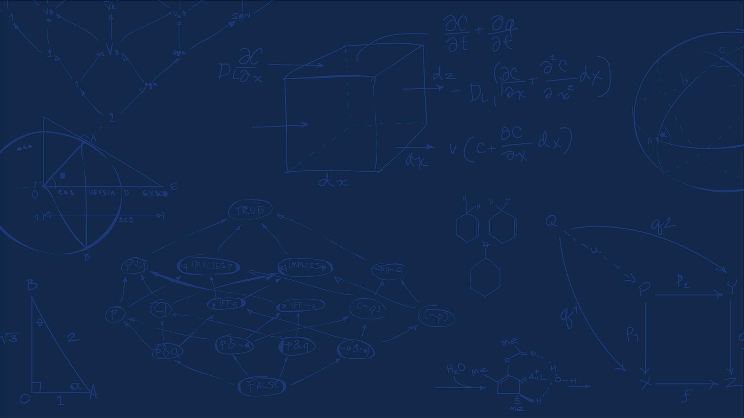

SE 423: Introduction to Mechatronics
Lecture 6-7: Encoders & PWM
Marius Juston
Monday, February 9th, 2026

Slide 2

Reminders
Office Hours:
Monday: 4-6 PM, Neel
Tuesday: 11-1 PM, Lakshmi
Tuesday: 1-3 PM, Samuel
Tuesday: 2-5 PM, Dan & Marius
Lab: Starting Lab 3 this week. This a 2-week lab!
Homeworks:
Check-offs for homework 2 Ex 1 & 2 are due February 17, 5PM (The end of office hours)
Check-offs for homework 2 Ex 3 & 4 are due February 24, 5PM (The end of office hours)
Answers and code submissions for homework 2 are due February 17, 9AM
LabVIEW:
All check-offs for LabVIEW 2 are due February 26, 5PM
SYSTEMS ENGINEERING
GRAINGER ENGINEERING

Slide 3
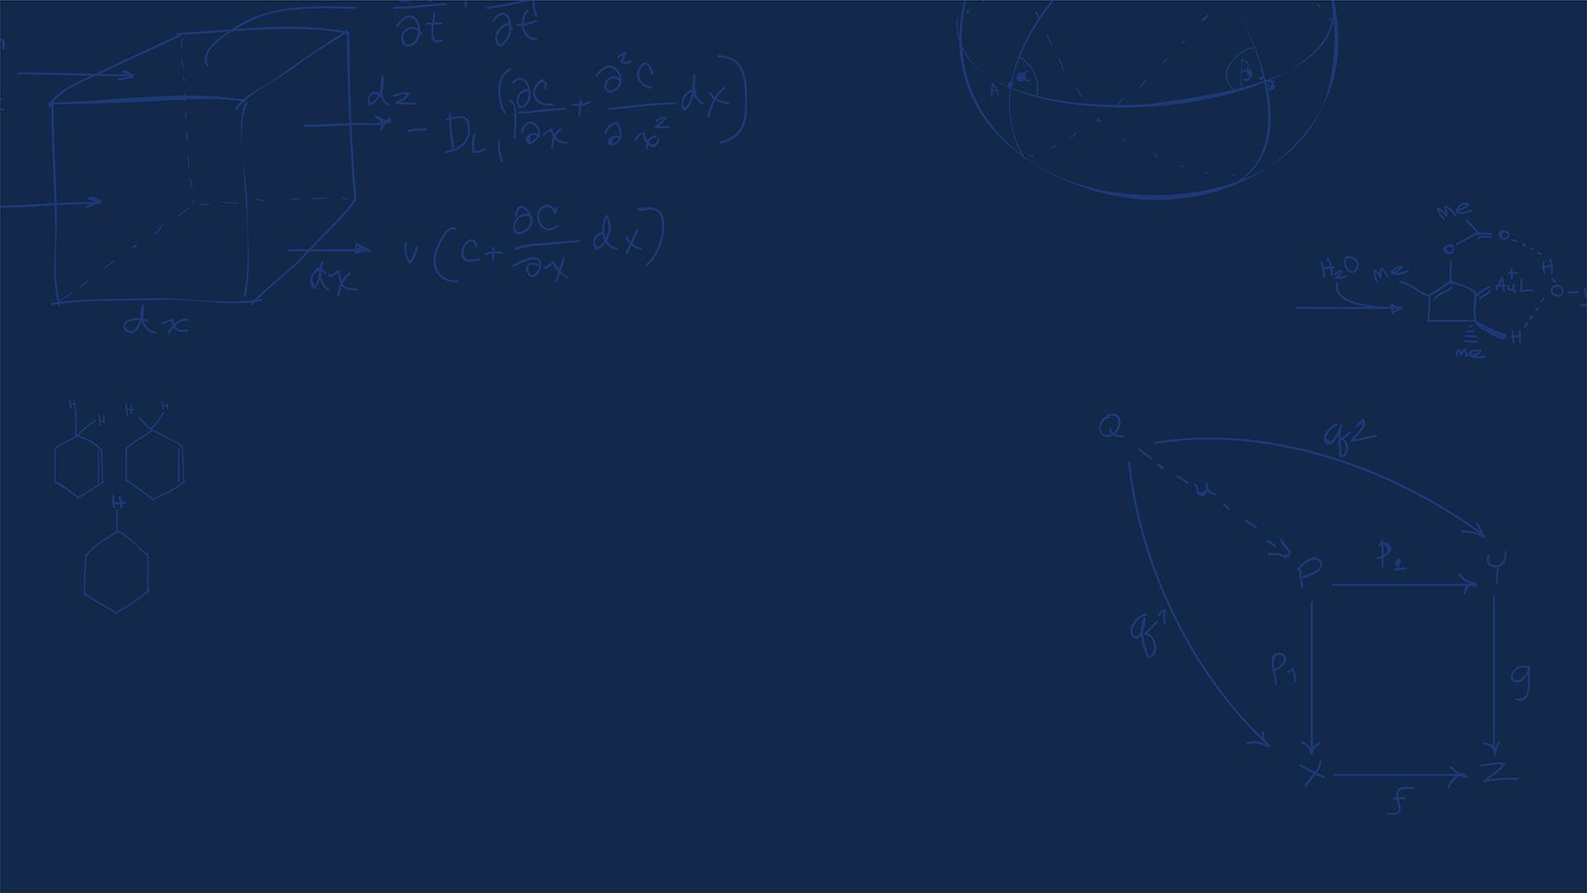
Questions?
Homework, Lab, LabVIEW questions?
(All submission times / days are final! Be early, as you see these HW can be very long! The times / days are always on Canvas / Gradescope / Lectures)
SYSTEMS ENGINEERING
GRAINGER ENGINEERING

Slide 4
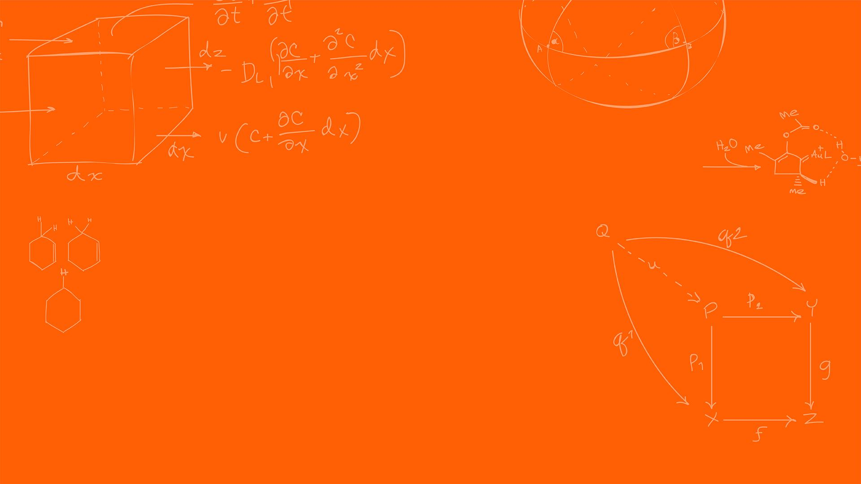

Optical Encoder
SYSTEMS ENGINEERING
GRAINGER ENGINEERING

Slide 5
Optical Encoder
How do we measure angular position or motion of a shaft into a digital value? Ideas?
The optical encoder is composed of a light emitting device (LED), photo sensors, and a disc called a code wheel with slits (holes) in the radial direction and detects rotational position information as an optical pulse signal.
When a code wheel attached to a rotating shaft such as a motor rotates, an optical pulse is generated depending on whether light emitted from a fixed light emitting element passes through a slit of the code wheel or not.
Photo sensor detects the optical pulse, converts it into an electrical signal, and outputs it.
SYSTEMS ENGINEERING
GRAINGER ENGINEERING

Slide 6
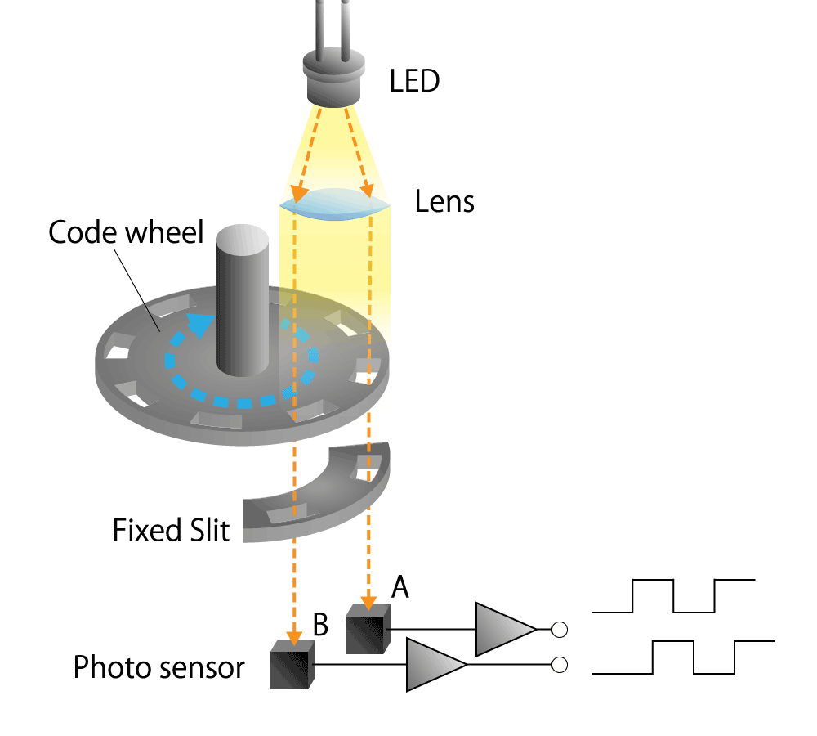
Optical Encoder
https://www.akm.com/global/en/products/rotation-angle-sensor/tutorial/optical-encoder/
SYSTEMS ENGINEERING
GRAINGER ENGINEERING

Slide 7
Optical Encoder
2 Different types of optical encoders,
An incremental optical encoder:
The code disc divided into sectors that are alternately transparent and opaque.
A light source is positioned on one side of the disc, and a light sensor on the other side.
As the disc rotates, the output from the detector switches alternately on and off, depending on whether the sector appearing between the light source and the detector is transparent or opaque.
The encoder produces a stream of square wave pulses which, when counted, indicate the angular position of the shaft.
SYSTEMS ENGINEERING
GRAINGER ENGINEERING

Slide 8
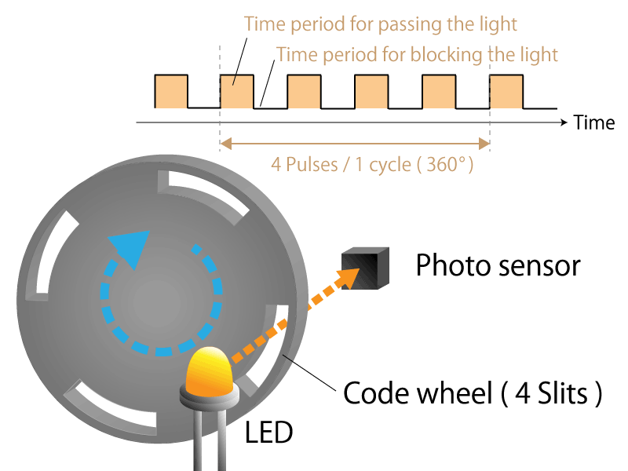
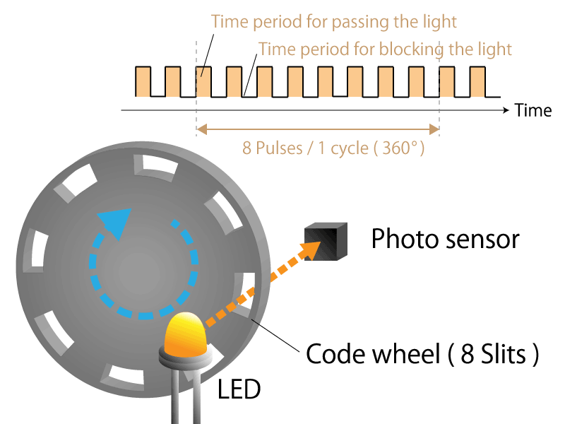
Optical Encoder - Resolution
4-slit incremental type rotary encoder
8-slit incremental type rotary encoder
https://www.akm.com/global/en/products/rotation-angle-sensor/tutorial/type-mechanism-2/
SYSTEMS ENGINEERING
GRAINGER ENGINEERING

Slide 9
What are some problems?
SYSTEMS ENGINEERING
GRAINGER ENGINEERING

Slide 10
Optical Encoder - Direction
https://www.akm.com/global/en/products/rotation-angle-sensor/tutorial/type-mechanism-2/
SYSTEMS ENGINEERING
GRAINGER ENGINEERING

Slide 11
Optical Encoder - Direction
https://www.akm.com/global/en/products/rotation-angle-sensor/tutorial/type-mechanism-2/
SYSTEMS ENGINEERING
GRAINGER ENGINEERING

Slide 12
Optical Encoder - Direction
https://www.akm.com/global/en/products/rotation-angle-sensor/tutorial/type-mechanism-2/
SYSTEMS ENGINEERING
GRAINGER ENGINEERING

Slide 13
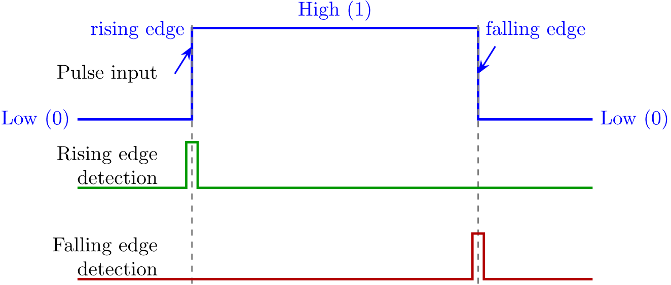
Optical Encoder - Direction
To encode the direction you have 2 channels, each of them offset by a phase of 90 degrees
The rotational direction can be determined depending on which pulse of the phase A or phase B rises B.
By subtracting the number of pulses in reverse rotation, the amount of rotation can be accurately determined.
SYSTEMS ENGINEERING
GRAINGER ENGINEERING

Slide 14
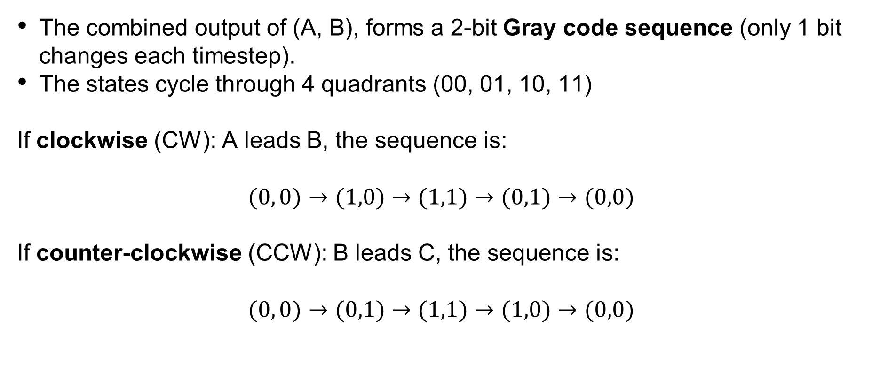
Optical Encoder - Direction
The combined output of (A, B), forms a 2-bit Gray code sequence (only 1 bit changes each timestep).
The states cycle through 4 quadrants (00, 01, 10, 11)
If clockwise (CW): A leads B, the sequence is:
$$(0, 0)→(1,0)→(1,1)→(0,1)→(0,0)$$
If counter-clockwise (CCW): B leads C, the sequence is:
$$(0, 0)→(0,1)→(1,1)→(1,0)→(0,0)$$
If I do not have an animation, I did not have time to make it.
SYSTEMS ENGINEERING
GRAINGER ENGINEERING

Slide 15
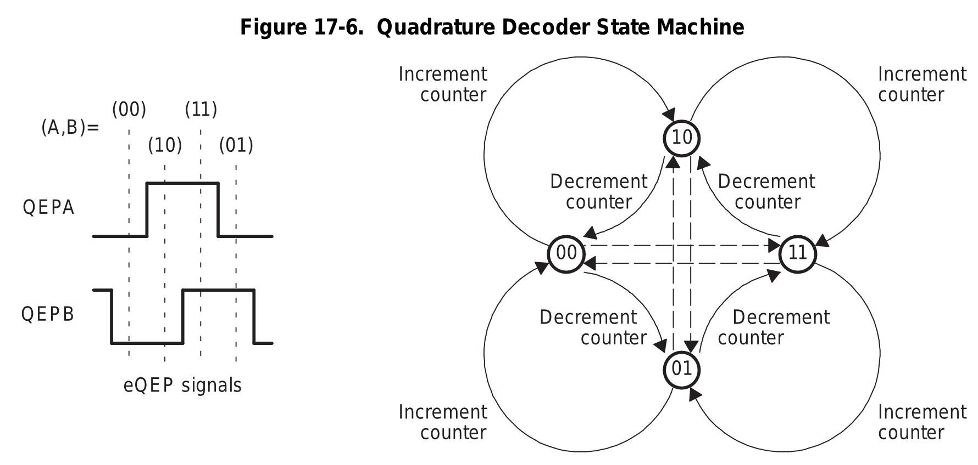
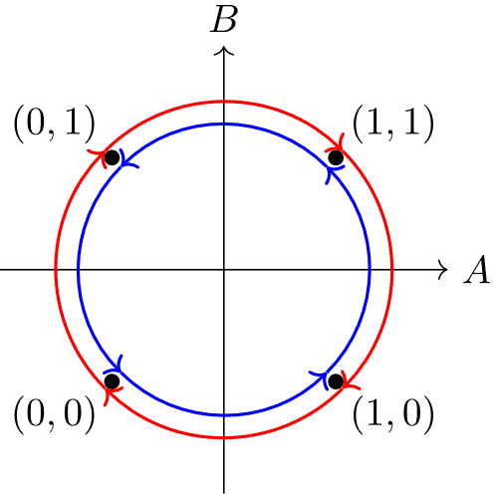
Optical Encoder - Direction
SYSTEMS ENGINEERING
GRAINGER ENGINEERING

Slide 16
What if you turn the robot off?
SYSTEMS ENGINEERING
GRAINGER ENGINEERING

Slide 17
Optical Encoder
An absolute optical encoder
An absolute optical encoder's disc is divided up into N sectors
Each sector is further divided radially along its length into opaque and transparent sections, forming a unique N-bit digital word with a maximum count of 2N – 1.
The digital word formed radially by each sector increments in value from one sector to the next, usually employing Gray code.
Binary coding could be used but can produce large errors if a single bit is incorrectly interpreted by the sensors.
Gray code overcomes this defect: the maximum error produced by an error in any single bit of the Gray code is only 1 LSB after the Gray code is converted into binary code.
A set of N light sensors responds to the N-bit digital word which corresponds to the disc's absolute angular position.
SYSTEMS ENGINEERING
GRAINGER ENGINEERING

Slide 18
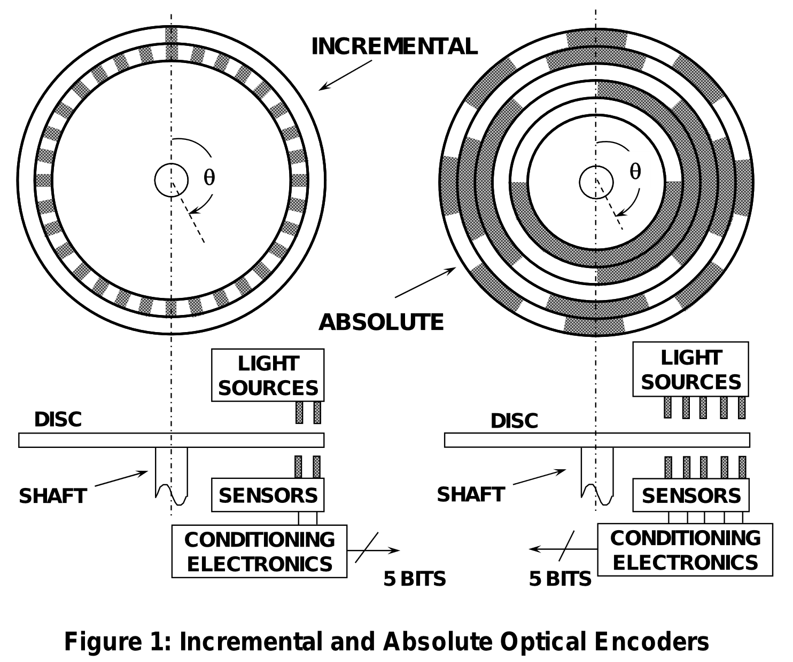
Optical Encoder
https://www.analog.com/media/en/training-seminars/tutorials/mt-029.pdf
SYSTEMS ENGINEERING
GRAINGER ENGINEERING

Slide 19
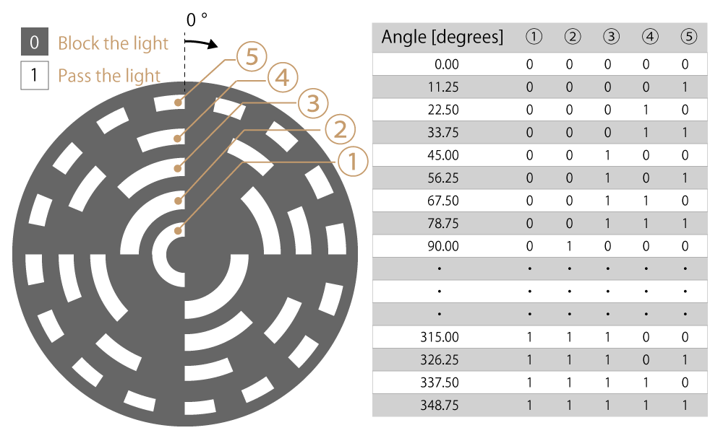
Optical Encoder
What type of encoding is this? Gray or binary?
https://www.akm.com/global/en/products/rotation-angle-sensor/tutorial/type-mechanism-2/
SYSTEMS ENGINEERING
GRAINGER ENGINEERING

Slide 20
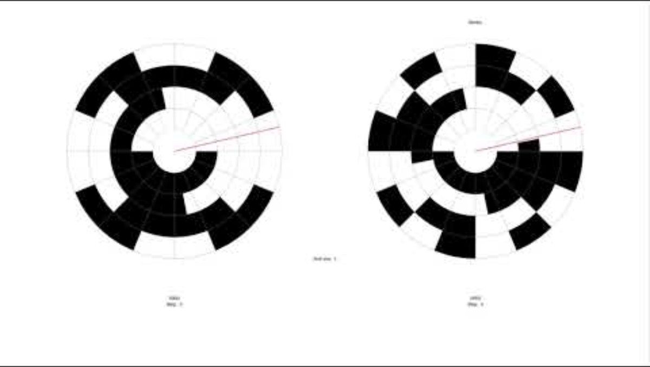
Optical Encoder
https://youtu.be/VKmMoT5hpVY
SYSTEMS ENGINEERING
GRAINGER ENGINEERING

Slide 21
Optical Encoder
https://www.akm.com/global/en/products/rotation-angle-sensor/tutorial/type-mechanism-2/
SYSTEMS ENGINEERING
GRAINGER ENGINEERING

Slide 22
eQEP
SYSTEMS ENGINEERING
GRAINGER ENGINEERING

Slide 23
eQEP
The eQEP peripheral is used to read data from an incremental optical encoder only.
As such what is the main data that needs to be read in?
The 2 phase signals!
SYSTEMS ENGINEERING
GRAINGER ENGINEERING

Slide 24
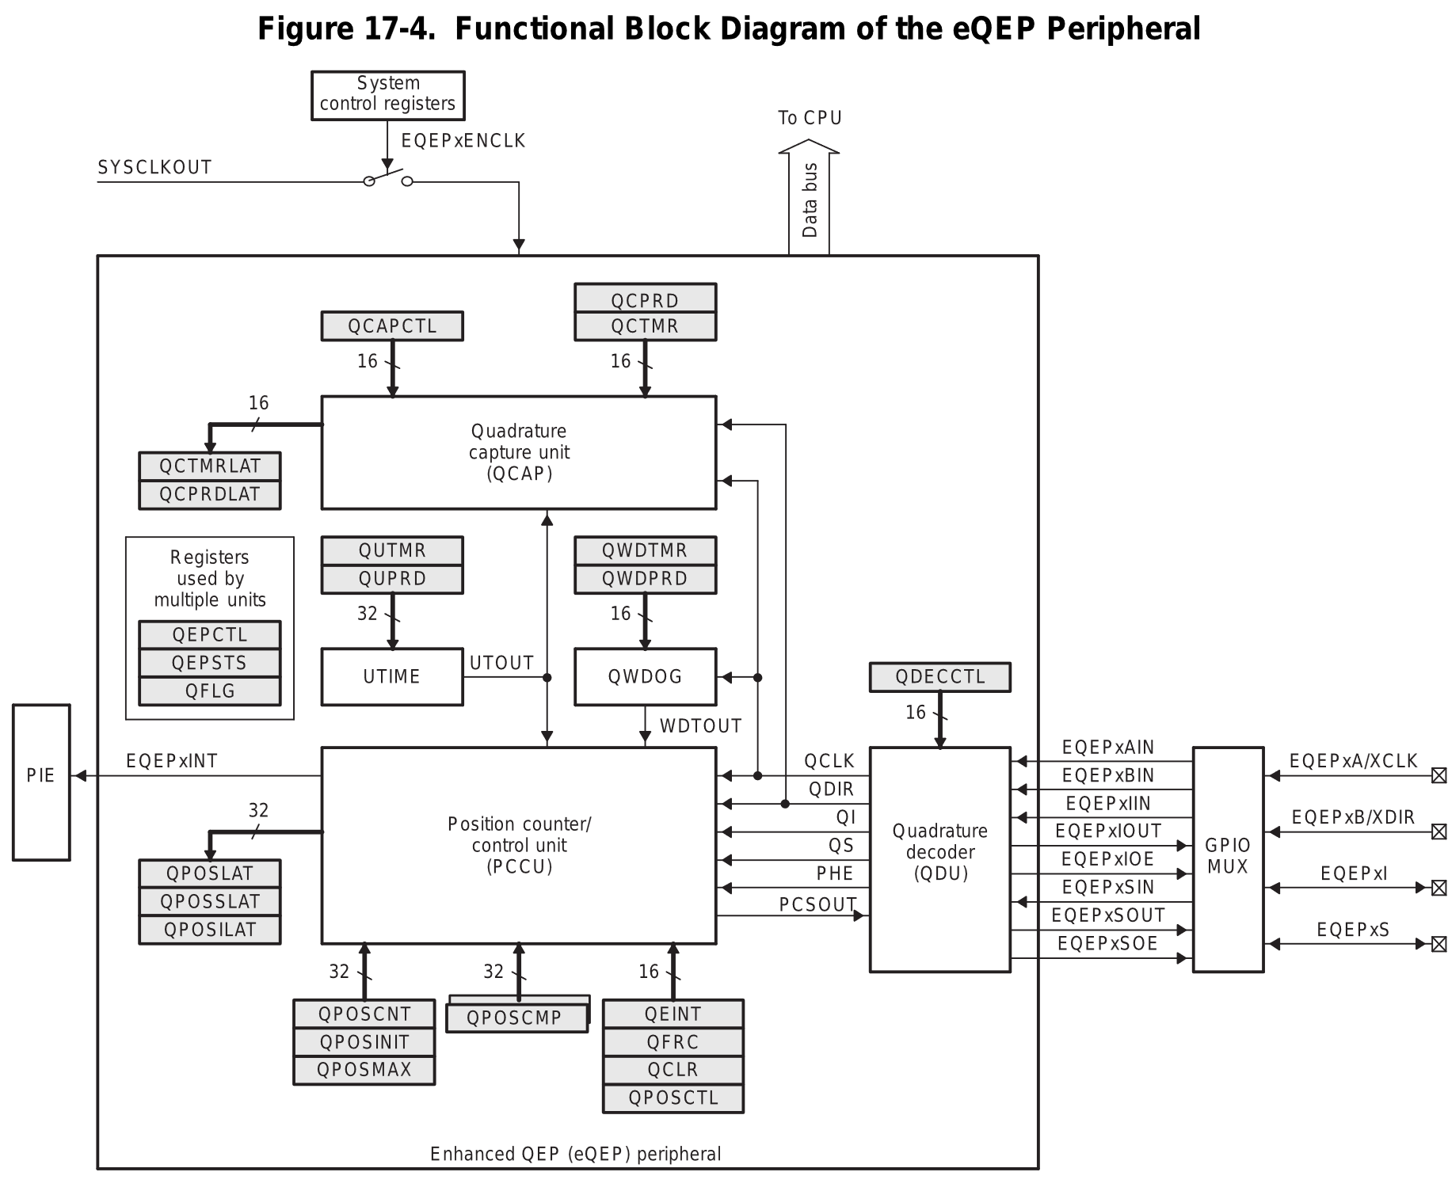
eQEP – Overview diagram
Does the decoding base on the phase signal
SYSTEMS ENGINEERING
GRAINGER ENGINEERING

Slide 25
eQEP
// setup eQEP1 pins for input
EALLOW;
//Disable internal pull-up for the selected output pins for reduced power consumption
GpioCtrlRegs.GPAPUD.bit.GPIO20 = 1; // Disable pull-up on GPIO20 (EQEP1A)
GpioCtrlRegs.GPAPUD.bit.GPIO21 = 1; // Disable pull-up on GPIO21 (EQEP1B)
GpioCtrlRegs.GPAQSEL2.bit.GPIO20 = 2; // Qual every 6 samples
GpioCtrlRegs.GPAQSEL2.bit.GPIO21 = 2; // Qual every 6 samples
EDIS;
SYSTEMS ENGINEERING
GRAINGER ENGINEERING

Slide 26
eQEP - QPxQSELn
The number of times the signal is sampled is either three samples or six samples as specified in the qualification selection (GPAQSEL1, GPAQSEL2, GPBQSEL1, and GPBQSEL2) registers. When three or six consecutive cycles are the same, then the input change will be passed through to the MCU.
All the samples must be consistent within that sampling period to change its output for the next output range.
Helps with reducing noise as a random change would not change the result.
SYSTEMS ENGINEERING
GRAINGER ENGINEERING

Slide 27
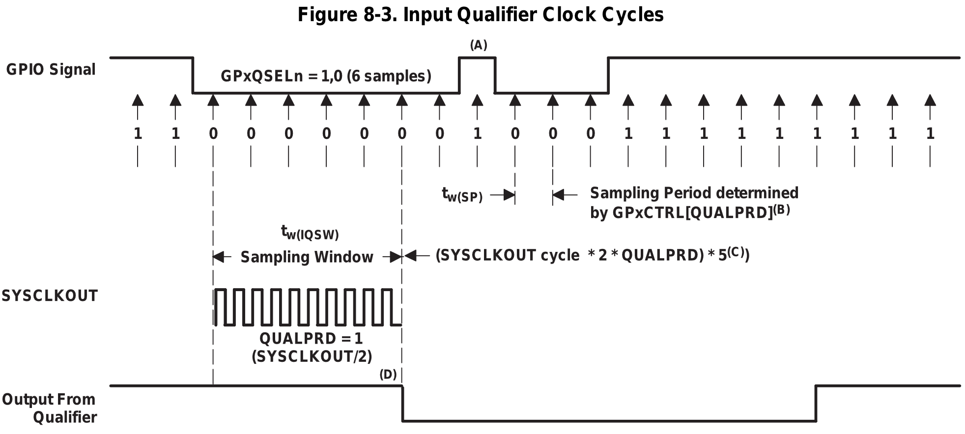
eQEP - QPxQSELn
All samples are 0, change output next cycle to be 0!
Not all samples are 0, keep the output next cycle to be 0!
All samples are 1, change output next cycle to be 1!
Set GPIO value to 0
Keep GPIO value to 0
Change GPIO value to 1
SYSTEMS ENGINEERING
GRAINGER ENGINEERING

Slide 28
eQEP
// setup eQEP1 pins for input
// This specifies which of the possible GPIO pins will be EQEP1 functional pins.
GPIO_SetupPinMux(20, GPIO_MUX_CPU1, 1); // set pin mux EQEP2A
GPIO_SetupPinMux(21, GPIO_MUX_CPU1, 1); // set pin mux EQEP2B
EQep1Regs.QEPCTL.bit.QPEN = 0; // make sure eQEP in reset
EQep1Regs.QDECCTL.bit.QSRC = 0; // Quadrature count mode
EQep1Regs.QPOSCTL.all = 0x0; // Disable eQEP Position Compare
EQep1Regs.QCAPCTL.all = 0x0; // Disable eQEP Capture
EQep1Regs.QEINT.all = 0x0; // Disable all eQEP interrupts
EQep1Regs.QPOSMAX = 0xFFFFFFFF; // use full range of the 32-bit count
EQep1Regs.QEPCTL.bit.FREE_SOFT = 2; // eQEP unaffected by emulation suspend in Code Composer
EQep1Regs.QPOSCNT = 0; // Set the initial position of the encoder
EQep1Regs.QEPCTL.bit.QPEN = 1; // Enable eQEP
SYSTEMS ENGINEERING
GRAINGER ENGINEERING

Slide 29
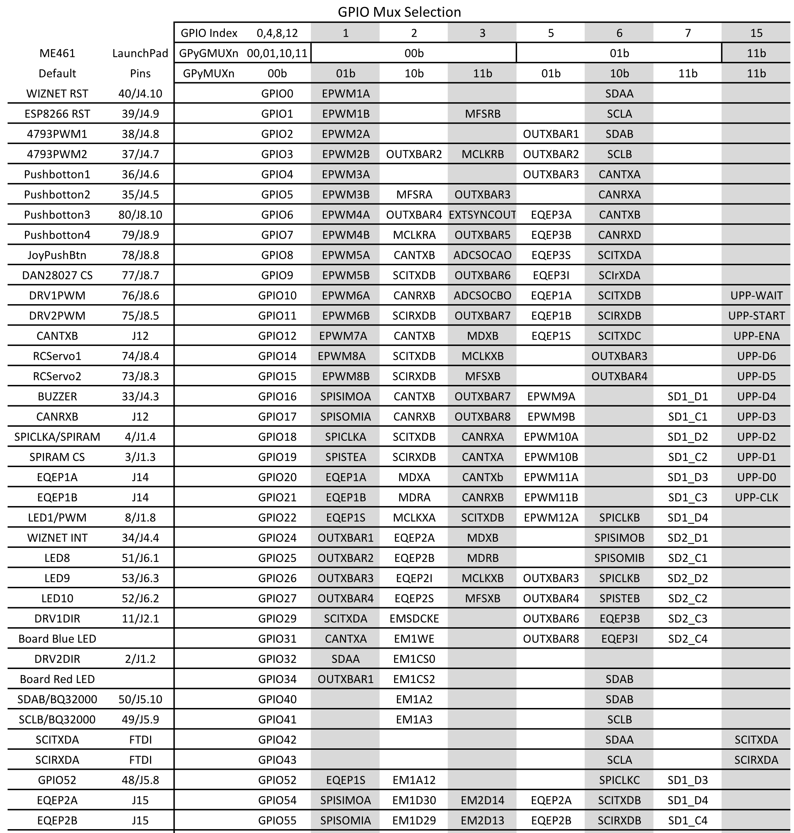
eQEP
SYSTEMS ENGINEERING
GRAINGER ENGINEERING

Slide 30
eQEP – QDECCTL:QSRC
Position-counter source selection
0h (R/W) = Quadrature count mode (QCLK = iCLK, QDIR = iDIR)
1h (R/W) = Direction-count mode (QCLK = xCLK, QDIR = xDIR)
2h (R/W) = UP count mode for frequency measurement (QCLK = xCLK, QDIR = 1)
3h (R/W) = DOWN count mode for frequency measurement (QCLK= xCLK, QDIR = 0)
SYSTEMS ENGINEERING
GRAINGER ENGINEERING

Slide 31
eQEP – QDECCTL:QSRC – Quadrature Count Mode
The quadrature decoder generates the direction and clock to the position counter in quadrature count
mode. Uses the 2-phase input to get the position and direction, this is the standard method.
SYSTEMS ENGINEERING
GRAINGER ENGINEERING

Slide 32
eQEP – QDECCTL:QSRC – Others Mode
Direction-Count Mode
Some position encoders provide direction and clock outputs, instead of quadrature outputs. In such cases,
direction-count mode can be used.
QEPA input will provide the clock for the position counter
QEPB input will have the direction information.
The position counter is incremented on every rising edge of a QEPA input when the direction input is high, and decremented when the direction input is low.
Up-Count Mode / Down-Count Mode
The counter direction signal is hard-wired for up / down -count and the position counter is used to measure the frequency of the QEPA input.
In up-count mode, it is recommended that the application not configure QEPB as a GPIO mux option, or ensure that a signal edge is not generated on the QEPB input.
SYSTEMS ENGINEERING
GRAINGER ENGINEERING

Slide 33
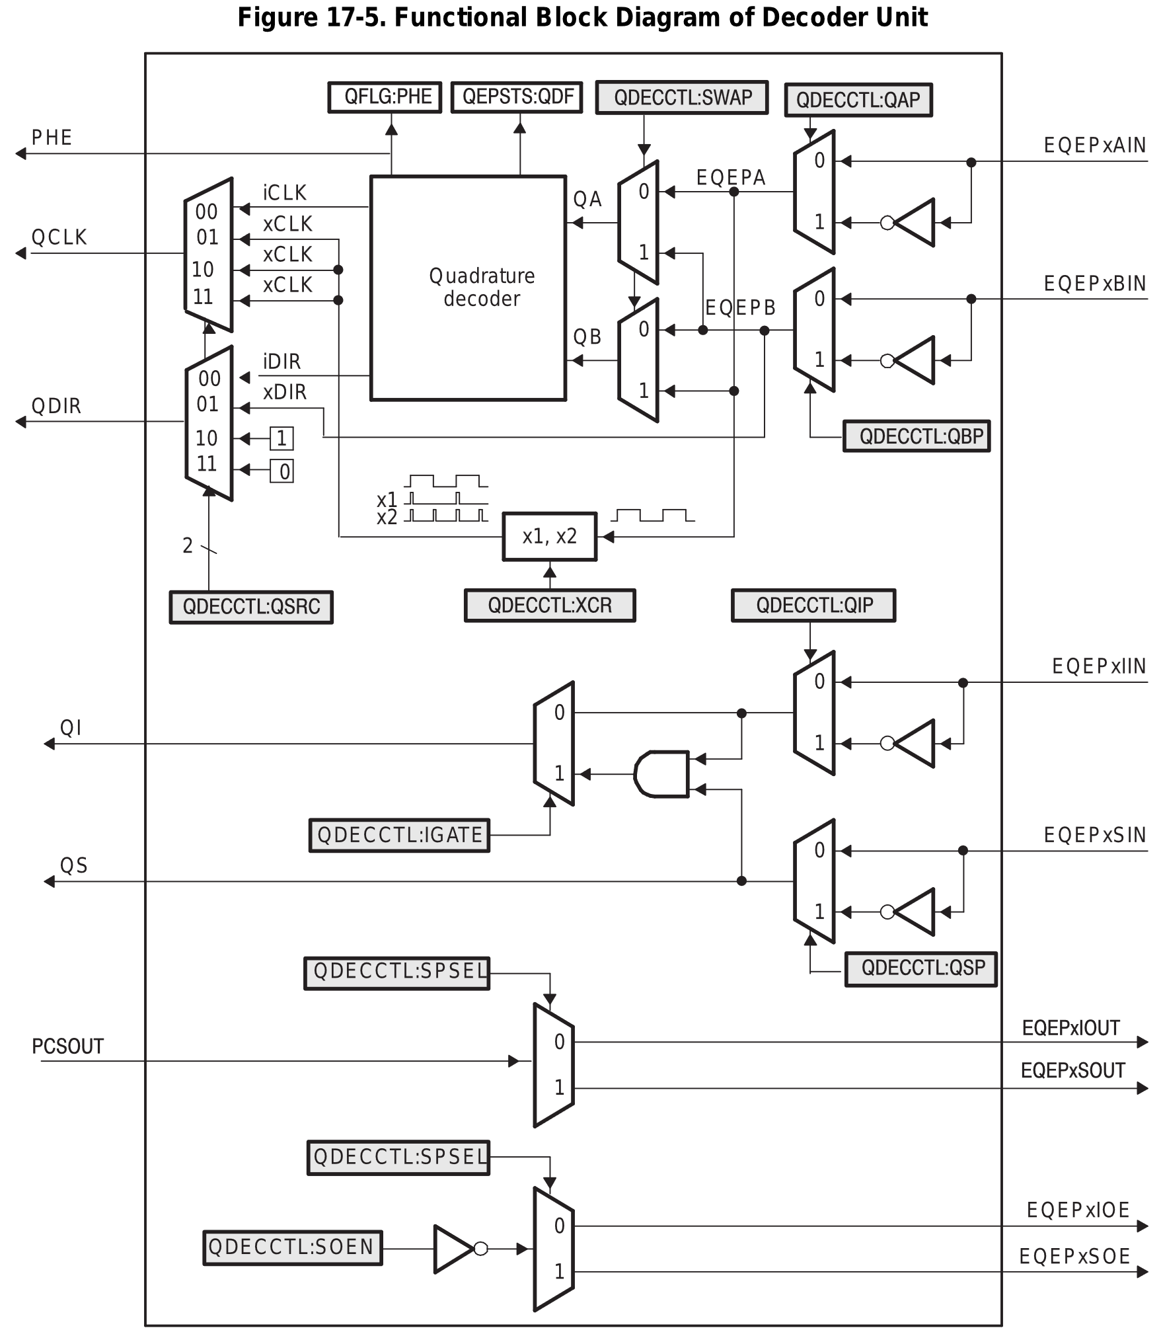
eQEP
Quadrature count mode
Up/Down count
Direction count mode
SYSTEMS ENGINEERING
GRAINGER ENGINEERING

Slide 34
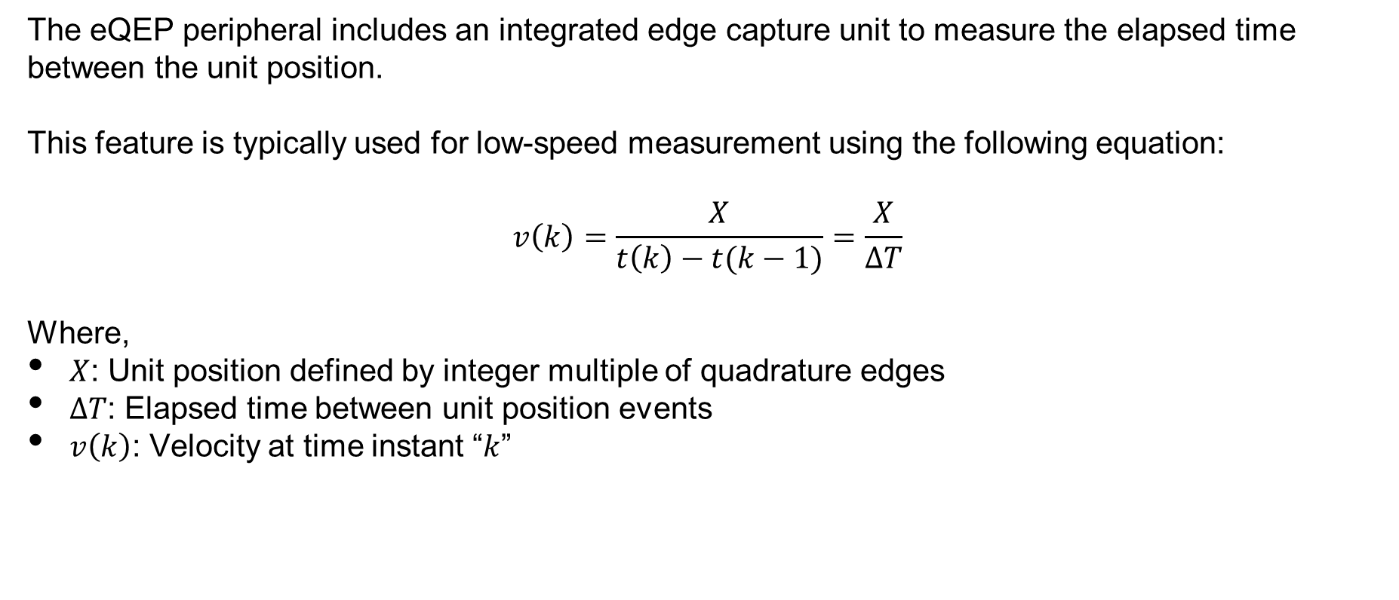
eQEP - CAP
The eQEP peripheral includes an integrated edge capture unit to measure the elapsed time between the unit position.
This feature is typically used for low-speed measurement using the following equation:
$$v\left(k\right)=\frac{X}{t\left(k\right)−t(k−1)}=\frac{X}{∆T}$$
Where,
$X$: Unit position defined by integer multiple of quadrature edges
$∆T$: Elapsed time between unit position events
$v\left(k\right)$: Velocity at time instant “$k$”
SYSTEMS ENGINEERING
GRAINGER ENGINEERING

Slide 35
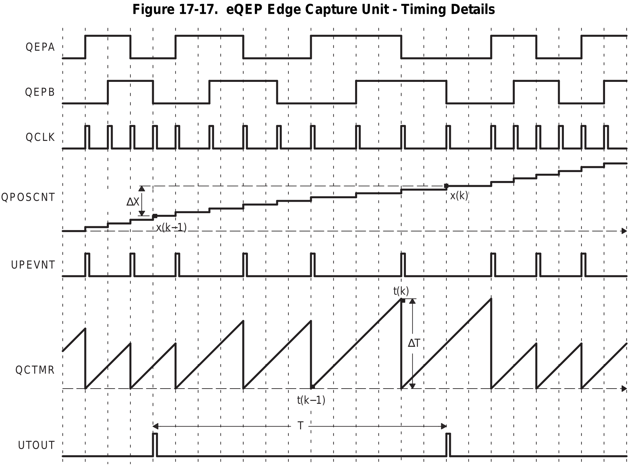
Optical Encoder
SYSTEMS ENGINEERING
GRAINGER ENGINEERING

Slide 36
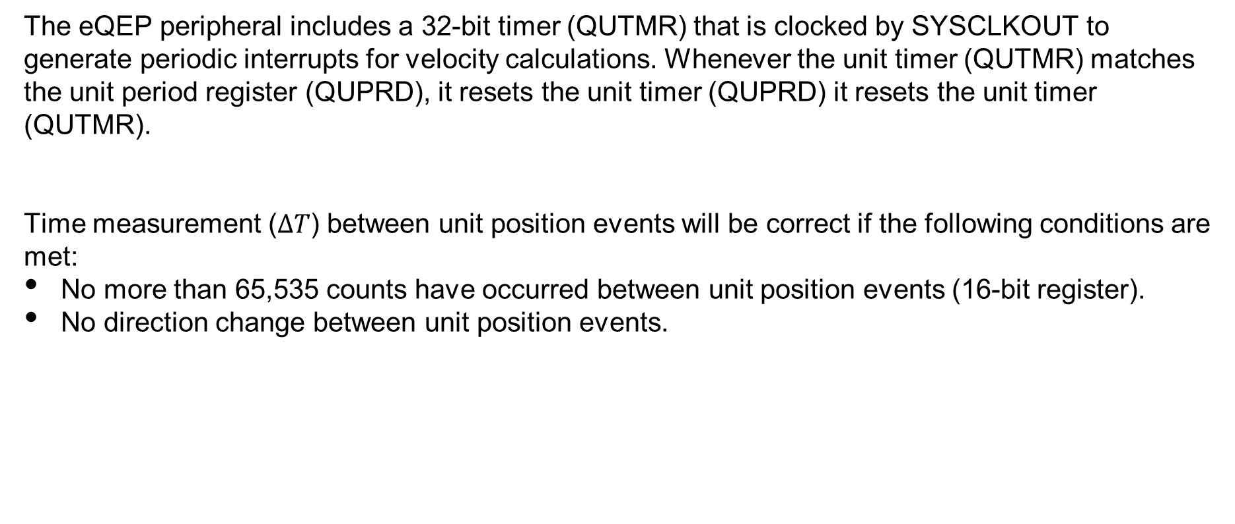
eQEP
The eQEP peripheral includes a 32-bit timer (QUTMR) that is clocked by SYSCLKOUT to generate periodic interrupts for velocity calculations. Whenever the unit timer (QUTMR) matches the unit period register (QUPRD), it resets the unit timer (QUPRD) it resets the unit timer (QUTMR).
Time measurement ($∆T$) between unit position events will be correct if the following conditions are met:
No more than 65,535 counts have occurred between unit position events (16-bit register).
No direction change between unit position events.
SYSTEMS ENGINEERING
GRAINGER ENGINEERING

Slide 37
Optical Encoder
float readEncLeft(void) {
int32_t raw = EQep1Regs.QPOSCNT;
return (raw*(-2*PI/(2000.0*20.0)));
}
Simple as that! You just read the registry!
SYSTEMS ENGINEERING
GRAINGER ENGINEERING

Slide 38
Absolute Optical Encoder
SYSTEMS ENGINEERING
GRAINGER ENGINEERING

Slide 39
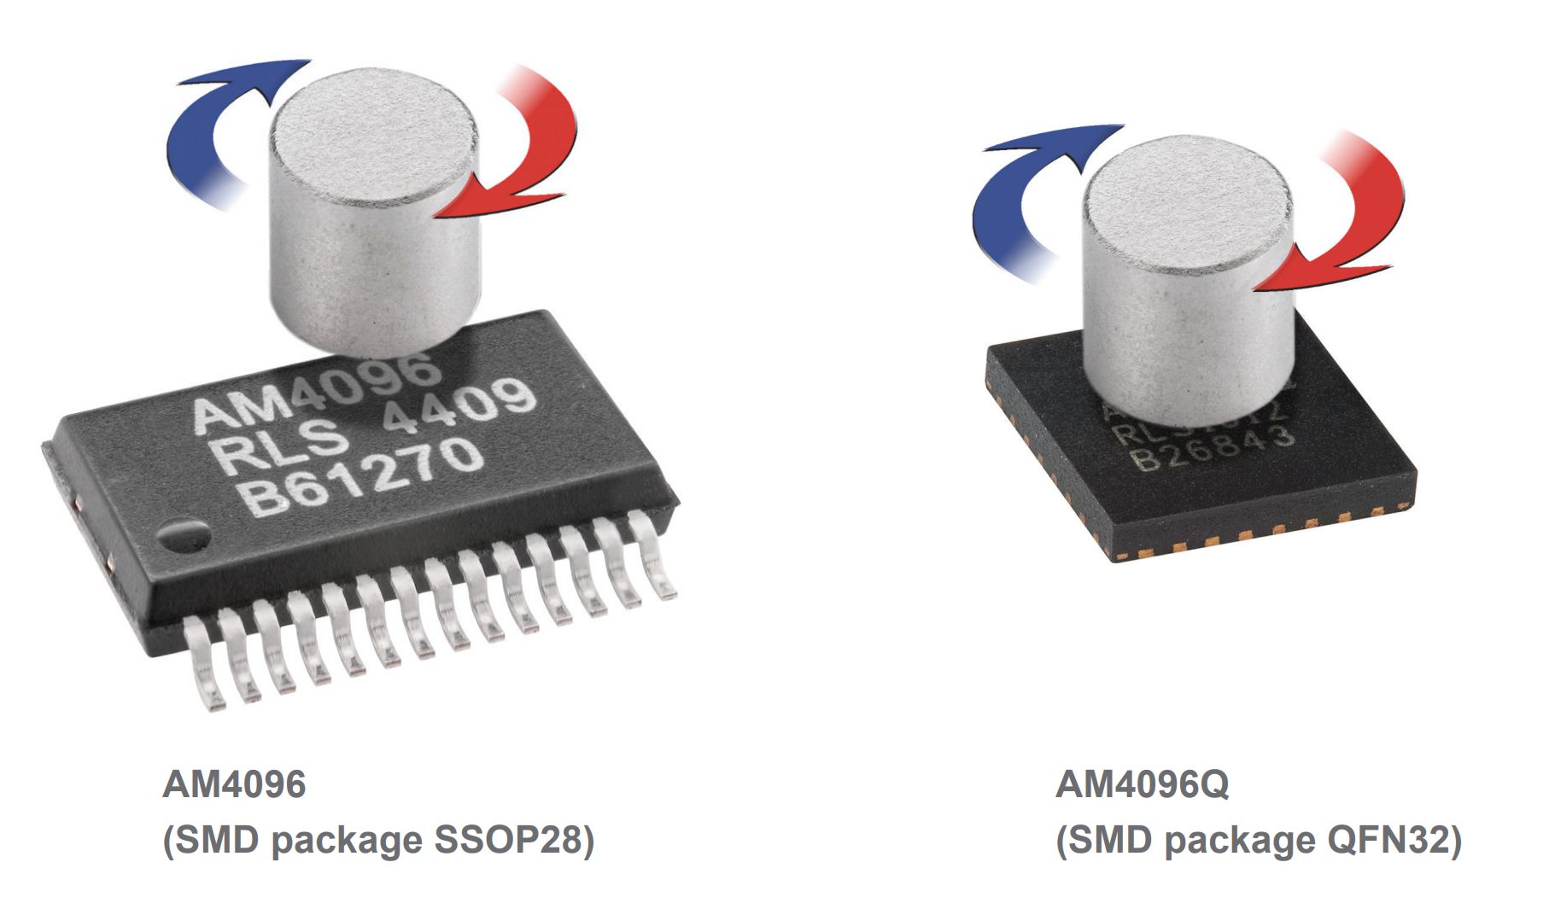
Absolute Encoder
There are multiple protocols for reading data from an optical encoder. We only use incremental encoders in this class.
Some protocols use SPI, some use UART or some kind of DAC signal, etc… the only way to be sure is to look at the official documentation!
For the following Magnetic Rotary Encoder (an absolute encoder that uses a magnet on top of the IC), we can extract the data from the SSI communication protocol.
https://www.rls.si/eng/am4096-12-bit-rotary-magnetic-encoder-chip
SYSTEMS ENGINEERING
GRAINGER ENGINEERING

Slide 40
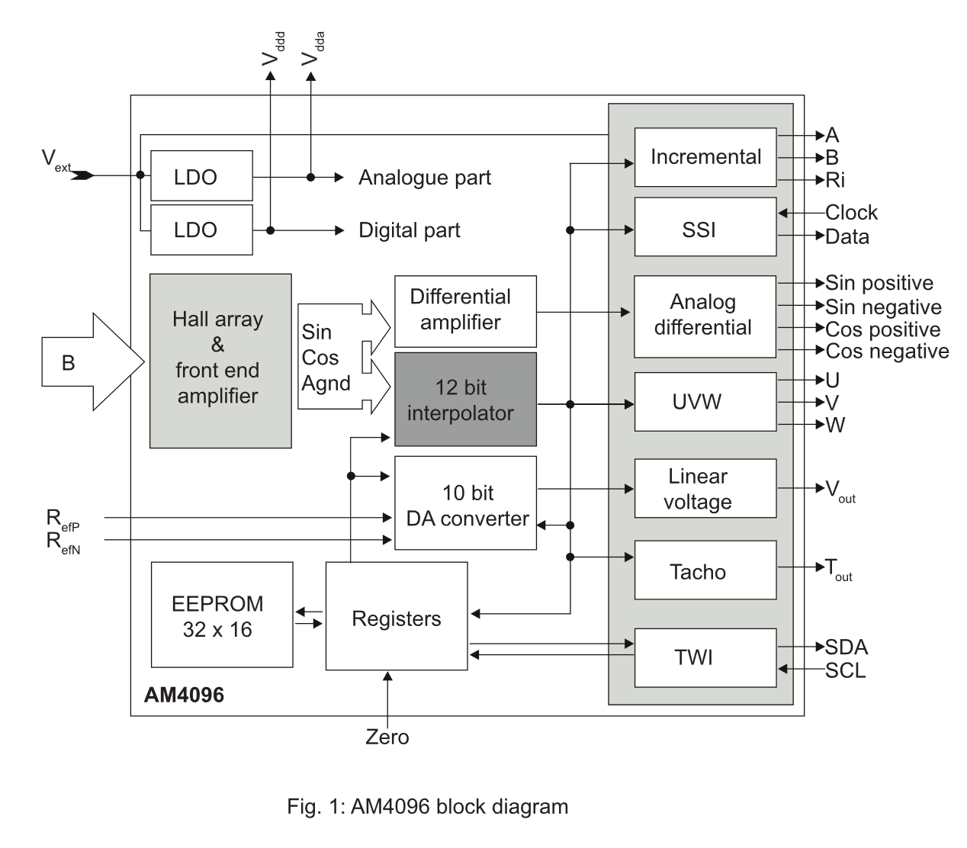
SSI
SYSTEMS ENGINEERING
GRAINGER ENGINEERING

Slide 41
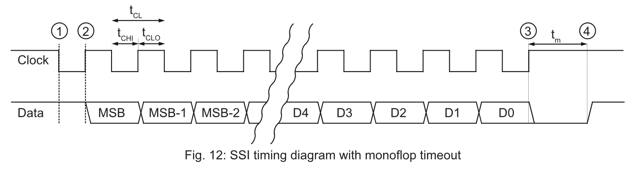
SSI
Like UART, start with high, then to start communication you start with a low value. The difference is that you are not sending “data” to ask, you are just sending a clock signal. The sensor is sending its preconfigured “data”.
This is a full-duplex signal (you send and receive at the same time).
The data below is specifically for the AS5145H – 12 bit angular magnetic encoder IC
https://look.ams-osram.com/m/5835d15632039c2e
SYSTEMS ENGINEERING
GRAINGER ENGINEERING

Slide 42
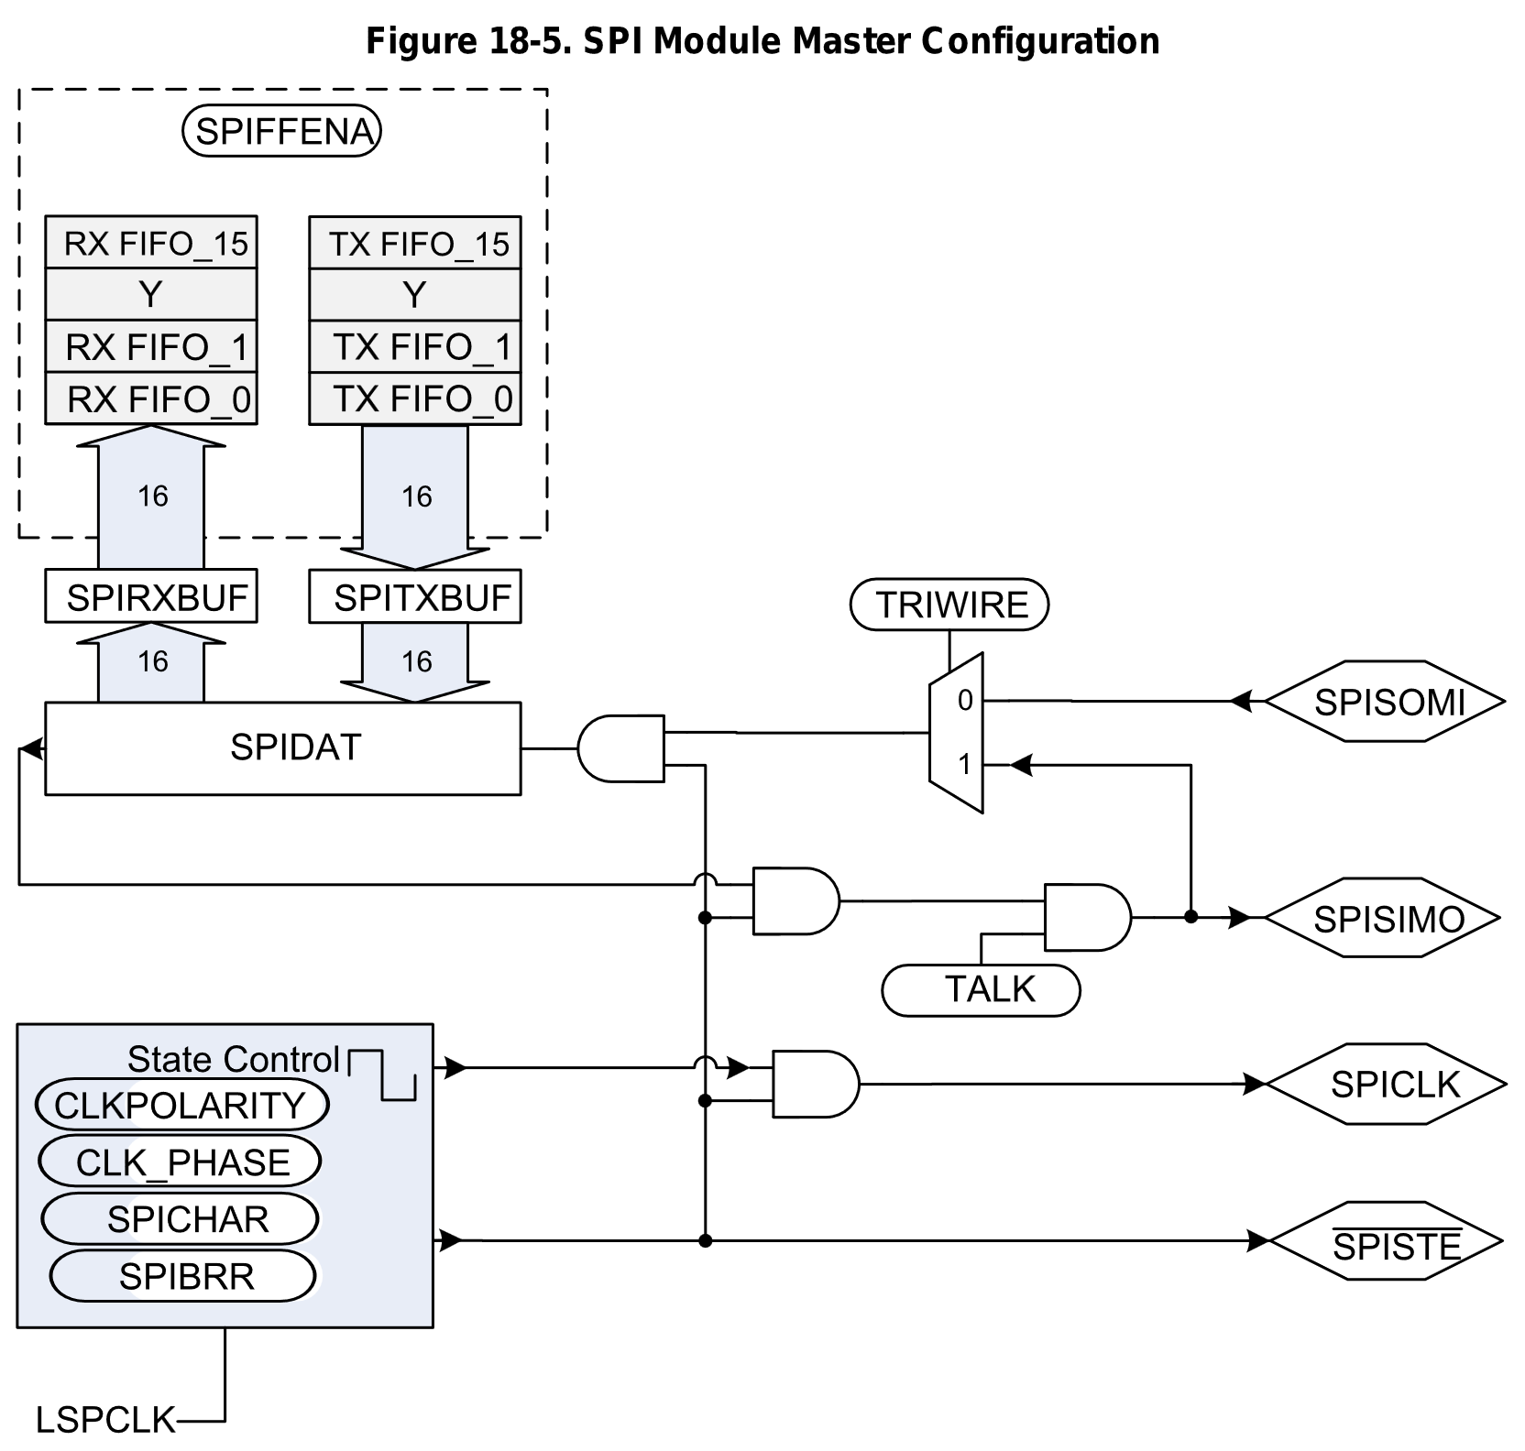
SSI
We can send the clock signal using SPI
SYSTEMS ENGINEERING
GRAINGER ENGINEERING

Slide 43
SSI
Communicate through the SPI
//need clock polarity = 1 (falling edge)
//collect data on falling edge -> phase = 1 (with delay)
SpiaRegs.SPICCR.bit.SPISWRESET = 0; //put spi in reset (reset before changin configurations)
SpiaRegs.SPICCR.bit.CLKPOLARITY = 1; //falling edge clock (starts high)
SpiaRegs.SPICCR.bit.SPICHAR = 7; //shift length for one character is 8 bits
SpiaRegs.SPICTL.all = 0x000E; //0000000000001110->clkphase = 1 (with delay), master mode,
//enable talk, spi int disabled, transmit on falling edge
SpiaRegs.SPIBRR.bit.SPI_BIT_RATE = 49; //set bit rate to 1Mhz so 50Mhz/50?
SpiaRegs.SPIPRI.bit.FREE = 1; //spi contunes even when emu halted
SpiaRegs.SPISTS.all=0x0000; //clear all flags
SpiaRegs.SPIFFCT.all=0x00; //set tx delay to no delays for full duplex ( read and write at the same time )
SYSTEMS ENGINEERING
GRAINGER ENGINEERING

Slide 44
SSI
SpiaRegs.SPIFFTX.bit.TXFIFO = 0; //put tx fifo in reset and hold there
SpiaRegs.SPIFFTX.bit.TXFFINTCLR = 1; //clear tx fifo interrupt flag (will not be using)
SpiaRegs.SPIFFRX.bit.RXFIFORESET = 0; //put rx fifo in reset and hold there
SpiaRegs.SPIFFTX.bit.SPIFFENA = 1; //spi fifo enhancements enable
SpiaRegs.SPIFFRX.bit.RXFFINTCLR = 1; //clear receive fifo interrupt flag
SpiaRegs.SPIFFRX.bit.RXFFIL = 3; //interrupt level is one word
SpiaRegs.SPIFFRX.bit.RXFFIENA = 1; //rx fifo interrupt enable
SpiaRegs.SPICTL.bit.OVERRUNINTENA = 1; //overrun interrupt enable
SpiaRegs.SPICTL.bit.SPIINTENA = 1; //interrupt enable
SpiaRegs.SPIFFTX.bit.TXFIFO = 1; //release tx fifo to operate
SpiaRegs.SPIFFRX.bit.RXFIFORESET = 1; //release rx fifo to operate
SpiaRegs.SPIFFTX.bit.SPIRST = 1; //spi can resume tx or rx (pull out of reset)
SpiaRegs.SPICCR.bit.SPISWRESET = 1; //pull spi out of reset (enable spi)
//pie and cpu enables for group 6 done in setupSpib (6.1 and 6.2 for spia)
SYSTEMS ENGINEERING
GRAINGER ENGINEERING

Slide 45
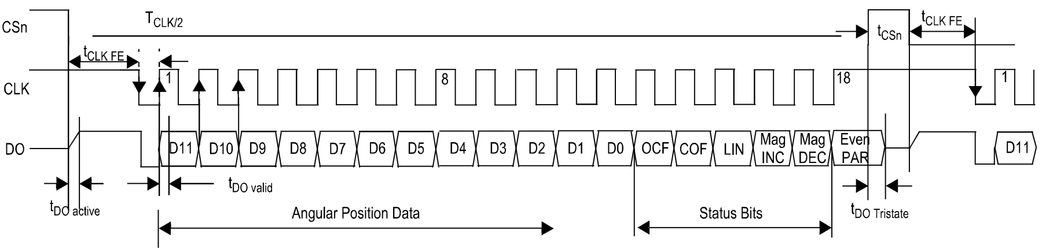
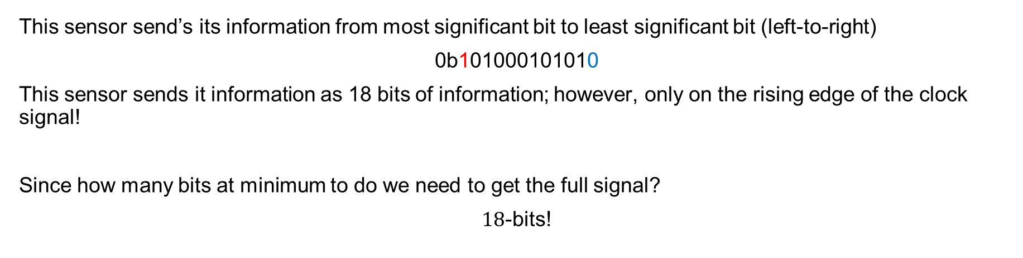
SSI
This sensor send’s its information from most significant bit to least significant bit (left-to-right)
0b101000101010
This sensor sends it information as 18 bits of information; however, only on the rising edge of the clock signal!
Since how many bits at minimum to do we need to get the full signal?
$18$-bits!
https://look.ams-osram.com/m/5835d15632039c2e
SYSTEMS ENGINEERING
GRAINGER ENGINEERING

Slide 46
SSI
Problem is that SPICHAR (how many bits SPI sends at a time), has a maximum of 16-bits and we need to send 24-bits. So, what do we do?
// Send 8-bit words
SpiaRegs.SPICCR.bit.SPICHAR = 7;
// Sending data function
void sendSPIData(void){
SpiaRegs.SPIFFRX.bit.RXFFIL = 3; //Going to R/W 3 entries
GpioDataRegs.GPCCLEAR.bit.GPIO73 = 1; //pull cs low to get ready to tx/rx
// since we have SPICHAR=7 (8-bits), we only store the top 8-bits
// SPI is set to FIFO mode so this works in a special way
for(i = 0; i < 3; i++) {
SpiaRegs.SPITXBUF = 0xAA00u; // You need to send something to receive something (does not matter what)!
}
}
SYSTEMS ENGINEERING
GRAINGER ENGINEERING

Slide 47
SSI
void spiaRxFifoIsr(void)
{
//received data right justified
spiaRxData[0] = SpiaRegs.SPIRXBUF & 0xFF;
spiaRxData[1] = SpiaRegs.SPIRXBUF & 0xFF;
spiaRxData[2] = SpiaRegs.SPIRXBUF & 0xFF;
theta.d = (((unsigned int) (spiaRxData[0] & 0x7F)) << 5) + (((unsigned int) (spiaRxData[1] & 0xF8)) >> 3);
// ... other math, ignore ...
SpiaRegs.SPIFFRX.bit.RXFFOVFCLR = 1; // Clear Overflow flag
SpiaRegs.SPIFFRX.bit.RXFFINTCLR = 1; // Clear Interrupt flag
PieCtrlRegs.PIEACK.all |= 0x20; // Issue PIE ack
}
SYSTEMS ENGINEERING
GRAINGER ENGINEERING

Slide 48
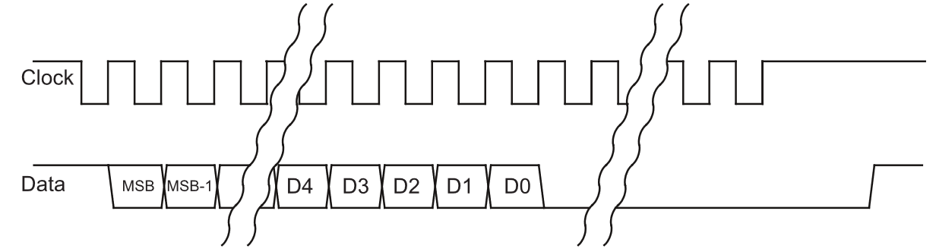
Absolute Encoder
You need a minimum of 19 low going edges to read in the first always high bit and then the remaining 18 bits.
We are sending 24 bits; the rest does not matter as it gets filtered out.
https://www.rls.si/eng/am4096-12-bit-rotary-magnetic-encoder-chip
SYSTEMS ENGINEERING
GRAINGER ENGINEERING

Slide 49
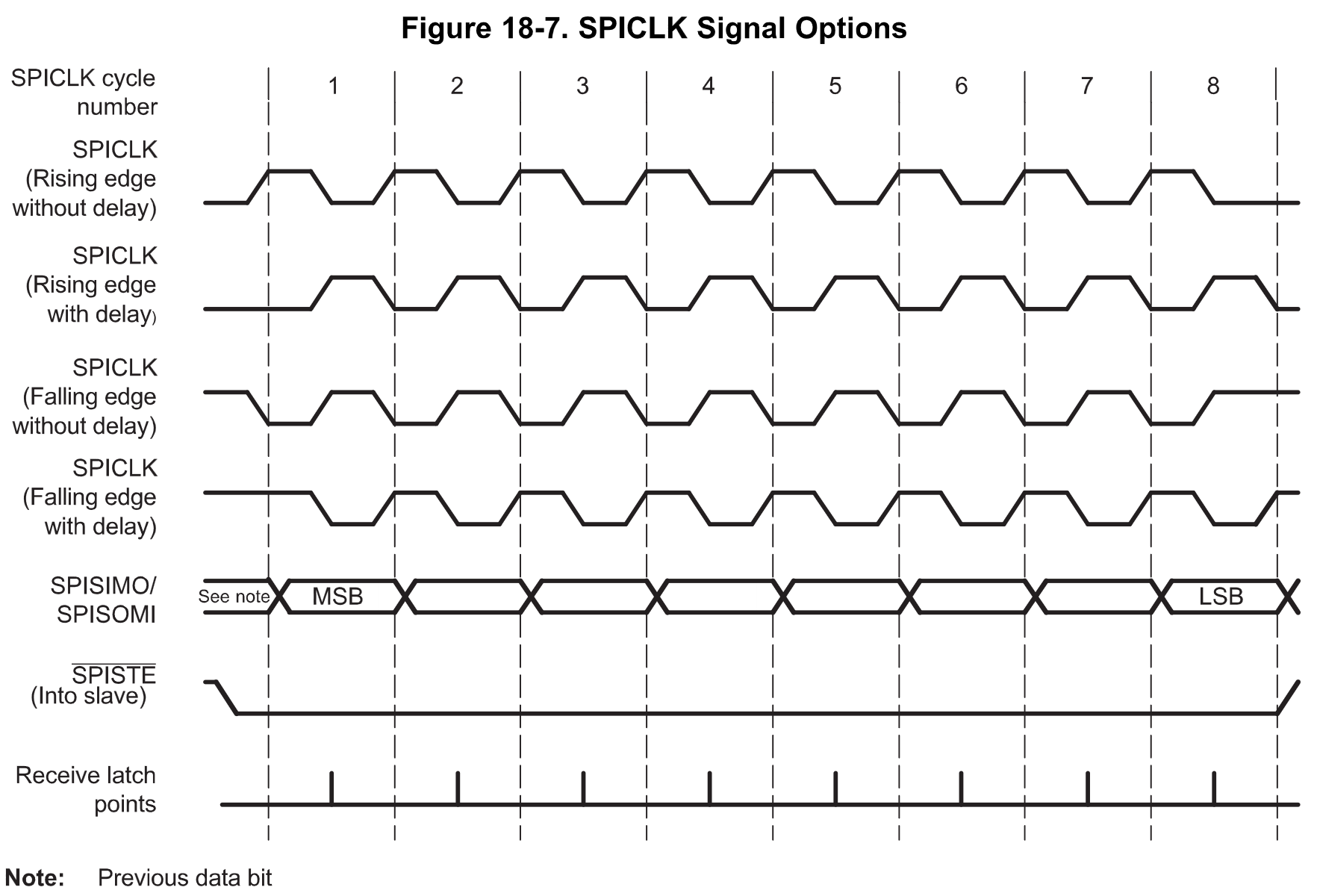
SSI
Polarity | Phase
0 | 0
0 | 1
1 | 0
1 | 1
SYSTEMS ENGINEERING
GRAINGER ENGINEERING

Slide 50
FIFO
SYSTEMS ENGINEERING
GRAINGER ENGINEERING

Slide 51
FIFO
Previously with the SPI we see that we did 2 weird things:
for(i = 0; i < 3; i++) {
SpiaRegs.SPITXBUF = 0xAA00u;
}
And,
spiaRxData[0] = SpiaRegs.SPIRXBUF & 0xFF;
spiaRxData[1] = SpiaRegs.SPIRXBUF & 0xFF;
spiaRxData[2] = SpiaRegs.SPIRXBUF & 0xFF;
What is weird here?
We are writing / reading from the same place! Why would the output be different?!
SYSTEMS ENGINEERING
GRAINGER ENGINEERING

Slide 52
FIFO
Instead of waiting every interrupt cycle to write long pieces of text to the SPI connection, we can instead use FIFO (First-In-First-Out), which is a buffer queuing system.
When you fill in one of the buffers RX / TX, the value automatically goes to one of the 16 FIFO slots (instantaneously), to be used later!
This allows you to store, in one function call, 16 FIFO buffer values both for transmit and receive!
Uses only “16 CPU cycles” instead of 16 interrupt calls!
Allows for large read / writes.
SYSTEMS ENGINEERING
GRAINGER ENGINEERING

Slide 53
FIFO
Looking back:
// Shifts into SPIDATA on the MSB side
for(i = 0; i < 3; i++) {
SpiaRegs.SPITXBUF = 0xAA00u;
}
// Shifts into SPIDATA on the LSB side
spiaRxData[0] = SpiaRegs.SPIRXBUF & 0xFF;
spiaRxData[1] = SpiaRegs.SPIRXBUF & 0xFF;
spiaRxData[2] = SpiaRegs.SPIRXBUF & 0xFF;
For the TX, TX FIFO_{0,..,15} start empty.
i = 0, TX FIFO_0 = 0xAAu;
i = 1, TX FIFO_{0,1} = 0xAAu;
i = 2, TX FIFO_{0,1,2} = 0xAAu;
For the RX, RX FIFO_{0,1,2} has data
Takes from RX FIFO_0 FIFO_{1,2} has data
Takes from RX FIFO_1 FIFO_{2} has data
Takes from RX FIFO_2 FIFO has no more data
(technically the next FIFO is always FIFO_0)
SYSTEMS ENGINEERING
GRAINGER ENGINEERING

Slide 54
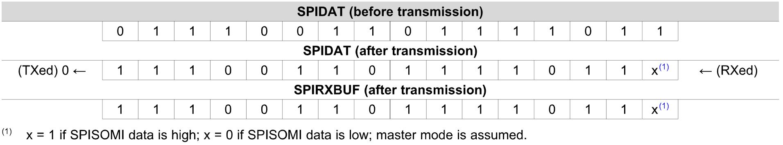
FIFO – Example 18-1
SYSTEMS ENGINEERING
GRAINGER ENGINEERING

Slide 55
SSI
The four-bit SPICHAR register field specifies the number of bits in the data character (1 to 16). The following statements apply to characters with fewer than 16 bits:
Data must be left-justified when written to SPIDAT and SPITXBUF.
Data read back from SPIRXBUF is right-justified.
SPIRXBUF contains the most recently received character, right-justified, plus any bits that remain from previous transmission(s) that have been shifted to the left (shown in Example 18-1).
SYSTEMS ENGINEERING
GRAINGER ENGINEERING

Slide 56
PWM
SYSTEMS ENGINEERING
GRAINGER ENGINEERING

Slide 57
How do LEDs become dimmer?
SYSTEMS ENGINEERING
GRAINGER ENGINEERING

Slide 58
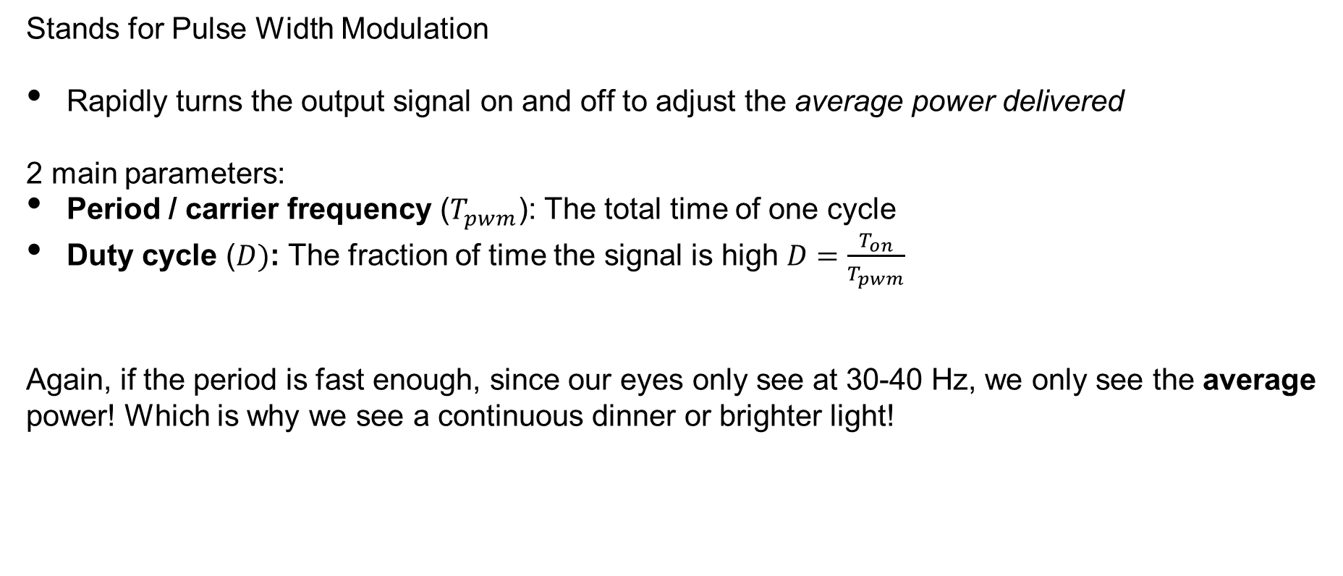
PWM - Introduction
Stands for Pulse Width Modulation
Rapidly turns the output signal on and off to adjust the average power delivered
2 main parameters:
Period / carrier frequency ($T_{pwm}$): The total time of one cycle
Duty cycle ($D)$: The fraction of time the signal is high $D=\frac{T_{on}}{T_{pwm}}$
Again, if the period is fast enough, since our eyes only see at 30-40 Hz, we only see the average power! Which is why we see a continuous dinner or brighter light!
SYSTEMS ENGINEERING
GRAINGER ENGINEERING

Slide 59
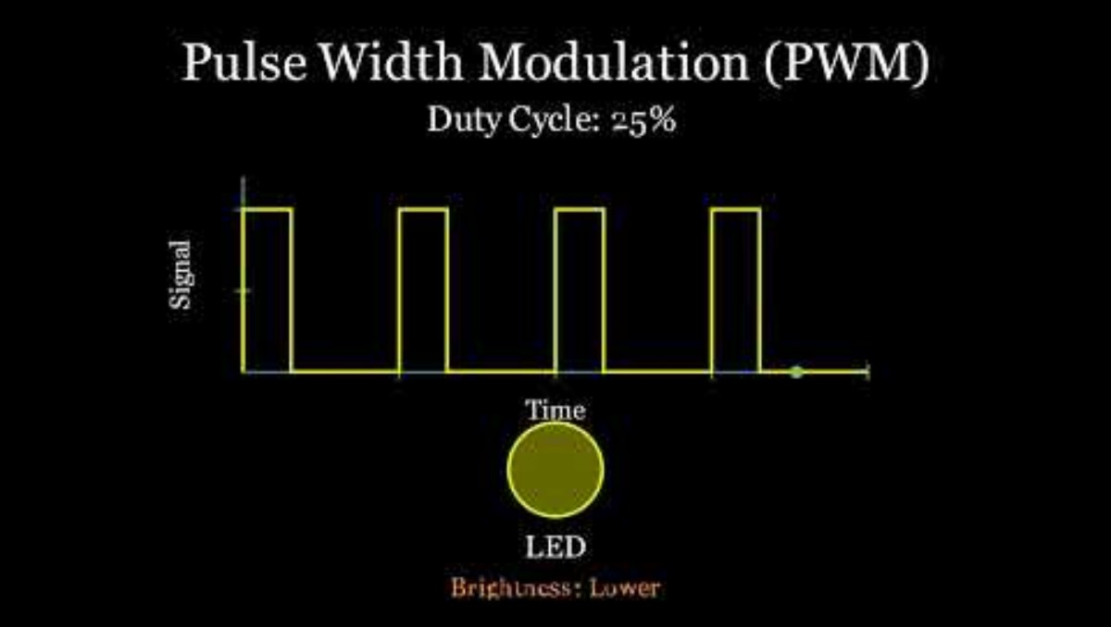
PWM - Introduction
https://youtu.be/IO5RBfq_5Uo?si=KMDtMRWZ-Gs9MQLh
SYSTEMS ENGINEERING
GRAINGER ENGINEERING

Slide 60
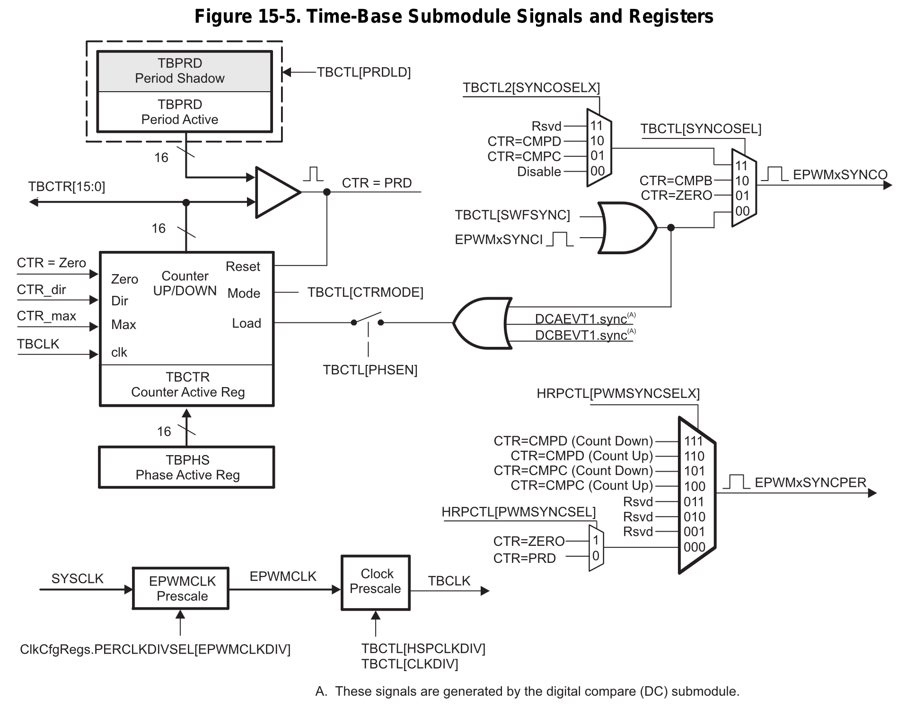
PWM
Clock signal
SYSTEMS ENGINEERING
GRAINGER ENGINEERING

Slide 61
PWM
The frequency of PWM events is controlled by the time-base period (TBPRD) register and the mode of the time-base counter. The time increment for each step is defined by the time-base clock (TBCLK) which is a prescaled version of the ePWM clock (EPWMCLK).
The time-base counter has three modes of operation selected by the time-base control register (TBCTL):
Up-Down-Count Mode: In up-down-count mode, the time-base counter starts from zero and increments until the period (TBPRD) value is reached. When the period value is reached, the time-base counter then decrements until it reaches zero.
Up-Count Mode: In this mode, the time-base counter starts from zero and increments until it reaches the value in the period register (TBPRD).
Down-Count Mode: In down-count mode, the time-base counter starts from the period (TBPRD) value and decrements until it reaches zero.
SYSTEMS ENGINEERING
GRAINGER ENGINEERING

Slide 62
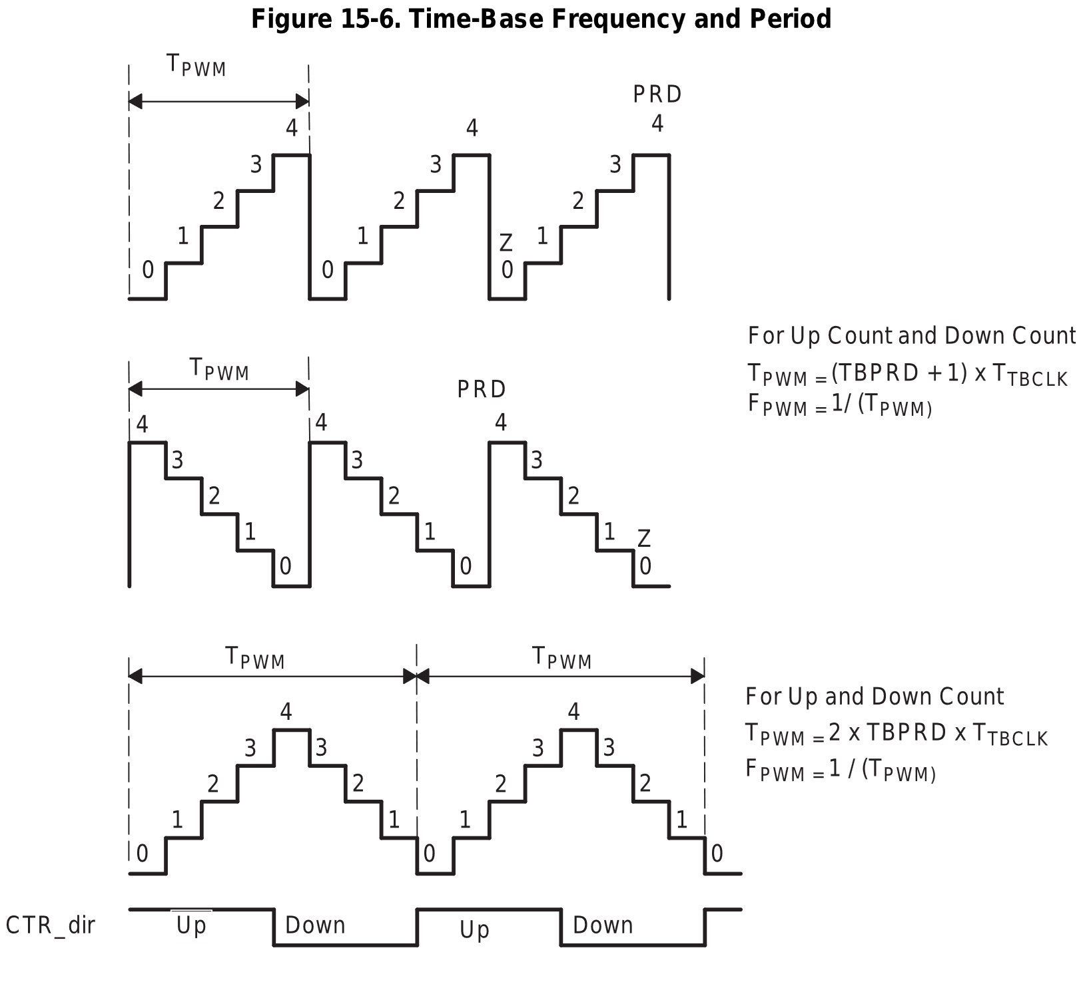
PWM – Counter mode
Up count
Down count
Up-down count
SYSTEMS ENGINEERING
GRAINGER ENGINEERING

Slide 63
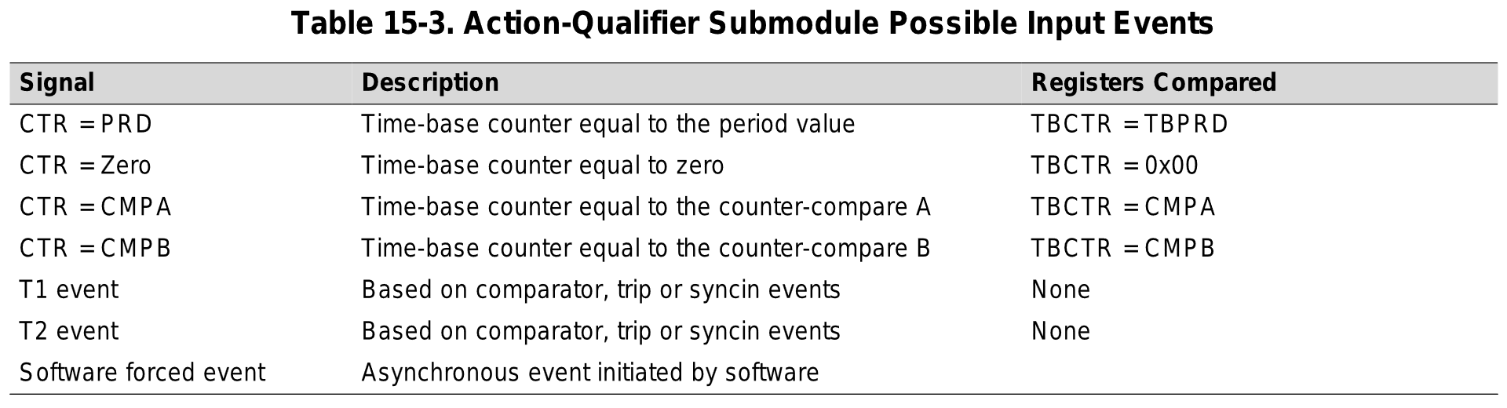
PWM – Counter-Compare Submodule
The counter-compare submodule takes as input the time-base counter value.
This value is continuously compared to the counter-compare A (CMPA) counter-compare B (CMPB) counter-compare C (CMPC) and counter-compare D (CMPD) registers.
When the time-base counter is equal to one of the compare registers, the counter-compare unit generates an appropriate event.
SYSTEMS ENGINEERING
GRAINGER ENGINEERING

Slide 64
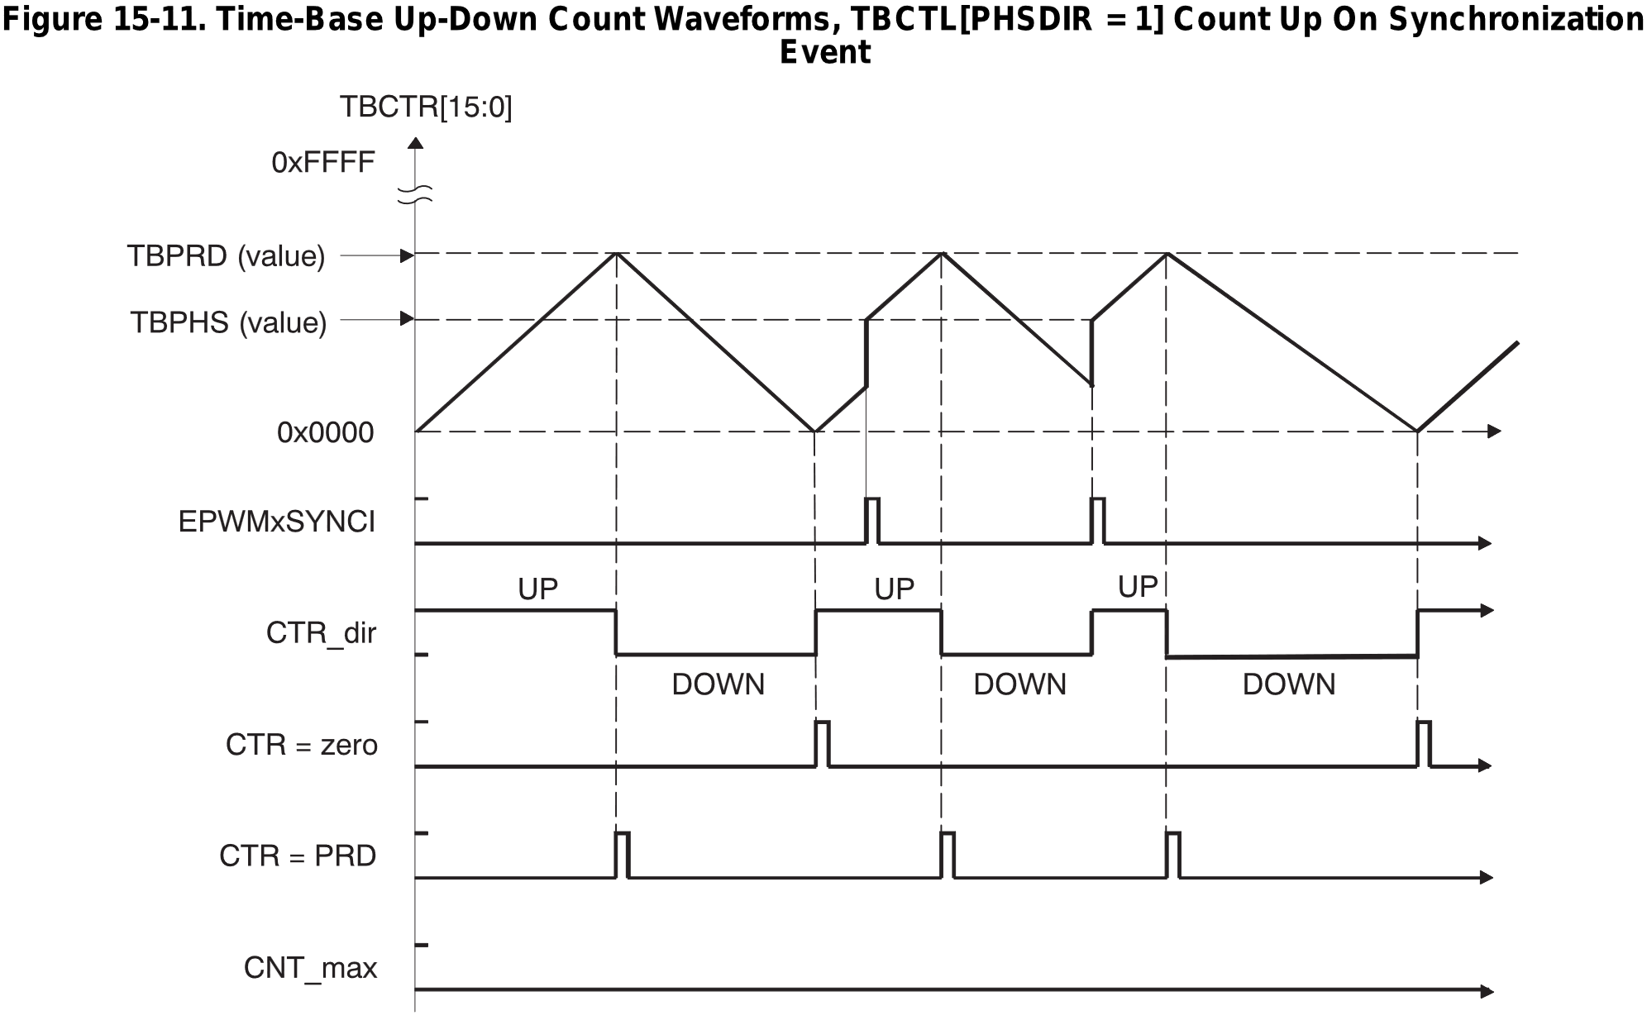
PWM
SYSTEMS ENGINEERING
GRAINGER ENGINEERING

Slide 65
PWM – Duty cycle
From the result of the comparison that get triggered, you can then output a signal to the ePWMA or ePWMB signals
The possible actions imposed on outputs EPWMxA and EPWMxB are:
Set High: Set output EPWMxA or EPWMxB to a high level.
Clear Low: Set output EPWMxA or EPWMxB to a low level.
Toggle: Toggle EPWMxA or EPWMxB
Do Nothing.
Allows you create complex signals.
SYSTEMS ENGINEERING
GRAINGER ENGINEERING

Slide 66
PWM – Duty cycle
Each registry bits allows you to configure the different comparison events
struct AQCTLA_BITS { // bits description
Uint16 ZRO:2; // 1:0 Action Counter = Zero
Uint16 PRD:2; // 3:2 Action Counter = Period
Uint16 CAU:2; // 5:4 Action Counter = Compare A Up
Uint16 CAD:2; // 7:6 Action Counter = Compare A Down
Uint16 CBU:2; // 9:8 Action Counter = Compare B Up
Uint16 CBD:2; // 11:10 Action Counter = Compare B Down
Uint16 rsvd1:4; // 15:12 Reserved
};
SYSTEMS ENGINEERING
GRAINGER ENGINEERING

Slide 67
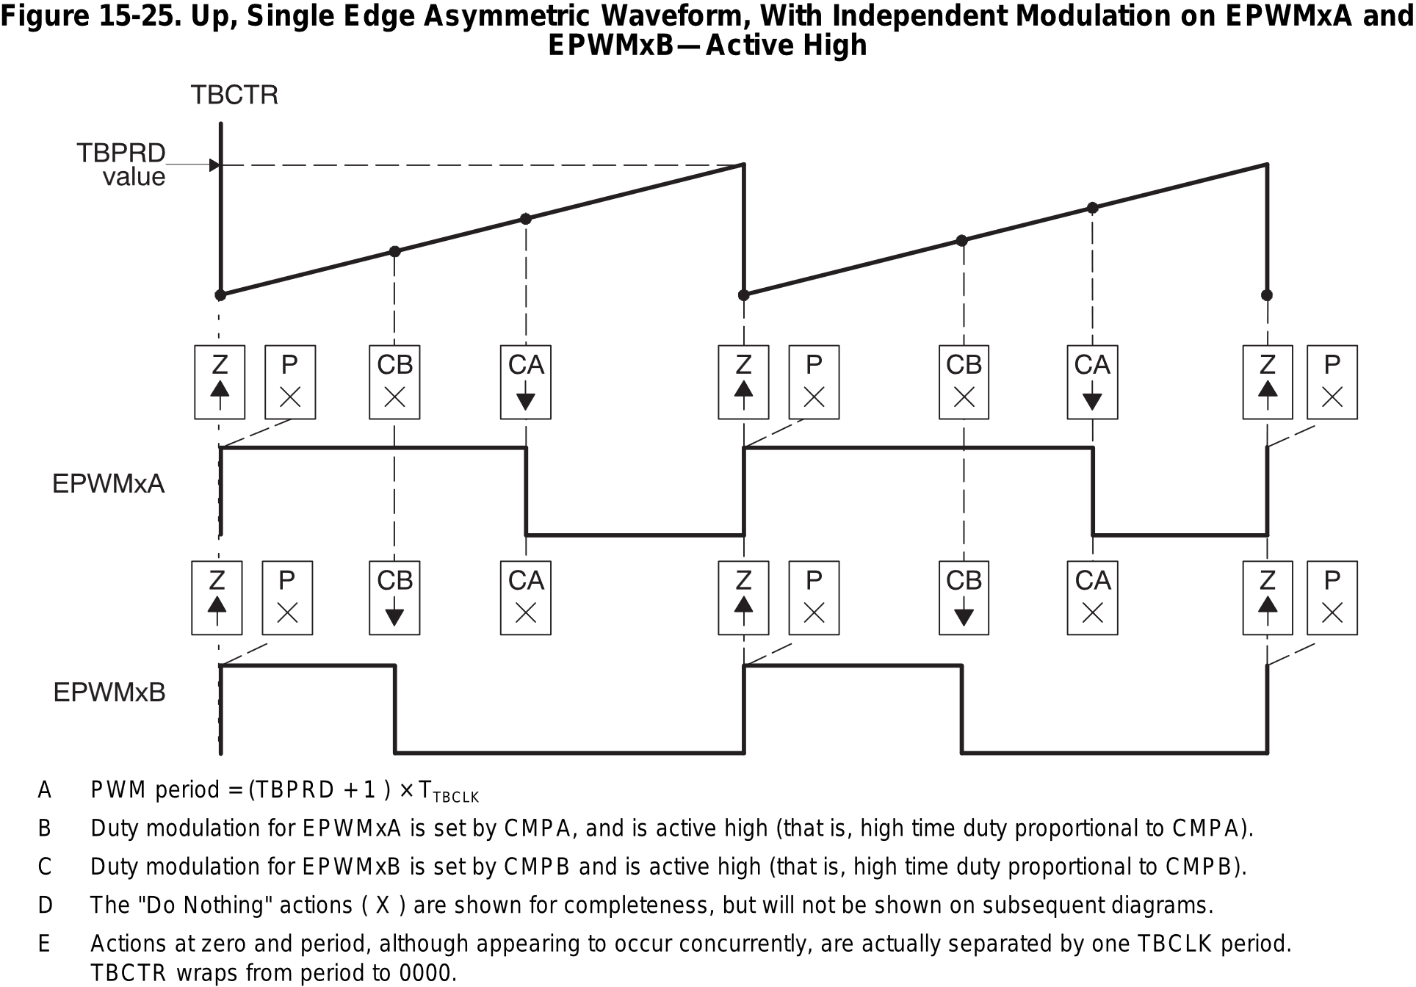
PWM – Duty cycle
SYSTEMS ENGINEERING
GRAINGER ENGINEERING

Slide 68
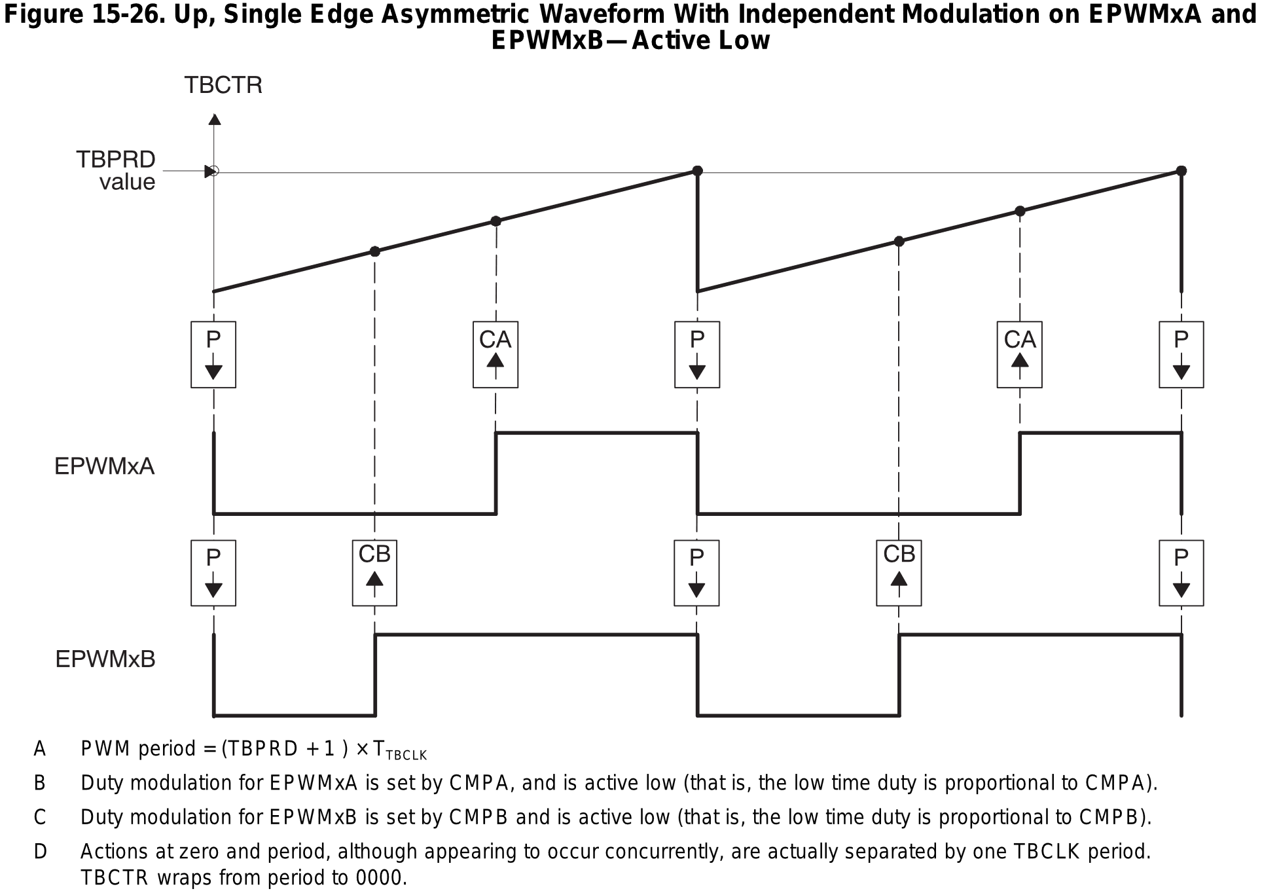
PWM – Duty cycle
What is it being set to?
What is this?
What is it being set to?
SYSTEMS ENGINEERING
GRAINGER ENGINEERING

Slide 69
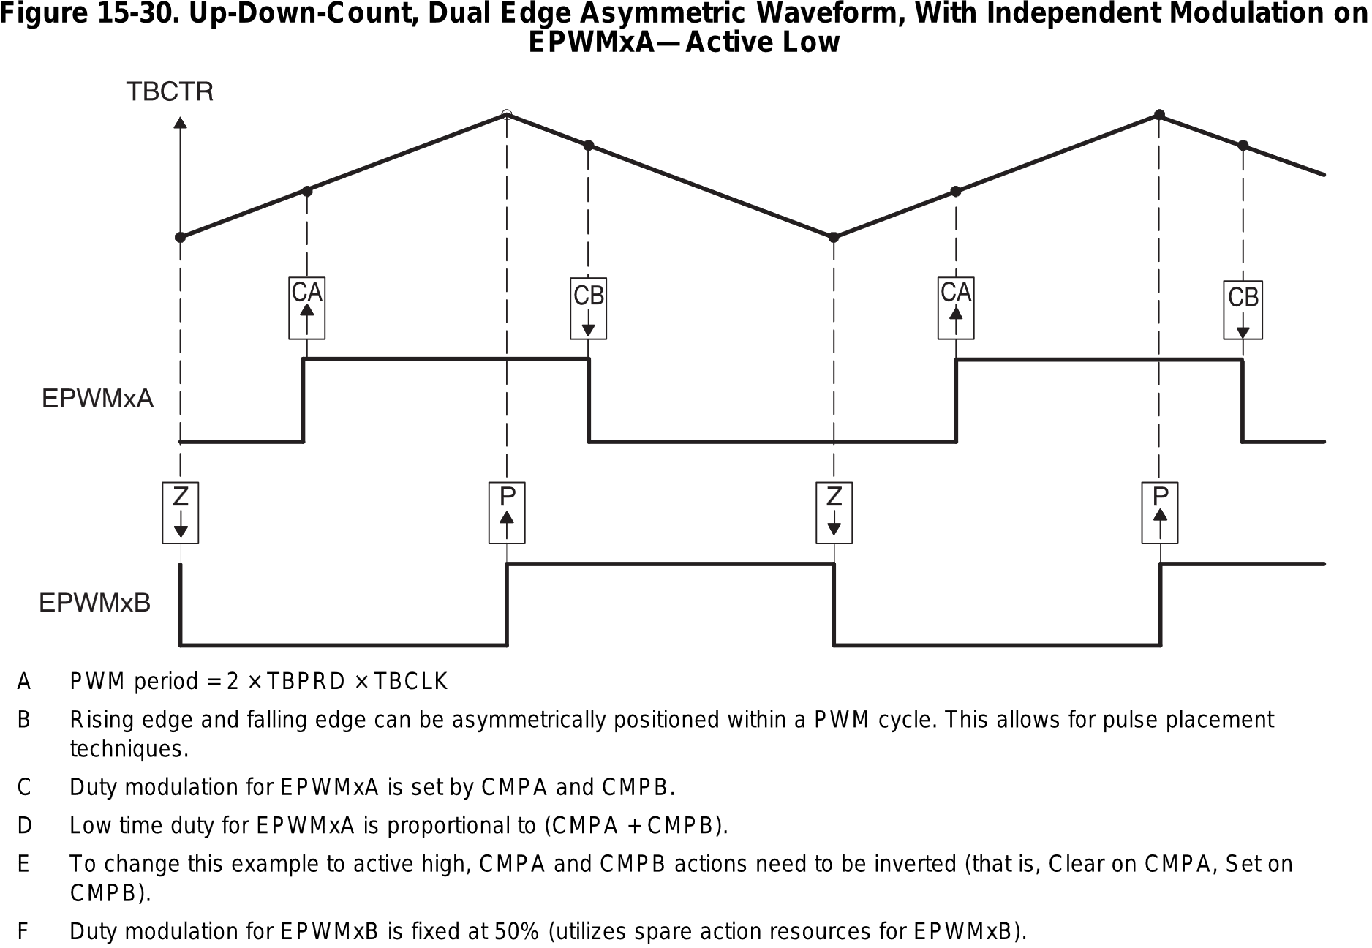
PWM – Duty cycle
What is this?
What is this?
What is this?
What is this?
SYSTEMS ENGINEERING
GRAINGER ENGINEERING

Slide 70
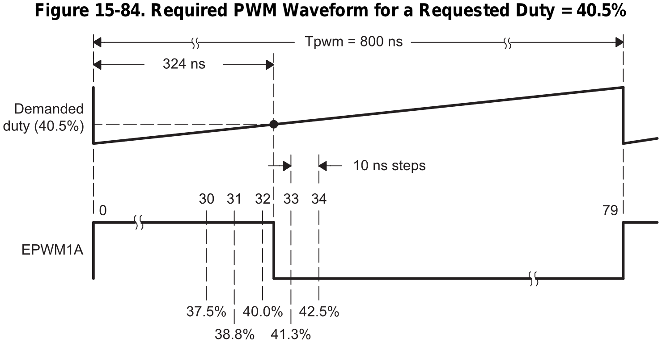
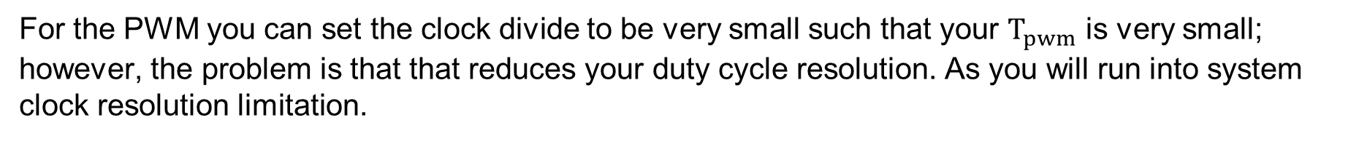
PWM – Duty cycle
For the PWM you can set the clock divide to be very small such that your $T_{pwm}$ is very small; however, the problem is that that reduces your duty cycle resolution. As you will run into system clock resolution limitation.
SYSTEMS ENGINEERING
GRAINGER ENGINEERING

Slide 71
PWM – Duty cycle
EALLOW;
// TBCTL
EPwm12Regs.TBCTL.bit.FREE_SOFT = 0x2; // Free Soft emulation = Free Run
EPwm12Regs.TBCTL.bit.CLKDIV = 0; // Clock divide = 1
EPwm12Regs.TBCTL.bit.CTRMODE = 1; // Count down Mode
EPwm12Regs.TBCTL.bit.PHSEN = 0; // Do not load time time-base counter from the time-base phase registry
// TBCTR
EPwm12Regs.TBCTR = 0; // Start Timer at zero
// TBPRD
// Set period of the PWM to 2kHz (500 us)
// Counter frequency is 50MHz
EPwm12Regs.TBPRD = 25000;
// CMPA
EPwm12Regs.CMPA.bit.CMPA = 12500; // Duty cycle at 50%, TBPRD / 2
EPwm12Regs.AQCTLA.bit.CAD = 0x1; // PWM12A output pin is set low when CMPA is reached
EPwm12Regs.AQCTLA.bit.PRD = 0x2; // the pin be set high when the TBCTR register is Period
EPwm12Regs.TBPHS.bit.TBPHS = 0;
EDIS;
GpioCtrlRegs.GPAPUD.bit.GPIO22 = 1; // For EPW12A
SYSTEMS ENGINEERING
GRAINGER ENGINEERING

Slide 72
PWM – Duty cycle
EPwm12Regs.TBPRD = 100;
EPwm12Regs.CMPA.bit.CMPA = 50;
What is the duty cycle?
50%
EPwm12Regs.TBPRD = 100;
EPwm12Regs.CMPA.bit.CMPA = 25;
What is the duty cycle?
25%
EPwm12Regs.TBPRD = 100;
EPwm12Regs.CMPA.bit.CMPA = 75;
What is the duty cycle?
75%
SYSTEMS ENGINEERING
GRAINGER ENGINEERING

Slide 73
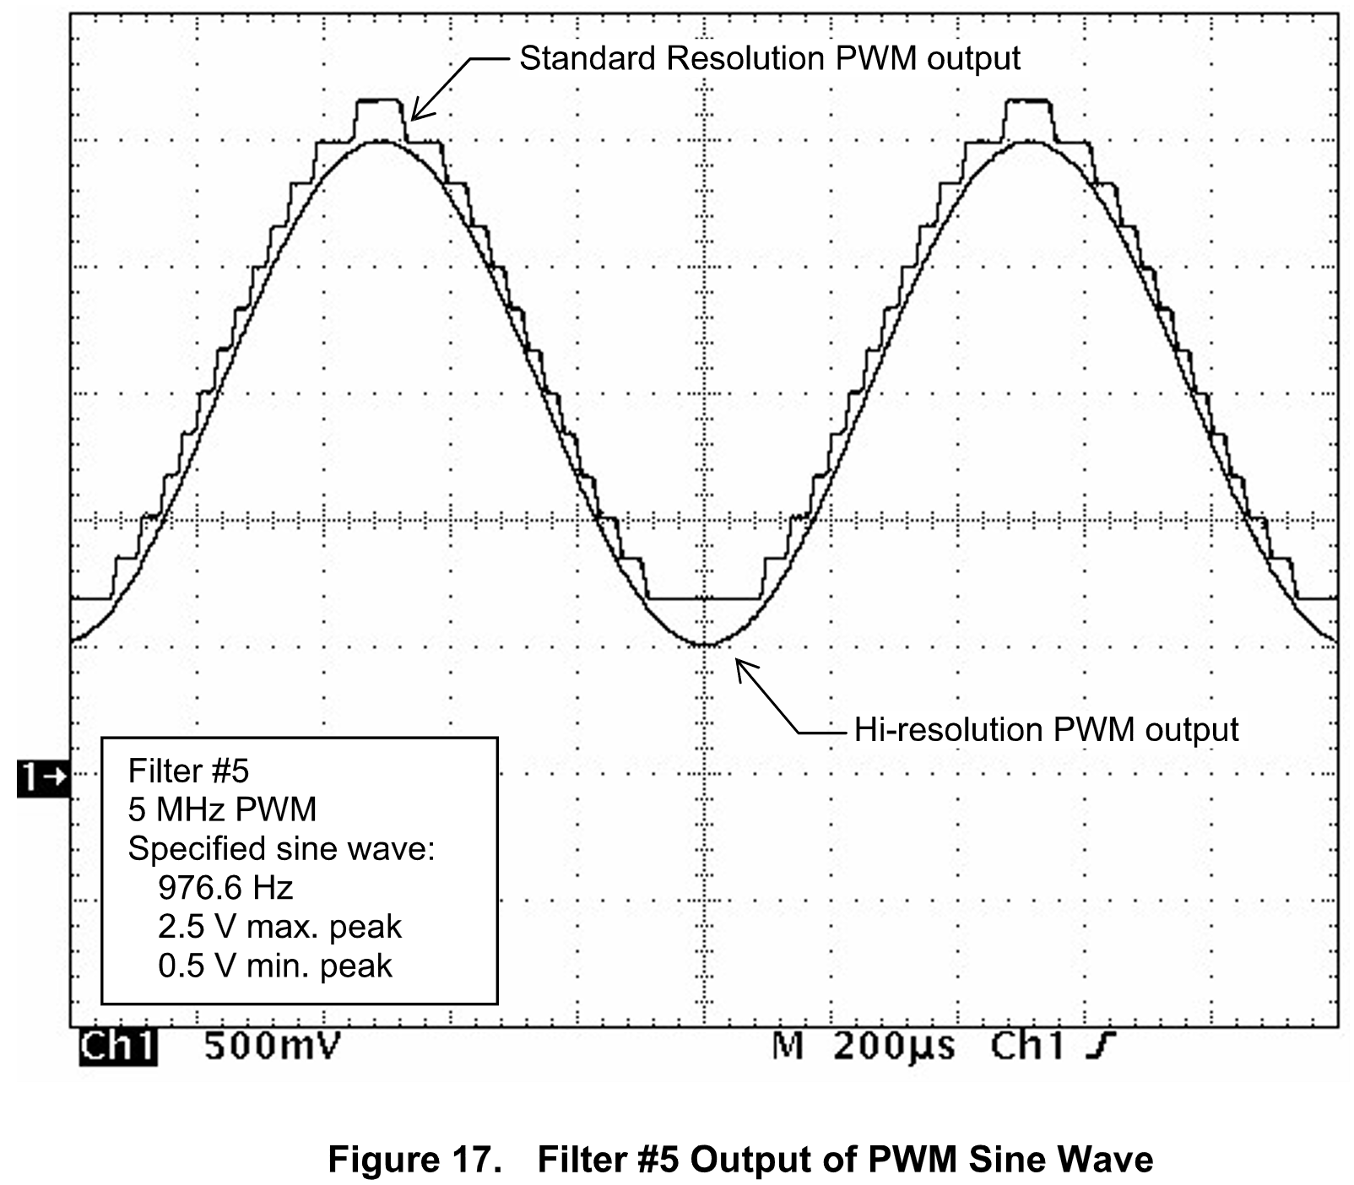
PWM – DAC
It is also possible to use PWM as a DAC! By selecting the proper duty cycle, any DAC output voltage can be obtained. You need to remove the high-frequency signals to make this work.
SYSTEMS ENGINEERING
GRAINGER ENGINEERING

Slide 74
Motor / Servo
SYSTEMS ENGINEERING
GRAINGER ENGINEERING

Slide 75
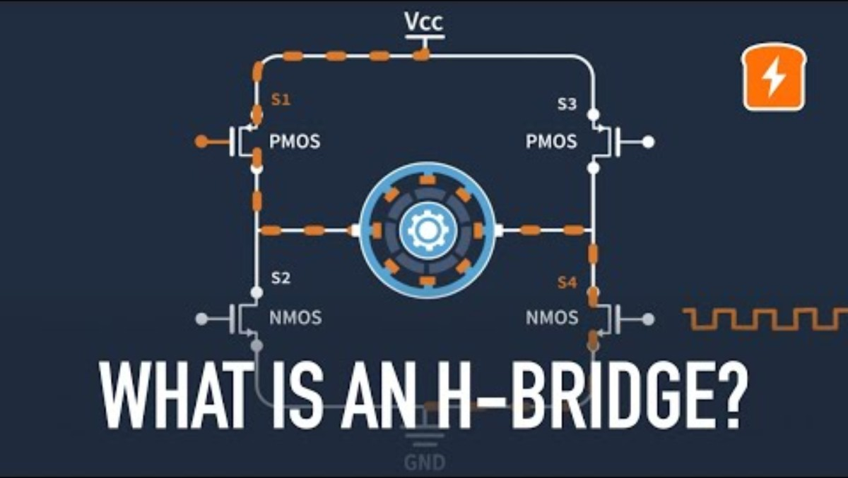
H-Bridge
SYSTEMS ENGINEERING
GRAINGER ENGINEERING

Slide 76
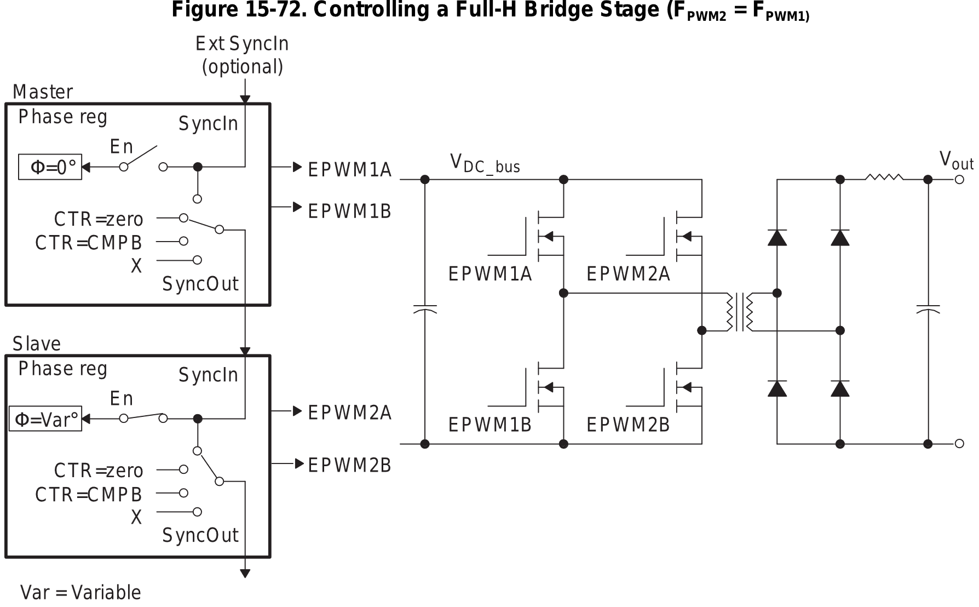
H-Bridge
SYSTEMS ENGINEERING
GRAINGER ENGINEERING

Slide 77
H bridge
For the H-bridge chip that we will be using in class, the work has been simplified for you where, you can control the velocity and direction from a single PWM signal.
The duty cycle from the PWM is what determines the motor’s behavior!
0% = turns the motor to go backwards
50% = turns the motor forwards and backwards (makes it so that the motor is stationary)
100% = turns the motor to go forward
What happens if we set a duty cycle of 75%?
We are going 50% of the maximum forward speed!
SYSTEMS ENGINEERING
GRAINGER ENGINEERING

Slide 78
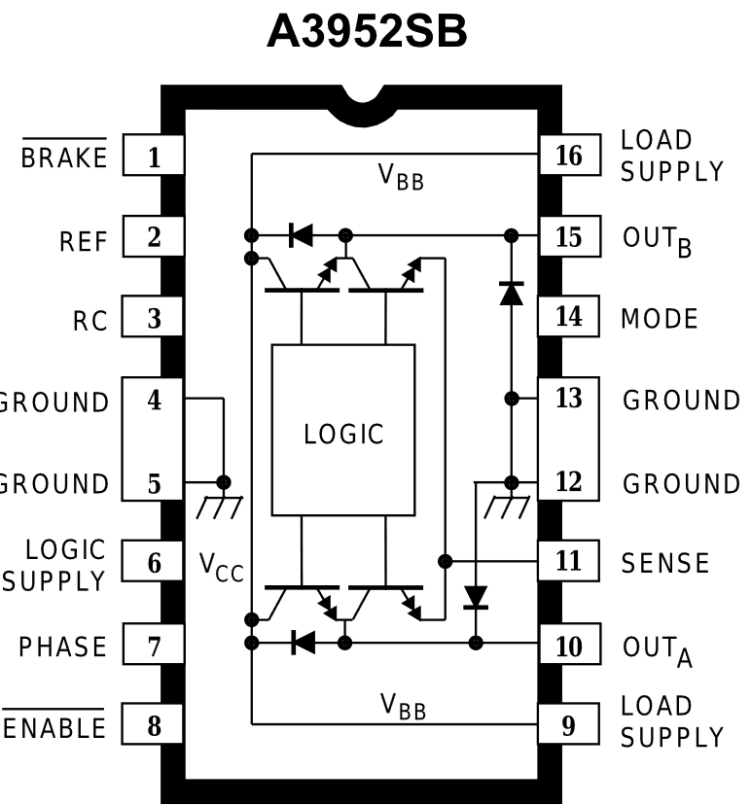
H bridge
SYSTEMS ENGINEERING
GRAINGER ENGINEERING

Slide 79
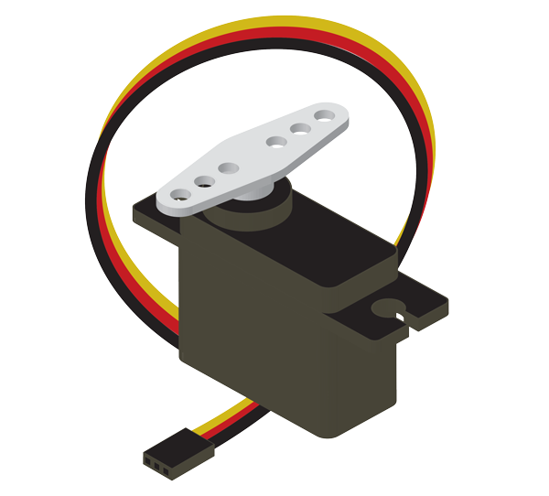
RC Servo
RC Servos are position-controlled devices (not continuous rotation) controlled by a specific PWM protocol.
2-types of servo motor,
Closed loop: physically limited to 0-180 degrees (usually) rotation (with an internal pin), you want to be careful to not go to the extremes too often, it is a mechanical stop.
Open loop: can do a full 360-degree rotation.
3 wires:
Power
GND
Control: where the PWM signal is injected
https://www.sparkfun.com/servos
SYSTEMS ENGINEERING
GRAINGER ENGINEERING

Slide 80
RC Servo
Maps PWM to desired orientation. For specific servo check the datasheet for:
For the specific period
Typically, 50Hz if not listed, which means a period of 20 ms = 20,000 μs
Operating range and duty cycle mapping.
SYSTEMS ENGINEERING
GRAINGER ENGINEERING

Slide 81
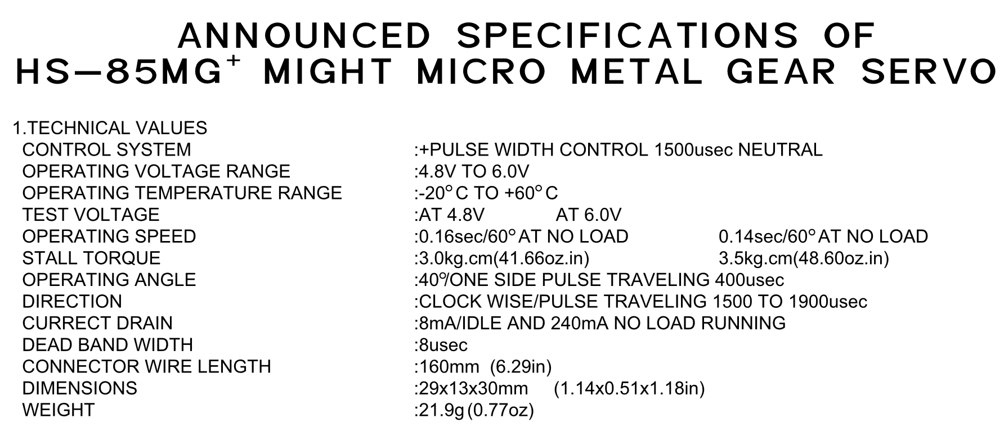
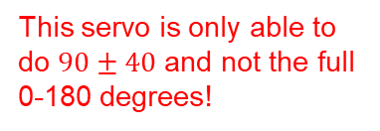
RC Servo – Example Datasheet
Using a PWM period of 20 ms, what is 90 degrees (neutral), 50 and 130?
Using a PWM period of 20 ms, what is 90 degrees (neutral), 0 and 180?
Represents 90 degrees
50 = 1100 us = 5.5%
130 = 1900 us = 9.5%
Tells you which direction is clockwise ( 130 degrees )
This servo is only able to do $90±40$ and not the full 0-180 degrees!
https://www.sparkfun.com/servo-hitec-hs-85mg-micro-size.html
SYSTEMS ENGINEERING
GRAINGER ENGINEERING

Slide 82
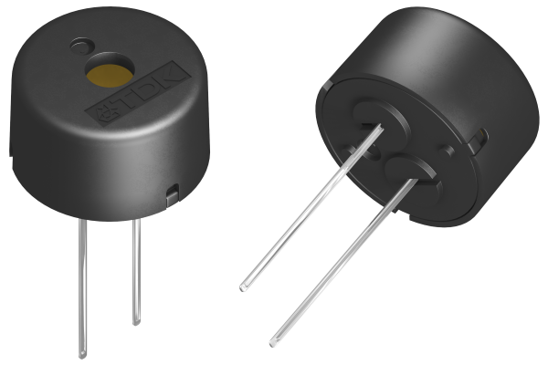
Piezo Buzzer
Instead of varying the duty cycle, we define notes by the frequency that we put into the buzzer!
Allows us to have different tones with PWM.
We thus set CMPA = 0, ZRO = 0b11 so that it toggles the output signal and just modify TBPRD.
Since we toggle the output, we need to half the period otherwise we would get the wrong note!
We will go through Fast Fourier Transform next week.
We set the clock divide (divide by 2) so that we can get lower notes!
SYSTEMS ENGINEERING
GRAINGER ENGINEERING

Slide 83
Piezo Buzzer
Divisions handle the clock divide + half frequency
#define C4NOTE ((uint16_t)(((FUDGEFACTORNOTE*50000000/2)/2)/261.63)) // TBPRD 47777
#define D4NOTE ((uint16_t)(((FUDGEFACTORNOTE*50000000/2)/2)/293.66)) // TBPRD 42566
#define E4NOTE ((uint16_t)(((FUDGEFACTORNOTE*50000000/2)/2)/329.63)) // TBPRD 37921
#define F4NOTE ((uint16_t)(((FUDGEFACTORNOTE*50000000/2)/2)/349.23)) // TBPRD 35793
#define G4NOTE ((uint16_t)(((FUDGEFACTORNOTE*50000000/2)/2)/392.00)) // TBPRD 31887
#define A4NOTE ((uint16_t)(((FUDGEFACTORNOTE*50000000/2)/2)/440.00)) // TBPRD 28409
#define B4NOTE ((uint16_t)(((FUDGEFACTORNOTE*50000000/2)/2)/493.88)) // TBPRD 25309
#define C5NOTE ((uint16_t)(((FUDGEFACTORNOTE*50000000/2)/2)/523.25)) // TBPRD 23889
#define D5NOTE ((uint16_t)(((FUDGEFACTORNOTE*50000000/2)/2)/587.33)) // TBPRD 21282
#define E5NOTE ((uint16_t)(((FUDGEFACTORNOTE*50000000/2)/2)/659.25)) // TBPRD 18960
#define F5NOTE ((uint16_t)(((FUDGEFACTORNOTE*50000000/2)/2)/698.46)) // TBPRD 17896
#define G5NOTE ((uint16_t)(((FUDGEFACTORNOTE*50000000/2)/2)/783.99)) // TBPRD 15944
#define A5NOTE ((uint16_t)(((FUDGEFACTORNOTE*50000000/2)/2)/880.00)) // TBPRD 14204
#define B5NOTE ((uint16_t)(((FUDGEFACTORNOTE*50000000/2)/2)/987.77)) // TBPRD 12654
#define F4SHARPNOTE ((uint16_t)(((FUDGEFACTORNOTE*50000000/2)/2)/369.99)) // TBPRD 33784
#define G4SHARPNOTE ((uint16_t)(((FUDGEFACTORNOTE*50000000/2)/2)/415.30)) // TBPRD 30098
#define A4FLATNOTE ((uint16_t)(((FUDGEFACTORNOTE*50000000/2)/2)/415.30)) // TBPRD 30098
#define C5SHARPNOTE ((uint16_t)(((FUDGEFACTORNOTE*50000000/2)/2)/554.37)) // TBPRD 22548
#define A5FLATNOTE ((uint16_t)(((FUDGEFACTORNOTE*50000000/2)/2)/830.61)) // TBPRD 15049
Note frequency!
We thus set TBPRD
SYSTEMS ENGINEERING
GRAINGER ENGINEERING

Slide 84
Questions?
SYSTEMS ENGINEERING
GRAINGER ENGINEERING

Slide 85


