Slide 1
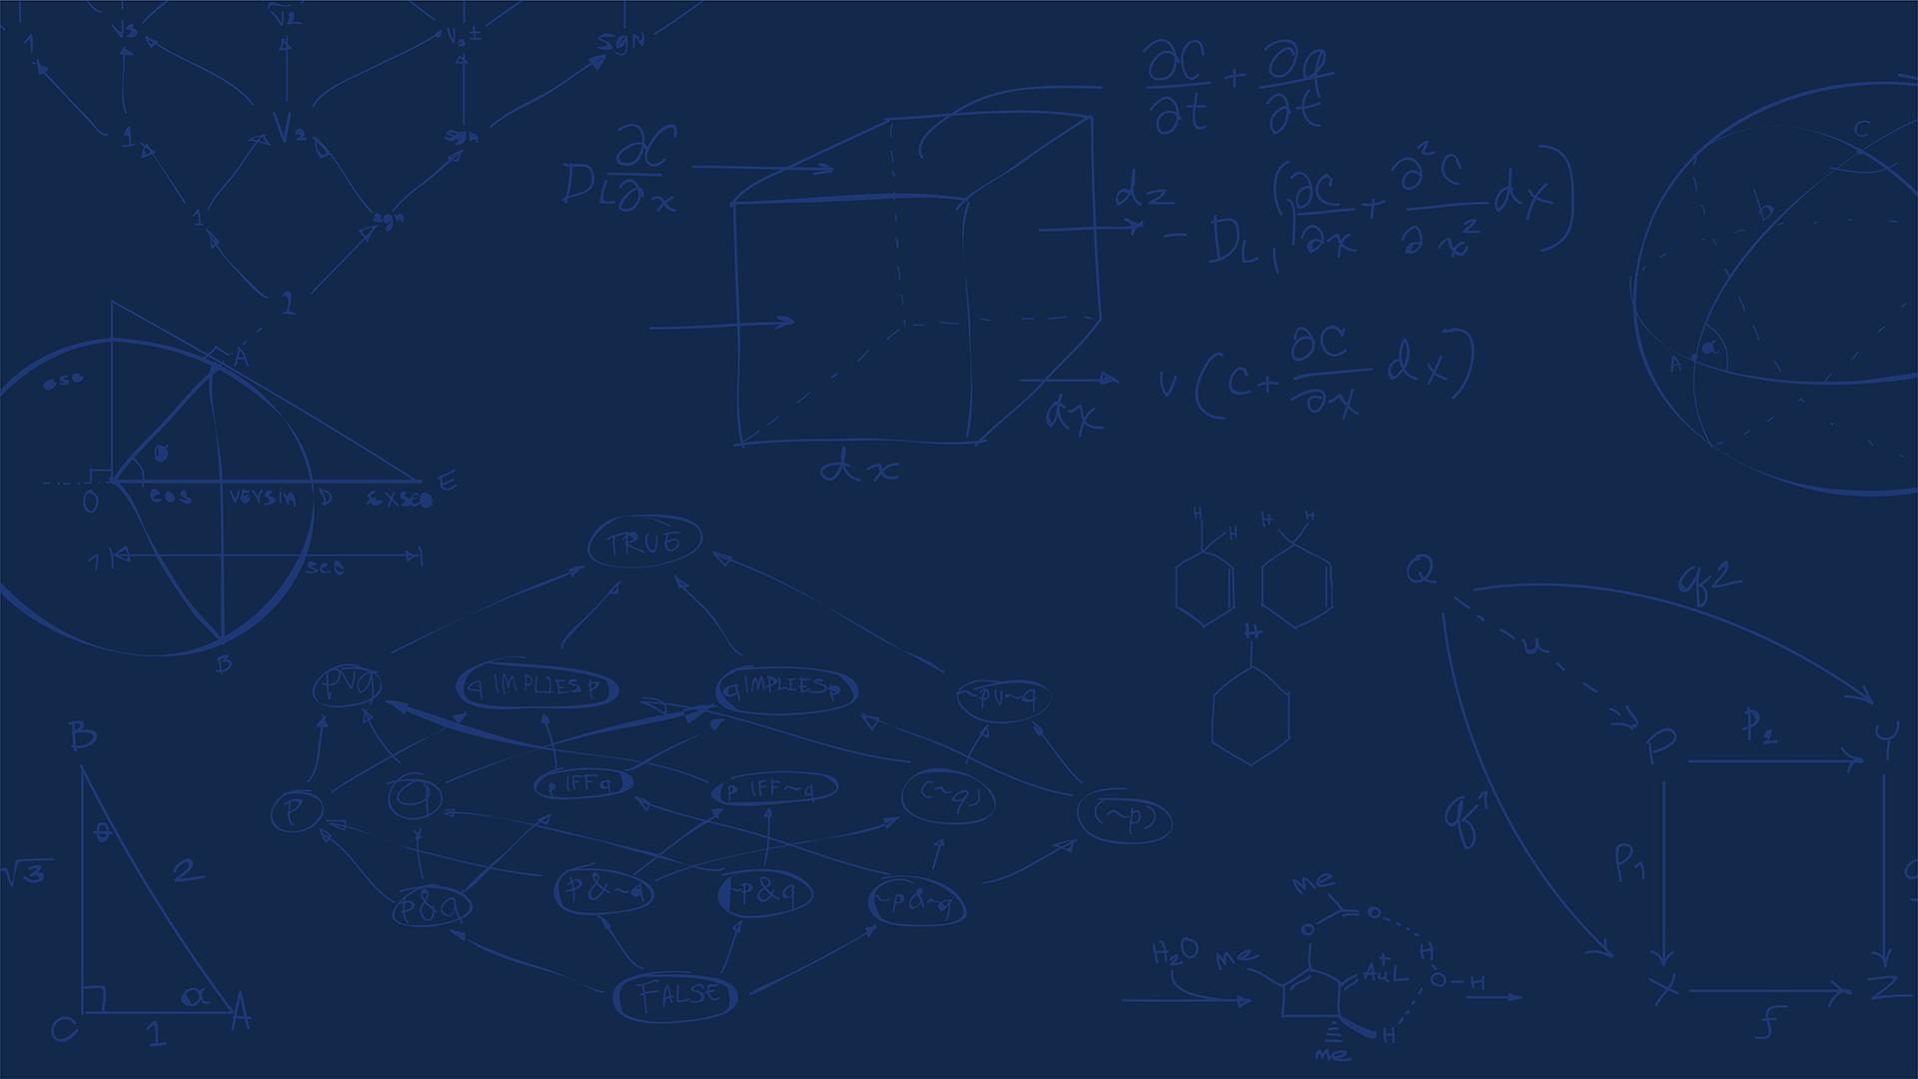

SE 423: Introduction to Mechatronics
Lecture 1: Introduction
Marius Juston
Wednesday January 21th, 2026
Notes:
My name is Marius Juston, a PhD candidate in the ISE program. You can call me Marius or Professor, whichever you prefer!
This class will be different from others you might have had, with a lot of learning-by-doing. In the lab and in homework,

Slide 2

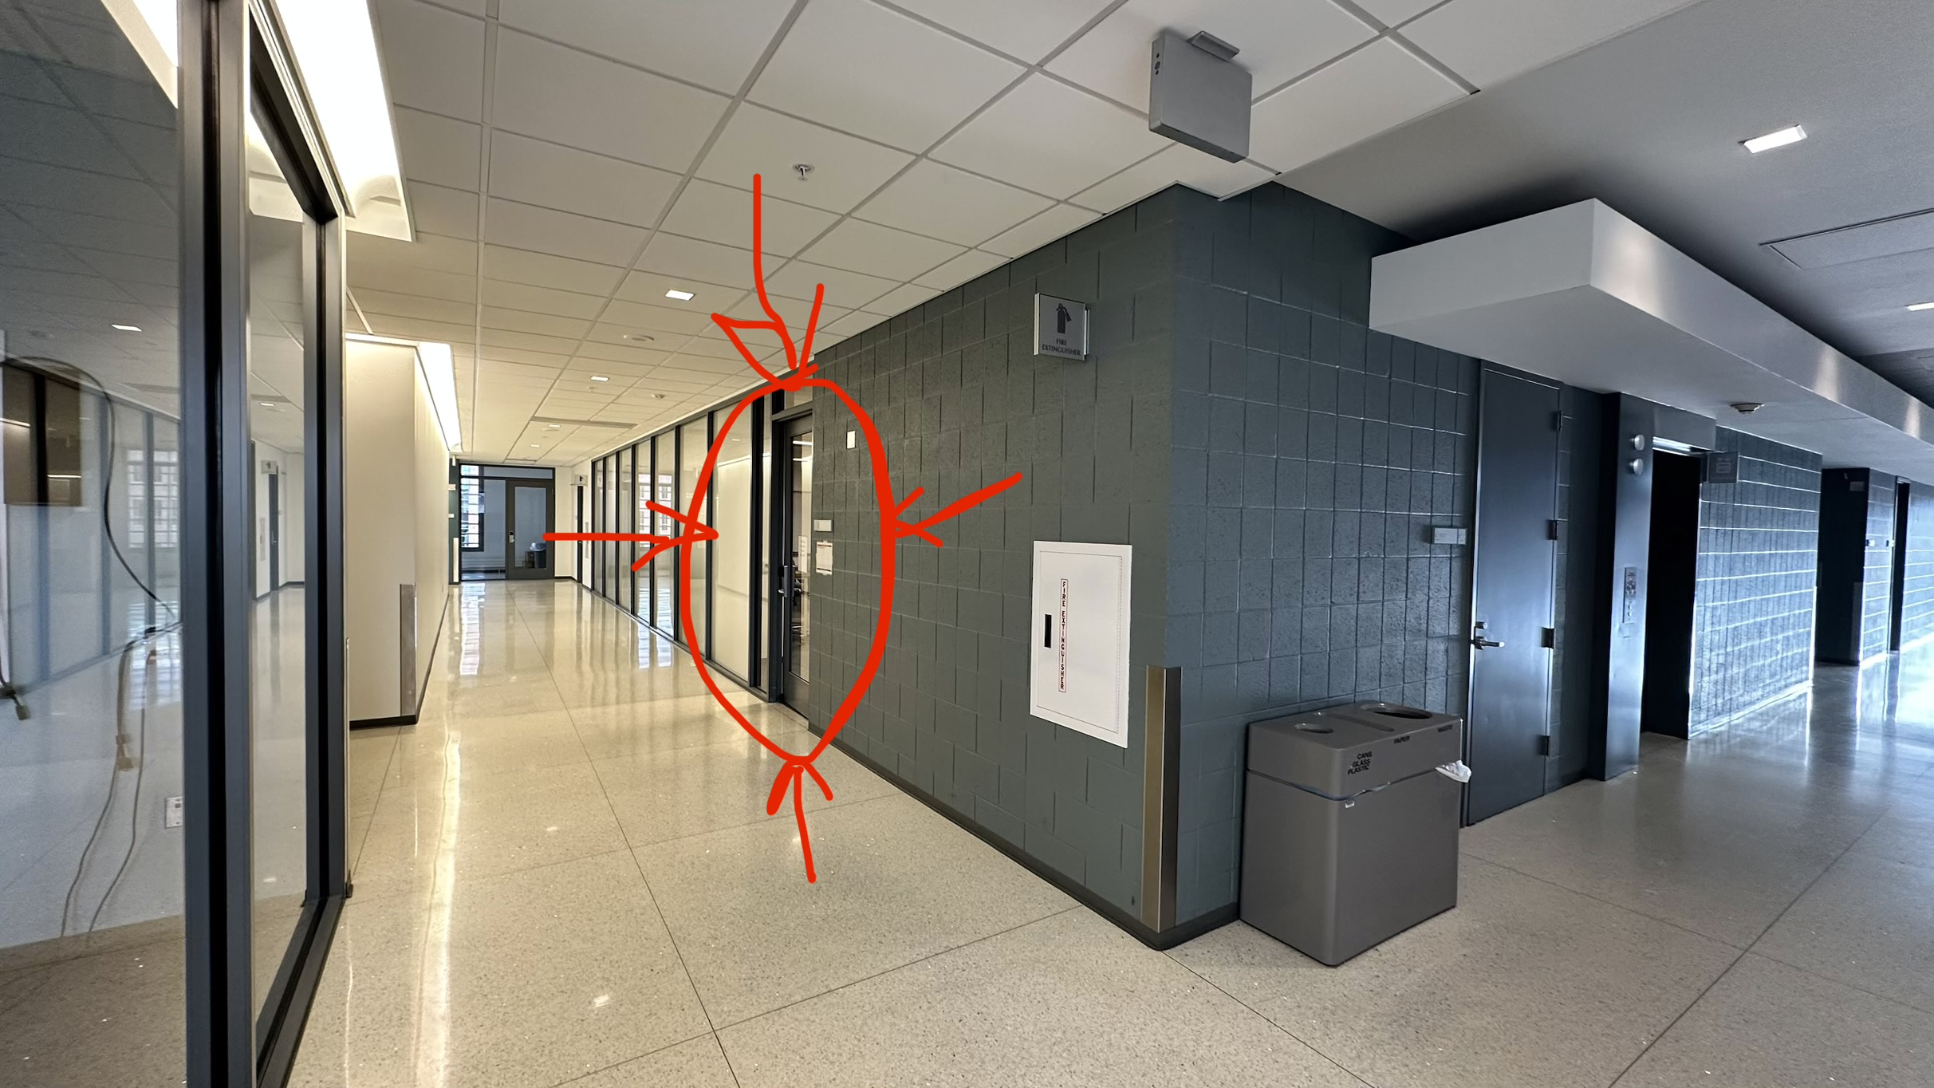
Course Information
Lectures: Monday and Wednesday 9:00am-9:50am
Locations:
Lecture: Here!
Lab: ECEB 3080
The Team:
Marius Juston: Instructor
Dan Block: Lab Instructor
Lakshmi Manoj: TA
Samuel Folorunsho: TA
Office hours: announced and posted on Canvas when finalized.
Recordings: Available on Illinois Media Space. Link available on course webpage
SYSTEMS ENGINEERING
GRAINGER ENGINEERING

Slide 3
Course Information
Canvas: https://canvas.illinois.edu/courses/64094
Will post the lecture slides
Gradescope: https://www.gradescope.com/courses/1232277
Should have already been automatically enrolled.
Recordings: Available on Illinois Media Space. Link available on course webpage
Most important link: https://coecsl.ece.illinois.edu/se423/
You will be using it very often this class, has the HWs, labs and final project documents
Converted documents in LaTeX:
Compiled PDFs: https://marius-juston.github.io/SE-423---Class-Material/
Raw LaTeX: https://github.com/Marius-Juston/SE-423---Class-Material
SYSTEMS ENGINEERING
GRAINGER ENGINEERING

Slide 4
Syllabus and evaluation
Syllabus: see course website
Course deliverables:
Check-off on all labs 30%
Homework 25%
LabVIEW Assignments 5%
Quizzes 5%
Semester Project 35%
Check-offs will be discussed later.
SYSTEMS ENGINEERING
GRAINGER ENGINEERING

Slide 5
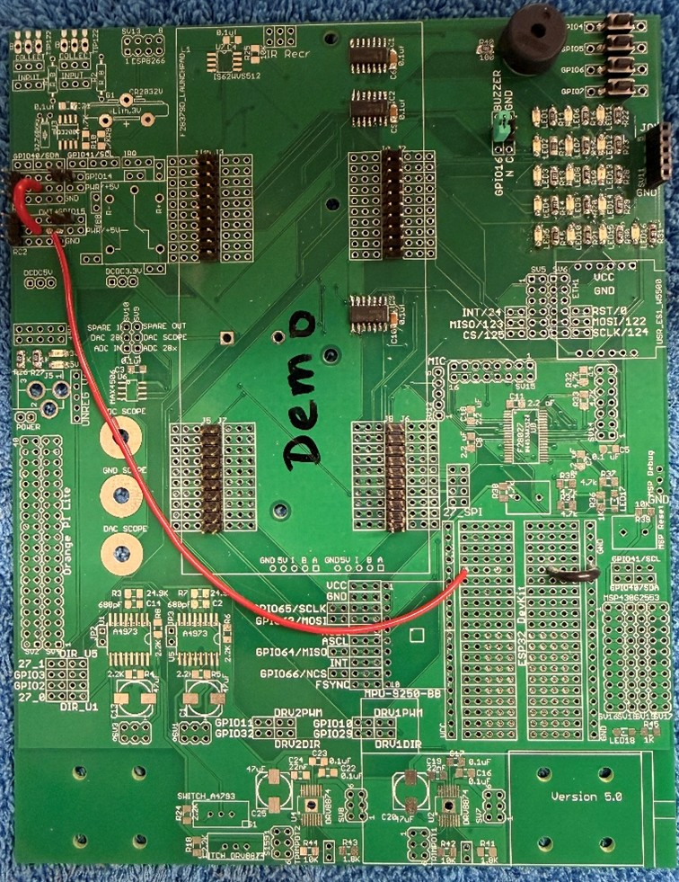
The Class - Intro
Very different from others you might have had, learn-by-doing!
No “hard” theory being taught.
You will start immediately, with lab this week.
Working on some soldering and setting up your HW board!
You get to keep the board afterwards.
SYSTEMS ENGINEERING
GRAINGER ENGINEERING

Slide 6
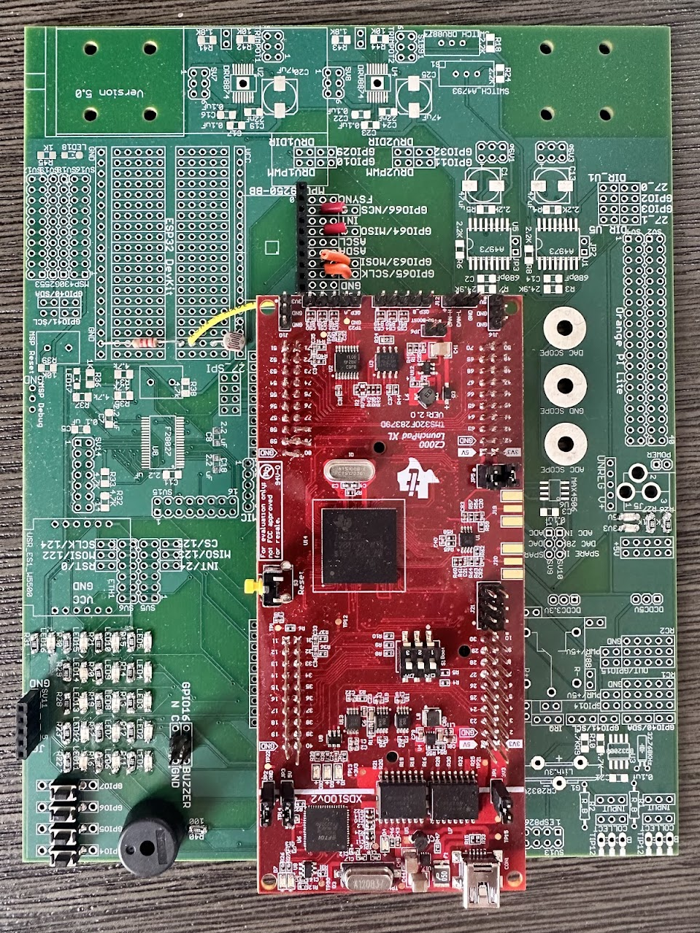
The Class - The “Red Board”
What are you going to be doing with the Red Board?
Playing with LEDs, push buttons, light sensors, RC servo, microphone, IMU
Texas Instruments Digital Signal Processor (DSP) running at 150 MHz
Arduino at 20–40 MHz
16-bit and 32-bit integers, only
Floating-point capabilities
You get to keep it for future mechatronic projects!
SYSTEMS ENGINEERING
GRAINGER ENGINEERING

Slide 7

The Class – C Programming
Who here knows how to program in C?
SYSTEMS ENGINEERING
GRAINGER ENGINEERING

Slide 8
The Class – C Programming
This class will be using the C programming language to code the embedded system
You will not be taught C, you will have to learn by yourself
Plenty of people have come in this class and have had near zero programming experience and have done fine, if you do the work.
This week you will not be doing C programming
Next week you will, so be sure to brush up / start learning it!
You will not be doing anything complicated in the language
minimal pointers usage
No special structures such as graphs, trees, linked-lists, etc.
Be especially familiar with the printf, especially useful in troubleshooting!
SYSTEMS ENGINEERING
GRAINGER ENGINEERING

Slide 9
The Class - Goal
By 2/3rd through the semester you are done with the HW green board ( not the Red Board )
Really going into HWs at the beginning of the semester
Gradually teaching you the robot car in Lab
By the end of the semester, you are going to be programming robot car to autonomously:
Path Planning: Go from A to B, with or without a map
Sensing and Perception: Use LiDAR, camera to make real-time decisions
Control Systems: Implement control loops (PID)
Groups of 3-5 people.
Participation is graded, so be sure to be able to contribute!
Learn how to learn to program a microcontroller!
Be able to read documentation and apply the documentation
SYSTEMS ENGINEERING
GRAINGER ENGINEERING

Slide 10
The Class - Goal
We have a long way to go!
Do all these things scare you a bit? That is good, we will teach you a lot of material by the end of the semester!
We do not sit here and teach theory;
We are not going to teach you why a PI controller is stable,
Why the A* star algorithm is optimal
We are going to tell you: “let us implement this algorithm”.
We are going to talk a lot about implementation.
How do we make sure that this is the circuit board?
Most of the code will be running on the little processor. It runs at 150 MHz, which is fast for an embedded system.
SYSTEMS ENGINEERING
GRAINGER ENGINEERING

Slide 11
The Class – AI Content
You will never start with a blank C code file; you will always have a starter code.
For all your HWs, you will always have a starter code file for each HW, which will be added to this project with the C code you need.
Students are allowed to use AI tools to help with their work, primarily for brainstorming, debugging, and conceptual support;
avoid for whole-code generation, especially if you are a beginner software engineer
Learn by doing!
If you use AI tools, you should understand it, be able to explain it in detail, and be able to re-implement it without using AI. You are here to learn, not just copy and paste!
You are expected to comment the lines that have been copied and pasted from AI with code comments stating the AI model used at the lines that have been copied and pasted.
SYSTEMS ENGINEERING
GRAINGER ENGINEERING

Slide 12
The Class – The first lab
Recommend you bring your laptop to lab so that you can install the software we will be using:
CodeComposer v12x (the testing of the v20x is still under process)
Bring your I-Card to the lab this week to obtain lab access.
You will have 24-hour access to the lab, and you can take your board home.
You will be in groups of 2 working together.
Do not come late to labs!!!
We do not want to have to start docking points for attendance!
Please try to read them beforehand. It will make things easier for you and speed things up, making things much quicker between you and your lab partner.
SYSTEMS ENGINEERING
GRAINGER ENGINEERING

Slide 13
The Class – Homework 1
There is a high-level frustration in this class. Working with hardware and software takes a lot of time, especially if you are completely new to this.
Asks C programming questions, with a link to a Linked-In class to teach you more-or-less all you need for this class.
Get started early!
We do not mind you working on the HWs together.
We do not want to see is identical C code.
Individual comments in your code to explain what you just did, put your initials at the beginning of the line
SYSTEMS ENGINEERING
GRAINGER ENGINEERING

Slide 14
The Class – LabVIEW Assignments
Used for visualization, real-time GUI to visualize the robot’s coordinates
Trying to convert to Python instead,
You can get started right now:
Install it in WebStore ( can take up to 4 hours to install so be carefull )
Use CitrixWorkspace (EWS workstations)
Get started early on it as well, already used in Lab 2
All straightforward, just follow the videos and copy the image inside the assignment document
Only checked for completion.
LabVIEW 3 and 4 are optional
SYSTEMS ENGINEERING
GRAINGER ENGINEERING

Slide 15
The Class – Check-offs
Throughout the assignments (labs, HWs, LabVIEW) you will be asked to show checkpoints to the TAs
Show something working
Answering a question
Both you and your teammate MUST be present for these checks. You will be asked to do the checks at another time otherwise.
Contact instructors, TAs to schedule another time.
SYSTEMS ENGINEERING
GRAINGER ENGINEERING

Slide 16
The Class – Code Submissions
You will submit your commented code in Gradescope
If you do not you will have points taken off
Compile assignment as PDF
Answer any other questions inside the assignment
// cpu_timer1_isr - CPU Timer1 ISR
__interrupt void cpu_timer1_isr(void)
{
CpuTimer1.InterruptCount++; // MJ: Increments the timer's internal interrupt counter
}
SYSTEMS ENGINEERING
GRAINGER ENGINEERING

Slide 17

The Class – Git
You will be using a version control (think of it as a backup system) called “git”
For it to be effective, be sure that you are “committing” and “pushing often! If you do not, then you will most likely lose your data
You are sharing the machines with all the sections; it is HIGHLY probably someone will accidentally change your code. ( yes, it happens very often )
Any software related job uses it, so best to get started on good practices now!
SYSTEMS ENGINEERING
GRAINGER ENGINEERING

Slide 18
The Class – Submission Deadline
Checkoffs will always be due Tuesdays at 5PM
Code submission / Questions will always be due Wednesdays at 9AM
Lab submission deadlines, Tuesday of the week when the next lab starts lab
SYSTEMS ENGINEERING
GRAINGER ENGINEERING

Slide 19
The Class – Next Steps
HW1 Question 1 and Reading Question 4
LabVIEW Assignment 1
Reading Lab 1 before next week
SYSTEMS ENGINEERING
GRAINGER ENGINEERING

Slide 20
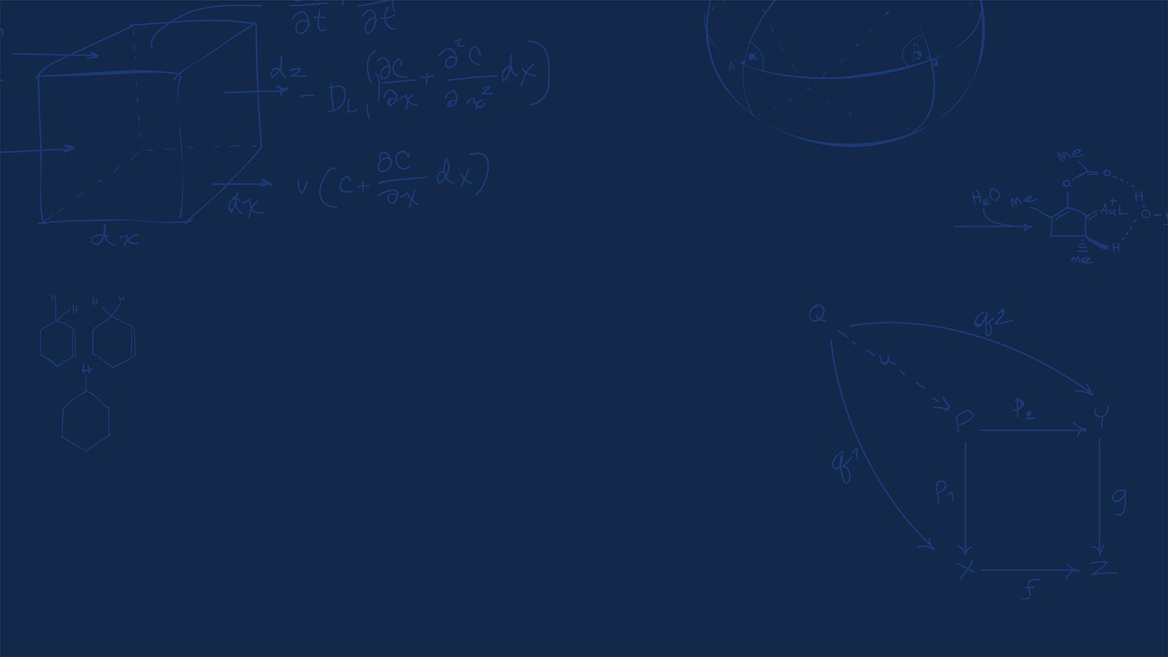
Questions?
(Students that have been unable to register, come talk to me after class)
SYSTEMS ENGINEERING
GRAINGER ENGINEERING

Slide 21
