Slide 1
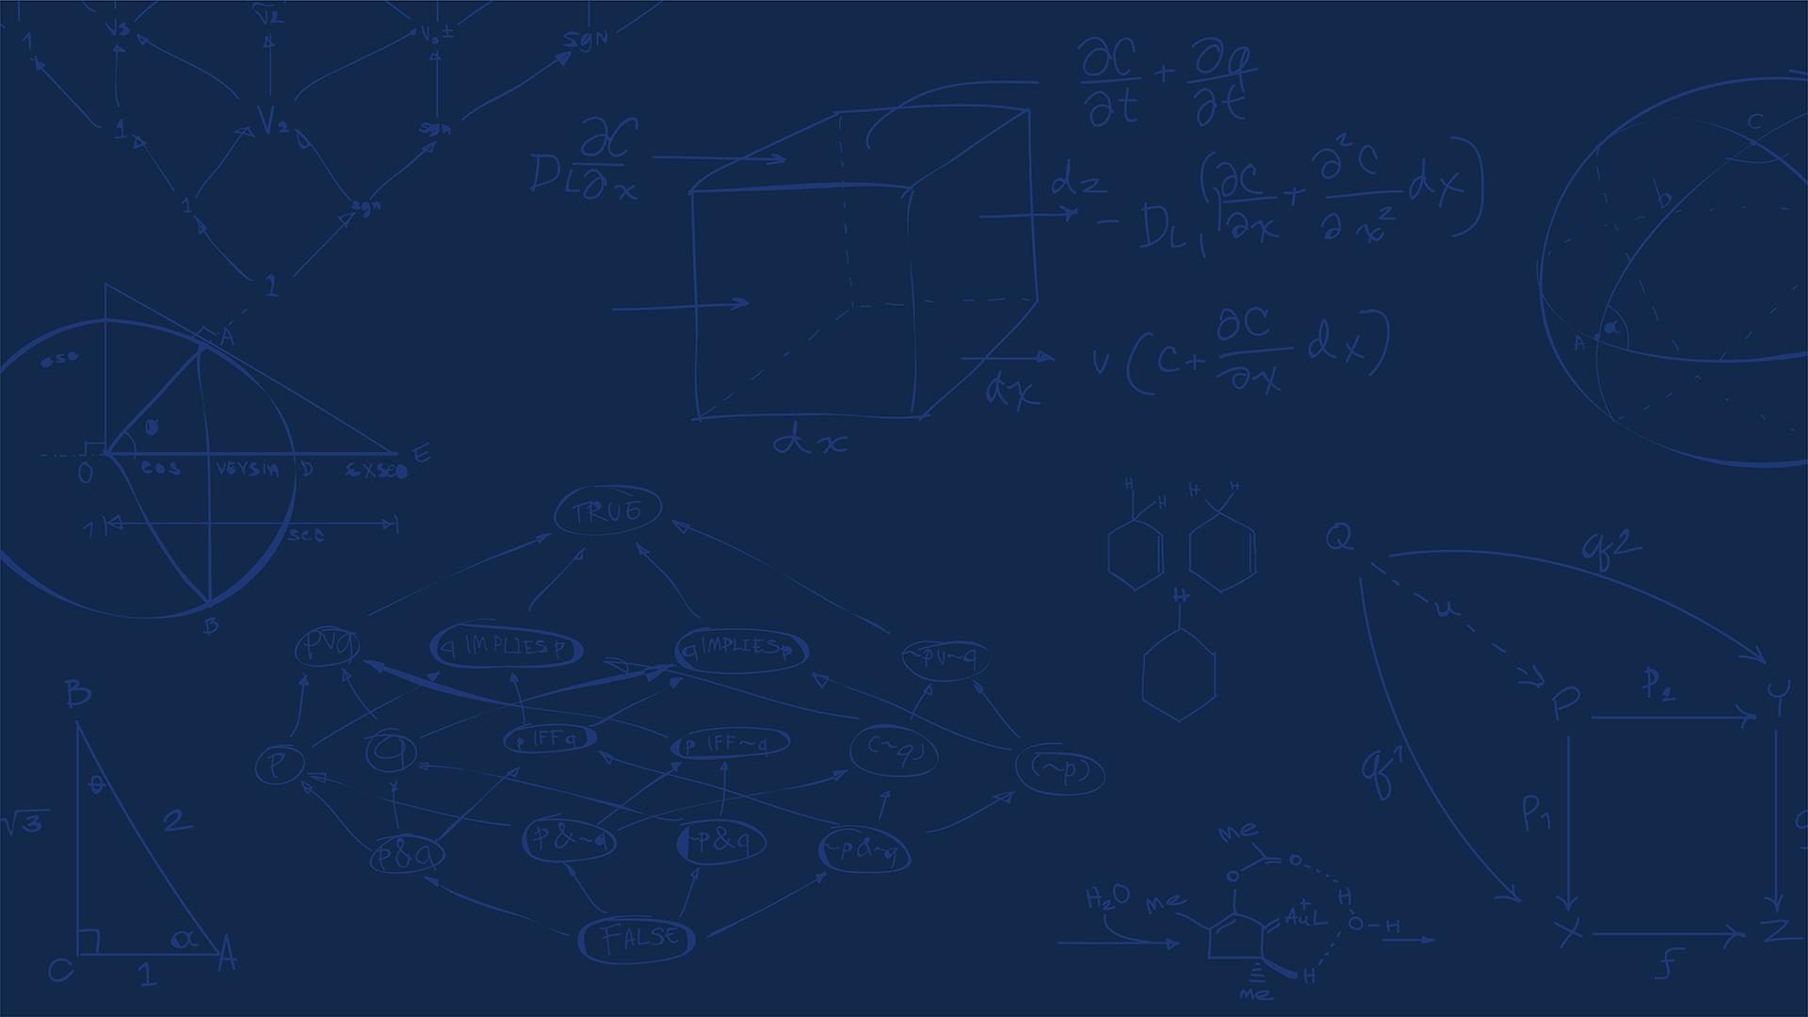

SE 423: Introduction to Mechatronics
Lecture 3: GPIO
Marius Juston
Wednesday, January 28th, 2026

Slide 2

Reminders
Office Hours:
Monday: 4-6 PM, Neel
Tuesday: 11-1 PM, Lakshmi
Tuesday: 1-3 PM, Samuel
Tuesday: 2-5 PM, Dan & Marius
Lab: Starting Lab 1 this week, will be using C so be sure to be prepared! ( don’t forget to turn in commented code)!
Homeworks (Next week):
All check-offs for homework 1 are due February 3, 5PM
Answers and code submissions for homework 1 are due February 4, 9AM
LabVIEW (Next week):
All check-offs for LabVIEW 1 are due February 5, 5PM
Small easy Quiz at the end of this lecture, like Monday, due at 11AM.
SYSTEMS ENGINEERING
GRAINGER ENGINEERING

Slide 3
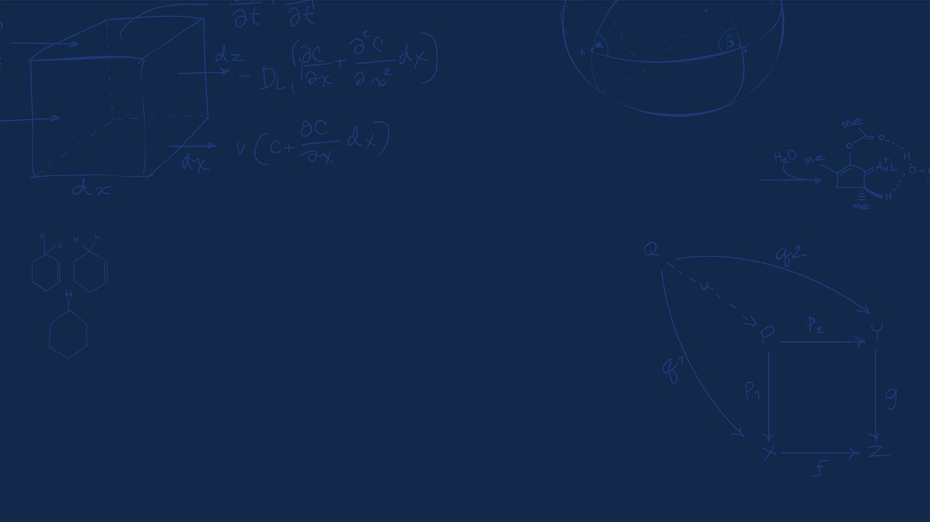
Questions?
Homework, Lab, LabVIEW, quiz questions?
( I sent an update for the reason for the 2 counters question )
SYSTEMS ENGINEERING
GRAINGER ENGINEERING

Slide 4
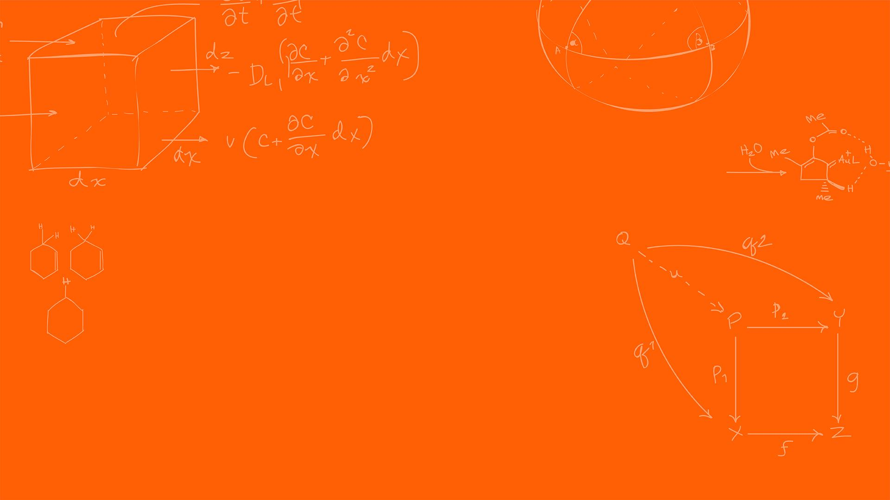

Digital Inputs / Outputs
SYSTEMS ENGINEERING
GRAINGER ENGINEERING

Slide 5
Digital Inputs / Outputs
What does it mean for something to be “digital”?
It is the control of your system / sensor using binary (0 or 1) signals.
Digital I/O is the lowest level electrical interface between software and hardware.
Almost every mechatronic system constrains at least one digital input / output.
Sensors often reduce complex physical phenomena to binary decisions ( limit reached / not reached, turned on or off )
Digital signals are inherently discrete
Digital I/O provides deterministic, low-latency interaction with the environment
SYSTEMS ENGINEERING
GRAINGER ENGINEERING

Slide 6
Digital Outputs
A digital output drives a pin to a logic level:
Logic 0 (LOW) → ≈0 V
Logic 1 (HIGH) → ≈3.3 V / 5 V
Logic levels are represented by voltage ranges, not exact values
Internally controlled by a latch / register
Can source or sink limited current (GPIO should not be used to drive power)
Digital outputs are not power supplies and must not directly drive loads. The GPIO have a total maximum of current it can supply, shared throughout all the pins.
If you power too many devices using GPIO, you might run out of power!
Examples:
Controlling LEDs
SYSTEMS ENGINEERING
GRAINGER ENGINEERING

Slide 7
Digital Outputs
Digital output control consists of :
Choosing the GPIO number
Selecting the GPIO pin mux selection
Setting direction = output
GPIO_SetupPinMux(34, GPIO_MUX_CPU1, 0);
GPIO_SetupPinOptions(34, GPIO_OUTPUT, GPIO_PUSHPULL);
You never write voltage, you write bits in registers
SYSTEMS ENGINEERING
GRAINGER ENGINEERING

Slide 8
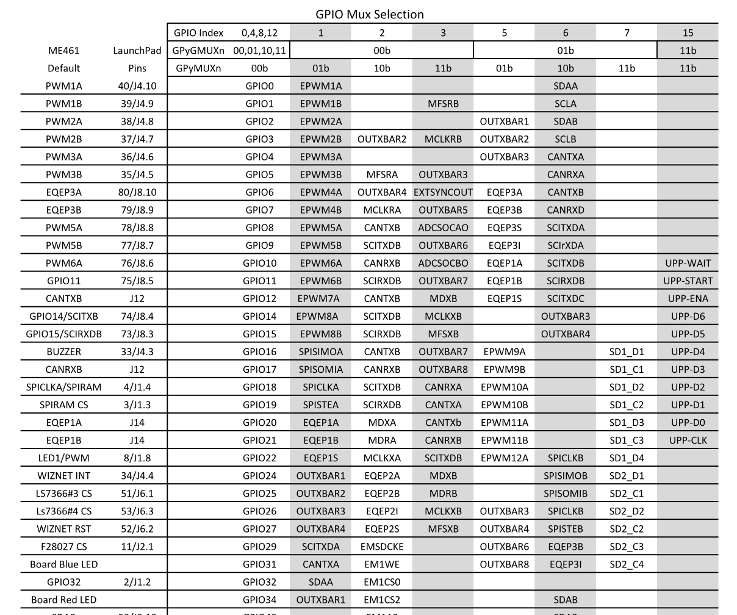
Digital Outputs
SYSTEMS ENGINEERING
GRAINGER ENGINEERING

Slide 9
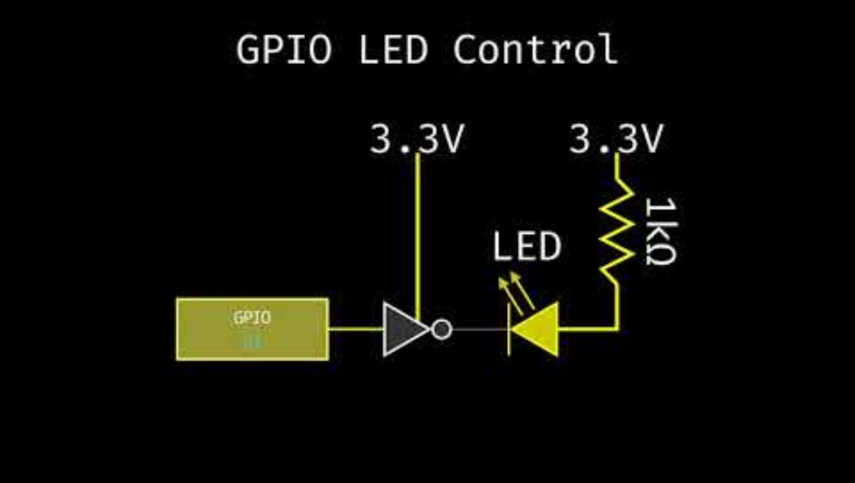
Controlling an LED
https://youtu.be/606DHE81HZ4?si=4FCUMsPSI-xp2QcO
SYSTEMS ENGINEERING
GRAINGER ENGINEERING

Slide 10
Digital Inputs
Digital input samples external voltage
Compared against logic thresholds:
LOW
HIGH
Examples:
Buttons
Switches
Some types of encoders
Problem with floating inputs, if input is not driven:
Voltage is undefined
Susceptible to noise
Input may randomly read 0 or 1
More on this with ADC
SYSTEMS ENGINEERING
GRAINGER ENGINEERING

Slide 11
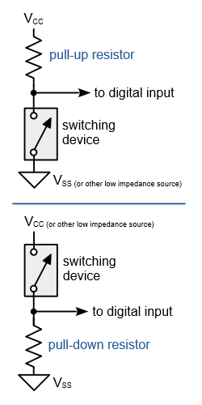
Pull-Up / Pull-Down Resistors
A pull-up resistor:
Connects input to Vcc
Defines default logic HIGH
When switch is:
Open: input → HIGH
Closed: input short circuits to GND → LOW
A pull-down resistor ( not used in our application ):
Connects input to GND
Defines default logic LOW
When switch is:
Open: input → LOW
Closed: input short circuits to GND → HIGH
This is all internal on the Red Board, makes it cleaner!
You don’t need to understand this, just put it in code!
https://en.wikipedia.org/wiki/Pull-up_resistor
SYSTEMS ENGINEERING
GRAINGER ENGINEERING

Slide 12
Digital Inputs
Digital output control consists of :
Choosing the GPIO number
Selecting the GPIO pin mux selection
Setting direction = input
Enable pull-up resistor
GPIO_SetupPinMux(7, GPIO_MUX_CPU1, 0);
GPIO_SetupPinOptions(7, GPIO_INPUT, GPIO_PULLUP);
You read the binary input using:
if(GpioDataRegs.GPADAT.bit.GPIO7){
// Do stuff
}
SYSTEMS ENGINEERING
GRAINGER ENGINEERING

Slide 13
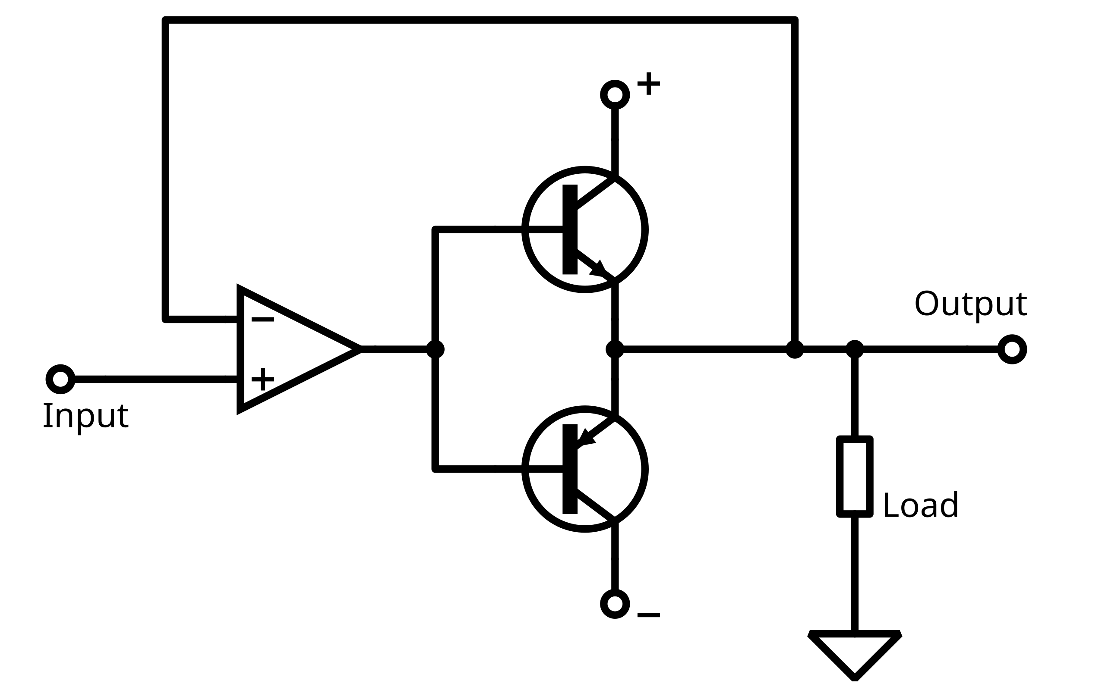
A PMOS transistor pulls the pin up to 3.3 V
Push-Pull - Output
A push-pull output uses two transistors:
A PMOS transistor pulls the pin up to 3.3 V
An NMOS transistor pulls the pin down to GND
Only one is ON at a time.
When a pin is an output:
You want deterministic voltage
You want noise immunity
You want defined transitions
A more detailed video here.
You don’t need to understand this, just put it in code!
NMOS
Operational Amplifier
PMOS
( I wanted to create the animation for this, but if this text is still here, then it has not been done yet.)
https://en.wikipedia.org/wiki/Push%E2%80%93pull_output
SYSTEMS ENGINEERING
GRAINGER ENGINEERING
Notes:
If input is high the NPN is turned on, PNP will be off current flows from +9 to ground. NPN sources current (called push)
If input is low the PNP is turned on, NPN will be off, current flows from ground to -9V, PNP sinks current (called pull)

Slide 14
A PMOS transistor pulls the pin up to 3.3 V
Push-Pull - Output
A pull-up resistor is:
Slow
Incapable of pulling LOW
So, for outputs, pull-ups are electrically irrelevant and often harmful.
NMOS
Operational Amplifier
PMOS
( I wanted to create the animation for this, but if this text is still here, then it has not been done yet.)
https://en.wikipedia.org/wiki/Push%E2%80%93pull_output
SYSTEMS ENGINEERING
GRAINGER ENGINEERING

Slide 15
Digital Outputs – too many GPIO output
Why would we run out of power?
Each GPIO output has its own transistors and can safely source or sink only a limited current.
However, all GPIOs draw that current from shared internal power and ground networks inside the chip.
Even if each individual pin is within its limit, the sum of all GPIO currents can exceed what the silicon, bond wires, or package can safely carry.
This is why microcontrollers specify both per-pin and total GPIO current limits, and why GPIOs must never be used as power supplies.
Think of each GPIO as a faucet drawing water from the same pipe.
Each faucet has a local limit (per-pin current)
The pipe has a global flow limit (total GPIO current)
Opening too many faucets:
Reduces pressure
Stresses the pipe
Causes failure elsewhere
SYSTEMS ENGINEERING
GRAINGER ENGINEERING

Slide 16
Pull-Up / Pull-Down Resistors - Input
What an input pin is:
Pin becomes high-impedance, sensitive to low current, allowing for high voltages
Sensitive to noise
The internal pull-up:
Weak resistor (~20-50 kΩ)
Slightly biases pin to logic HIGH
Can be overridden by external hardware (button to GND)
Without pull-up, just using floating-inputs, you would be sensitive to random noise, returning:
Random bits
Thus, unpredictable control behavior
https://en.wikipedia.org/wiki/Pull-up_resistor
SYSTEMS ENGINEERING
GRAINGER ENGINEERING

Slide 17
Pin Mux
SYSTEMS ENGINEERING
GRAINGER ENGINEERING

Slide 18
Pin Mux
The Red Board has only 80 pins but 160 GPIO!
We also need the pins to do multiple specialized things,
GPIO (General Purpose Input-Output)
PWM output (Pulse Width Modulation)
SPI (Serial Peripheral Interface)
I2C (Inter-Integrated Circuit)
CAN (Controller Area Network)
UART (Universal Asynchronous Receiver-Transmitter)
ADC trigger, etc. (Analog-to-Digital Converter)
Whole list is in the pin mux list, you will be using this in Lab 1!
This sharing is managed by the pin multiplexer!
Pins and GPIOs are not for hardware wiring / optimality reasons.
SYSTEMS ENGINEERING
GRAINGER ENGINEERING

Slide 19
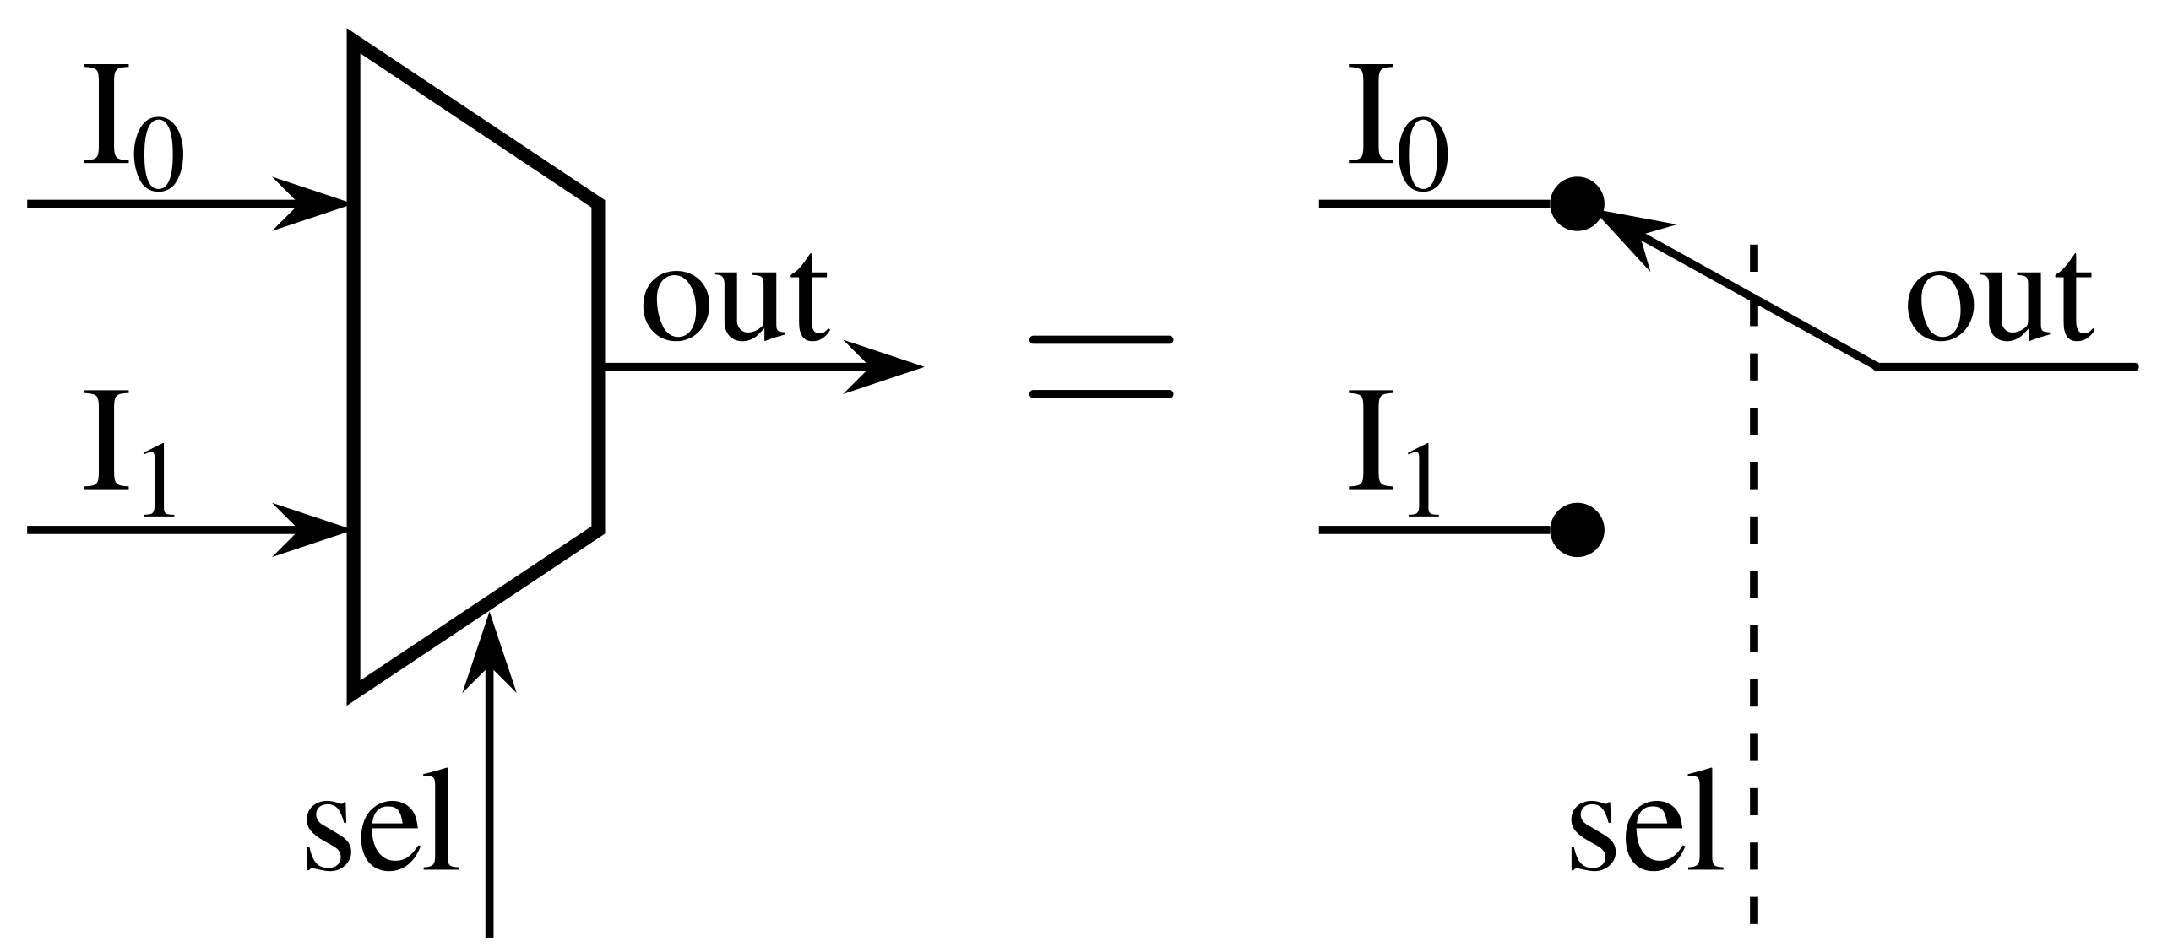
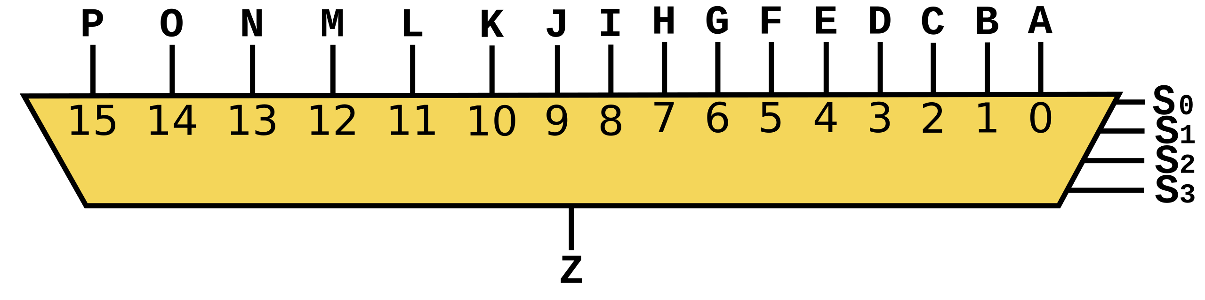
What is the Pin Multiplexer (PinMux)
This is a hardware switch that selects which peripheral controls a pin:
https://en.wikipedia.org/wiki/Multiplexer
SYSTEMS ENGINEERING
GRAINGER ENGINEERING

Slide 20
Pin Mux
Up to twelve independent peripheral signals are multiplexed on a single GPIO-enabled pin in addition to
the CPU-controlled I/O capability.
Each pin output can be controlled by either a peripheral or one of the
four CPU masters (CPU1, CPU1.CLA, CPU2, or CPU2.CLA). There are six I/O ports:
Port A consists of GPIO0-GPIO31
Port B consists of GPIO32-GPIO63
Port C consists of GPIO64-GPIO95
Port D consists of GPIO96-GPIO127
Port E consists of GPIO128-GPIO159
Port F consists of GPIO160-GPIO168
GpioDataRegs.GPBTOGGLE.bit.GPIO34 = 1;
SYSTEMS ENGINEERING
GRAINGER ENGINEERING

Slide 21
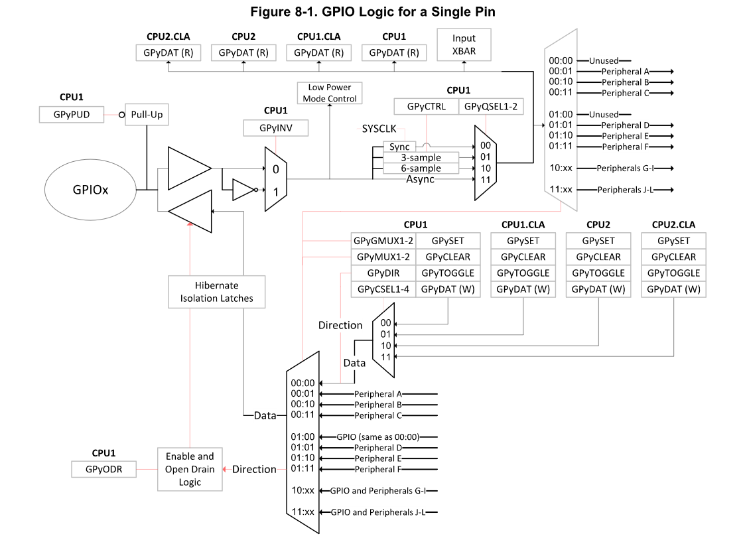
Pin Mux
PinMux has 12 inputs, requires how many bits in the selector?
( I wanted to create the animation for this, but if this text is still here, then it has not been done yet.)
SYSTEMS ENGINEERING
GRAINGER ENGINEERING
Notes:
If a student wants to help me create the animation. I would love your help!!! It takes a lot of time to make these things work!
Group mux = G
There are 8 groups, 0,

Slide 22
Pin Mux – Code ( Not the exact code for reduced spacing )
void GPIO_SetupPinMux(Uint16 gpioNumber, Uint16 cpu, Uint16 muxPosition)
{
volatile Uint32 *gpioBaseAddr; // volatile means that the variable may change from external sources (i.e. interrupts)
volatile Uint32 *mux, *gmux, *csel;
Uint16 pin32, pin16, pin8;
pin32 = gpioNumber % 32;
pin16 = gpioNumber % 16;
pin8 = gpioNumber % 8;
gpioBaseAddr = (Uint32 *)&GpioCtrlRegs + (gpioNumber/32)*GPY_CTRL_OFFSET;
mux = gpioBaseAddr + GPYMUX + pin32/16;
gmux = gpioBaseAddr + GPYGMUX + pin32/16;
csel = gpioBaseAddr + GPYCSEL + pin32/8;
EALLOW; // block that controls the physical multiplexer
// 0x3UL means 0b11 but in int32_t (i.e. 0b11 with 30 leading 0s)
*mux &= ~(0x3UL << (2*pin16));
*gmux &= ~(0x3UL << (2*pin16));
*gmux |= (Uint32)((muxPosition >> 2) & 0x3UL) << (2*pin16);
*mux |= (Uint32)(muxPosition & 0x3UL) << (2*pin16);
*csel &= ~(0x3L << (4*pin8));
*csel |= (Uint32)(cpu & 0x3L) << (4*pin8);
EDIS;
}
SYSTEMS ENGINEERING
GRAINGER ENGINEERING

Slide 23
Common PinMux mistake
GPIO_SetupPinMux(19, GPIO_MUX_CPU1, 0);
GPIO_SetupPinOptions(19, GPIO_OUTPUT, GPIO_PUSHPULL);
Using the pin number instead of the GPIO number
Using the wrong GPIO for the pin that you want
Direction is not set correctly
Pull-up disabled unintentionally
Make sure to read the documentation
SYSTEMS ENGINEERING
GRAINGER ENGINEERING

Slide 24
Git / GitHub
SYSTEMS ENGINEERING
GRAINGER ENGINEERING

Slide 25
Git / GitHub
Local (git)
Remote (GitHub)
Working Directory
Staging Area
Local Repository
Remote Repository
git clone
git add
git commit
git push
git pull
git checkout
SYSTEMS ENGINEERING
GRAINGER ENGINEERING

Slide 26
Questions?
SYSTEMS ENGINEERING
GRAINGER ENGINEERING

Slide 27


