Slide 1
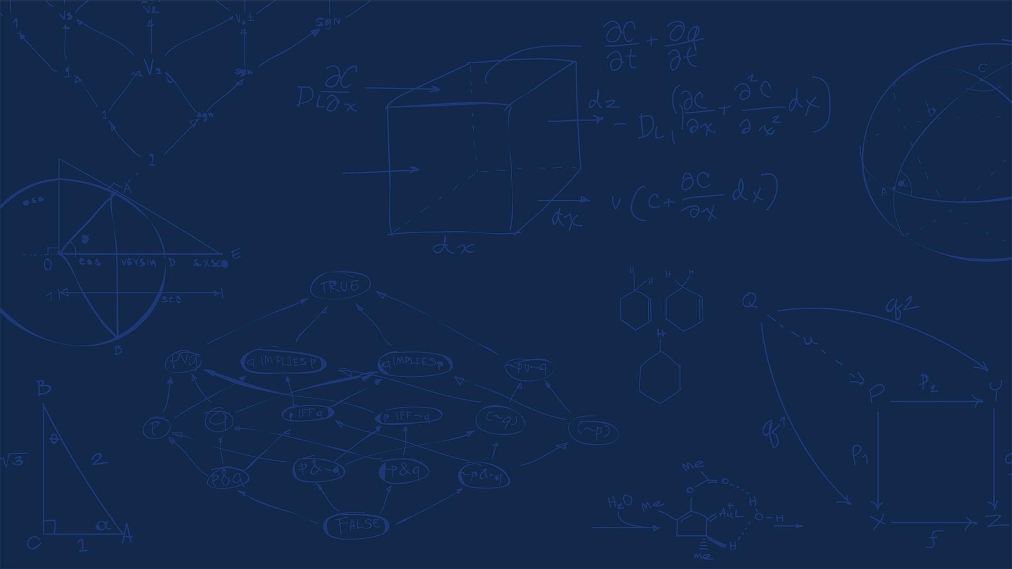

SE 423: Introduction to Mechatronics
Lecture 20-21: Sensor Fusion and Kalman Filters
Marius Juston
Monday, April 6th, 2026

Slide 2

Review – 5-minute partner discussion
Talk to the person next to you and answer these questions.
What assumptions were made during path planning / trajectory planning?
What sensors on the robot help determine it’s the location in the world?
When could the odometry and the IMU give different values? Which one should you trust?
If your IMU says you accelerated forward, but LiDAR scan matching says you didn’t move, what should the system believe?
SYSTEMS ENGINEERING
GRAINGER ENGINEERING

Slide 3
Reminders
Office Hours:
Monday: 4-6 PM, Neel
Tuesday: 11-1 PM, Lakshmi
Tuesday: 1-3 PM, Samuel
Tuesday: 2-5 PM, Dan & Marius
Lab: Finishing Lab 6 this week. This a 3-week lab!
Don’t forget to have the Lab LabVIEW application implemented before lab.
Homeworks:
Check-offs for homework 4 Ex 4 are due April 7, 5PM (The end of office hours)
Remainder of homework 4 due on Gradescope on April 8, 9AM
Next homework is primarily the personal project due on April 22, 9AM.
I would highly recommend you thinking now and maybe even starting it now if you have a good idea already!
SYSTEMS ENGINEERING
GRAINGER ENGINEERING

Slide 4
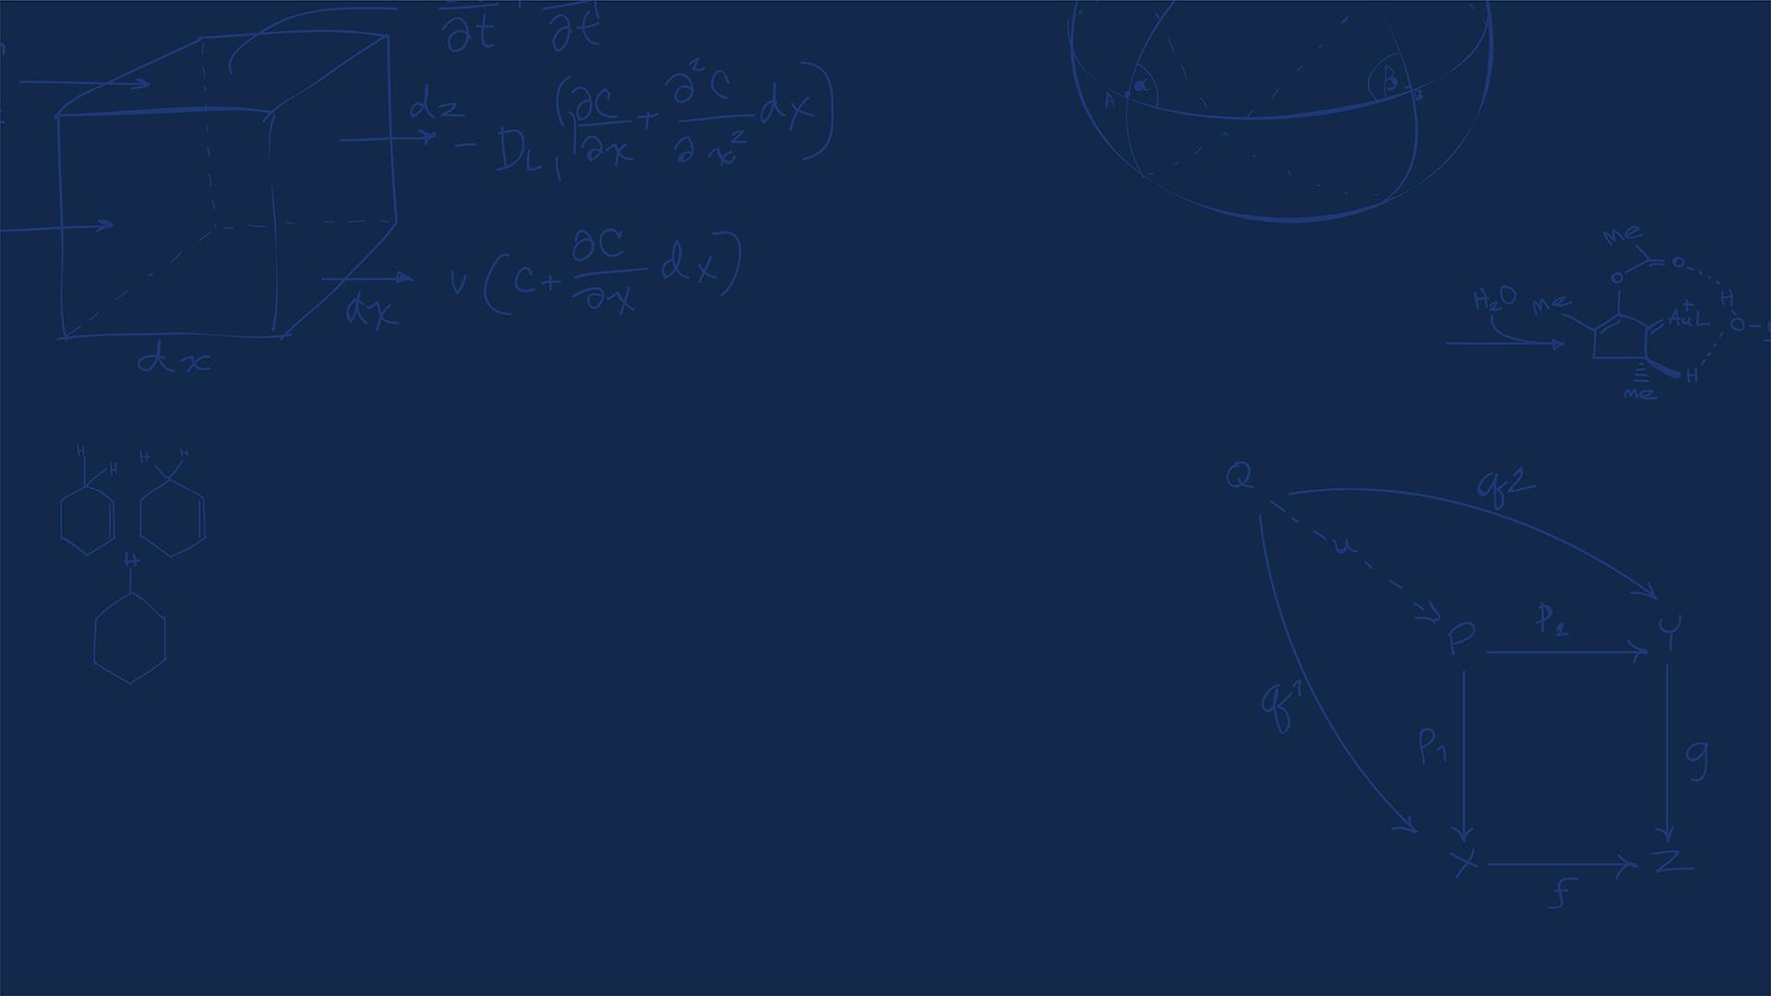
Questions?
Homework, Lab, LabVIEW?
SYSTEMS ENGINEERING
GRAINGER ENGINEERING

Slide 5
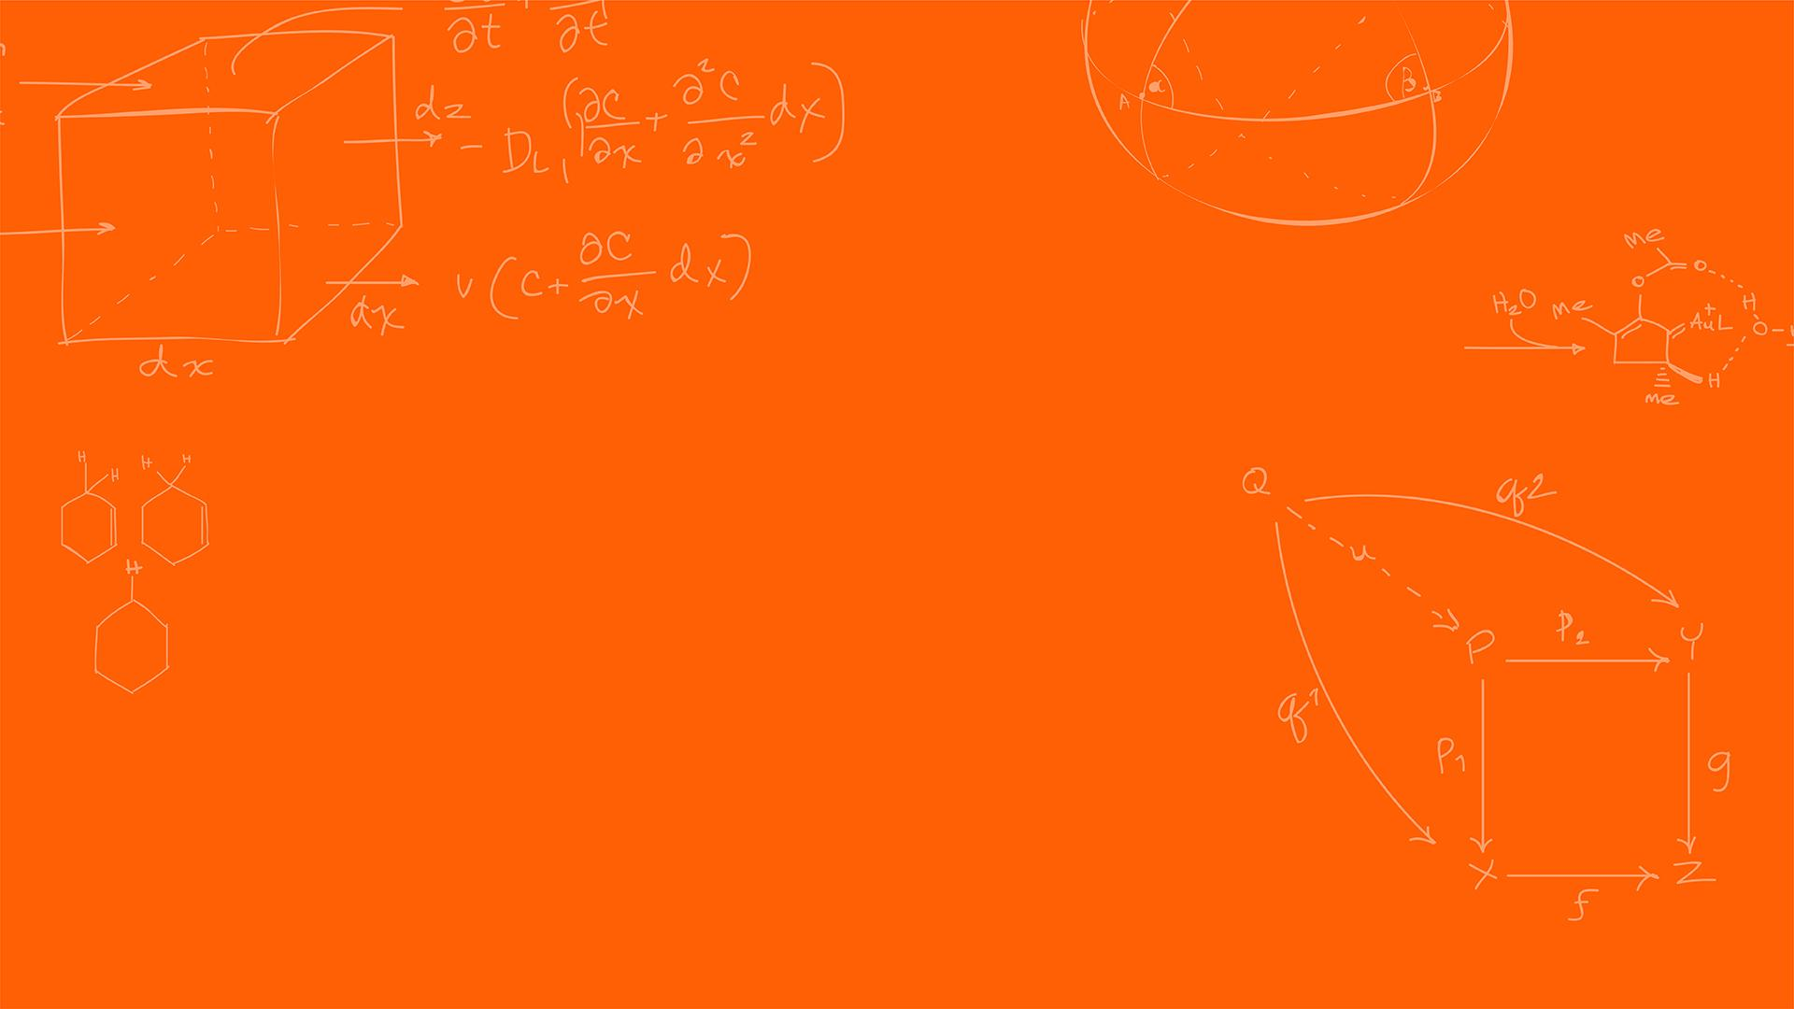

Sensor Fusion
SYSTEMS ENGINEERING
GRAINGER ENGINEERING

Slide 6
Sensor Fusion
In the real world, motors don't spin exactly as commanded due to friction and voltage drops.
Sensors have electrical noise, mechanical imperfections, and environmental interference.
What can cause the LiDAR to fail?
Reflective / absorptive surfaces: glass, mirrors, black materials
Fog, rain, dust, snow
Fast motion relative to scan frequency
What can cause the odometry to fail?
Slippery terrain for wheel slip
When can cause the IMU fail?
IMU drift
Saturating the sensors
If we blindly execute our path plan open-loop, the robot will quickly crash.
SYSTEMS ENGINEERING
GRAINGER ENGINEERING

Slide 7
Sensor Fusion
We need Localization: determining the robot's state (position, velocity, orientation) in the real world.
To solve the localization problem, SE 423 robots use multiple sensors.
Proprioceptive sensors measure internal states: Wheel Encoders (Odometry) and IMUs.
Exteroceptive sensors measure the external environment: LiDAR.
No single sensor is perfect; they all lie to us in different ways.
SYSTEMS ENGINEERING
GRAINGER ENGINEERING

Slide 8
Sensor Fusion
Wheel encoders count the rotations of the robot's wheels. By knowing wheel radius and track width, we calculate forward kinematics to estimate position. It provides high-frequency, smooth data for short-term movement.
Similarly, IMUs generate high-frequency, smooth data for short-term movement based on the integration of acceleration.
LiDAR, unlike odometry and IMUs, LiDAR gives us absolute measurements relative to the environment.; however, due to the additional data, the sensor runs at a lower frequency (e.g., 10Hz) compared to an IMU (e.g., 500Hz).
If we are in a perfectly square, featureless hallway, can LiDAR tell us our position along the hallway? What about the IMU / odometry?
SYSTEMS ENGINEERING
GRAINGER ENGINEERING

Slide 9
Sensor Fusion
We have fast, smooth sensors that drift (IMU, Odometry).
We have slow, computationally heavy sensors that don't drift (LiDAR).
How do we combine them?
Simple averaging doesn't work because their reliability changes over time.
If 2 sensors given measurements give different values which, should you trust?
What if your sensors give you the confidence of their measurements? I.e. the LiDAR is 75% sure of its position and the IMU / Odometry are, in total, 25% sure of their positions?
SYSTEMS ENGINEERING
GRAINGER ENGINEERING

Slide 10
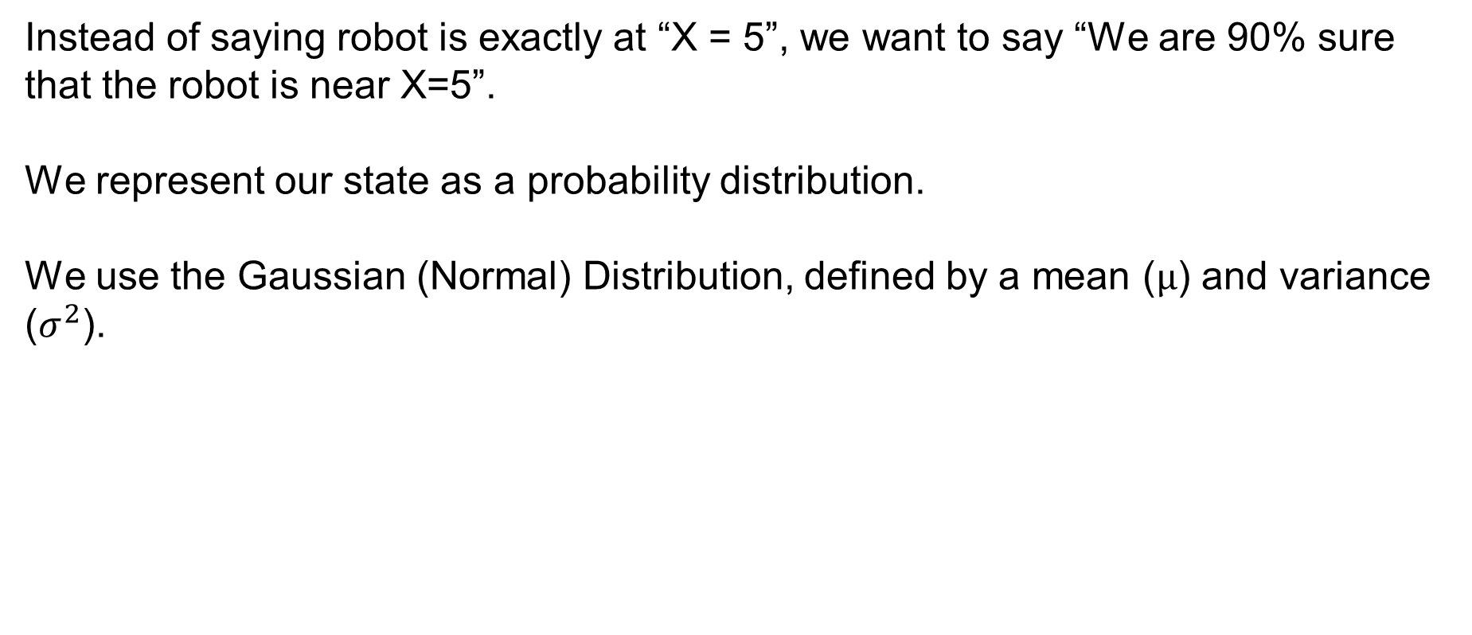
Sensor Fusion
Instead of saying robot is exactly at “X = 5”, we want to say “We are 90% sure that the robot is near X=5”.
We represent our state as a probability distribution.
We use the Gaussian (Normal) Distribution, defined by a mean ($μ$) and variance ($σ^{2}$).
https://en.wikipedia.org/wiki/Normal_distribution
SYSTEMS ENGINEERING
GRAINGER ENGINEERING

Slide 11
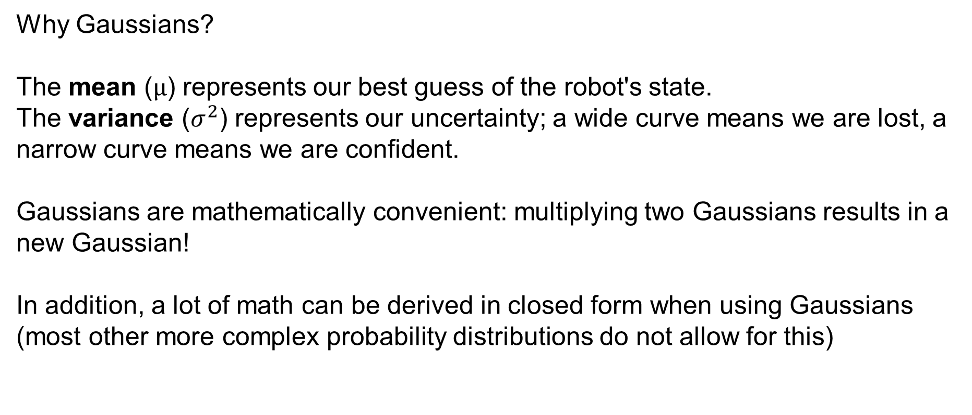
Sensor Fusion
Why Gaussians?
The mean ($μ$) represents our best guess of the robot's state.
The variance ($σ^{2}$) represents our uncertainty; a wide curve means we are lost, a narrow curve means we are confident.
Gaussians are mathematically convenient: multiplying two Gaussians results in a new Gaussian!
In addition, a lot of math can be derived in closed form when using Gaussians (most other more complex probability distributions do not allow for this)
SYSTEMS ENGINEERING
GRAINGER ENGINEERING

Slide 12
Sensor Fusion
Which sensor would you trust more?
SYSTEMS ENGINEERING
GRAINGER ENGINEERING

Slide 13
1D Kalman Filter
SYSTEMS ENGINEERING
GRAINGER ENGINEERING

Slide 14
Sensor Fusion
The Kalman Filter is an optimal estimator for linear systems subject to Gaussian noise.
When would the Kalman Filter not be appropriate?
If your sensor or system if non-linear and / or does not follow a Gaussian noise distribution! Always understand how your sensors / system acts and the underlying assumptions for algorithms!
It operates in a continuous, two-step loop: Predict and Update.
SYSTEMS ENGINEERING
GRAINGER ENGINEERING

Slide 15
Sensor Fusion
SYSTEMS ENGINEERING
GRAINGER ENGINEERING

Slide 16
Sensor Fusion
Step 1: The robot moves. We use our fast, noisy sensors (Odometry/IMU) to Predict where we are. Our uncertainty grows.
Step 2: The robot looks. We take a measurement with our absolute sensor (LiDAR) to Update our belief. Our uncertainty shrinks.
Rinse and repeat thousands of times a second.
SYSTEMS ENGINEERING
GRAINGER ENGINEERING

Slide 17
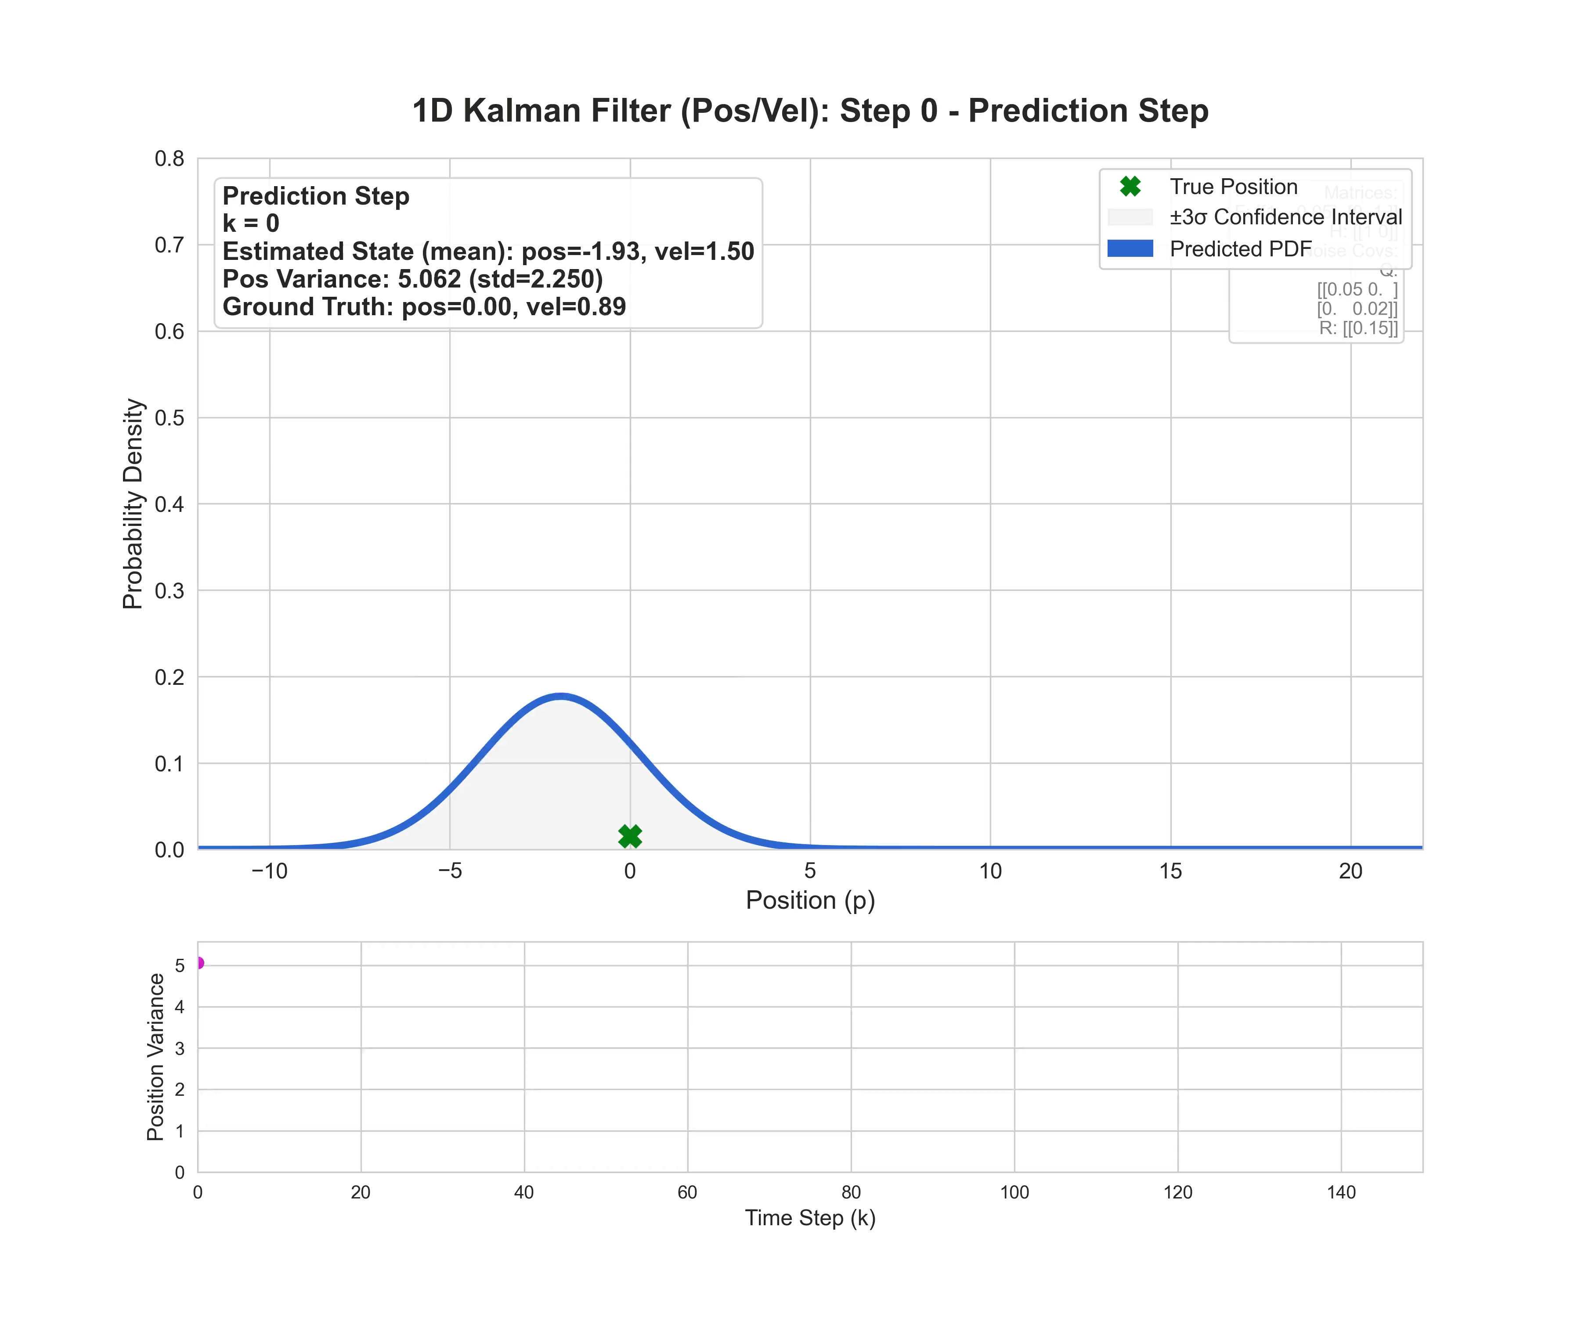
Sensor Fusion
SYSTEMS ENGINEERING
GRAINGER ENGINEERING

Slide 18
Predict
SYSTEMS ENGINEERING
GRAINGER ENGINEERING

Slide 19
Sensor Fusion
Last lectures, we covered algorithms like A*, Dijkstras, Hybrid A* for path planning.
We learned to compute an optimal, collision-free trajectory from Point A to Point B.
However, path planning operates in a perfect, simulated world!
The fundamental assumption we made about the robot to execute these plans were:
Perfect localization and actuation!
SYSTEMS ENGINEERING
GRAINGER ENGINEERING

Slide 20
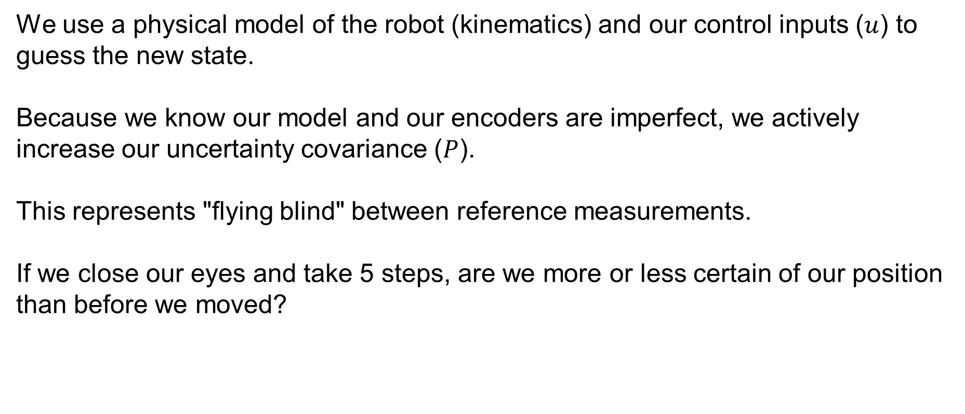
Sensor Fusion – Predict Step
We use a physical model of the robot (kinematics) and our control inputs ($u$) to guess the new state.
Because we know our model and our encoders are imperfect, we actively increase our uncertainty covariance ($P$).
This represents "flying blind" between reference measurements.
If we close our eyes and take 5 steps, are we more or less certain of our position than before we moved?
SYSTEMS ENGINEERING
GRAINGER ENGINEERING

Slide 21
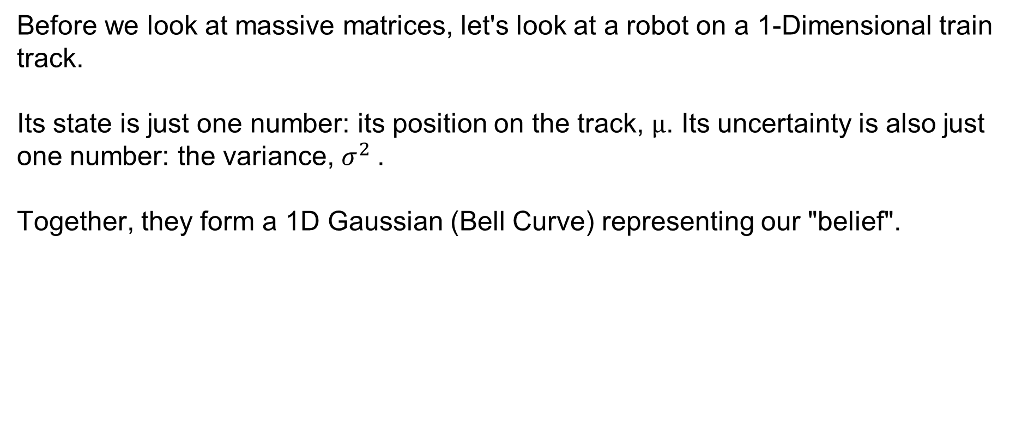
Sensor Fusion – Predict Step
Before we look at massive matrices, let's look at a robot on a 1-Dimensional train track.
Its state is just one number: its position on the track, $μ$. Its uncertainty is also just one number: the variance, $σ^{2}$.
Together, they form a 1D Gaussian (Bell Curve) representing our "belief".
SYSTEMS ENGINEERING
GRAINGER ENGINEERING

Slide 22
Sensor Fusion – Predict Step
SYSTEMS ENGINEERING
GRAINGER ENGINEERING

Slide 23
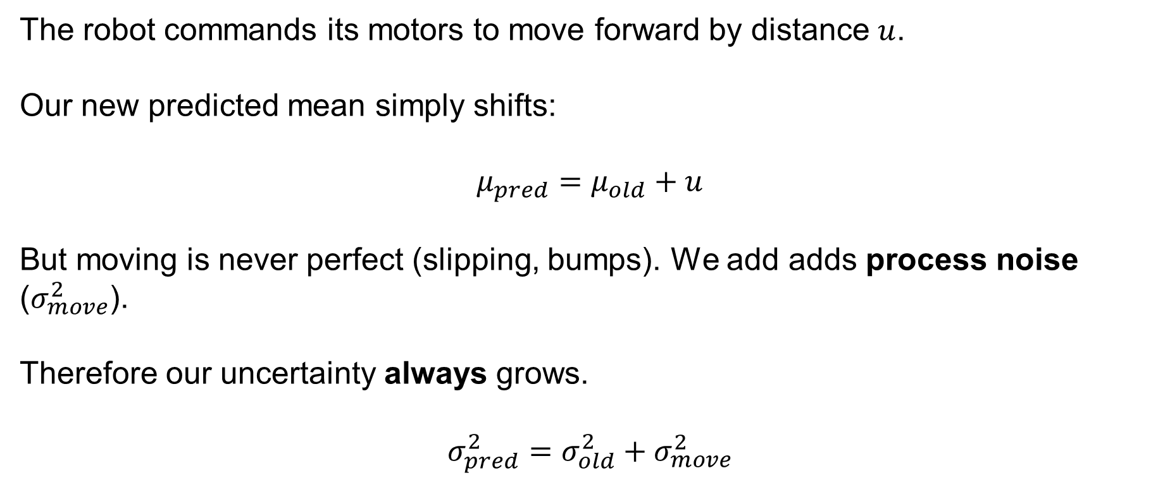
Sensor Fusion – Predict Step
The robot commands its motors to move forward by distance $u$.
Our new predicted mean simply shifts:
$$μ_{pred}=μ_{old}+u$$
But moving is never perfect (slipping, bumps). We add adds process noise ($σ_{move}^{2}$).
Therefore our uncertainty always grows.
$$σ_{pred}^{2}=σ_{old}^{2}+σ_{move}^{2}$$
SYSTEMS ENGINEERING
GRAINGER ENGINEERING

Slide 24
Sensor Fusion – Predict Step
SYSTEMS ENGINEERING
GRAINGER ENGINEERING

Slide 25
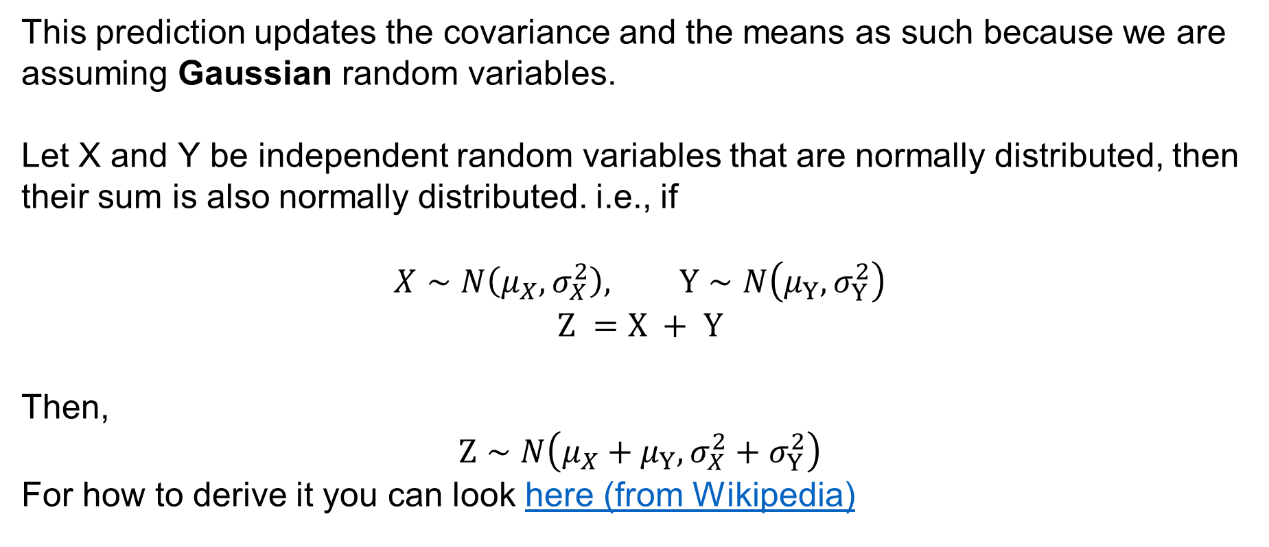
Sensor Fusion – Predict Step
This prediction updates the covariance and the means as such because we are assuming Gaussian random variables.
Let X and Y be independent random variables that are normally distributed, then their sum is also normally distributed. i.e., if
$$X∼N\left(μ_{X},σ_{X}^{2}\right), Y∼N\left(μ_{Y},σ_{Y}^{2}\right)$$
$$Z =X + Y$$
Then,
$$Z∼N\left(μ_{X}+μ_{Y},σ_{X}^{2}+σ_{Y}^{2}\right)$$
For how to derive it you can look here (from Wikipedia)
SYSTEMS ENGINEERING
GRAINGER ENGINEERING

Slide 26
Update
SYSTEMS ENGINEERING
GRAINGER ENGINEERING

Slide 27
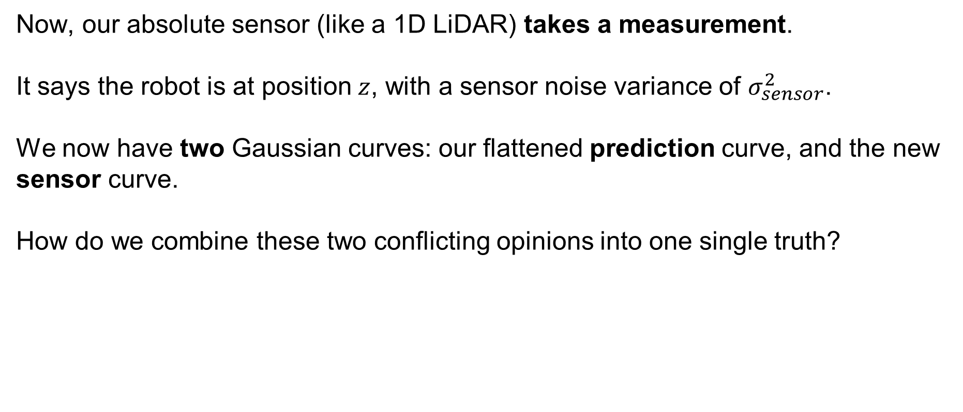
Sensor Fusion – Predict Step
Now, our absolute sensor (like a 1D LiDAR) takes a measurement.
It says the robot is at position $z$, with a sensor noise variance of $σ_{sensor}^{2}$.
We now have two Gaussian curves: our flattened prediction curve, and the new sensor curve.
How do we combine these two conflicting opinions into one single truth?
SYSTEMS ENGINEERING
GRAINGER ENGINEERING

Slide 28
Sensor Fusion – Predict Step
SYSTEMS ENGINEERING
GRAINGER ENGINEERING

Slide 29
Sensor Fusion – Predict Step
In probability, to fuse two independent estimates, we multiply their distributions together.
The magical property of Gaussians: Multiplying two Gaussians always produces a new Gaussian.
Because the new curve represents the overlapping area of agreement, it is always taller and narrower than both original curves.
Fusing data reduces uncertainty!
SYSTEMS ENGINEERING
GRAINGER ENGINEERING

Slide 30
Sensor Fusion – Predict Step
SYSTEMS ENGINEERING
GRAINGER ENGINEERING

Slide 31
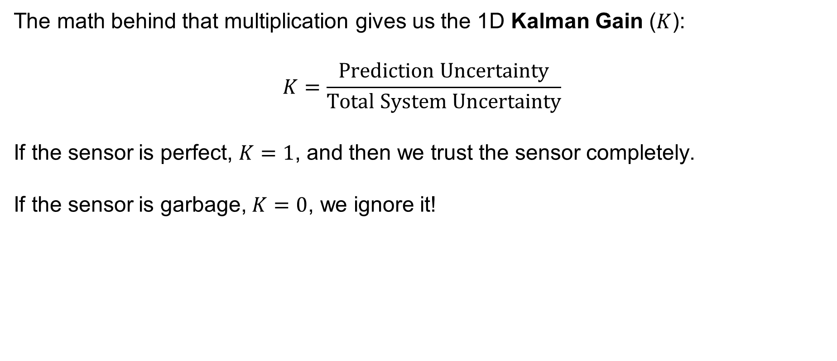
Sensor Fusion – Predict Step
The math behind that multiplication gives us the 1D Kalman Gain ($K$):
$$K=\frac{Prediction Uncertainty}{Total System Uncertainty}$$
If the sensor is perfect, $K=1$, and then we trust the sensor completely.
If the sensor is garbage, $K=0$, we ignore it!
SYSTEMS ENGINEERING
GRAINGER ENGINEERING

Slide 32
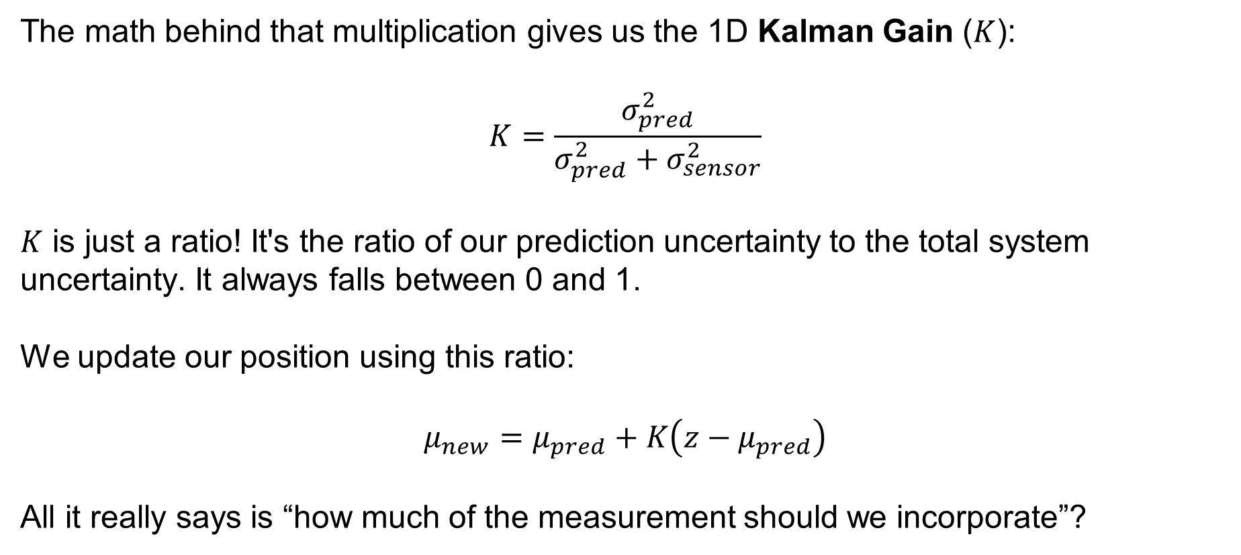
Sensor Fusion – Predict Step
The math behind that multiplication gives us the 1D Kalman Gain ($K$):
$$K=\frac{σ_{pred}^{2}}{σ_{pred}^{2}+σ_{sensor}^{2}}$$
$K$ is just a ratio! It's the ratio of our prediction uncertainty to the total system uncertainty. It always falls between 0 and 1.
We update our position using this ratio:
$$μ_{new}=μ_{pred}+K\left(z−μ_{pred}\right)$$
All it really says is “how much of the measurement should we incorporate”?
SYSTEMS ENGINEERING
GRAINGER ENGINEERING

Slide 33
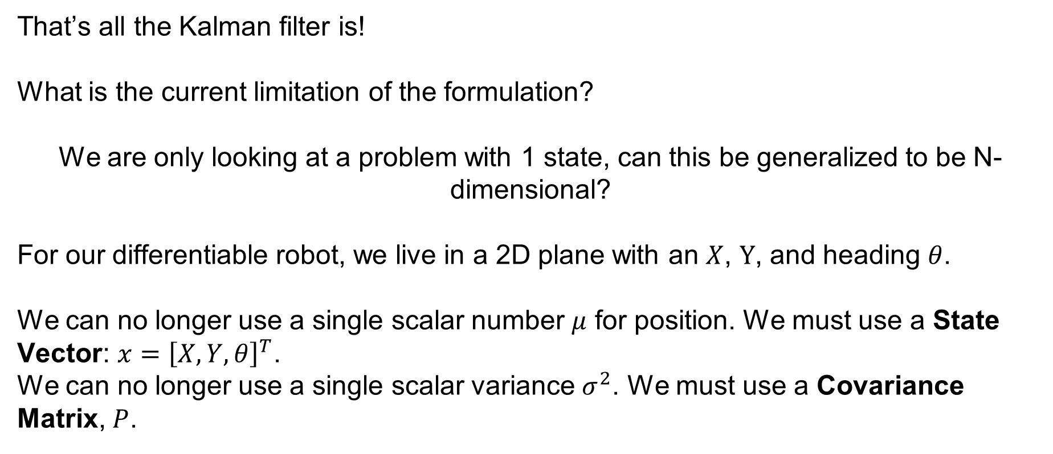
Sensor Fusion – Predict Step
That’s all the Kalman filter is!
What is the current limitation of the formulation?
We are only looking at a problem with 1 state, can this be generalized to be N-dimensional?
For our differentiable robot, we live in a 2D plane with an $X$, $Y$, and heading $θ$.
We can no longer use a single scalar number $μ$ for position. We must use a State Vector: $x={\left[X,Y,θ\right]}^{T}$.
We can no longer use a single scalar variance $σ^{2}$. We must use a Covariance Matrix, $P$.
SYSTEMS ENGINEERING
GRAINGER ENGINEERING

Slide 34
ND - Kalman Filter
SYSTEMS ENGINEERING
GRAINGER ENGINEERING

Slide 35
Predict
SYSTEMS ENGINEERING
GRAINGER ENGINEERING

Slide 36
Sensor Fusion – Predict Step
SYSTEMS ENGINEERING
GRAINGER ENGINEERING

Slide 37

Sensor Fusion – Predict Step
Let's translate our 1D prediction ($μ_{pred}=μ_{old}+u$) to N-Dimensions:
$x_{k|k−1}=Fx_{k−1|k−1}+Bu_{k}$
$μ$ becomes the state vector $x$
$F$ is our state transition matrix (how physics updates the state).
SYSTEMS ENGINEERING
GRAINGER ENGINEERING

Slide 38
Sensor Fusion – Predict Step
SYSTEMS ENGINEERING
GRAINGER ENGINEERING

Slide 39
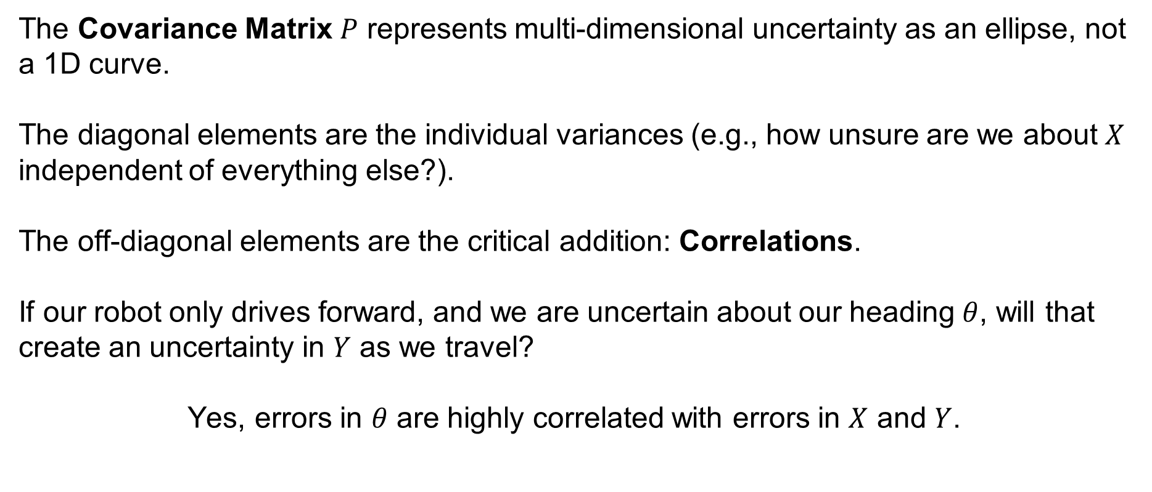
Sensor Fusion – Predict Step
The Covariance Matrix $P$ represents multi-dimensional uncertainty as an ellipse, not a 1D curve.
The diagonal elements are the individual variances (e.g., how unsure are we about $X$ independent of everything else?).
The off-diagonal elements are the critical addition: Correlations.
If our robot only drives forward, and we are uncertain about our heading $θ$, will that create an uncertainty in $Y$ as we travel?
Yes, errors in $θ$ are highly correlated with errors in $X$ and $Y$.
SYSTEMS ENGINEERING
GRAINGER ENGINEERING

Slide 40
Sensor Fusion – Predict Step
SYSTEMS ENGINEERING
GRAINGER ENGINEERING

Slide 41
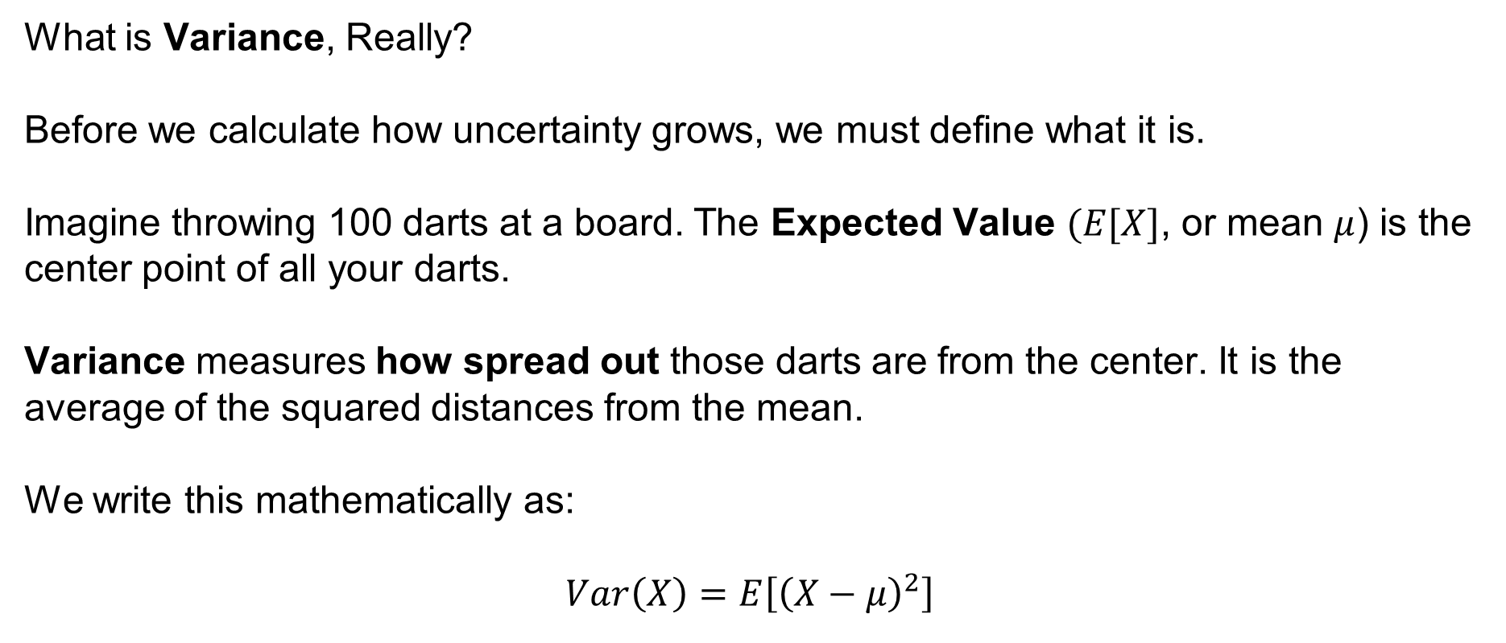
Sensor Fusion – Predict Step
What is Variance, Really?
Before we calculate how uncertainty grows, we must define what it is.
Imagine throwing 100 darts at a board. The Expected Value $(E[X]$, or mean $μ$) is the center point of all your darts.
Variance measures how spread out those darts are from the center. It is the average of the squared distances from the mean.
We write this mathematically as:
$$Var\left(X\right)=E\left[{\left(X−μ\right)}^{2}\right]$$
SYSTEMS ENGINEERING
GRAINGER ENGINEERING

Slide 42
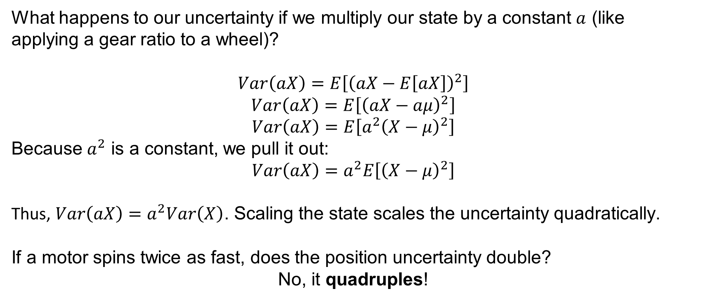
Sensor Fusion – Predict Step
What happens to our uncertainty if we multiply our state by a constant $a$ (like applying a gear ratio to a wheel)?
$$Var\left(aX\right)=E\left[{\left(aX−E\left[aX\right]\right)}^{2}\right]$$
$$Var\left(aX\right)=E\left[{\left(aX−aμ\right)}^{2}\right]$$
$$Var\left(aX\right)=E\left[a^{2}{\left(X−μ\right)}^{2}\right]$$
Because $a^{2}$ is a constant, we pull it out:
$$Var\left(aX\right)=a^{2}E\left[{\left(X−μ\right)}^{2}\right]$$
Thus, $Var\left(aX\right)=a^{2}Var\left(X\right)$. Scaling the state scales the uncertainty quadratically.
If a motor spins twice as fast, does the position uncertainty double?
No, it quadruples!
SYSTEMS ENGINEERING
GRAINGER ENGINEERING

Slide 43
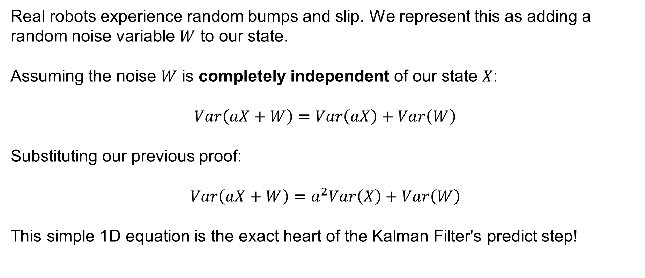
Sensor Fusion – Predict Step
Real robots experience random bumps and slip. We represent this as adding a random noise variable $W$ to our state.
Assuming the noise $W$ is completely independent of our state $X$:
$$Var\left(aX+W\right)=Var\left(aX\right)+Var\left(W\right)$$
Substituting our previous proof:
$$Var\left(aX+W\right)=a^{2}Var\left(X\right)+Var\left(W\right)$$
This simple 1D equation is the exact heart of the Kalman Filter's predict step!
SYSTEMS ENGINEERING
GRAINGER ENGINEERING

Slide 44
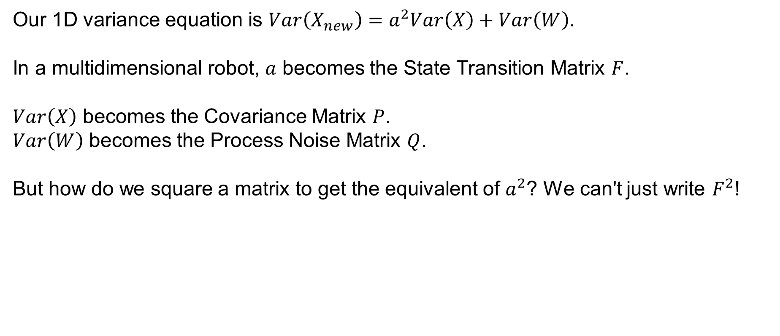
Sensor Fusion – Predict Step
Our 1D variance equation is $Var\left(X_{new}\right)=a^{2}Var\left(X\right)+Var\left(W\right)$.
In a multidimensional robot, $a$ becomes the State Transition Matrix $F$.
$Var\left(X\right)$ becomes the Covariance Matrix $P$.
$Var\left(W\right)$ becomes the Process Noise Matrix $Q$.
But how do we square a matrix to get the equivalent of $a^{2}$? We can't just write $F^{2}$!
SYSTEMS ENGINEERING
GRAINGER ENGINEERING

Slide 45
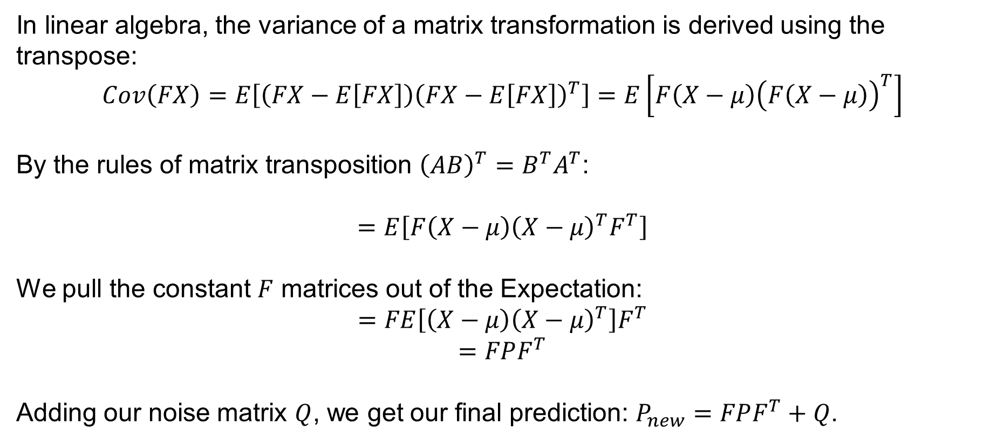
Sensor Fusion – Predict Step
In linear algebra, the variance of a matrix transformation is derived using the transpose:
$$Cov\left(FX\right)=E\left[\left(FX−E\left[FX\right]\right){\left(FX−E\left[FX\right]\right)}^{T}\right]=E\left[F\left(X−μ\right){\left(F\left(X−μ\right)\right)}^{T}\right]$$
By the rules of matrix transposition ${\left(AB\right)}^{T}=B^{T}A^{T}$:
$$=E\left[F\left(X−μ\right){\left(X−μ\right)}^{T}F^{T}\right]$$
We pull the constant $F$ matrices out of the Expectation:
$$=FE\left[\left(X−μ\right){\left(X−μ\right)}^{T}\right]F^{T}$$
$$=FPF^{T}$$
Adding our noise matrix $Q$, we get our final prediction: $P_{new}=FPF^{T}+Q$.
SYSTEMS ENGINEERING
GRAINGER ENGINEERING

Slide 46
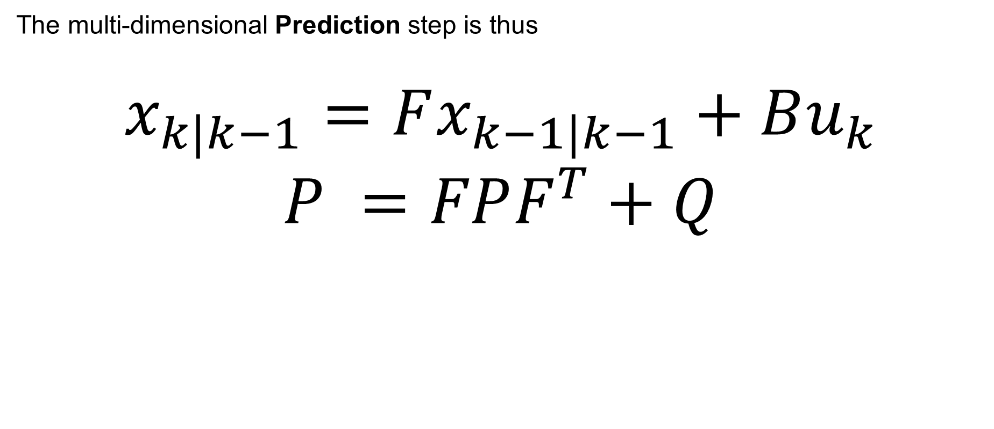
Sensor Fusion – Predict Step
The multi-dimensional Prediction step is thus
$$x_{k|k−1}=Fx_{k−1|k−1}+Bu_{k}$$
$$P =FPF^{T}+Q$$
SYSTEMS ENGINEERING
GRAINGER ENGINEERING

Slide 47
Update
SYSTEMS ENGINEERING
GRAINGER ENGINEERING

Slide 48
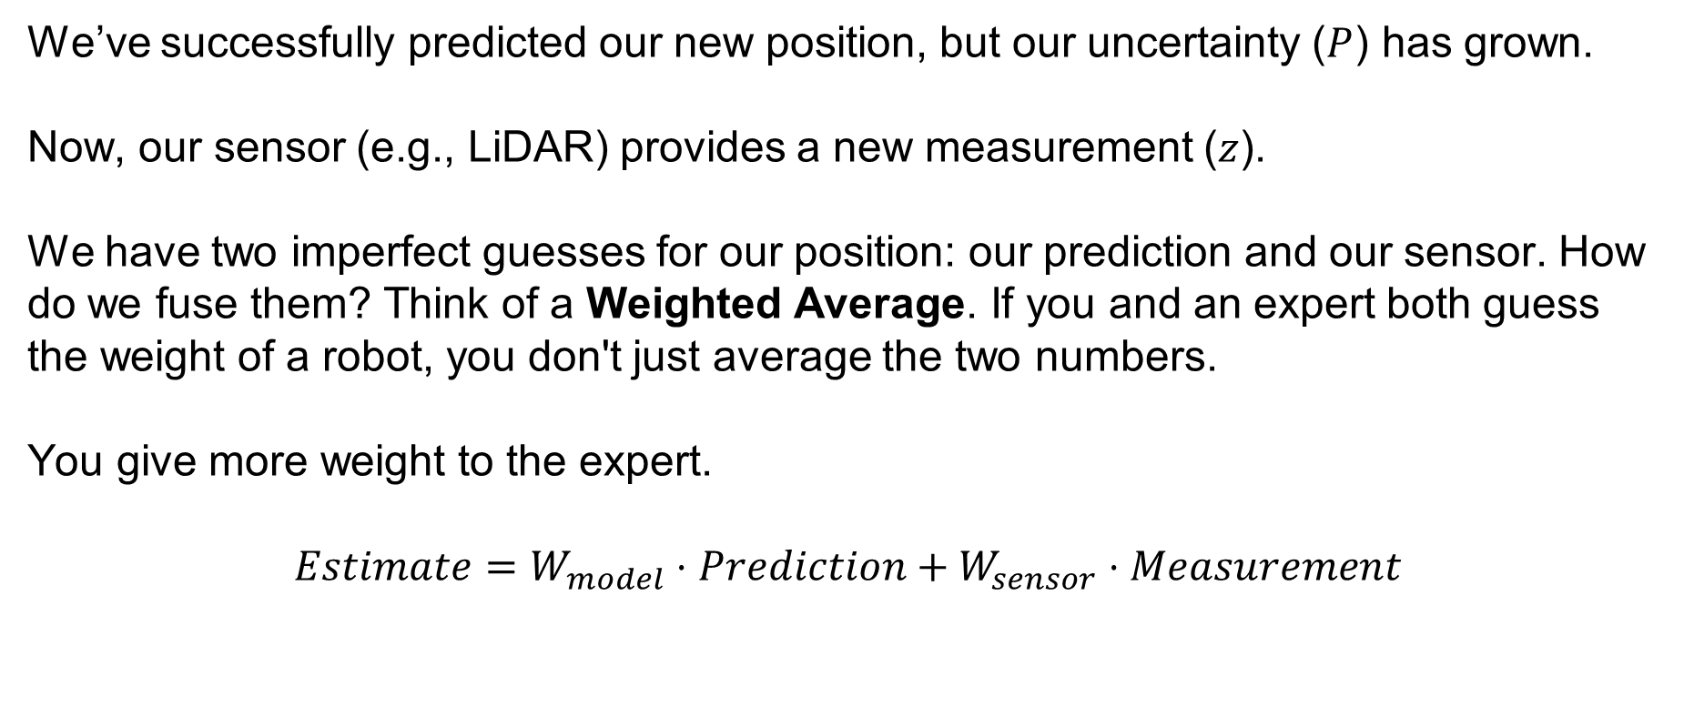
Sensor Fusion – Predict Step
We’ve successfully predicted our new position, but our uncertainty ($P$) has grown.
Now, our sensor (e.g., LiDAR) provides a new measurement ($z$).
We have two imperfect guesses for our position: our prediction and our sensor. How do we fuse them? Think of a Weighted Average. If you and an expert both guess the weight of a robot, you don't just average the two numbers.
You give more weight to the expert.
$$Estimate=W_{model}⋅Prediction+W_{sensor}⋅Measurement$$
SYSTEMS ENGINEERING
GRAINGER ENGINEERING

Slide 49
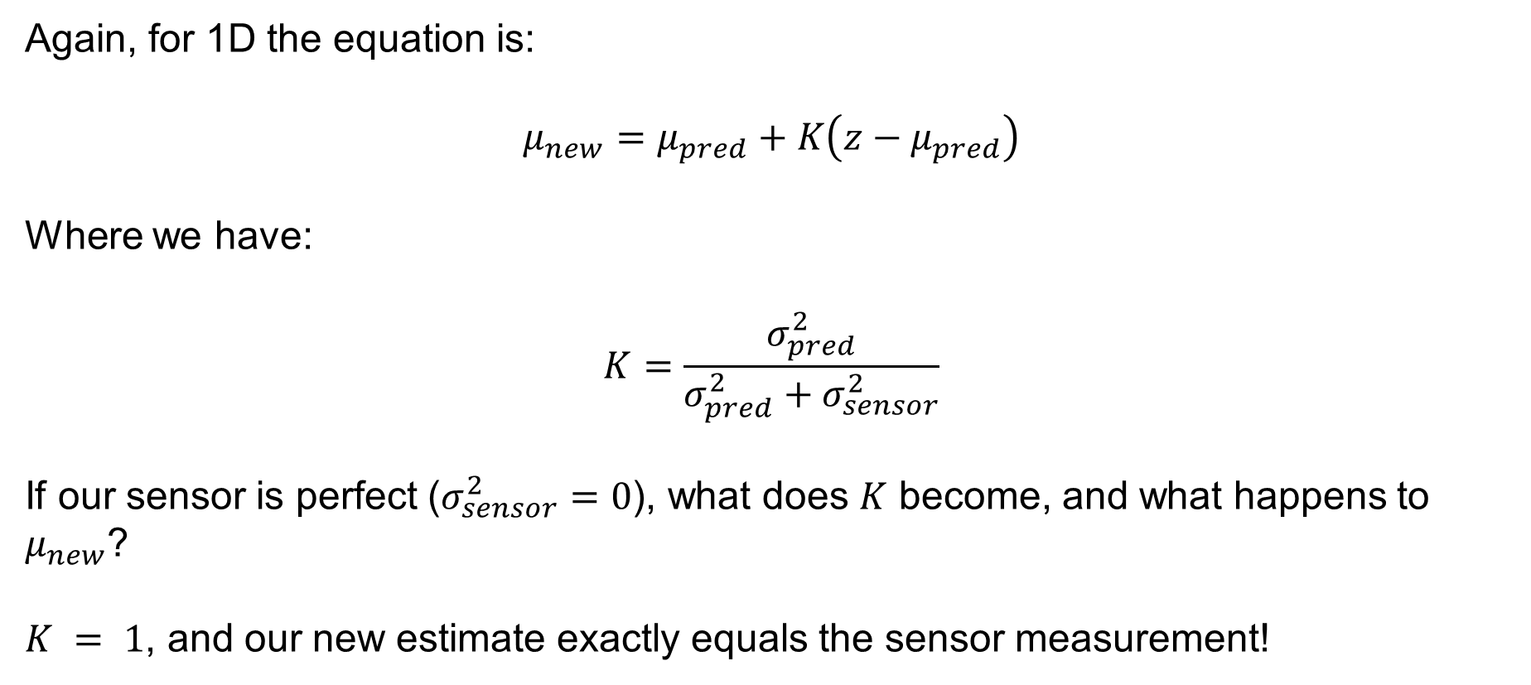
Sensor Fusion – Predict Step
Again, for 1D the equation is:
$$μ_{new}=μ_{pred}+K\left(z−μ_{pred}\right)$$
Where we have:
$$K=\frac{σ_{pred}^{2}}{σ_{pred}^{2}+σ_{sensor}^{2}}$$
If our sensor is perfect ($σ_{sensor}^{2}=0$), what does $K$ become, and what happens to $μ_{new}$?
$K = 1$, and our new estimate exactly equals the sensor measurement!
SYSTEMS ENGINEERING
GRAINGER ENGINEERING

Slide 50
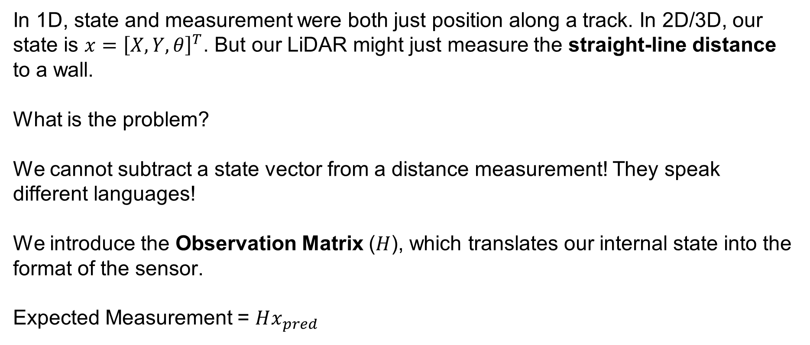
Sensor Fusion – Predict Step
In 1D, state and measurement were both just position along a track. In 2D/3D, our state is $x={\left[X,Y,θ\right]}^{T}$. But our LiDAR might just measure the straight-line distance to a wall.
What is the problem?
We cannot subtract a state vector from a distance measurement! They speak different languages!
We introduce the Observation Matrix ($H$), which translates our internal state into the format of the sensor.
Expected Measurement = $Hx_{pred}$
SYSTEMS ENGINEERING
GRAINGER ENGINEERING

Slide 51
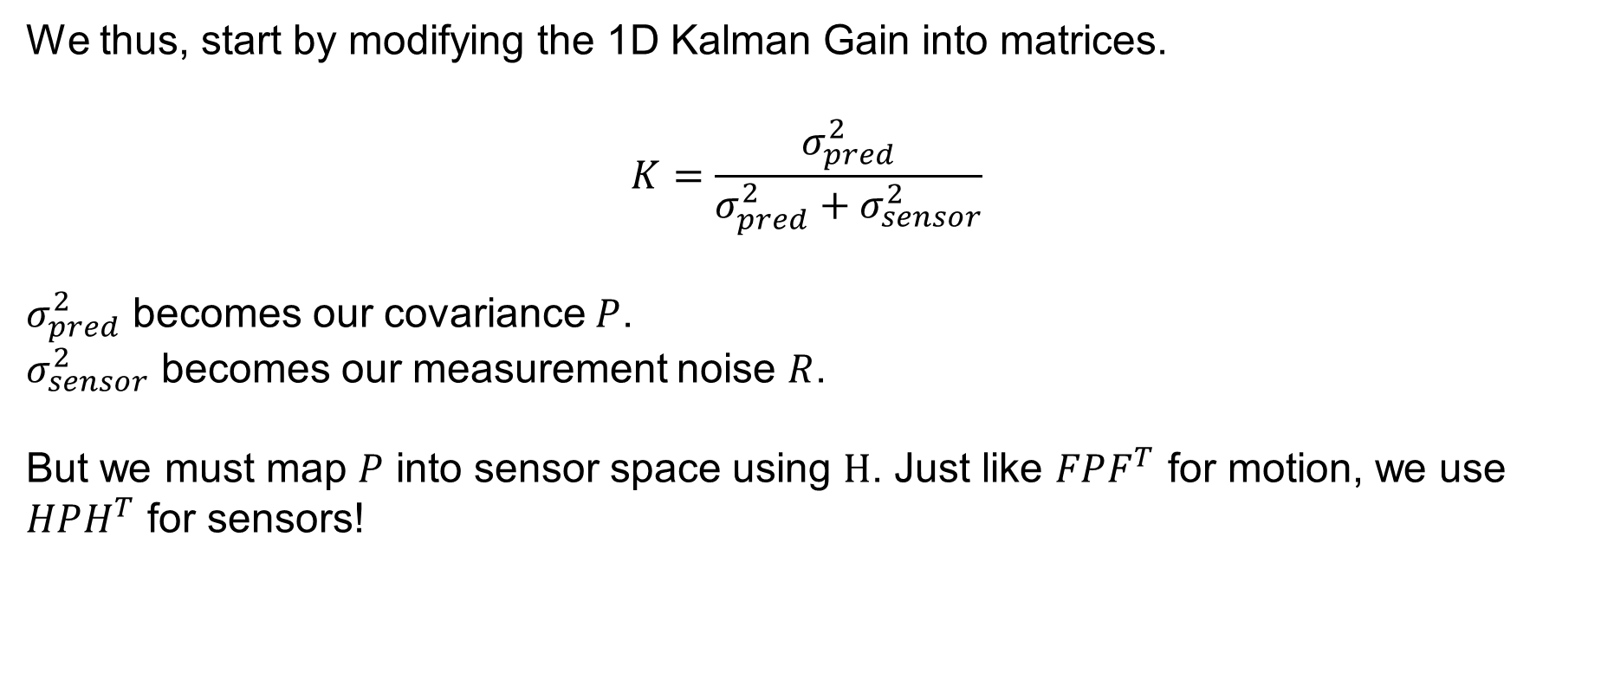
Sensor Fusion – Predict Step
We thus, start by modifying the 1D Kalman Gain into matrices.
$$K=\frac{σ_{pred}^{2}}{σ_{pred}^{2}+σ_{sensor}^{2}}$$
$σ_{pred}^{2}$ becomes our covariance $P$.
$σ_{sensor}^{2}$ becomes our measurement noise $R$.
But we must map $P$ into sensor space using $H$. Just like $FPF^{T}$ for motion, we use $HPH^{T}$ for sensors!
SYSTEMS ENGINEERING
GRAINGER ENGINEERING

Slide 52
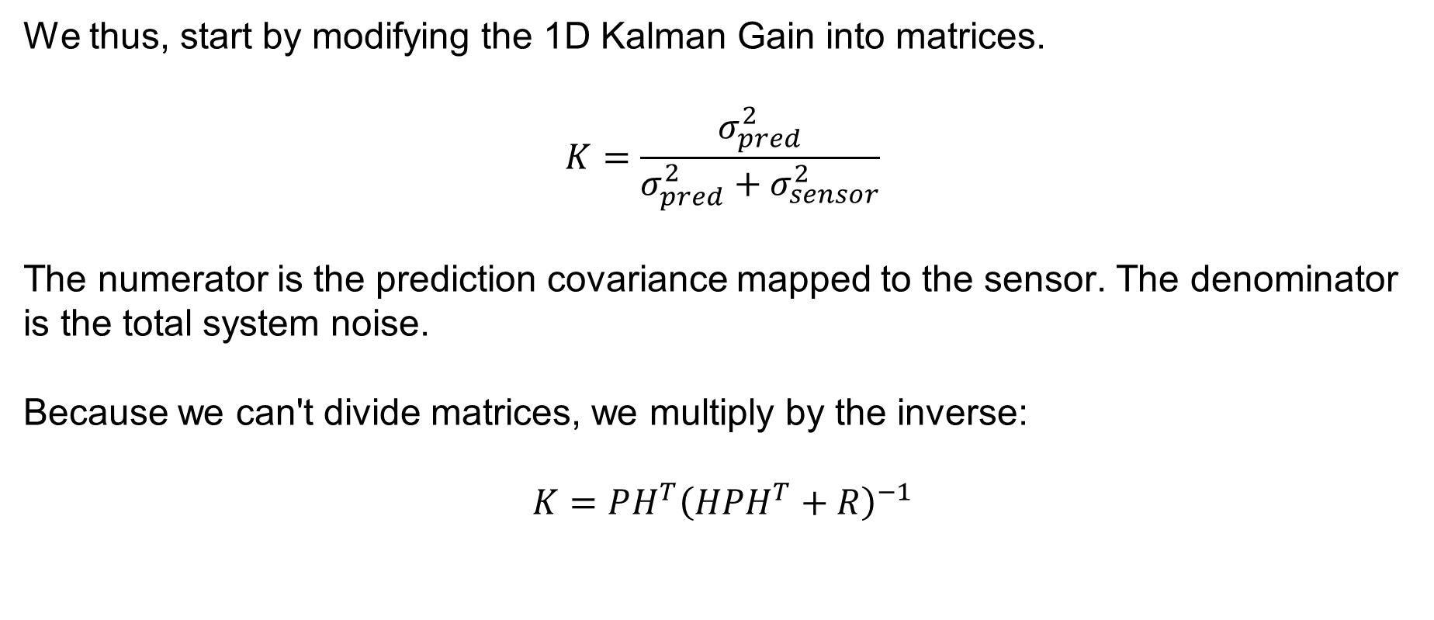
Sensor Fusion – Predict Step
We thus, start by modifying the 1D Kalman Gain into matrices.
$$K=\frac{σ_{pred}^{2}}{σ_{pred}^{2}+σ_{sensor}^{2}}$$
The numerator is the prediction covariance mapped to the sensor. The denominator is the total system noise.
Because we can't divide matrices, we multiply by the inverse:
$$K=PH^{T}{\left(HPH^{T}+R\right)}^{−1}$$
SYSTEMS ENGINEERING
GRAINGER ENGINEERING

Slide 53
Sensor Fusion – Predict Step
SYSTEMS ENGINEERING
GRAINGER ENGINEERING

Slide 54
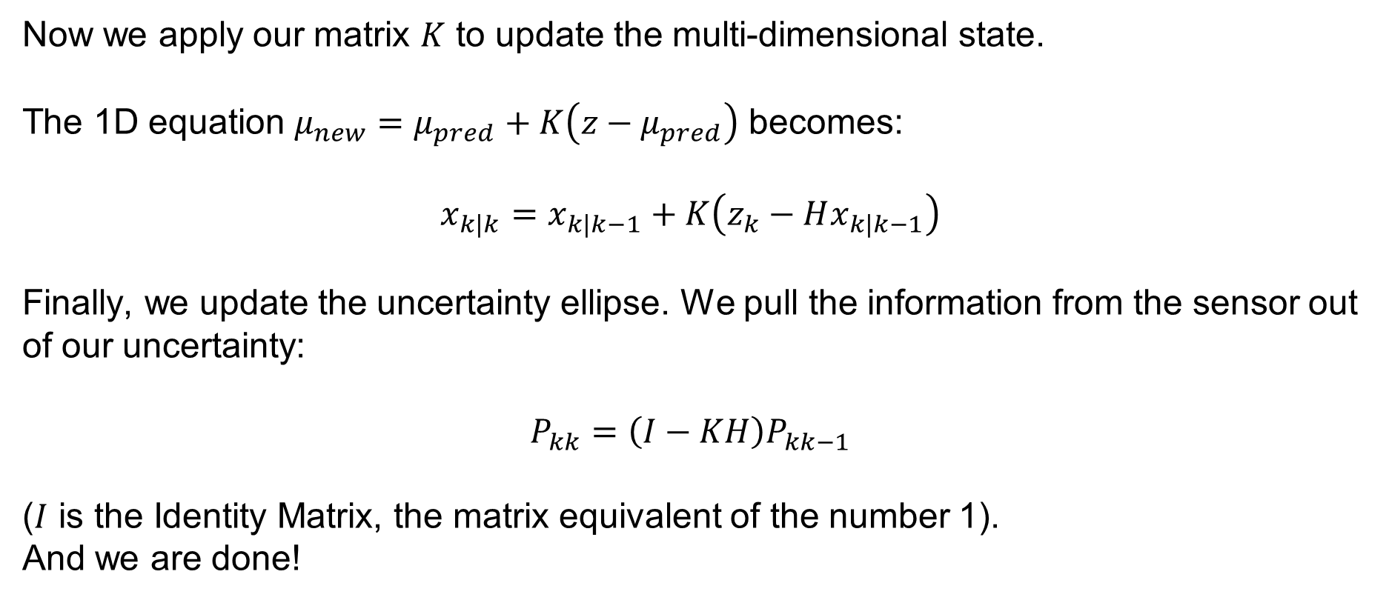
Sensor Fusion – Predict Step
Now we apply our matrix $K$ to update the multi-dimensional state.
The 1D equation $μ_{new}=μ_{pred}+K\left(z−μ_{pred}\right)$ becomes:
$$x_{k|k}=x_{k|k−1}+K\left(z_{k}−Hx_{k|k−1}\right)$$
Finally, we update the uncertainty ellipse. We pull the information from the sensor out of our uncertainty:
$$P_{kk}=\left(I−KH\right)P_{kk−1}$$
($I$ is the Identity Matrix, the matrix equivalent of the number 1).
And we are done!
SYSTEMS ENGINEERING
GRAINGER ENGINEERING

Slide 55
Sensor Fusion – Predict Step
SYSTEMS ENGINEERING
GRAINGER ENGINEERING

Slide 56
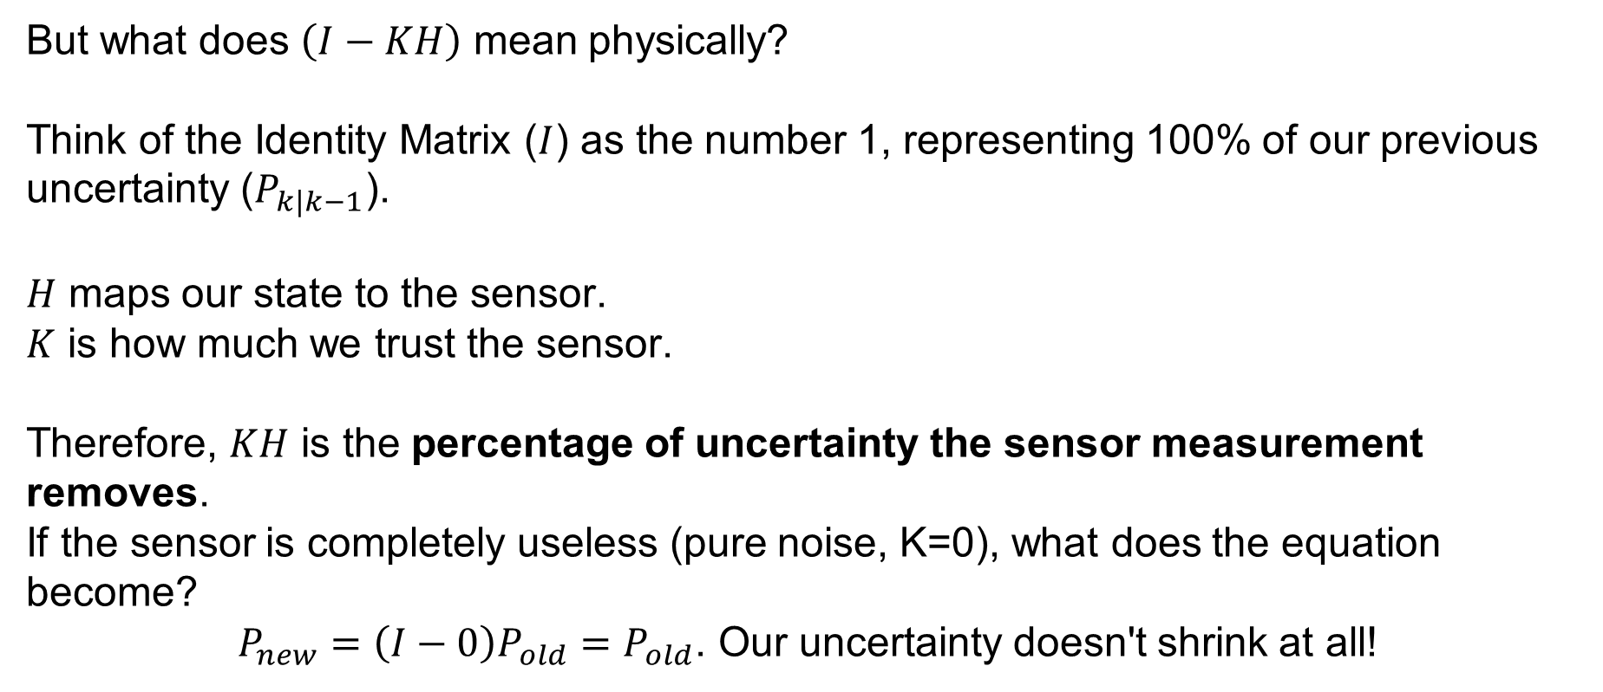
Sensor Fusion – Predict Step
But what does $\left(I−KH\right)$ mean physically?
Think of the Identity Matrix ($I$) as the number 1, representing 100% of our previous uncertainty ($P_{k|k−1}$).
$H$ maps our state to the sensor.
$K$ is how much we trust the sensor.
Therefore, $KH$ is the percentage of uncertainty the sensor measurement removes.
If the sensor is completely useless (pure noise, K=0), what does the equation become?
$P_{new}=\left(I−0\right)P_{old}=P_{old}$. Our uncertainty doesn't shrink at all!
SYSTEMS ENGINEERING
GRAINGER ENGINEERING

Slide 57
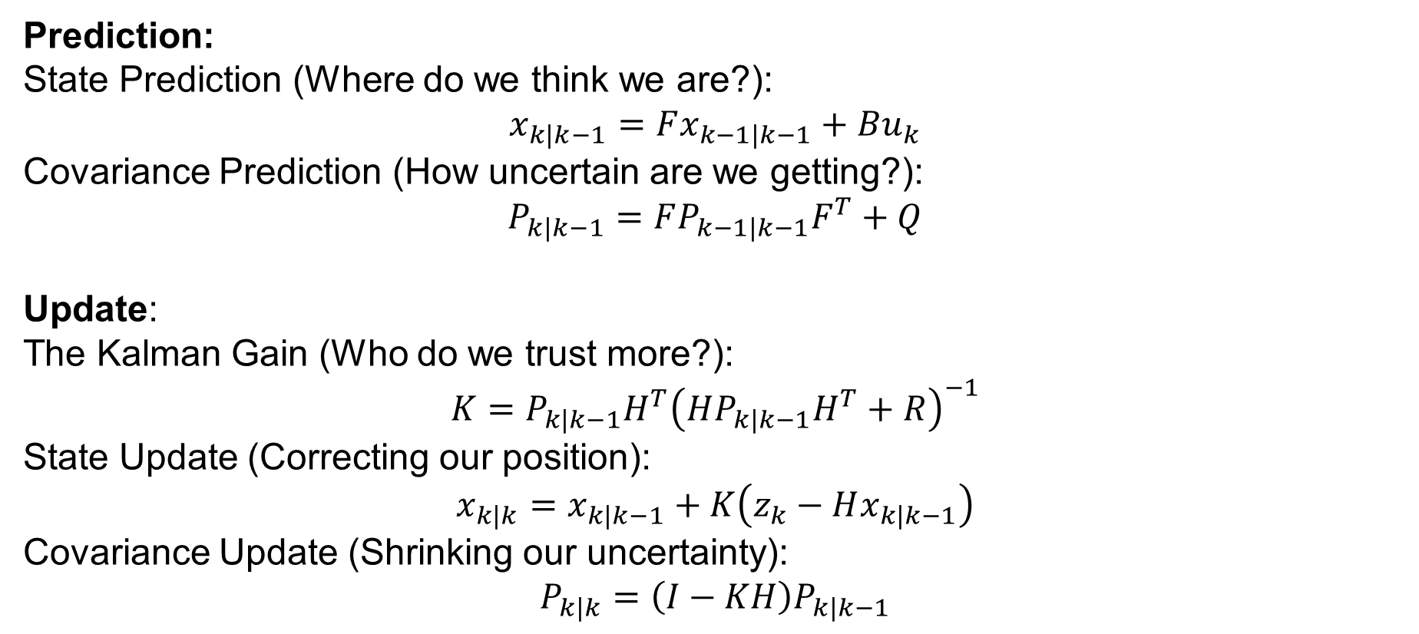
Sensor Fusion – Predict Step
Prediction:
State Prediction (Where do we think we are?):
$$x_{k|k−1}=Fx_{k−1|k−1}+Bu_{k}$$
Covariance Prediction (How uncertain are we getting?):
$$P_{k|k−1}=FP_{k−1|k−1}F^{T}+Q$$
Update:
The Kalman Gain (Who do we trust more?):
$$K=P_{k|k−1}H^{T}{\left(HP_{k|k−1}H^{T}+R\right)}^{−1}$$
State Update (Correcting our position):
$$x_{k|k}=x_{k|k−1}+K\left(z_{k}−Hx_{k|k−1}\right)$$
Covariance Update (Shrinking our uncertainty):
$$P_{k|k}=\left(I−KH\right)P_{k|k−1}$$
SYSTEMS ENGINEERING
GRAINGER ENGINEERING

Slide 58
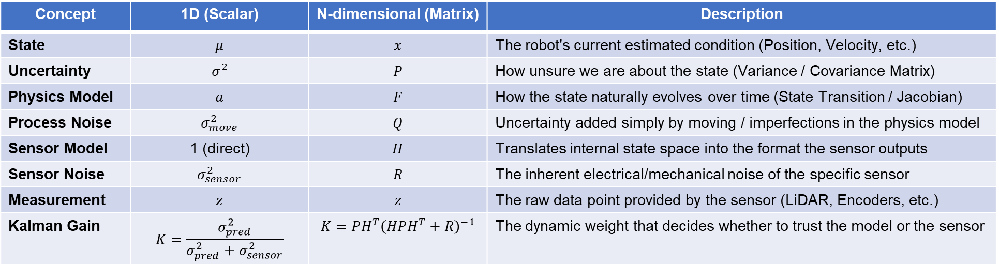
Sensor Fusion – Predict Step
Concept | 1D (Scalar) | N-dimensional (Matrix) | Description
State | $$μ$$ | $$x$$ | The robot's current estimated condition (Position, Velocity, etc.)
Uncertainty | $$σ^{2}$$ | $$P$$ | How unsure we are about the state (Variance / Covariance Matrix)
Physics Model | $$a$$ | $$F$$ | How the state naturally evolves over time (State Transition / Jacobian)
Process Noise | $$σ_{move}^{2}$$ | $$Q$$ | Uncertainty added simply by moving / imperfections in the physics model
Sensor Model | 1 (direct) | $$H$$ | Translates internal state space into the format the sensor outputs
Sensor Noise | $$σ_{sensor}^{2}$$ | $$R$$ | The inherent electrical/mechanical noise of the specific sensor
Measurement | $$z$$ | $$z$$ | The raw data point provided by the sensor (LiDAR, Encoders, etc.)
Kalman Gain | $$K=\frac{σ_{pred}^{2}}{σ_{pred}^{2}+σ_{sensor}^{2}}$$ | $$K=PH^{T}{\left(HPH^{T}+R\right)}^{−1}$$ | The dynamic weight that decides whether to trust the model or the sensor
SYSTEMS ENGINEERING
GRAINGER ENGINEERING

Slide 59
Optional Derivations
SYSTEMS ENGINEERING
GRAINGER ENGINEERING

Slide 60
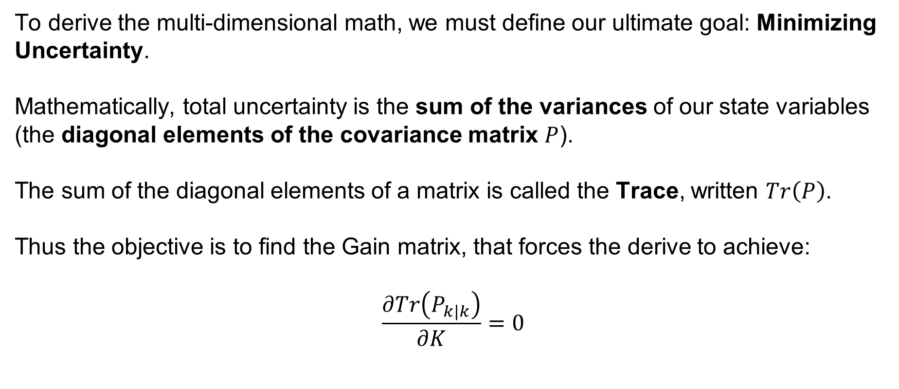
Sensor Fusion – Predict Step
To derive the multi-dimensional math, we must define our ultimate goal: Minimizing Uncertainty.
Mathematically, total uncertainty is the sum of the variances of our state variables (the diagonal elements of the covariance matrix $P$).
The sum of the diagonal elements of a matrix is called the Trace, written $Tr\left(P\right)$.
Thus the objective is to find the Gain matrix, that forces the derive to achieve:
$$\frac{∂Tr\left(P_{k|k}\right)}{∂K}=0$$
SYSTEMS ENGINEERING
GRAINGER ENGINEERING

Slide 61
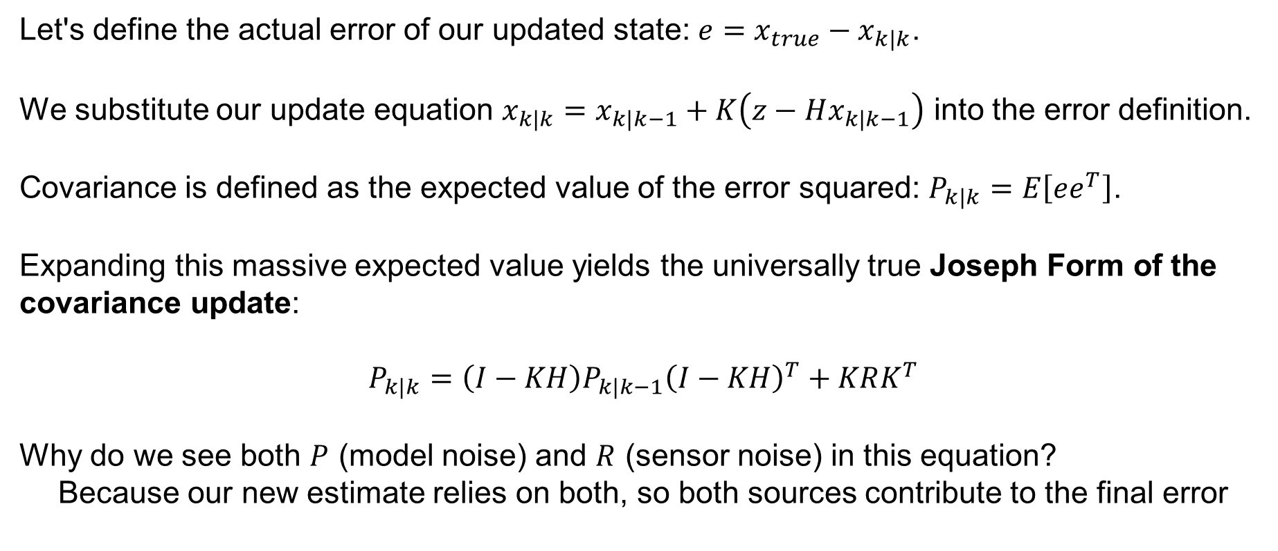
Sensor Fusion – Predict Step
Let's define the actual error of our updated state: $e=x_{true}−x_{k|k}$.
We substitute our update equation $x_{k|k}=x_{k|k−1}+K\left(z−Hx_{k|k−1}\right)$ into the error definition.
Covariance is defined as the expected value of the error squared: $P_{k|k}=E\left[ee^{T}\right]$.
Expanding this massive expected value yields the universally true Joseph Form of the covariance update:
$$P_{k|k}=\left(I−KH\right)P_{k|k−1}{\left(I−KH\right)}^{T}+KRK^{T}$$
Why do we see both $P$ (model noise) and $R$ (sensor noise) in this equation?
Because our new estimate relies on both, so both sources contribute to the final error
SYSTEMS ENGINEERING
GRAINGER ENGINEERING

Slide 62
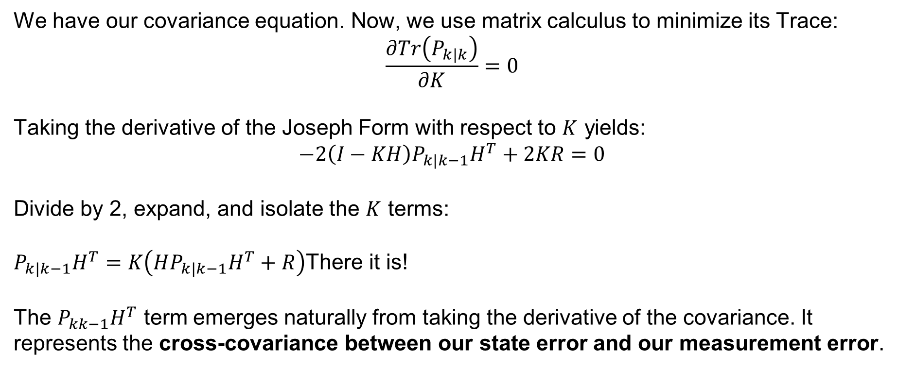
Sensor Fusion – Predict Step
We have our covariance equation. Now, we use matrix calculus to minimize its Trace:
$$\frac{∂Tr\left(P_{k|k}\right)}{∂K}=0$$
Taking the derivative of the Joseph Form with respect to $K$ yields:
$$−2\left(I−KH\right)P_{k|k−1}H^{T}+2KR=0$$
Divide by 2, expand, and isolate the $K$ terms:
$P_{k|k−1}H^{T}=K\left(HP_{k|k−1}H^{T}+R\right)$There it is!
The $P_{kk−1}H^{T}$ term emerges naturally from taking the derivative of the covariance. It represents the cross-covariance between our state error and our measurement error.
SYSTEMS ENGINEERING
GRAINGER ENGINEERING

Slide 63
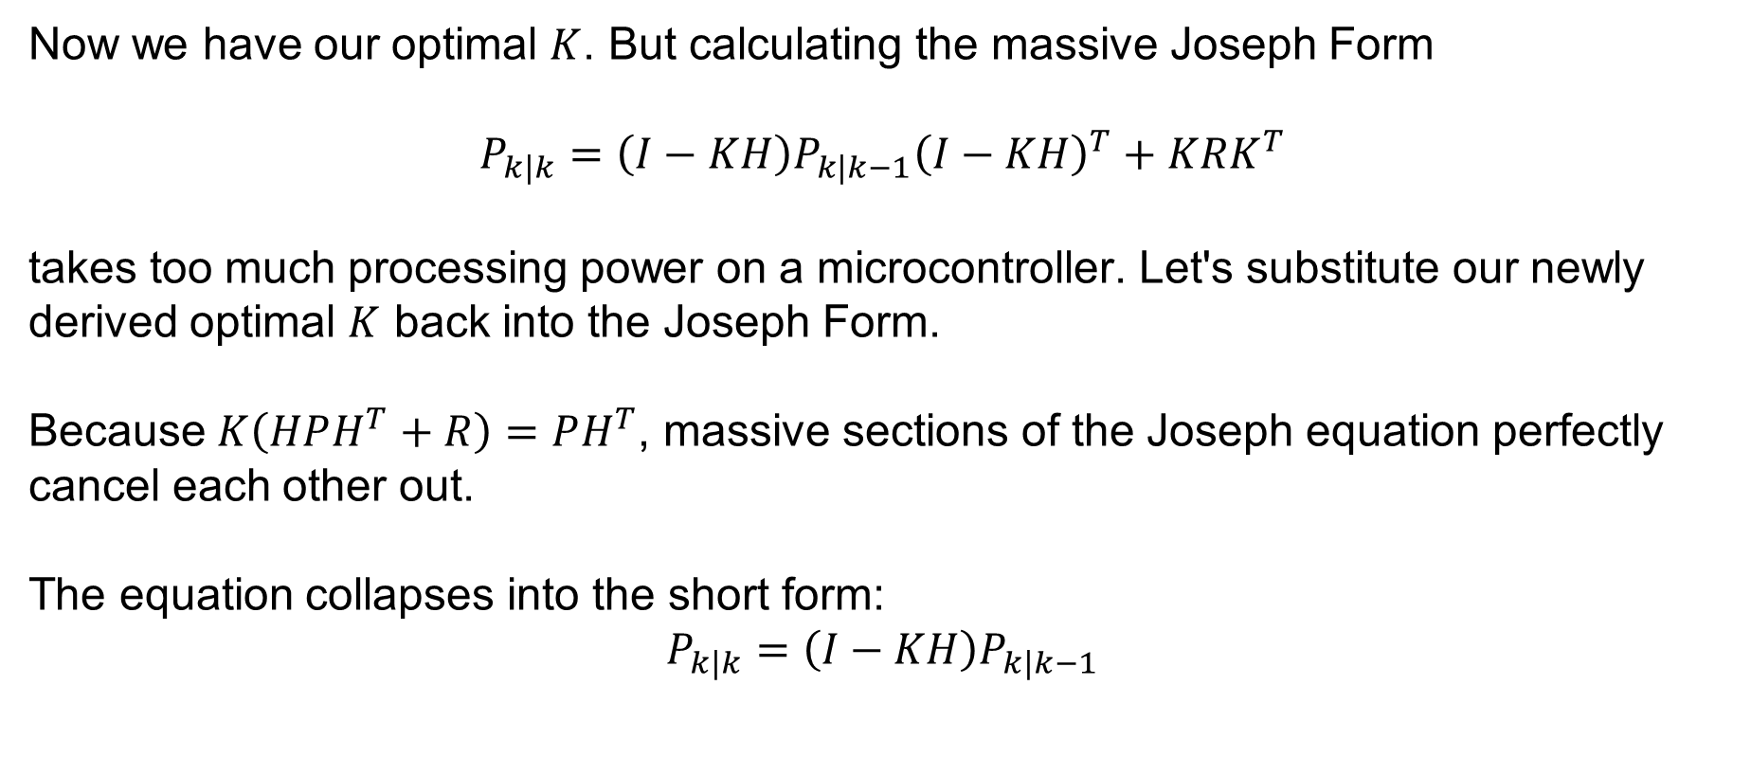
Sensor Fusion – Predict Step
Now we have our optimal $K$. But calculating the massive Joseph Form
$$P_{k|k}=\left(I−KH\right)P_{k|k−1}{\left(I−KH\right)}^{T}+KRK^{T}$$
takes too much processing power on a microcontroller. Let's substitute our newly derived optimal $K$ back into the Joseph Form.
Because $K\left(HPH^{T}+R\right)=PH^{T}$, massive sections of the Joseph equation perfectly cancel each other out.
The equation collapses into the short form:
$$P_{k|k}=\left(I−KH\right)P_{k|k−1}$$
SYSTEMS ENGINEERING
GRAINGER ENGINEERING

Slide 64
Kalman Filter Example
SYSTEMS ENGINEERING
GRAINGER ENGINEERING

Slide 65
Review – 5-minute partner discussion
Talk to the person next to you and answer these questions.
The Kalman Filter works as a 2 steps process, what are they called?
What are the conditions on the sensor / process noise?
What are the conditions imposed on the state transition of the system?
SYSTEMS ENGINEERING
GRAINGER ENGINEERING

Slide 66

Kalman Filter Example
Up to this point, we have looked at a lot of theoretical matrices: $F, H, P, Q, R$
But that is always difficult to understand. We will build a complete, multi-dimensional Kalman Filter from scratch for a simple robotic system!
Let’s go back to our previous autonomous train example from before!
SYSTEMS ENGINEERING
GRAINGER ENGINEERING

Slide 67
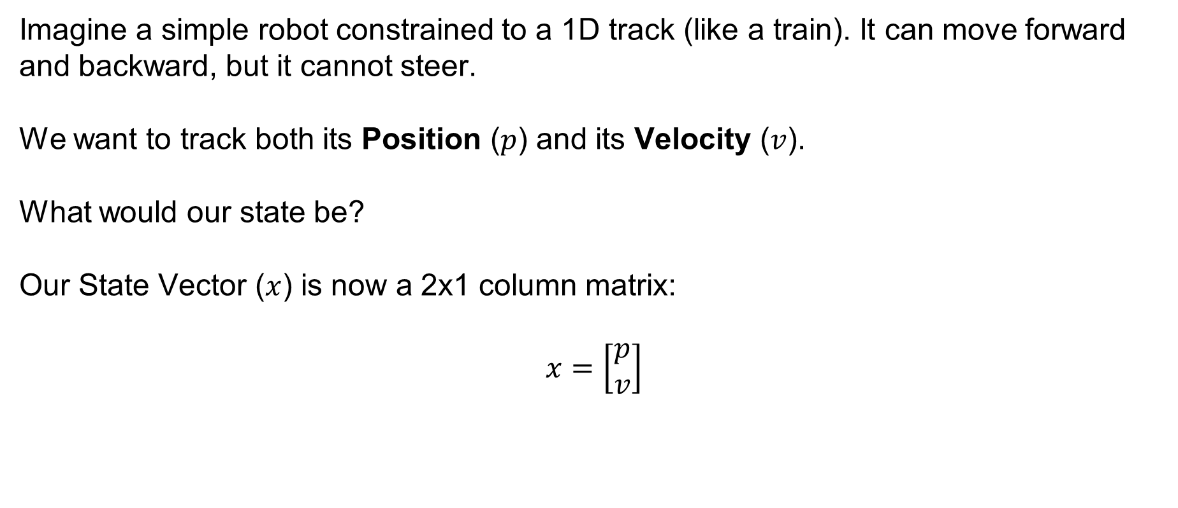
Kalman Filter Example
Imagine a simple robot constrained to a 1D track (like a train). It can move forward and backward, but it cannot steer.
We want to track both its Position ($p$) and its Velocity ($v$).
What would our state be?
Our State Vector ($x$) is now a 2x1 column matrix:
$$x=\left[\begin{matrix}p \\ v\end{matrix}\right]$$
SYSTEMS ENGINEERING
GRAINGER ENGINEERING

Slide 68
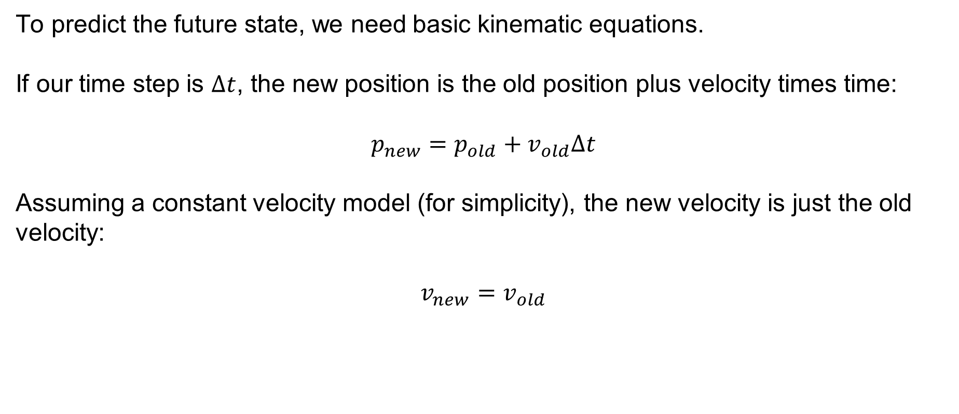
Kalman Filter Example
To predict the future state, we need basic kinematic equations.
If our time step is $Δt$, the new position is the old position plus velocity times time:
$$p_{new}=p_{old}+v_{old}Δt$$
Assuming a constant velocity model (for simplicity), the new velocity is just the old velocity:
$$v_{new}=v_{old}$$
SYSTEMS ENGINEERING
GRAINGER ENGINEERING

Slide 69
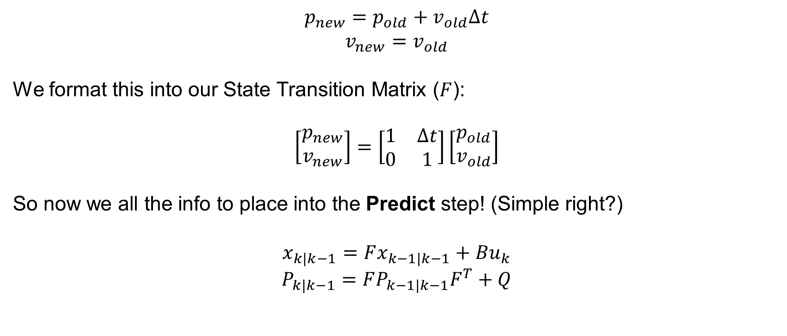
Kalman Filter Example
$$p_{new}=p_{old}+v_{old}Δt$$
$$v_{new}=v_{old}$$
We format this into our State Transition Matrix ($F$):
$$\left[\begin{matrix}p_{new} \\ v_{new}\end{matrix}\right]=\left[\begin{matrix}1 & Δt \\ 0 & 1\end{matrix}\right]\left[\begin{matrix}p_{old} \\ v_{old}\end{matrix}\right]$$
So now we all the info to place into the Predict step! (Simple right?)
$$x_{k|k−1}=Fx_{k−1|k−1}+Bu_{k}$$
$$P_{k|k−1}=FP_{k−1|k−1}F^{T}+Q$$
SYSTEMS ENGINEERING
GRAINGER ENGINEERING

Slide 70
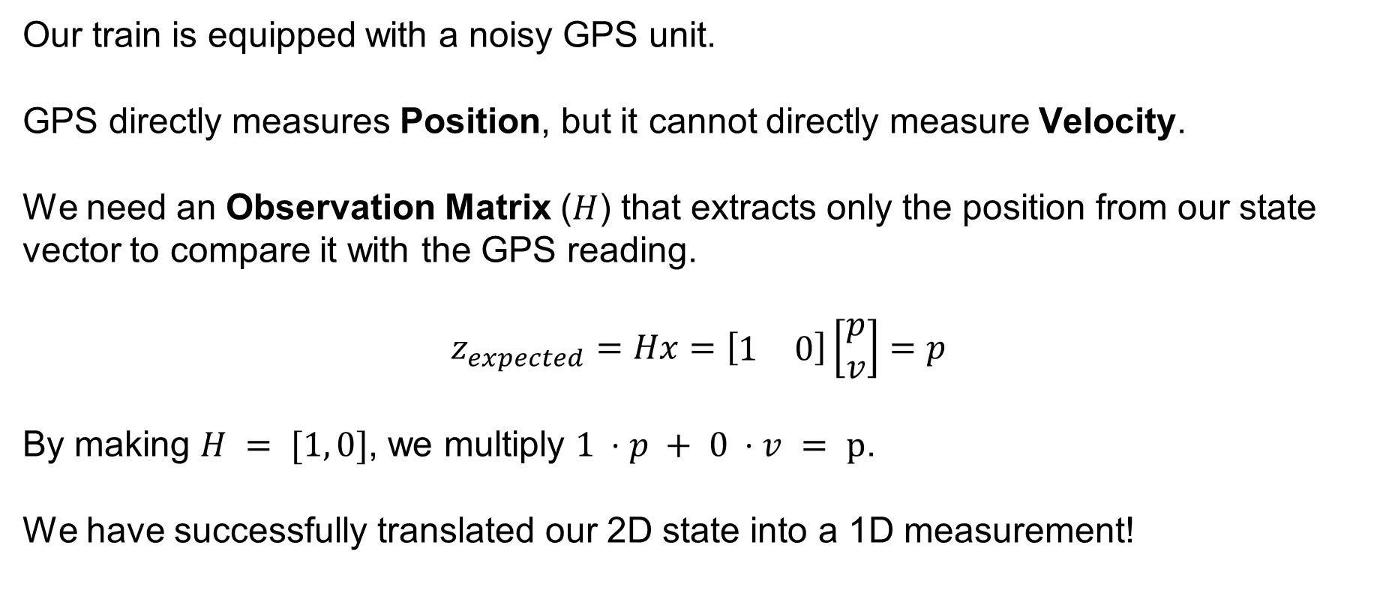
Kalman Filter Example
Our train is equipped with a noisy GPS unit.
GPS directly measures Position, but it cannot directly measure Velocity.
We need an Observation Matrix ($H$) that extracts only the position from our state vector to compare it with the GPS reading.
$$z_{expected}=Hx=\left[\begin{matrix}1 & 0\end{matrix}\right]\left[\begin{matrix}p \\ v\end{matrix}\right]=p$$
By making $H = [1, 0]$, we multiply $1 ⋅p + 0 ⋅v = p$.
We have successfully translated our 2D state into a 1D measurement!
SYSTEMS ENGINEERING
GRAINGER ENGINEERING

Slide 71
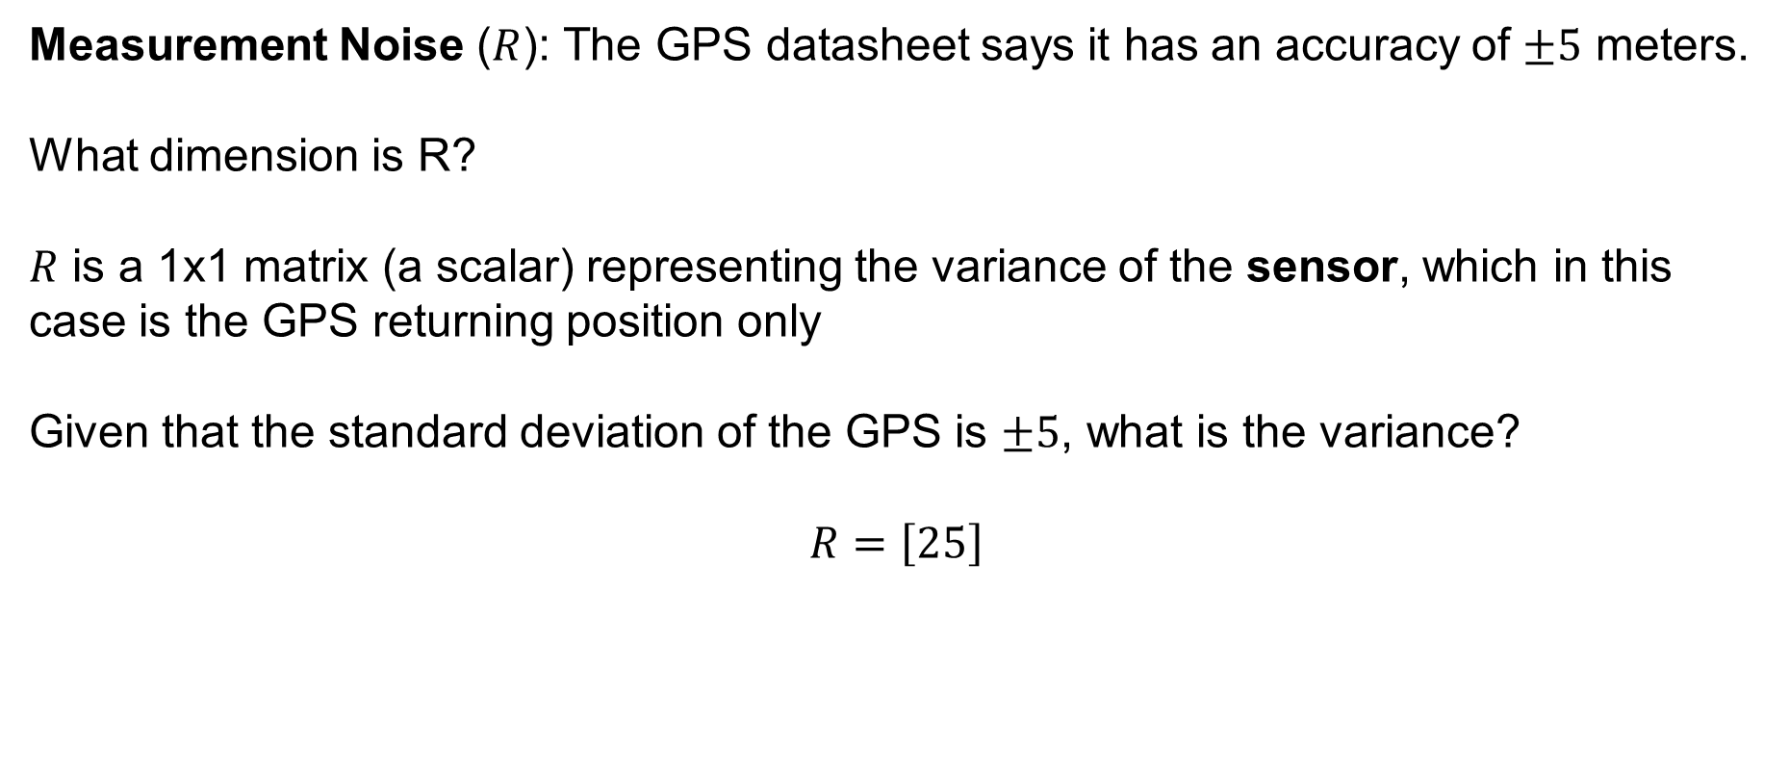
Kalman Filter Example
Measurement Noise ($R$): The GPS datasheet says it has an accuracy of $±5$ meters.
What dimension is R?
$R$ is a 1x1 matrix (a scalar) representing the variance of the sensor, which in this case is the GPS returning position only
Given that the standard deviation of the GPS is $±5$, what is the variance?
$$R=\left[25\right]$$
SYSTEMS ENGINEERING
GRAINGER ENGINEERING

Slide 72
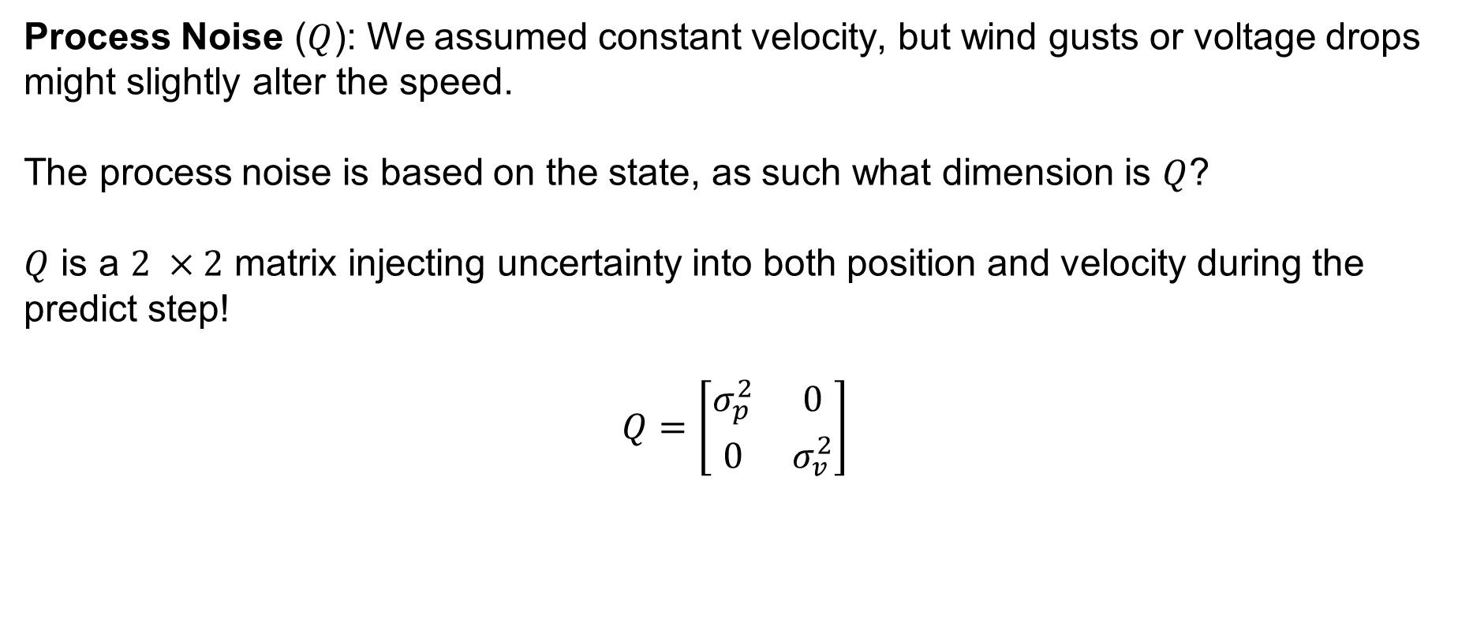
Kalman Filter Example
Process Noise ($Q$): We assumed constant velocity, but wind gusts or voltage drops might slightly alter the speed.
The process noise is based on the state, as such what dimension is $Q$?
$Q$ is a $2 ×2$ matrix injecting uncertainty into both position and velocity during the predict step!
$$Q=\left[\begin{matrix}σ_{p}^{2} & 0 \\ 0 & σ_{v}^{2}\end{matrix}\right]$$
SYSTEMS ENGINEERING
GRAINGER ENGINEERING

Slide 73
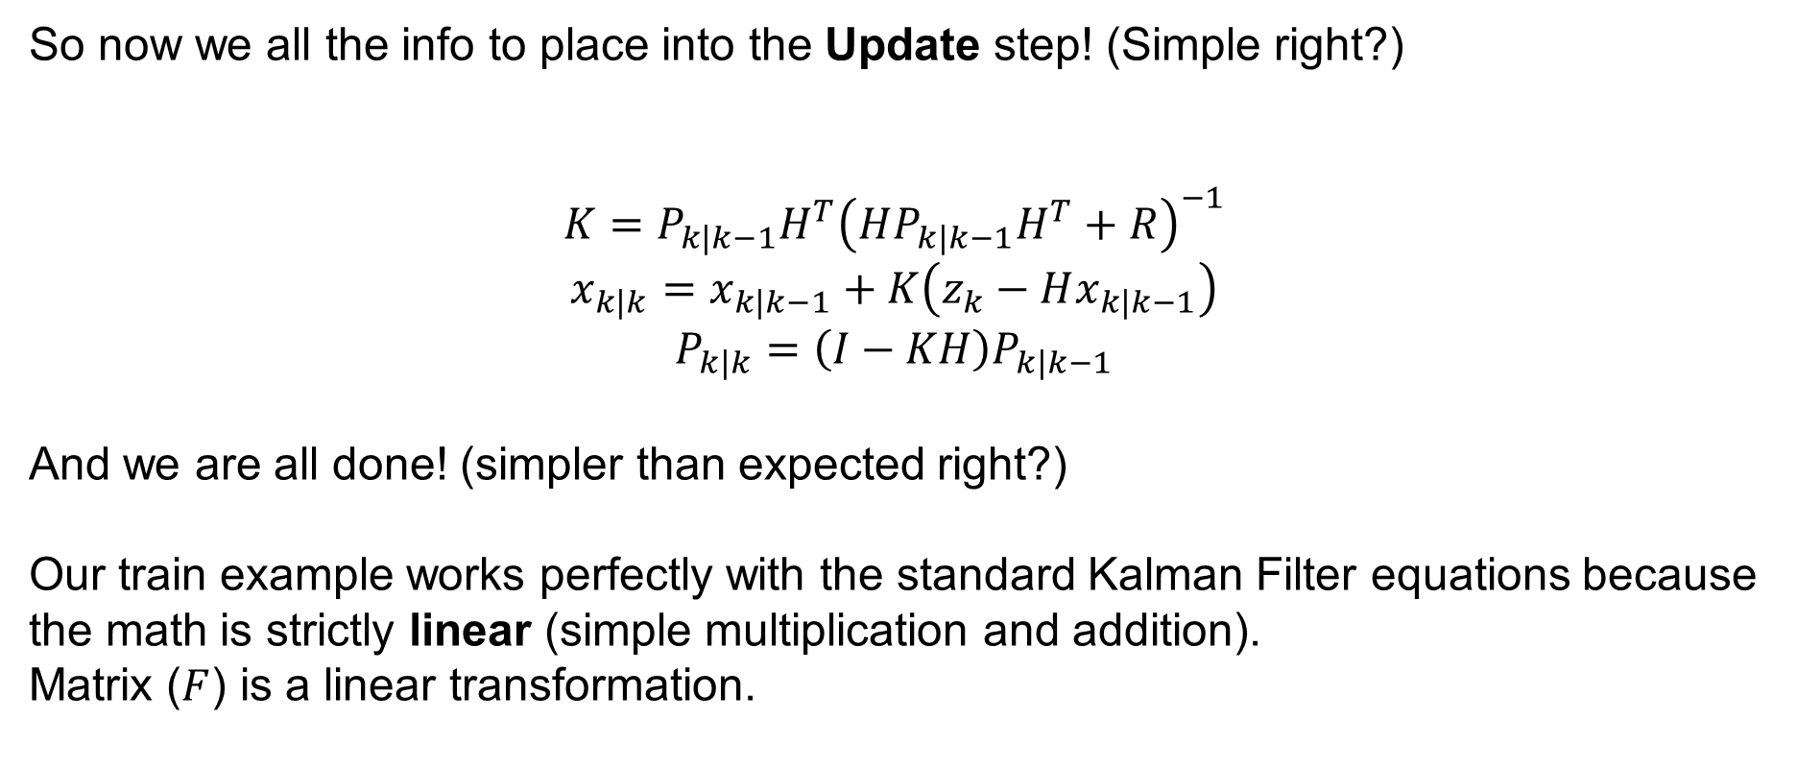
Kalman Filter Example
So now we all the info to place into the Update step! (Simple right?)
$$K=P_{k|k−1}H^{T}{\left(HP_{k|k−1}H^{T}+R\right)}^{−1}$$
$$x_{k|k}=x_{k|k−1}+K\left(z_{k}−Hx_{k|k−1}\right)$$
$$P_{k|k}=\left(I−KH\right)P_{k|k−1}$$
And we are all done! (simpler than expected right?)
Our train example works perfectly with the standard Kalman Filter equations because the math is strictly linear (simple multiplication and addition).
Matrix ($F$) is a linear transformation.
SYSTEMS ENGINEERING
GRAINGER ENGINEERING

Slide 74
Extended (Nonlinear) Kalman Filter
SYSTEMS ENGINEERING
GRAINGER ENGINEERING

Slide 75
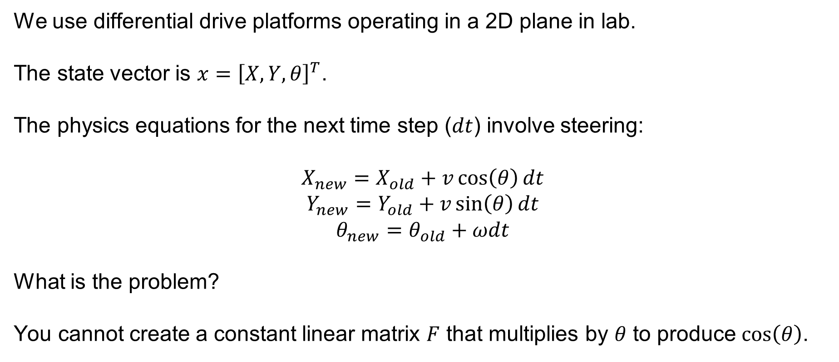
Extended Kalman Filter
We use differential drive platforms operating in a 2D plane in lab.
The state vector is $x={\left[X,Y,θ\right]}^{T}$.
The physics equations for the next time step ($dt$) involve steering:
$$X_{new}=X_{old}+v\cos\left(θ\right)dt$$
$$Y_{new}=Y_{old}+v\sin\left(θ\right)dt$$
$$θ_{new}=θ_{old}+ωdt$$
What is the problem?
You cannot create a constant linear matrix $F$ that multiplies by $θ$ to produce $\cos\left(θ\right)$.
SYSTEMS ENGINEERING
GRAINGER ENGINEERING

Slide 76
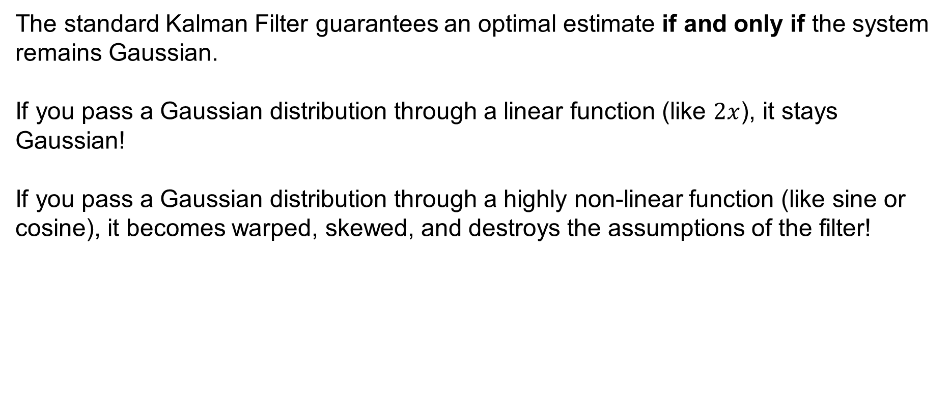
Extended Kalman Filter
The standard Kalman Filter guarantees an optimal estimate if and only if the system remains Gaussian.
If you pass a Gaussian distribution through a linear function (like $2x$), it stays Gaussian!
If you pass a Gaussian distribution through a highly non-linear function (like sine or cosine), it becomes warped, skewed, and destroys the assumptions of the filter!
SYSTEMS ENGINEERING
GRAINGER ENGINEERING

Slide 77
Extended Kalman Filter
SYSTEMS ENGINEERING
GRAINGER ENGINEERING

Slide 78
Extended Kalman Filter
SYSTEMS ENGINEERING
GRAINGER ENGINEERING

Slide 79
Extended Kalman Filter
To solve this, we introduce the Extended Kalman Filter (EKF)
The EKF uses the Taylor Series expansion to approximate the non-linear curves as flat lines right at our current operating point.
By zooming in incredibly close to the robot's current state, the curve looks like a straight line.
We use that temporary straight line (tangent) to update our uncertainty.
What calculus tool allows us to find these tangents?
Derivates (in this case Partial Derivatives)
SYSTEMS ENGINEERING
GRAINGER ENGINEERING

Slide 80
Extended Kalman Filter
SYSTEMS ENGINEERING
GRAINGER ENGINEERING

Slide 81
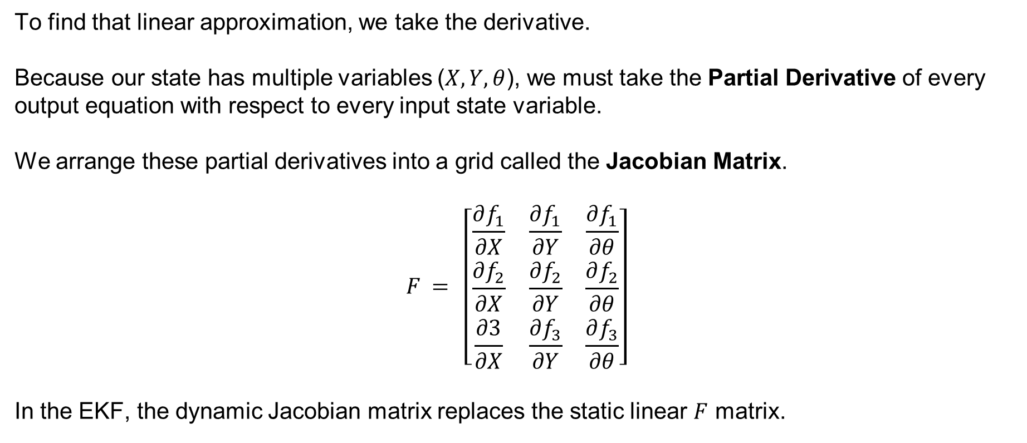
Extended Kalman Filter
To find that linear approximation, we take the derivative.
Because our state has multiple variables ($X, Y, θ$), we must take the Partial Derivative of every output equation with respect to every input state variable.
We arrange these partial derivatives into a grid called the Jacobian Matrix.
$$F = \left[\begin{matrix}\frac{∂f_{1}}{∂X} & \frac{∂f_{1}}{∂Y} & \frac{∂f_{1}}{∂θ} \\ \frac{∂f_{2}}{∂X} & \frac{∂f_{2}}{∂Y} & \frac{∂f_{2}}{∂θ} \\ \frac{∂3}{∂X} & \frac{∂f_{3}}{∂Y} & \frac{∂f_{3}}{∂θ}\end{matrix}\right]$$
In the EKF, the dynamic Jacobian matrix replaces the static linear $F$ matrix.
SYSTEMS ENGINEERING
GRAINGER ENGINEERING

Slide 82
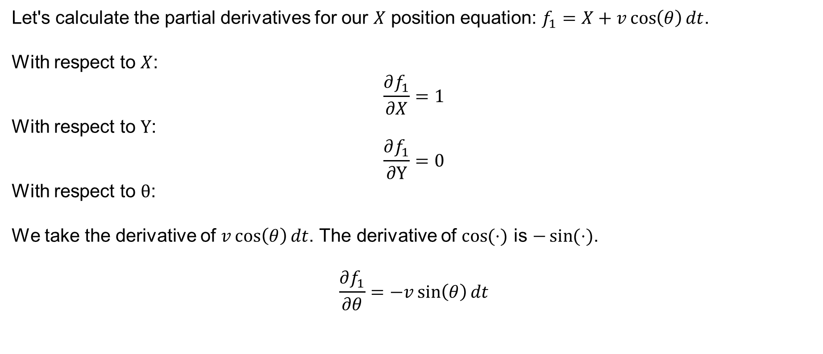
Extended Kalman Filter
Let's calculate the partial derivatives for our $X$ position equation: $f_{1}=X+v\cos\left(θ\right)dt$.
With respect to $X$:
$$\frac{∂f_{1}}{∂X}=1$$
With respect to $Y$:
$$\frac{∂f_{1}}{∂Y}=0$$
With respect to $θ$:
We take the derivative of $v\cos\left(θ\right)dt$. The derivative of $\cos{(⋅)}$ is $−\sin{(⋅)}$.
$$\frac{∂f_{1}}{∂θ}=−v\sin\left(θ\right)dt$$
SYSTEMS ENGINEERING
GRAINGER ENGINEERING

Slide 83

Extended Kalman Filter
Let's calculate the partial derivatives for our $Y$ position equation: $f_{2}=Y+v\sin\left(θ\right)dt$.
With respect to $X$:
$$\frac{∂f_{2}}{∂X}=0$$
With respect to $Y$:
$$\frac{∂f_{2}}{∂Y}=1$$
With respect to $θ$:
We derive $v\sin\left(θ\right)dt$. The derivative of $\sin{(⋅)}$ is $\cos{ (⋅)}$.
$$\frac{∂f_{2}}{∂θ}=v\cos\left(θ\right)dt$$
SYSTEMS ENGINEERING
GRAINGER ENGINEERING

Slide 84
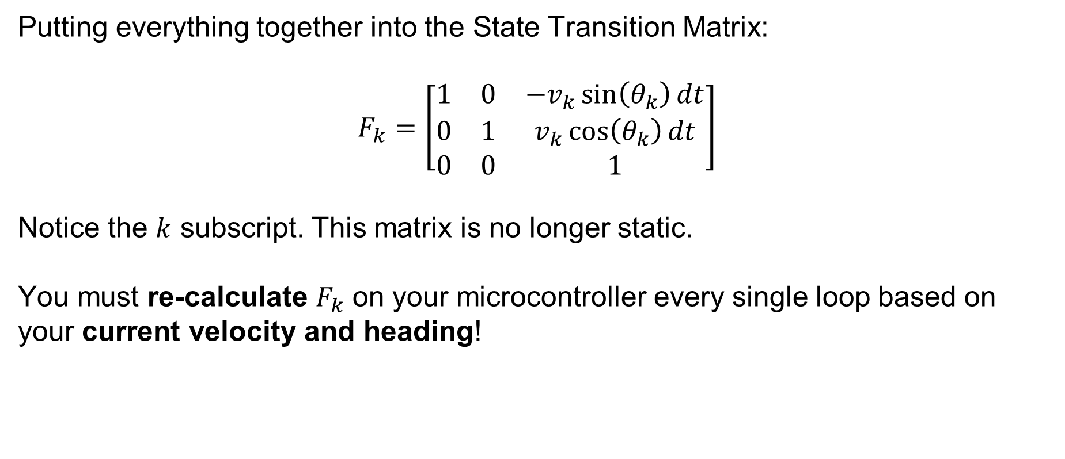
Extended Kalman Filter
Putting everything together into the State Transition Matrix:
$$F_{k}=\left[\begin{matrix}1 & 0 & −v_{k}\sin\left(θ_{k}\right)dt \\ 0 & 1 & v_{k}\cos\left(θ_{k}\right)dt \\ 0 & 0 & 1\end{matrix}\right]$$
Notice the $k$ subscript. This matrix is no longer static.
You must re-calculate $F_{k}$ on your microcontroller every single loop based on your current velocity and heading!
SYSTEMS ENGINEERING
GRAINGER ENGINEERING

Slide 85
Predict
SYSTEMS ENGINEERING
GRAINGER ENGINEERING

Slide 86
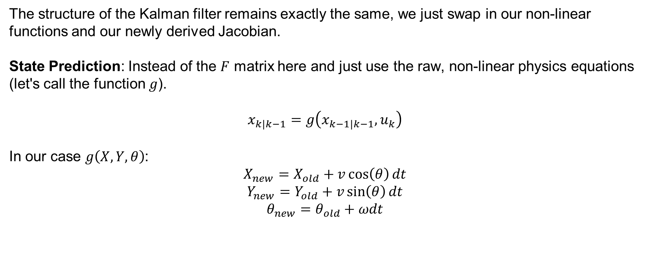
Extended Kalman Filter
The structure of the Kalman filter remains exactly the same, we just swap in our non-linear functions and our newly derived Jacobian.
State Prediction: Instead of the $F$ matrix here and just use the raw, non-linear physics equations (let's call the function $g$).
$$x_{k|k−1}=g\left(x_{k−1|k−1},u_{k}\right)$$
In our case $g\left(X,Y,θ\right)$:
$$X_{new}=X_{old}+v\cos\left(θ\right)dt$$
$$Y_{new}=Y_{old}+v\sin\left(θ\right)dt$$
$$θ_{new}=θ_{old}+ωdt$$
SYSTEMS ENGINEERING
GRAINGER ENGINEERING

Slide 87

Extended Kalman Filter
Covariance Prediction: We use our calculated Jacobian $F_{k}$ to warp the uncertainty ellipse properly.
$$P_{k|k−1}=F_{k}P_{k−1|k−1}F_{k}^{T}+Q$$
What dimension is Q in our nonlinear case?
SYSTEMS ENGINEERING
GRAINGER ENGINEERING

Slide 88
Extended Kalman Filter
SYSTEMS ENGINEERING
GRAINGER ENGINEERING

Slide 89
Update
SYSTEMS ENGINEERING
GRAINGER ENGINEERING

Slide 90

Extended Kalman Filter
The same logic applies to sensors.
If a sensor measurement is non-linear (like a radar measuring angle and distance), we use the non-linear measurement function $h$ to predict the measurement, and a sensor Jacobian $H_{k}$ to calculate the gain.
SYSTEMS ENGINEERING
GRAINGER ENGINEERING

Slide 91

Extended Kalman Filter
Let's say our robot is being tracked by a stationary radar tower located at the origin $\left(0,0\right)$
The radar doesn't measure $X$ and $Y$ coordinates. It outputs a measurement vector $z$ containing two values: distance ($r$) and bearing angle ($φ$).
$$z=\left[\begin{matrix}r \\ φ\end{matrix}\right]$$
SYSTEMS ENGINEERING
GRAINGER ENGINEERING

Slide 92

Extended Kalman Filter
During the Predict Step, we need to guess what the radar should see based on our internal belief of where we are (try to guess the radar measurement).
We use geometry to map our state space into sensor space. This is our non-linear measurement function, $h\left(x\right)$:
$$r=\sqrt{X^{2}+Y^{2}}$$
$$φ=\arctan\left(\frac{Y}{X}\right)$$
Just like kinematics, we cannot express this as a linear matrix multiplication. We must use Jacobians to linearize it!
SYSTEMS ENGINEERING
GRAINGER ENGINEERING

Slide 93

Extended Kalman Filter
We must take the partial derivatives of $r$ and $φ$ with respect to our state variables ($X, Y, θ$).
Let's look at the distance equation: $r=\sqrt{X^{2}+Y^{2}}$
Using the chain rule:
With respect to $X$: $\frac{∂r}{∂X}=\frac{X}{\sqrt{X^{2}+Y^{2}}}=\frac{X}{r}$
With respect to $Y: \frac{∂r}{∂Y}=\frac{Y}{\sqrt{X^{2}+Y^{2}}}=\frac{Y}{r}$
With respect to $θ: \frac{∂r}{∂θ}=0$
SYSTEMS ENGINEERING
GRAINGER ENGINEERING

Slide 94

Extended Kalman Filter
Now the bearing equation: $φ=\arctan\left(Y/X\right)$.
The derivative of $\arctan\left(u\right)is\frac{1}{1+u^{2}}⋅u^{′}$.
After some algebra:
With respect to $X$: $\frac{∂φ}{∂X}=−\frac{Y}{X^{2}+Y^{2}}=−\frac{Y}{r^{2}}$
With respect to $Y$: $\frac{∂φ}{∂Y}=\frac{X}{X^{2}+Y^{2}}=\frac{X}{r^{2}}$
With respect to $θ$: $\frac{∂φ}{∂θ}=0$
SYSTEMS ENGINEERING
GRAINGER ENGINEERING

Slide 95

Extended Kalman Filter
We assemble our partial derivatives into a $2 ×3$ matrix (2 measurement outputs, 3 state variables).
This is our dynamic $H_{k}$ matrix for the current time step:
$$H_{k}=\left[\begin{matrix}\frac{X}{r} & \frac{Y}{r} & 0 \\ & & \\ −\frac{Y}{r^{2}} & \frac{X}{r^{2}} & 0\end{matrix}\right]$$
We calculate this exact matrix every single loop using our predicted $X$ and $Y$ values.
SYSTEMS ENGINEERING
GRAINGER ENGINEERING

Slide 96

Extended Kalman Filter
Now that we have our non-linear $h\left(x\right)$ and our linear Jacobian $H_{k}$, we execute the EKF Update step:
1. Calculate Kalman Gain:
$$K_{k}=P_{kk−1}H_{k}^{T}{\left(H_{k}P_{kk−1}H_{k}^{T}+R\right)}^{−1}$$
2. Correct the State: (Notice we use $h\left(x\right)$ to calculate the residual, not $H_{k}$!)
$$x_{k|k}=x_{k|k−1}+K_{k}\left(z_{measured}−\left[\begin{matrix}\sqrt{X^{2}+Y^{2}} \\ \arctan\left(Y/X\right)\end{matrix}\right]\right)$$
3. Shrink Covariance:
$$P_{kk}=\left(I−K_{k}H_{k}\right)P_{kk−1}$$
SYSTEMS ENGINEERING
GRAINGER ENGINEERING

Slide 97
Extended Kalman Filter
And that’s it! That’s the extended Kalman filter!
There are more complex filters out there such as Particle Filters, Unscented filters, Lie Group Kalman Filters.
But all they are trying to do is improve the estimate of the non-linearity in the system!
Everything else is the same, they all have update and predict steps!
SYSTEMS ENGINEERING
GRAINGER ENGINEERING

Slide 98
Extended Kalman Filter
SYSTEMS ENGINEERING
GRAINGER ENGINEERING

Slide 99
Questions?
SYSTEMS ENGINEERING
GRAINGER ENGINEERING

Slide 100


