Slide 1
Doubly Linked List
CS 300 – Data Structures
By Marius Popescu

Slide 2
Node for a doubly linked list (Link)
A node contains:
data: one or more data fields - may be organized as structure, object, etc.
a pointer that can point to the next node
A pointer to the previous node
Pointer
Data
Pointer

Slide 3
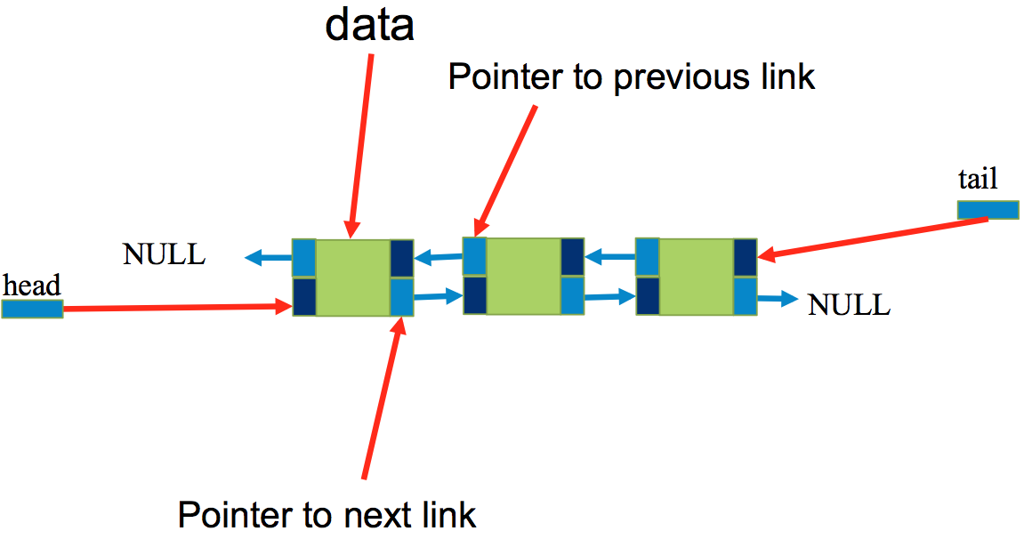
Doubly Linked List

Slide 4
Advantages
Doubly Linked lists are a dynamic data structure, allocating the needed memory while the program is running.
Insertion and deletion node operations are easily implemented in a doubly linked list.
Linear data structures such as stacks and queues are easily executed with a doubly linked list.
They can reduce access time and may expand in real time without memory overhead.

Slide 5
Disadvantages
They have a tendency to use more memory due to pointers requiring extra storage space.
Nodes in a linked list must be read in order from the beginning as linked lists are inherently sequential access.
Nodes are not stored contiguously, greatly increasing the time required to access individual elements within the list.
Difficulties arise in linked lists when it comes to reverse traversing. For instance, singly linked lists are cumbersome to navigate backwards and while doubly linked lists are somewhat easier to read, memory is wasted in allocating space for a back pointer.

Slide 6
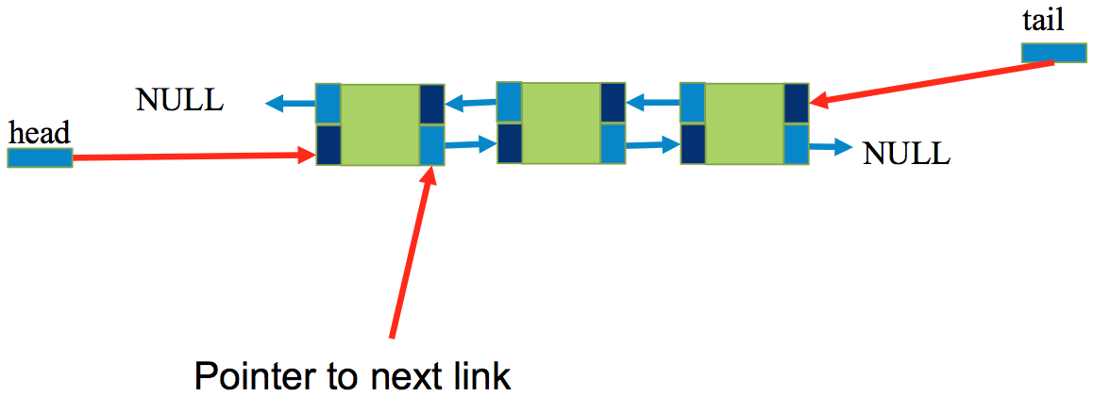
Append:

Slide 7
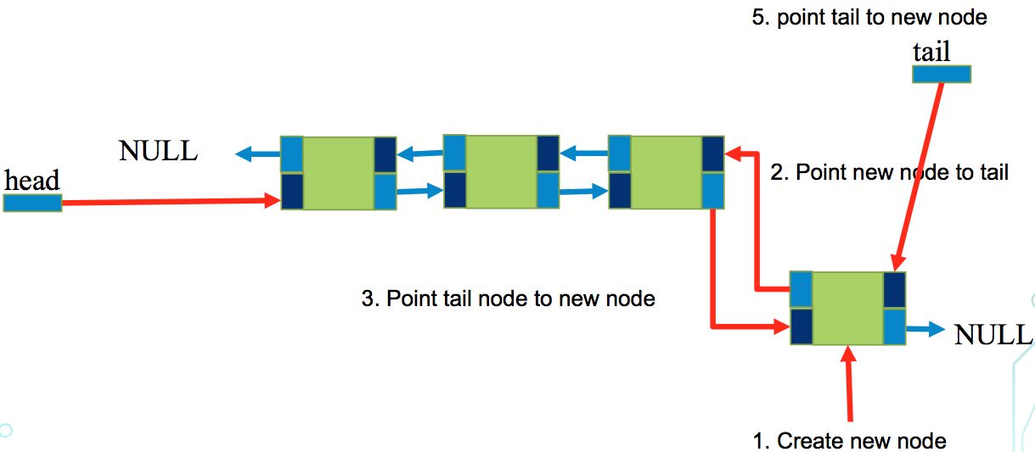
Append:

Slide 8
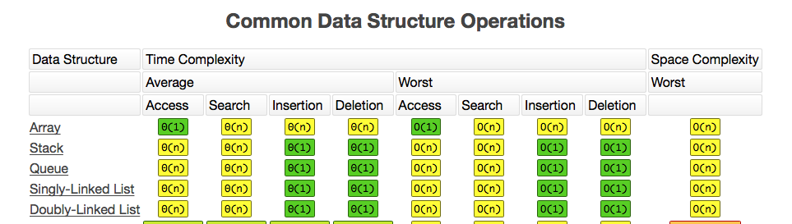
Doubly Linked List complexity is O(n)

Slide 9
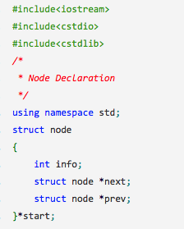
Doubly Linked Lists Implementation

Slide 10
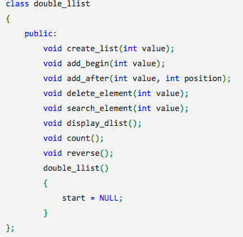

Slide 11
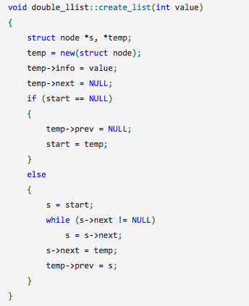

Slide 12
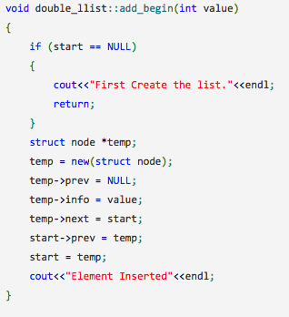

Slide 13
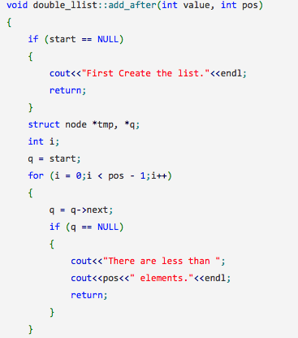

Slide 14
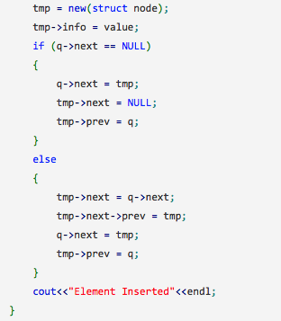

Slide 15
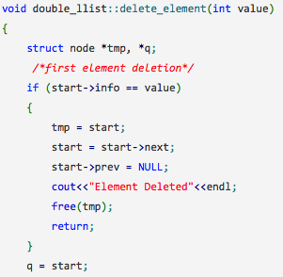

Slide 16
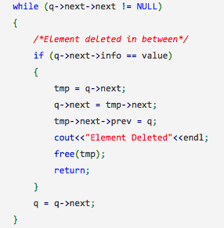

Slide 17
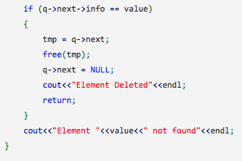

Slide 18
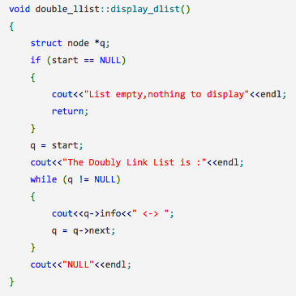

Slide 19
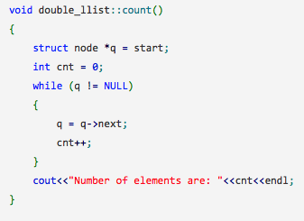

Slide 20
