Slide 1
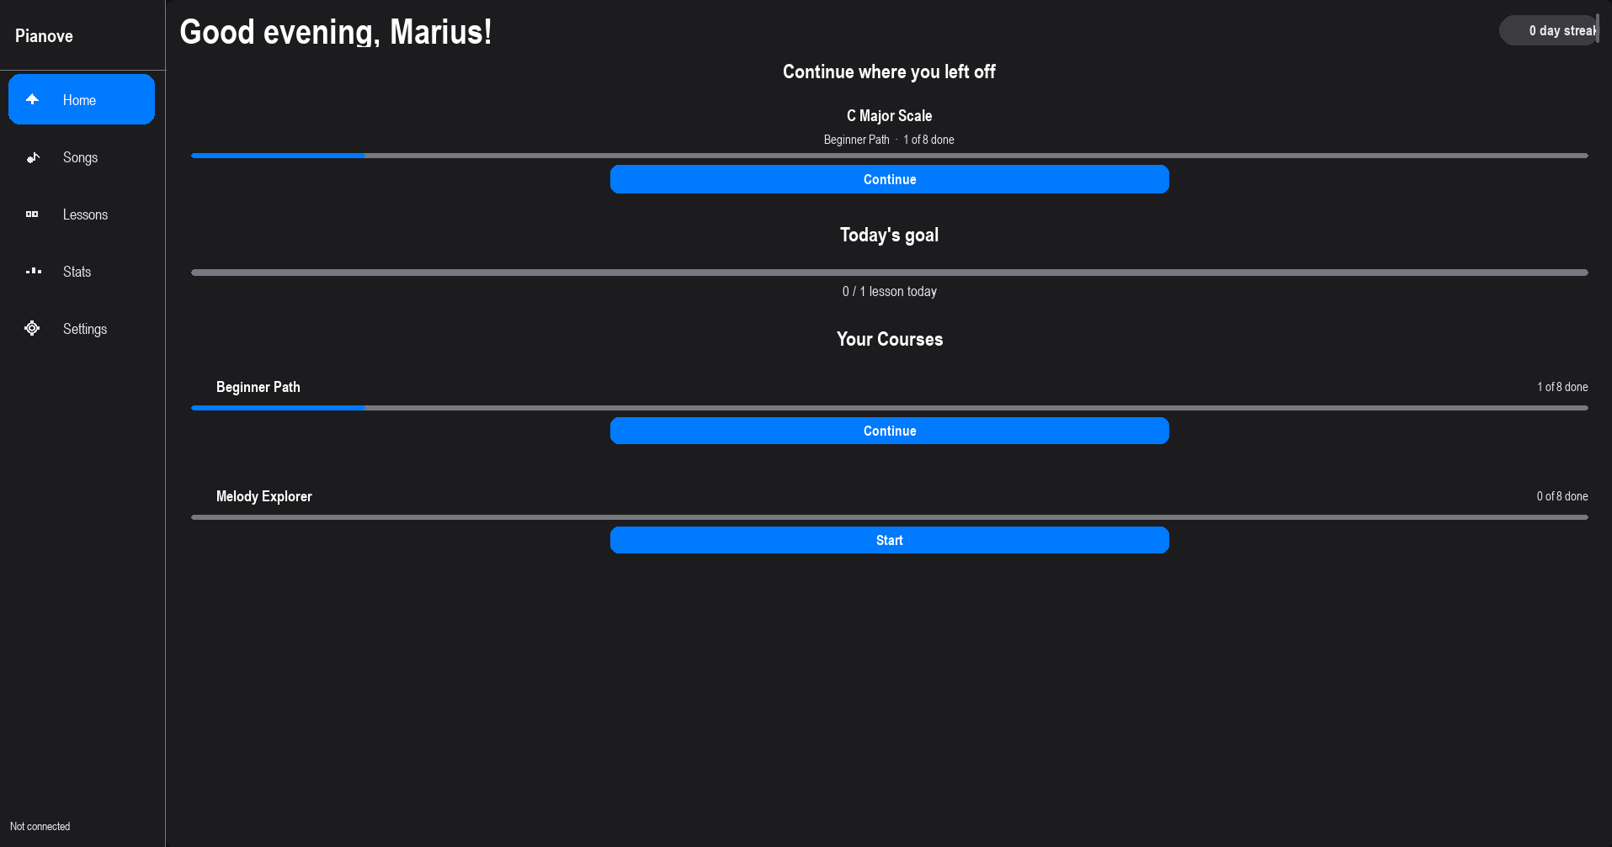
FSFE · YOUTH HACKING FOR FREEDOM 2026
Pianove
Free, open-source piano learning software.
No account. No subscription. Entirely offline.
Marius Angermann
Notes:
Intro + one-liner. Free, open-source, offline piano app. Two libraries built from scratch: PyLute (notation), PyLay (UI). Personal project, grew into three open-source releases.

Slide 2
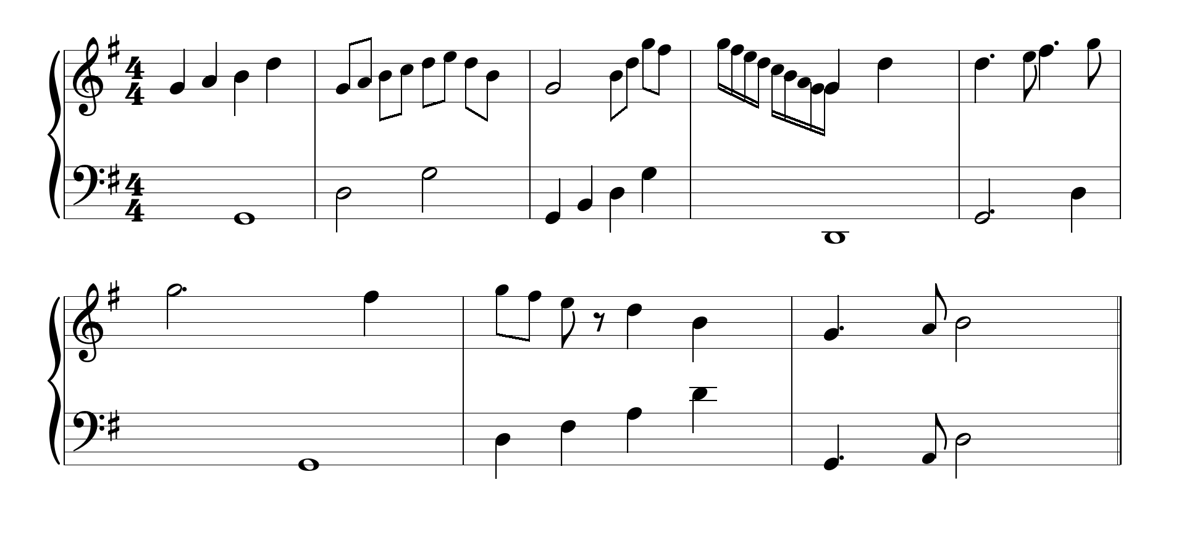
01 · THE SPARK
A fun challenge, first
• Learning piano. Live on MuseScore browsing sheet music.
• One question stuck: could I render this myself, in code?
• Constraint: pygame only. No web stack, no notation engine to lean on.
• Result: PyLute. Parses MusicXML, renders proportional sheet music, any surface, any size.
Pianove · YH4F 2026
2
Notes:
Side project, no bigger plan at first. Pygame chosen on purpose: no existing engine to lean on. Had to build everything myself: clefs, key sigs, beams, ties, dynamics, spacing.

Slide 3
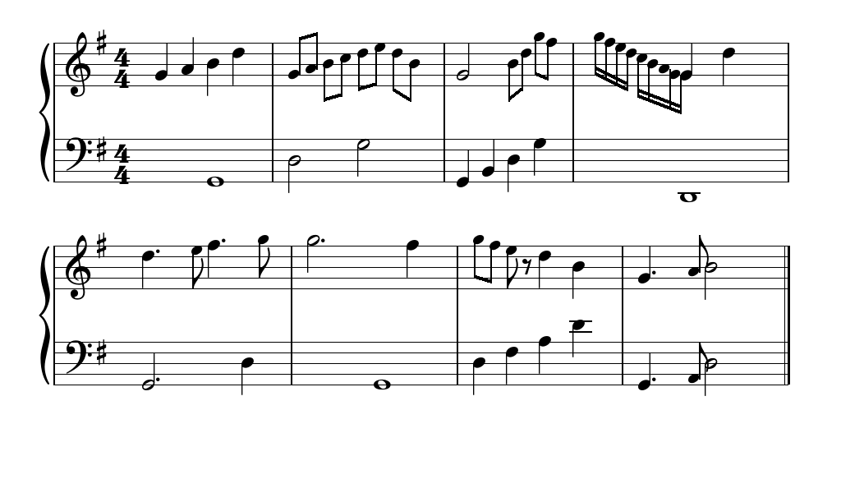
PYLUTE
MusicXML → sheet music, in pygame
• Parses standard MusicXML (.xml, .musicxml, .mxl)
• Renders clefs, key signatures, beams, ties, dynamics, articulations
• Bravura SMuFL font, bundled in the package
• Draws to any pygame surface, any size. Fully independent of Pianove
import pylute
score = pylute.load_musicxml("piece.xml", surface=screen)
score.draw()
Pianove · YH4F 2026
3
Notes:
Standalone library, doesn't know Pianove exists. Pip-installable on its own once published. Hardest technical piece: proportional notation layout from raw MusicXML.

Slide 4
02 · THE PROBLEM
Then I wanted to practice for free. Forever.
• Simply Piano, Flowkey, Playground: well-built. All subscription-based, fixed song library.
• Don't offer the piece you want? Too bad.
• I wanted any piece I could find as a MusicXML file. Free, forever. And the hard part, the renderer, was already built.
“What if I built my own app on top of PyLute and made it completely free?”
Pianove · YH4F 2026
4
Notes:
The pivot: renderer experiment becomes an app ambition. Renderer already done. But an app needs a real UI. That's the next problem.

Slide 5
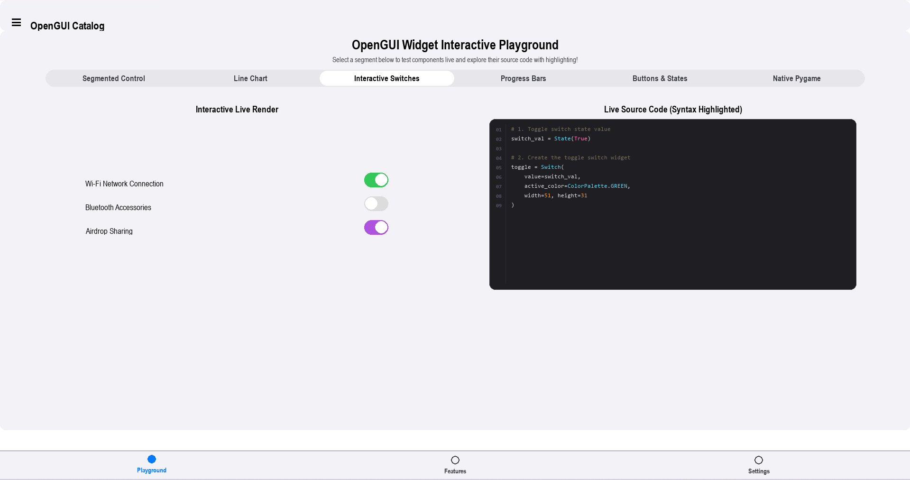
03 · THE UI PROBLEM
Pygame UI looks like it's from 2004
• pygame_gui, thorpy, pgzero exist. They work.
• But they all look the same. Flat grey, harsh borders, no animation, no cohesion.
• I wanted a modern desktop feel. Smooth, rounded, physical.
• Nothing came close, so I built one from scratch: PyLay (“lay” as in layout).
Pianove · YH4F 2026
5
Notes:
Second library, forced by necessity. Evaluated existing pygame UI options, none hit the bar. Built PyLay: iOS-inspired, theming, spring-physics animation, reactive layout.

Slide 6
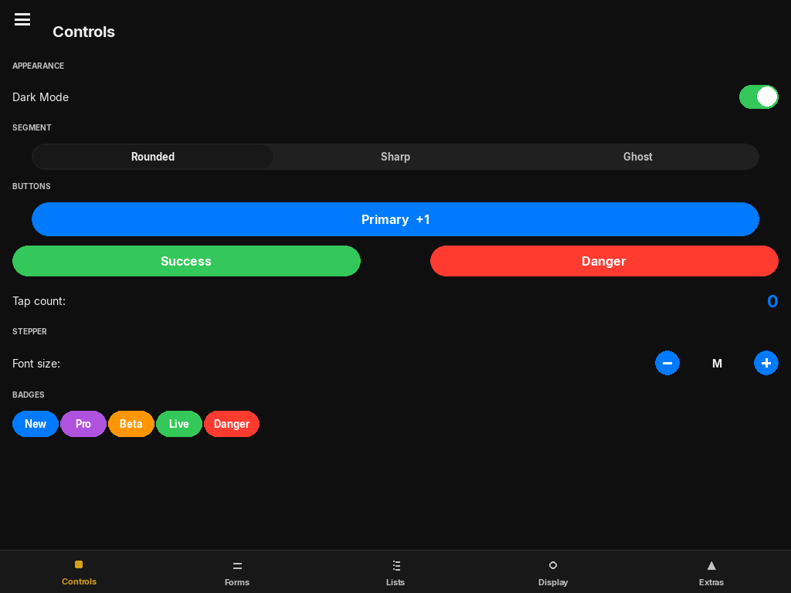
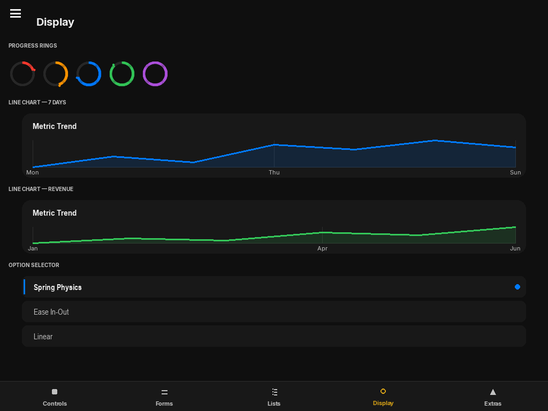
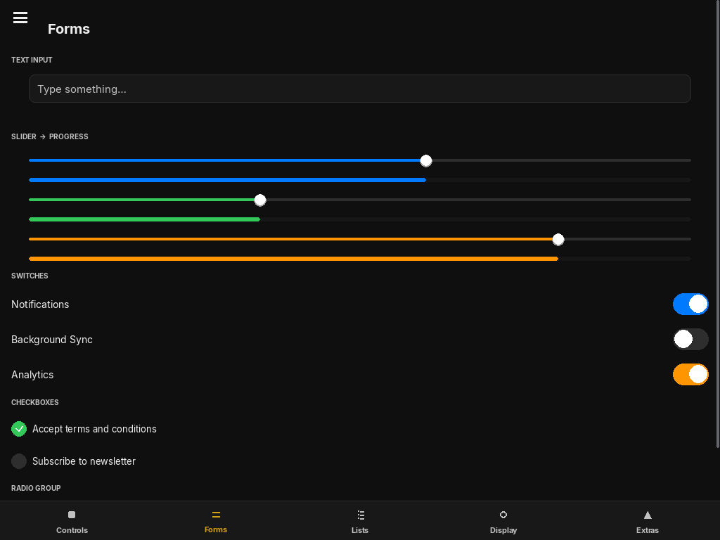
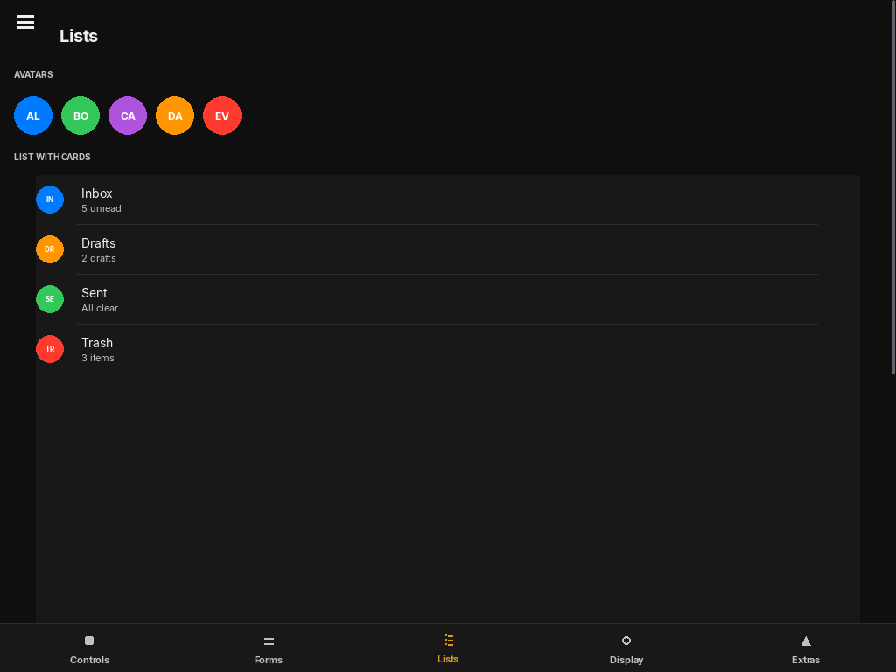
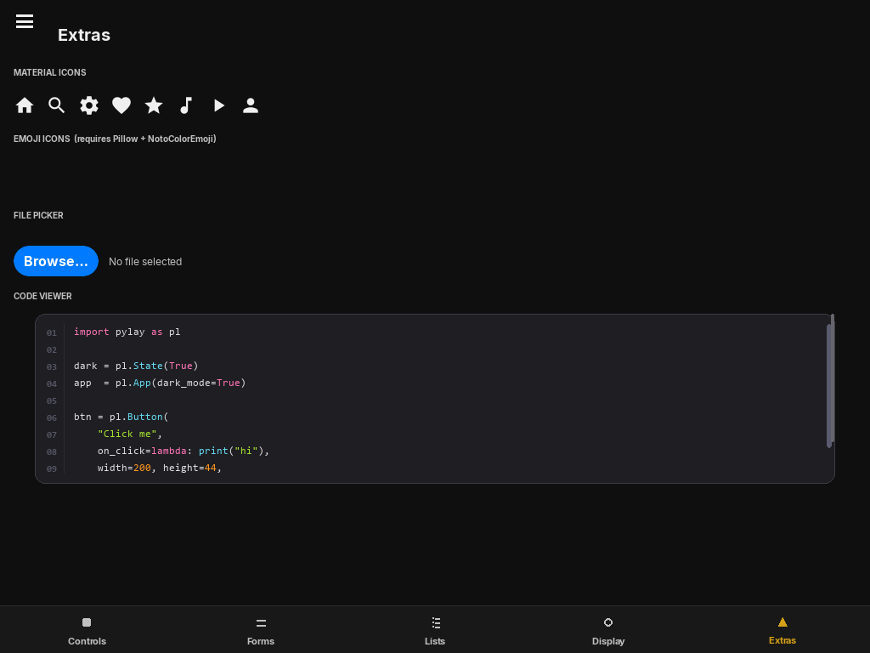
PYLAY
A complete UI framework for pygame
29 Widgets
Button, Switch, Slider, TextField, SegmentedControl, LineChart, FilePicker, more.
Physics Animations
Spring-based, velocity-damped. Buttons bounce. Panels slide with weight.
Reactive Layout
Rescales on window resize. Fractional sizing, flex-like stacks.
Theming System
Full dark/light iOS-style colour system, every screen.
Observable State
Bind callbacks. UI rebuilds itself, no manual re-render.
Page Router
Animated transitions, navigation history. Drawers, bottom nav.
Pianove · YH4F 2026
6
Notes:
Biggest engineering investment of the three. Own layout engine, spring animation, theming. Makes Pianove feel like a real app, not a pygame demo. Live demo: the 29-widget test file if the jury wants to see it.

Slide 7
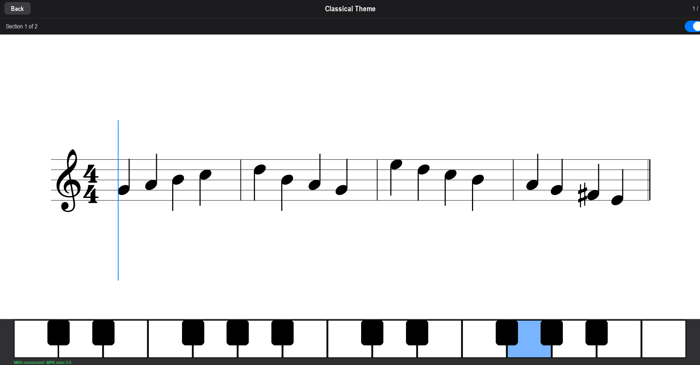
04 · EVERYTHING COMES TOGETHER
Pianove
• PyLute renders the sheet music. PyLay provides the interface. Together: a full piano app.
• Real-time MIDI input. Shows the notes to play, tracks accuracy, guides through lessons. Fully offline.
• Any MusicXML file. Any song. Permanently free.
Pianove · YH4F 2026
7
Notes:
Payoff slide, the two libraries become the product. Emphasize real-time MIDI: live feedback against the score as you play.

Slide 8
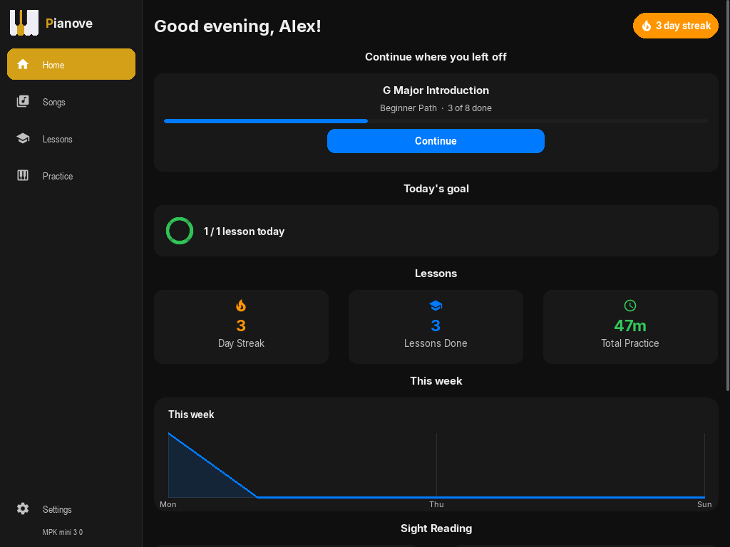
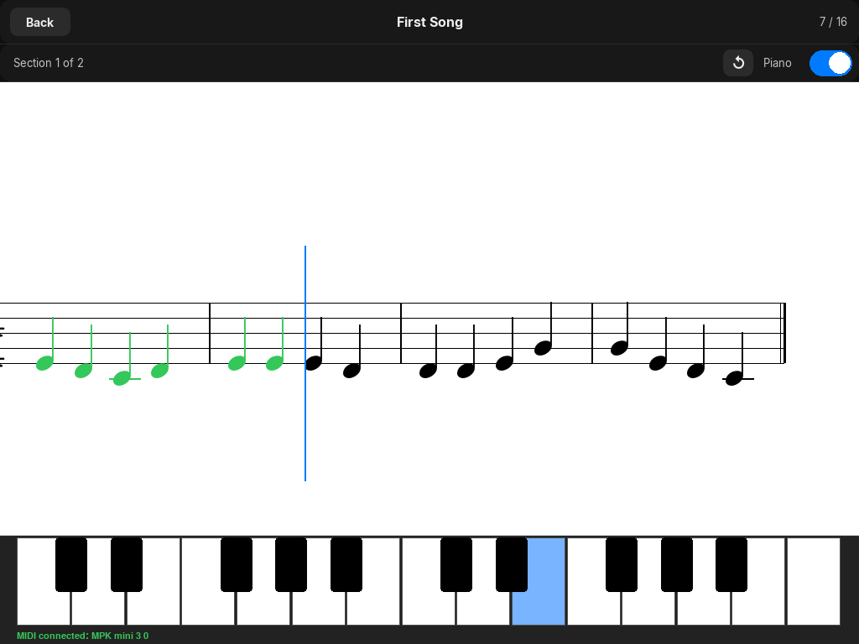
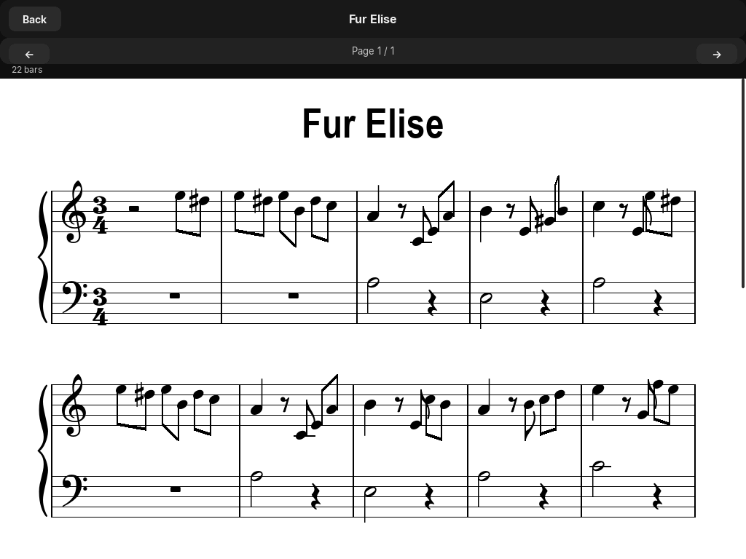
PRODUCT WALKTHROUGH
Home · Lessons · Any song
Home dashboard, streaks & stats
Structured lesson in progress
Import & play any MusicXML file
• 16 built-in lessons · Progress tracking & streaks · Built-in synthesiser, GeneralUser GS soundfont bundled
Pianove · YH4F 2026
8
Notes:
Walk through the product: dashboard, an active lesson with live keyboard feedback, and the import screen. Any MusicXML file works, not just the 16 built-in lessons.

Slide 9
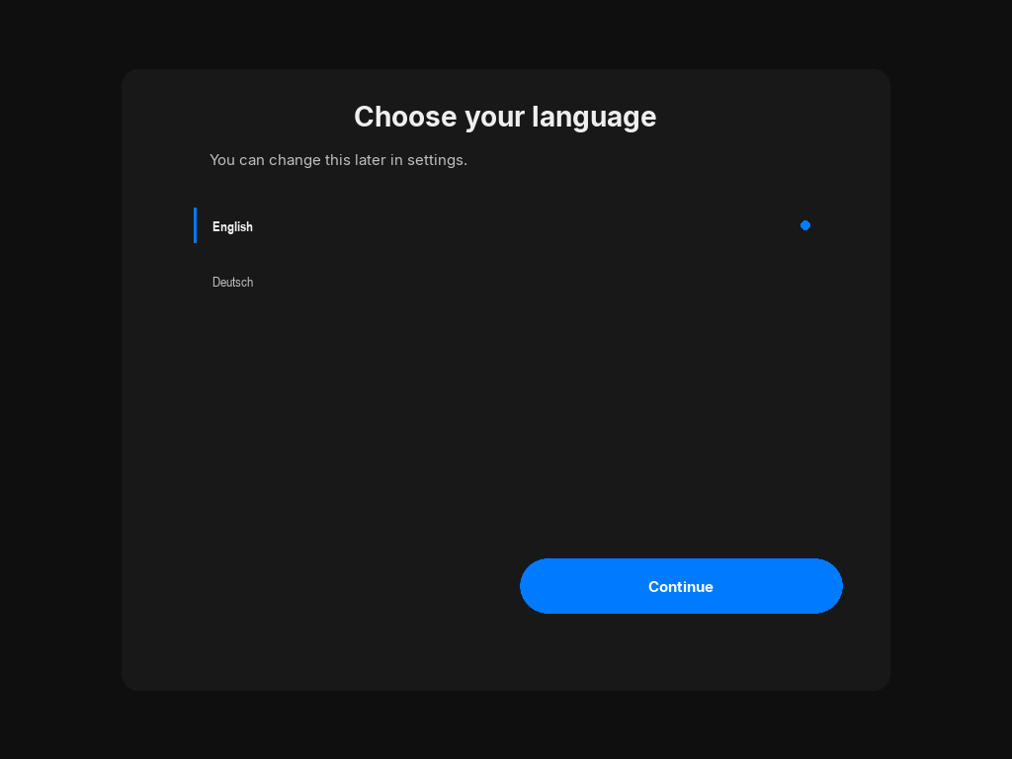
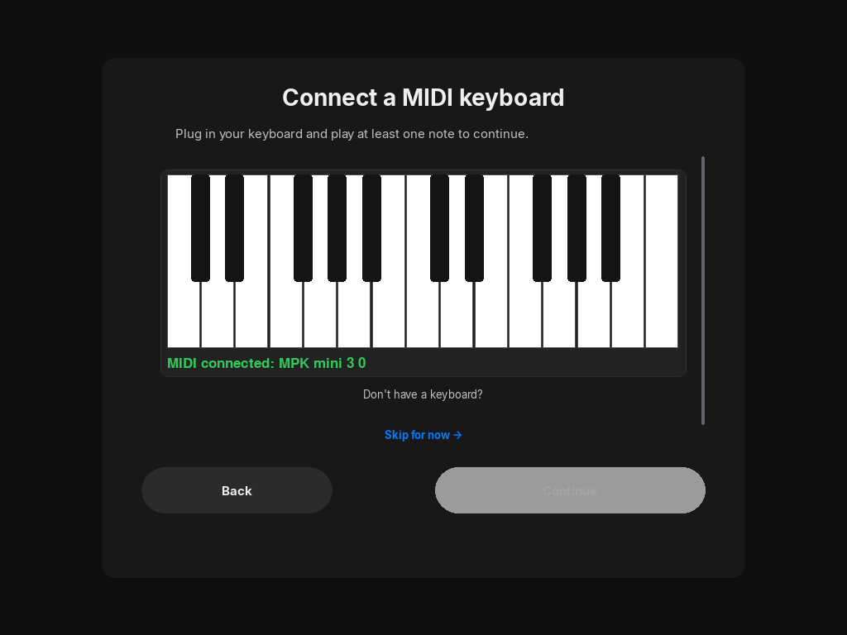
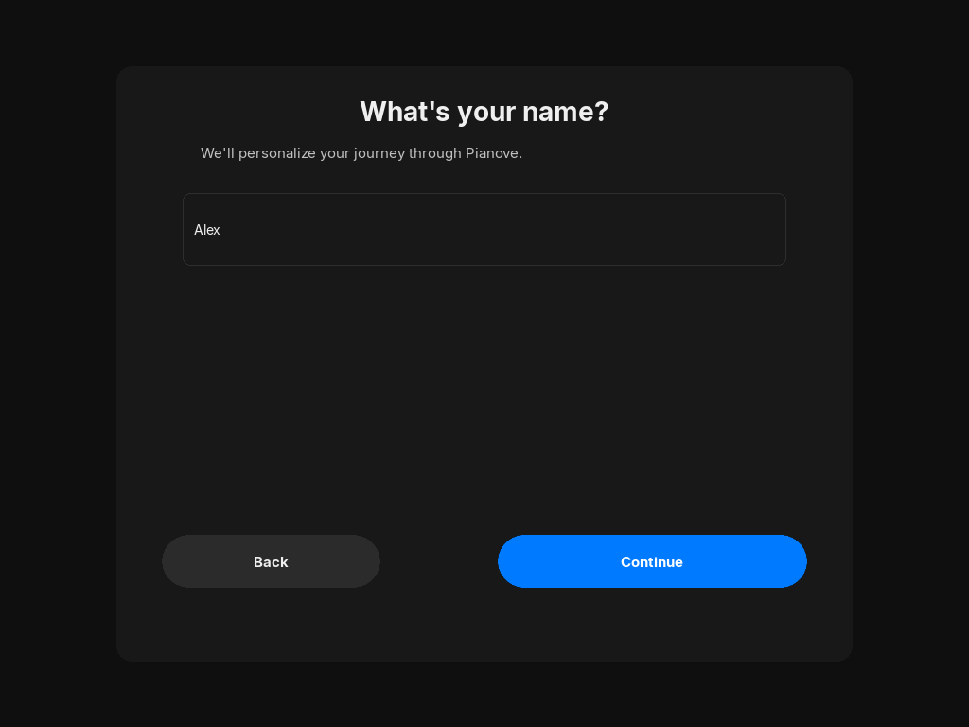
ACCESSIBLE BY DESIGN
Onboarding & setup
Language selection, EN / DE
Automatic MIDI device detection
Personalised setup
• MIDI keyboard detected automatically. No keyboard? Test mode covers it. No account, no sign-up, no internet.
Pianove · YH4F 2026
9
Notes:
Real, polished onboarding wizard, not a hacked-together demo. Works without a MIDI keyboard too, in test mode, accessible to anyone evaluating on a laptop.

Slide 10
UNDER THE HOOD
Three projects, one repository
Pianove Application
MIDI input, lesson system, score viewer, built-in synthesiser
PyLute Library — PyLute/
Music notation renderer, built on pygame + Bravura SMuFL font
PyLay Library — PyLay/
iOS-inspired pygame UI framework. 29 widgets, spring animation, theming
PyLute and PyLay are fully independent libraries. No dependency on Pianove or each other. Stack: Python 3.10+, pygame. No external services, no network calls, no telemetry.
Pianove · YH4F 2026
10
Notes:
Repo structure for technical questions. Three genuinely separable projects. PyLute and PyLay pip-installable into any other pygame project with zero Pianove-specific code.

Slide 11
WHY THIS FITS YH4F
Free software, by design
• GNU GPL v3.0. The whole application, both libraries.
• No account, no subscription, no telemetry, no network calls. Stays on the user's machine.
• PyLute and PyLay released independently. Reusable contributions to the pygame ecosystem, not internal implementation details.
• Built because commercial alternatives lock content behind subscriptions. A direct response, in the spirit of user freedom the competition celebrates.
Pianove · YH4F 2026
11
Notes:
Why this fits FSFE's mission. Not just source-available: GPLv3, offline-first, no telemetry, libraries released independently so other devs benefit. Free as in freedom, not just price.

Slide 12
ROADMAP
What's next
• Publish PyLute and PyLay to PyPI. Plain pip install.
• Multiple voices on a single staff in PyLute
• Slur arcs and repeat barlines in PyLute
• A pytest test suite for both libraries
Pianove · YH4F 2026
12
Notes:
Honest about what's missing: no test suite yet, not on PyPI yet. Frame as roadmap, not weakness. Libraries work today, this is packaging and polish.

Slide 13
One small idea. Three open-source projects.
github.com/MariusAngermann08/Pianove
mariusangermann08.github.io/Pianove
Thank you. Questions?
Notes:
Open the floor. Have app + PyLay 29-widget demo ready to alt-tab into.

