Slide 1

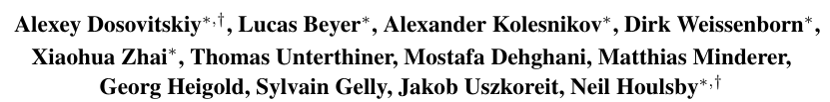

Slide 2
Intro :
Self-attention-based architectures widely used in NLP
Give model notions of position of words in a sentence
Pre trained on large corpus and fined tuned for small specific tasks
CNN remains dominant in computer vision
Some models try to implement the Self-attention but unsuccessfully
Goal of the article = implement a standard transformer (for NLP) directly to image with the fewest possible modification
Converted an image into token (patches) similar to words
Flattening to a linear vector (similar to word embedding)
Supervised learning

Slide 3
Trained on medium dataset ImageNet without strong regularisation
Modest accuracies (not very good)
Transformers lack translation equivariance and locality
They don’t generalize well
When trained on big data set
Excellent results
Around 90% accuracy

Slide 4
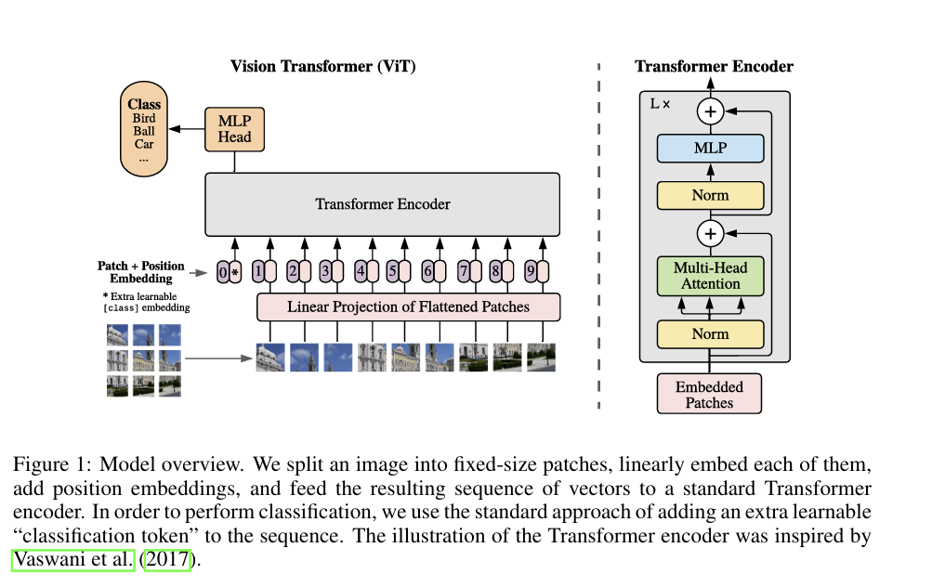

Slide 5
Method : Transformation of the pictures
follow the original Transformer (Vaswani et al., 2017)
Works with 1D input
Turn the image from 2D with C channel into N patches with C channel
N = Height * Width/Patches_size²
Flatten the patches and pass it through a fully connected trainable linear layer
Result a sequence recognized by the transformer

Slide 6
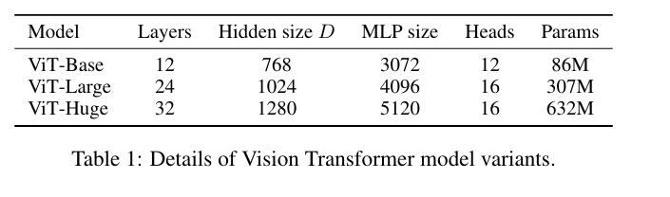
Method : Structure of the network
Classic model + classification head
Adding of a position embedding (give the position of the patch to the model)
Hybrid architecture possible using features map from CNN
For fine-tuning
Train a model on large data set
Replace the head with a zero-initialized layer

Slide 7
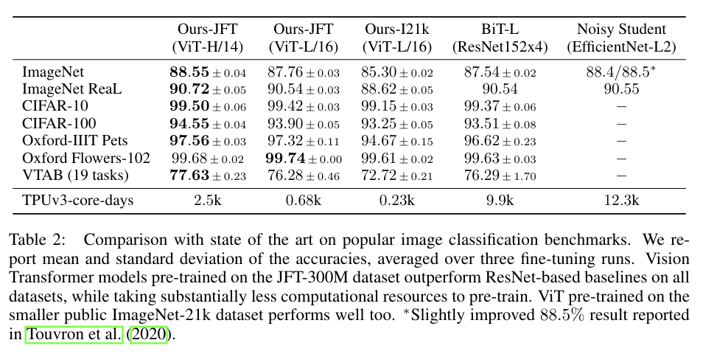
Comparison to the state of the art
BiT = supervised transfer learning with large ResNets
Noisy student = semi-supervised learning large Efficientnet

Slide 8
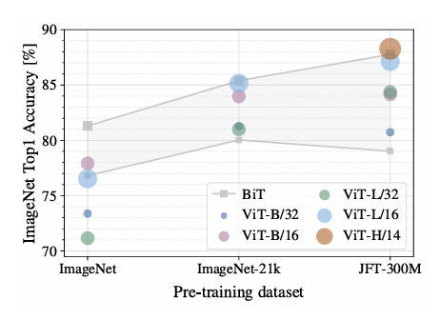
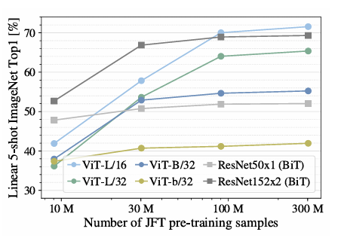
Importance of the size of the pre-training dataset

Slide 9
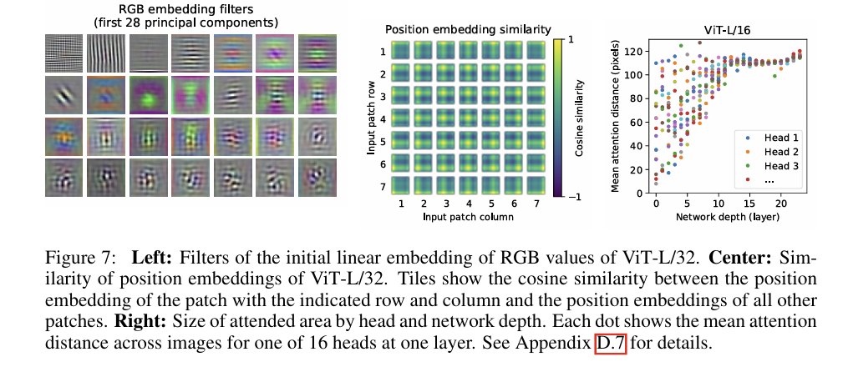
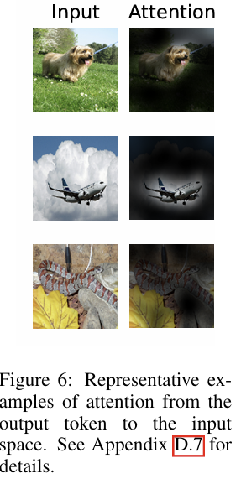
Inspecting vision transformer
The learn position embedding shows that patches that are close have similar embedding
Learn the notion of position with row/columns and sinusoidal
even early in the network, some parts of the model integrate global information
Some heads stay very local (looking only at nearby patches)
They behave similarly to convolutional filters in early CNN layers
Attention becomes more global at deeper layers

Slide 10
Conclusion
Application of transformers to computer vision
Interpret image as a sequence of patches
Work well on large dataset

